Slide 1
Optimizing optimizers
in PyTorch

Slide 2
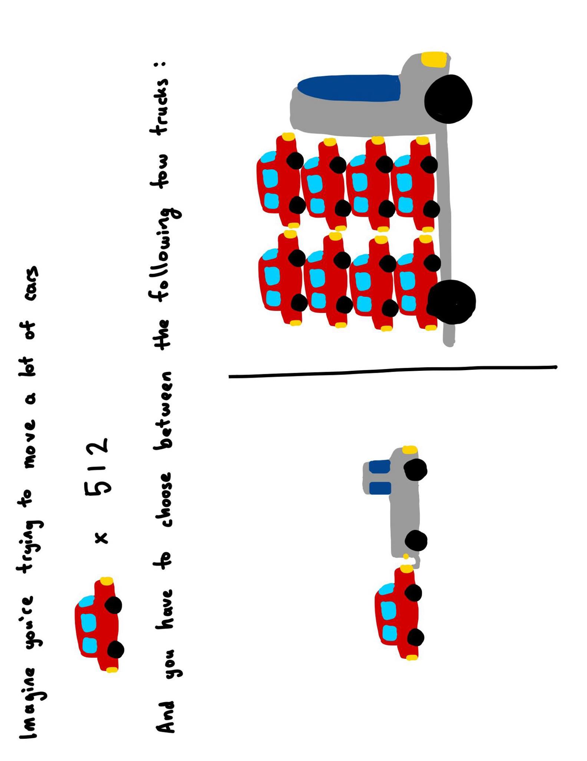

Runtime vs memory
Runtime and memory usage are often at odds with each other
you’re towing 512 cars from A to B. which truck do you take?

Slide 3
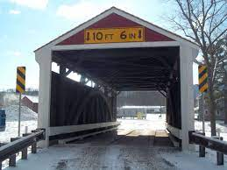
Runtime vs memory
Runtime and memory usage are often at odds with each other
you’re towing 512 cars from A to B. which truck do you take?
what if the only way to B had a low clearance bridge?

Slide 4

Runtime vs memory
Runtime and memory usage are often at odds with each other
Today, we focus on speeeeeeeeed!
yes this does mean memory will take a hit, disclaimer

Slide 5
Fusion, the high level idea

Slide 6
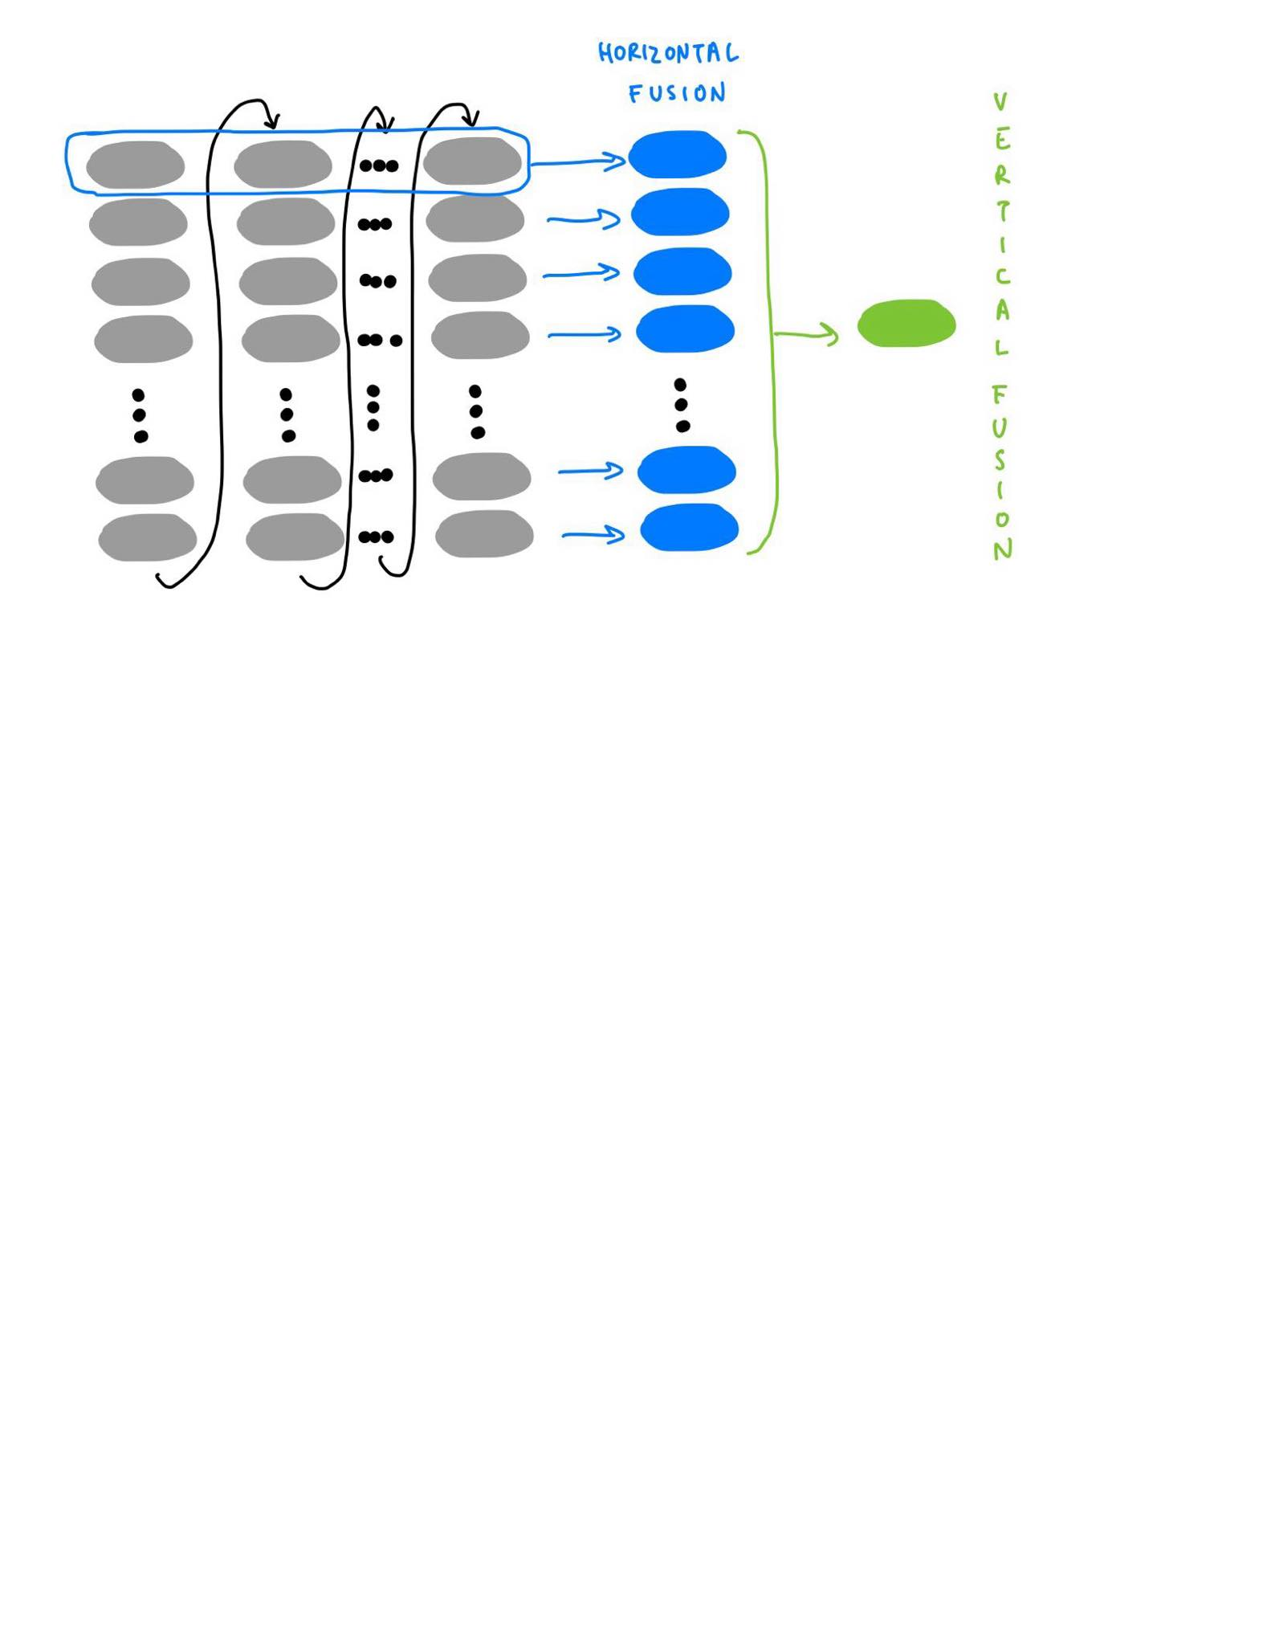
your simplest optimizer
for i, param in enumerate(params):
grad = grads[i] if not maximize else -grads[i]
exp_avg = exp_avgs[i]
exp_avg_sq = exp_avg_sqs[i]
step_t = state_steps[i]
# update step
step_t += 1
# Perform stepweight decay
param.mul_(1 - lr * weight_decay)
# Decay the first and second moment running average coefficient
exp_avg.lerp_(grad, 1 - beta1)
exp_avg_sq.mul_(beta2).addcmul_(grad, grad, value=1 - beta2)
step = _get_value(step_t)
bias_correction1 = 1 - beta1 ** step
bias_correction2 = 1 - beta2 ** step
step_size = lr / bias_correction1
bias_correction2_sqrt = _dispatch_sqrt(bias_correction2)
denom = (exp_avg_sq.sqrt() / bias_correction2_sqrt).add_(eps)
param.addcdiv_(exp_avg, denom, value=-step_size)
for loop/single tensor
https://github.com/pytorch/pytorch/blob/b5ba80828f77c565bcda7558da97c792af32d517/torch/optim/adamw.py#L362

Slide 7
horizontally fused optimizer
torch._foreach_add_(device_state_steps, 1)
# Perform stepweight decay
if weight_decay != 0:
torch._foreach_mul_(device_params, 1 - lr * weight_decay)
# Decay the first and second moment running average coefficient
torch._foreach_lerp_(device_exp_avgs, device_grads, 1 - beta1)
torch._foreach_mul_(device_exp_avg_sqs, beta2)
torch._foreach_addcmul_(device_exp_avg_sqs, device_grads, device_grads, 1 - beta2)
. . .
torch._foreach_div_(exp_avg_sq_sqrt, bias_correction2_sqrt)
torch._foreach_add_(exp_avg_sq_sqrt, eps)
torch._foreach_addcdiv_(device_params, device_exp_avgs, exp_avg_sq_sqrt, step_size)
foreach
https://github.com/pytorch/pytorch/blob/b5ba80828f77c565bcda7558da97c792af32d517/torch/optim/adamw.py#L480

Slide 8
entirely fused optimizer
torch._fused_adamw_(
device_params,
device_grads,
device_exp_avgs,
device_exp_avg_sqs,
device_max_exp_avg_sqs,
device_state_steps,
amsgrad=amsgrad,
lr=lr,
beta1=beta1,
beta2=beta2,
weight_decay=weight_decay,
eps=eps,
maximize=maximize,
grad_scale=device_grad_scale,
found_inf=device_found_inf,
)
…fused
(thanks NVIDIA)
https://github.com/pytorch/pytorch/blob/b5ba80828f77c565bcda7558da97c792af32d517/torch/optim/adamw.py#L616

Slide 9
The Gist: the fewer kernels you launch on CUDA, the faster.
Notes:
vertical fusion also includes removing intermediates altogether, which is diff from just eliminating launches

Slide 10
Fusion, the nitty gritty

Slide 11
starting with multi_tensor_apply

Slide 12

you know how mitochondria is the powerhouse of the cell?
multi_tensor_apply is the powertruck of our speedy optimizers.
CPU
GPU
multi_tensor_apply allows us to operate over a list of Tensors vs a single tensor.

Slide 13
Example with torch.add
add(
Tensor self, Tensor other, *,
Scalar alpha=1
) -> Tensor
_foreach_add(
Tensor[] self, Tensor[] other, *,
Scalar alpha=1
) -> Tensor[]

Slide 14
Under the hood in CUDA
_foreach_add(Tensor[] self, Tensor[] other, *, Scalar alpha=1) -> Tensor[]
How would you write this one?
add(Tensor self, Tensor other, *, Scalar alpha=1) -> Tensor
A simplified CUDA kernel signature, assuming we have float Tensors:
__device__ void add_kernel(
float* self,
float* other,
float* res,
float alpha=1) {
…
}

Slide 15
Attempt 1: use std::vector
_foreach_add(Tensor[] self, Tensor[] other, *, Scalar alpha=1) -> Tensor[]
__device__ void _foreach_add_kernel(
std::vector<float*> self,
std::vector<float*> other,
std::vector<float*> res,
float alpha=1) {
…
}
Does this work?
add(Tensor self, Tensor other, *, Scalar alpha=1) -> Tensor
__device__ void add_kernel(
float* self,
float* other,
float* res,
float alpha=1) {
…
}

Slide 16
Attempt 1: use std::vector
_foreach_add(Tensor[] self, Tensor[] other, *, Scalar alpha=1) -> Tensor[]
__device__ void _foreach_add_kernel(
std::vector<float*> self,
std::vector<float*> other,
std::vector<float*> res,
float alpha=1) {
…
}
Does this work?
No because CUDA doesn”t recognize std::vectors!
add(Tensor self, Tensor other, *, Scalar alpha=1) -> Tensor
__device__ void add_kernel(
float* self,
float* other,
float* res,
float alpha=1) {
…
}

Slide 17
Attempt 2: fine i”ll use a C-style array then
_foreach_add(Tensor[] self, Tensor[] other, *, Scalar alpha=1) -> Tensor[]
__device__ void _foreach_add_kernel(
float** self,
float** other,
float** res,
float alpha=1) {
…
}
Does this work?
add(Tensor self, Tensor other, *, Scalar alpha=1) -> Tensor
__device__ void add_kernel(
float* self,
float* other,
float* res,
float alpha=1) {
…
}

Slide 18
Attempt 2: fine i”ll use a C-style array then
_foreach_add(Tensor[] self, Tensor[] other, *, Scalar alpha=1) -> Tensor[]
__device__ void _foreach_add_kernel(
float** self,
float** other,
float** res,
float alpha=1) {
…
}
Does this work?
Nope! This will cause an Illegal Memory Access (IMA)
because the outer pointer * is a CPU address!
add(Tensor self, Tensor other, *, Scalar alpha=1) -> Tensor
__device__ void add_kernel(
float* self,
float* other,
float* res,
float alpha=1) {
…
}

Slide 19
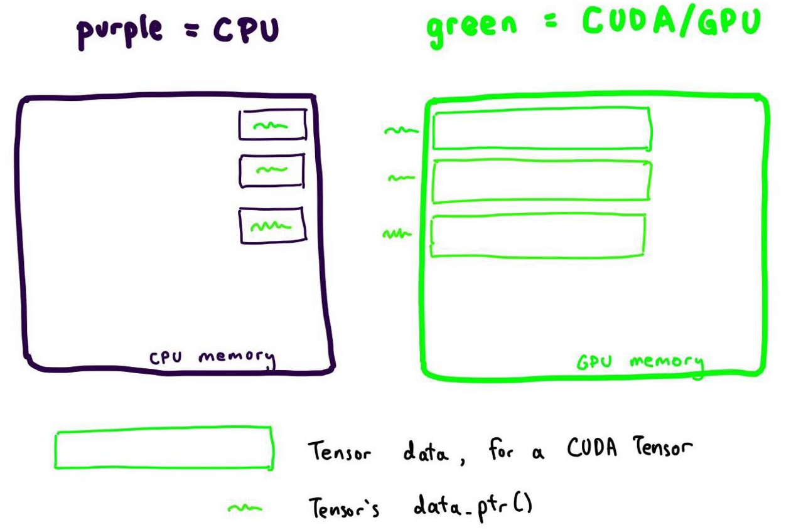
Attempt 2: fine i”ll use a C-style array then
Look again at the add_kernel.
add(Tensor self, Tensor other, *, Scalar alpha=1) -> Tensor
__device__ void add_kernel(
float* self,
float* other,
float* res,
float alpha=1) {
…
}

Slide 20
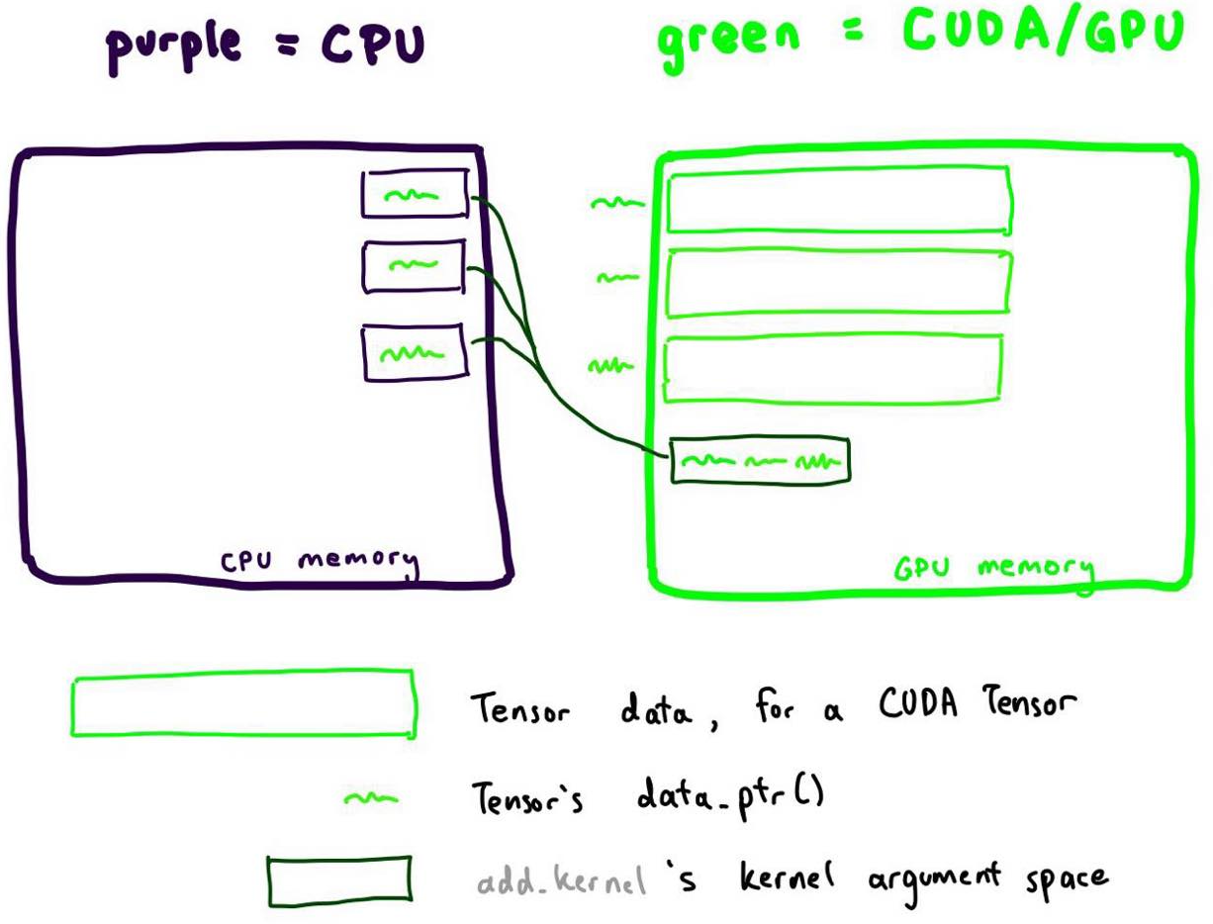
Attempt 2: fine i”ll use a C-style array then
When we dereference in the CUDA kernel, it is OK! The address is in GPU.
add(Tensor self, Tensor other, *, Scalar alpha=1) -> Tensor
__device__ void add_kernel(
float* self,
float* other,
float* res,
float alpha=1) {
…
}
you’re going to dereference in here!

Slide 21
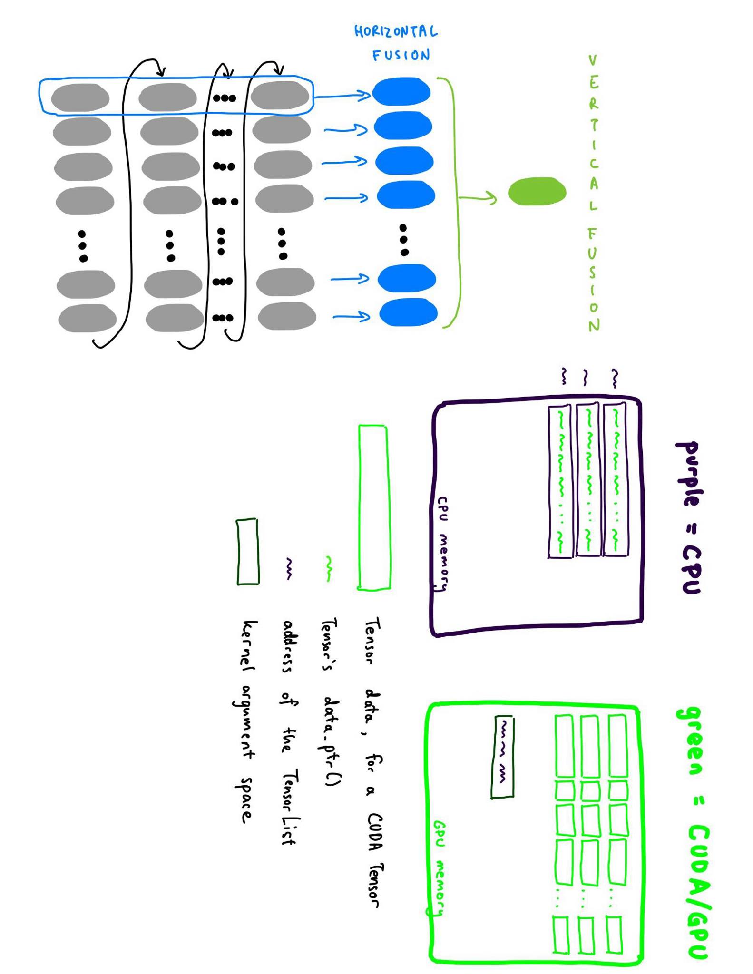
Attempt 2: fine i”ll use a C-style array then
__device__ void _foreach_add_kernel(
float** self,
float** other,
float** res,
float alpha=1) {
…
}
But not so our _foreach_add kernel.
While Tensors live in GPU, the list part
of TensorLists live in CPU.

Slide 22

Attempt 2: fine i”ll use a C-style array then
__device__ void _foreach_add_kernel(
float** self,
float** other,
float** res,
float alpha=1) {
…
}
But not so our _foreach_add kernel.
While Tensors live in GPU, the list part
of TensorLists live in CPU.
Dereferencing a CPU address from GPU =>
you’re going to dereference in here!

Slide 23
Attempt 3: pass by chonky boi (not reference)
struct TensorListMetadata {
const float* addresses[3][NUM_TENSORS];
};
<add all the addresses into the struct>
__device__ void _foreach_add_kernel(
TensorListMetadata tlm,
float alpha=1) {
…
}
Does this work?
add(Tensor self, Tensor other, *, Scalar alpha=1) -> Tensor
__device__ void add_kernel(
float* self,
float* other,
float* res,
float alpha=1) {
…
}

Slide 24
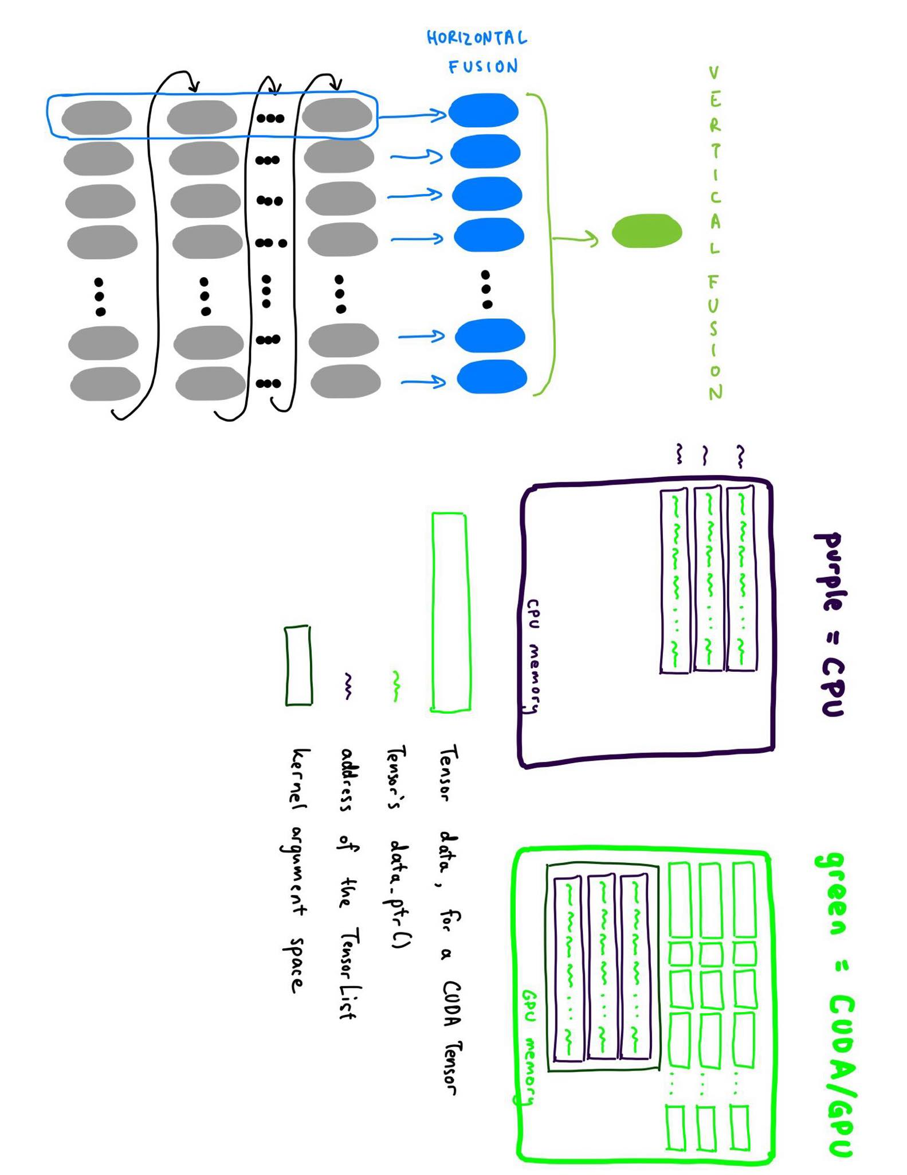
Attempt 3: pass by chonky boi (not reference)
struct TensorListMetadata {
const float* addresses[3][NUM_TENSORS];
};
<add all the addresses into the struct>
__device__ void _foreach_add_kernel(
TensorListMetadata tlm,
float alpha=1) {
…
}
Does this work? It passes CI! Yay!

Slide 25
~ the end ~

Slide 26
~ the end ~
jk

Slide 27
I actually did land a PR like this and it got reverted :(
Cuz some! how! an illegal memory access happened for some models (like timm_efficientdet).
I minified the repro to the following and played around with N.
params = [torch.rand(2, 3, device="cuda") for _ in range(N)]
torch._foreach_norm(params, ord=1)
torch.cuda.synchronize()
Now would you join me on my (binary) search!
(yes, this example is for norm and not add, but the principle is the same!)

Slide 28
Let”s binary search over N.
params = [torch.rand(2, 3, device="cuda") for _ in range(N)]
torch._foreach_norm(params, ord=1)
torch.cuda.synchronize()
N = 500

Slide 29

Let”s binary search over N.
params = [torch.rand(2, 3, device="cuda") for _ in range(N)]
torch._foreach_norm(params, ord=1)
torch.cuda.synchronize()
N = 500
N = 256

Slide 30
Let”s binary search over N.
params = [torch.rand(2, 3, device="cuda") for _ in range(N)]
torch._foreach_norm(params, ord=1)
torch.cuda.synchronize()
N = 500
N = 256
N = 400

Slide 31
Let”s binary search over N.
params = [torch.rand(2, 3, device="cuda") for _ in range(N)]
torch._foreach_norm(params, ord=1)
torch.cuda.synchronize()
N = 500
N = 256
N = 400
N = 450

Slide 32
Let”s binary search over N.
params = [torch.rand(2, 3, device="cuda") for _ in range(N)]
torch._foreach_norm(params, ord=1)
torch.cuda.synchronize()
N = 500
N = 256
N = 400
N = 450
N = 425

Slide 33
Let”s binary search over N.
params = [torch.rand(2, 3, device="cuda") for _ in range(N)]
torch._foreach_norm(params, ord=1)
torch.cuda.synchronize()
N = 500
N = 256
N = 400
N = 450
N = 425
N = 412

Slide 34
Let”s binary search over N.
params = [torch.rand(2, 3, device="cuda") for _ in range(N)]
torch._foreach_norm(params, ord=1)
torch.cuda.synchronize()
N = 500
N = 256
N = 400
N = 450
N = 425
N = 412
N = 420

Slide 35
Let”s binary search over N.
params = [torch.rand(2, 3, device="cuda") for _ in range(N)]
torch._foreach_norm(params, ord=1)
torch.cuda.synchronize()
N = 500
N = 256
N = 400
N = 450
N = 425
N = 412
N = 420
N = 423

Slide 36
Let”s binary search over N.
params = [torch.rand(2, 3, device="cuda") for _ in range(N)]
torch._foreach_norm(params, ord=1)
torch.cuda.synchronize()
N = 500
N = 256
N = 400
N = 450
N = 425
N = 412
N = 420
N = 423
N = 424

Slide 37
Let”s binary search over N.
params = [torch.rand(2, 3, device="cuda") for _ in range(N)]
torch._foreach_norm(params, ord=1)
torch.cuda.synchronize()
N = 500
N = 256
N = 400
N = 450
N = 425
N = 412
N = 420
N = 423
N = 424
what is so special about these numbers?
what could be going on here?

Slide 38
Attempt 3: pass by chonky boi (not reference) cont.
struct TensorListMetadata {
const float* addresses[3][NUM_TENSORS];
};
<add all the addresses into the struct>
__device__ void _foreach_add_kernel(
TensorListMetadata tlm,
float alpha=1) {
…
}
Does this work? Only if NUM_TENSORS < 424?

Slide 39

Attempt 3: pass by chonky boi (not reference) cont.
Expectation: Reality:
Fun fact: CUDA Kernel argument space has a max limit of 4KB 🥲

Slide 40
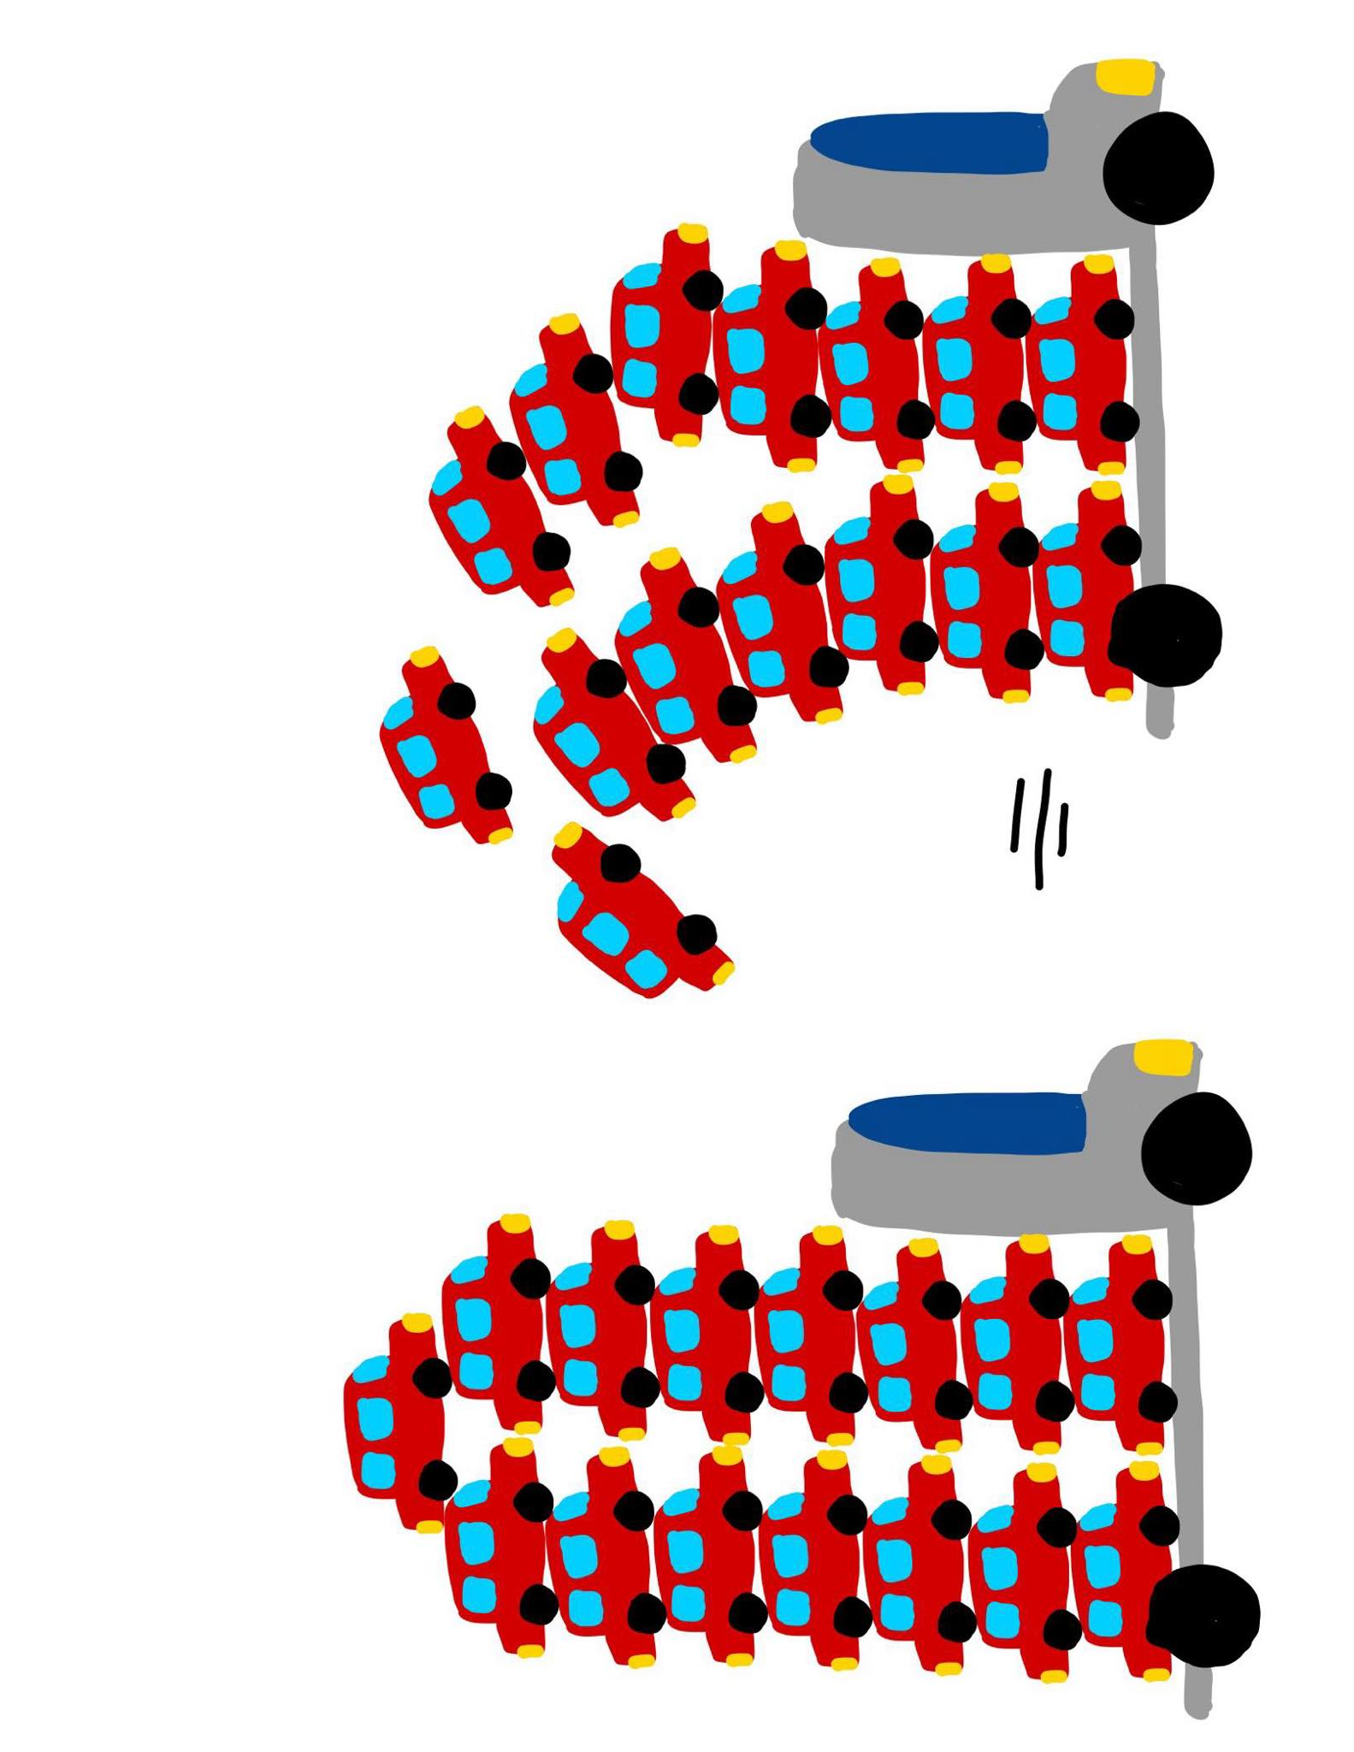
Attempt 3: pass by chonky boi (not reference) cont.
Expectation: Reality:
Fun fact: CUDA Kernel argument space has a max limit of 4KB 🥲 so what now?

Slide 41
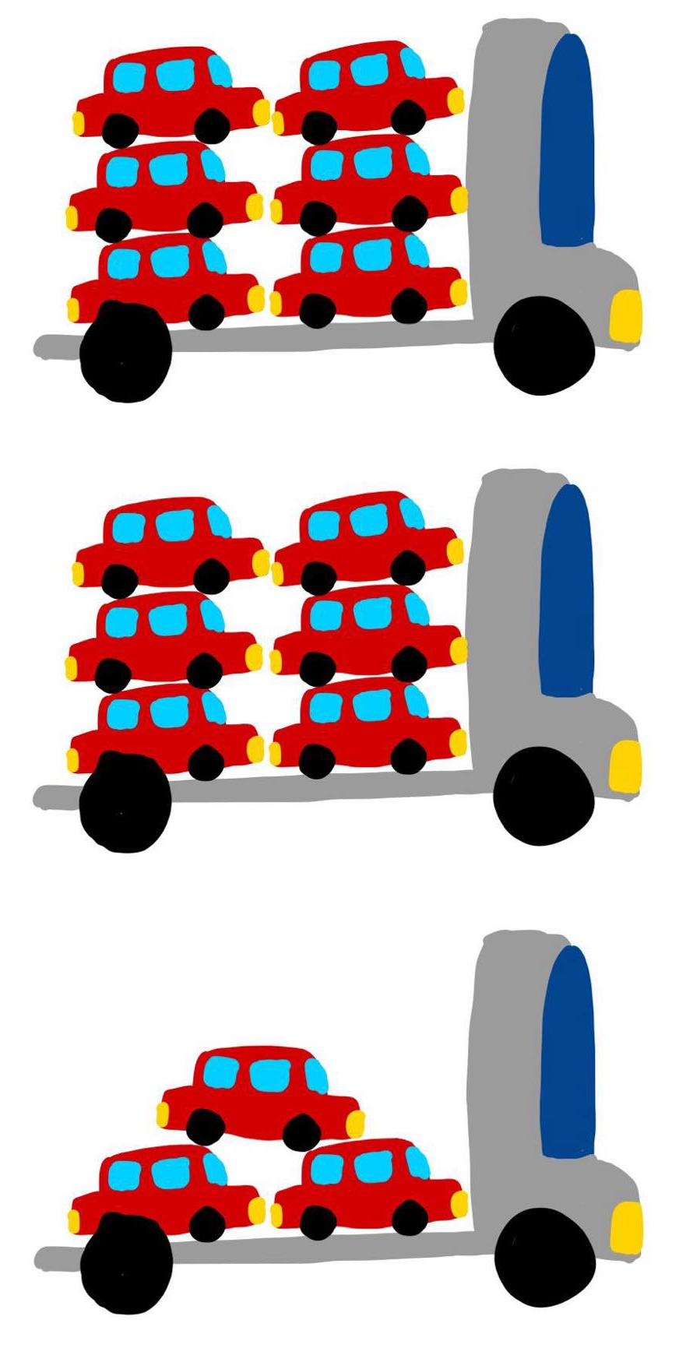
Attempt 4: just launch more kernels; make more trips
struct TensorListMetadata {
const float* addresses[3][MAX_NUM_TENSORS];
};
<make multiple structs>
<add a chunk of the addresses to each>
<launch the kernel multiple times>
__device__ void _foreach_add_kernel(
TensorListMetadata tlm,
float alpha=1) {
…
}

Slide 42
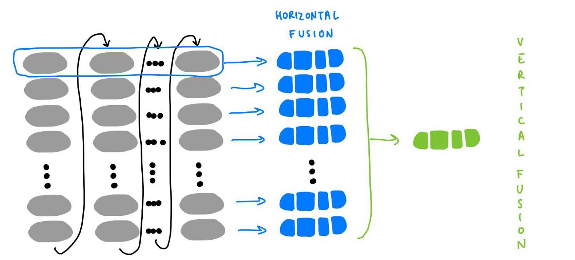
Attempt 4 is what we do today. But we could do better.
While we claim to horizontally fuse into 1 kernel…we often end up with more:

Slide 43
How: revisit attempt 2
__device__ void _foreach_add_kernel(
float** self,
float** other,
float** res,
float alpha=1) {
…
}
We wanna turn those purple * to green *.
How? Move them to CUDA beforehand!
(thanks Yifu Wang!)

Slide 44
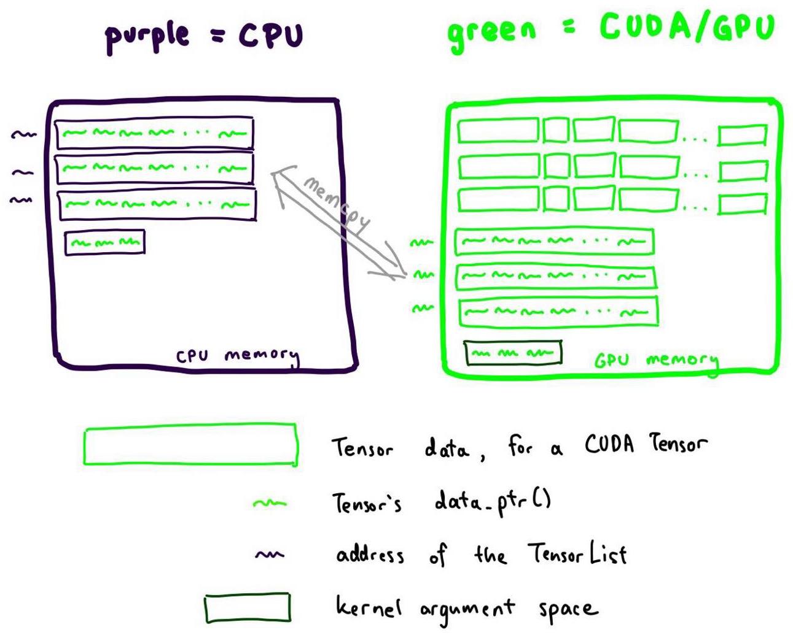
How: revisit attempt 2
<memcpy the lists of addresses to CUDA>
__device__ void _foreach_add_kernel(
float** self,
float** other,
float** res,
float alpha=1) {
…
}
We thereby avoid the 4KB constraint in the kernel argument to enable launching just one kernel. But remember, memcpy is $$$!

Slide 45
Conclusion: we will be doing a mix of struct + memcpy
if it fits, use the struct otherwise, take the memcpy hit

Slide 46
Did you notice I split up the fused implementation too?
This is cuz our fastest fused impls also rely on multi_tensor_apply!

Slide 47
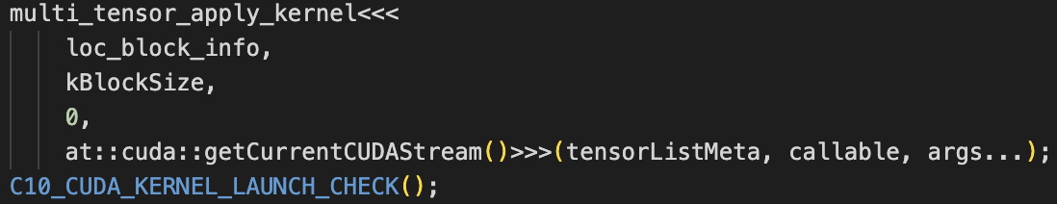
Did you notice I split up the fused implementation too?
Whereas _foreach_add will call multi_tensor_apply with a Callable that does addition, _fused_adamw will call multi_tensor_apply with a bigger Callable.

Slide 48
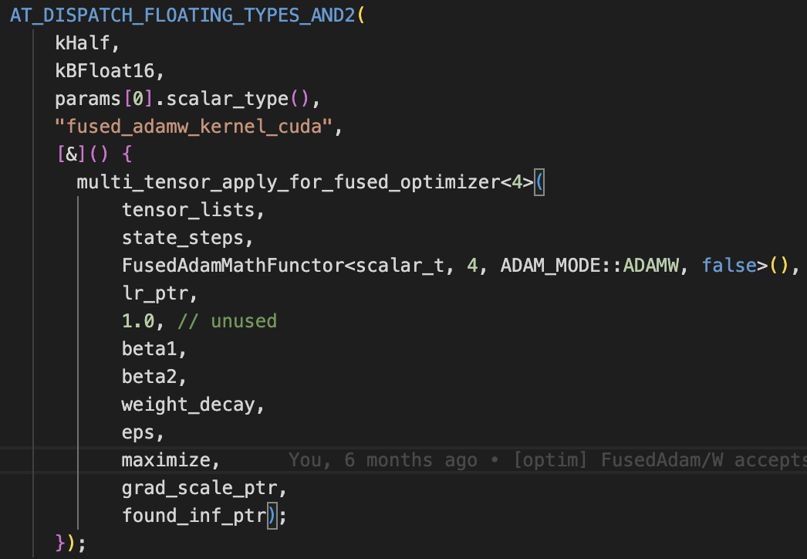
Did you notice I split up the fused implementation too?
Whereas _foreach_add will call multi_tensor_apply with a Callable that does addition, _fused_adamw will call multi_tensor_apply with a bigger Callable.

Slide 49
so let”s peek at FusedAdamMathFunctor

Slide 50
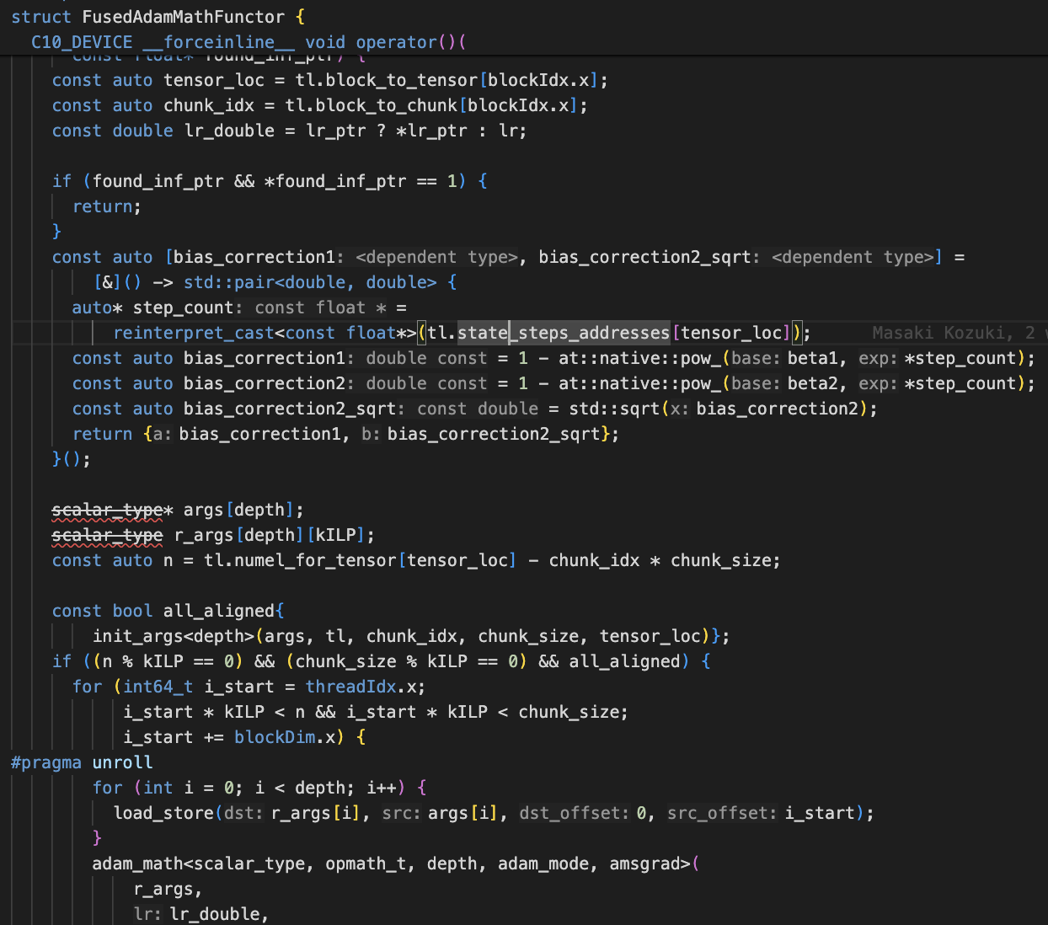
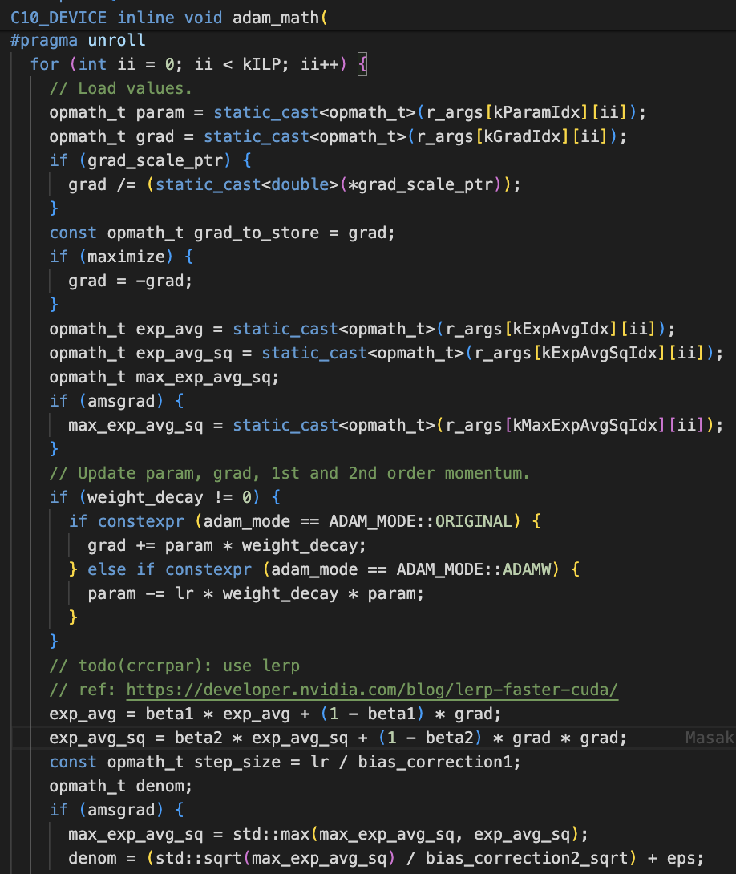

Slide 51
…that was very manual.

Slide 52
What if we could automate vertical fusion?
with just 1 line?

Slide 53
Enter torch.compile()

Slide 54
torch.compile()”s strength is vertical fusion

Slide 55
How do I use torch.compile() with optimizers?
optimizer = torch.optim.AdamW(params)
@torch.compile(fullgraph=False)
def compiled_step():
optimizer.step()
Now call compiled_step instead of optimizer.step() in your training loop. That’s it!
(okay I suppose that was 2 lines)

Slide 56
Inductor will generate a lorge triton kernel
xpid_offset = xpid - 0
xnumel = 512
xoffset = xpid_offset * XBLOCK
xindex = xoffset + tl.arange(0, XBLOCK)[:]
xmask = xindex < xnumel
x0 = xindex
tmp0 = tl.load(in_ptr0 + (x0), xmask)
tmp1 = tl.load(in_ptr1 + (x0), xmask)
tmp6 = tl.load(in_ptr2 + (x0), xmask)
tmp13 = tl.load(in_ptr3 + (x0), xmask)
tmp17 = tl.load(in_ptr4 + (0))
tmp18 = tl.broadcast_to(tmp17, [XBLOCK])
tmp2 = tmp1 - tmp0
tmp3 = 0.09999999999999998
tmp4 = tmp2 * tmp3
tmp5 = tmp0 + tmp4
tmp7 = 0.999
tmp8 = tmp6 * tmp7
tmp9 = tmp1 * tmp1
tmp10 = 0.0010000000000000009
tmp11 = tmp9 * tmp10
tmp12 = tmp8 + tmp11
tmp14 = 0.99999
tmp15 = tmp13 * tmp14
tmp16 = tl.sqrt(tmp12)
tmp19 = tl.math.pow(tmp7, tmp18)
tmp20 = 1.0
tmp21 = tmp19 - tmp20
tmp22 = -tmp21
tmp23 = tl.sqrt(tmp22)
tmp24 = tmp16 / tmp23
tmp25 = 1e-08
tmp26 = tmp24 + tmp25
tmp27 = 0.9
tmp28 = tl.math.pow(tmp27, tmp18)
tmp29 = tmp28 - tmp20
tmp30 = 0.001
tmp31 = tmp29 / tmp30
tmp32 = 1 / tmp31
tmp33 = tmp26 / tmp32
tmp34 = tmp5 / tmp33
tmp35 = tmp15 + tmp34
tl.store(out_ptr0 + (x0), tmp5, xmask)
tl.store(out_ptr3 + (x0), tmp35, xmask)
tl.store(out_ptr4 + (x0), tmp12, xmask)

Slide 57
When does it work? (or not work?)
You must have CUDA capability 7.0+ for Triton
All optimizers in pytorch/pytorch with a foreach implementation are now compilable
So everything except L-BFGS and SparseAdam
Vertical fusion of any sequence of supported _foreach_* ops should work!
try out your experimental optimizers!
open an issue when this isn’t true
Compiled optimizers is in beta! Try it out and complain lots here!

Slide 58
So should you stop learning CUDA?

Slide 59
So should you stop learning CUDA?
NO!
NO!
NO!
NO!
NO!
NO!
NO!
NO!
what about horizontal fusion?
NO!
NO!
NO!
NO!
NO!
NO!
NO!
NO!
NO!
NO!
NO!
NO!
NO!
NO!
NO!
NO!
NO!
NO!
NO!
triton isn’t all powerful!
really knowing Triton means knowing CUDA
NO!
NO!
NO!
NO!
NO!
NO!
NO!
NO!
NO!
NO!
NO!
NO!
NO!

Slide 60
thanks! questions?

