Slide 1
GPU Sparsity
03/21/24

Slide 2
About Me
PyTorch Core
Architecture Optimization
Quantization / Sparsity
GenAI (LLMs, ViT)
Based in NYC
UCLA (Go Bruins!)
Email: jessecai@meta.com
Github: @jcaip

Slide 3
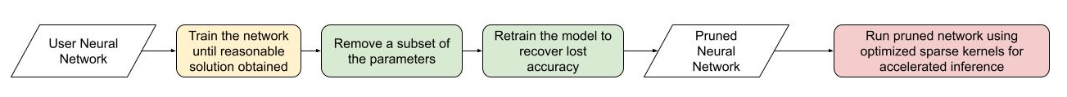
What is Sparsity / Pruning?
Why waste compute use many parameters when few parameter do trick ?
Two parts:
Accuracy: zero out parameters from the model
Performance: how to make multiplying by zero fast
Dates back to Optimal Brain Damage (Hinton 89)

Slide 4
Sparsity (Performance)
Multiplying by zero is fast!
0 * 1231231 vs 123123123 * 123123
But not if you still do the computation
You can still do long multiplication for 0 * 1231231 and this will take a similar amount of time as 2 * 1231231
So let’s add a bunch of zeros to our model and skip those computations

Slide 5
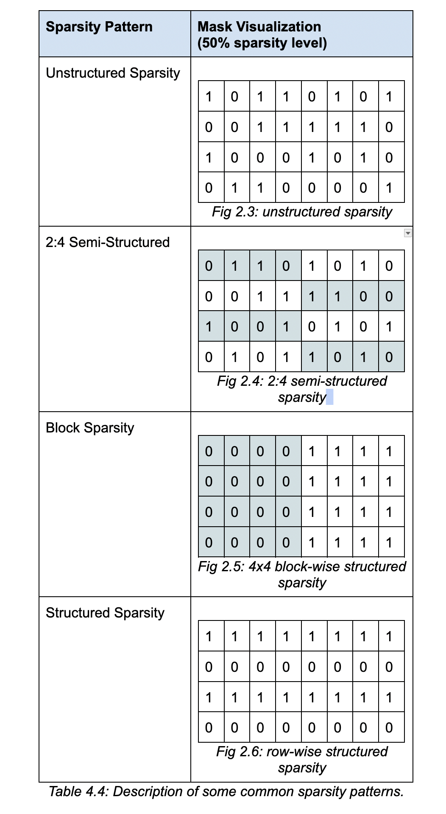
How should we add zeros?
Different Sparsity Patterns
We want flexibility for accuracy
But we want structure for performance reasons

Slide 6
Sparsity (Performance)
How can we do that for tensors multiplication?
Sparse representations + Sparse kernels
Store the data and structure independently
COO representation
[ 1 2 3 0 0 0 -> index: < (0,0) (0,1) (0,2) > 0 0 0 ] data: < 1 2 3 >
Sparse matmul
Only faster at high sparsity levels (>99%)

Slide 7
OK but how to parallelize?
Unstructured sparsity is cool and accuracy preserving but you can’t make it fast on GPUs
Not easy to parallelize
GPUs work on blocks - we can’t have blocks with structure with unstructured sparsity
How to make it fast on GPU
What if we remove a row instead of just a single param? structured pruning
We can reuse dense kernels (yay)
But the accuracy impact is large and difficult to deal with

Slide 8
GPU Sparsity
Semi-structured (2:4) sparsity
Fixed 50% sparsity level, up to 2x theoretical max speedup
Relatively easy to recover accuracy.
Block sparsity
Block based on block size, speedups of ~3.4x at 90% sparsity
Requires more advanced algorithms to recover accuracy (DRESS)

Slide 9
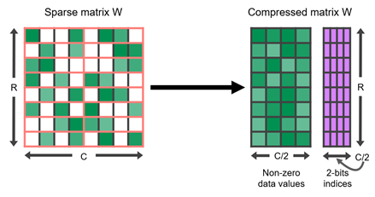
Semi-Structured (2:4) Sparsity
Also known as M:N / fine-grained structured sparsity
2 in every 4 elements are 0
Can be applied to STRIP or TILE
Theoretical 2x max acceleration
1.6x on average in practice
Depends on matrix shapes
Simple retraining recipe
Prune once the retrain
cuSPARSELt vs CUTLASS backend

Slide 10
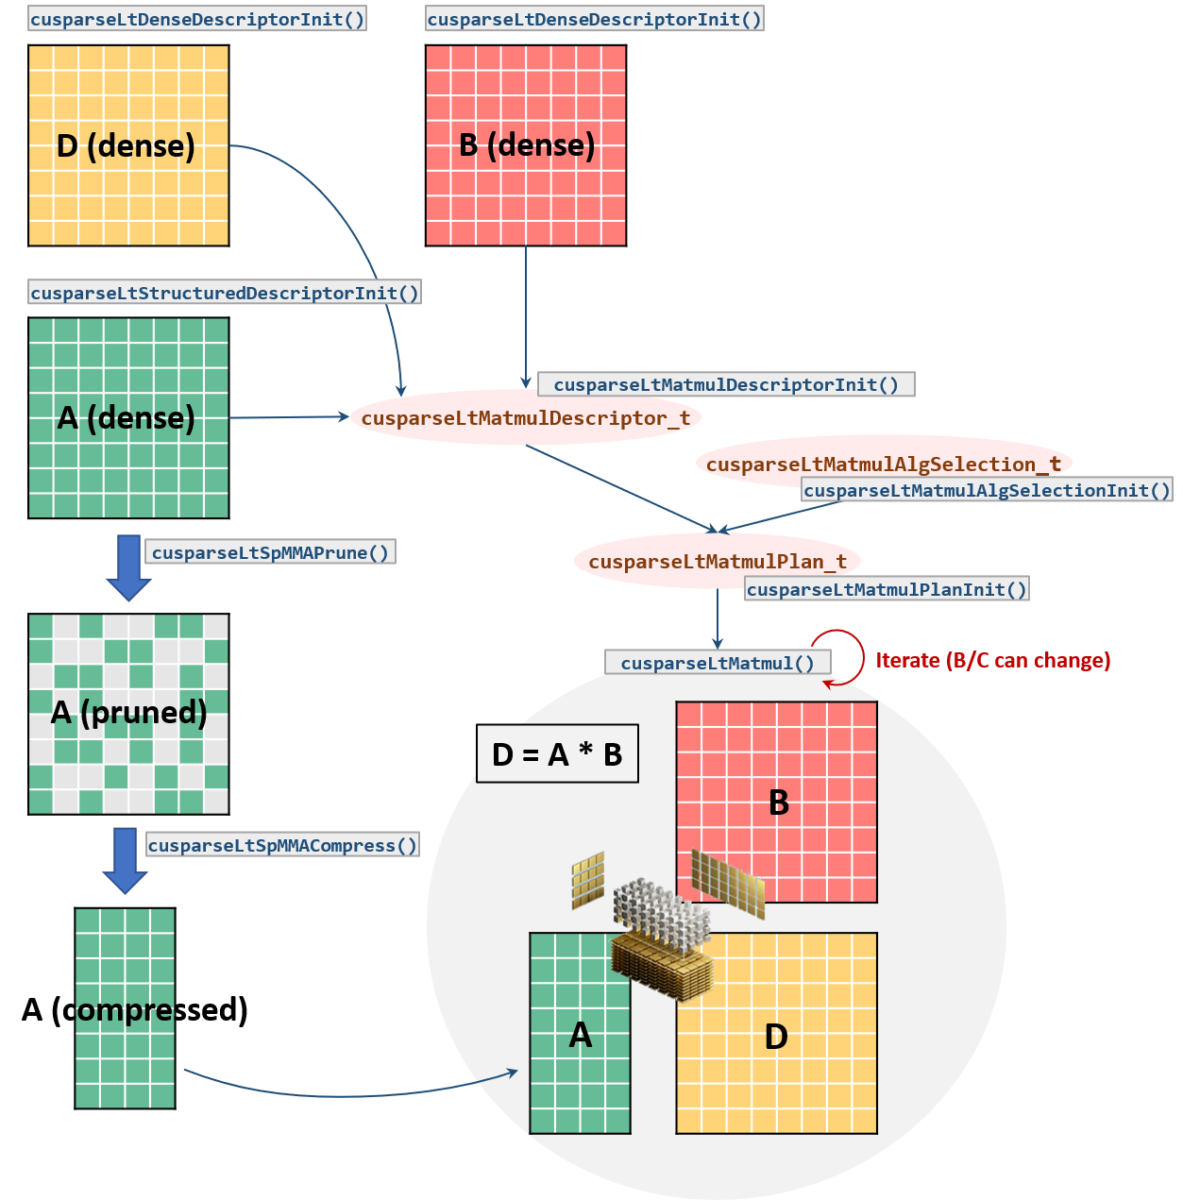

Slide 11
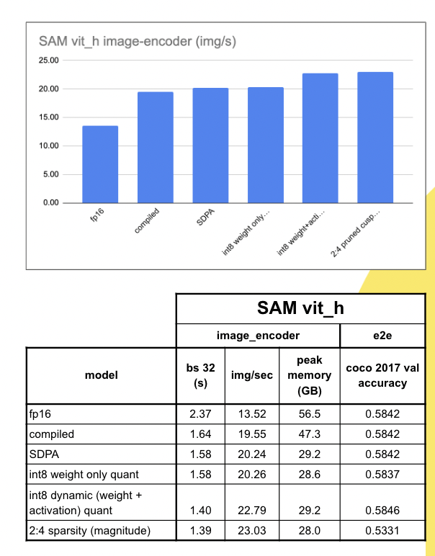
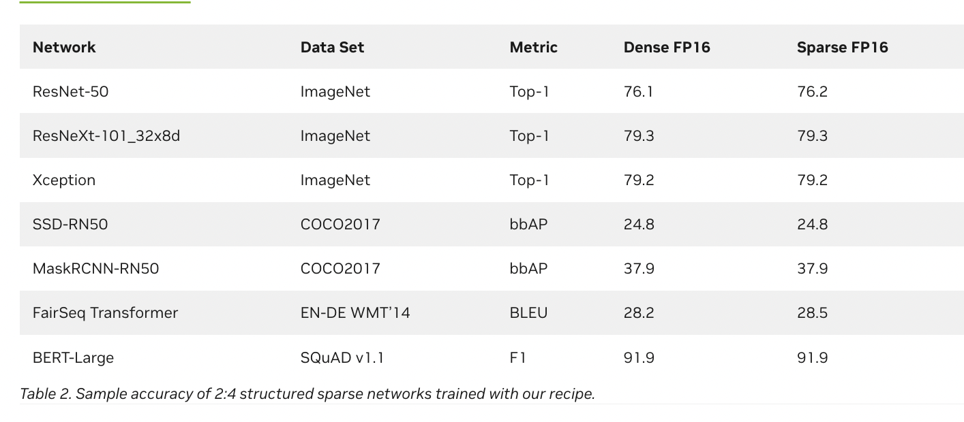
E2E Results

Slide 12
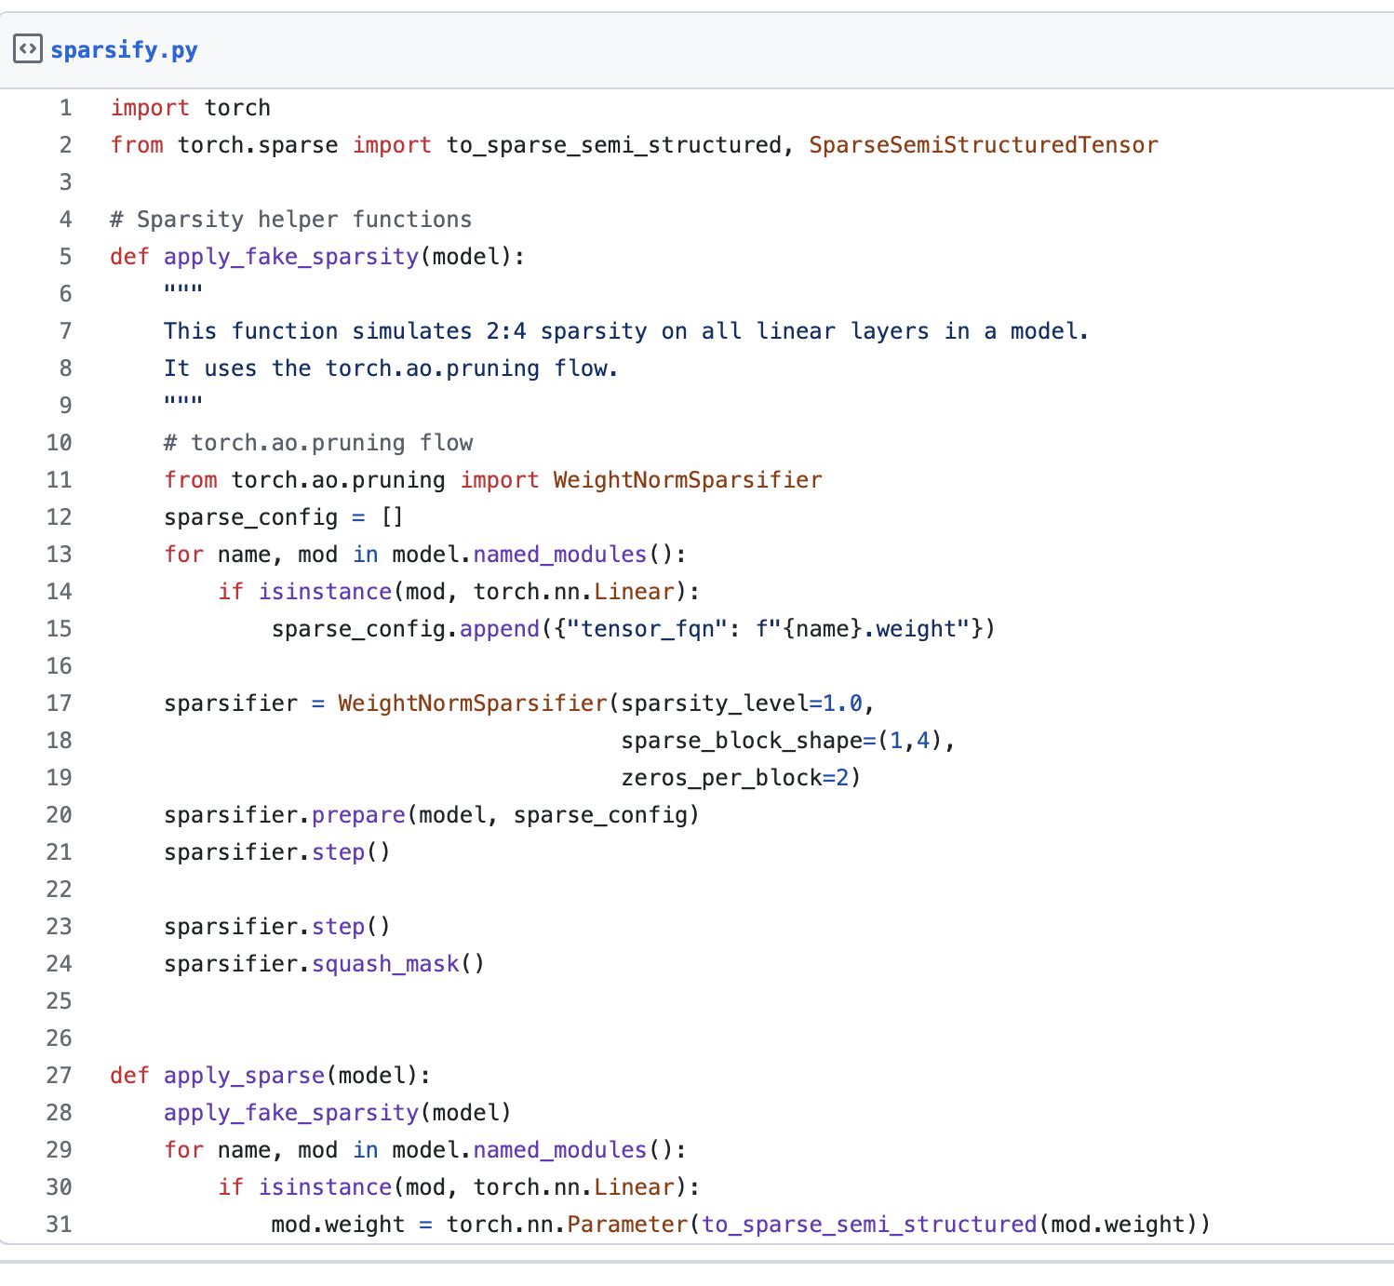
Easy API
https://gist.github.com/jcaip/44376cd69d3a05cbe16610b4379d9b70
Get zeros into the right spots, then call
to_sparse_semi_structured
Works with torch.compile!
Needed to fuse transpositions
Only first matrix sparse
xW’ = (xW’)’’ = (Wx’)’

Slide 13
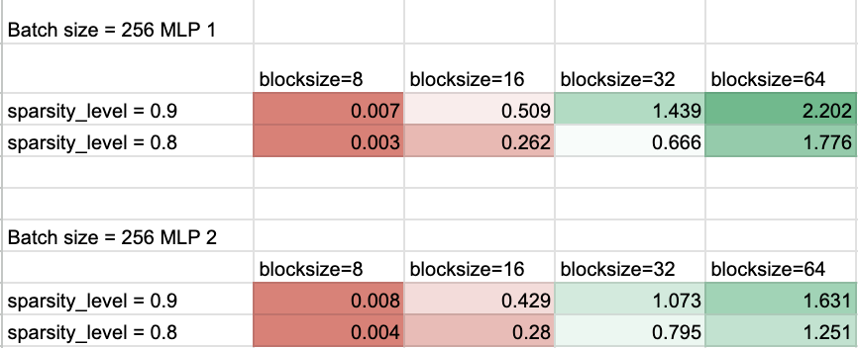
Block Sparsity
Use Superblock to recover accuracy
Microbenchmarks for ViT-L Layers:
E2E result: ImageNet ViT-L 1.44x speedup with minimal acc loss (78 -> 76)

Slide 14
Current Work
Composing with quantization
Performance
Accuracy
2:4 sparse training
Pruning algorithm experimentation (torchao)
We need help here!!! This is a the current sticking point

Slide 15
2:4 Sparse Training

Slide 16
2:4 sparsity for training
Can we use 2:4 sparsity for training? Yes!
Main Idea:
Sparsify + sparse_mm < dense_mm
Need both W and W_t for forward / backward pass
xFormers ran experiments with DINO show 10-20% e2e speedup with 0.5% acc gap (81.6 -> 80.5) on ImageNet-1k
Applying 2:4 sparsity to activations

Slide 17
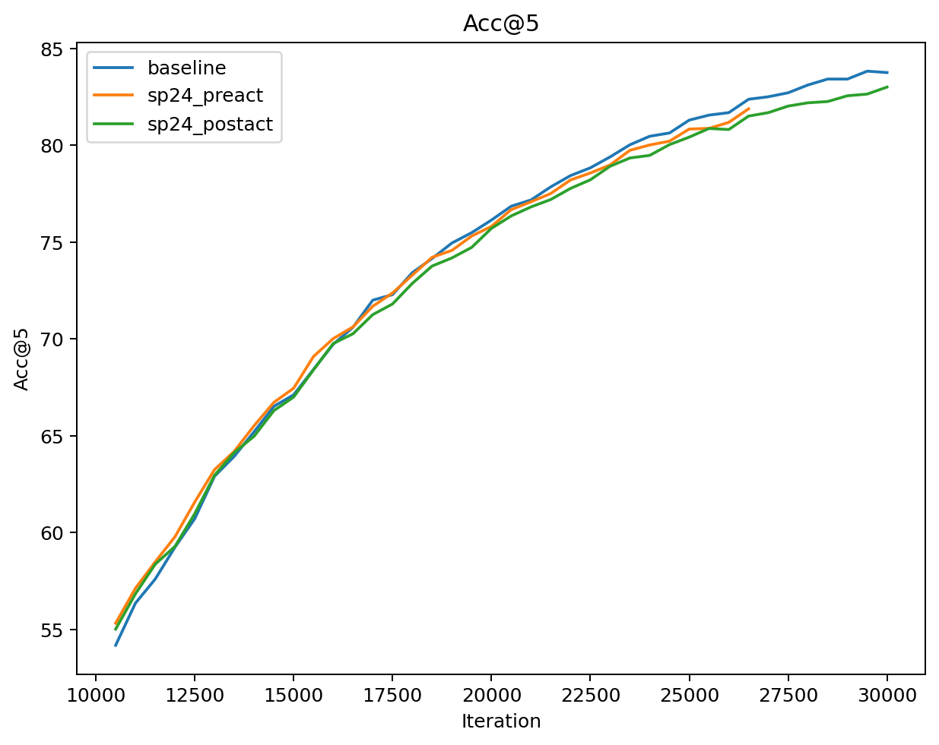

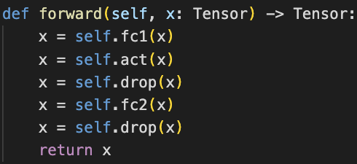


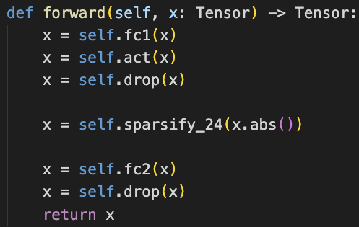
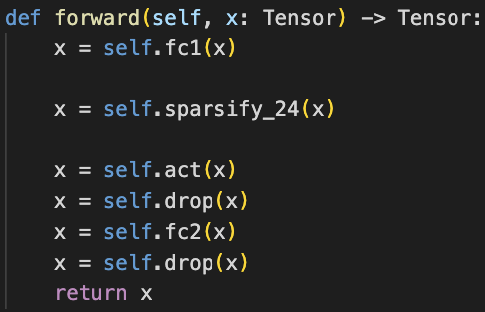
Initial results - ViT-Base on ImageNet / MLP with GeLU

Slide 18
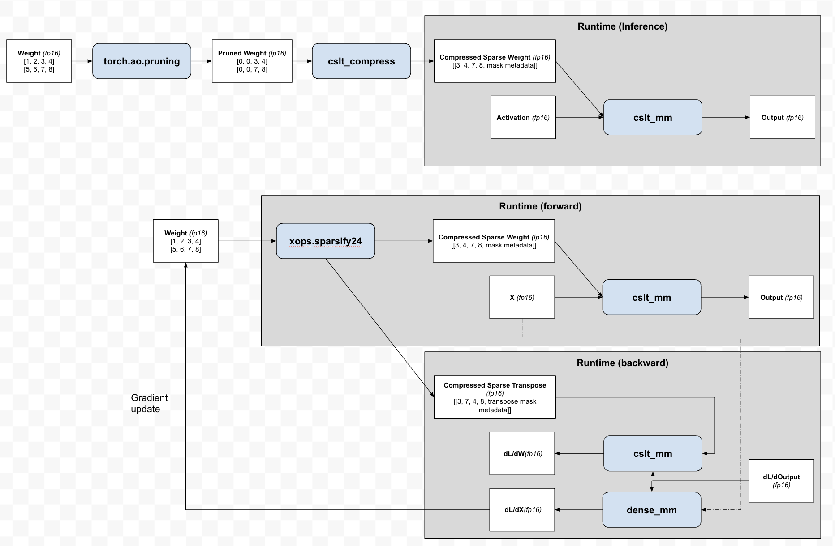

Slide 19
Difference between inference and training
Training:
Only compute benefit, slight memory penalty (9/8) *
Sparsification happens at runtime
Need both W and W_t
Needs contiguous output for distributed collective
Inference:
Compute + memory speedup
Sparsification happens offline
Just W is sufficient
Can return a view and torch.compile away subsequent transposition

Slide 20
2:4 sparse training components
Fast sparsification ops:
Allow us to quickly calculate X_compressed and X_t_compressed.
Note that we need both for the forward and backward pass respectively.
Custom autograd.Function
Forwards: returns sparse tensor subclass (X_compressed)
output = X @ W.T
Backwards: gradient update (use X_t_compressed)
input.grad = output.grad @ W.grad = output.grad.T @ input
cuSPARSELt
Transposition fusion for subsequent distributed collective.

Slide 21
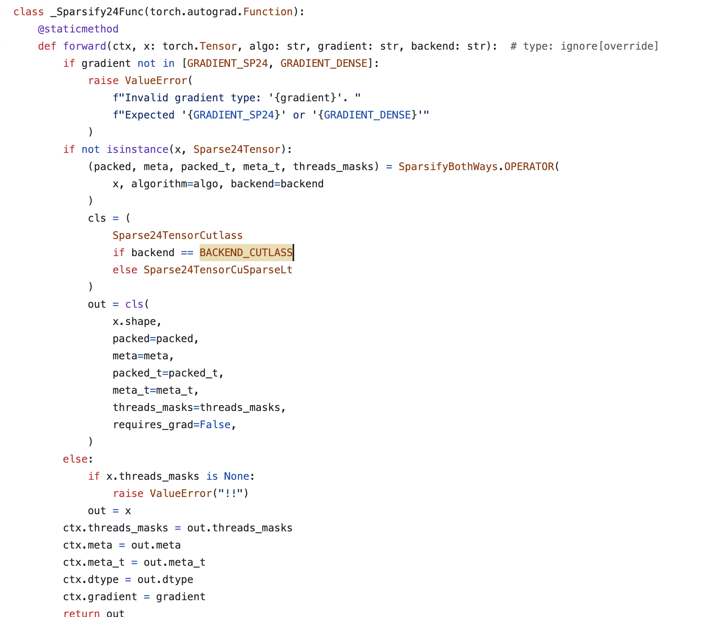

Slide 22
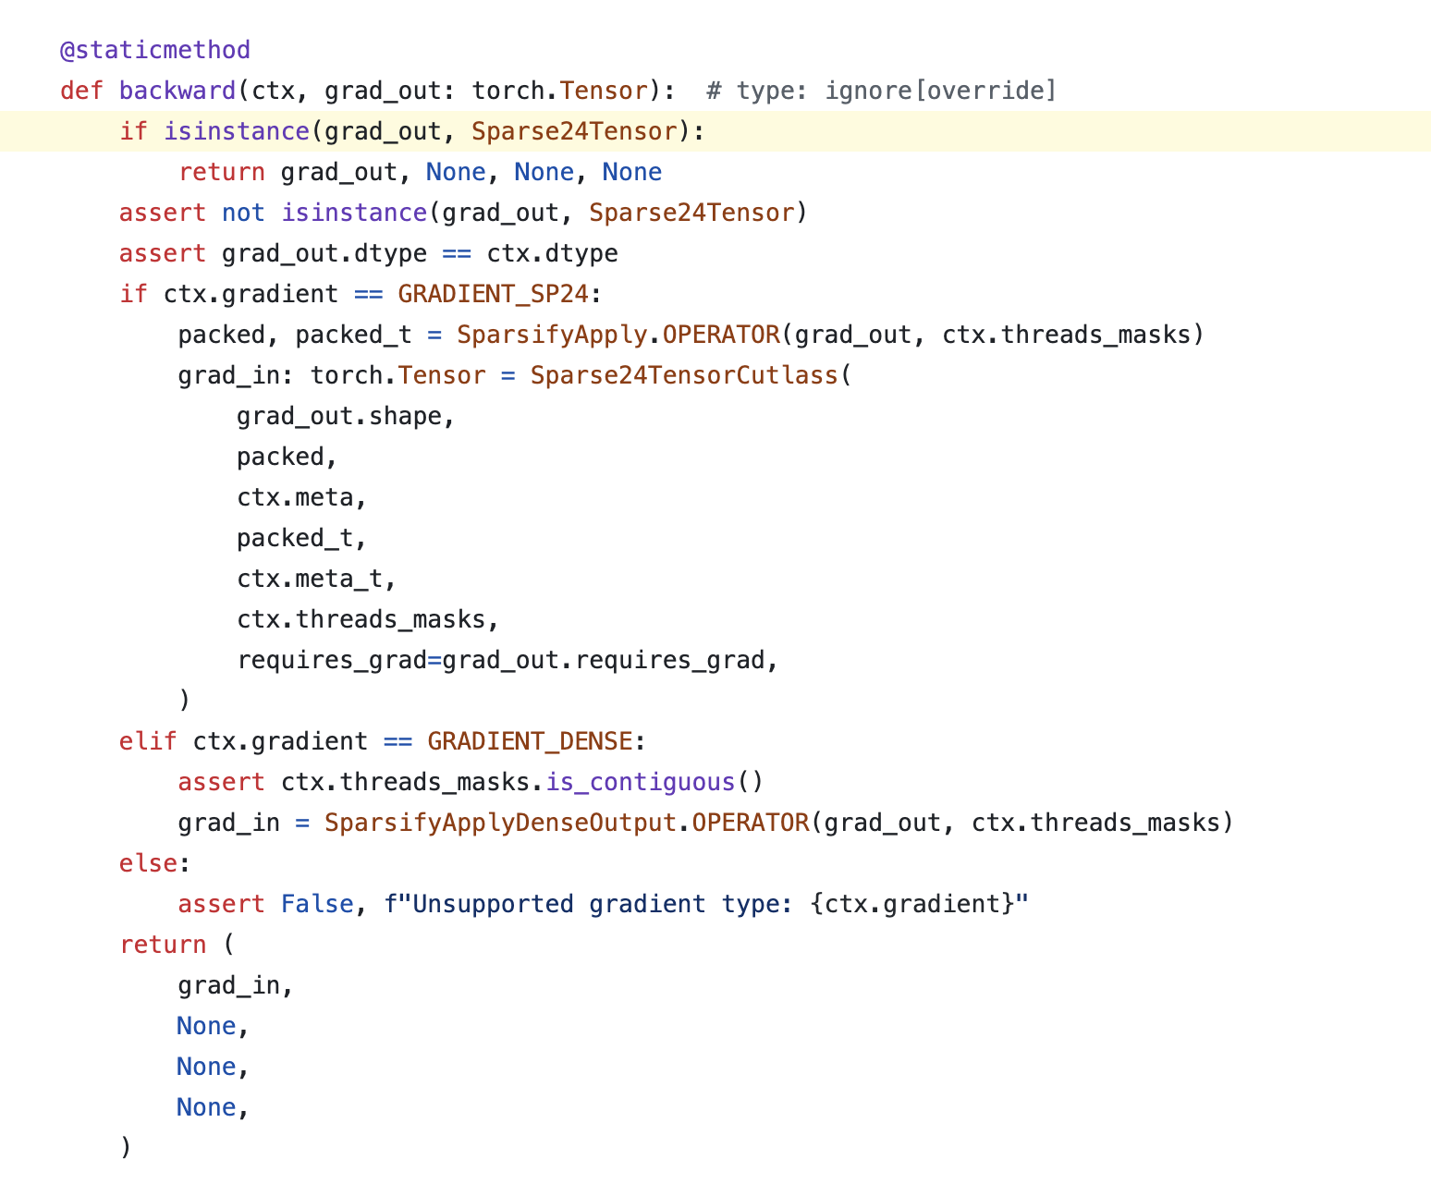

Slide 23
Open Questions
Custom autograd functions + torch.compile
See here for more info
Dynamo when speculating expects that the gradient flowing in is a subclass, because the output of forward is a subclass for the autograd Function
Can we reuse the same memory for specified elements of the sparse tensor?
Specified elements look to be the same, but swizzled between A_compressed and A_t_compressed
Can we rewrite fast sparsification with torch.compile?
Alek from Quantsight has written fast torch.compile routines for CUTLASS, could we do the same thing but for cuSPARSELt?

Slide 24
Future Work

Slide 25
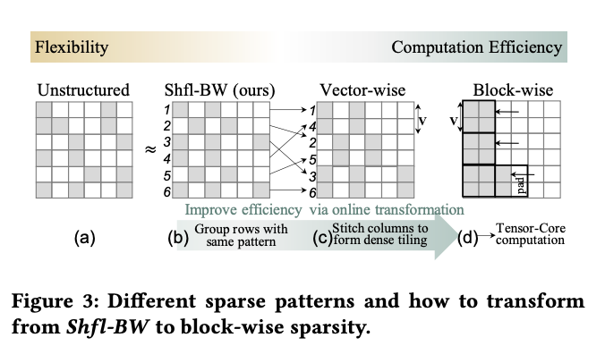
Future Work
Block sparsity + 2:4 sparsity
Blocks that are 2:4 sparse themselves
2:4 sparse arrangement of blocks
Fusing a shuffle into the sparsity pattern (SHFL-BW)
More flexibility for accuracy
We can fuse the shuffle with torch.compile -> minimal perf hit
2:4 Sparse dropout
Do people still use dropout anymore?

Slide 26
Future Work (cuda-mode specific)
Closing CUTLASS and cuSPARSELt gap
Aleksandar Samardžić has done a great job of this
Fuse transposition into matmul
Fuse dequant into CUTLASS kernel
Autotuning parameters for sparse kernels
Writing larger fused kernels
More flexible sparsity patterns
Load-as-sparse kernels
Add to triton ?

Slide 27
Conclusion
It’s early but we’re building towards something that could 2x (or more) the size of models.
Accuracy is the main blocker right now
We can give researchers more flexible sparsity patterns
Performance
We’ve show that sparsity works on GPUs and is faster
We can push performance by stacking sparsity / working on the corner cases
Accuracy and Performance are getting more intertwined

