Slide 1
TTS and Words Filter Based on Readability
计44
黄锐皓

Slide 2
Basic Functions
Show Categories
Show News List
Refresh and Get Older News
View News
Adjust Subscriptions
Favorites and Share

Slide 3
Features
Material Design: TabLayout+ViewPager, CardView, CoordinatorLayout, NestedScrollView, CollapsingToolbarLayout, AppBarLayout, SwipeRefreshLayout, NavigationDrawer, FloatingActionButton, RecyclerView(Efficiency)
Cache: memory → database → Internet
Open Source Library: Volley, SugarORM, Picasso

Slide 4
More Functions
听闻?
TTS
android.speech.tts.TextToSpeech√

Slide 5
Getting Content of News
Parse html? Same format√ Difficult
Safari-Reading Mode (text, anchor, images...)
Readability based on node.js√

Slide 6
Readability
A library based on node.js
Run js on Android? With Termux√ Appropriate but tiring (lazy)
Node.js Server√ Not that appropriate but easy
Get news info from ihandy server → Get source url → Pass source url to my readability server → Return simplified html → Load html in WebView(with js enabled)

Slide 7
Implementation
Get pure text (readability and regex)
Android built in TTS

Slide 8
Further more
新闻滤镜？
Pure Text → Split → Count → Threshold → Invisible or Special Marker

Slide 9
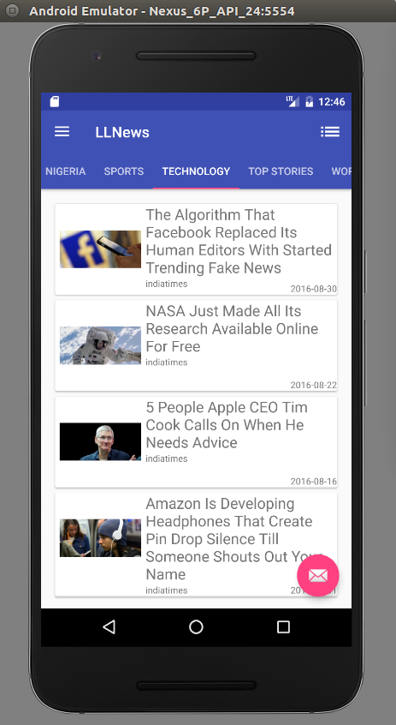
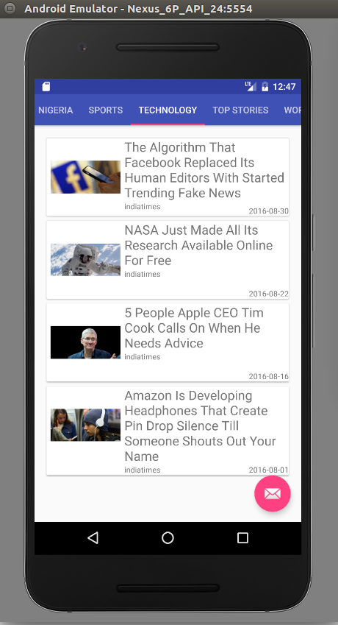
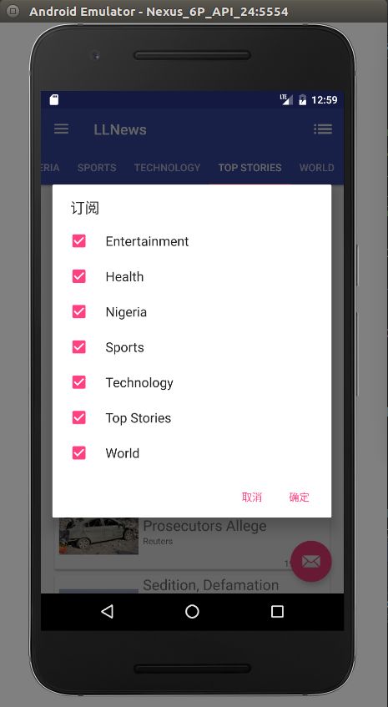
Pictures

Slide 10
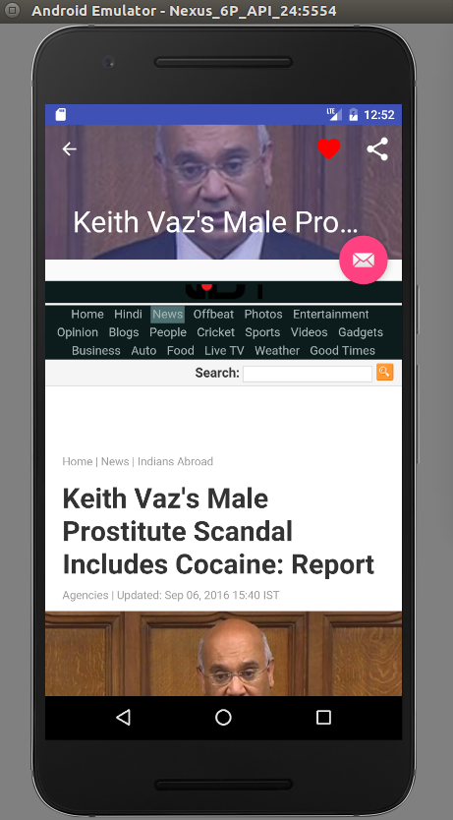
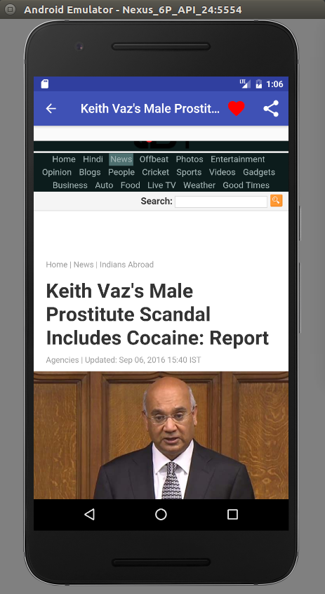
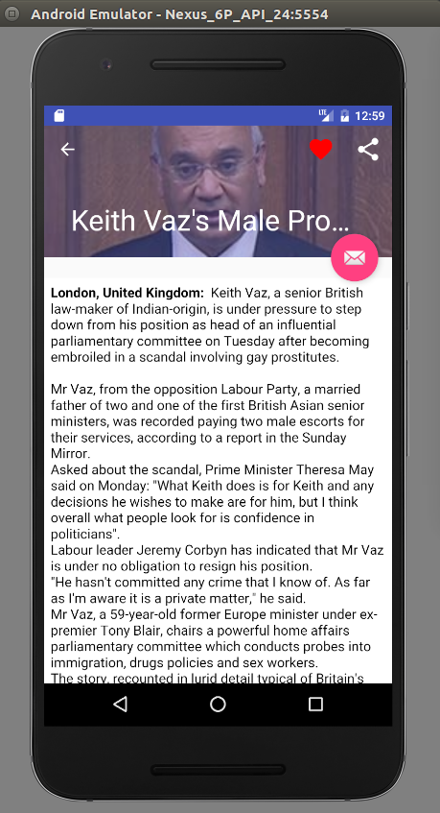
Pictures

Slide 11
No more Pictures
Maybe on AVD?

Slide 12
Thanks!

