Slide 1
Project 1
Distance-vector Routing implementation
Only need to implement
a class called DVRouter
DVRouter
B
3
D
2
1
C
1
A
7

Slide 2
Key Implementation Pointers
Route establishment
Centered around distance-vector updates
(don’t use link-state secretly, we will find you ☺ )
How to process an update.
When to send new updates? (Penalty if you send too many)
Packet Forwarding
Select the next hop based on forwarding table.
Freedom to construct appropriate data structure to store routing information.

Slide 3
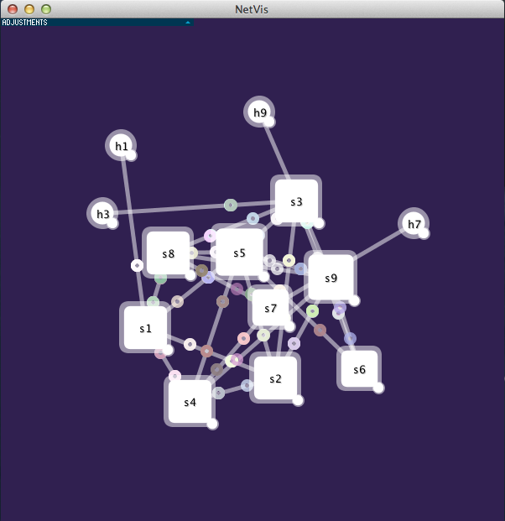
Provided Code
Simulator that can link up hosts and your DVRouters in different topologies and forward packets.
Refer to the simulator guide
A visualizer (NetVis) where you can see the topology and packets.

Slide 4
Tips
If you find it hard to start
Read example code, (hub.py , linear.py…)
Write in incremental steps
If you don’t know what can go wrong
Test, test, test…
P(pass | untested) -> low
If you feel confident
Submit!

Slide 5
Grading
Basic functionality (80 pts)
updates, forwarding…
Handle link weights (10 pts)
vs. hop count
Incremental updates (10 pts)
A sends (B:2, C:1, D:3) and later (B:2, C:1, D:4)
Now, for the 2nd update, only sends (D:4)

Slide 6
Regrading Policy
Max 30 line diff allowed from the original code.
If diff <=10, 10% penalty,
If diff >10, <=20, 20% penalty
If diff >20, <=30, 30% penalty
Original late penalty applies
Final grade = re-graded score

Slide 7
Logistics
GSIs: Qifan, Murphy and Radhika
Additional OH for help with the project – will be announced on Piazza
These slides, Spec and code online midnight, today
Due October 6, at noon.

