Slide 1



Reimagining crisis capital infrastructure –
with AI, blockchain, and digital assets -
so that humanitarian aid is funded instantly, transparently,
and at scale.
Turn your capital into impact
Approach
Team
Contact
Contact
Join dSDR Token
Waitlist
Notes:
Navigation Bar locks
All rectangle buttons need contact forms

Slide 2

A Broken System In Need Of Reinvention
The global crisis infrastructure is fragmented, delayed, and inefficient.
It’s marked by disbursement lags of up to 20 months in U.S. federal programs, 17–30% leakage across traditional aid flows, and capital trapped in slow grant cycles. NGOs face high administrative burdens, while opaque reporting further limits accountability and impact.
A Reimagined Model: Programmable Humanitarian Infrastructure
The Tokenization Foundation replaces fragmented aid systems with a programmable, real-time infrastructure:
Funds are tokenized and delivered directly to recipients’ digital wallets
Blockchain enables instant, traceable, and secure transfers
AI provides real-time oversight, analytics, and adaptive governance
The Problem
The Solutions
Notes:
Below the fold on the homepage

Slide 3

Impact
Infrastructure Designed To Deliver:
50–70% faster disbursement of crisis funds
30–50% reduction in administrative overhead
Real-time transparency and traceability
Over five years, the platform is expected to reach + billion people globally, while scaling transaction volume into the hundreds of millions annually.
Notes:
First page of Impact Section

Slide 4

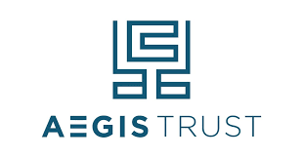



Building The Infrastructure Ecosystem With Two Initial Founding Governing Council Members
Interested in getting on our Council? Link to Contact form
As Featured In (this section will need to be added after we get media coverage)
Notes:
Homepage
Featured in Media Section will be added after April 20 and we get coverage. Logos will link to articles.

Slide 5


Join The Movement
The Tokenization Foundation invites institutions, partners, and early supporters to participate in building a new global standard for humanitarian aid.
Contact Us
Join dSDR Token
Waitlist
Notes:
Homepage
Call-To-Action Boxes Link To forms
Last “Capital That Responds” section is the footer
LinkedIn logo links to our page https://www.linkedin.com/company/tokenization-foundation/
Legal Disclosure

Slide 6

Reimaging A Fully Tokenized Ecosystem for Humanitarian Aid Capital
Money Market
Fund
Aegis
Trust
Mint, Custody,
Convert Tokens
Tokens
Blockchain
AI Technology
Distribution Partners
Beneficiaries
Notes:
First Page Of Approach Section

Slide 7
The dSDR Token Explained
The network is designed for stability, participation, and long-term growth, with a fixed total supply of 10 billion tokens. Governance is led by a 10-member Governing Council of partners responsible for network oversight, stability, and adoption. Users can stake dSDR with validators to help secure the network and earn rewards, while validators and stakers actively contribute to ecosystem development. Tokens are gradually released from the treasury to support security and sustainable expansion. dSDR also serves as the network’s governance token, powering services such as token minting, transactions, and reward incentives for adopting AI agents to amplify skills and impacts across stakeholders from donors, social workers to beneficiaries.
Click To Read Our White Paper (pdf)
Notes:
Call-To-Action Boxes Link To forms
Last “Capital That Responds” section is the footer

Slide 8
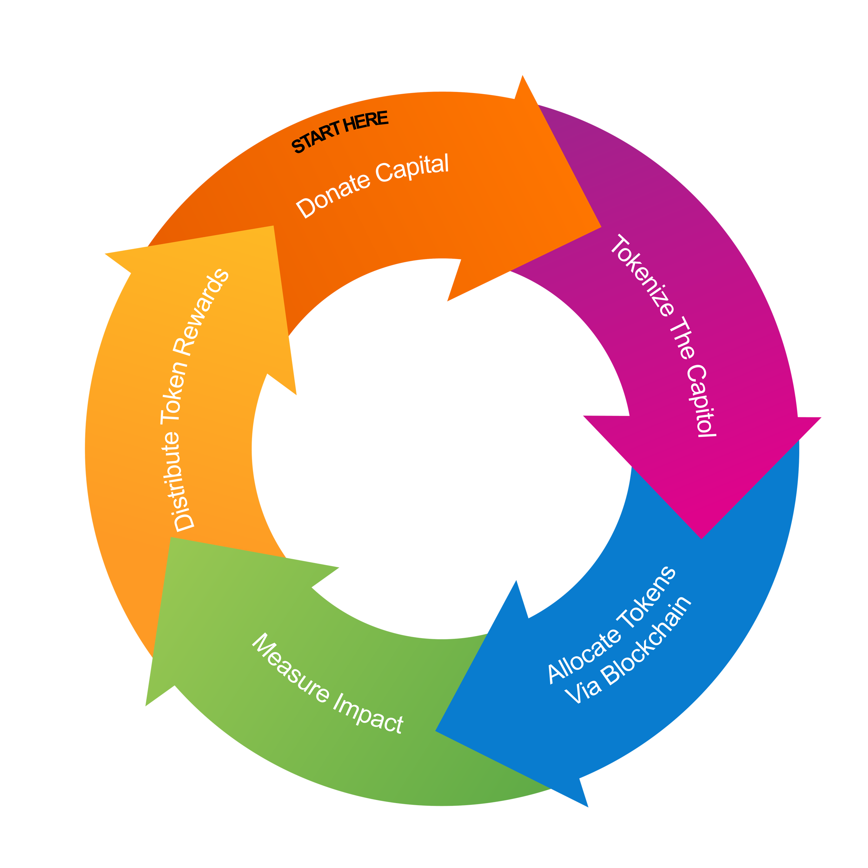
The Token’s Role In Creating A Capital Loop
Notes:
Participate In Tokenized Money Market Fund
Donate % Of Yield (Tax Deductable)

Slide 9
How AI Powers The Tokenization Foundation
The gap between available resources and the people who need them has never been a shortage of funding. It has been a shortage of infrastructure intelligent enough to move that funding accurately, transparently, and at scale. Our AI-powered core principle is built on 'Skills as Infrastructure' and the question of how to move resources and capability simultaneously, at scale, with accountability." The most durable form of resource transfer is one that compounds. A payment moves once. A skill multiplies.
At Tokenization Foundation, we embed skills augmentation directly into the distribution layer. As resources move to participants, AI simultaneously identifies skill gaps, surfaces relevant learning, and delivers certified capability - not generic training, but precise, context-specific expertise matched to each participant's situation and goals. AI augments both
Practitioner intelligence. Field practitioners are the most valuable layer of any distribution network. AI amplifies practitioners' judgment by surfacing relevant context, flagging anomalies, and reducing administrative burden, allowing them to spend time with participants, not paperwork.
Precision allocation. AI continuously analyzes need signals - geographic, contextual, and temporal - and routes resources to where they create the most impact. Reduced manual gatekeeping and committee delays. The system makes allocation decisions in real time, based on verifiable data.
What this means in practice:
For participants, resources arrive with the knowledge to use them well, whether that is financial literacy, agricultural technique, health protocol, or legal understanding.
For practitioners, AI surfaces relevant skills in real time, reducing the time between identifying a need and addressing it.
For funding organizations, every transfer is paired with capability data, creating a longitudinal record of impact that goes beyond disbursement to measurable growth.

Slide 10
About Us
How It All Started
The Tokenization Foundation was born from a direct engagement with the United Nations, which approached Aegis Trust Company to explore whether blockchain could solve persistent inefficiencies in crisis-relief funding. That collaboration revealed a clear and urgent truth: the current system cannot operate at the speed or scale modern crises demand—creating the need for a fundamentally new approach.
Notes:
First page of Impact Section
This copy will change after we get approval from UN. Will match press release.

Slide 11

Meet The Team
Serra
Lynne
Anita
Kerstin
Photo
Photo
Photo
Photo
Short Bio Here
Short Bio Here
Short Bio Here
Short Bio Here
Contact Us
Notes:
Bio Copy and Images coming
Contact Us Links to form

Slide 12
Meet The Team
Serra
Lynne
Anita
Kerstin
Photo
Photo
Photo
Photo
Short Bio Here
Short Bio Here
Short Bio Here
Short Bio Here
Contact Us
Notes:
Bio Copy and Images coming
Contact Us Links to form

Slide 13
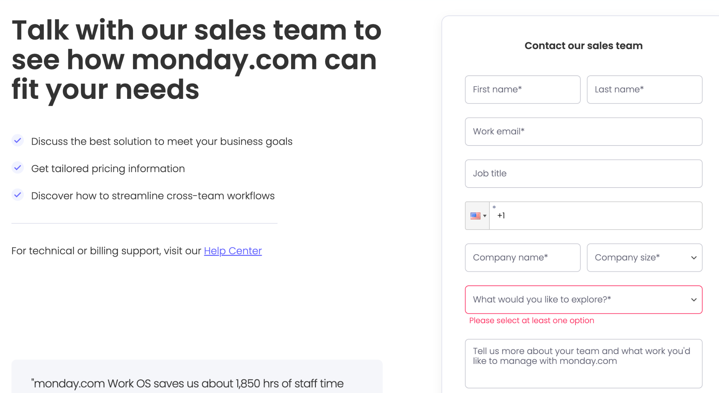
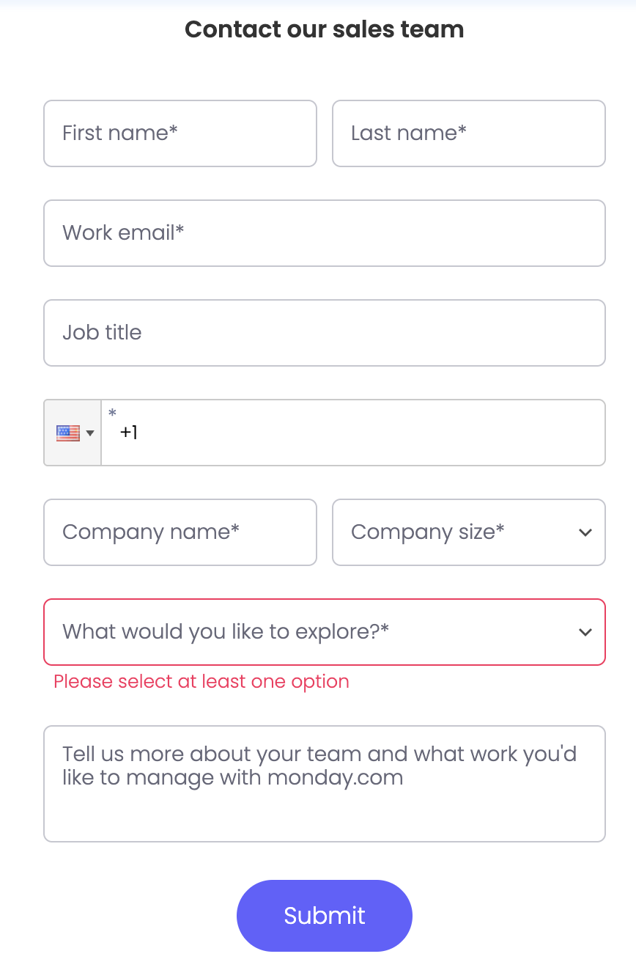
TF Form Content
Contact Form Examples
When user clicks on Contact button, redirect to this form
Copy on Left should read:
Talk with one of our team members. Fill out the form on your right. We’ll email you right back.
Form Fields:
First Name*
Last Name*
Work Emai*:
Job Title:
Phone number:
Drop down country codes - if easy
Company Name:
What would you like to explore?*
Drop down menu:
Institutional investment
Easly access to our dSDR Waitlist and/or Whitelist
Interest in our Governing Council
Media inquiries
Other
Blank Box: Write more here, if you’d like
Note: * fields required to submit
Submit button
Need advise on where submitted forms collect.

Slide 14
dSDR Waitlist (same format as contact form)
When user clicks on dSDR Waitlist button, redirect to this form
(Headline, left side) Join our mission to tokenize humanitarian aid - so that it can be funded instantly, transparently, and at scale.
10 billion totally supply gradually released to support security and long-term growth
dSDR pays for network services (token minting, transactions, AI agents) via low costs pegged to USD
Users can stake dSDR to validators to secure network and earn rewards
(Headline, right side) Join our waitlist for updates on the 2027 dSDR token release.
Form Fields:
First Name*
Last Name*
Work Emai*:
Submit button
Need advise on where submitted forms collect.

Slide 15
Limit Contact Form Spam Tactics
🛡️ Best Anti-Spam Stack (What actually works)
🥇 1. Invisible CAPTCHA (best overall)
Use Google reCAPTCHA v3 or Cloudflare Turnstile
Runs in the background—no user friction
👉 Best combo of security + UX
🥈 2. Honeypot Field (simple + very effective)
Add a hidden field (e.g., “Company Fax Number”)
Humans won’t fill it → bots often will
👉 If field is filled → auto-block submission
✔️ Zero impact on real users ✔️ Stops a surprising % of spam

