Slide 1
SQL Injection Analysis
Work 3 — modelling an attack as a directed graph
Zhang San · IDU 12345678 · variant 1

Slide 2
Topic: SQL injection
CWE-89; OWASP Top 10 2021 A03: Injection
Input is executed as SQL code -> auth bypass, read/write any table
Precondition: an input point concatenated into SQL; the more DB privileges, the worse
Why it: connects directly to Work 1 and Work 2, and the state machine is clean

Slide 3
Attacker's sequence of actions
1 Recon: crawl, port scan, find endpoints that take strings
2 Probe: submit a quote, trigger an SQL error, confirm the injection point
3 Exploit: ' OR 1=1-- to bypass login; UNION SELECT to read the user table
4 Exfiltrate: sqlmap dump, or page the data out
5 Destroy: stacked UPDATE / DROP, change prices or delete tables
6 Blind: boolean/time-based blind injection with SLEEP(), exhausting the pool

Slide 4
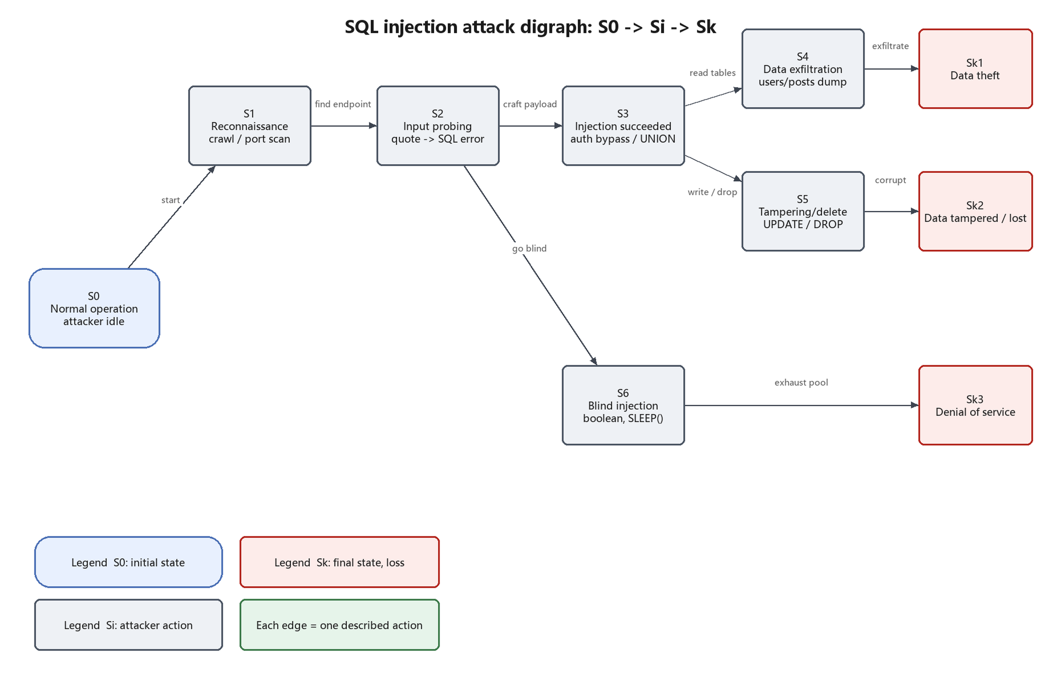
Directed graph: S0 -> Si -> Sk (each edge = one attacker action)

Slide 5
States and evidence
S0 normal -> S1 recon -> S2 injection point found -> S3 injection succeeded
S3 -> S4 dump data -> Sk1 information theft
S3 -> S5 tamper/delete -> Sk2 information modified or lost
S2 -> S6 blind/heavy queries -> Sk3 denial of service
Every state has observable evidence: logs, errors, slow queries, traffic

Slide 6
Countermeasures: cut the edges
Prevent: parameterized queries, allow-lists, least-privilege DB account, no verbose errors
Detect: WAF rules, database auditing, slow-query and connection monitoring
Respond: force password resets and enable 2FA, restore from backup, rate limit
Priority: edges closest to S0 are the cheapest to harden with the highest payoff

Slide 7
Conclusion
SQL injection is a broken boundary between data and code
A directed graph turns a vague narrative into verifiable states and actions
Every edge is both an attack step and a place to break the attack
The same attack can be drawn differently, but S0 and Sk must stay stable

