Slide 1
Data to Text Generation Research
北明算法组--黄贤存
2019-04-10

Slide 2
Content
E2E NLG Challenge
Excellent Paper’s Models
Inspiration for us
Thinking and Discussing

Slide 3
E2e nlg Challenge
MR >>> N L G
a) similar to human generated reference texts.
b) highly rated by humans.
DataSet
Restaurant domain,50k instances, a dialogue act-based MR and up to 5 references in natural language
https://github.com/tuetschek/e2e-dataset/releases/download/v1.0.0/e2e-dataset.zip
Metrics
BLEU、NIST、 METEOR、 ROUGE-L、 CIDEr 、专家人工
https://github.com/huangxiancun/e2e-metrics
Notes:
1、类似于人类生成的文本一样2、还能让人类高度评价

Slide 4
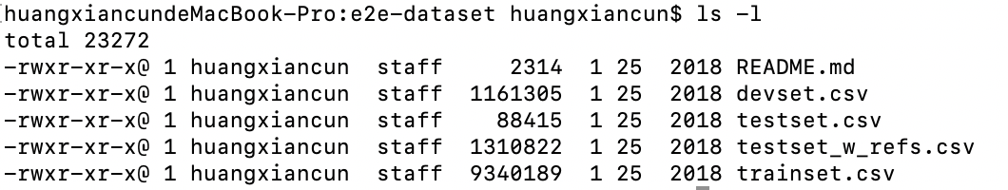
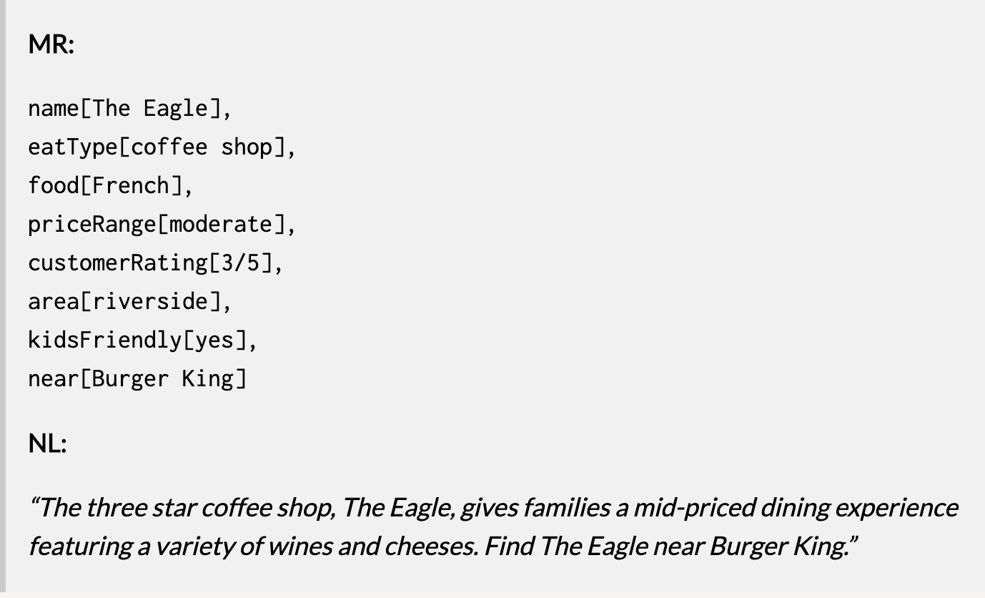
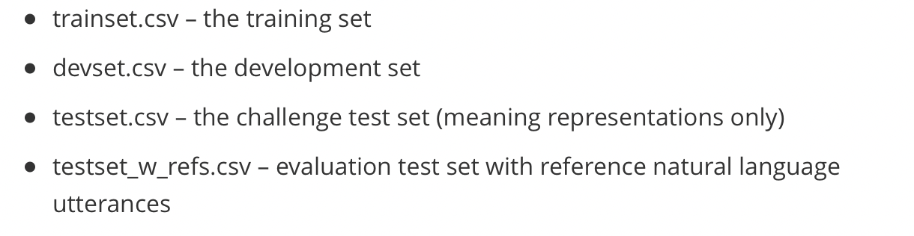
dataset

Slide 5
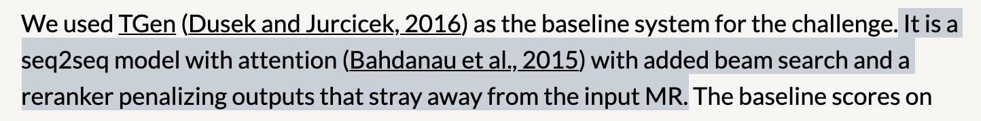
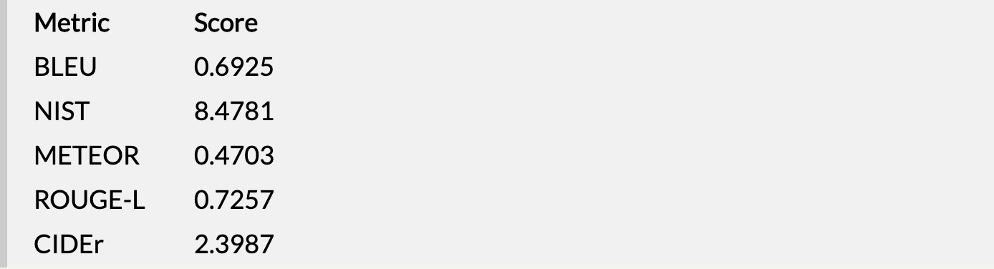
Baseline metrics

Slide 6
Excellent Paper’s Models
Findings of the E2E NLG Challenge
A Deep Ensemble Model with Slot Alignment for Sequence-to-Sequence Natural Language Generation
End-to-End Content and Plan Selection for Data-to-Text Generation
Sequence-to-Sequence Generation for Spoken Dialogue via Deep Syntax Trees and Strings
…

Slide 7
Findings of The E2E NLG Challenge

Slide 8
A Deep Ensemble Model With Slot Alignment For Sequence-to-sequence Natural Language Generation

Slide 9
End-to-end Content And Plan Selection For Data-to-text Generation

Slide 10
Sequence-to-sequence Generation For Spoken Dialogue Via Deep Syntax Trees And Strings

Slide 11
Inspiration For US

Slide 12
Thinking and Discussing

Slide 13
References
http://www.macs.hw.ac.uk/InteractionLab/E2E/
http://www.raincent.com/content-10-13074-1.html
https://github.com/huangxiancun/data2text_generation

Slide 14
Thanks !

