Slide 1
Data to Text Generation Research
北明算法组--黄贤存
2019-04-10

Slide 2
Content
E2E NLG Challenge
Excellent Paper’s Models
Inspiration for us
Thinking and Discussing

Slide 3
E2e nlg Challenge
MR >>> N L G
a) similar to human generated reference texts.
b) highly rated by humans.
DataSet
Restaurant domain,50k instances, a dialogue act-based MR and up to 5 references in natural language
https://github.com/tuetschek/e2e-dataset/releases/download/v1.0.0/e2e-dataset.zip
Metrics
BLEU、NIST、 METEOR、 ROUGE-L、 CIDEr 、专家人工
https://github.com/huangxiancun/e2e-metrics
Notes:
1、类似于人类生成的文本一样2、还能让人类高度评价

Slide 4
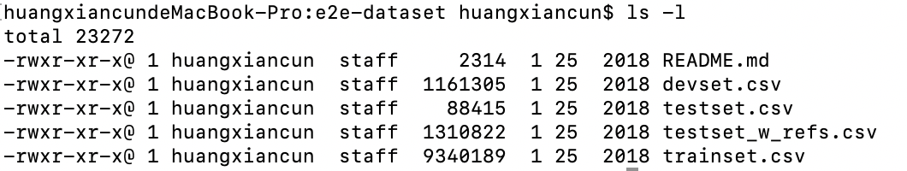
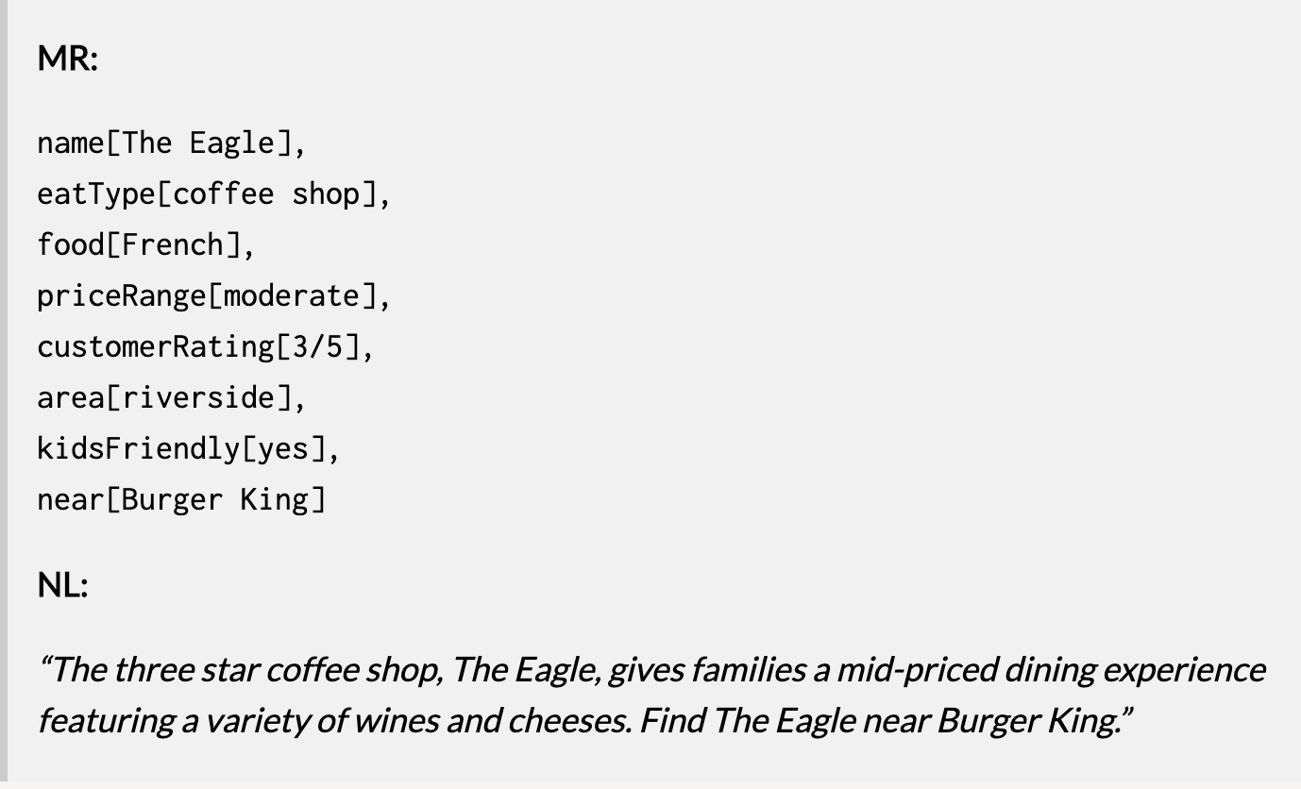
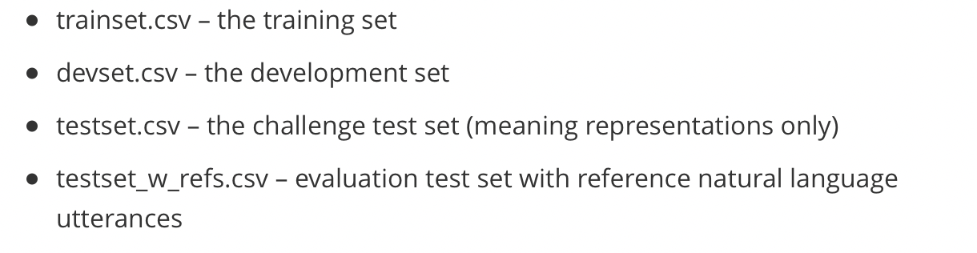
dataset

Slide 5
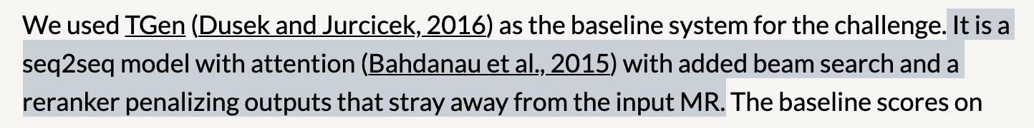
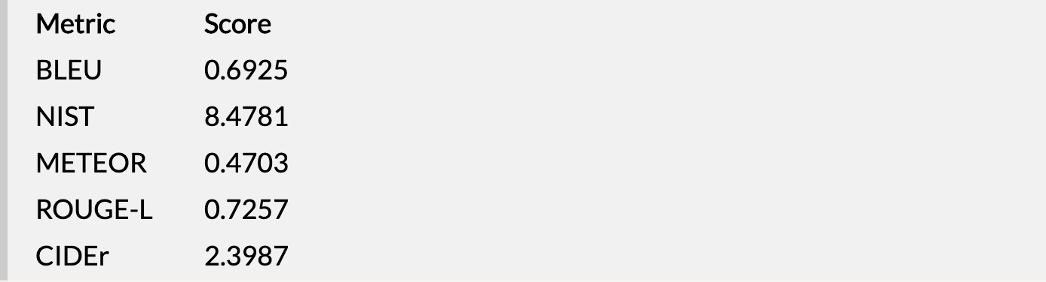
Baseline metrics

Slide 6
Excellent Paper’s Models
Findings of the E2E NLG Challenge
A Deep Ensemble Model with Slot Alignment for Sequence-to-Sequence Natural Language Generation
End-to-End Content and Plan Selection for Data-to-Text Generation
…

Slide 7
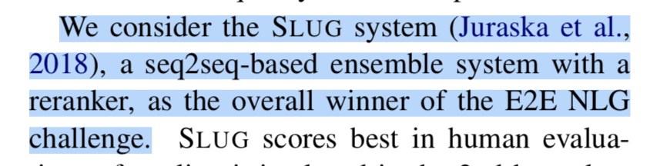
Findings of The E2E NLG Challenge
Dataset.
(82-9-9)
Systems in the Competition
(17,62,1/3工业界)
Evaluation Results

Slide 8
A Deep Ensemble Model With Slot Alignment For Sequence-to-sequence Natural Language Generation
Seq2seq with Attention
The model thus learns a soft alignment between the source and the target sequence.
Ensembling（三个模型，其中2个bi-lstm，一个cnn） + BeamSearch + Rerank
参考[4]、[5]
a domain-independent slot aligner that could be applied to any dataset, regardless of its size, and beyond the reranking task.
这个属性槽对齐器，可以把MR中没有涉及的属性值过滤掉，涉及到的做对齐对应。
delexicalization (去词汇化)就是把句子中出现的属性值，用属性名称替换。
Data Expansion （数据扩充) Solt Permutation and Utterance/MR Splitting
Sentence Planning via Data Selection (生成句子规划选择)
Notes:
加州大学圣克鲁斯分校

Slide 9
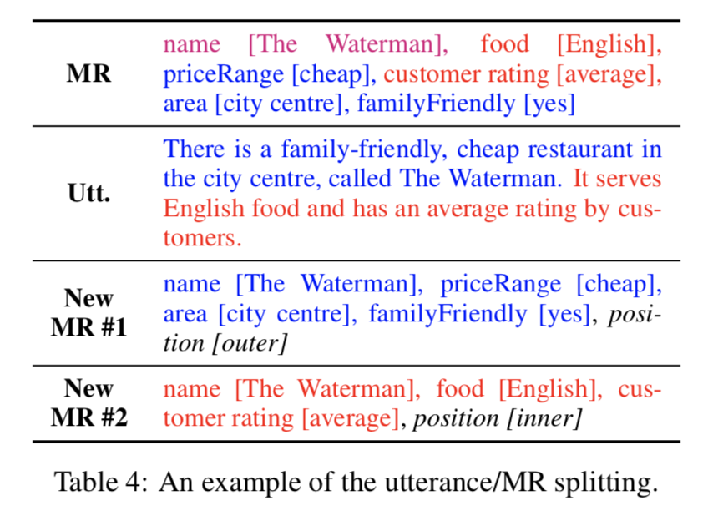
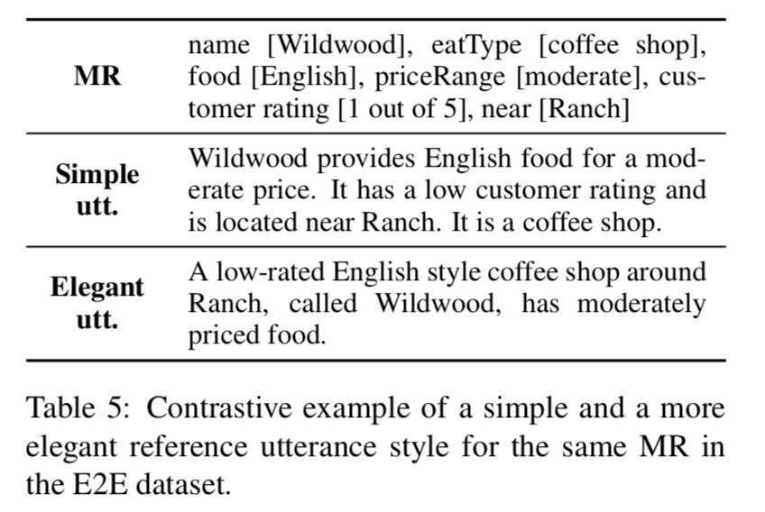

Slide 10
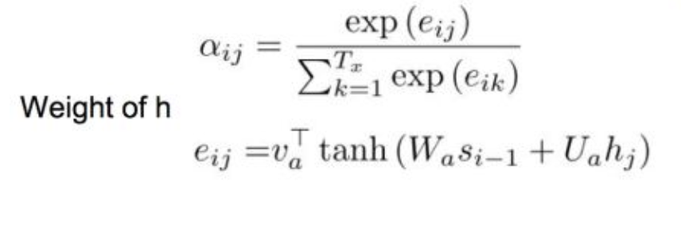
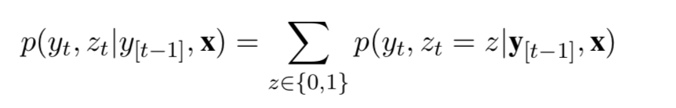
End-to-end Content And Plan Selection For Data-to-text Generation
Pointer-Generator Network
Dot
Mlp
Copy Model
Coverage and Length Penalty
We observed that generated text using vanilla S2S models with and without copy mechanism commonly omits some of the values in their inputs. To mitigate this effect, we use two penalty terms during inference; a length and a coverage penalty.
Notes:
哈弗大学

Slide 11
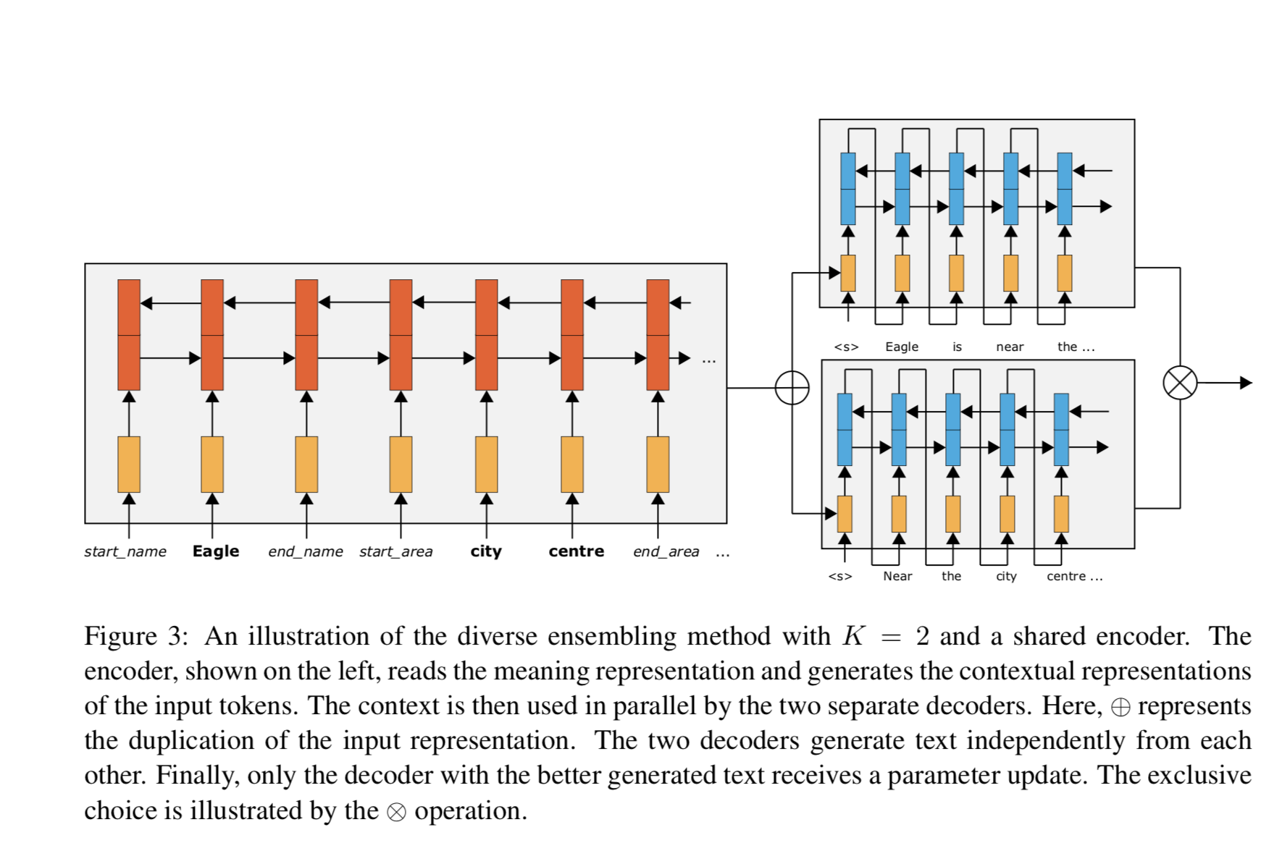
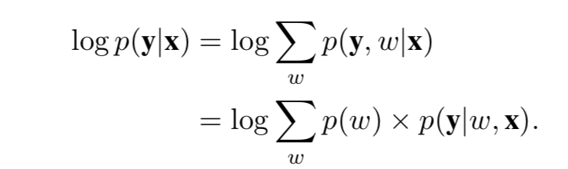

Slide 12
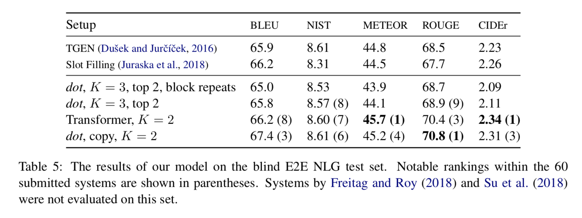

Slide 13
Inspiration For US
E2E 方式实现，必须依赖与数据的处理逻辑或者技巧。
基于baseline模型进行数据分析，把分析结果要落实到模型架构上。
多关注评价指标与数据处理的关系。
数据扩充还是有必要的。

Slide 14
Idea and Method
MR>>>Token序列（数据处理模块）
Delexicalization
Rule(属性值在句子中的位置)
Data expansion
Word2vec
…
Token 序列>>>Model（模型模块）
Feature Extractor
CNN
LSTM or bi-lstm
Transformer
…
Copy attention
Multi-Decoder （适用多个句子结构）
…
Model>>>Metric（评价模块）
BLEU
NIST
METEOR
ROUGE-L
CIDEr
…

Slide 15
Thinking and Discussing
我们的数据是什么样的？
我们评价指标选什么样的？
科研项目是以论文还是以发明专利形式给出？

Slide 16
References
[1] http://www.macs.hw.ac.uk/InteractionLab/E2E/
[2] http://www.raincent.com/content-10-13074-1.html
[3] https://github.com/huangxiancun/data2text_generation
[4] https://zhuanlan.zhihu.com/p/49271699
[5] https://zhuanlan.zhihu.com/p/28048246
[6] https://github.com/UKPLab/e2e-nlg-challenge-2017

Slide 17
Thanks !

