Slide 1
栈和队列 stack & queue
无隅

Slide 2
栈和队列
栈： LIFO(Last in first out) 后进先出
队列： FIFO(First in first out) 先进先出

Slide 3
栈的初始化与基本操作
Java类库: Stack<String> stack = new Stack<>();
基本操作：
方法 | 参数 | 返回值 | 时间复杂度
push | Element | Element/void | O(1)
pop | void | Element | O(1)
peek | void | Element | O(1)
isEmpty | void | boolean | O(1)

Slide 4
栈的实现
定义属性字段
在数组的基础上实现
属性： elements, size, capacity
构造器实现
定义方法
push, pop, peek, isEmpty

Slide 5
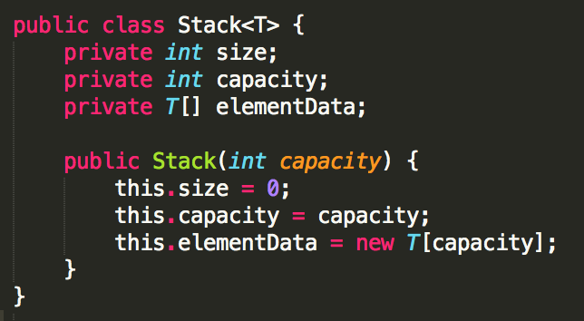
栈的实现 – 属性及构造器

Slide 6
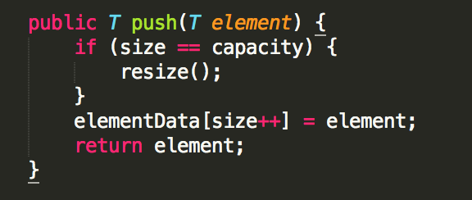
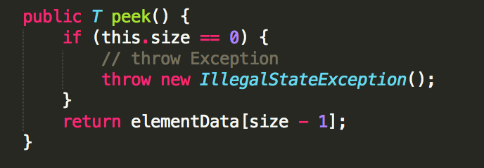
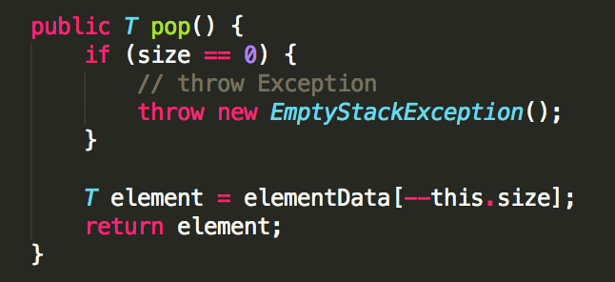
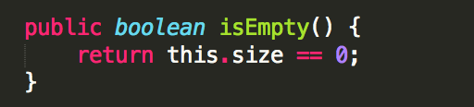
栈的实现 – 方法、函数

Slide 7
什么时候考虑使用栈
调用函数
递归
深度优先搜素DFS(Depth-first Search)

Slide 8
栈和堆在计算机操作系统上的概念
栈区 stack
存储primitive variables function call
栈区的读取速度更快
堆区 heap
堆区存放引用类型变量
堆区可以动态地分配内存空间

Slide 9
队列的初始化与基本操作
Java类库: Queue<String> queue = new LinkedList<>();
基本操作：
方法 | 参数 | 返回值 | 时间复杂度
offer (add) | Element | boolean | O(1)
poll (remove) | void | Element | O(1)
Peek (element) | void | Element | O(1)

Slide 10
队列的实现
定义属性字段
在链表的基础上实现
属性： elements, size, capacity
构造器实现
定义方法
offer, poll, peek, isEmpty

Slide 11
队列的实现 – 属性及构造器

Slide 12
什么时候考虑使用队列
广度优先搜索BFS (Breadth-first Search)
优先队列 Priority Queue (Heap)
多任务调度

Slide 13
栈与队列典型题目

Slide 14
Implement Queue using Stacks
Implement the following operations of a queue using stacks.
push(x) -- Push element x to the back of queue.
pop() -- Removes the element from in front of queue.
peek() -- Get the front element.
empty() -- Return whether the queue is empty.

Slide 15
Implement Queue using Stack思路
Use two Stacks to implement a queue
Consider the basic operations of these two data structures
How to minimize the time complexity

Slide 16
Max Stack
Design a stack that supports push, pop, top, and retrieving the maximum element in constant time.
push(x) -- Push element x onto stack.
pop() -- Removes the element on top of the stack.
top() -- Get the top element.
getMax() -- Retrieve the maximum element in the stack.

Slide 17
Max Stack思路
One stack cannot tell the max in O(1)
Need another stack to store the max
time <=> space

Slide 18
Valid Parentheses
Given a string containing just the characters '(', ')', '{', '}', '[' and ']', determine if the input string is valid.
The brackets must close in the correct order, "()" and "()[]{}" are all valid but "(]" and "([)]" are not.

Slide 19
Valid Parentheses思路
We need to use the stack to store the information: which left parentheses has not been matched yet
Stack can help store every unused parentheses, no matter when the parentheses appears

Slide 20
Valid Parentheses – follow up
返回括号对的个数
返回”{}”类型括号对的个数

Slide 21
Decode String

Slide 22
作业

