Slide 1
CrashTuner: Detecting Crash-Recovery Bugs in Cloud Systems via Meta-Info Analysis
黄鑫鑫
2019/12/04

Slide 2
Crash-recovery bugs
Problem：It is difficult to detect crash-recovery bugs since these bugs can only be exposed when nodes crash under special timing conditions
Resolution：Present CrashTuner, a novel fault-injection testing approach via meta-info analysis to combat crash-recovery bugs
Notes:
节点故障是很常见的，本身不是问题，但是在节点故障后的恢复机制中，有一些bug会导致系统崩溃，而这样的bug又很难检测出来。。

Slide 3
Crash-recovery bugs
Bugs in crash-recovery-related mechanisms
These bugs break fault-tolerance schemes and hence easily lead to system failures
It is difficult to detect crash-recovery bugs
These bugs can only be exposed when nodes crash under special timing conditions
Notes:
在分布式系统，节点的故障一般可以通过系统的容错机制来恢复

Slide 4
Challenge
Current techniques detect crash-recovery bugs via fault-injection testing
It is challenging to hit the small bug-triggering windows due to the huge state-space of the system
Notes:
现有bug检测技术一般用故障注入测试来检测bug，要在庞大的状态空间里找到触发bug的时间窗口，就像大海捞针一样

Slide 5
Fault-Injection testing
Random fault injection is ineffective
Systematic approaches applie manual specifications to effectively restrict the large search space
Although great progress has been made, these approaches still suffer from the state explosion problem
Most (>99.9%) injected faults are unnecessary and very few new crash recovery bugs were reported
Notes:
现有技术难以让状态空间收敛到一个合理范围

Slide 6
CrashTuner
Precisely identify bug-triggering points where node crash events can be injected
We refer to such program points as crash points
CrashTuner precisely locates crash points by automatically inferring meta-info variables
It is realized via a log-based static program analysis
It is fully automatic and no manual specifications are needed
Notes:
2 本文作者发现，只要在故障点插入宕机事件，就可以有效地触发潜在的bug

Slide 7
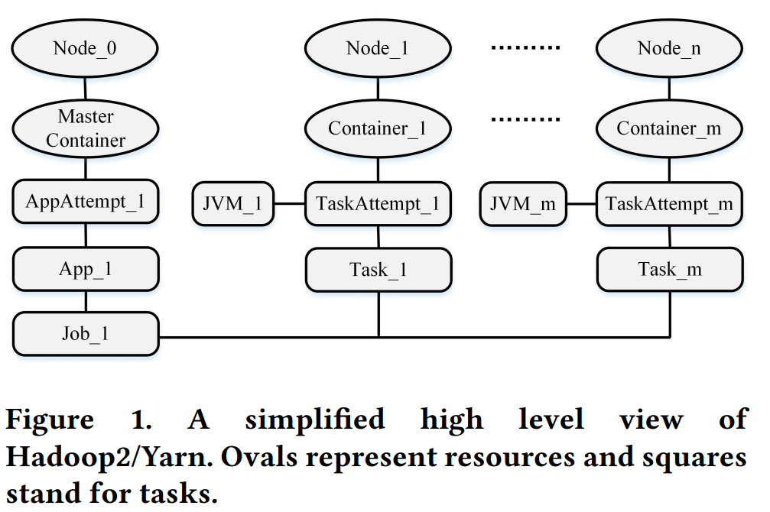
high-level system state
Distributed systems consist of clusters of nodes
Jobs and resources are divided into small pieces,and then assigned to each individual node
The set of nodes, and their associated tasks and resources, together form a high-level view of the system state
Notes:
什么叫meta-info呢
hadoop2的high-level system state
high-level系统状态：节点 及其关联的资源和任务
系统有nodes(node0,node1...noden)
每个节点管理1到多个容器.
每个容器上有一个JVM进程
JVM会执行一个Task的一个Attempt

Slide 8
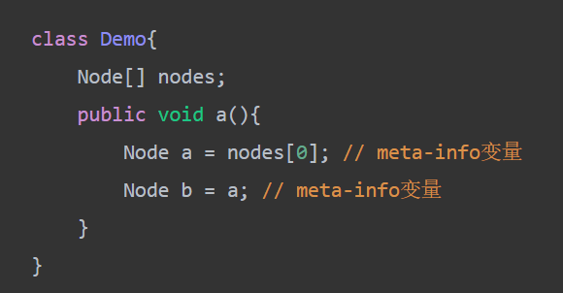
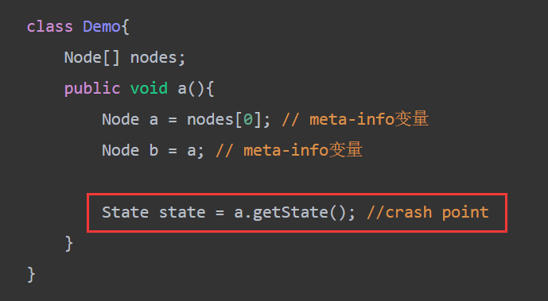
Meta-info variables
Variables referencing high-level system state information
High-level system state information is stored in the heap memory of different nodes
Node crash or recovery events will change the system state
The crash points are the program points accessing meta-info variables. Crash-recovery bugs are triggered when a node crashes at crash points
Notes:
故障点是访问Meta-info变量的地方。那么什么是meta-info变量呢

Slide 9
Crash Points
The pre-read scenario: Node N crashes before its meta-info is read by another node M
The post-write scenario: Node N crashes after M updates the system state (i.e., stores to meta-info variables).
Notes:
The pre-read scenario: Node N crashes before its metainfo is read by another node M. Node M is not aware of the crash and keeps using the stale information of N, leading to aborts and job failures
The post-write scenario: Node N crashes after M updates the system state (i.e., stores to meta-info variables). In the recovery process, intermediate updates of N need to be discarded and rolled back. The recovery process may mis-handle the corrupted state, leading to failed (or incorrect) recovery attempts

Slide 10
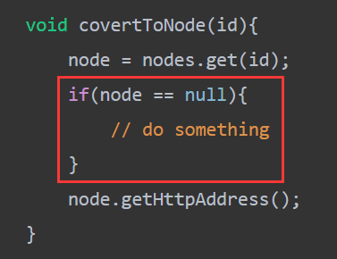
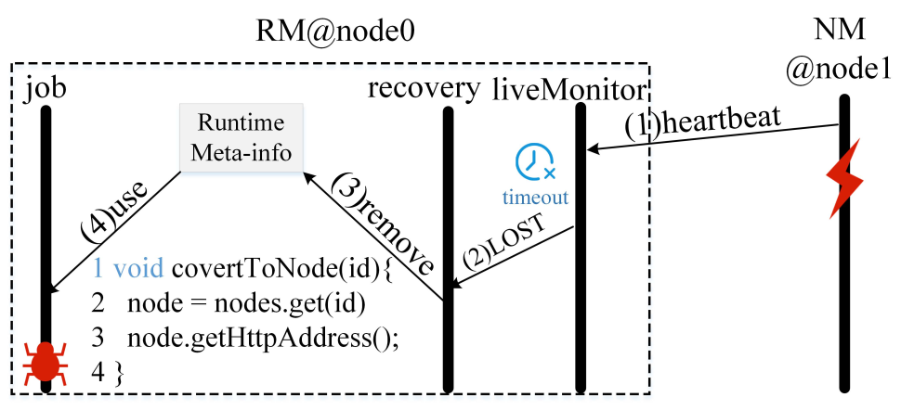
Pre-read scenario
Node N crashes before its meta-info is read by another node M
Notes:
代码第3行会有一个空指针异常
如果有健康检查的话也没有问题
如果是After read的话，代码就不会有问题，只是当任务调度到node1上时会失败，这个失败系统可以处理
一个node挂了以后，所有读该node的变量都应该检查，在代码中加入if语句可以避免这种bug

Slide 11
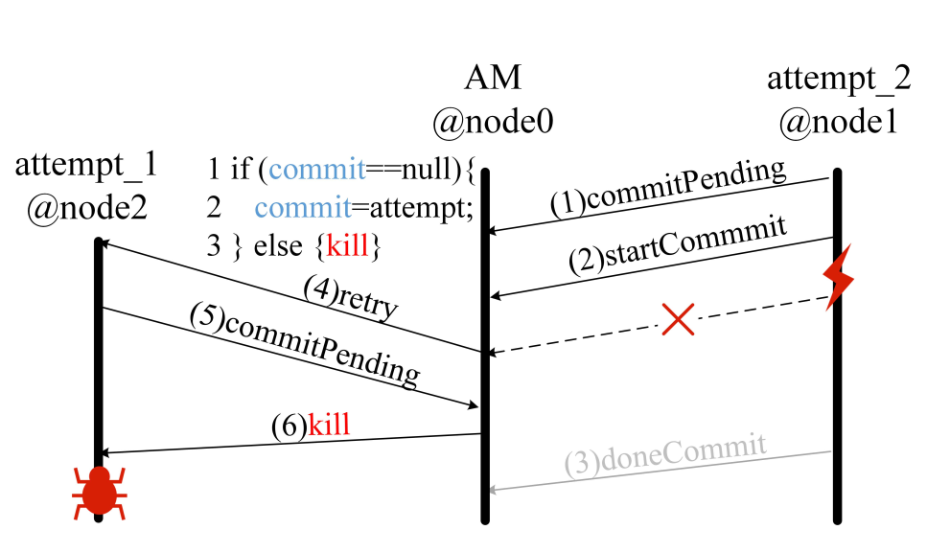
Post-write scenario
Notes:
如果node1在doneCommit后挂，那么attempt_1会被成功提交
如果node1在commitPending前挂掉，recovery会fork另外一个attempt，
代码是在第5步后执行的

Slide 12
which variables are metainfo variables
Node-referencing variables and their directly or indirectly related variables are meta-info variables
Object fields holding same values of meta-info variables are meta-info variables
Notes:
1. Two variables are related if they appear in a same runtime log instance
1. We could easily identify node referencing variables (and their runtime values) from runtime logs

Slide 13
How to identify meta-info variables
We apply log analysis to discover the set of meta-info variables logged at runtime
Notes:
1. Two variables are related if they appear in a same runtime log instance
1. We could easily identify node referencing variables (and their runtime values) from runtime logs

Slide 14
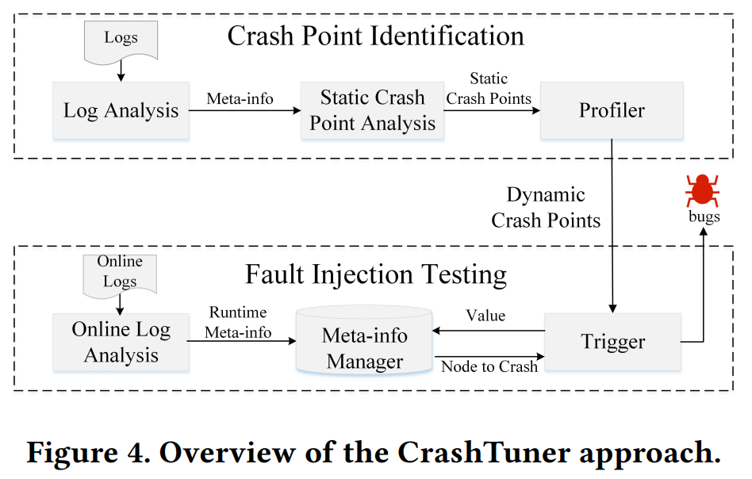
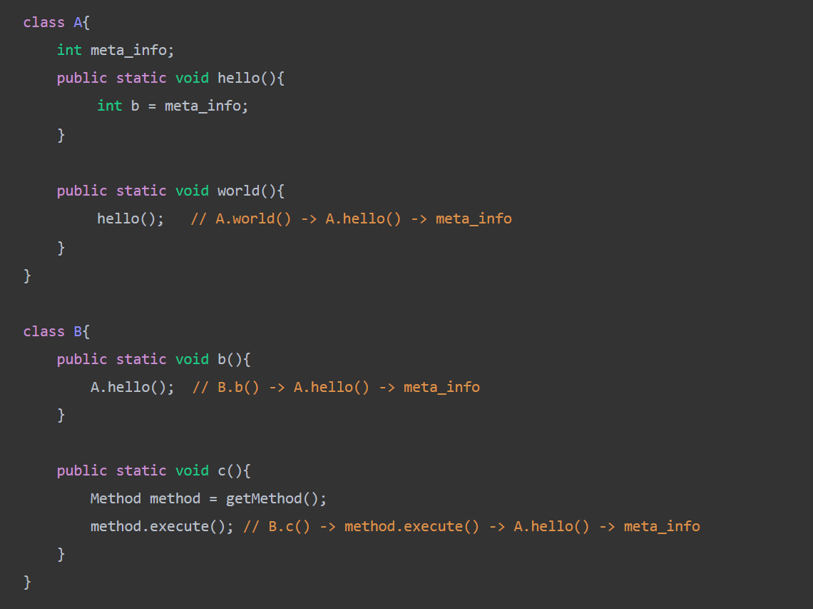
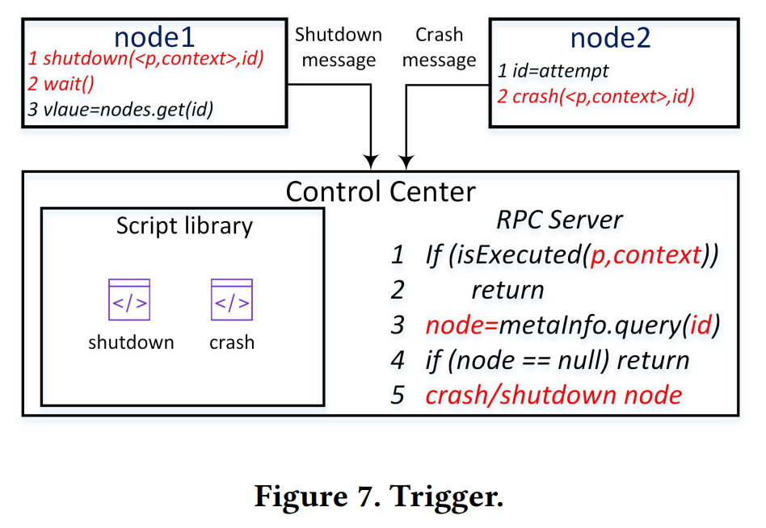
CrashTuner Approach
Notes:
3
日志分析得到meta-info
根据meta-info去代码里，找到meta-info type，以及Static Crash Point
Profiler通过类似代理的方法，在静态点前打印调用栈---Thread.currentThread().getStackTrace()
Online Logs收集每个节点的日志，并进行分析
trigger：Profiler是运行在各个节点的。id是meta-info的值，center通过它可以去查到要宕掉的节点。
Dynamic Crash Points：A dynamic crash point is represented as a tuple of two elements < P,Context >, where P is the program point and Context is the call stack.
我们使用运行时的调用栈来区分执行同一个程序点的上下文。如果同一个程序点执行时的上下文不同，则认为它们是不同的故障点
Static Crash Point Analysis finds out all other metainfo variables in the system by examining the types of existing meta-info variables. Object fields with equivalent types of existing meta-info variables are regarded as meta-info variables.（检查成员变量包含meta-info变量的类）
Profiler runs the given workload to record the dynamic crash points (an executed static crash point with a distinct call stack) at runtime. Those static crash points not executed are discarded.
（Profile 运行任务来记录动态奔溃点。没有被执行的静态点就丢弃掉）

Slide 15
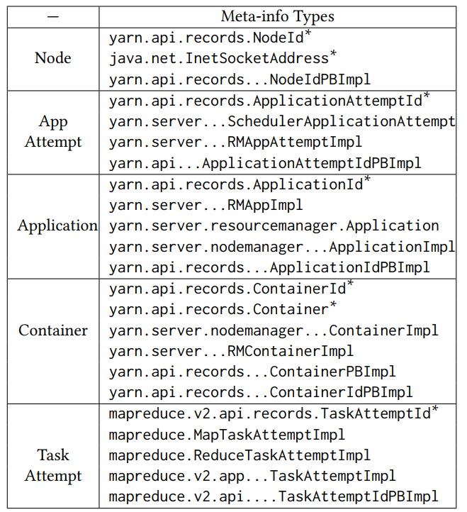
Meta-info Types
Notes:
Static Crash Point Analysis：
带*的是从日志中分析出来的类型
不带*的是从代码中分析出来的
通过putXXX or getXXX 访问成员变量
before or after 就是静态Crash Point

Slide 16
Bugs
使用CrashTuner对每个系统进行测试，耗时17.39小时
复现了66个现有故障恢复bug中的59个
CrashTuner detects 21 new bugs that have never been reported before
Including 8 critical bugs(classified by the original developers)
16 of them have already been fixed (14 patches provided by us)

Slide 17
CrashTuner
CrashTuner has been applied to test the 5 representative distributed systems (Hadoop2/Yarn,HBase,HDFS,ZooKeeper,Cassandra)
Reproduce 59 out of 66 existing crash recovery bugs
Reports 21 new crash-recovery bugs that have never been found before
Including 8 critical bugs(classified by the original developers)
16 of them have already been fixed (14 patches provided by us)
Notes:
2 本文作者发现，只要在故障点插入宕机事件，就可以有效地触发潜在的bug

Slide 18
Bugs fixes
20 patches submitted: 15 accepted, 5 under review, 1 rejected
15 accepted : 8 introduce sanity checks, 7 add handlers for unexpected exceptions
1 rejected (HBASE-22017):
we fix the race condition in the server process
the original developers created a new issue (HBASE-22047) and fixed the
problem on the client side
1 not submitted(HBASE-22041):
we find the following comment: //TODO: How many times should we retry
the original developers were already aware of the problem
we could not figure out the right retry threshold

Slide 19
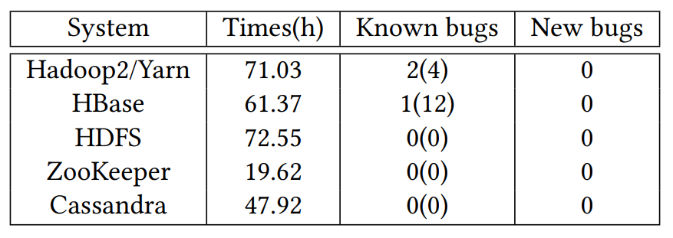
Random Crash Injection
Notes:
4.4.1
在运行任务时，随机选择一个时间点和一个节点，插入一个故障事件，每个系统运行3000次测试
一共发现了3个bug(14次)，发现的bug CrashTuner都能发现
3个bug都是在启动一个新的节点的时候发生的，因为启动节点是个耗时操作，随机故障注入方法在bug触发事件窗口比较大的情况下会有比较大的命中率
平均找到一个bug花费了17.03个小时，如果不计算重复发现的bug，每个bug的发现需要花费90.83小时
而CrashTuner每1.7个小时就能发现一个bug，效率更高

Slide 20
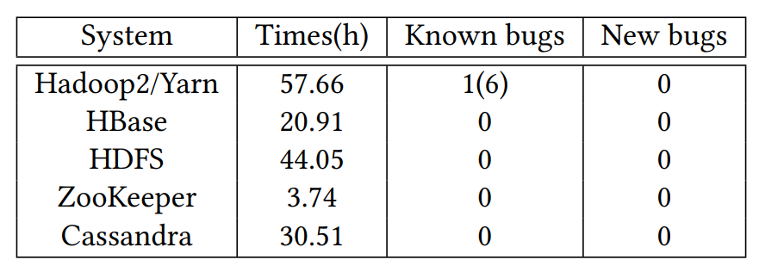
IO Fault Injection
Notes:
4.4.2
找到了一个bug，平均找到一个bug花费24.15小时
CrashTuner也能找到这个bug，并且能找到其他更多的bug，比较实际的故障点比IO点要多多了
还有一个有意思的事情，在查看日志的时候，发现在IO故障注入测试时，其实发生了很多的异常，但这些异常都被系统处理了，原因：一般情况下，开发者都有处理IO操作异常的习惯
所以IO故障注入实际并不是很有效

Slide 21
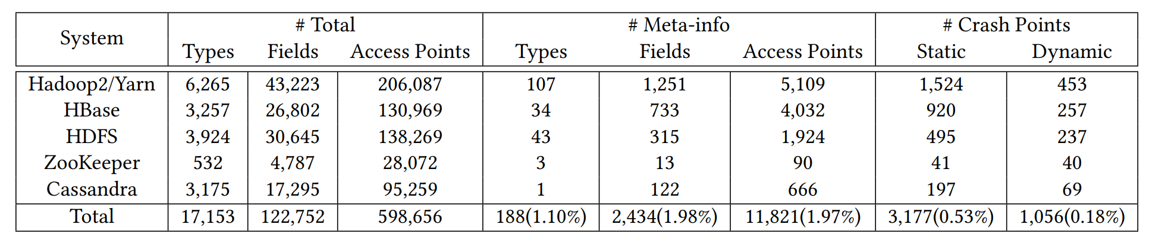
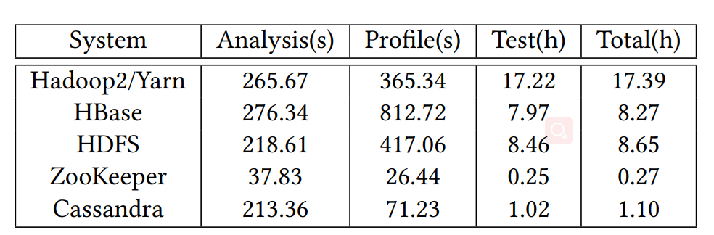
Efficiency
Notes:
4.4.2
访问点的数量下降了
CrashTuner测试各个系统花费的时间。性能不错，分析阶段在5分钟内完成，Hadpoop2测试所有动态故障点用了17.22小时

Slide 22
Conclusion
find a pattern：while accessing variables referencing high-level system state information, it often triggers crash-recovery bugs
identify crash points by automatically inferring meta-info variables via a log-based static program analysis
the approach is automatic and no manual specification is required
Notes:
这篇论文说了什么呢？
发现了一个规律

Slide 23
Contributions
propose a novel approach to crash-recovery bug detection
develop CrashTuner, a simple yet effective tool to detect crash-recovery bugs
evaluate CrashTuner using five representative distributed systems
Notes:
贡献

Slide 24
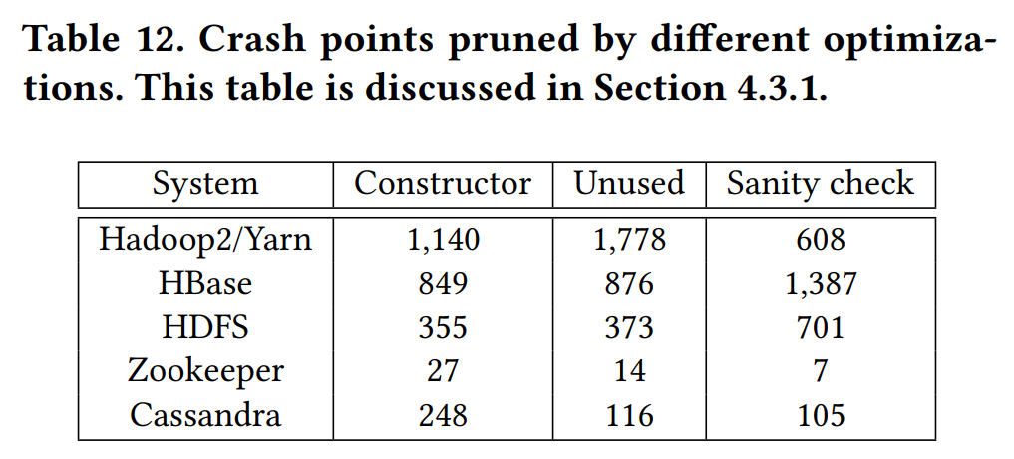
Efficiency
Notes:
4.3.1 优化
丢弃了3种成员变量的引用：
1 ： 只在类的构造方法中设置的成员变量
2 ： 没有被使用的read reference或只用在日志中
3 ： 在使用前有经过sanity check的read reference
一共减少了3.76倍的故障点
被丢弃掉的故障点中没有发现bug

Slide 25
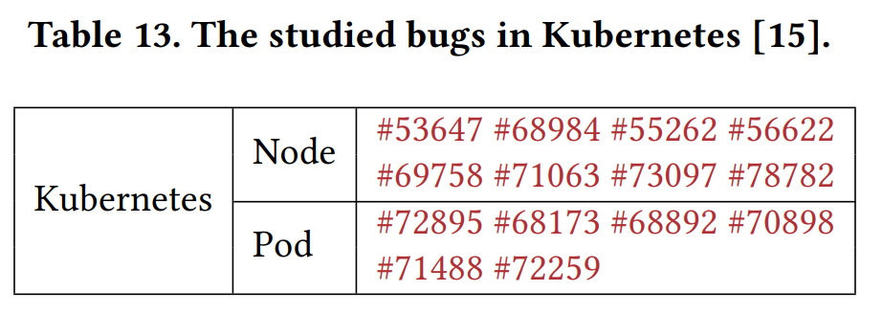
Efficiency
Notes:
4.4
CrashTuner使用Java编写，并且前面测试了5中基于Java的分布式系统
测试发现了K8S的14个调度相关的bug。
root causes of crashrecovery bugs ：
1. failing to handle corrupted metainfo (the post-write scenario)
2. using stale meta-info (the pre-read scenario)
CrashTuner可以更高效地检测出这种bug

