Slide 1
Exploring The Scientific Landscapes With Data Science
Yuan Huang
Notes:
Today I’m going to talk about a project I’m currently working on using data science techniques to build a web application product that helps researchers to better understand the research landscape and find out the most important research papers for them.

Slide 2
Motivations
Science Overflow:
2.5 million new scientific papers are published each year
In Physics, nearly 300 articles are posted on arXiv.com everyday
Understand the scientific landscape
Identify important papers/authors in the field of interest
Recommend important research articles based on user’s interest and history
Notes:
As a physicist by training, whenever I want to enter a new field or start a new project, I would like to do a thorough literature search, but always find myself overwhelmed by the number of papers in the field. According to research, there are 2.5 million new research papers published every year. And in the field of Physics, there are around 300 preprint papers posted on arXiv, which is the online repository for many scientific fields.
Since last year, I began to grow a strong interest in Data Science and took several Data Science Courses online and from our CS department in UMass. As I learn more and more Machine Learning techniques, I realize that it would be really helpful to build a product to help researchers to find relevant information in the ocean of scientific papers using Data Science techniques.
After discussing the product ideas with many colleagues of mine, since they will be the targeted users of my product, I set three main goals for my project: 1) understand the landscape of the research field, how do they divide into different subfields, how subfields are interacting with each other; 2) for each field of interest, identify the most important papers and authors; 3) a more advanced functionality would be to recommend important articles or newly published articles in a user’s field according to user’s research history and interest.

Slide 3
Explicit Connections in Research Papers: Citations
Knowledge/idea inheritance and evolution
Citation Network (Graph)
Directed graph, only going back in time
Notes:
One advantage to study research papers is that they have a very standard format and all of them have very strict requirements for citations. The citations between papers give us a direct way to study how papers are connected with each other, and how knowledge and ideas are inherited and evolving in time.
The citation network of papers is a directed graph, with papers as nodes and citation as directed edges that only going backward in time.
In my product, I will mostly leverage on the research paper’s citation network to build my final product.

Slide 4
Outline
Community Detection in Citation Network and Visualizations
Research Article Recommendations
Notes:
In today’s talk, I will cover two parts of the project, one is the community detection in the Physics Article citation network and the visualizations; the other part is a prototype of the recommendation product.

Slide 5
Community Detection
Community:
densely connected internally, while sparsely connected in between
1
2
Notes:
The community in a graph is a group of nodes that are densely connected internally but with sparse connections with nodes from other community.
In the example I am showing here, the graph is divided into two communities.
The task of community detection in networks are a very popular and important topic in network analysis. It is very similar to the unsupervised clustering task, with major difference which is the data points are represented as a graph, only topological structure but no well-defined distance. I will use the term community and clusters interchangeably in the talk.

Slide 6
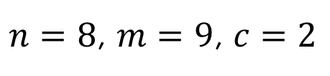
Evaluation of Clustering: Modularity
$n=8$, $m=9$, $c=2$
n nodes, m edges, c clusters
1
2
Notes:
Before we talk about specific model to detect the clusters, I want to first discuss how do we evaluate a clustering result in a graph. The metric mostly commonly used is the modularity score, which represents how strongly connected the nodes within each cluster compared to nodes between different clusters. To introduce the exact definition of modularity, I first need to define several notations. I will use n to represent number of nodes, m as number of edges, c as the number of clusters.

Slide 7


Evaluation of Clustering: Modularity
$n=8$, $m=9$, $c=2$
n nodes, m edges, c clusters
edges from cluster i to j
1
$$e_{ij}=\frac{\# \text{edges} i→j}{m}$$
$$e_{11}=4/9$$
2
Notes:
Then I can define the fraction of edges from cluster I to cluster j in the graph. I and j can be the same or different.

Slide 8

Evaluation of Clustering: Modularity
$n=8$, $m=9$, $c=2$
n nodes, m edges, c clusters
edges from cluster i to j
1
$$e_{ij}=\frac{\# \text{edges} i→j}{m}$$
$$e_{11}=4/9$$
$$e_{12}=2/9$$
2

Slide 9


Evaluation of Clustering: Modularity
$n=8$, $m=9$, $c=2$
n nodes, m edges, c clusters
edges from cluster i to j
all edges start from cluster i
1
$$e_{ij}=\frac{\# \text{edges} i→j}{m}$$
$$e_{11}=4/9$$
$$a_{i}=\frac{\# \text{edges} \text{from} i}{m}$$
$$e_{12}=2/9$$
$$a_{1}=6/9$$
2
Notes:
Sum all the edges coming from a cluster I, we can define ai as the fraction of edges starting from i.

Slide 10
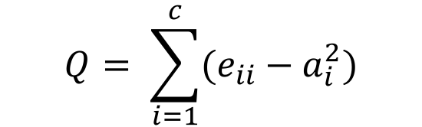
Evaluation of Clustering: Modularity
$n=8$, $m=9$, $c=2$
n nodes, m edges, c clusters
edges from cluster i to j
all edges start from cluster i
1
$$e_{ij}=\frac{\# \text{edges} i→j}{m}$$
$$e_{11}=4/9$$
$$a_{i}=\frac{\# \text{edges} \text{from} i}{m}$$
$$e_{12}=2/9$$
Modularity
$$Q= \sum_{i=1}^{c}{(e_{ii}−a_{i}^{2})}$$
$$a_{1}=6/9$$
2
Notes:
With all these notations, we can have the definition for modularity, which is the fraction of the edges that fall within the given groups minus the expected fraction if edges were distributed randomly.

Slide 11
Algorithms for Community Detection
Global optimization? NP-hard!
Greedy algorithms: Louvain algorithm
Bottom-up (agglomerative) hierarchical clustering
Reference:
Fast unfolding of communities in large networks
Blondel, Guillaume, Lambiotte, Lefebvre
Journal of Statistical Mechanics: Theory and Experiment, 2008
Notes:
With the modularity metric at hand, we can think about algorithms to optimize the score. Unfortunately finding a global optimization for modularity is a NP-hard problem that is impractical to implement. Instead normally people would use greedy algorithms to incrementally increase the modularity and achieve a local optimum. One commonly used example is the Louvain algorithm which is a bottom up hierarchical algorithm that is very efficient and can give high performance compared to other methods in many cases.

Slide 12
Louvain Algorithm
Notes:
The idea of the algorithm is to assign a unique cluster label to each node as the initial state. Then iterate through each node, calculate the modularity gain of merge the node of any of its neighbor node and merge it with the neighbor with highest modularity gain. After one round, clusters will be formed in the graph, and merging all the nodes in a cluster into a bigger node, add the weight of edges together between each of these bigger nodes. On this compressed graph, repeat the iteration of merging again, until there’s nothing left to merge.

Slide 13
Determine the Number of Clusters

Slide 14
Determine the Number of Clusters
Keep growing the tree up to the top
Plot modularity score as a function of #clusters
Q
C (# clusters)
Notes:
The hierarchical clustering builds up a tree of clustering through the whole learning process. One important question to ask is when should we stop? In other words, how do I determine how many clusters I should keep in the graph? For example, in this case, 2 clusters or 3 clusters both seem to be reasonable choices. But it is better that we use some quantitative metric to do the selection. One way to that is perform the whole merging process in the algorithm till the top of the tree, keep track of modularity score at each step, and then plot modularity as a function of cluster number. The curve of modularity normally would look like this. The peak position would the optimal choice for c.

Slide 15
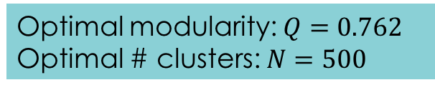
Results in Physics Articles Citation Network
All articles published on Physical Review Letter, Review of Modern Physics, and Physical Review X from 2007 to 2015 (data requested from APS)
27,695 articles and 91,346 citation links
Lots of small clusters
Optimal modularity: $Q=0.762$
Optimal # clusters: $N=500$
A few large clusters
Notes:
Now it is time to try the community detection algorithm on the citation network of physics papers. I requested the citation data from the American Physical Society website for all the publications in their journals dating back to 1875. As for now, I only looked at all the articles published on three most important physics journals in the past 10 years.

Slide 16
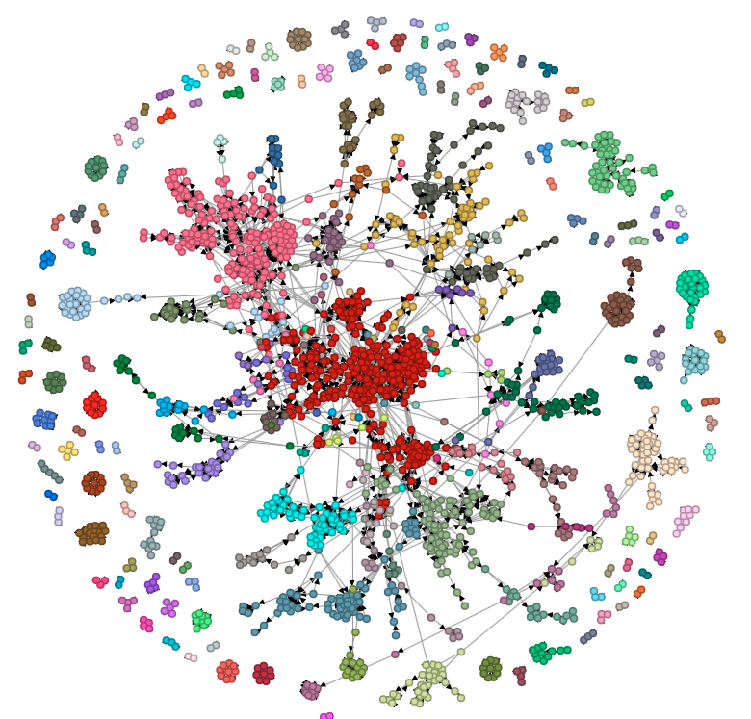
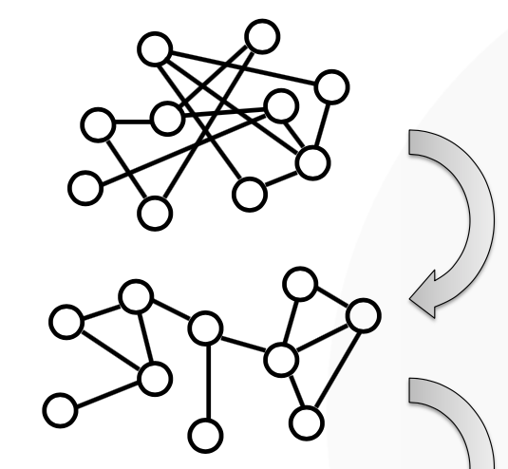
Visualize Citation Network: Force-directed layout
D3.js force-directed graph
Randomly Selected 2,000 articles

Slide 17
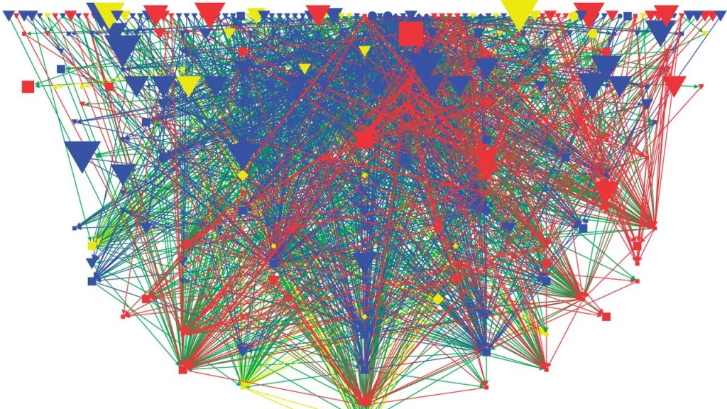
Visualize Citation Network: Force-directed layout
27,695 articles?
Too messy to look at!!
Solution:
Visualize clusters as a single node

Slide 18
DEMO

Slide 19
Other algorithms
Markov-Chain Monte Carlo
Stochastic process to get out of the local minimum
Non-binary hierarchical clustering
Much smaller hierarchical tree
Less memory consuming, but also less efficient

Slide 20
Outline
Community Detection in Citation Network and Visualizations
Research Article Recommendations

Slide 21
Recommend Articles
Query user’s publication history
Find out the field/sub-field that user has published in
Recommend high-impact articles in these fields

Slide 22
DEMO

Slide 23




Infrastructure
NVD3
Masonry
Data base
Server
Client

Slide 24
Business Applications
Citation relationship in legal documents, patents
Information spreading on social networks
User segmentation, influential user identification

Slide 25
Backups

Slide 26
Determine the Number of Clusters
C=2

Slide 27
Determine the Number of Clusters
C=3

