Slide 1
Android 拨号搜索机制源码分析
分享人：黄亚玲
日 期：2016.08.15

Slide 2
目 录
A
拨号搜索机制
B
引导搜索
C
字符搜索
D
工作中的应用

Slide 3
拨号搜索机制
从用户输入到搜索的过程
引导搜索
搜索
从数据库搜索字符串的过程

Slide 4
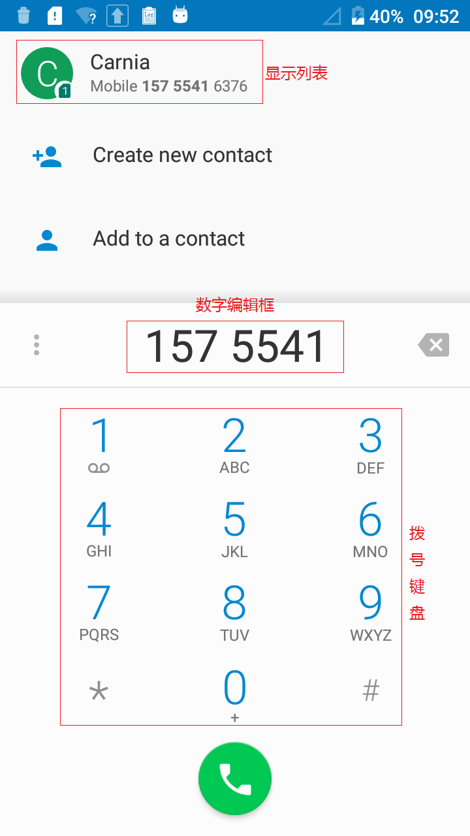
引导搜索

Slide 5
引导搜索
1.从拨号键盘到编辑框
3.从搜索框到显示列表
2.从编辑框到搜索框
4.触发搜索机制

Slide 6
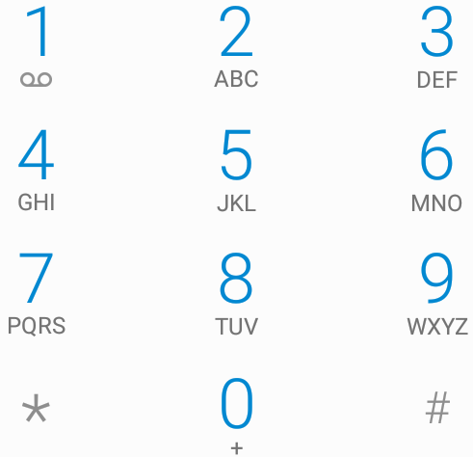
从拨号键盘到编辑框
Sourcefile：packages/apps/Dialer/src/com/android/dialer/dialpad/DialpadFragment.java
private void configureKeypadListeners(View fragmentView) {
final int[] buttonIds = new int[] {R.id.one, R.id.two,...};
DialpadKeyButton dialpadKey;
for (int i = 0; i < buttonIds.length; i++) {
dialpadKey = (DialpadKeyButton) fragmentView.findViewById(buttonIds[i]);
dialpadKey.setOnPressedListener(this);
}
...
}

Slide 7
从拨号键盘到编辑框
public void onPressed(View view, boolean pressed) {
if (pressed && getActivity() != null
&& !((DialtactsActivity)getActivity()).isDialpadShown()) {
Log.d(TAG, "onPressed but dialpad is not shown, skip !!!");
return;
}
if (pressed) {
switch (view.getId()) {
case R.id.one: {
keyPressed(KeyEvent.KEYCODE_1);//将点击事件转换成标准的键盘事件
break;
}
...
}
mPressedDialpadKeys.add(view);
} else {
mPressedDialpadKeys.remove(view);
if (mPressedDialpadKeys.isEmpty()) {
stopTone();
}
}
}

Slide 8
从编辑框到搜素框
private void keyPressed(int keyCode) {
if (getView() == null || getView().getTranslationY() != 0) {
return;
}
switch (keyCode) {
case KeyEvent.KEYCODE_1:
playTone(ToneGenerator.TONE_DTMF_1, TONE_LENGTH_INFINITE);
break;
...
}
mHaptic.vibrate();
KeyEvent event = new KeyEvent(KeyEvent.ACTION_DOWN, keyCode);
//传递给编辑框
mDigits.onKeyDown(keyCode, event);
final int length = mDigits.length();
if (length == mDigits.getSelectionStart() && length == mDigits.getSelectionEnd()) {
mDigits.setCursorVisible(false);
}
}

Slide 9
从编辑框到搜索框
Sourcefile：packages/apps/Dialer/src/com/android/dialer/dialpad/DialpadFragment.java
当编辑框检测到KeyDown事件后，就会将当前键盘的输入放入编辑框中，并触发TextWatcher的相关方法：
@Override
public void afterTextChanged(Editable input) {
...
if (mDialpadQueryListener != null) {
mDialpadQueryListener.onDialpadQueryChanged
(mDigits.getText().toString());
}
...
}

Slide 10
从编辑到搜索框
Sourcefile：packages/apps/Dialer/src/com/android/dialer/DialtactsActivity.java
public void onDialpadQueryChanged(String query) {
...
final String normalizedQuery = SmartDialNameMatcher.normalizeNumber
(query,DialerFeatureOptions.isDialerSearchEnabled() ?
SmartDialNameMatcher.SMART_DIALPAD_MAP
: SmartDialNameMatcher.LATIN_SMART_DIAL_MAP);
if (!TextUtils.equals(mSearchView.getText(), normalizedQuery)) {
if (mDialpadFragment == null || !mDialpadFragment.isVisible()) {
if (!TextUtils.isEmpty(normalizedQuery)) {
mPendingSearchViewQuery = normalizedQuery;
}
return;
}
mSearchView.setText(normalizedQuery);
}
...
}

Slide 11
从搜索框到显示列表
搜索框下面的列表用于在搜索时显示搜索结果，他所处的位置是复用的，可以选择性的加载三种Fragment：
PhoneFavoriteFragment，非搜索状态，进入拨号界面的默认加载项
SmartDialSearchFragment，搜索模式
RegularSearchFragment搜索模式
对于最常用的用户在拨号键盘输入内容触发的搜索，将会加载SmartDialSearchFragment。此时搜索框需要将要搜索的文本传递给SmartDialSearchFragment

Slide 12
从搜索框到显示列表
Sourcefile：packages/apps/Dialer/src/com/android/dialer/DialtactsActivity.java
public void onTextChanged(CharSequence s, int start, int before, int count) {
final String newText = s.toString();
if (newText.equals(mSearchQuery)) {//退出搜索模式
return;
}
mSearchQuery = newText;// 存储当前的搜索文本
if (!TextUtils.isEmpty(newText)) {
final boolean sameSearchMode = (mIsDialpadShown && mInDialpadSearch) ||(!mIsDialpadShown && mInRegularSearch);
if (!sameSearchMode) {//进入搜索模式
enterSearchUi(mIsDialpadShown, mSearchQuery, true /* animate */);
}
}
//将值传递给mSmartDialSearchFragment
if (mSmartDialSearchFragment != null && mSmartDialSearchFragment.isVisible()) {
mSmartDialSearchFragment.setQueryString(mSearchQuery, false /* delaySelection */);
} …}

Slide 13
触发搜索机制
Sourcefile ： packages/apps/ContactsCommon/src/com/android/contacts/common/list/ContactEntryListFragment.java
SmartDialSearchFragment拿到搜索的文本后，需要传递给自己的Adapter才能完成搜索任务。
public void setQueryString(String queryString, boolean delaySelection) {
if (!TextUtils.equals(mQueryString, queryString)) {
...
if (mAdapter != null) {
//传递给Adapter
mAdapter.setQueryString(queryString);
//触发搜索
reloadData();
}
}
}

Slide 14
触发搜索机制
Sourcefile ： packages/apps/ContactsCommon/src/com/android/contacts/common/list/ContactEntryListFragment.java
protected void reloadData() {
removePendingDirectorySearchRequests();
mAdapter.onDataReload();
mLoadPriorityDirectoriesOnly = true;
mForceLoad = true;
startLoading();//触发新的Adapter
}

Slide 15
触发搜索机制
Sourcefile ： packages/apps/ContactsCommon/src/com/android/contacts/common/list/ContactEntryListFragment.java
protected void startLoading() {
Log.d(TAG, "startLoading");
if (mAdapter == null) {
return;
}
configureAdapter();//配置Adapter要搜索的文本
int partitionCount = mAdapter.getPartitionCount();
for (int i = 0; i < partitionCount; i++) {
Partition partition = mAdapter.getPartition(i);
if (partition instanceof DirectoryPartition) {
DirectoryPartition directoryPartition = (DirectoryPartition)partition;
if (directoryPartition.getStatus() == DirectoryPartition.STATUS_NOT_LOADED) {
if (directoryPartition.isPriorityDirectory() || !mLoadPriorityDirectoriesOnly) {
startLoadingDirectoryPartition(i);
} }
} else {
getLoaderManager().initLoader(i, null, this); //通过LoaderManager进行异步查询
} }
mLoadPriorityDirectoriesOnly = false;
}

Slide 16
触发搜索机制
Sourcefile：packages/apps/Dialer/src/com/android/dialer/list/SmartDialSearchFragment.java
public Loader<Cursor> onCreateLoader(int id, Bundle args) {
if (id == getDirectoryLoaderId()) {
return super.onCreateLoader(id, args);
} else {
final SmartDialNumberListAdapter adapter = (SmartDialNumberListAdapter) getAdapter();
if (DialerFeatureOptions.isDialerSearchEnabled()) {
DialerSearchCursorLoader loader = new DialerSearchCursorLoader(super.getContext(),
usesCallableUri());
adapter.configureLoader(loader);
return loader;
} else {
//创建SmartDialCursorLoader
SmartDialCursorLoader loader = new SmartDialCursorLoader(super.getContext());
adapter.configureLoader(loader);
return loader;
}
}
}

Slide 17
触发搜索机制
Sourcefile ： packages/apps/ContactsCommon/src/com/android/contacts/common/list/ContactEntryListFragment.java
public void onLoadFinished(Loader<Cursor> loader, Cursor data) {
….
int loaderId = loader.getId();
if (loaderId == DIRECTORY_LOADER_ID) {
mDirectoryListStatus = STATUS_LOADED;
mAdapter.changeDirectories(data);
startLoading();
} else {//更新adapter
onPartitionLoaded(loaderId, data);
if (isSearchMode()) {
int directorySearchMode = getDirectorySearchMode();
if (directorySearchMode != DirectoryListLoader.SEARCH_MODE_NONE) {
….
} else {
mDirectoryListStatus = STATUS_NOT_LOADED;
getLoaderManager().destroyLoader(DIRECTORY_LOADER_ID);
}
}
}

Slide 18
触发搜索机制
Sourcefile ： packages/apps/ContactsCommon/src/com/android/contacts/common/list/ContactEntryListFragment.java
protected void onPartitionLoaded(int partitionIndex, Cursor data) {
if (partitionIndex >= mAdapter.getPartitionCount()) {
Log.d(TAG, "[onPartitionLoaded] return");
return;
}
Log.d(TAG, "[onPartitionLoaded]");
//更新adapter的cursor，刷新列表
mAdapter.changeCursor(partitionIndex, data);
setProfileHeader();
if (!isLoading()) {
completeRestoreInstanceState();
}
}

Slide 19
字符搜索
Sourcefile：packages/apps/Dialer/src/com/android/dialer/dialpad/SmartDialCursorLoader.java
public Cursor loadInBackground() {
...
final DialerDatabaseHelper dialerDatabaseHelper = DatabaseHelperManager.getDatabaseHelper(mContext); //查找匹配结果
final ArrayList<ContactNumber> allMatches = dialerDatabaseHelper.getLooseMatches(mQuery,mNameMatcher);
//构建cursor给adapter使用
final MatrixCursor cursor = new MatrixCursor(PhoneQuery.PROJECTION_PRIMARY);
Object[] row = new Object[PhoneQuery.PROJECTION_PRIMARY.length];
for (ContactNumber contact : allMatches) {
row[PhoneQuery.PHONE_ID] = contact.dataId;
row[PhoneQuery.PHONE_NUMBER] = contact.phoneNumber;
row[PhoneQuery.CONTACT_ID] = contact.id;
row[PhoneQuery.LOOKUP_KEY] = contact.lookupKey;
row[PhoneQuery.PHOTO_ID] = contact.photoId;
row[PhoneQuery.DISPLAY_NAME] = contact.displayName;
cursor.addRow(row);
}
return cursor;
}

Slide 20
数据库的创建及搜索机制
public void onCreate(SQLiteDatabase db) {
(db);
}
private void setupTables(SQLiteDatabase db) {
dropTables(db);
db.execSQL("CREATE TABLE " + Tables.SMARTDIAL_TABLE + "...");//smartdial_table
db.execSQL("CREATE TABLE " + Tables.PREFIX_TABLE + "...");//prefix_table
db.execSQL("CREATE TABLE " + Tables.PROPERTIES + "...");//properties
setProperty(db, DATABASE_VERSION_PROPERTY,String.valueOf(DATABASE_VERSION));
resetSmartDialLastUpdatedTime();
}
prefix_table表：该表是对所有联系人的电话号码以及英文姓名进行解析，形成搜索的索引表单
smartdial_table表：包含 phone_number、contact_id、display_name、photo_id、starred、last_smartdial_update_time等字段，在搜索时，会利用用户输入区prefix_table中进行匹配，对于匹配成功的记录，根据prefix_table表中对应的contact_id再来smartdial_table中查找该联系人的详细信息，也就是头像、姓名、收藏状态等，并把这些信息构建为Cursor类数据，返回给查询者。

Slide 21
数据库的更新
protected void onResume() {
super.onResume();
if (!DialerFeatureOptions.isDialerSearchEnabled()) {
mDialerDatabaseHelper.startSmartDialUpdateThread();
}
}
从联系人数据库中读取从上次更新到现在时间段内更新的联系人记录；
在removeDeletedContacts()中，删除已经被删除的联系人记录；
在removePotentiallyCorruptedContacts()中，删除已经损坏的联系人记录；
在removeUpdatedContacts()中，删除需要更新的联系人记录；
在insertUpdatedContactsAndNumberPrefix()中，将更新的联系人数据插入到smartdial_table中，并把联系人号码插入到prefix_table中；
在insertNamePrefixes()中，将本次需要更新的联系人的姓名转换为数字存入prefix_table中；
为数据库建立索引。

Slide 22
数据库的查询
public ArrayList<ContactNumber> getLooseMatches(String query,SmartDialNameMatcher nameMatcher) {
…
//搜索语句，从prefix_table中搜索匹配项，并从smartdial_table中读取匹配项的详细信息
final Cursor cursor = db.rawQuery("SELECT " +
SmartDialDbColumns.DATA_ID + ", " +
SmartDialDbColumns.DISPLAY_NAME_PRIMARY + ", " +
SmartDialDbColumns.PHOTO_ID + ", " +
SmartDialDbColumns.NUMBER + ", " +
SmartDialDbColumns.CONTACT_ID + ", " +
SmartDialDbColumns.LOOKUP_KEY +
" FROM " + Tables.SMARTDIAL_TABLE + " WHERE " +
SmartDialDbColumns.CONTACT_ID + " IN " +
" (SELECT " + PrefixColumns.CONTACT_ID +
" FROM " + Tables.PREFIX_TABLE +
" WHERE " + Tables.PREFIX_TABLE + "." + PrefixColumns.PREFIX +
" LIKE '" + looseQuery + "')" +
" ORDER BY " + SmartDialSortingOrder.SORT_ORDER,
new String[] {currentTimeStamp});
if (cursor == null) {
return result;
}

Slide 23
数据库的查询
//对匹配项去重，并构建搜索结果
while ((cursor.moveToNext()) && (counter < MAX_ENTRIES)) {
final long dataID = cursor.getLong(columnDataId);
final String displayName = cursor.getString(columnDisplayNamePrimary);
final String phoneNumber = cursor.getString(columnNumber);
final long id = cursor.getLong(columnId);
final long photoId = cursor.getLong(columnPhotoId);
final String lookupKey = cursor.getString(columnLookupKey);
final ContactMatch contactMatch = new ContactMatch(lookupKey, id);
//该匹配项已经被收录，无需重复添加到结果中
if (duplicates.contains(contactMatch)) {
continue;
}
final boolean nameMatches = nameMatcher.matches(displayName);
final boolean numberMatches =(nameMatcher.matchesNumber(phoneNumber, query) != null);
//匹配成功，且没有重复项
if (nameMatches || numberMatches) {
duplicates.add(contactMatch);
result.add(new ContactNumber(id, dataID, displayName, phoneNumber, lookupKey,
photoId));
counter++;
}

Slide 24
工作中的应用
号码匹配：
功能宏：
作用位置：

Slide 25
Thank you！

