Slide 1
Incrementally Maintaining Classification using an RDBMS
Presented by: Noah Golmant
October 3, 2016

Slide 2
HAZY
“An end-to-end system for imprecision management”

Slide 3
Goals:
How?
Integrate classification models into run-time operation with RDBMS
Incorporate new training examples in a real-time, dynamic environment
Model-based Views
Incremental Maintenance

Slide 4
Goals:
How?
Integrate classification models into run-time operation with RDBMS
Incorporate new training examples in a real-time, dynamic environment
Model-based Views
Incremental Maintenance

Slide 5

Model-based Views
Expose statistical computations through relational views
Standard SQL semantics:
Queries for updates, inserts, and deletes
Triggers to propagate updates

Slide 6
Model-based Views
CREATE CLASSIFICATION VIEW Labeled_Papers KEY id -- (id, class) ENTITIES FROM Papers KEY id -- (id, title, ...) LABELS FROM Paper_Area LABEL l -- (label) EXAMPLES FROM Example_Papers KEY id LABEL l -- (id, label) FEATURE FUNCTION tf_bag_of_words
T(id, l)

Slide 7
Model-based Views
Eager Approach: maintain V as a materialized view where updates to class labels occur immediately after a model update.
Lazy approach: in response to read of an input id, read feature vector and label using current model.
Incremental model maintenance should improve both of these approaches for:
Single Entity read
All Members read
Update

Slide 8
Goals:
How?
Integrate classification models into run-time operation with RDBMS
Incorporate new training examples in a real-time, dynamic environment
Model-based Views
Incremental Maintenance

Slide 9
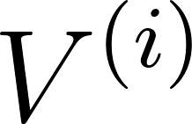
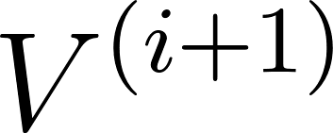
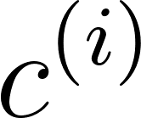

Incremental Maintenance
At round i, we receive new examples to update a materialized view .
HAZY divides this into two problems:
How to perform an incremental step to update the old model to with (preferably low) cost .
Decide when to reorganize to obtain a model by training on the whole dataset with a fixed cost .

Slide 10
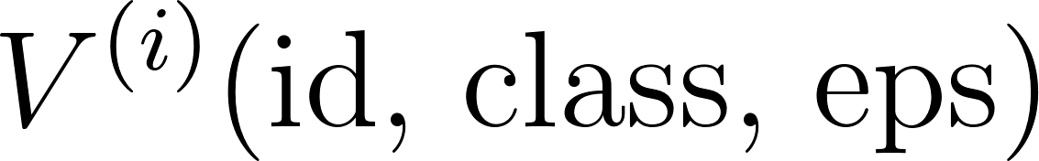
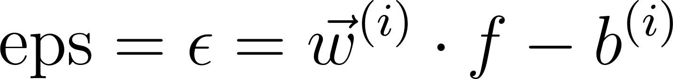
Incremental Maintenance
At round i, maintain a materialized view:
Where:
Let s be the last round at which HAZY reorganized the model.

Slide 11
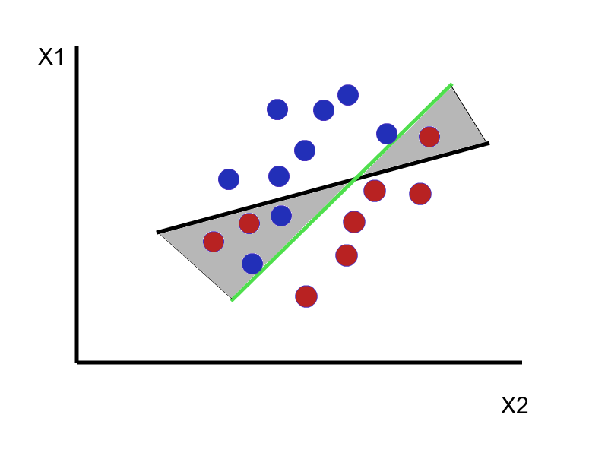

Slide 12
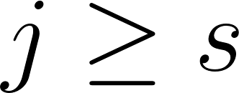
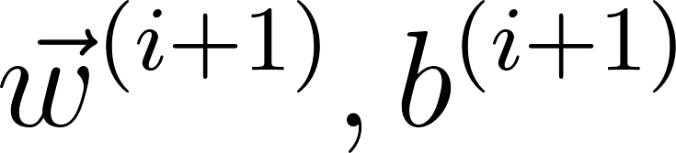
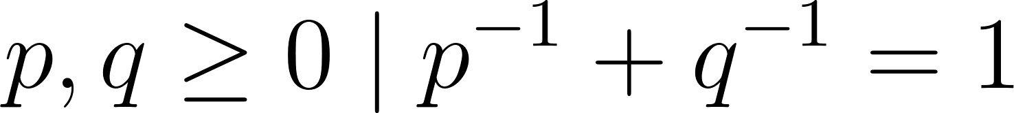
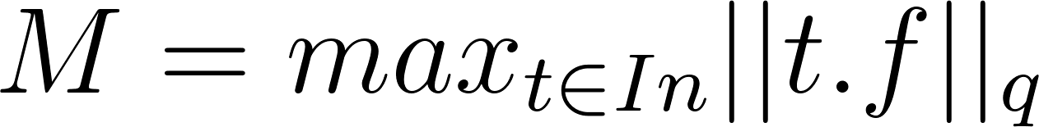
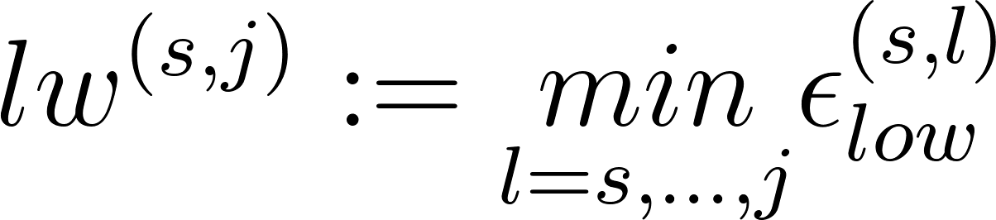
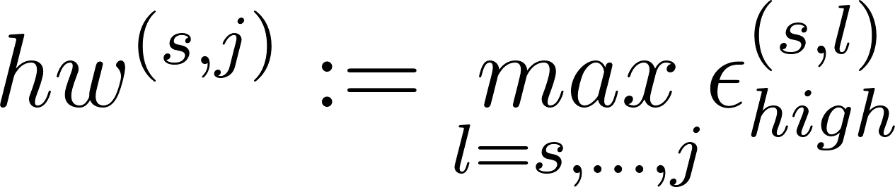
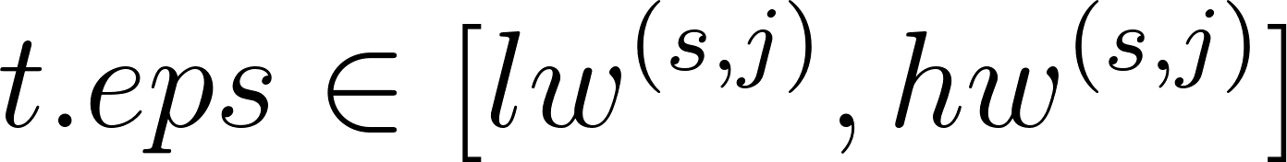
Incremental Maintenance
Let be a round after the “anchor” s.
Only need to reclassify tuples satisfying:

Slide 13
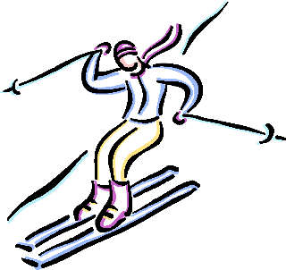
Reorganization - The Skiing Strategy

Slide 14
Reorganization - The Skiing Strategy
You are going skiing for an unknown number of days d. Every day you choose between renting a pair of skis for $1 and buying the pair for $10.
When should you purchase the skis?
Minimize the ratio between what you would pay using some decision strategy and what you would pay if you knew d.

Slide 15
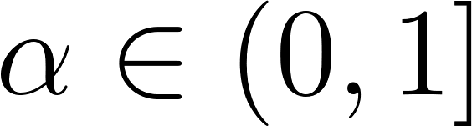
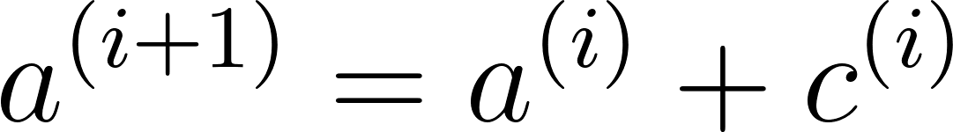
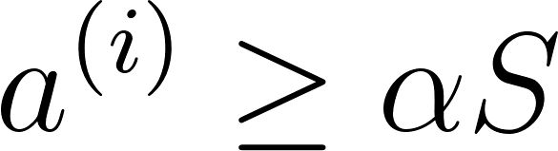
Reorganization - The Skiing Strategy
Choose some .
At each round i, accumulate a total cost:
Reorganize when:
Then reset the accumulated cost to 0.
This is a 2-approximation of the optimal strategy, and is optimal among all online, deterministic strategies**.
Reorganization: update the model, re-cluster on t.eps, and rebuild indices.
**Assuming reorganizing more recently does not raise the cost.

Slide 16
Architectural Optimizations
In-memory architecture:
Maintain classification view in memory, discard when memory needs to be revoked.
Cluster the data (on t.eps) in memory.
We only need to persist the entities and training examples since everything else can be re-computed.
Hybrid architecture:
Maintain buffer for entities.
Cache t.eps if we can’t store all the entities in memory.

Slide 17
Questions, Issues
How does this fit with the semantics of streaming systems?
Not “black box” enough:
Featurization still exposed (vs. LASER source nodes).
Lazy and eager approaches have different semantics.
Scalability - balancing throughput with feature length, dataset size.
Drift, dataset size and the monotonicity assumption.

Slide 18
Questions, Issues
Pushing incremental maintenance through the model training process:
SGD is orders of magnitude slower on larger datasets when performed in HAZY system vs. a hand-coded C file. Can this be improved without bulk-loading?
Can we take advantage of epsilon clustering during training?

