Slide 1
Managing the ML Lifecycle
Giulio Zhou

Slide 2
Background and Context
In the past few decades, we’ve seen an explosion of ML applications - generating untold quantities of data - with real-time demands for scalable serving and learning
Most of the attention/hype goes to the ML algorithms themselves (decision trees, logistic regression, deep neural networks, etc) rather than ML systems design and implementation
In 2012, Google’s ad networks served 29,741,270,774 ads per day
Google Technical Debt paper lists some problems of interest, does not discuss potential solutions in great detail

Slide 3
What defines a “good” ML system?
Good question
A good ML system should:
Serve predictions quickly and correctly across all levels of load
Utilize the right combination of contextual and historical data
Rapidly incorporate feedback into models
Be flexible and easy to extend to new machine learning models
Definition may vary for companies and machine learning algorithms at different scales (i.e. MapReduce is great for Google, but only if you’re Google, Facebook, Amazon, etc)

Slide 4
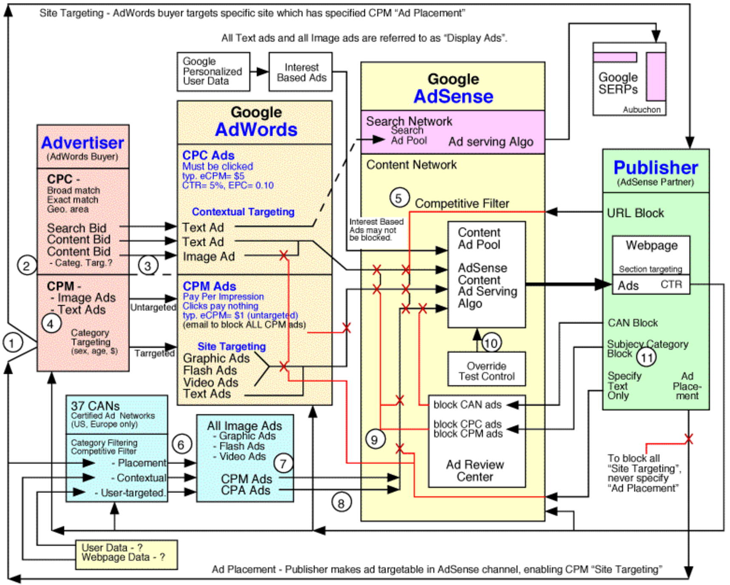
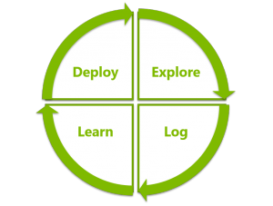
Ideal ML Pipeline
Reality
Expectations

Slide 5
Problems and Motivation
By the nature of machine learning models, “the desired behavior cannot be effectively implemented in software logic without dependency on external data” (Google, et al)
Traditional SW design principles of abstraction and isolation are not always enforceable with data
Specifically:
Data comes in a multitude of forms
At large scales, the generation and consumption of signals are decoupled
Feedback loops are necessary but can have unintended consequences
Need to balance rate of innovation with long-term maintainability
“Technical Debt”

Slide 6
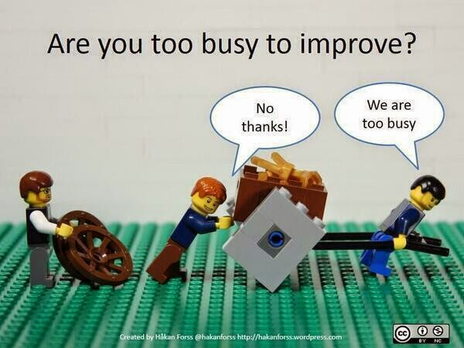
Technical Debt: When to refactor?

Slide 7
Sparsity is Challenging
Bag of Words text models can have dimensionality on the order of billions with only a few hundred non-zero values
In many applications, features are often missing and/or noisy
Training data is typically unbalanced; in the case of ad serving, there are usually far more no-click examples than clicked examples
Cannot apply familiar techniques such as dropout - a computer vision trick to occasionally turn off activations to learn robust models - in training
Important to take these lessons into account to:
Optimize the performance of ML systems
Ensure that good models can be learned in a real-time setting

Slide 8
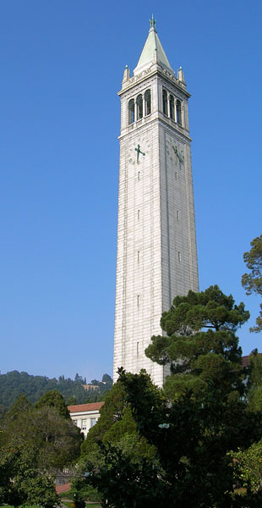

The Brittleness of ML Systems
Entanglement (CACE)
Hidden/Unintended Feedback loops
Data Dependencies
Glue code &
Pipeline jungles
Dead code paths, Configuration Bloat

Slide 9
The Brittleness of ML Systems (cont.)
Changing Anything Changes Everything
ML systems combine signals and features together, cannot be considered truly independent
Changes in feature usage or logging can dramatically affect various slices of the distribution
Enforcing modularity may help, but adds a different kind of complexity
Hidden and Unintended Feedback Loops
Undeclared consumers of signals
Feedback loops operate on longer timescale, unnoticeable in initial reviews
Data dependencies
Glue code and pipeline jungles
Dead code paths and configuration bloat

Slide 10
Ex: Data Dependencies
Underutilized data dependencies: Legacy features, bundled features, epsilon-features
Features could be removed with little to no reduction in accuracy, but the model assigns them non-negative weight since they’re present
Model unintentionally learns correlations between features, what happens if those features suddenly diverge (perhaps because of some “improvement”)?
Infeasible to support static analysis of data dependencies at large scales

Slide 11
Ex: Unspecified Consumers (Font size feedback)
An “intelligent” font size module takes in CTR (click-through rate) as an input signal
Larger font size make ads more noticeable but also susceptible to unintentional clicking, increasing CTR but creating an undesired feedback loop
Font size
Font size
Font size

Slide 12
Ex: Correction Policy Cascade
Input
a
A
a’
A’
a’’
A’’

Slide 13
Ex: Correction Policy Cascade (cont.)
Input
a
A
a’
A’
Instead, from the beginning, encode the necessary features to distinguish between use cases A, A’ and A’’
a’’
A’’

Slide 14
Ex: Glue Code/Pipeline Jungles
To build upon existing ML frameworks and ensure interoperability between systems all written in different languages
Most of the code goes into formatting data and outputs into intermediate forms
Freezes the system to the peculiarities of specific ML packages, stifling innovation
As mentioned previously, data comes in a multitude of forms and must be wrangled into a usable form
“Pipeline jungles” can emerge from too much black-boxing, and the resulting decoupling of production/consumption of features
The result is an endless array of scrapes, joins, resampling steps, is failure-prone and must be maintained with expensive end-to-end integration tests

Slide 15
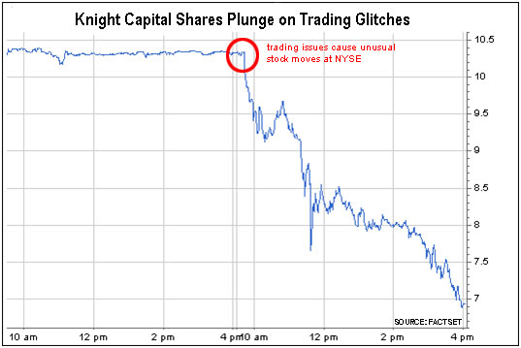
Ex: Dead codepaths, Knight Capital
Technician forgets to copy the new Retail Liquidity Program (RLP) code to one of servers, execution with repurposed flag leads to cascade of unusual stock moves at NYSE
In just 45 minutes, Knight Capital lost $465 million

Slide 16
Brief counter-argument
“All he would say was that sometimes you have to burn it down and start over.” - Kelly Braffet, Last Seen Leaving
Many of the previously mentioned points apply to large, mature systems (typical of those found at Google)
Only doable if (1) you can hire entire teams of teams dedicated to this task or (2) if the system is sufficiently small
Static analysis of data dependencies is potentially feasible in smaller settings
What if you can’t afford to reimplement a ML system from scratch?

Slide 17
(Somewhat) Successful Solutions
Online learning algorithms (streaming per-coordinate descent, learning rates) to more quickly adapt to feedback
Facebook and Google ad serving systems discuss this
Google metadata index
Internal tool for tracking and maintaining signals, earmark old signals for deprecation or vet new ones for introduction
Eliminate unimportant and redundant features using L1 regularization, boosting to get sparse solutions
Develop model monitoring and data visualization tools to track behavior and uncover data dependencies

Slide 18
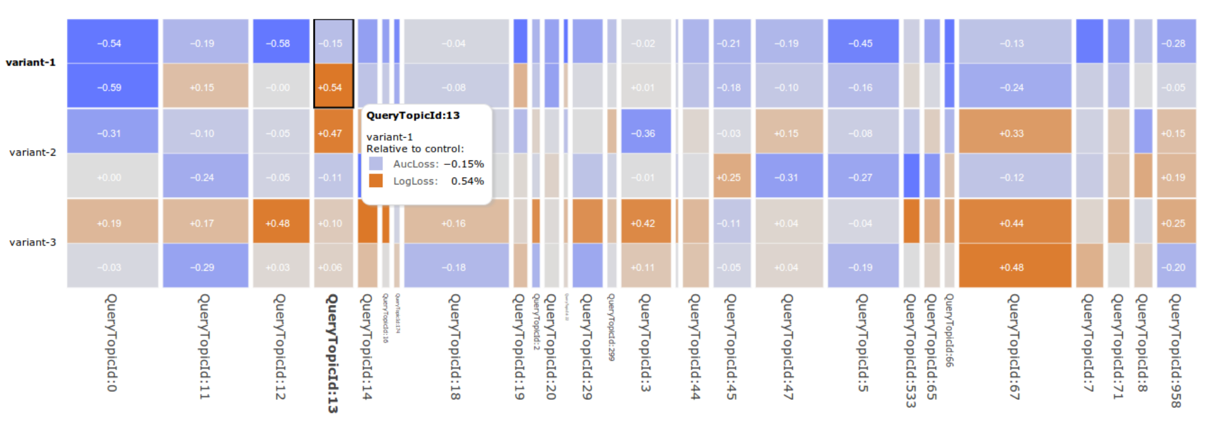
Ex: Understanding through Visualization
Visualize beyond aggregate metrics via per-country or per-topic slicing

Slide 19
Lessons/How to better innovate
Design principles: what are some takeaways when designing scalable machine learning systems?
Important to move fast, but keep in mind the tradeoff between quick wins and long-term maintainability of the system
It’s impossible to build a perfect system from the beginning; you should try anyway, and then proceed with these lessons in mind
Lessons for Clipper and RISE system design
Lightweight online layer for correction and personalization
Monitoring and visualization modules for tracking model performance
(Joey) Any other ways we’re connecting this with our new RISE projects?

Slide 20
Questions?

