Slide 1
615 Final Project
by Yaqi Huang

Slide 2
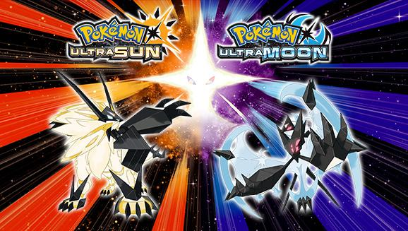
The topic I have chosen for the final project is about a game which I have been playing recently, which is called $Pokémon Ultra Moon$. The publisher "The Pokémon Company" always launch two versions of game when the new game is released, for example, in this case would be Pokémon Ultra Moon and Pokémon Ultra Sun. They provide different legendary pokémon for different versions. The version I purchased was Pokémon Ultra Moon. For this project, I am interested in the followings:
what is the overall response of this new game from the players using twitter.
Is there any difference in comments between Pokémon Ultra Moon and Pokémon Ultra Sun.
Is there any of the difference corresponds to the region?
To answer the above, I have conducted the following technics:
Sentimemt Analysis
Wordcloud
Mapping

Slide 3
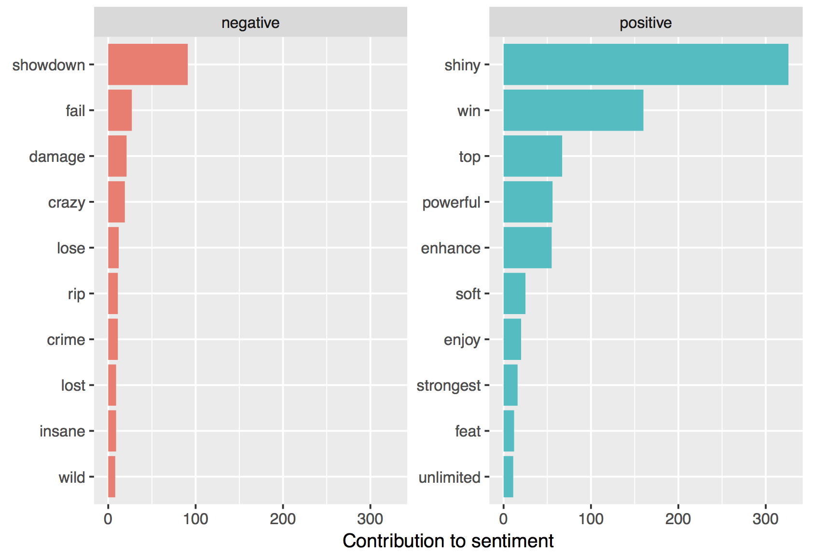
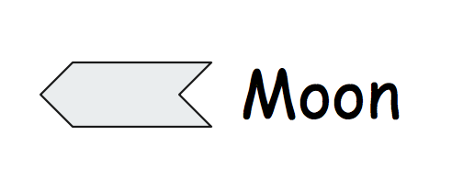
Sentiment Analysis

Slide 4
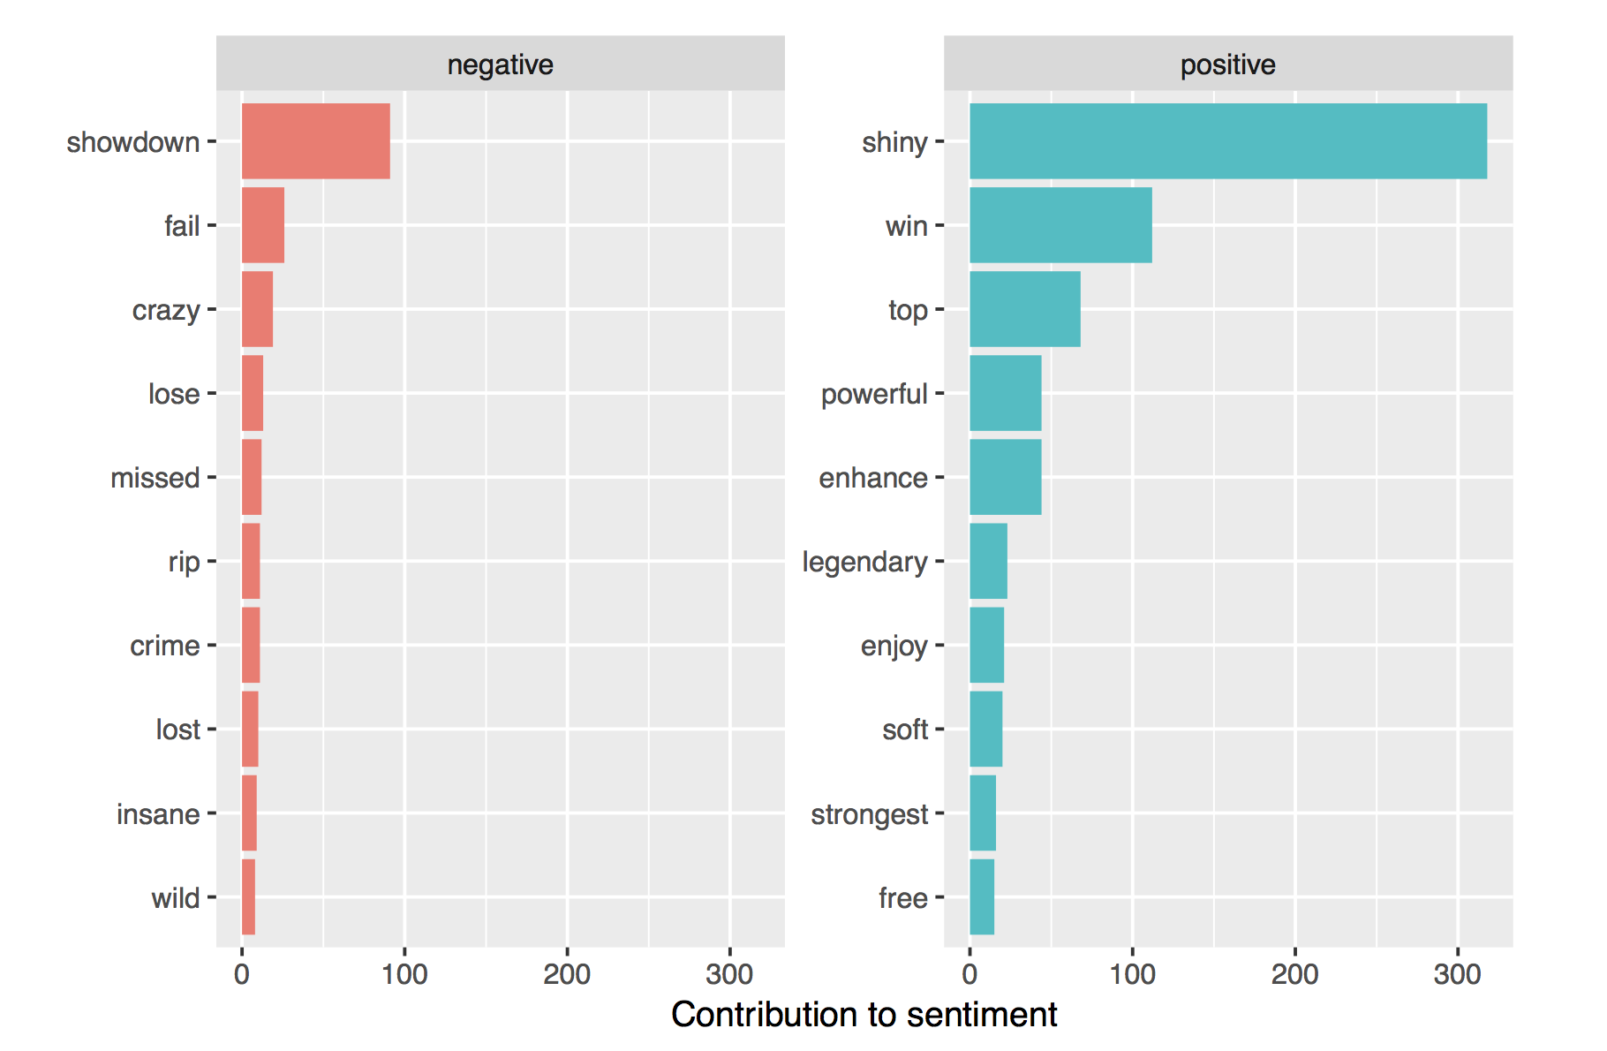

Sentiment Analysis

Slide 5
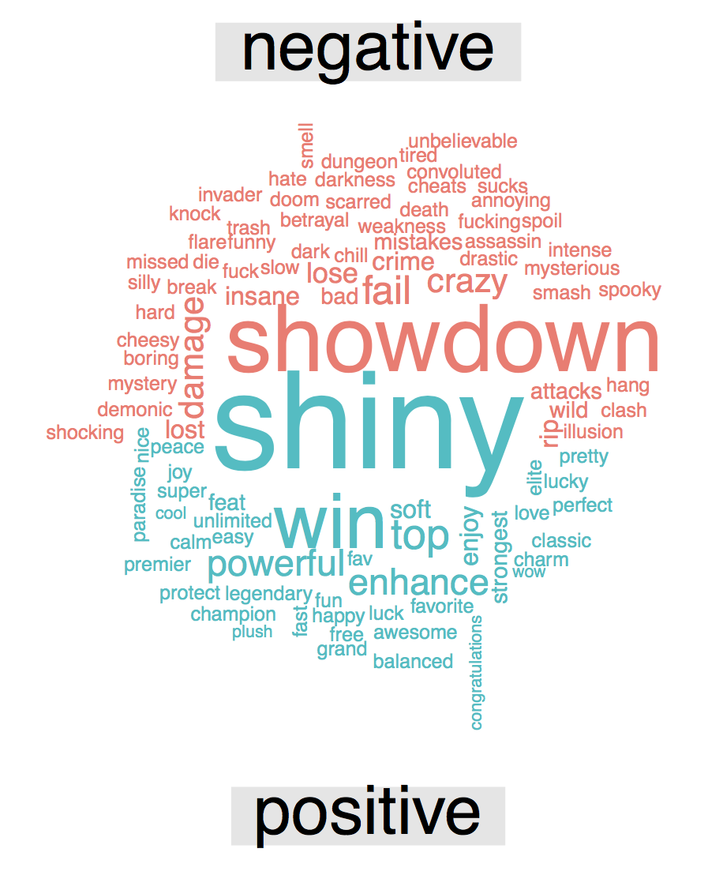
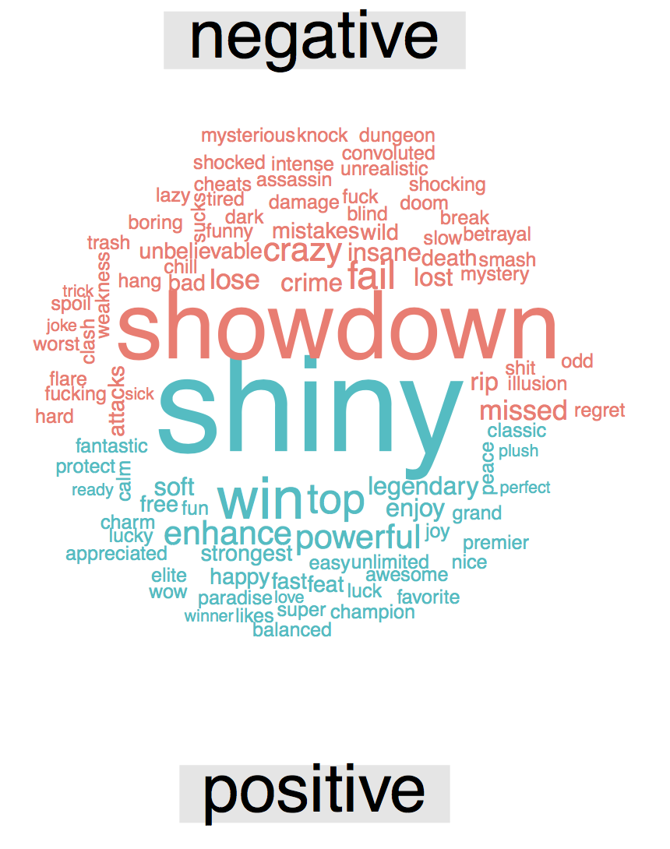
Wordcloud
Moon
Sun

Slide 6
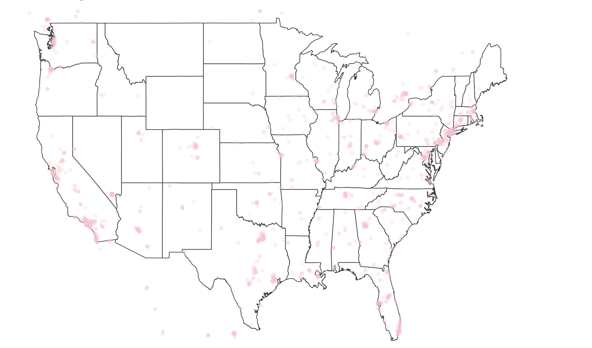
Mapping

Slide 7
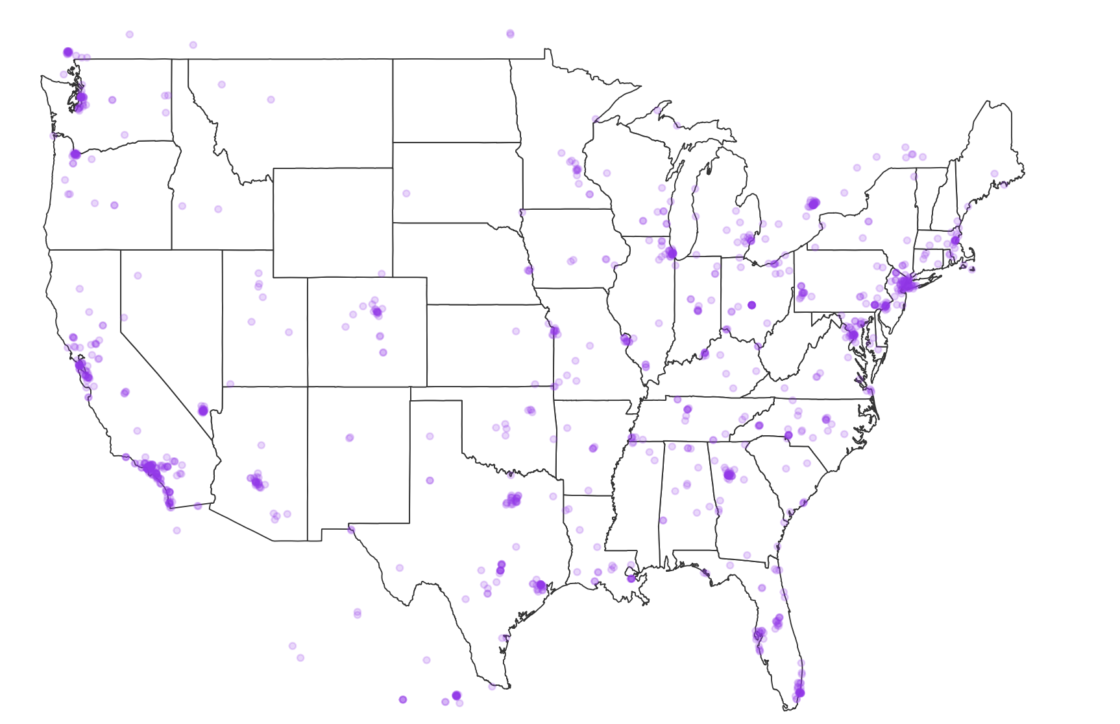
Mapping

Slide 8
Thanks !!

