Slide 1
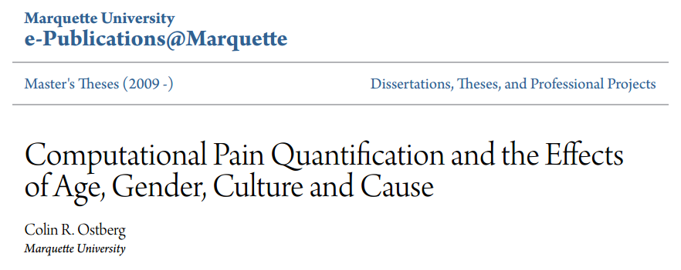
2018/12/05

Slide 2
Introduction
Automatic facial expression recognition, and in particular pain expression recognition, are fields that have been studied extensively. However, nothing has explored the possibility of an automatic pain quantification algorithm, able to output pain levels based upon a facial image.
Goals:
Provide a novel approach to computational pain quantification;
Investigate the effects of age, gender, culture and cause on the computational pain quantification method;
Provide two distinct datasets of facial pain images with correlated pain intensity values, both of approximately 400 images, databases that do not exist elsewhere.

Slide 3
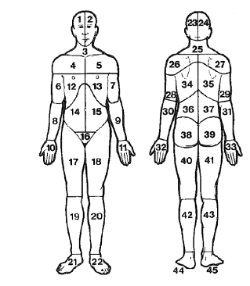
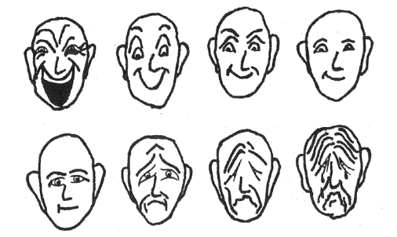
Introduction
The typical and most comprehensive pain assessment is the McGill Pain Questionnaire.
Four dimensions: intensity, location, quality and affect.
Intensity
Location
Quality: sharp, hot, dull, cold, sensitive, itchy, deep and surface.
Affect: bearable, distracting, unpleasant, uncomfortable, distressing, oppressive, miserable, awful, frightful, dreadful, horrible, agonizing, unbearable, intolerance and excruciating.

Slide 4
Related works
Existing Facial Detection, Facial Recognition and Emotional Recognition Methods.
Skin Color Facial Detection Method
Facial Action Coding System Emotion Recognition Method
Eigenface Emotion Recognition Method
Existing Pain Detection Methods
Facial Action Coding System Pain Detection Method
Eigenface Pain Detection Method
Support Vector Machine Pain Detection Method

Slide 5
Related works
Eigenface Pain Detection Method
特征脸Eigenface的思想是把人脸从像素空间变换到另一个空间，在另一个空间中做相似性的计算。Eigenface选择的空间变换方法是PCA，即主成分分析。Eigenface方法利用PCA得到人脸分布的主要成分，得到对应的特征向量，这些特征向量就是“特征脸”。每个特征向量或者特征脸相当于捕捉或者描述人脸之间的一种变化或特性。这就意味着每个人脸都可以表示为这些特征脸的线性组合。实际上，经过PCA后的空间就是每一个特征脸或者特征向量为基的空间，在这个空间下，每个人脸就是一个点，这个点的坐标就是这个人脸在每个特征基下的投影坐标。

Slide 6
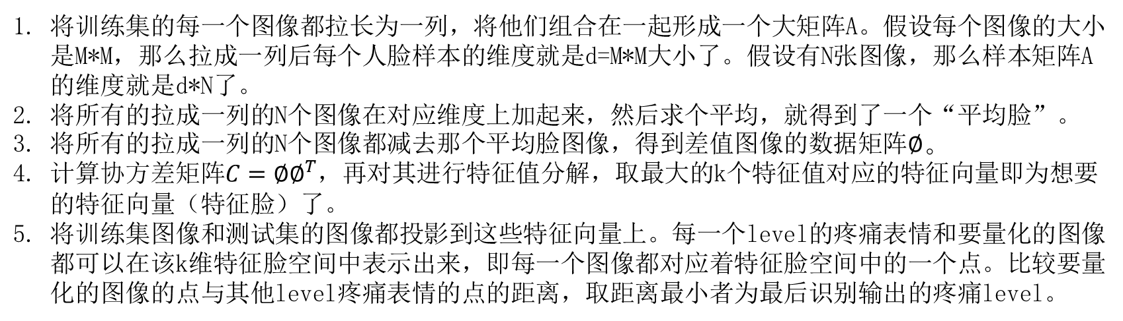
Related works
基于特征脸的疼痛表情量化算法步骤：
将训练集的每一个图像都拉长为一列，将他们组合在一起形成一个大矩阵A。假设每个图像的大小是M*M，那么拉成一列后每个人脸样本的维度就是d=M*M大小了。假设有N张图像，那么样本矩阵A的维度就是d*N了。
将所有的拉成一列的N个图像在对应维度上加起来，然后求个平均，就得到了一个“平均脸”。
将所有的拉成一列的N个图像都减去那个平均脸图像，得到差值图像的数据矩阵$∅。$
计算协方差矩阵$C={∅∅}^{T}$，再对其进行特征值分解，取最大的k个特征值对应的特征向量即为想要的特征向量（特征脸）了。
将训练集图像和测试集的图像都投影到这些特征向量上。每一个level的疼痛表情和要量化的图像都可以在该k维特征脸空间中表示出来，即每一个图像都对应着特征脸空间中的一个点。比较要量化的图像的点与其他level疼痛表情的点的距离，取距离最小者为最后识别输出的疼痛level。

Slide 7
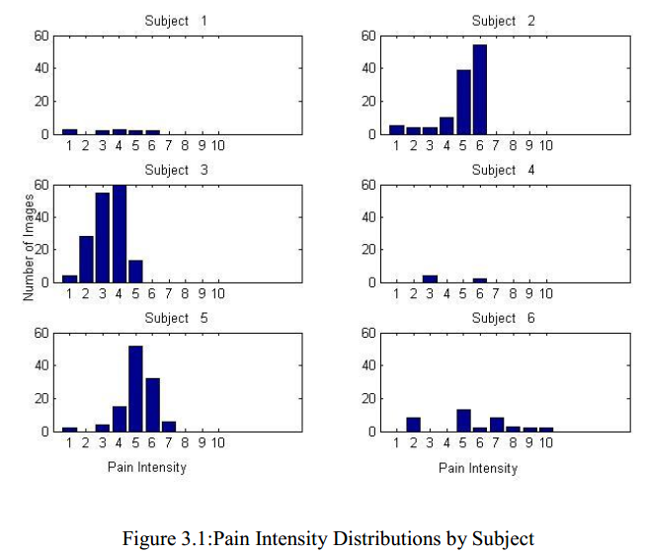
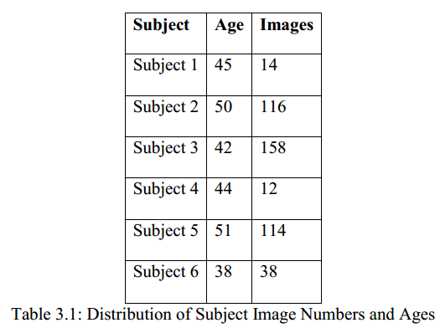
Our Method
Dataset: collected data from rural breast cancer patients, 444 images totally.

Slide 8
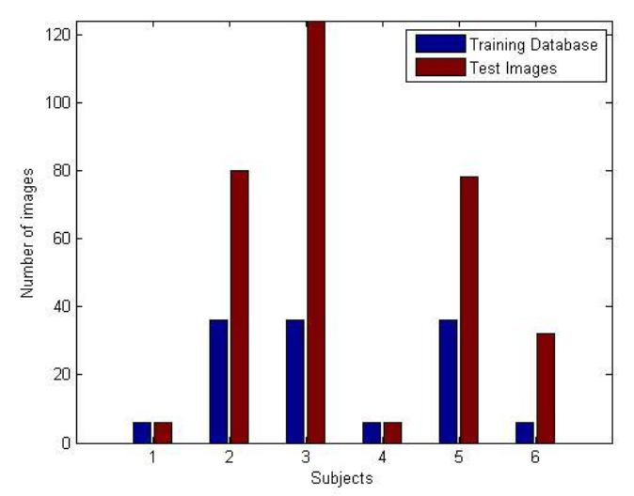
Our Method
Training set: 36 images randomly selected from all patients and pain.
Test set: the remaining 408 images.
The mean absolute error: 2.267
Personalizing the method
The dataset was divided based on patients, and then further divided into test and training datasets.
The mean absolute error: 1.2458

Slide 9
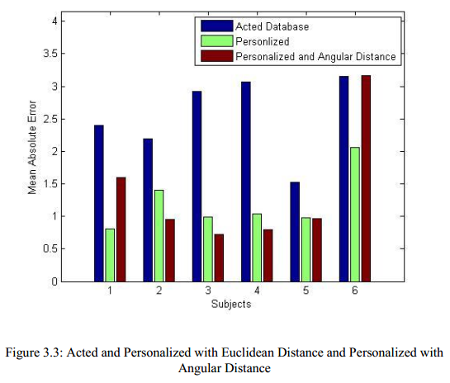
Our Method
Use Cosine distance instead of Euclidean distance to determine distances between training projections and input projections
The mean absolute error: 1.29

Slide 10
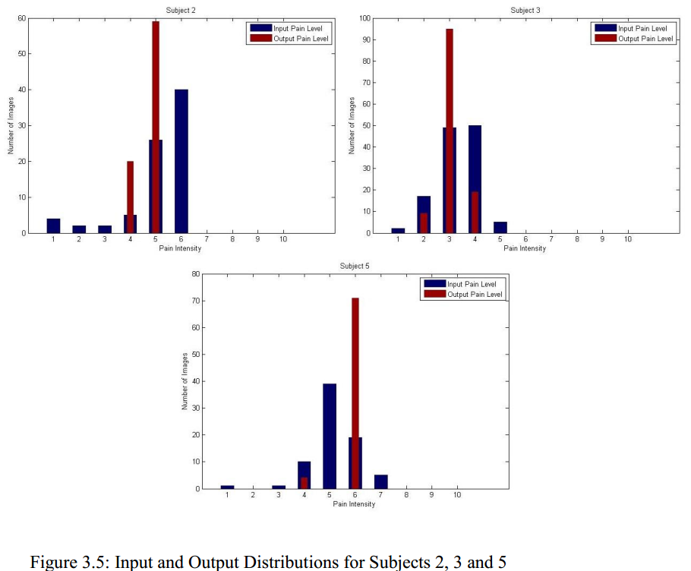
Our Method
Integration of SVM with computational pain quantification method.
While having a low mean absolute error is important, it was equally important that the output was in the same distribution of the input.
The current distributions are presented in Figure 3.5
Mann Whitney U test indicative that the input data and output data come from the same distribution, but could still be improved.

Slide 11
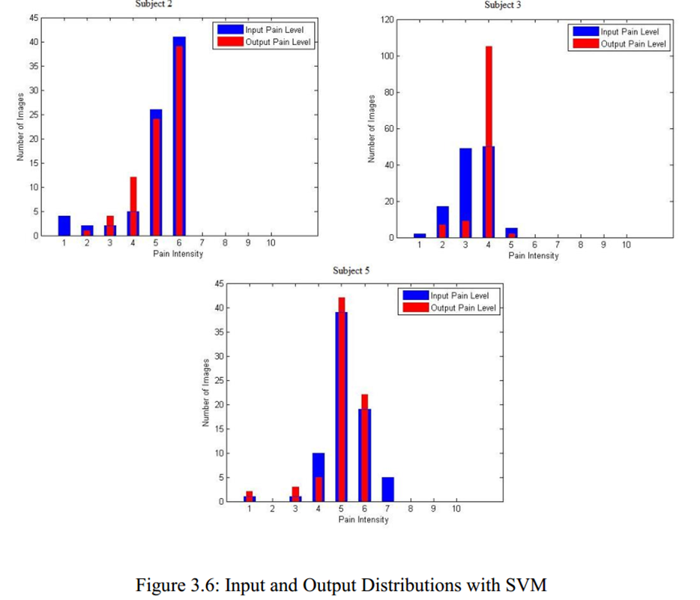
Our Method
Integration of SVM with computational pain quantification method.
While SVM had minimal impact on mean absolute error, it showed a marked difference in distribution.
Mann Whitney U test were again performed, resulting in all three subjects passing with higher p values than before.

Slide 12
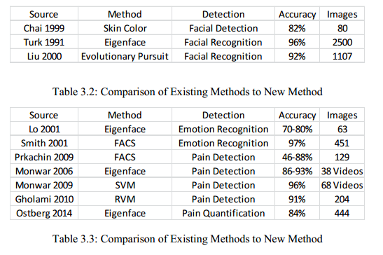
Our Method
Discussion of computational pain quantification method results

Slide 13
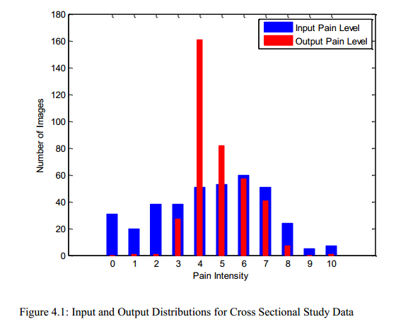
Validation
Cross Sectional Study data: 518 images totally.
Training set: 70 images in Cross Sectional Study data;
Test set: the remaining images;
Mean absolute error: 3
Training set: the entire Longitudinal Study set, 444 images totally;
Test set: the Cross Sectional Study data;
Mean absolute error: 1.96

Slide 14
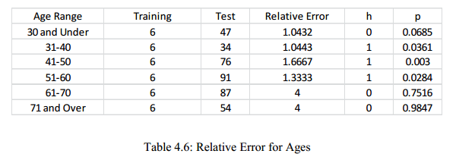
Validation
Age
Note that an h value of 0 represents passing the Mann-Whitney U test.

Slide 15
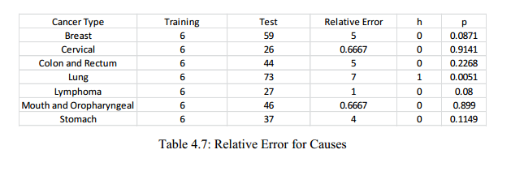
Validation
Cause

Slide 16
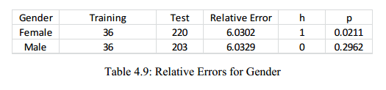
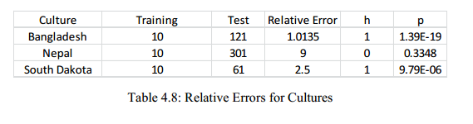
Validation
Gender
Culture

