Slide 1
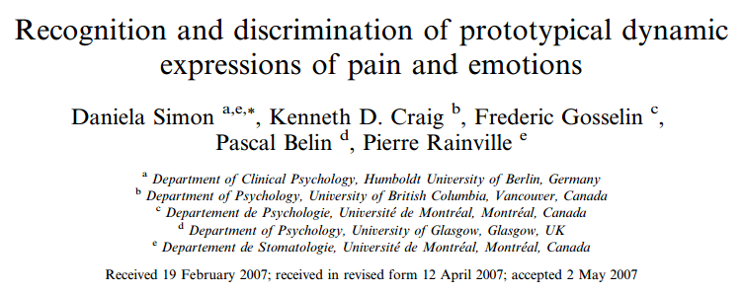
2018/11/21

Slide 2
Introduction
Pain expression has been described to be unique and distinct from the six prototypical facial expressions of basic emotions(anger, disgust, fear, happiness, sadness and surprise)
Recognize facial expression using FACS (Facial Action Coding System)

Slide 3

FACS

Slide 4
Data set
One-second film clips were recorded in 8 actors displaying neutral facial expressions and expressions of pain and the basic emotions of anger, disgust, fear, happiness, sadness and surprise, totally 64 clips.
The one-second films begin with neutral facial expression and end up with the maximum facial movement.

Slide 5
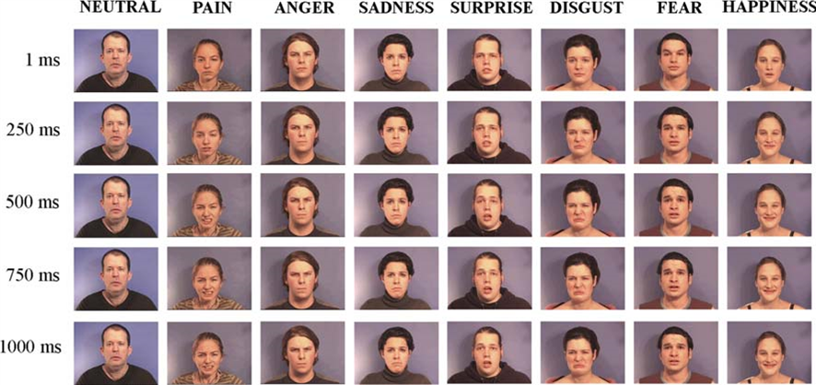
Data set

Slide 6
Method
15 observers count the AUs(Active Units) of each one-second clip.
Estimate the intensity of each AU (a = trace of the action to e = maximum evidence).
Compare the observed AUs with prototypical expression of pain and basic emotions.

Slide 7
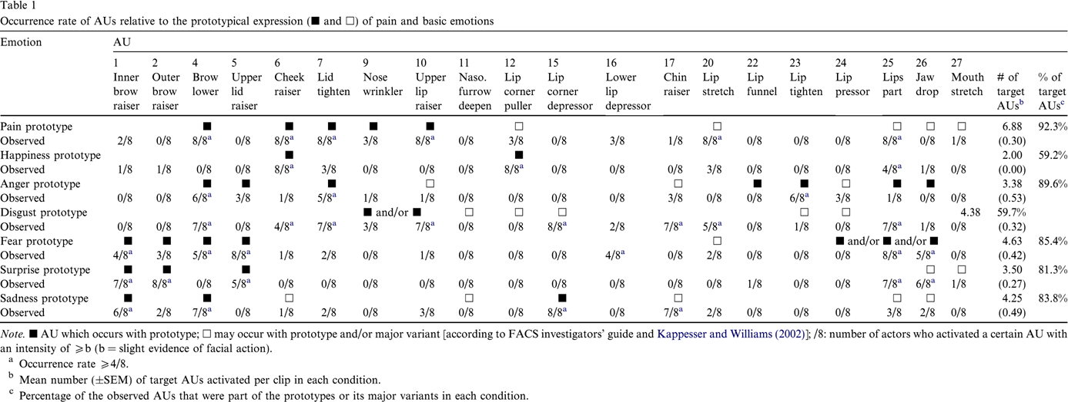
Method

Slide 8
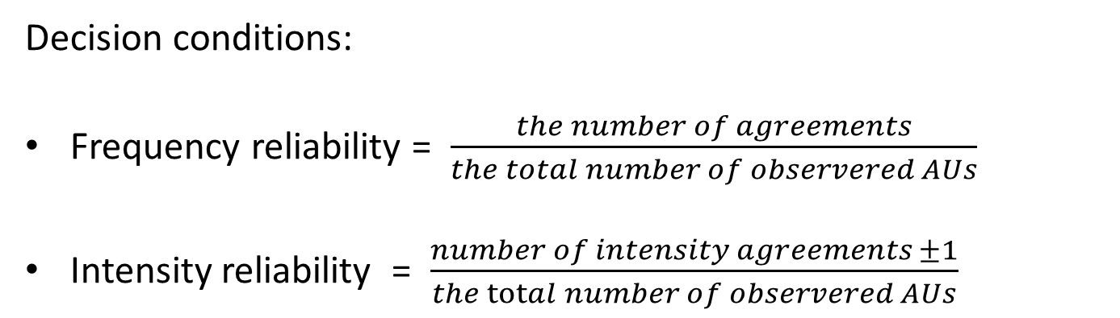
Method
Decision conditions:
Frequency reliability = $\frac{the number of agreements}{the total number of observered AUs}$
Intensity reliability = $\frac{number of intensity agreements ±1}{the total number of observered AUs}$

