Slide 1
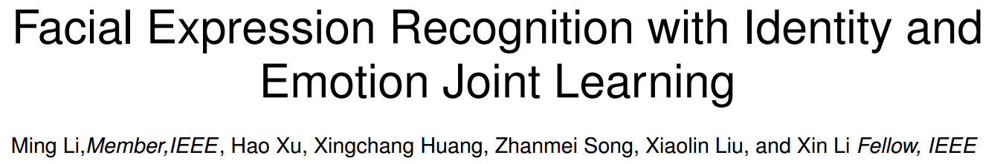
2018/10/24

Slide 2
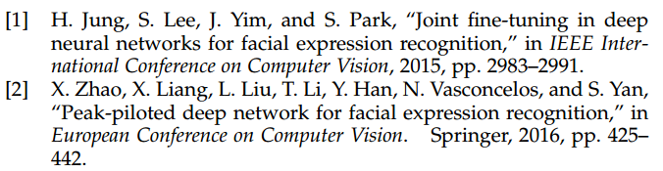
Introduction
Facial Expression Recognition (FER) is aiming to recognize facial expressions with discrete categories( e.g., neutral, sad, contempt, happy, surprise, angry, fear, disgust, etc.) or continuous levels(e.g., valance, arousal) from still images or video.

Slide 3
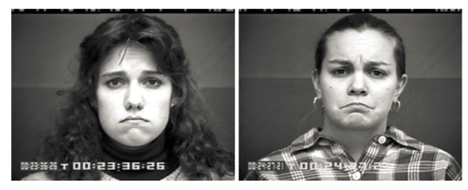
Challenges
Lack of large scale labeled training data
Inconsistent and unreliable emotion labels
The differences between some facial expressions might be subtle
The inter-subject variability
Solution: Add a compact description of the subject’s facial identity or biometric information as an auxiliary input to the model, such as the shape or appearance of face.

Slide 4

Related work
Xu et al. proposed a transfer learning method from face recognition to FER using CNN directly.
Jung et al. proposed a joint fine-tuning method that jointly learns the parameters from image sequences.

Slide 5
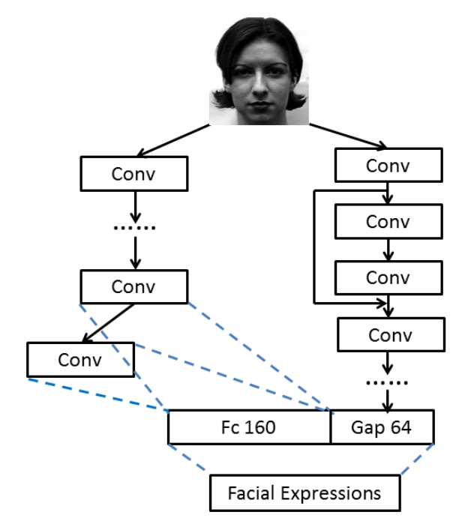


Our model
DeepID
ResNet

Slide 6
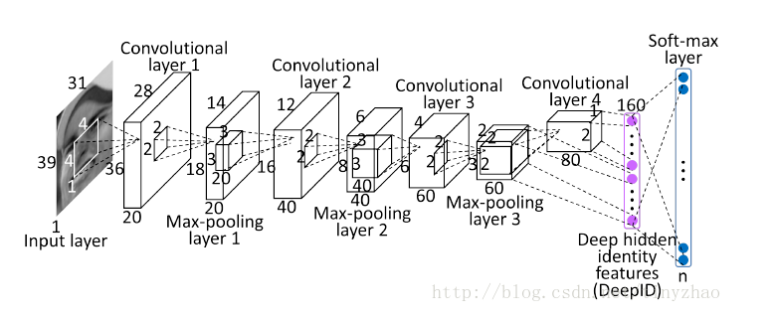
Our model
DeepID network
Four convolution layers.
Learns fully-connected layer (DeepID2 feature) from both the third and fourth convolutional layers.
Generate a compact feature representation with 160 dimensions.

Slide 7
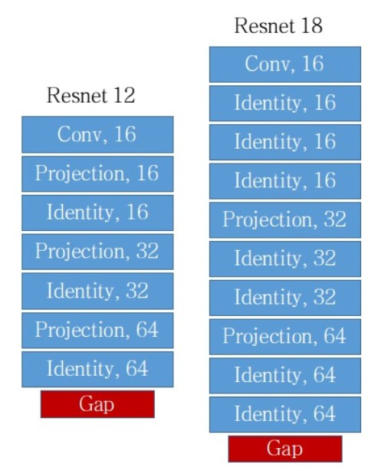
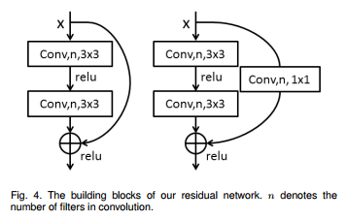
Our model
ResNet
Identity
Projection
For CK+
For FER+

Slide 8

Our model
ResNet
Shortcut connect for deep residual learning
Batch normalization after each convolution and before the ReLU activations for faster convergence and better accuracy
Use global average pooling to generate a compact representation with reduced number of parameters
Identity
Projection
For CK+
For FER+

Slide 9
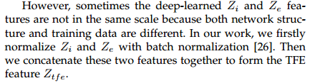
Our model
Identity and Emotion Feature Concatenation
Zi : the identity feature
Ze : the emotion feature
Firstly, normalize Zi and Ze with batch normalization.
Then, concatenate these two features together to form the TFE feature Ztfe.

Slide 10
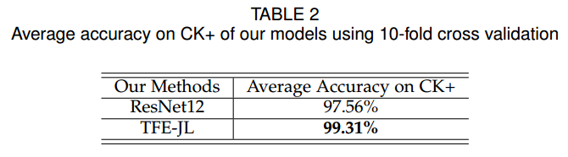
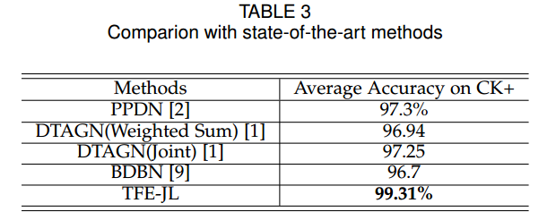
Experimental Result
CASIA-WebFace dataset is used for identity feature extraction.
Two popular FER datasets are used for deep-learned emotion feature extraction and joint learning: CK+ and FER+.
Evaluation on CK+

Slide 11
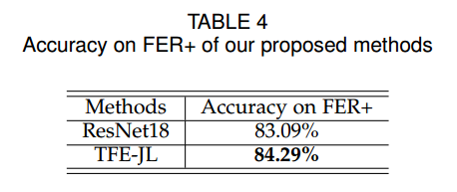
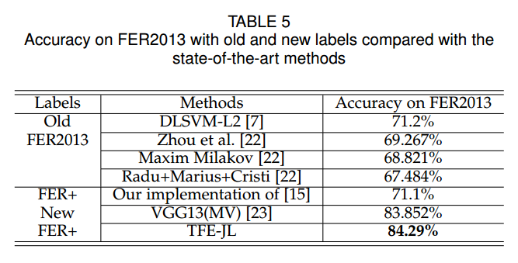
Experimental Result
Evaluation on FER+

Slide 12
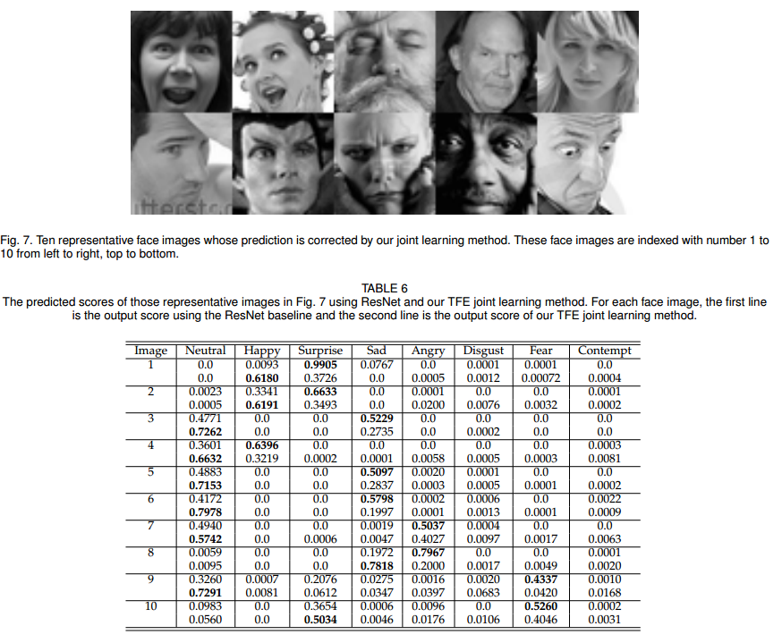
Experimental Result

Slide 13
Future work
Investigate the effect of face image format differences.
Explore other transfer learning and multi-task learning methods for the FER task.

