Slide 1
A Survey in the Named Entity Recognition Focus on Deep Neural Network, Active Learning and Adversarial Learning
Presented by: Junpeng Zhu
Jan 2, 2019
ID：52184506004

Slide 2
OUTLINE
Introduction
Methodology
Models
Conclusions
Opinions

Slide 3
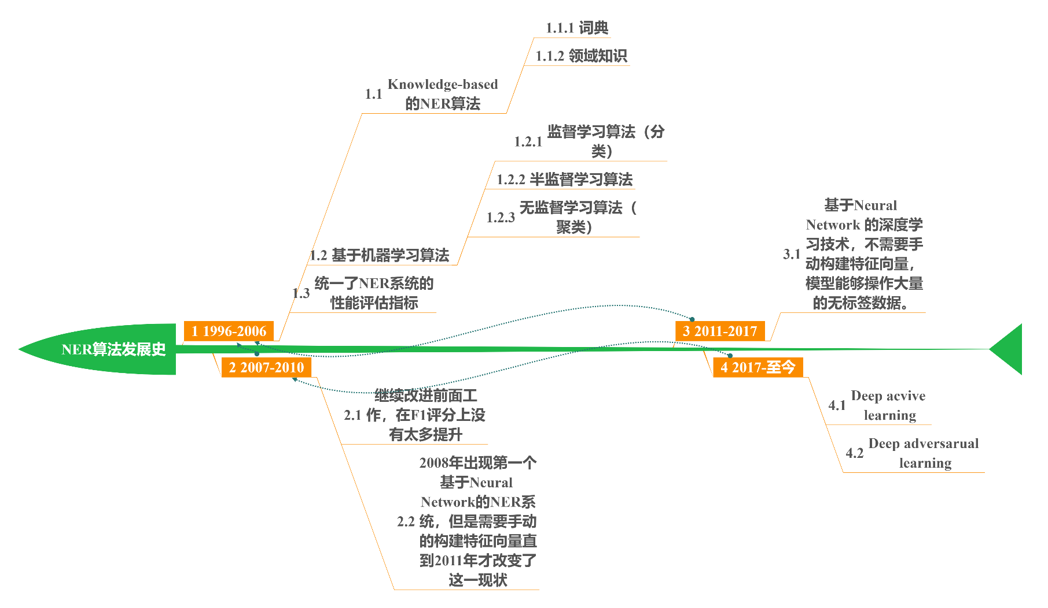
INTRODUCTION

Slide 4
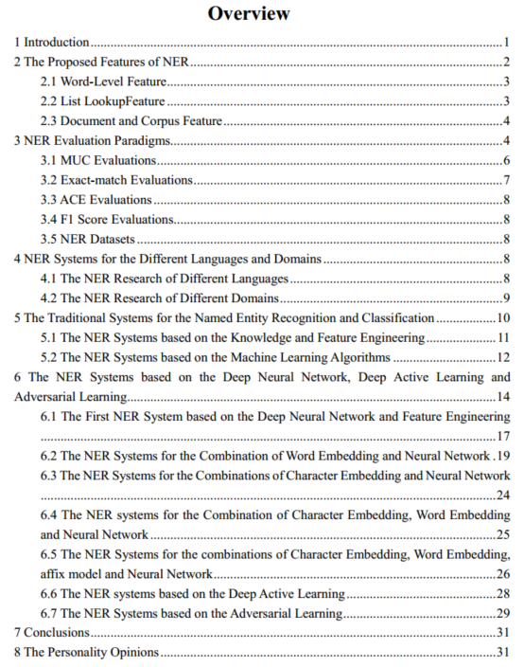
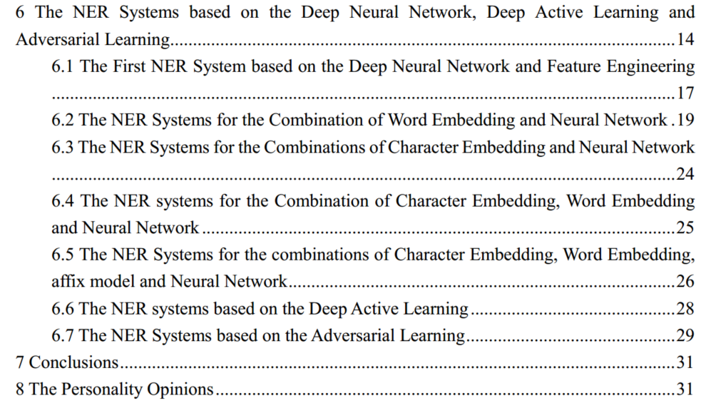
INTRODUCTION

Slide 5
INTRODUCTION
Named Entity Recognition (NER) is a key component in NLP systems
Accurate systems using deep neural networks (DNN) have only been introduced in the last few years
We present a comprehensive survey of deep neural network , deep active learning and adversarial learning architectures, experimental results, advantages and disadvantages for NER systems

Slide 6
OUTLINE
Introduction
Methodology
Models
Conclusions
Opinions

Slide 7
METHODOLOGY
named entity recognition, neural network architectures for named entity recognition, neural network based named entity recognition models, deep learning models for named entity recognition, deep active learning for the named entity recognition and deep adversarial learning for the named entity recognition
In total, 44 articles were reviewed and were selected for the survey.

Slide 8
OUTLINE
Introduction
Methodology
Models
Conclusions
Opinions

Slide 9
MODELS
The First NER System based on the Deep Neural Network and Feature Engineering
The NER Systems for the Combination of Word Embedding and Neural Network
The NER Systems for the Combinations of Character Embedding and Neural Network
The NER systems for the Combination of Character Embedding, Word Embedding and Neural Network
The NER Systems for the combinations of Character Embedding, Word Embedding, affix model and Neural Network
The NER systems based on the Deep Active Learning
The NER Systems based on the Adversarial Learning

Slide 10
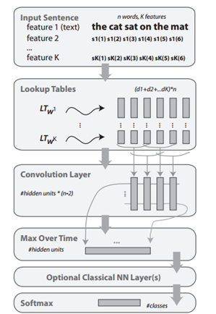
The First NER System based on the Deep Neural Network and Feature Engineering
The first layer extracts features for each word. The first layer has to map words into real-valued vectors.
The second layer extracts features from the sentence treating it as a sequence with local and global structure (i.e., it is not treated like a bag of words).
The following layers are classical NN layers. A general deep NN architecture for NLP. Given an input sentence, the NN outputs class probabilities for one chosen word.
Collobert R, Weston J. A unified architecture for natural language processing: Deep neural networks with multitask learning[C]//Proceedings of the 25th international conference on Machine learning （ICML'08）. ACM, 2008: 160-167.

Slide 11
The First NER System based on the Deep Neural Network and Feature Engineering
ER labeled data was obtained by running the Stanford Named Entity Recognizer over the PropBank dataset（https://propbank.github.io/） version 1 (about 1 million words). It uses the dictionary of the 30, 000 most common words from Wikipedia, converted to lower case. Other words were considered as unknown and mapped to a special word.
Collobert R, Weston J. A unified architecture for natural language processing: Deep neural networks with multitask learning[C]//Proceedings of the 25th international conference on Machine learning （ICML'08）. ACM, 2008: 160-167.

Slide 12
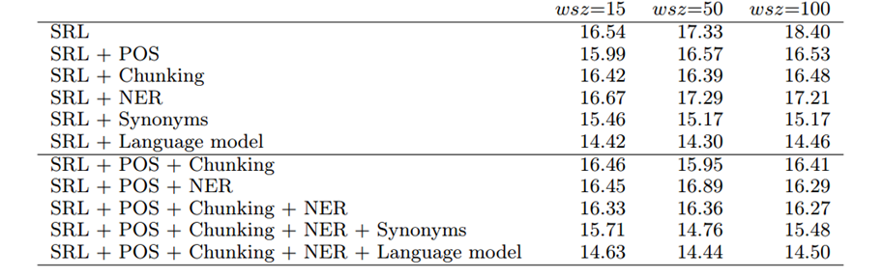
The First NER System based on the Deep Neural Network and Feature Engineering
Collobert R, Weston J. A unified architecture for natural language processing: Deep neural networks with multitask learning[C]//Proceedings of the 25th international conference on Machine learning （ICML'08）. ACM, 2008: 160-167.

Slide 13
The First NER System based on the Deep Neural Network and Feature Engineering
Advantages
Making full use of huge data sets
The model is the better for generalization than others which based on the combination of feature-engineering and machine learning algorithms
This is an important result, given that the NLP community considers syntax as a mandatory feature for semantic extraction
Collobert R, Weston J. A unified architecture for natural language processing: Deep neural networks with multitask learning[C]//Proceedings of the 25th international conference on Machine learning （ICML'08）. ACM, 2008: 160-167.

Slide 14
The First NER System based on the Deep Neural Network and Feature Engineering
Disadvantages
The model is not avoid to use the hand-constructed feature vector which based on the feature-engineer, which manually constructed feature vectors from orthographic features (e.g., capitalization of the first character), dictionaries and lexicons.
There is no F1 score results for the combination of NER and deep neural network
A large number of hand-labeled data is necessary for the model, which is limited.
Collobert R, Weston J. A unified architecture for natural language processing: Deep neural networks with multitask learning[C]//Proceedings of the 25th international conference on Machine learning （ICML'08）. ACM, 2008: 160-167.

Slide 15
MODELS
The First NER System based on the Deep Neural Network and Feature Engineering
The NER Systems for the Combination of Word embedding and Neural Network
The NER Systems for the Combinations of Character Embedding and Neural Network
The NER systems for the Combination of Character Embedding, Word Embedding and Neural Network
The NER Systems for the combinations of Character Embedding, Word Embedding, affix model and Neural Network
The NER systems based on the Deep Active Learning
The NER Systems based on the Adversarial Learning

Slide 16
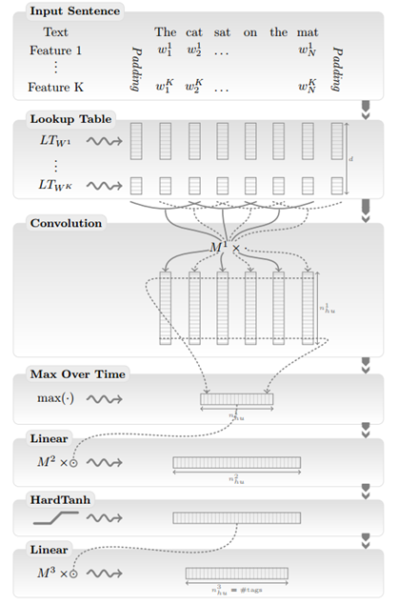
The NER Systems for the Combination of Word embedding and Neural Network
The first layer extracts features for each word.
The second layer extracts features from a window of words or from the whole sentence, treating it as a sequence with local and global structure (i.e., it is not treated like a bag of words).
The following layers are standard Neural Network layers.
Collobert R, Weston J, Bottou L, et al. Natural language processing (almost) from scratch[J]. Journal of Machine Learning Research （JMLR'11）, 2011, 12(Aug): 2493-2537.

Slide 17
The NER Systems for the Combination of Word embedding and Neural Network
Our first English corpus is the entire English Wikipedia. We have removed all paragraphs containing non-roman characters and all MediaWiki markups. The resulting text was tokenized using the Penn Treebank tokenizer script.14 The resulting data set contains about 631 million words. As in our previous experiments, we use a dictionary containing the 100,000 most common words in WSJ, with the same processing of capitals and numbers. Again, words outside the dictionary were replaced by the special “RARE” word.
2）Our second English corpus is composed by adding an extra 221 million words extracted from the Reuters RCV1 (Lewis et al., 2004) data set.15 We also extended the dictionary to 130,000 words by adding the 30,000 most common words in Reuters. This is useful in order to determine whether improvements can be achieved by further increasing the unlabeled data set size.
Collobert R, Weston J, Bottou L, et al. Natural language processing (almost) from scratch[J]. Journal of Machine Learning Research （JMLR'11）, 2011, 12(Aug): 2493-2537.

Slide 18
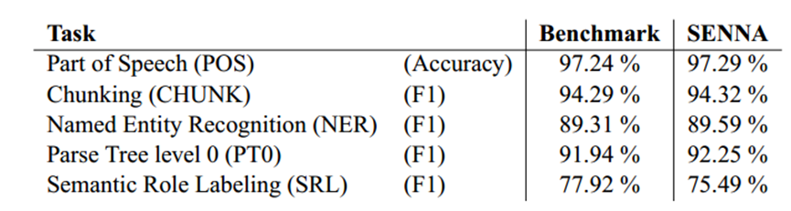
The NER Systems for the Combination of Word embedding and Neural Network
Collobert R, Weston J, Bottou L, et al. Natural language processing (almost) from scratch[J]. Journal of Machine Learning Research （JMLR'11）, 2011, 12(Aug): 2493-2537.

Slide 19
The NER Systems for the Combination of Word embedding and Neural Network
The authors achieved 89.59% F1 score on English CoNLL 2003 dataset by including gazetteers and SENNA embeddings.
The paper rely on large unlabeled data sets and let the training algorithm discover internal representations that prove useful for all the tasks of interest.
Collobert R, Weston J, Bottou L, et al. Natural language processing (almost) from scratch[J]. Journal of Machine Learning Research （JMLR'11）, 2011, 12(Aug): 2493-2537.

Slide 20
The NER Systems for the Combination of Word embedding and Neural Network
Advantages
The model make full use of huge data set and unlabeled data, which is almost from scratch.
The model is the better for generalization than others.
Using the word embeddings vector instead of hand-constructed feature vectors, which is represented by n-dimension vector space.
Collobert R, Weston J, Bottou L, et al. Natural language processing (almost) from scratch[J]. Journal of Machine Learning Research （JMLR'11）, 2011, 12(Aug): 2493-2537.

Slide 21
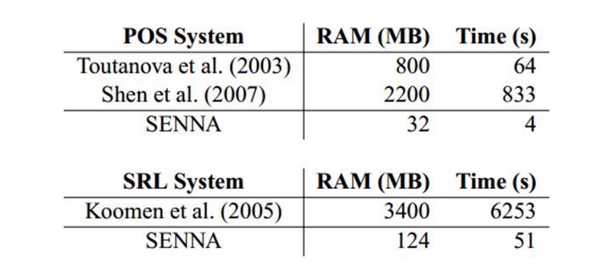
The NER Systems for the Combination of Word embedding and Neural Network
Advantages
The RAM and computational speed are most fast between systems based on the word embeddings, which is minimal computational requirements.
Collobert R, Weston J, Bottou L, et al. Natural language processing (almost) from scratch[J]. Journal of Machine Learning Research （JMLR'11）, 2011, 12(Aug): 2493-2537.

Slide 22
The NER Systems for the Combination of Word embedding and Neural Network
Advantages
avoid task-specific engineering and disregarding a lot of prior knowledge
Disadvantages
It is necessary to add others languages new corpora for F1 score.
The model is dependent to the word embedding.
It is necessary to resort the word embedding.
Collobert R, Weston J, Bottou L, et al. Natural language processing (almost) from scratch[J]. Journal of Machine Learning Research （JMLR'11）, 2011, 12(Aug): 2493-2537.

Slide 23
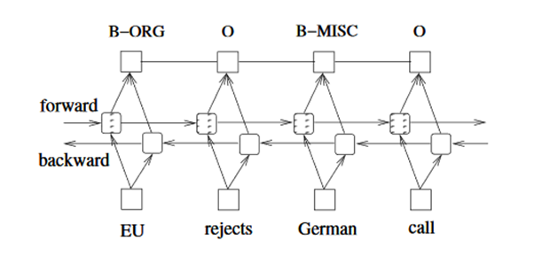
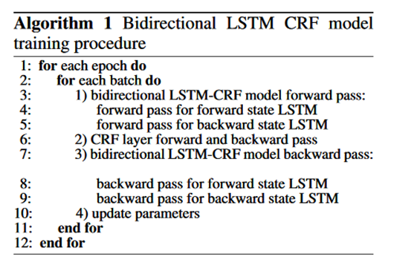
The NER Systems for the Combination of Word embedding and Neural Network
In each epoch, we divide the whole training data to batches and process one batch at a time. Each batch contains a list of sentences which is determined by the parameter of batch size. For each batch, we first run bidirectional LSTM-CRF model forward pass which includes the forward pass for both forward state and backward state of LSTM. As a result, we get the output score for all tags at all positions.
Huang Z, Xu W, Yu K. Bidirectional LSTM-CRF models for sequence tagging[J]. arXiv preprint arXiv:1508.01991, 2015.

Slide 24
The NER Systems for the Combination of Word embedding and Neural Network
Then, the model runs CRF layer forward and backward pass to compute gradients for network output and state transition edges. After that, we can back propagate the errors from the output to the input, which includes the backward pass for both forward and backward states of LSTM. 3）Finally we update the network parameters which include the state transition matrix, and the original bidirectional LSTM parameters.

Slide 25
The NER Systems for the Combination of Word embedding and Neural Network
Datasets and Experimental Results 84.26% F1 score on English CoNLL 2003 dataset
Conclusions The model is the first work of applying a BI-LSTM-CRF model to NLP benchmark sequence tagging data. The model is robust and it has less dependence on word embedding as compared to the observation in (Collobert et.al., 2011). It can achieve accurate tagging accuracy without resorting to word embedding
Huang Z, Xu W, Yu K. Bidirectional LSTM-CRF models for sequence tagging[J]. arXiv preprint arXiv:1508.01991, 2015.

Slide 26
The NER Systems for the Combination of Word embedding and Neural Network
Advantages
The experiments show that BI-LSTM-CRF model is robust
It has less dependence on word embedding as compared to previous observations (Collobert et al., 2011). It can produce accurate tagging performance without resorting to word embedding.
The first work of applying a BI-LSTM-CRF model to NLP benchmark sequence tagging data
Without resorting to word embedding
Huang Z, Xu W, Yu K. Bidirectional LSTM-CRF models for sequence tagging[J]. arXiv preprint arXiv:1508.01991, 2015.

Slide 27
The NER Systems for the Combination of Word embedding and Neural Network
Disadvantages
The F1 score is less than previous models, which is necessary improved.
It is not enough for experiments which use English corpus only. The experimental results should add the new corpora.
Huang Z, Xu W, Yu K. Bidirectional LSTM-CRF models for sequence tagging[J]. arXiv preprint arXiv:1508.01991, 2015.

Slide 28
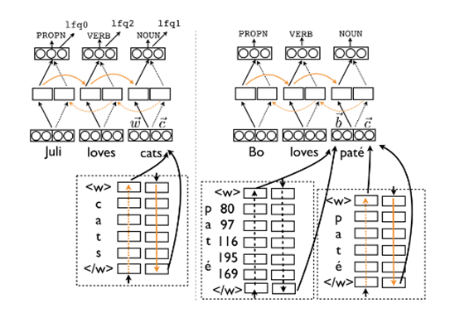
The NER Systems for the Combination of Word embedding and Neural Network
evaluate the effectiveness of different representations in bi-LSTMs
compare these models across a large set of languages and under varying conditions(data size, label noise)
propose a novel bi-LSTM model with auxiliary loss，which combines the POS tagging loss function with an auxiliary loss function that accounts for rare words.
Plank B, Søgaard A, Goldberg Y. Multilingual part-of-speech tagging with bidirectional long short-term memory models and auxiliary loss[J]. arXiv preprint arXiv:1604.05529, 2016. 引用：127

Slide 29
The NER Systems for the Combination of Word embedding and Neural Network
evaluate the effectiveness of different representations in bi-LSTMs
compare these models across a large set of languages and under varying conditions(data size, label noise)
propose a novel bi-LSTM model with auxiliary loss，which combines the POS tagging loss function with an auxiliary loss function that accounts for rare words.
Plank B, Søgaard A, Goldberg Y. Multilingual part-of-speech tagging with bidirectional long short-term memory models and auxiliary loss[J]. arXiv preprint arXiv:1604.05529, 2016. 引用：127

Slide 30
The NER Systems for the Combination of Word embedding and Neural Network
Datasets For the multilingual experiments, we use the data from the Universal Dependencies project v1.2 (Nivre et al., 2015) (17 POS) with the canonical data splits. We consider all languages that have at least 60k tokens and are distributed with word forms, resulting in 22 languages. We also report accuracies on WSJ (45 POS) using the standard splits (Collins, 2002; Manning, 2011).
Plank B, Søgaard A, Goldberg Y. Multilingual part-of-speech tagging with bidirectional long short-term memory models and auxiliary loss[J]. arXiv preprint arXiv:1604.05529, 2016. 引用：127

Slide 31
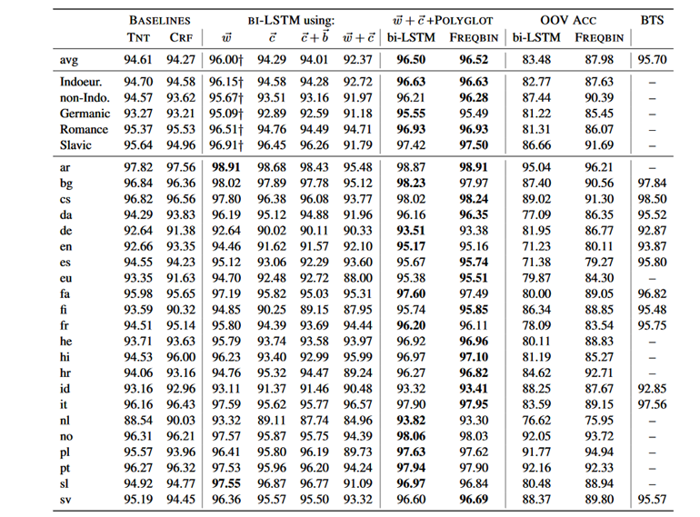
The NER Systems for the Combination of Word embedding and Neural Network
Plank B, Søgaard A, Goldberg Y. Multilingual part-of-speech tagging with bidirectional long short-term memory models and auxiliary loss[J]. arXiv preprint arXiv:1604.05529, 2016. 引用：127

Slide 32
The NER Systems for the Combination of Word embedding and Neural Network
Conclusions
The paper evaluated token and sub-token-level representations for neural network-based part-of-speech tagging across 22 languages and proposed a novel multi-tasks bi-LSTM with auxiliary loss.
The auxiliary loss is effective at improving the accuracy of rare words.
Plank B, Søgaard A, Goldberg Y. Multilingual part-of-speech tagging with bidirectional long short-term memory models and auxiliary loss[J]. arXiv preprint arXiv:1604.05529, 2016. 引用：127

Slide 33
The NER Systems for the Combination of Word embedding and Neural Network
Advantages
It is not sensitive to data set size and label noise
Across 22 languages, and the F1 score is better than previous systems.
It works especially well for morphologically complex languages
Disadvantages
The model is increasingly complex , but the change of F1 score is not much obvious.
Plank B, Søgaard A, Goldberg Y. Multilingual part-of-speech tagging with bidirectional long short-term memory models and auxiliary loss[J]. arXiv preprint arXiv:1604.05529, 2016. 引用：127

Slide 34
MODELS
The First NER System based on the Deep Neural Network and Feature Engineering
The NER Systems for the Combination of Word Embedding and Neural Network
The NER Systems for the Combinations of Character Embedding and Neural Network
The NER systems for the Combination of Character Embedding, Word Embedding and Neural Network
The NER Systems for the combinations of Character Embedding, Word Embedding, affix model and Neural Network
The NER systems based on the Deep Active Learning
The NER Systems based on the Adversarial Learning

Slide 35
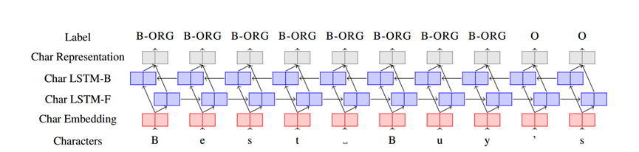
The NER Systems for the Combinations of Character Embedding and Neural Network
Sentence is represented as a sequence of characters.
Kuru O, Can O A, Yuret D. Charner: Character-level named entity recognition[C]//Proceedings of COLING 2016, the 26th International Conference on Computational Linguistics （COLING'16）: Technical Papers. 2016: 911-921.

Slide 36
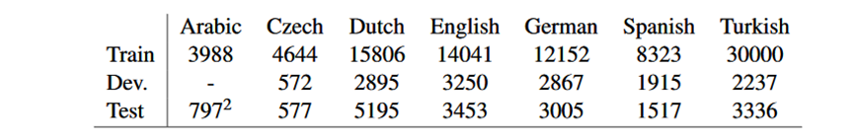
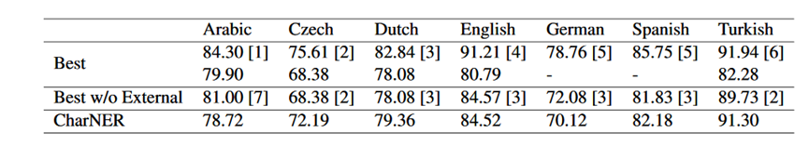
The NER Systems for the Combinations of Character Embedding and Neural Network
Kuru O, Can O A, Yuret D. Charner: Character-level named entity recognition[C]//Proceedings of COLING 2016, the 26th International Conference on Computational Linguistics （COLING'16）: Technical Papers. 2016: 911-921.

Slide 37
The NER Systems for the Combination of Word embedding and Neural Network
Advantages
character-level model. Taking characters as the primary representation is superior to considering words as the basic input unit.
The main contribution is to show that the same deep character level model is able to achieve good performance on multiple languages without hand engineered features or language specific external resources.
Plank B, Søgaard A, Goldberg Y. Multilingual part-of-speech tagging with bidirectional long short-term memory models and auxiliary loss[J]. arXiv preprint arXiv:1604.05529, 2016. 引用：127

Slide 38
The NER Systems for the Combination of Word embedding and Neural Network
Disadvantages
There is nothing specific to NER in the model. It should be evaluate on other tasks such as part-of-speech tagging and shallow parsing. (Multi-tasks)
The robust experiment is lack.
Plank B, Søgaard A, Goldberg Y. Multilingual part-of-speech tagging with bidirectional long short-term memory models and auxiliary loss[J]. arXiv preprint arXiv:1604.05529, 2016. 引用：127

Slide 39
MODELS
The First NER System based on the Deep Neural Network and Feature Engineering
The NER Systems for the Combination of Word Embedding and Neural Network
The NER Systems for the Combinations of Character Embedding and Neural Network
The NER systems for the Combination of Character Embedding, Word Embedding and Neural Network
The NER Systems for the combinations of Character Embedding, Word Embedding, affix model and Neural Network
The NER systems based on the Deep Active Learning
The NER Systems based on the Adversarial Learning

Slide 40
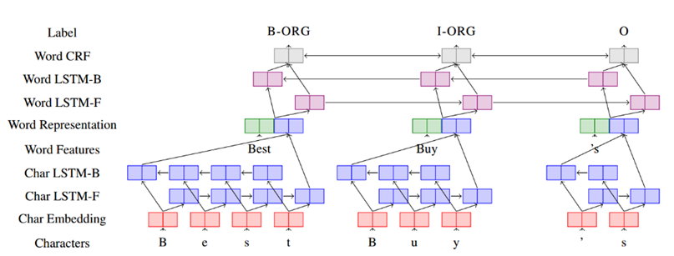
The NER systems for the Combination of Character Embedding, Word Embedding and Neural Network
Ma X, Hovy E. End-to-end sequence labeling via bi-directional lstm-cnns-crf[J]. arXiv preprint arXiv:1603.01354, 2016. 引用：435

Slide 41
The NER Systems for the Combination of Word embedding and Neural Network
Dataset and Experimental Results The F1 score of the model achieves 91.21% using CoNLL2003
Conclusions and Advantages It is a truly end-to-end model relying on no task-specific resources, feature engineering or data pre-processing.
Plank B, Søgaard A, Goldberg Y. Multilingual part-of-speech tagging with bidirectional long short-term memory models and auxiliary loss[J]. arXiv preprint arXiv:1604.05529, 2016. 引用：127

Slide 42
The NER Systems for the Combination of Word embedding and Neural Network
Disadvantages
The model can be further improved by exploring multi-tasks learning approaches to combine more useful and correlated information. In a word, it is not support for multi-tasks learning.
The model may be further explored in the different application areas such as bioinformatics, medical.
It is necessary to add the new corpora for supporting the F1 score.
Plank B, Søgaard A, Goldberg Y. Multilingual part-of-speech tagging with bidirectional long short-term memory models and auxiliary loss[J]. arXiv preprint arXiv:1604.05529, 2016. 引用：127

Slide 43
MODELS
The First NER System based on the Deep Neural Network and Feature Engineering
The NER Systems for the Combination of Word Embedding and Neural Network
The NER Systems for the Combinations of Character Embedding and Neural Network
The NER systems for the Combination of Character Embedding, Word Embedding and Neural Network
The NER Systems for the combinations of Character Embedding, Word Embedding, affix model and Neural Network
The NER systems based on the Deep Active Learning
The NER Systems based on the Adversarial Learning

Slide 44
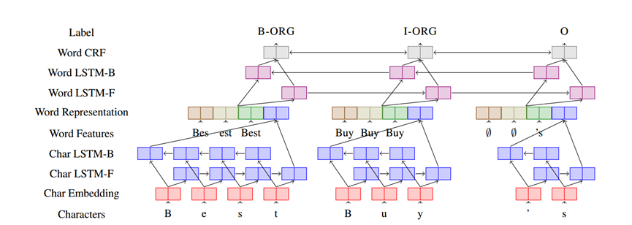
The NER Systems for the combinations of Character Embedding, Word Embedding, affix model and Neural Network
Yadav V, Sharp R, Bethard S. Deep Affix Features Improve Neural Named Entity Recognizers[C]//Proceedings of the Seventh Joint Conference on Lexical and Computational Semantics. 2018: 167-172

Slide 45
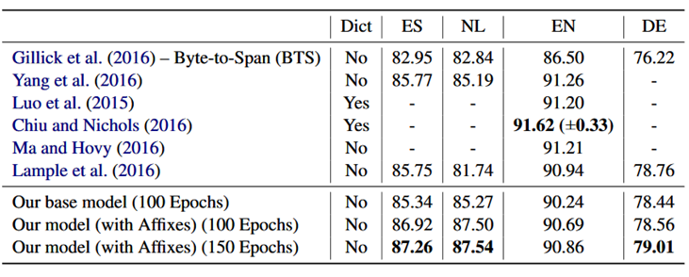
The NER Systems for the combinations of Character Embedding, Word Embedding, affix model and Neural Network
Datasets and Experimental Results
Yadav V, Sharp R, Bethard S. Deep Affix Features Improve Neural Named Entity Recognizers[C]//Proceedings of the Seventh Joint Conference on Lexical and Computational Semantics. 2018: 167-172

Slide 46
The NER Systems for the combinations of Character Embedding, Word Embedding, affix model and Neural Network
Conclusions Straight-forward and language-independent approach shows performance gains compared to other neural systems for NER, achieving a new state of the art on Spanish, Dutch, and German NER as well as the MedLine portion of DrugNER
Yadav V, Sharp R, Bethard S. Deep Affix Features Improve Neural Named Entity Recognizers[C]//Proceedings of the Seventh Joint Conference on Lexical and Computational Semantics. 2018: 167-172

Slide 47
The NER Systems for the combinations of Character Embedding, Word Embedding, affix model and Neural Network
Advantages
The model is tested in multi-languages, which shows up the ability of generalization.
Disadvantages
The model adds the most successful features from feature-engineering approaches：affixes, which is necessary to the labeled datasets. The pro-process is different to us.
Yadav V, Sharp R, Bethard S. Deep Affix Features Improve Neural Named Entity Recognizers[C]//Proceedings of the Seventh Joint Conference on Lexical and Computational Semantics. 2018: 167-172

Slide 48
MODELS
The First NER System based on the Deep Neural Network and Feature Engineering
The NER Systems for the Combination of Word Embedding and Neural Network
The NER Systems for the Combinations of Character Embedding and Neural Network
The NER systems for the Combination of Character Embedding, Word Embedding and Neural Network
The NER Systems for the combinations of Character Embedding, Word Embedding, affix model and Neural Network
The NER systems based on the Deep Active Learning
The NER Systems based on the Adversarial Learning

Slide 49
The NER systems based on the Deep Active Learning
In this work, the combination of deep learning and active learning drastically reduced the number of labeled data. The CNN-CNN-LSTM model consisting of convolutional character and word encoders and a long short term memory (LSTM) tag decoder. The model achieves nearly state-of-the-art performance on standard datasets for the task while being computationally much more efficient than best performing models
主动学习：通过“选择策略”主动从未标注的样本集中挑选部分（1个或N个）样本让相关领域的专家进行标注；然后将标注过的样本增加到训练数据集给“学习模块”进行训练；当“学习模块”满足终止条件时即可结束程序，否则不断重复上述步骤获得更多的标注样本进行训练。
Shen Y, Yun H, Lipton Z C, et al. Deep Active Learning for Named Entity Recognition[J]. arXiv preprint arXiv:1707.05928, 2017. 引用：21

Slide 50
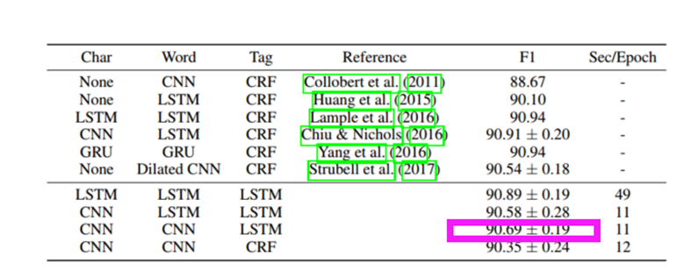
The NER systems based on the Deep Active Learning
Dataset On the CoNLL-2003 English dataset
Shen Y, Yun H, Lipton Z C, et al. Deep Active Learning for Named Entity Recognition[J]. arXiv preprint arXiv:1707.05928, 2017. 引用：21

Slide 51
The NER systems based on the Deep Active Learning
Advantages
The model achieves the incremental training with each batch of new labels: mix newly annotated samples with the older ones, and update the neural network weights for a small number of epochs, before querying for labels in a new round. This modification drastically reduces the computational requirements of active methods and makes it practical to deploy them.
The model contains convolutional character-level encoder, convolutional word-level encoder, and long short term memory (LSTM) tag decoder, which trains much faster than other deep models.
Shen Y, Yun H, Lipton Z C, et al. Deep Active Learning for Named Entity Recognition[J]. arXiv preprint arXiv:1707.05928, 2017. 引用：21

Slide 52
The NER systems based on the Deep Active Learning
Disadvantages
The model is necessary to the labeled data sets is used in training steps, but it is necessary to sample a little of data only.
It is necessary to add the new corpora for supporting the F1 score.
Shen Y, Yun H, Lipton Z C, et al. Deep Active Learning for Named Entity Recognition[J]. arXiv preprint arXiv:1707.05928, 2017. 引用：21

Slide 53
MODELS
The First NER System based on the Deep Neural Network and Feature Engineering
The NER Systems for the Combination of Word Embedding and Neural Network
The NER Systems for the Combinations of Character Embedding and Neural Network
The NER systems for the Combination of Character Embedding, Word Embedding and Neural Network
The NER Systems for the combinations of Character Embedding, Word Embedding, affix model and Neural Network
The NER systems based on the Deep Active Learning
The NER Systems based on the Adversarial Learning

Slide 54
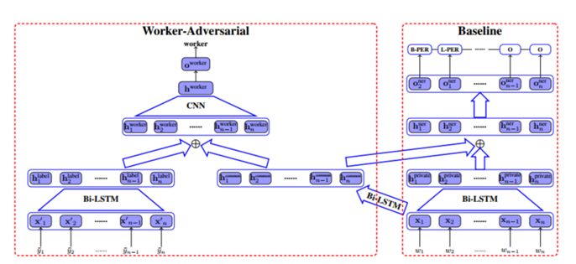
The NER Systems based on the Adversarial Learning
To quickly obtain new labeled data, we can choose crowd-sourcing as an alternative way at lower cost in a short time. But as an exchange, crowd annotations from non-experts may be of lower quality than those from experts. To make full use of noisy sequence labels, the following model is proposed. Inspired by adversarial learning, the model uses a common Bi-LSTM and a private Bi-LSTM for representing annotator-generic and -specific information.
Yang Y S, Zhang M, Chen W, et al. Adversarial Learning for Chinese NER from Crowd Annotations[C]// Proceedings of the AAAI Conference on Artificial Intelligence (AAAI’18), 2018.

Slide 55
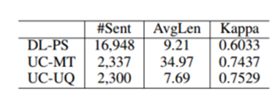
The NER Systems based on the Adversarial Learning
Datasets The datasets include labeled datasets and unlabeled datasets.
Yang Y S, Zhang M, Chen W, et al. Adversarial Learning for Chinese NER from Crowd Annotations[C]// Proceedings of the AAAI Conference on Artificial Intelligence (AAAI’18), 2018.

Slide 56
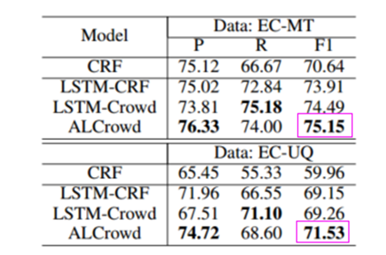
The NER Systems based on the Adversarial Learning
Experimental Results
Yang Y S, Zhang M, Chen W, et al. Adversarial Learning for Chinese NER from Crowd Annotations[C]// Proceedings of the AAAI Conference on Artificial Intelligence (AAAI’18), 2018.

Slide 57
The NER Systems based on the Adversarial Learning
Conclusions The experimental results show that the proposed approach outperforms strong baseline systems.
Advantages The adversarial learning makes full use of noisy sequence labels
Disadvantages The model cannot handle entities separated by other entities or non-entity words.
Yang Y S, Zhang M, Chen W, et al. Adversarial Learning for Chinese NER from Crowd Annotations[C]// Proceedings of the AAAI Conference on Artificial Intelligence (AAAI’18), 2018.

Slide 58
OUTLINE
Introduction
Methodology
Models
Conclusions
Opinions

Slide 59
CONCOLUTIONS
Neural network models generally outperform feature-engineered models.
The combination of character and word hybrid neural networks generally outperform other representational choices.
The current methods make full use of unlabeled, large number of data sets.

Slide 60
CONCOLUTIONS
Another interesting direction is to apply models to data from other domains such as social media (Twitter and Weibo).
Can other supervised learning methods replace affixes of feature engineering methods in the Section 6.5?
There is still interesting progress to be made by incorporating key features of past feature-engineered models into modern Neural Network architectures.

Slide 61
CONCOLUTIONS
The combination of LSTM and CRF is still the focused research topic, especially in the different ways of using small corpus and training sets.
The adversarial learning makes full use of noisy sequence labels.
It should be explored for transfer learning, active learning and joint learning in NER systems.

Slide 62
OUTLINE
Introduction
Methodology
Models
Conclusions
Opinions

Slide 63
OPINIONS
With the evolution of the computer sciences technologies, such as knowledge engineer, machine learning, deep neural network, active learning and adversarial learning, the progress of the NER systems.
It is trends to combine NER systems and focused methods.
It is weak to the NER systems for the specific domains, Which should be explored for us.

Slide 64
OPINIONS
It may be future work for the NER systems for the combinations of character embedding, word embedding, and neural network adds the unsupervised learning, supervised learning or semi-supervised learning algorithms.

