Slide 1
Running Spark on a High-Performance Cluster using RDMA Networking and NVMe Flash
Patrick Stuedi, IBM Research

Slide 2
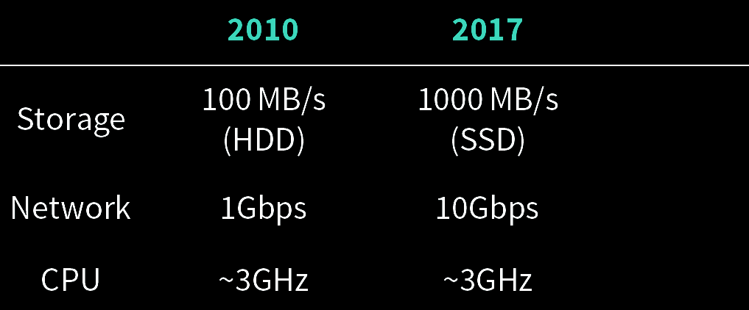
Hardware Trends
community target
2010
2017
100 MB/s
100ms
1000 MB/s
200us
1Gbps
50us
10Gbps
20us

Slide 3

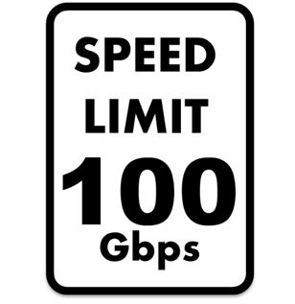
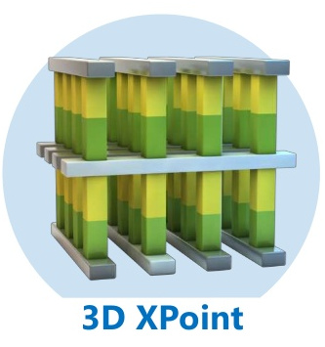

Hardware Trends
community target
our
target
2010
2017
2017
100 MB/s
100ms
1000 MB/s
200us
10 GB/s
50us
1Gbps
50us
10Gbps
20us
100Gbps
1us

Slide 4
User-Level APIs
Needed to
achieve
1us RTT!
Traditional / Kernel-based
User-Level / Kernel-Bypass
Storage App
Network App
Storage App
Network App
SPDK
OS Kernel
OS Kernel
OS Kernel
RDMA, DPDK
FileSystem
Sockets
Block Layer
TCP/IP
Kernel
Kernel
iSCSI
Ethernet
HDD
NIC
SSD, NIC
NIC

Slide 5
Remote Data Access
DRAM
NVMe Flash

Slide 6
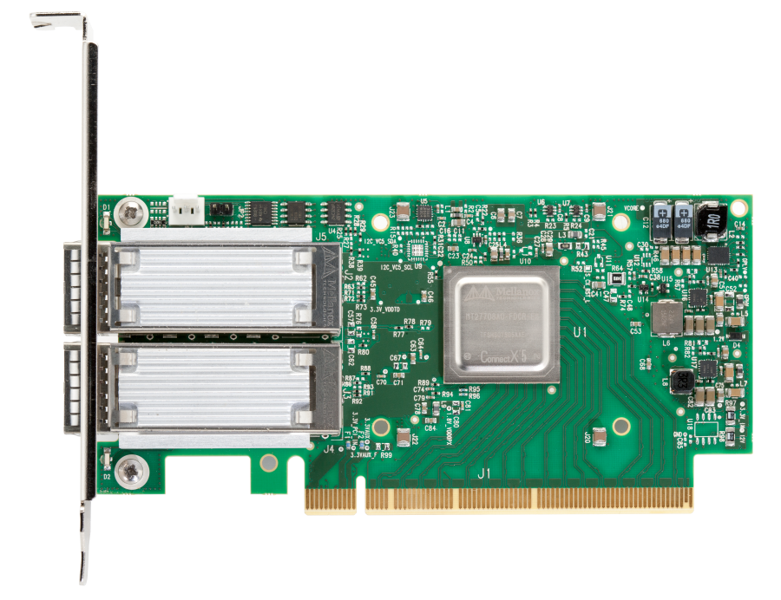
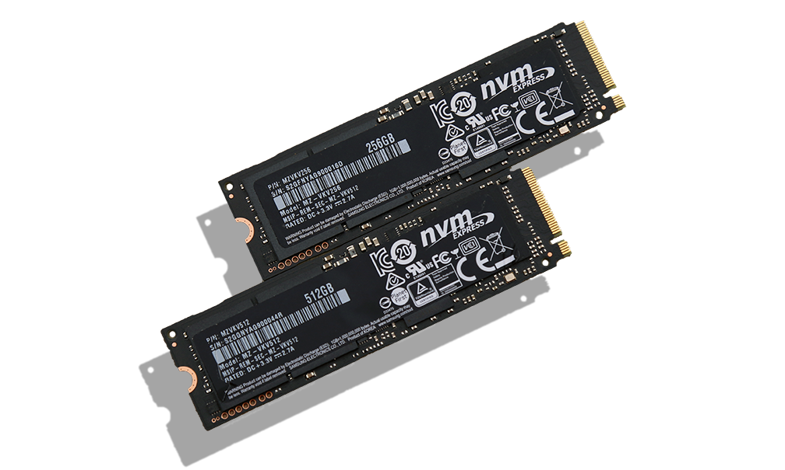
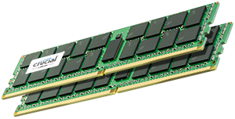
Let's Use it!
Performance!
Realtime!
Disaggregation!
SQL
Streaming
MLlib
GraphX
Spark
High-Performance RDMA network
DRAM
NVMe Flash

Slide 7

Case Study: Sorting in Spark
Input
Cores
Map
Reduce
Output
Net
Ser
Sort
Net
Ser
Sort
Net
Ser
Sort
read & classify
shuffle
store

Slide 8
Experiment Setup
Total data size: 12.8 TB
Cluster size: 128 nodes
Cluster hardware:
  DRAM: 512 GB DDR 4
  Storage: 4x 1.2 TB NVMe SSD
  Network: 100GbE Mellanox RDMA
Flash bandwidth
per node matches
network bandwidth

Slide 9
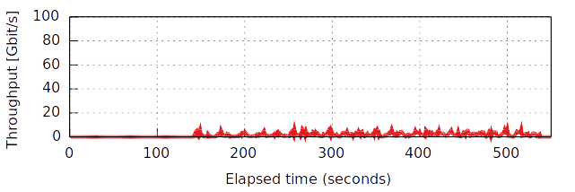

How is the Network Used?
Hardware limit

Slide 10
What is the Problem?
Sorter
TeraSort
Serializer
Spark
Netty
sockets
filesystem
JVM
TCP/IP
block layer
Ethernet
iSCSI
NIC
SSD
Spark uses legacy networking and storage APIs: no kernel-bypass
Spark itself introduces additional I/O layers: Netty, serializer, sorter, etc.

Slide 11
Example: Shuffle (Map)
Object
Sorter
Buffer
Kryo
Buffer
BufferedOutputStream
Buffer
JNI backend
Buffer
File System Buffer Cache
Buffer

Slide 12
Example: Shuffle (Map)
Object
Sorter
Buffer
Kryo
Buffer
Stream
Buffer
JNI
Buffer
FS
Buffer

Slide 13
Example: Shuffle (Map+Reduce)
Object
Sorter
Buffer
Object
Kryo
Buffer
Sorter
Stream
Buffer
Buffer
Kryo
JNI
Buffer
Buffer
Buffer
Netty
FS
Buffer
Buffer
Buffer
Buffer
Socket
network

Slide 14
Example: Shuffle (Map+Reduce)
Object
Difficult at
100 Gbps!
Sorter
Buffer
Object
Kryo
Buffer
Sorter
Stream
Buffer
Buffer
Kryo
JNI
Buffer
Buffer
Buffer
Netty
FS
Buffer
Buffer
Buffer
Buffer
Socket
network

Slide 15
How can we fix this...
Not just for shuffle
  Also for broadcast, RDD transport, inter-job sharing, etc.
Not just for RDMA and NVMe hardware
  But for any possible future high-performance I/O hardware
Not just for co-located compute/storage
  Also for resource disaggregation, heterogeneous resource distribution, etc.
Not just improve things
  Make it perform at the hardware limit

Slide 16

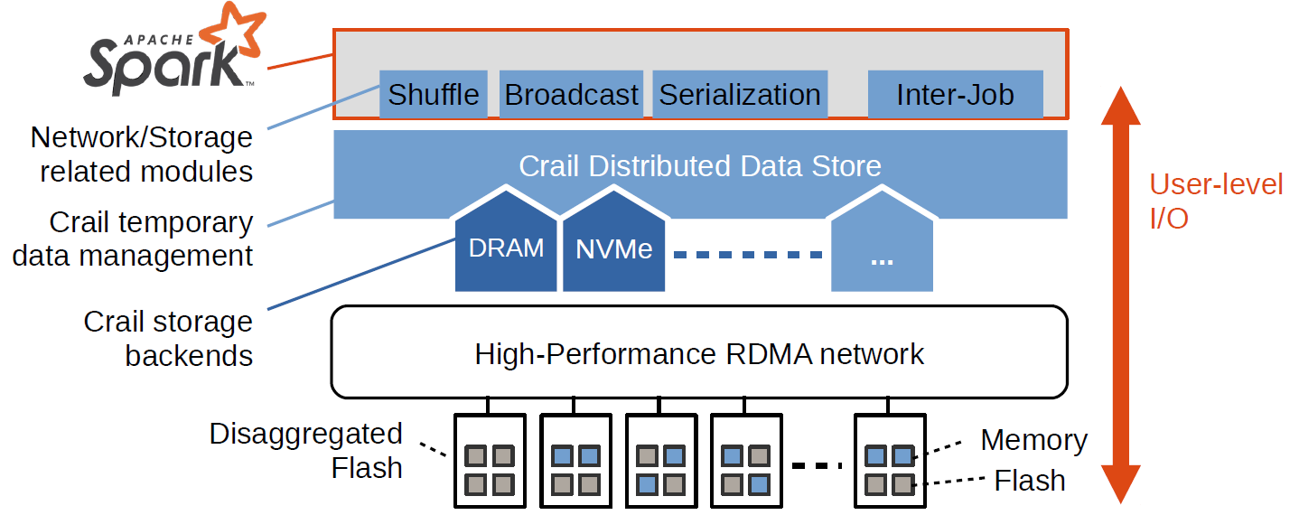
The CRAIL Approach

Slide 17
Example: Crail Shuffle (Map)
Object
No buffering
Crail Serializer
CrailOutputStream
Buffer
memcpy
RDMA
NVMe
NVMeF
local
DRAM
remote DRAM
local Flash
remote Flash

Slide 18
Example: Crail Shuffle (Reduce)
Object
No buffering
Crail Serializer
Buffer
CrailInputStream
memcpy
RDMA
NVMe
NVMeF
local
DRAM
remote DRAM
local Flash
remote Flash

Slide 19
Example: Crail Shuffle (Reduce)
Similar for
broadcast,
Input/output,
RDD, etc.
Object
No buffering
Crail Serializer
Buffer
CrailInputStream
memcpy
RDMA
NVMe
NVMeF
local
DRAM
remote DRAM
local Flash
remote Flash

Slide 20
Performance: Configuration
Experiments
  Performance: Broadcast, GroupBy, Sorting, SQL (memory)
  Disaggregation, tiering: Sorting (memory/flash)
Cluster size: 8 nodes, except TeraSort: 128 nodes
Cluster hardware:
  DRAM: 512 GB DDR 4
  Storage: 4x 1.2 TB NVMe SSD
  Network: 100GbE Mellanox RDMA

Slide 21
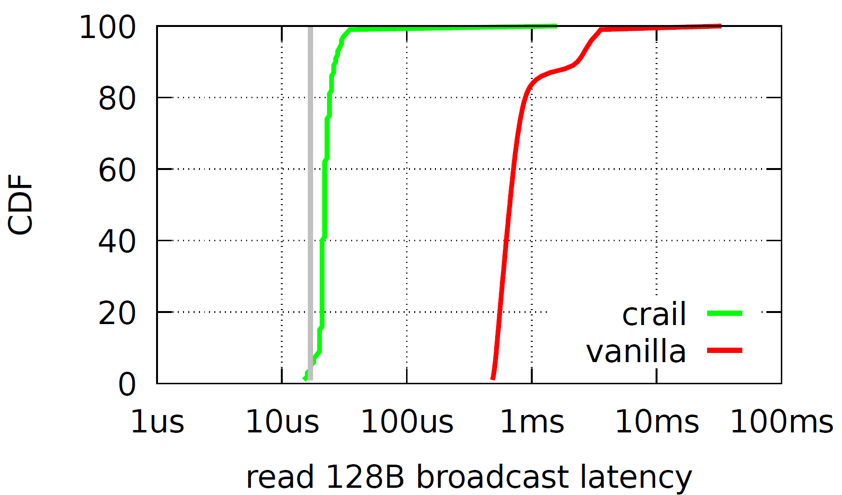
Spark Broadcast
2
Spark
Executor
Spark
driver
4
CDF
Broadcast reading
RPC+RDMA
Broadcast writing
RPC+2xRDMA+RPC
1
3
/spark/broadcast/broadcast_0
Crail Store
val bcVar = sc.Broadcast(new Array[Byte](128))
sc.parallelize(1 to tasks, tasks).map(_ => {
bcVar.value.length
}).count

Slide 22
Spark GroupBy (240GB)
Runtime
Network Usage
Spark
Exec0
Spark
Exec1
Spark
ExecN
map: Hash
Append (file)
hash
hash
hash
1
/shuffle/1/ f0 f1 fN
/shuffle/2/ f0 f1 fN
/shuffle/3 f0 f1 fN
Crail Store
2
reduce: fetch
Bucket (dir)
Spark
Exec0
Spark
Exec1
Spark
ExecN
val pairs = sc.parallelize(1 to tasks, tasks).flatmap(_ => {
var values = new array[(Long,Array[Byte])](numKeys)
values = initValues(values)
}).cache().groupByKey().map(v => v._1).count()

Slide 23
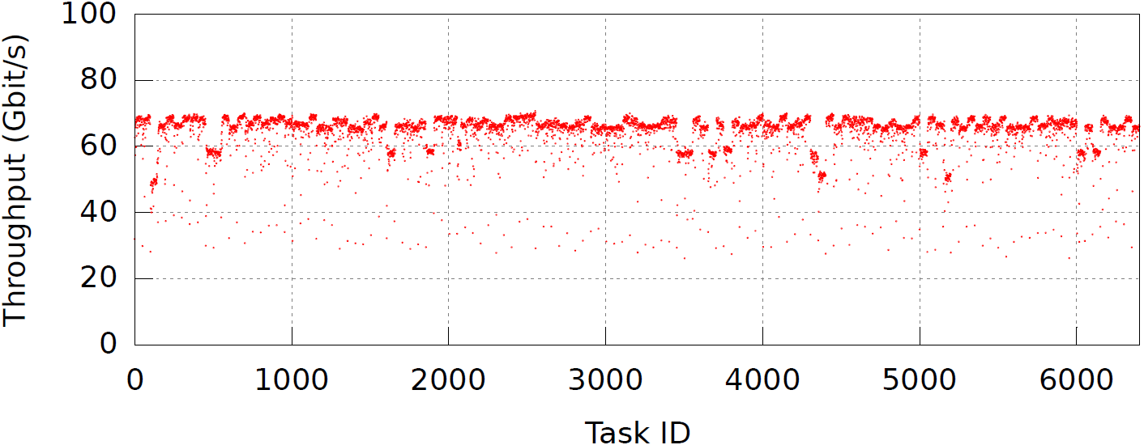
Sorting 12.8 TB on 128 nodes
Sorting Runtime
Spark/Crail Network Usage
6x
Throughput (Gbit/s)
Task ID

Slide 24
How fast is this?
Spark
Native C
distributed
sorting
benchmark
www.sortingbenchmark.org
 | Spark/Crail | Winner 2014 | Winner 2016
Size (TB) | 12.8 | 100 | 100
Time (sec) | 98 | 1406 | 134
Total cores | 2560 | 6592 | 10240
Network HW (Gbit/s) | 100 | 10 | 100
Rate/core (GB/min) | 3.13 | 0.66 | 4.4
Sorting rate of
Crail/Spark only 27%
slower than rate of
Winner 2016

Slide 25
Spark SQL Join
Spark
Exec0
Spark
Exec1
Spark
ExecN
1
read from
hdfs/crail/alluxio
parquet
parquet
parquet
map: Hash
Append (file)
hash
hash
hash
2
/shuffle/1/ f0 f1 fN
/shuffle/2/ f0 f1 fN
/shuffle/3 f0 f1 fN
Crail Store
Time (sec)
deserize
deserize
deserize
3
Sort
Merge join
sort
sort
sort
join
join
join
Spark/
Alluxio
Spark/
Crail
hdfs/crail/alluxio
write
write
write
4
val ds1 = spSess.read.parquet(“...”) //100GB dataset
val ds2 = spSess.read.parquet(“...”) //100GB dataset
val resultDS = ds1.joinWith(ds1, ds1(key) === ds2(key))
resultDS.write.format(“parquet”).mode(SaveMode.Overwrite).save(“...”)

Slide 26
Storage Tiering: DRAM & NVMe
Spark
Spark
Exec0
Spark
Exec1
Spark
ExecN
Vanilla
Spark
(100%
in-memory)
Input/Output/
Shuffle/
Network
Memory Tier
Flash
Tier
memory/flash ratio
Using NVMe flash instead of memory for input/output/shuffle
data results in only 48% performance cost

Slide 27
DRAM & Flash Disaggregation
Vanilla/Alluxio
Spark
Exec0
Spark
Exec1
Spark
ExecN
Crail/
NVMe
Crail/
DRAM
storage
nodes
compute
nodes
With Crail, Spark sorting worload can be run both with memory and
flash disaggregated without performance cost

Slide 28
Conclusions
Effectively using high-performance I/O hardware in Spark is challenging
Crail is an attempt to re-think how data processing frameworks (not only Spark) should interact with network and storage hardware
  User-level I/O, storage disaggregation, memory/flash convergence

Slide 29


Crail for Spark is Open Source
www.crail.io
github.com/zrlio/spark-io
github.com/zrlio/crail
github.com/zrlio/parquetgenerator
github.com/zrlio/crail-terasort

Slide 30
Thank You.

Slide 31
The CRAIL Approach
Shuffle
Broadcast
Serialization
Inter-Job
Network/Storage related modules
Crail Distributed Data Store
User-level
I/O
Crail temporary data store
DRAM
NVMe
BlkDv
...
Crail storage
tiers
High-Performance RDMA network
Disaggregated
Flash
Memory
Flash

