Slide 1
Running Spark on a High-Performance Cluster using RDMA Networking and NVMe Flash
Patrick Stuedi, IBM Research
Notes:
Good morning everybody
This talk about running Spark on a cluster with high-performance networking and storage hardware.

Slide 2
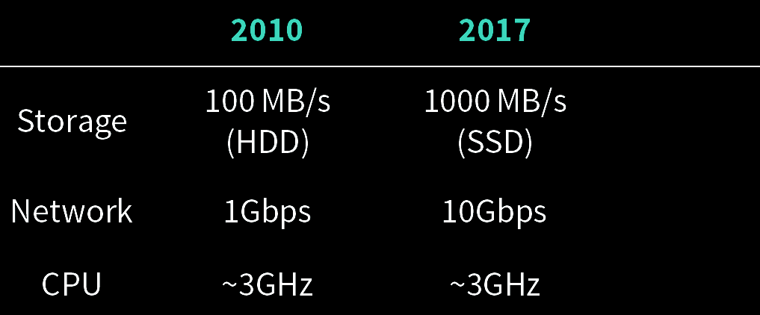
Hardware Trends
community target
2010
2017
100 MB/s
100ms
1000 MB/s
200us
1Gbps
50us
10Gbps
20us
Notes:
Let me start with a brief look at some hardware performance trends that are motivating the work I'm presenting today.
If you have been attending Spark Summit East this February, then you may remember this table which I copied from the keynote. It shows that since 2010 when Spark was released, network and storage hardware have undergone a 10x or more improvement, both in terms of throughput and latency. In 2010, a typical Spark deployment would use hard disks for storage and a 1Gbps network fabric. Today, if you're running Spark you may have most of your short term storage on SSD and the network will probably a 10Gbps network or faster. That type of hardware is commonly available across the different cloud offerings and you could say it's the community's target hardware.

Slide 3


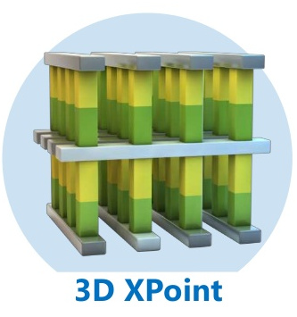

Hardware Trends
community target
our
target
2010
2017
2017
100 MB/s
100ms
1000 MB/s
200us
10 GB/s
50us
1Gbps
50us
10Gbps
20us
100Gbps
1us
Notes:
Now, if we look at the high-end segment of network and storage hardware, we have for instance NVMe flash, 3D Xpoint and 100GbE. These technologies offer another 10x improvement over today's community hardware. In today's talk I will show how to run Spark on such hardware, particularly focusing on 100 Gbit Ethernet and NVMe flash.

Slide 4
User-Level APIs
Needed to
achieve
1us RTT!
Traditional / Kernel-based
User-Level / Kernel-Bypass
Storage App
Network App
Storage App
Network App
SPDK
OS Kernel
OS Kernel
OS Kernel
RDMA, DPDK
FileSystem
Sockets
Block Layer
TCP/IP
Kernel
Kernel
iSCSI
Ethernet
HDD
NIC
SSD, NIC
NIC
Notes:
It's known that often changes in hardware require adjustments to software as well in order to fully leverage the hardware capabilities. This is the case also for high-performance network and storage hardware, where in both cases user-level APIs where introduced to avoid overheads of the kernel during I/O operations. For instance, NVMe flash can be accessed directly from userspace using the open source Storage Performance Developer Kit, or short SPDK. Similarly for networking there is RDMA or DPDK, both are ways to access networking hardware almost without kernel involvement.

Slide 5
Remote Data Access
DRAM
NVMe Flash
User-level APIs offer 2-10x better performance than
traditional kernel-based APIs
Notes:
Using the user-level APIs instead of the traditional kernel-based methods pays off performance wise. This is shown on the left for networking and on the right for storage.
For network we show the time it takes to fetch a certain amount of data from a remote server, first using traditional sockets, then later using RDMA. Note that RDMA not only provides user-level hardware access, it also has explicit methods to access remote memory referred to as one-sided operations. Using those methods, fetching a 1MB block over a 100Gbps network takes less than 100us, while doing the same over kernel sockets takes almost 250. The performance differences between the two access methods gets bigger as the I/O size gets smaller an more latency sensitive.
On the right side we run a smilar experiment for storage, where also we measure the time it takes to access some amount of data from a remote server, first using iSCSI and then using NVMe of fabrics. NVMe over fabrics is a new standard that allows access to remote flash directly from user-space. As can be seen using NVMe over fabrics the access latency can be reduced by almost a factor of 2 compared to iSCSI.
Generally the message here if we want the best performance out of new fast networking and storage hardware, we should make sure software is accessing the hardware directly from userpace if possible.

Slide 6
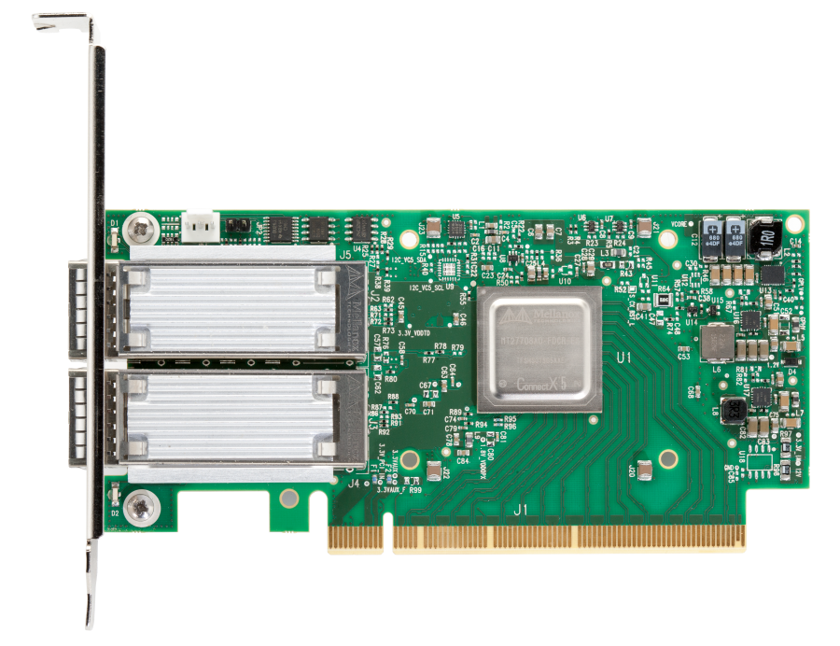
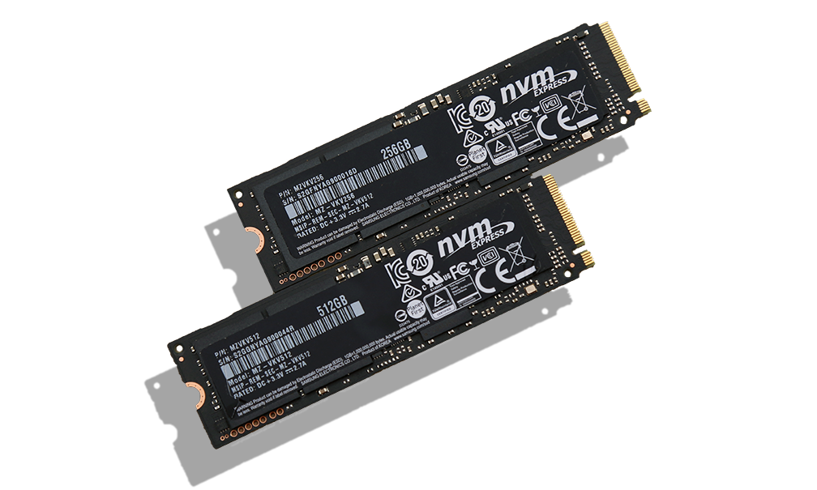
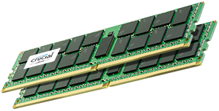
Let's Use it!
Performance!
Realtime!
Disaggregation!
SQL
Streaming
MLlib
GraphX
Spark
High-Performance RDMA network
DRAM
NVMe Flash

Slide 7

Case Study: Sorting in Spark
Input
Cores
Map
Reduce
Output
Net
Ser
Sort
Net
Ser
Sort
Net
Ser
Sort
read & classify
shuffle
store

Slide 8
Experiment Setup
Total data size: 12.8 TB
Cluster size: 128 nodes
Cluster hardware:
  DRAM: 512 GB DDR 4
  Storage: 4x 1.2 TB NVMe SSD
  Network: 100GbE Mellanox RDMA
Flash bandwidth
per node matches
network bandwidth

Slide 9
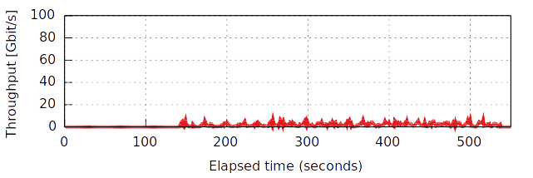

How is the Network Used?
Hardware limit

Slide 10
What is the Problem?
Sorter
TeraSort
Serializer
Spark
Netty
sockets
filesystem
JVM
TCP/IP
block layer
Ethernet
iSCSI
NIC
SSD
Spark uses legacy networking and storage APIs: no kernel-bypass
Spark itself introduces additional I/O layers: Netty, serializer, sorter, etc.

Slide 11
Example: Shuffle (Map)
Object
Sorter
Buffer
Kryo
Buffer
BufferedOutputStream
Buffer
JNI backend
Buffer
File System Buffer Cache
Buffer

Slide 12
Example: Shuffle (Map)
Object
Sorter
Buffer
Kryo
Buffer
Stream
Buffer
JNI
Buffer
FS
Buffer

Slide 13
Example: Shuffle (Map+Reduce)
Object
Sorter
Buffer
Object
Kryo
Buffer
Sorter
Stream
Buffer
Buffer
Kryo
JNI
Buffer
Buffer
Buffer
Netty
FS
Buffer
Buffer
Buffer
Buffer
Socket
network

Slide 14
Example: Shuffle (Map+Reduce)
Object
Difficult at
100 Gbps!
Sorter
Buffer
Object
Kryo
Buffer
Sorter
Stream
Buffer
Buffer
Kryo
JNI
Buffer
Buffer
Buffer
Netty
FS
Buffer
Buffer
Buffer
Buffer
Socket
network

Slide 15
How can we fix this...
Not just for shuffle
  Also for broadcast, RDD transport, inter-job sharing, etc.
Not just for RDMA and NVMe hardware
  But for any possible future high-performance I/O hardware
Not just for co-located compute/storage
  Also for resource disaggregation, heterogeneous resource distribution, etc.
Not just improve things
  Make it perform at the hardware limit

Slide 16

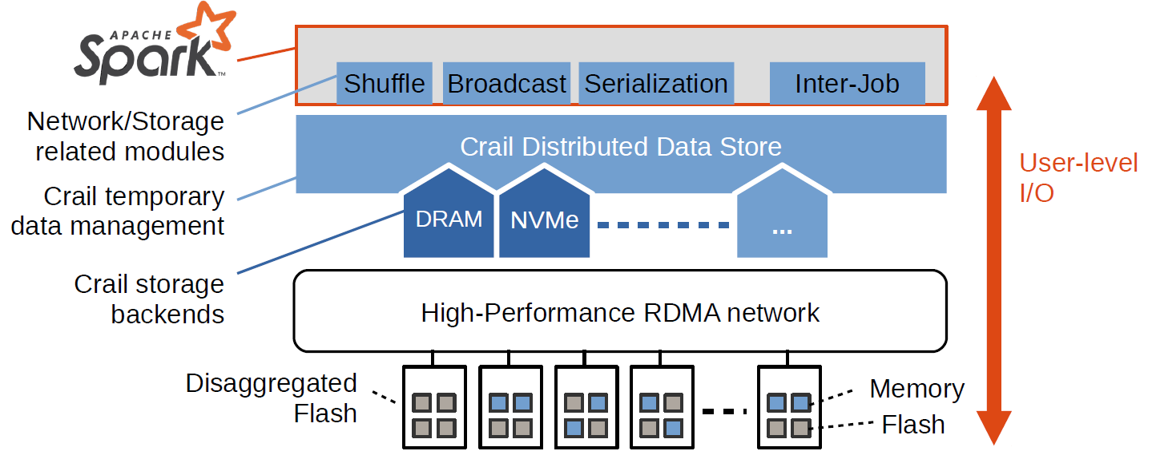
The CRAIL Approach

Slide 17
Example: Crail Shuffle (Map)
Object
No buffering
Crail Serializer
CrailOutputStream
Buffer
memcpy
RDMA
NVMe
NVMeF
local
DRAM
remote DRAM
local Flash
remote Flash

Slide 18
Example: Crail Shuffle (Reduce)
Object
No buffering
Crail Serializer
Buffer
CrailInputStream
memcpy
RDMA
NVMe
NVMeF
local
DRAM
remote DRAM
local Flash
remote Flash

Slide 19
Example: Crail Shuffle (Reduce)
Similar for
broadcast,
Input/output,
RDD, etc.
Object
No buffering
Crail Serializer
Buffer
CrailInputStream
memcpy
RDMA
NVMe
NVMeF
local
DRAM
remote DRAM
local Flash
remote Flash

Slide 20
Performance: Configuration
Experiments
  Memory-only: Broadcast, GroupBy, Sorting, SQL
  Memory/Flash: disaggregation, tiering
Cluster size: 8 nodes, except Sorting: 128 nodes
Cluster hardware:
  DRAM: 512 GB DDR 4
  Storage: 4x 1.2 TB NVMe SSD
  Network: 100GbE Mellanox RDMA
Spark 2.1.0, Alluxio 1.4, Crail 1.0
Hadoop.tmp.dir: RamFS for microbenchmarks, flash SSD for workloads

Slide 21
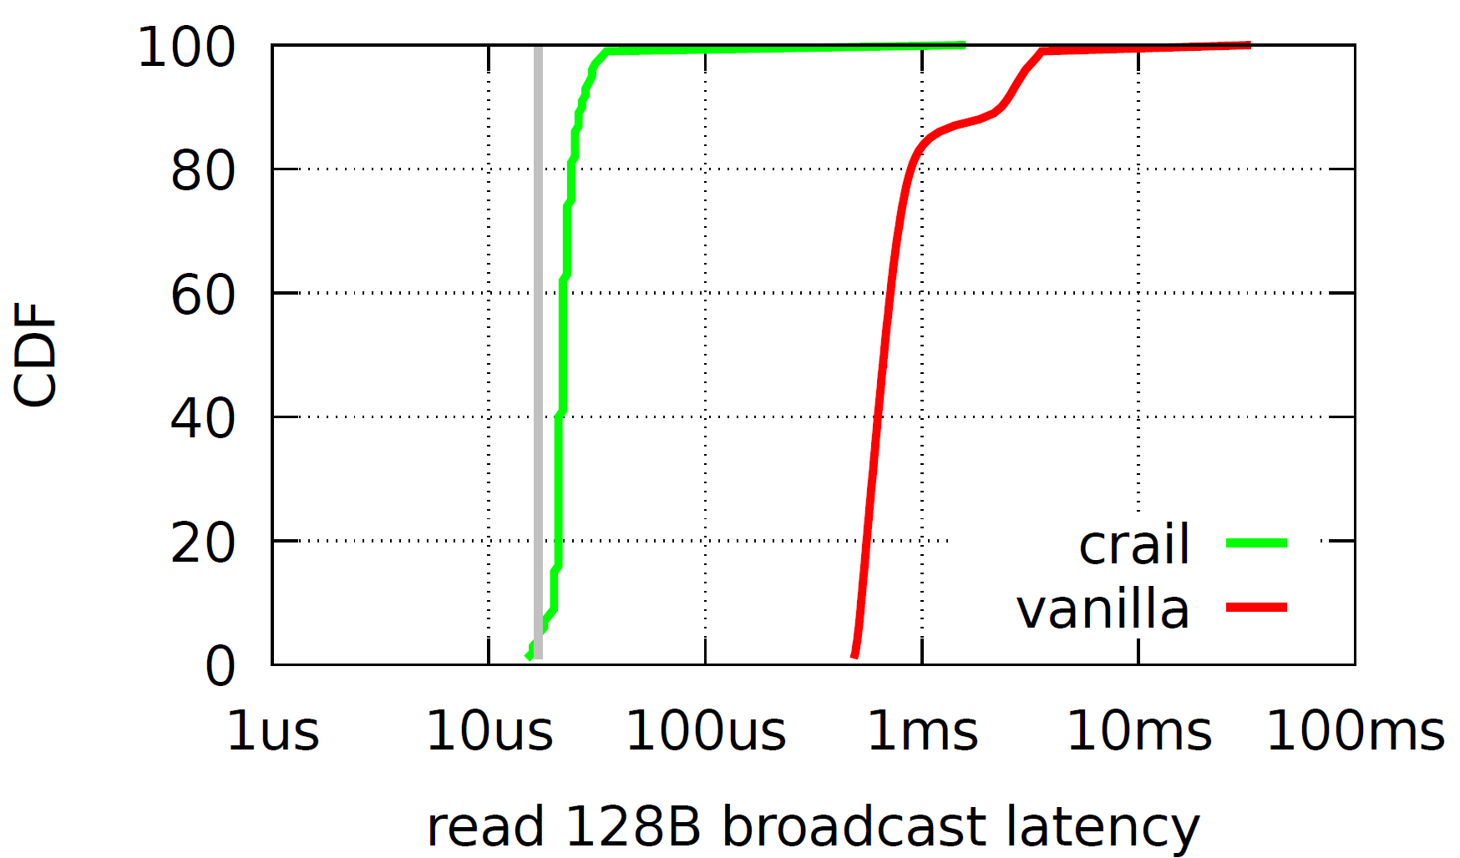
Spark Broadcast
2
Spark
Executor
Spark
driver
4
CDF
Broadcast reading
RPC+RDMA
Broadcast writing
RPC+2xRDMA+RPC
1
3
/spark/broadcast/broadcast_0
Crail Store
val bcVar = sc.Broadcast(new Array[Byte](128))
sc.parallelize(1 to tasks, tasks).map(_ => {
bcVar.value.length
}).count

Slide 22
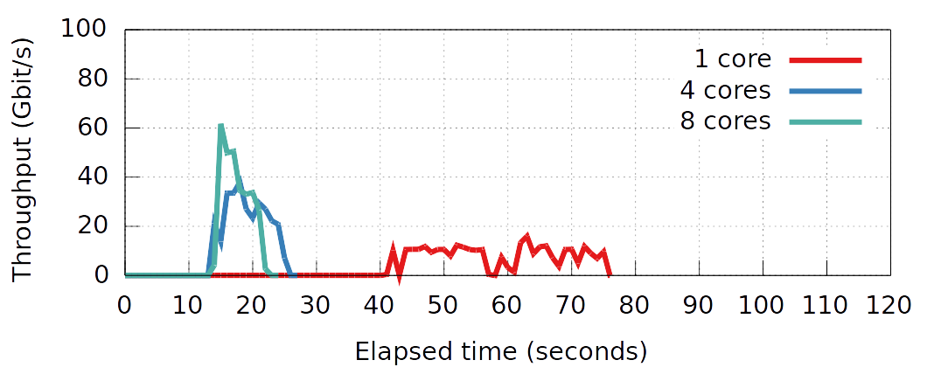
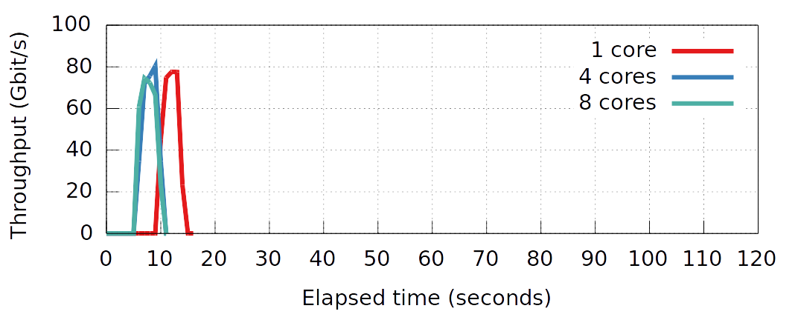
Spark GroupBy (80M keys, 4K)
Spark
Exec0
Spark
Exec1
Spark
ExecN
Spark/
Vanilla
map: Hash
Append (file)
hash
hash
hash
1
/shuffle/1/ f0 f1 fN
/shuffle/2/ f0 f1 fN
/shuffle/3 f0 f1 fN
Crail
Spark/
Crail
2x
2
2.5x
5x
reduce: fetch
Bucket (dir)
Spark
Exec0
Spark
Exec1
Spark
ExecN
val pairs = sc.parallelize(1 to tasks, tasks).flatmap(_ => {
var values = new array[(Long,Array[Byte])](numKeys)
values = initValues(values)
}).cache().groupByKey().count()

Slide 23
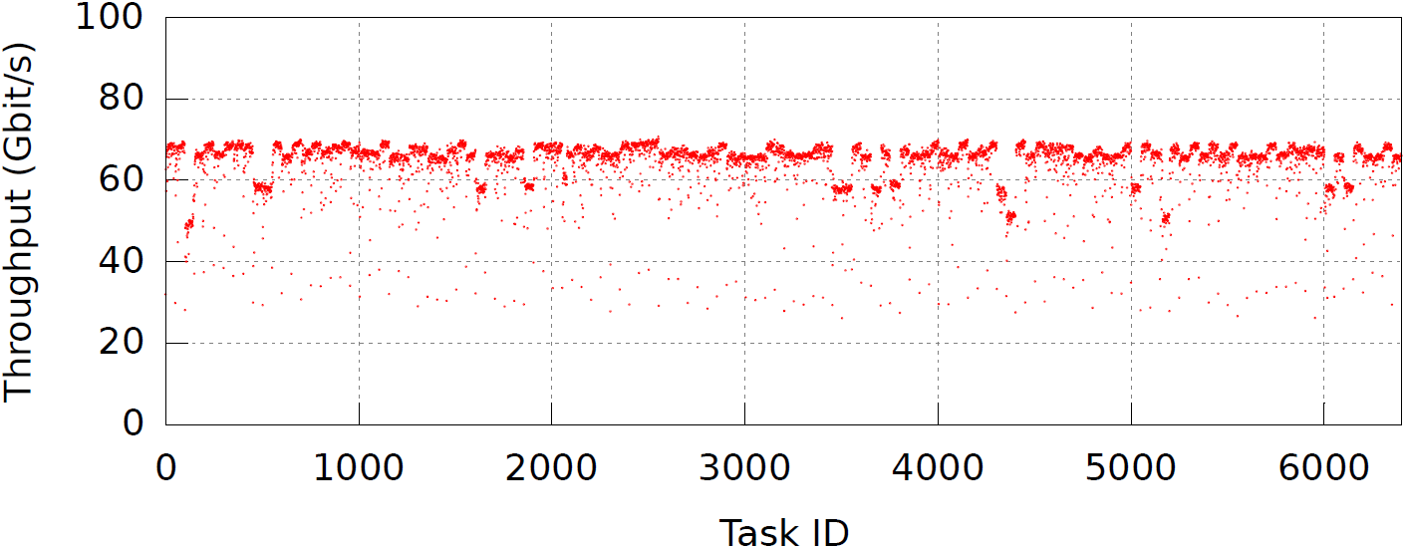
Sorting 12.8 TB on 128 nodes
Sorting Runtime
Spark/Crail Network Usage
6x
time(sec)
Throughput (Gbit/s)
Task ID

Slide 24
How fast is this?
Spark
Native C
distributed
sorting
benchmark
www.sortingbenchmark.org
 | Spark/Crail | Winner 2014 | Winner 2016
Size (TB) | 12.8 | 100 | 100
Time (sec) | 98 | 1406 | 134
Total cores | 2560 | 6592 | 10240
Network HW (Gbit/s) | 100 | 10 | 100
Rate/core (GB/min) | 3.13 | 0.66 | 4.4
Sorting rate of
Crail/Spark only 27%
slower than rate of
Winner 2016

Slide 25
Spark SQL Join
Spark
Exec0
Spark
Exec1
Spark
ExecN
1
read from
Hdfs/crail/alluxio
parquet
parquet
parquet
map: Hash
Append (file)
hash
hash
hash
2
/shuffle/1/ f0 f1 fN
/shuffle/2/ f0 f1 fN
/shuffle/3 f0 f1 fN
Crail Store
Time (sec)
deser
deser
deser
3
Sort
Merge join
sort
sort
sort
join
join
join
Spark/
Alluxio
Spark/
Crail
hdfs/crail/alluxio
write
write
write
4
val ds1 = sparkSession.read.parquet(“...”) //64GB dataset
val ds2 = sparkSession.read.parquet(“...”) //64GB dataset
val resultDS = ds1.joinWith(ds2, ds1(“key”) === ds2(“key”)) //~100GB
resultDS.write.format(“parquet”).mode(SaveMode.Overwrite).save(“...”)

Slide 26
Storage Tiering: DRAM & NVMe
sorting runtime
Spark
Spark
Exec0
Spark
Exec1
Spark
ExecN
Vanilla
Spark
(100%
in-memory)
Input/Output/
Shuffle/
Time (sec)
Network
Memory Tier
Flash
Tier
memory/flash ratio
With Crail, replacing memory with NVMe flash
for storing input/output/shuffle reduces the 200GB sorting runtime by only 48%

Slide 27
DRAM & Flash Disaggregation
Vanilla/Alluxio
sorting runtime
Input/Output/
Shuffle
Spark
Exec0
Spark
Exec1
Spark
ExecN
Time (sec)
Crail/
NVMe
Crail/
DRAM
storage
nodes
compute
nodes
Using Crail, a Spark 200GB sorting workload can be run with
memory and flash disaggregated at no extra cost

Slide 28
Conclusions
Effectively using high-performance I/O hardware in Spark is challenging
Crail is an attempt to re-think how data processing frameworks (not only Spark) should interact with network and storage hardware
  User-level I/O, storage disaggregation, memory/flash convergence
Spark's modular architecture allows Crail to be used seamlessly

Slide 29


Crail for Spark is Open Source
www.crail.io
github.com/zrlio/spark-io
github.com/zrlio/crail
github.com/zrlio/parquetgenerator
github.com/zrlio/crail-terasort

Slide 30
Thank You.
Contributors:
Animesh Trivedi, Jonas Pfefferle, Michael Kaufmann, Bernard Metzler, Radu Stoica, Ioannis Koltsidas, Nikolos Ioannou, Christoph Hagleitner, Peter Hofstee, Evangelos Eleftheriou, ...

