Slide 1
Serverless Machine Learning on Modern Hardware
IBM Research
#Res6SAIS

Slide 2
Serverless Computing
Increasingly popular execution model
  No need to setup/configure/manage a cluster
  Automatic, dynamic and fine-grained scaling of resources
  Sub-second billing
Many platforms and frameworks
  AWS Lambda, Google Cloud Functions, Azure Functions, OpenWhisk, PyWren, Databricks Serverless

Slide 3
Challenge: Performance
May have to dynamically spin up containers per function call
  Takes several 200-300 milliseconds for a “cold” container
Input data needs to be fetched from remote storage (e.g., S3 object store)
  As opposed to compute-local storage, e.g., HDFS
Intermediate needs to be temporarily stored on remote storage (e.g. S3, Redis)
  Becomes problematic as workloads get more complex
  Affects operations like shuffle, broadcast, etc.,

Slide 4
Example: MapReduce (Cluster)
Compute & Store Nodes
Map Stage
data is mostly
written and
read locally
Compute & Store Nodes
Reduce Stage
Compute & Store Nodes

Slide 5
Serverless MapReduce
data is
exclusively
written and
read remotely
Dynamically growing/shrinking
compute cloud
Map Stage
Shuffle
Reduce Stage
Storage Service (e.g, S3, Redis)

Slide 6
Sorting 100GB
Increasing flexibility
Increasing performance

Slide 7
Is I/O a problem?
Increasing flexibility
Increasing performance

Slide 8
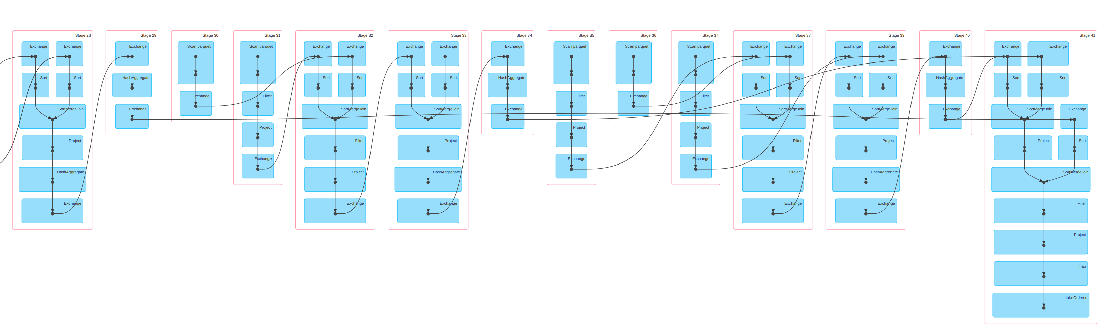
What about other workloads?
Example: SQL, Query 77 / TPC-DS benchmark

Slide 9
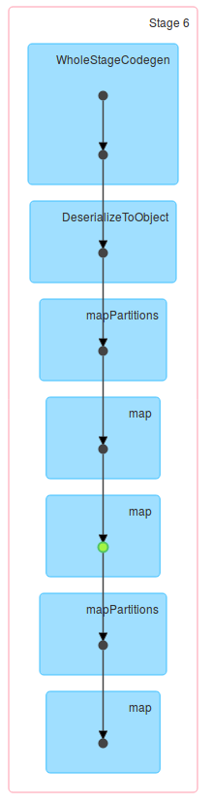
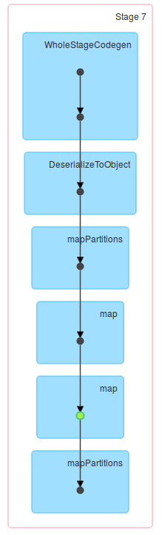
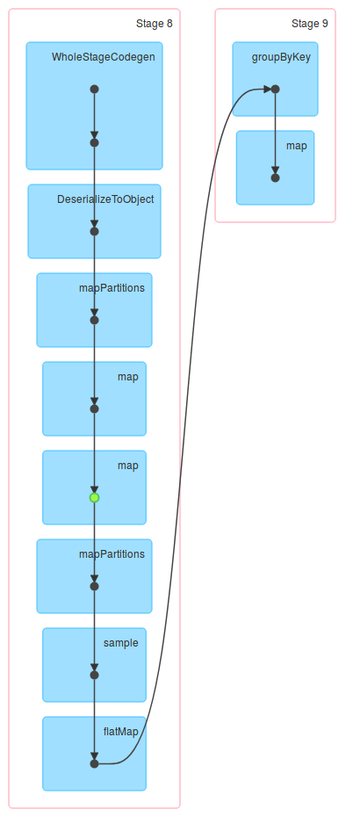
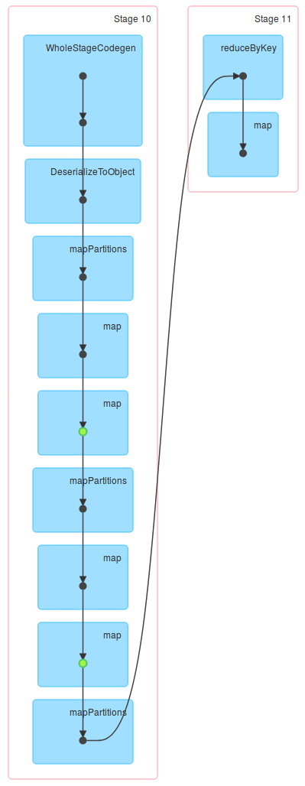
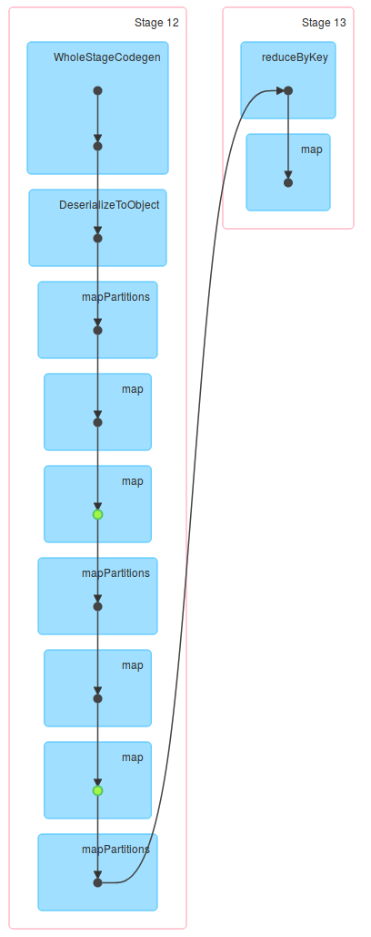
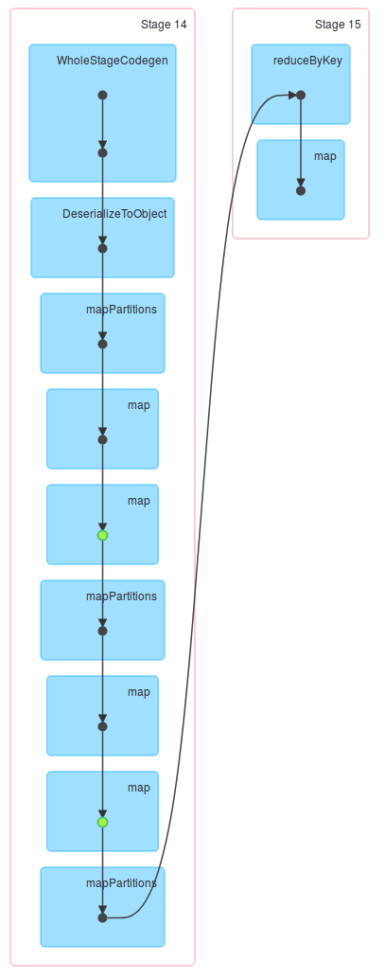

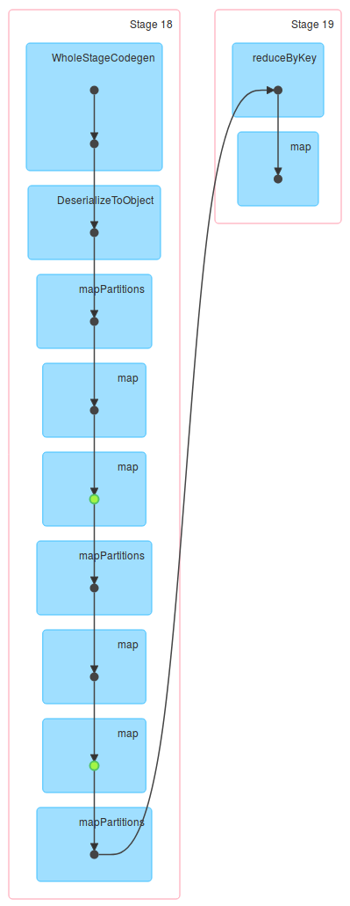
What about other workloads?
Example: RandomForest

Slide 10
Challenge #2: Workloads
Serverless originally designed for simple use cases
  E.g., image post-processing triggered by an upload
What about more complex workloads?
  MapReduce: Can be implemented on top of most frameworks
  SQL? Databricks
  Machine Learning?

Slide 11
Serverless: Different Workloads
Serverless frameworks not designed to run arbitrary workloads

Slide 12
Workloads and Frameworks
 | Microservices | Workflows | MapReduce | SQL | ML
AWS λ, Google CF, Azure F
AWS λ + AWS StepFunction
PyWren
Databricks Serverless
Serverless frameworks not designed to run arbitrary workloads

Slide 13
Backup

Slide 14
Template Tite
Template List
Template List
  Template item

Slide 15
Example: MapReduce
Map Stage
Reduce Stage
Server Machines

Slide 16
Sorting 100GB
Serverless execution is 3-4x slower than an optimized cluster configuration

Slide 17
Sorting 100GB
Increasing flexibility
Increasing performance
Serverless execution is 3-4x slower than an optimized cluster configuration

Slide 18
Sorting: Is I/O a problem?
Increasing flexibility
Increasing performance
With serverless, substantial amount of time is spent on reading from remote storage

Slide 19
Sorting: Is I/O a problem?
With serverless, substantial amount of time is spent on reading from remote storage

Slide 20
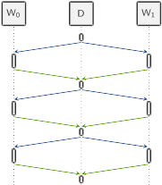
What about other workloads?
Example: CoCoa...

