Slide 1
Serverless Machine Learning on Modern Hardware
Patrick Stuedi, Michael Kaufmann, Adrian Schuepbach
IBM Research
#Res6SAIS

Slide 2
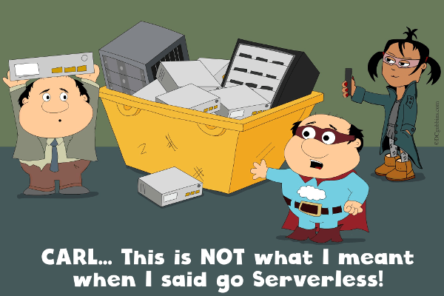
Serverless Computing
No need to setup/manage a cluster
Automatic, dynamic and fine-grained scaling
Sub-second billing
Many frameworks: AWS Lambda, Google Cloud Functions, Azure Functions, Databricks Serverless, etc.

Slide 3
Challenge: Performance
Example:
Sorting 100GB
Runtime [seconds]
AWS λ Databricks Databricks Spark Spark
Serverless Standard On-premise On-premise++
Increasing flexibility
Increasing performance
Spark/On-Premise++: Running Apache Spark on a High-Performance Cluster using RDMA and NVMe Flash, Spark Summit’17

Slide 4
Challenge: Performance
Example:
Sorting 100GB
64 lambda
workers
Runtime [seconds]
AWS λ Databricks Databricks Spark Spark
Serverless Standard On-premise On-premise++
Increasing flexibility
Increasing performance
Spark/On-Premise++: Running Apache Spark on a High-Performance Cluster using RDMA and NVMe Flash, Spark Summit’17

Slide 5
Challenge: Performance
Example:
Sorting 100GB
serverless cluster
with autoscaling
min machines: 1
max machines: 8
64 lambda
workers
Runtime [seconds]
AWS λ Databricks Databricks Spark Spark
Serverless Standard On-premise On-premise++
Increasing flexibility
Increasing performance
Spark/On-Premise++: Running Apache Spark on a High-Performance Cluster using RDMA and NVMe Flash, Spark Summit’17

Slide 6
Challenge: Performance
Example:
Sorting 100GB
serverless cluster
with autoscaling
min machines: 1
max machines: 8
64 lambda
workers
standard cluster
no autoscaling
8 machines
Runtime [seconds]
AWS λ Databricks Databricks Spark Spark
Serverless Standard On-premise On-premise++
Increasing flexibility
Increasing performance
Spark/On-Premise++: Running Apache Spark on a High-Performance Cluster using RDMA and NVMe Flash, Spark Summit’17

Slide 7
Challenge: Performance
Example:
Sorting 100GB
serverless cluster
with autoscaling
min machines: 1
max machines: 8
64 lambda
workers
standard cluster
no autoscaling
8 machines
Runtime [seconds]
100Gb/s
Ethernet
AWS λ Databricks Databricks Spark Spark
Serverless Standard On-premise On-premise++
Increasing flexibility
Increasing performance
Spark/On-Premise++: Running Apache Spark on a High-Performance Cluster using RDMA and NVMe Flash, Spark Summit’17

Slide 8
Challenge: Performance
Example:
Sorting 100GB
serverless cluster
with autoscaling
min machines: 1
max machines: 8
64 lambda
workers
standard cluster
no autoscaling
8 machines
Runtime [seconds]
100Gb/s
Ethernet
RDMA,
NVMe flash,
NVMeF
AWS λ Databricks Databricks Spark Spark
Serverless Standard On-premise On-premise++
Increasing flexibility
Increasing performance
Spark/On-Premise++: Running Apache Spark on a High-Performance Cluster using RDMA and NVMe Flash, Spark Summit’17

Slide 9
Why is it so hard?
Scheduler: when to best add/remove resources?
Container startup: may have to dynamically spin up containers
Storage: input data needs to be fetched from remote storage (e.g., S3)
  As opposed to compute-local storage such as HDFS
Data sharing: intermediate needs to be temporarily stored on remote storage (S3, Redis)
  Affects operations like shuffle, broadcast, etc.,

Slide 10
Why is it so hard?
Scheduler: when to best add/remove resources?
Container startup: may have to dynamically spin up containers
Storage: input data needs to be fetched from remote storage (e.g., S3)
  As opposed to compute-local storage such as HDFS
Data sharing: intermediate needs to be temporarily stored on remote storage (S3, Redis)
  Affects operations like shuffle, broadcast, etc.,

Slide 11
Example: MapReduce (Cluster)
Compute & Store Nodes
Map Stage
data is mostly
written and
read locally
Compute & Store Nodes
Reduce Stage
Compute & Store Nodes

Slide 12
Example: MapReduce (Serverless)
Dynamically growing/shrinking
compute cloud
data is
exclusively
written and
read remotely
Map Stage
Shuffle
Reduce Stage
Storage Service (e.g, S3, Redis)

Slide 13
I/O Overhead: Sorting 100GB
Runtime [seconds]
60%
32%
18%
49%
22%
38%
3%
AWS λ Databricks Databricks Spark Spark
Serverless Standard On-premise On-premise++
19%
59%
Spark Spark
On-premise On-premise++
Shuffle overheads are significantly higher when intermediate data is stored remotely

Slide 14
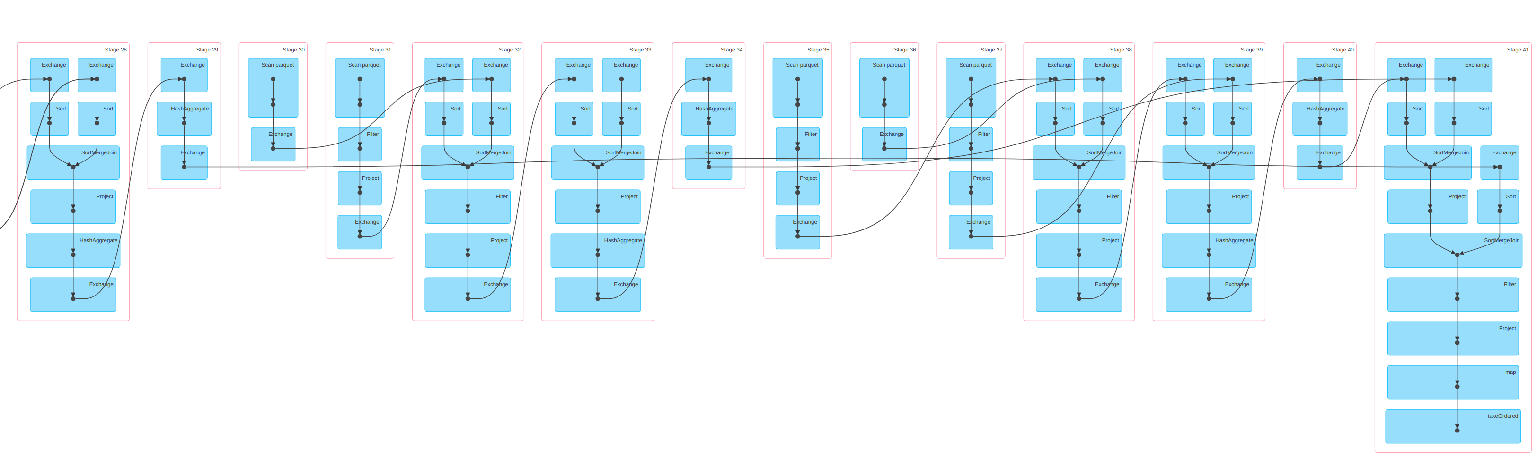
What about other workloads?
Example: SQL, Query 77 / TPC-DS benchmark

Slide 15
What about other workloads?
Example: SQL, Query 77 / TPC-DS benchmark
Shuffle/Broadcast
(needs to be stored remotely)

Slide 16
What about other workloads?
Example: Iterative ML (e.g., linear regression)
could be co-located
with worker nodes
W
W
PS
W
W
*) read training data
*) fetch model params
*) compute
*) update model
*) use cached data
*) fetch model params
*) compute
*) update model

Slide 17
What about other workloads?
Example: Iterative ML (e.g., linear regression)
could be co-located
with worker nodes
W
W
PS
W
W
*) read training data
*) fetch model params
*) compute
*) update model
*) use cached data
*) fetch model params
*) compute
*) update model

Slide 18
What about other workloads?
Example: Iterative ML (e.g., linear regression)
could be co-located
with worker nodes
Needs to be
remote
W
W
PS
W
W
W
scale
out
*) read training data
*) fetch model params
*) compute
*) update model
*) use cached data
*) fetch model params
*) compute
*) update model
read remote data

Slide 19
What about other workloads?
Example: Iterative ML (e.g., linear regression)
could be co-located
with worker nodes
Needs to be
remote
W
W
PS
W
W
W
scale
out
*) read training data
*) fetch model params
*) compute
*) update model
*) use cached data
*) fetch model params
*) compute
*) update model
read remote data
barrier, need to wait

Slide 20
Can we..
..use Spark to run such workloads in a serverless fashion?
  Dynamic scaling of compute nodes while jobs are running
  No cluster configuration
  No startup time overhead
..eliminate the performance overheads?
  Workloads should run as fast as on a dedicated cluster

Slide 21
Design Options
Scheduling:
  Use serverless framework to schedule executors
  Use serverless framework to schedule tasks
  Enable sharing of executors among different applications
Intermediate data:
  Executors cooperate with scheduler to flush data remotely
  Consequently store all intermediate state remotely
1
2
3
1
2

Slide 22
Design Options
High startup
Latency!
Scheduling:
  Use serverless framework to schedule executors
  Use serverless framework to schedule tasks
  Enable sharing of executors among different applications
Intermediate data:
  Executors cooperate with scheduler to flush data remotely
  Consequently store all intermediate state remotely
1
2
3
1
2

Slide 23
Design Options
High startup
Latency!
Scheduling:
  Use serverless framework to schedule executors
  Use serverless framework to schedule tasks
  Enable sharing of executors among different applications
Intermediate data:
  Executors cooperate with scheduler to flush data remotely
  Consequently store all intermediate state remotely
1
Slow!
2
3
1
2

Slide 24
Design Options
High startup
Latency!
Scheduling:
  Use serverless framework to schedule executors
  Use serverless framework to schedule tasks
  Enable sharing of executors among different applications
Intermediate data:
  Executors cooperate with scheduler to flush data remotely
  Consequently store all intermediate state remotely
1
Slow!
2
3
1
2

Slide 25
Design Options
High startup
Latency!
Scheduling:
  Use serverless framework to schedule executors
  Use serverless framework to schedule tasks
  Enable sharing of executors among different applications
Intermediate data:
  Executors cooperate with scheduler to flush data remotely
  Consequently store all intermediate state remotely
1
Slow!
2
3
Complex!
1
2

Slide 26
Design Options
High startup
Latency!
Scheduling:
  Use serverless framework to schedule executors
  Use serverless framework to schedule tasks
  Enable sharing of executors among different applications
Intermediate data:
  Executors cooperate with scheduler to flush data remotely
  Consequently store all intermediate state remotely
1
Slow!
2
3
Complex!
1
2

Slide 27

Architecture Overview
send schedule
Driver
register
HCS/
Scheduler
send job DAG
Intermediate data
launch
task
assign
application
register
register
Metadata
server
Storage
server
Executor
Intermediate
data
crail.apache.org

Slide 28
Architecture Overview
send schedule
Driver
register
HCS/
Scheduler
send job DAG
Intermediate data
launch
task
assign
application
register
register
Metadata
server
Storage
server
Executor
Intermediate
data
crail.apache.org

Slide 29
Architecture Overview
send schedule
Driver
register
HCS/
Scheduler
send job DAG
Intermediate data
launch
task
assign
application
register
register
Metadata
server
Storage
server
Executor
Intermediate
data
crail.apache.org

Slide 30
Architecture Overview
send schedule
Driver
register
HCS/
Scheduler
send job DAG
Intermediate data
launch
task
assign
application
Executors get
dynamically
re-assigned to
apps/drivers
register
register
Metadata
server
Storage
server
Executor
Intermediate
data
crail.apache.org

Slide 31
HCS Scheduler
Executor
Driver
REST API
REST API
request resource
Resource
Manager
Scheduler
assign resource
“Oracle”

Slide 32
HCS Scheduler
computes task
schedule
Executor
Driver
REST API
REST API
request resource
Resource
Manager
Scheduler
assign resource
“Oracle”

Slide 33
HCS Scheduler
computes task
schedule
Executor
Driver
REST API
REST API
request resource
Resource
Manager
Scheduler
assign resource
Uses ML to
predict task
runtimes
based on
previous runs
“Oracle”

Slide 34
HCS Scheduler
computes task
schedule
Executor
Driver
REST API
REST API
request resource
Resource
Manager
Scheduler
assign resource
Uses ML to
predict task
runtimes
based on
previous runs
determines
resource set
(executors)
for a given
schedule
“Oracle”

Slide 35
HCS Scheduler
“The HCl Scheduler:
Going all-in on Heterogeneity”,
Michael Kaufmann et al., HotCloud’17
computes task
schedule
Executor
Driver
REST API
REST API
request resource
Resource
Manager
Scheduler
assign resource
Uses ML to
predict task
runtimes
based on
previous runs
determines
resource set
(executors)
for a given
schedule
“Oracle”

Slide 36
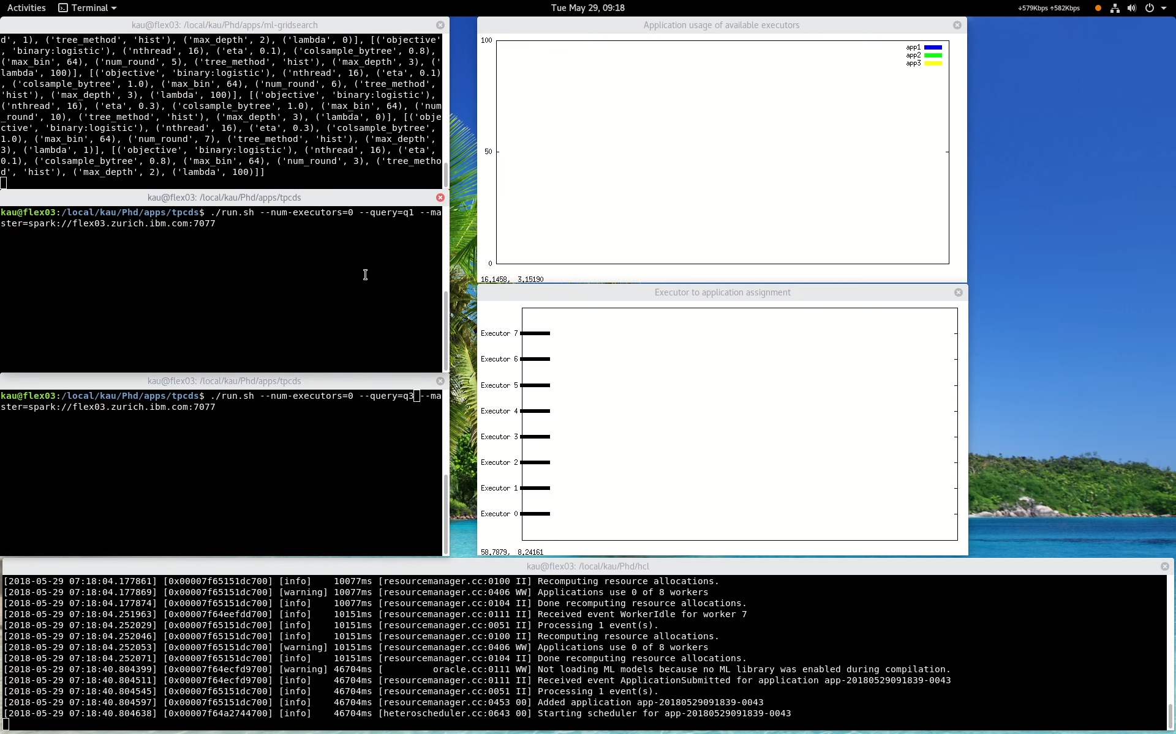
Video: Putting things together
Application 1:
GridSearch
Resource view:
fraction of resources
each app consumes
Application 2:
SQL TPC-DS
Executor view:
Which app an executor
currently runs
Application 3:
SQL TPC-DS
HCL
Scheduler

Slide 37
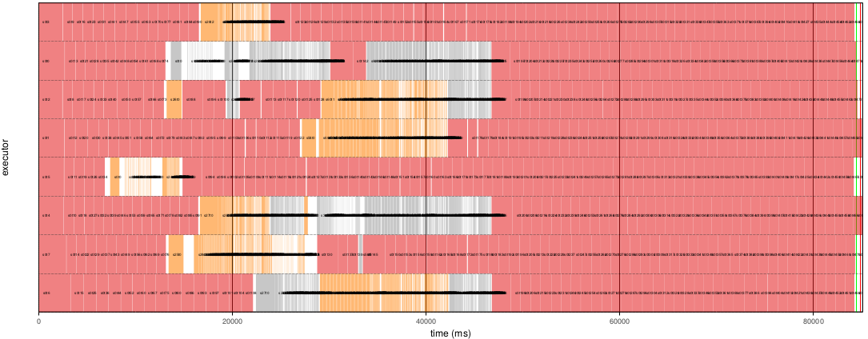
Scheduling Snapshot
Grid Search
SQL
Executors
Time

Slide 38
Let’s look at performance...
Compute cluster size: 8 nodes: IBM Power8 Minsky
Storage cluster size: 8 nodes, IBM Power8 Minsky
Cluster hardware:
  DRAM: 512 GB
  Storage: 4x 1.2 TB NVMe SSD
  Network: 10Gb/s Ethernert, 100Gb/s RoCE
  GPU: NVIDIA P100, NVLink
Workloads
  ML: Logistic Regression using the CoCoa framework
  SQL: TCP-DS

Slide 39
ML: Logistic Regression
KDDA data set
6.5 GB
Runtime [seconds]
Vanilla
Cluster,100Gb/s
Vanilla
Serverless
HCS/Crail
TCP,100Gb/s
HCS/Crail
RDMA,100Gb/s
Using HCS/Crail we can store intermediate data remotely and reduce the runtime for ML

Slide 40
TPC-DS: Query #87
Runtime [seconds]
Vanilla
Cluster
HCS/Crail
TCP,10Gb/s
HCS/Crail
TCP,100Gb/s
HCS/Crail
RDMA,100Gb/s
We need a fast network and an optimized software stack to eliminate storage overheads

Slide 41
TPC-DS: Query #3
Runtime [seconds]
Executing short running queries on a warm serverless cluster improves performance

Slide 42
Conclusion
Efficient serverless computing is challenging
  Local state (e.g. shuffle, cached input, network state) is lost as compute cloud scales up/down
This talk: turning Spark into a serverless framework by
  Implementing HCS, a new serverless scheduler
  Consequently storing compute state remotely using Apache Crail
Supports arbitrary Spark workloads with almost no performance overhead
  MapReduce, SQL, Iterative Machine Learning
Implicit support for fast network and storage hardware
  e.g, RDMA, NVMe, NVMf

Slide 43
Future Work
Containerize the platform
Add support for dynamic re-partitioning on scale events
Add support for automatic caching
Add more sophisticated scheduling policies

Slide 44



Links
Running Apache Spark on a High-Performance Cluster Using RDMA and NVMe Flash, Spark Summit’17, https://tinyurl.com/yd453uzq
Apache Crail, http://crail.apache.org
HCS Scheduler, github.com/zrlio/hcs
Spark-HCS, github.com/zrlio/spark-hcs
Spark-IO, github.com/zrlio/spark-io

Slide 45
Thanks to
Michael Kaufmann, Adrian Schuepbach, Jonas Pfefferle, Animesh Trivedi, Bernard Metzler, Ana Klimovic, Yawen Wang

