Slide 1
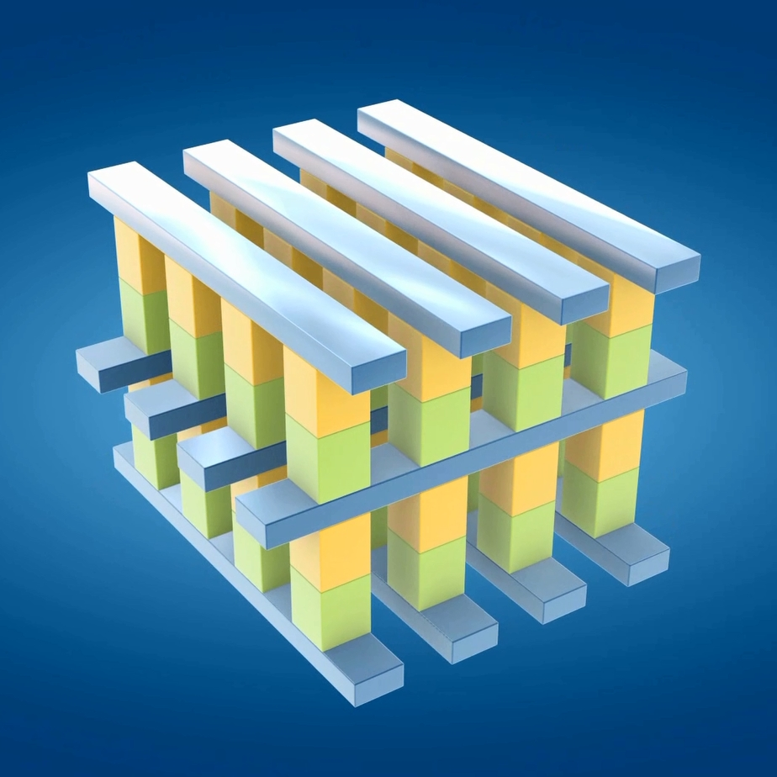
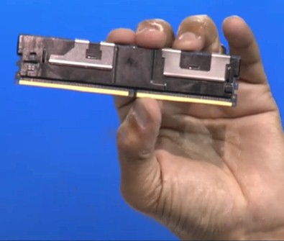
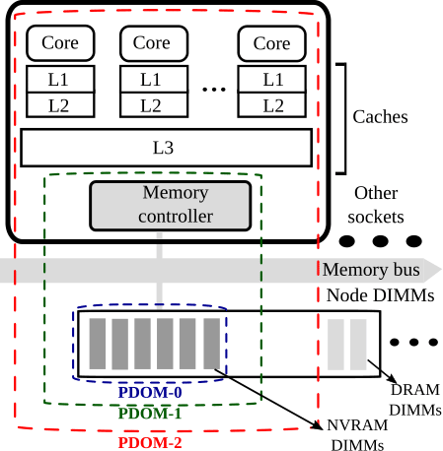
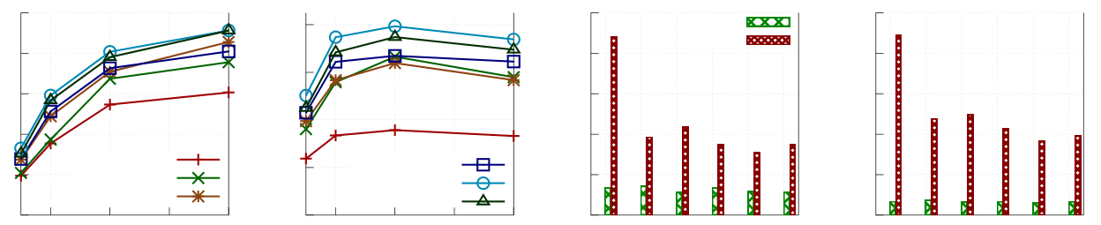
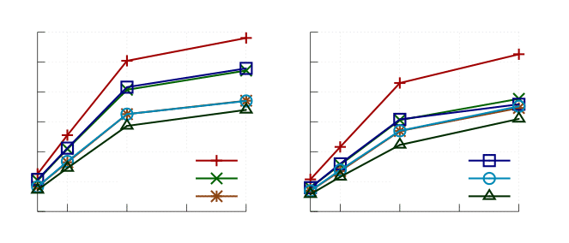
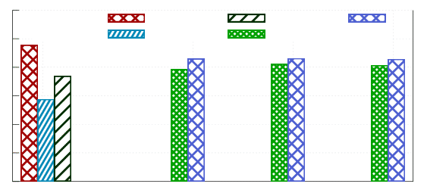
Persistent Memory Transactions
Virendra J. Marathe, Achin Mishra, Amee Trivedi, Yihe Huang, Faisal Zaghloul, Sanidhya Kashyap,
Margo Seltzer, Tim Harris, Steve Byan, Bill Bridge¹, and Dave Dice
Oracle Labs ¹Oracle
Persistent Memory: What is it?
Looks like DRAM
Byte-addressable
DIMMs across memory bus
Cacheable
Low latency: 1000X lower than NAND flash (3D XPoint); projected to eventually eclipse DRAM performance (e.g. STT-MRAM, Carbon-NanoTubes, etc.)
Acts like Storage: State persists across restarts
Dense: projections better than DRAM (~10X, 3D XPoint)
Cost expected to be between DRAM and NAND flash
Persistent Memory Access Primitives
Load/Store instructions (identical to load/store instructions for DRAM)
Persisting stores
clflush: Legacy cache line flush
clflush-opt: New lightweight instruction to do the flushing more asynchronously
clwb: Cache-line writeback; retains does not evict cache line
sfence/mfence/etc.: Instruction with fence semantics will guarantee all prior writebacks and flushes have taken effect
ntstore: Non-temporal store to memory controller buffers
pcommit: Deprecated instruction for stronger persistence
Writing programs that can recover from failures is hard; we need a better programming model: Transactions to the rescue!!
Transactions for Persistent Memory
Several runtime systems proposed
Mnemosyne, NV-Heaps, NVM-Direct,
NVML’s libpmemobj, SoftWRaP,etc.
Implementations siding with either redo logging
or undo logging for transactional writes
Arguments largely based on intuition, or
inadequate evaluation
No comprehensive evaluation of performance
trade offs over wide swath of parameters
Workload’s access patterns
Persistence barrier latencies
Cache locality of the runtimes
Transaction runtime bookkeeping overheads
Our work does this broad performance analysis
Persistence Domains: What does it take to persist updates?
Lesson I: Mods can be contagious
Persistent Memory Transactions: API and Runtimes
Persistence Domain: Portion of the memory
hierarchy that is effectively persistent
DIMM-only (PDOM-0)
DIMM + memory controller
buffers (PDOM-1)
Entire memory hierarchy (PDOM-2)
Transactional API macros:
TXN_BEGIN, TXN_COMMIT, TXN_READ,
TXN_WRITE, and other accessors
Transactional Writes and Persist Barriers
Transaction T
Undo log
Redo log
Copy-on-write
Write A
old A
new A
ptr(A)
Transactional Writes: Trade Offs
old B
new B
ptr(B)
Txn Writes | Pros | Cons
Undolog | Reads are uninstrumented loads | Too many persist barriers
Redolog | Constant (4) pbarriers | Need to instrument reads Redolog lookups for read-after-write scenarios
Copy-On-Write (COW) | Constant (4) pbarriers Fixed lookup overhead for read-after-write scenarios | Increased memory management overhead or memory footprint Adverse effects on cache locality
Write B
A
Operations | Persistence Domains
 | PDOM-0 | PDOM-1 | PDOM-2
Write | store clwb/clflushopt | store clwb/clflushopt | Store
Ordering Persists | sfence pcommit sfence | sfence | nop
pbarrier
async
writeback,
flush
Old
New
N writes
4 pbarriers
for Commit
4 pbarriers
for Commit
Commit
O(N) pbarriers
+
4 pbarriers
for Commit
(a)
(b)
(c)
Evaluation
Intel Software Emulation Platform
Emulated broad range of load and persist barrier latencies (0—1000 nsecs)
Reporting 300 nsec load latency and 500 (PDOM-0), 100 (PDOM-1), and 0 (PDOM-2) nsec persist barrier latencies to approximate the 3 persistence domains
Microbenchmarking
Simple 2-D array of 64-bit integers read/updated using transaction
Test runs configured to cover broad range of access granularities, read/write mixes, and transaction lengths
Array: Transaction either reads or increments all integers in a slot, via a single coarse grain read-increment-update per slot.
Each transaction touches 20 slots. Array-RAW increments each individual integer in a slot, thereby increasing read-after-write instances.
Persistent Memcached
Comprehensive re-write of Memcached for “instant warmup”
COW has significant programmability challenges
Concurrent updates to a single object not supported
COW requires its own allocator; Memcached has its own
Decided not to port Memcached to COW’s interface
Transactions are complex
Get performs 25 reads and 5 writes
Put performs 80-90 reads and 24 writes (most writes are
read-after-write instances)
Fits with the Array-RAW benchmark with 25-30% read-after-writes
Performance behavior is similar to Array-RAW
Undo logging scales worse than redo logging for 50% reads
for longer persist barrier latencies (PDOM-0 and PDOM-1)
The bar charts explain: Put transactions take longer, which
exacerbates contention on Memcached’s locks
250k
200k
150k
100k
50k
0k
(a) Throughput – 90% reads (b) Throughput – 50% reads (c) Get/Put Latency – 90% reads (d) Get/Put Latency – 50% reads
80k
60k
40k
20k
0k
250
200
150
100
50
0
Get
Put
500
400
300
200
100
0
Operations/sec
Undo/PDOM-0
Redo/PDOM-0
Undo/PDOM-1
Undo/PDOM-2
Redo/PDOM-2
Undo/PDOM-2
Transactions latency (usecs)
2 4 6 8
#cores
2 4 6 8
#cores
Undo/P0
Redo/P0
Undo/P1
Redo/P1
Undo/P2
Redo/P2
Undo/P0
Redo/P0
Undo/P1
Redo/P1
Undo/P2
Redo/P2
Persistent Key-Value Store
Contains central growable persistent hash table
Used transactions for consistent updates
Base version, required for COW, instruments all accesses to
persistent objects
Optimized version avoids some transactional instrumentation
Transactions are short; no significant difference between undo
and redo logging
COW performs worst because of extra level of indirection and greater
memory churn
SQLite
A lightweight database; supports ACID
transactions, uses rollback/write-ahead
log in the Commit() function
Our version: Minor mod to Commit() to
directly write dirty pages to database file
(using our transactions)
This is a write-only transaction; big
write set with coarse writes
In-memory is best case performance;
transactions help come close to 10-15%
Undo log incurs checksum overheads
Conclusions
No single transaction runtime is a clear winner
A complex interplay between multiple factors
Workload read/write access patterns
Persistence Domains
Cache Locality
Transaction runtime bookkeeping overheads
COW appears to be a non-starter, but choice between undo and redo
logging based runtimes is non-trivial
Recent work (Dude-TM, Kamino-Tx) has pushed the performance
envelope further by leveraging DRAM as a cache
Would be interesting to add those works in the mix here
(a) Throughput – 90% reads
(b) Throughput – 50% reads
In-memory
Rollback
WAL
Undo
Redo
1000K
800K
600K
400K
200K
0K
1000K
800K
600K
400K
200K
0K
Operations / sec
DRAM
Redo-opt
Redo
Undo-opt
Undo
COW
Stock PDOM-0 PDOM-1 PDOM-2

