Slide 1
On Main-memory Multicore Transaction Performance
Yihe Huang, Harvard University
Student Research Competition at SOSP’19

Slide 2
Background
Concurrency Control (CC) mechanisms enable ACID transactions and are subjects of active research.
Many main-memory database uses Optimistic Concurrency Control (OCC) due to its low overhead in uncontended workloads.

Slide 3
Background
Most main-memory CC research centers on addressing OCC’s performance issue at high contention.
  Conventional wisdom suggests that OCC collapses at high contention.

Slide 4
Our Findings
In the well-understood TPC-C benchmark, OCC’s perceived performance collapse can be explained by implementation factors unrelated to CC.
With good implementation choices, OCC does not suffer from any collapse and performs reasonably well.

Slide 5
Major CC Paradigms: Optimistic
Timestamp-based concurrency control
Start
Observe
timestamp
Read
Validate
timestamps
& commit

Slide 6
Major CC Paradigms: Pessimistic
Lock-based concurrency control
Start
Lock
Read/
Write
Unlock
& commit

Slide 7
Major CC Paradigms: MVCC
Updates preserve
old versions
Multi-versioning
Start
Obtain read
timestamp
Read
Read
Commit
Read @
timestamp
Garbage collect
Unreachable
old versions

Slide 8
Modern Day CC Research
Focus on OCC’s performance issue at high contention
  Since OCC is clearly the king for low contention
Presented solution is usually a rehash of OCC, Locking, and MVCC techniques
But is the collapse real?

Slide 9
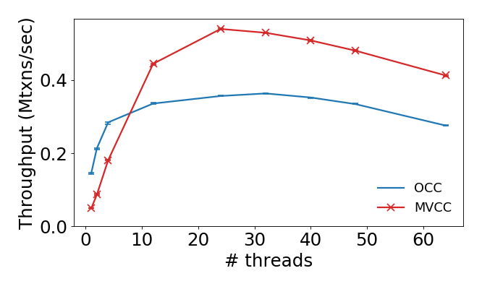
Our Observation
TPC-C high contention (1 warehouse)
No collapse!

Slide 10
Reasons for (Previously) Perceived Collapse
Contention in index phantom protection
Secondary implementation factors such as the memory allocator, contention regulation, etc.

Slide 11
TPC-C Index Contention
Index B-tree leaf node
(new order table)
Node timestamp for optimistic phantom protection
wid=1
did=0
oid=999
wid=1
did=1
Oid=1
Insertion/removal of orders in different districts can trigger phantom protection conflicts!

Slide 12
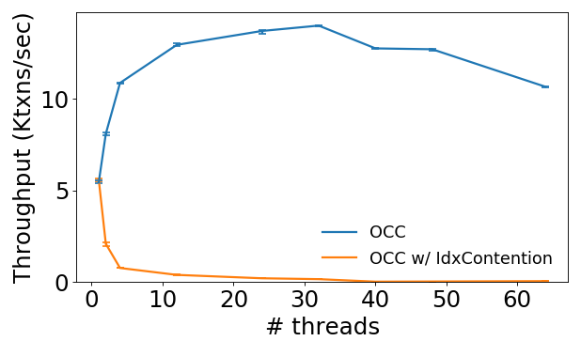
TPC-C Index Contention
It matters a lot!
Delivery transaction throughput, TPC-C high contention
Looks like
collapse

Slide 13
More Implementation Factors
Allocator
  libc default vs. rpmalloc
Abort mechanism
  C++ exceptions vs. additional return values
Contention regulation
  None vs. randomized exponential backoff
Index type choice
  B-trees for all indexes vs. hash tables for non-range indexes

Slide 14
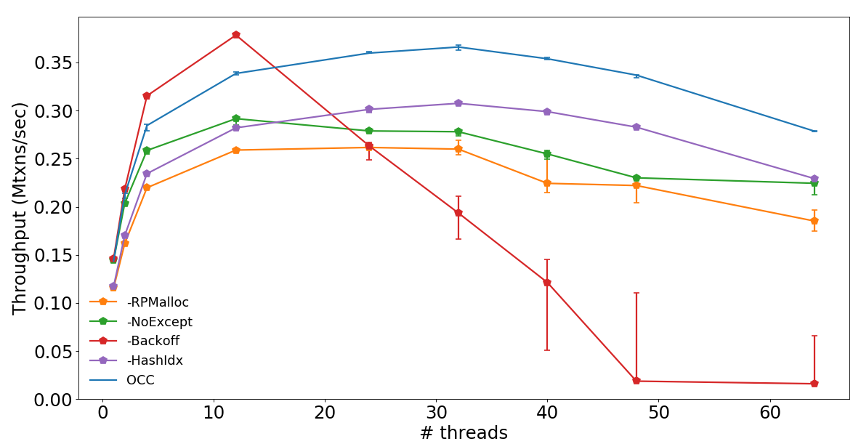
Impact of Implementation Factors

Slide 15
Lessons Learned
Many factors unrelated to CC can greatly shape performance.
If not done carefully, comparison experiments can lead to misleading results, mistaking effects of secondary factors as fundamental limitations of CC algorithms.

