Slide 1
Github Copilot Workshop

Slide 2
Github Copilot Workshop
Your end-to-end guide to installation, features, chat, customization, enterprise networking, and hands-on labs
Notes:
- Welcome everyone to the GitHub Copilot Workshop - This deck condenses the README into presentation-ready slides - We’ll cover setup, features, enterprise considerations, customizations, and hands-on labs

Slide 3
Agenda
Module 1: Overview and Key Concepts
Module 2: Installation and Configuration
Module 3: Networking, Security, and Data Flow
Module 4: Customization and Fine-Tuning
Module 5: Core Coding Features
Module 6: Copilot Chat
Module 7: Advanced Features and Agent Mode
Module 8: Copilot Spaces
Module 9: Use Cases
Module 10: Hands-On Exercises

Slide 4
Module 1: Overview and Key Concepts
AI coding assistant across IDEs, GitHub.com, CLI, Desktop, Mobile
Conversational coding, commit assistance, real-time web search
Editor Preview: multi-file edits, next-step suggestions
Copilot Extensions integrate third-party tools via Marketplace
Coding Agent (Preview) automates issues and PRs, powered by MCP
Notes:
- Describe model families and where Copilot runs - Note the emerging capabilities in Editor Preview

Slide 5
Module 1 - Key Features
Get code suggestions as you type
Make large-scale changes across multiple files
Ask questions about coding issues
Refactor and improve your code structure
Fix bugs and debug your code
Set up foundational code for new projects or files
Configure and generate tests
Generate documentation for your code

Slide 6
Module 1 - Scenarios
Regular expressions; boundary condition validation
Hard-to-remember keywords, e.g., HTML/CSS
Algorithms or unfamiliar languages
Complete object fields by common sense
Understand complex code; generate documentation
Generate unit tests
Summarize PR changes; Agent mode edits

Slide 7
Module 1 - Supported Models
OpenAI: o3, o3-mini, o4-mini (Preview), GPT-5 (Preview)
Anthropic Claude: Sonnet 3.5/3.7/4, Opus 4
Google Gemini: 2.0 Flash, 2.5 Pro (Preview)

Slide 8
Module 2: Installation and Configuration
Install GitHub Copilot extension in your IDE
Sign in to GitHub and enable Copilot features
Verify network connectivity or configure proxy if required
Optional: Install mitmproxy for traffic inspection lab
Link: GitHub Copilot Features settings page

Slide 9
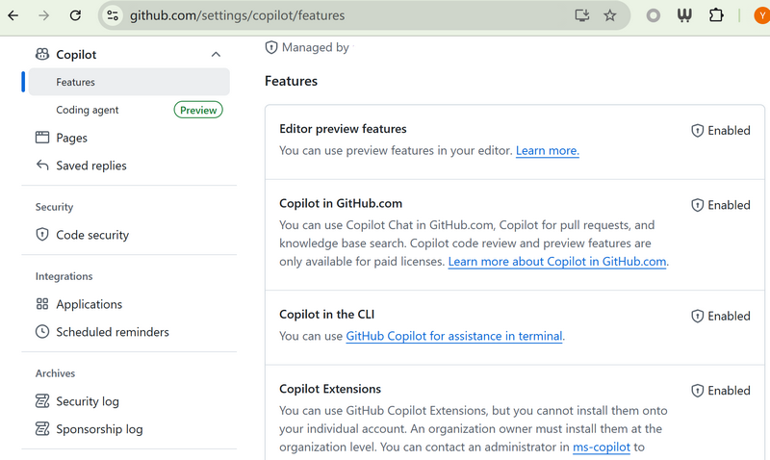
Github Copilot Policy

Slide 10
Module 2 - IDE Settings
Install extension(s) and recommended plugins
Review and adjust key settings as needed
VS Code: open user settings JSON for advanced config
Example: enterprise authProvider; commit message instructions

Slide 11
Code: Module 2 - IDE Settings
{ "github.copilot.advanced": { "authProvider": "github-enterprise" }, "github.copilot.chat.commitMessageGeneration.instructions": [ { "text": "Follow the conventional commits format strictly ..." } ] }

Slide 12
Module 3: Networking, Security, and Data Flow
Understand enterprise network paths and controls
Proxy and firewall issues can block Copilot
WebSockets, TLS inspection, certificate pinning conflicts
Rate limiting, VPN constraints, zero trust policies
Reference allowlist and network settings docs

Slide 13
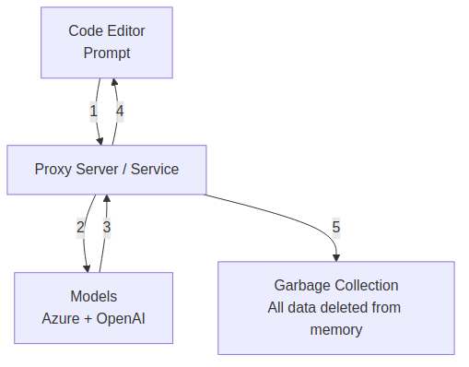
Diagram: Module 3: Networking, Security, and Data Flow

Slide 14
Module 3 - Common Network Issues
Blocked domains and misconfigured proxy variables
TLS/SSL inspection breaks encrypted traffic integrity
WebSocket limitations; dropped persistent connections
PAC file misrouting; IDS/IPS false positives
Firewall ACLs or VPN routing issues

Slide 15
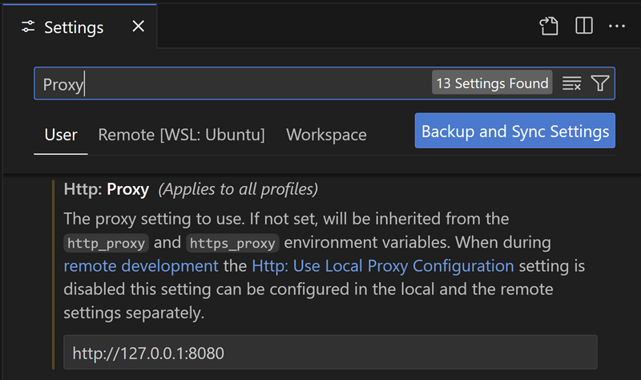
VSCode Http Proxy

Slide 16
Module 3 - Inspecting Traffic (Linux)
Use mitmproxy to inspect Copilot traffic
Configure IDE proxy to localhost:8080
Install mitmproxy CA certificate into system trust
Sample trace available in repository

Slide 17
Code: Module 3 - Inspecting Traffic (Linux)
mitmdump --listen-host 0.0.0.0 --listen-port 8080 --mode regular --flow-detail 4 openssl x509 -in ~/.mitmproxy/mitmproxy-ca-cert.pem -inform PEM -out ~/.mitmproxy/mitmproxy-ca-cert.crt sudo mkdir /usr/share/ca-certificates/extra sudo cp ~/.mitmproxy/mitmproxy-ca-cert.crt /usr/share/ca-certificates/extra/mitmproxy-ca-cert.crt sudo dpkg-reconfigure ca-certificates sudo update-ca-certificates

Slide 18
Module 4: Customization and Fine-Tuning
Default deployment vs lightweight custom instructions
Deep customization with custom models (note deprecation)
Knowledge Base for enterprise-grounded answers
Community-contributed instructions and prompts

Slide 19
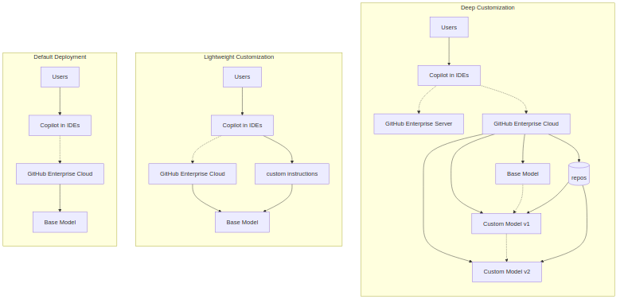
Diagram: Module 4: Customization and Fine-Tuning

Slide 20
Module 5: Core Coding Features
Comment-to-function generation (Python example)
Pattern completion in constructors and boilerplate
Next Edit Suggestions (NES) to chain edits
Refactor, modify, review with inline experiences

Slide 21
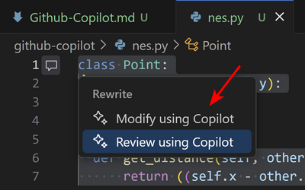
Github-Copilot-Refactor

Slide 22
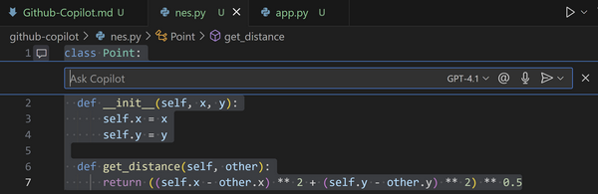
Github-Copilot-Code-Modify

Slide 23
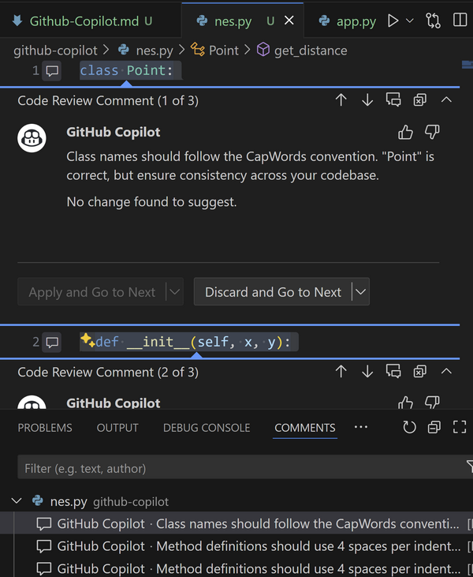
Github-Copilot-Code-Review

Slide 24
Module 6: Copilot Chat
Shortcuts for Chat View, Quick Chat, Inline Chat
Real-time collaboration on current file/selection
Prompt examples for explain, fix, tests, docs
Use @ participants and # variables for context
Built-in slash commands for frequent tasks

Slide 25
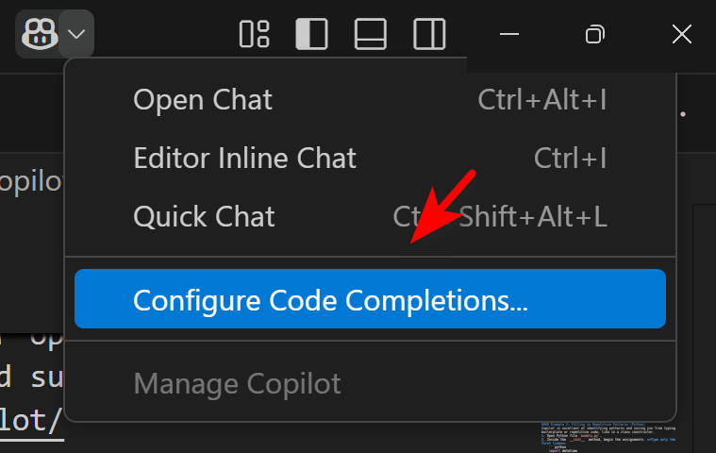
Github Copilot Configuration

Slide 26
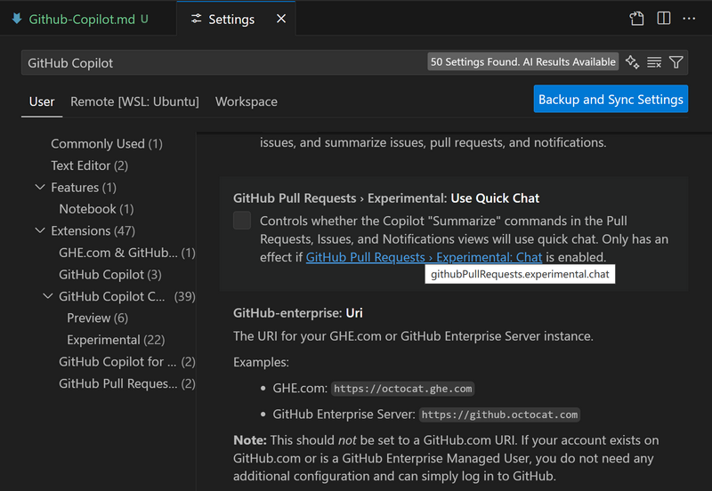
Github Copilot Settings

Slide 27
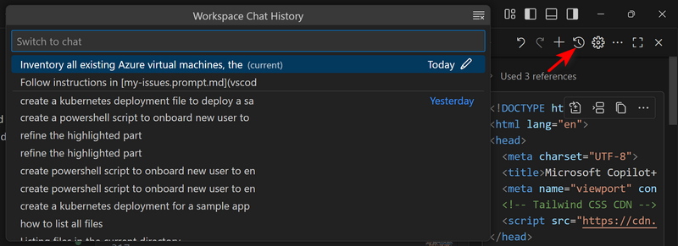
Github-Copilot-Chat-History

Slide 28
Module 7: Advanced + Agent Mode
Extensions add domain-specific tools into Chat
Copilot Edit: up to 10 files, rate limited
Agent mode: multi-step, less deterministic, preview
MCP servers supercharge agentic operations
Custom instructions and org-level governance

Slide 29
Module 8: Copilot Spaces
Organize context for teams; share curated spaces
Onboarding, system knowledge, style guides
System instructions to ground responses
Example space for code generation

Slide 30
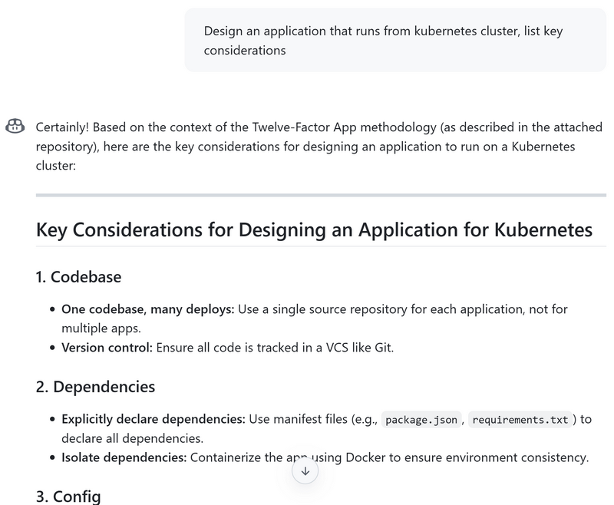
Github-Spaces

Slide 31
Use Cases Overview
Network Operations Planning
Architecture Design to Azure Terraform Script
Work with Azure MCP
Work with M365 Graph API
PowerShell Script Generation
Context7 Integration for Up-to-date Code
Use Coding Agent for Azure Terraform
Create Enterprise Support Portal with Spark
Migrate AWS Lambda to Azure Functions
Modernize Java Applications with Copilot
Spec-Driven Development with Copilot
Design to Code (Figma MCP)

Slide 32
Network Operations Planning
Goal: optimize Azure network resources and cost
Context: custom chat mode for network planning
Key asset: Network Planning image reference

Slide 33
Code: Network Operations Planning
Could you please review my existing Azure network resources and share recommendations to improve optimization and cost-efficiency in the overall network architecture?

Slide 34
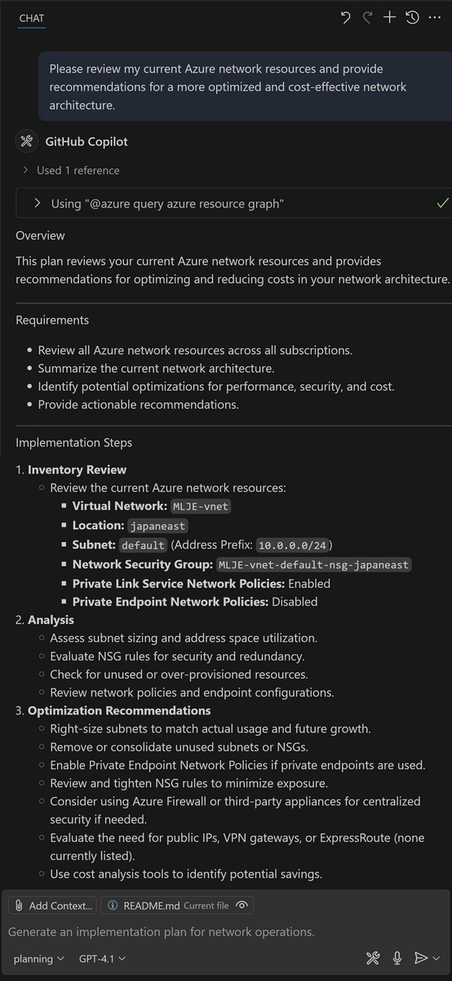
Github Copilot Network Planning

Slide 35
Architecture Design to Terraform
Goal: generate Terraform from architecture diagram
Context: use custom chat mode
Asset: Azure-Arch.png referenced

Slide 36
Code: Architecture Design to Terraform
Based on the architecture outlined in Azure-Arch.png, please generate a Terraform deployment script that provisions the corresponding resources.

Slide 37
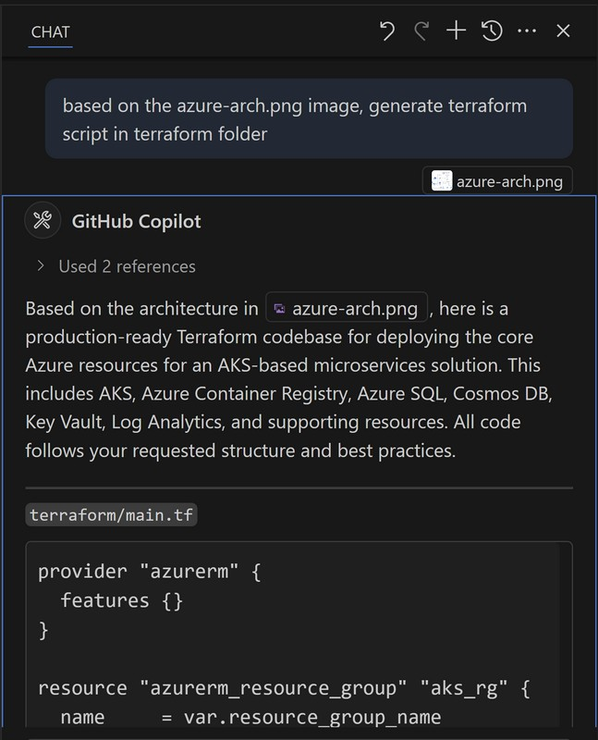
Github Copilot Terraform

Slide 38
Work with Azure MCP
Goal: visualize deployed resources
Start azure-mcp server from mcp.json

Slide 39
Code: Work with Azure MCP
Please generate a Mermaid diagram that provides an overview of all my currently deployed resources.

Slide 40
Work with M365 Graph API
Goal: list calendar meetings
Start microsoft-graph MCP server

Slide 41
Code: Work with M365 Graph API
Please list out my meetings for tomorrow

Slide 42
PowerShell Script Generation
Goal: onboard new users from CSV (enterprise demo)
Steps: create AD user, license, add to Teams group
Include robust error handling and logging

Slide 43
Code: PowerShell Script Generation
PowerShell script to onboard new users from a CSV file named 'new_hires.csv'. The script must perform the following actions for each user: 1. Import the CSV (FirstName, LastName, Department, Title). 2. Generate a secure, random initial password. 3. Create an AD user in OU matching Department. 4. Construct UPN 'firstname.lastname@yourcompany.com'. 5. Assign a Microsoft 365 E5 license to the new user. 6. Add the user to the 'All-Staff' Microsoft Teams group. 7. Include robust error handling with try/catch blocks. 8. Log all actions to a transcript file.

Slide 44
Context7 Integration
Goal: real-time code suggestions/updates
Context: keep codebase aligned with best practices

Slide 45
Code: Context7 Integration
Create a Next.js middleware that checks for a valid JWT in cookies and redirects unauthenticated users to `/login`. use context7

Slide 46
Coding Agent for Azure Terraform
Goal: scripts and GitHub workflows from diagram
Use Mermaid diagram to drive resource provisioning

Slide 47
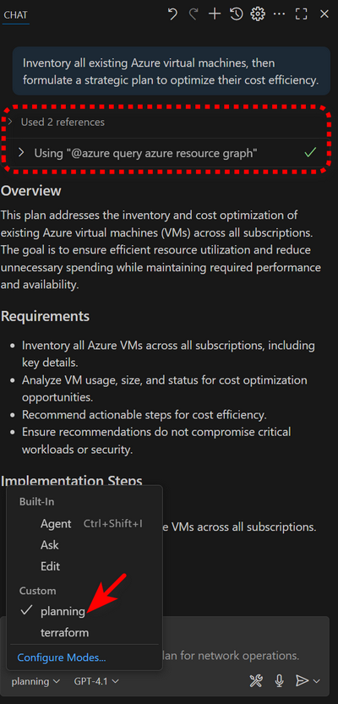
Github Copilot Custom Chat

Slide 48
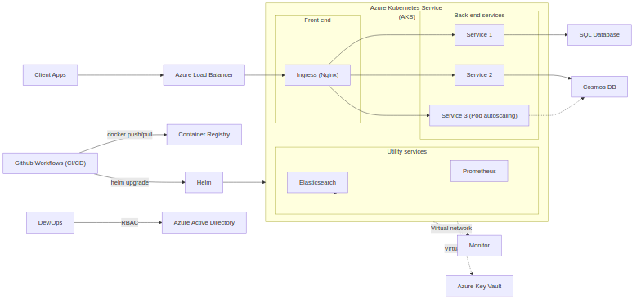
Diagram: Coding Agent for Azure Terraform

Slide 49
Enterprise Support with GitHub Spark
Goal: no-code micro apps for support portal
Demo link and sample app provided

Slide 50
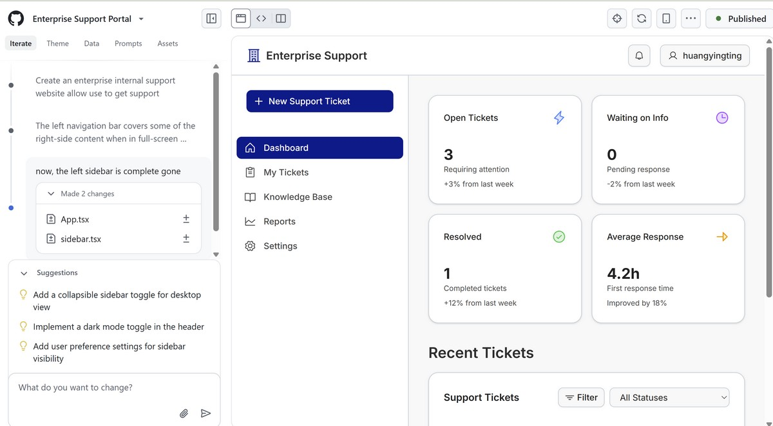
Github-Spark

Slide 51
Enterprise Support with GitHub Spark
Demo: Use Spark to Create Enterprise Support Website
App: Enterprise Support (public link)

Slide 52
Migrate Lambda to Azure Functions
Use GitHub Copilot for Azure extension
Add custom chat mode; migrate functions
Reference sample repo: serverless-face-blur-service

Slide 53
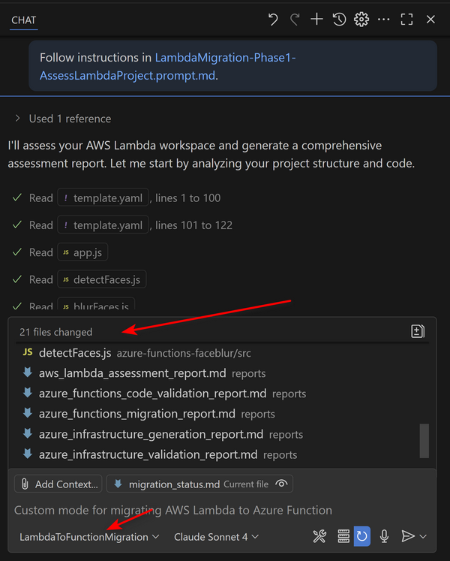
Github-Copilot-Lambda-Migration

Slide 54
Modernize Java Applications
Use Copilot to refactor and optimize Java
Reference: Java Migration Copilot Samples

Slide 55
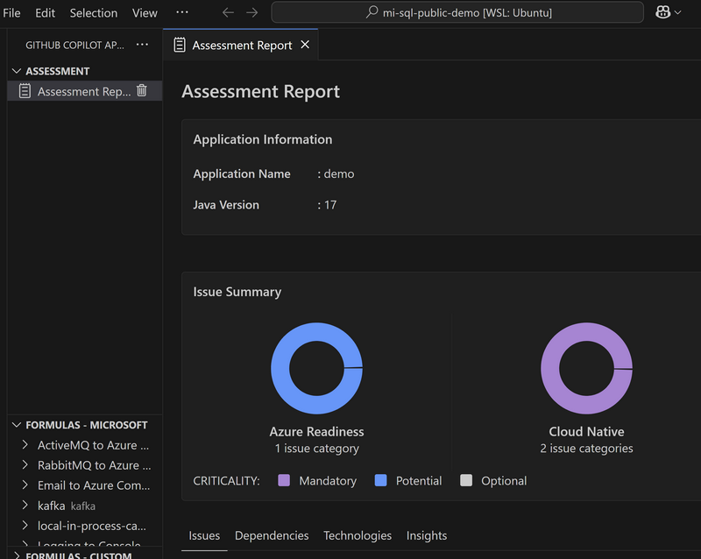
Github-Copilot-Java-Modernization

Slide 56
Spec-Driven Development
Files: requirements.md, design.md, tasks.md
Process: define, design, task, implement
Sample: Claim-Pilot application walkthrough

Slide 57
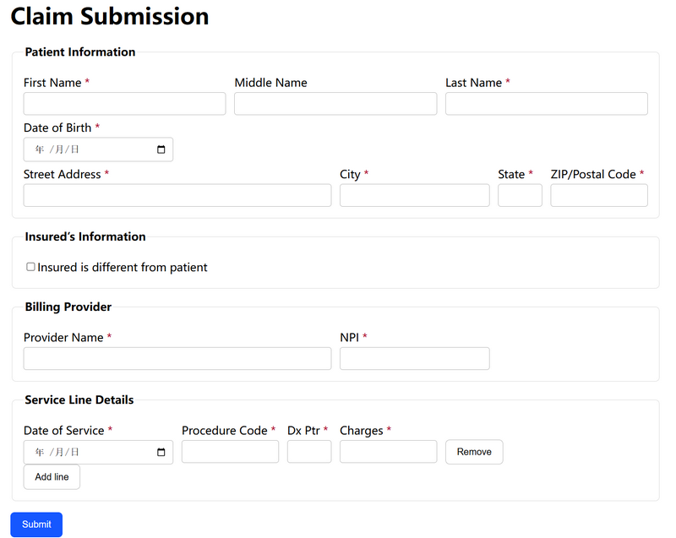
Claim Pilot

Slide 58
Design to Code (Figma MCP)
Generate React app from Figma components
Use Dev Mode MCP server and prompts

Slide 59
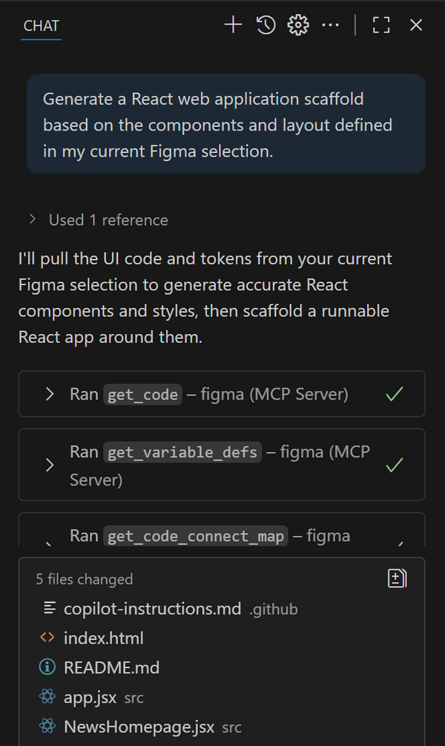
Github Copilot Figma

Slide 60
Module 10: Hands-On Overview
Exercise 1: Azure CLI rapid provisioning
Exercise 2: PowerShell automation runbooks
Exercise 3: Terraform for core web app
Exercise 4: Refactor Bicep with best practices
Exercise 5: Mermaid architecture diagrams
Exercise 6: SQL schema and procedure generation
Exercise 7: Multi-stage Dockerfile authoring
Exercise 8: Kubernetes manifests for AKS

Slide 61
Exercise 1: Azure CLI Provisioning
Objective: create RG, storage, container quickly
Tools: gh copilot, @azure chat, az CLI
Steps: suggest RG; generate storage; create blob
Outcome: resources visible in Azure portal

Slide 62
Exercise 2: PowerShell Runbooks
Objective: stop tagged VMs on schedule
Auth: managed identity; robust logging
Steps: params, connect, query tagged VMs, stop
Outcome: automated cost savings

Slide 63
Exercise 3: Terraform Web App
Objective: App Service, Web App, SQL DB
Refinements: firewall rule, variables, outputs
Outcome: validated Terraform plan

Slide 64
Exercise 4: Refactor Bicep
Objective: modularize and align with best practices
Steps: generate monolith, explain, refactor modules
Outcome: simplified main, reusable modules

Slide 65
Exercise 5: Mermaid Diagrams
Objective: visualize cloud-native architecture
Steps: prompt, embed code, preview in VS Code
Outcome: clear diagrams in documentation

Slide 66
Exercise 6: SQL Schemas
Objective: create Orders table, stored procedure
Context: provide Customers schema for accuracy
Outcome: correct DDL and DML artifacts

Slide 67
Exercise 7: Dockerfile Authoring
Objective: multi-stage, small secure image
Steps: builder stage; slim runtime; .dockerignore
Outcome: production-ready container image

Slide 68
Exercise 8: Kubernetes Manifests
Objective: deploy Flask app on AKS
Resources: Deployment (3 replicas), Service (LB)
Outcome: public app on port 80

Slide 69
Conclusion / Next Steps
Explore Copilot Extensions and custom modes
Apply enterprise networking best practices
Reuse prompts and spaces for team workflows
Continue with hands-on labs and demos
Notes:
- Encourage attendees to try exercises in their environment - Solicit feedback on enterprise setup and demos

