Slide 1
BDS介绍
亢曼曼

Slide 2
BDS Phase简介
BDS Architectuarl Protocol
BDS 终止服务
HiiDatabase VFR & UNI
EFI Driver Mode
BDS Flow

Slide 3
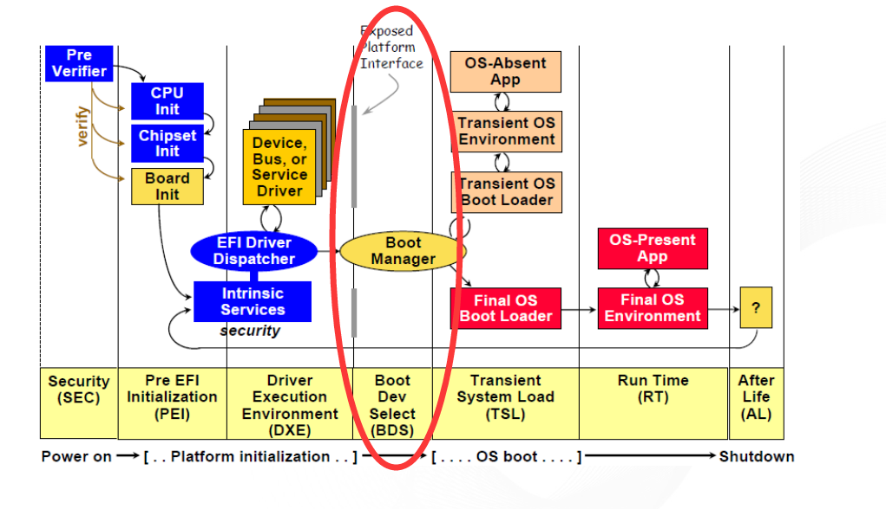
BDS Phase简介-What is BDS Phase
The Boot Device Selection (BDS) phases work together with DXE phase to establish consoles and attempt the booting of operating systems

Slide 4
BDS Phase简介-What BDS phase do
为什么需要BDS
提供一个和OS沟通的界面
提供一个Set Hardware状态的界面

Slide 5
BDS Phase简介-What BDS phase do
EFI 执行过程中，在BDS阶段之前只完成部分的系统初始化和配置，重要的显示和启动是在BDS阶段实现的
启动必要的驱动
–PCI Enumeration
–Connect consoles (VGA, USB KBD)
–Boot device initialization (IDE/SCSI/AHCI/NET)
进入Setup
–Boot Manager
–Device Setting
–System information
选择从哪个设备启动到系统OS
–Boot Legacy OS
–Boot UEFI OS

Slide 6
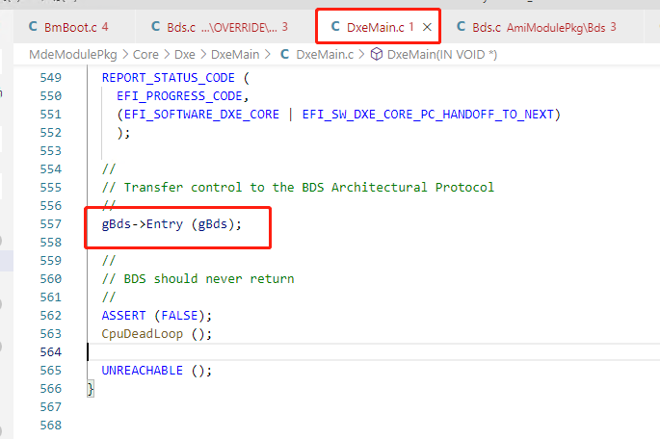
BDS Architectural Protocol
BDS Architectural Protocol提供一个在DXE阶段结束时的入口地址，它本身是在DXE阶段被install，而执行代表进入BDS
它会在所有DXE driver dispatcher完成后被调用
它负责系统运行从DXE阶段到BDS阶段

Slide 7
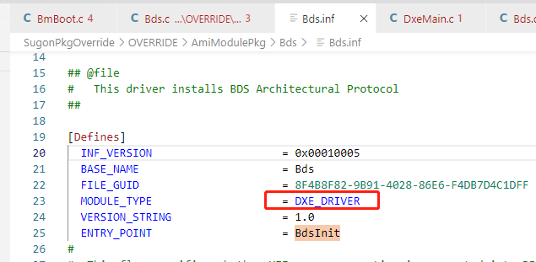

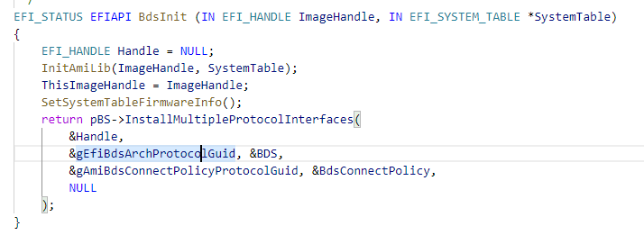
BDS Architectural Protocol
BDS模块是一个Dxe Driver

Slide 8
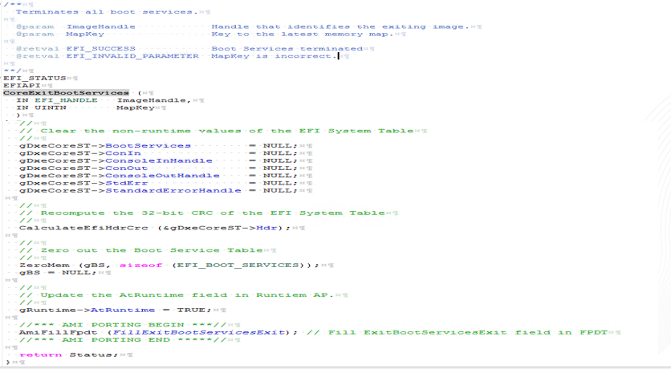
BDS 终止服务
终止启动服务
在OS加载和成功启动完成后，BDS阶段就结束了
OS加载器或者OS kernel可以通过调用ExitBootServices()服务来中止BDS阶段，调用结束后，所有的启动服务都会释放其使用过的资源
调用返回后，系统进入RT阶段

Slide 9
HiiDatabase VFR & UNI
字串(String Token/.UNI)
用Unicode, 可以在同一个画面显示不同国家的语言
用Token支援多国语言的显示
字体
采用bitmap方式存放，并以Unicode来索引
系统提供ASCII & ISO Latin-1
只有用到的字体会放入
键盘
支持不同国家的键盘对应
表(Form/.VFR/.IFR)
类似HTML的做法，用来描述表单与项目之间的关连
VFR是以文字档案的型式存在，方便版面的修改
IFR是VFR 编译后的二进制格式，表的描述则以OpCode的形式存在，以节省ROM的空间

Slide 10
EFI Driver Mode
Driver Model四部曲
Initialize
–安裝BindingProtocols到DXE Core
•Support
•Start
•Stop
Support
–检测是否可以支持传入的Handle
Start
–连接Driver与Handle
Stop
–断开Driver跟Handle之间的联系

Slide 11
EFI Driver Mode-Initialize
EFI_DRIVER_BINDING_PROTOCOL gSataControllerDriverBinding= {
SataControllerSupported,
SataControllerStart,
SataControllerStop,
1, // version
NULL, // ImageHandle
NULL // DriverBindingHandle
};
EFI_STATUS
InitializeSataControllerDriver(
IN EFI_HANDLE ImageHandle,
IN EFI_SYSTEM_TABLE *SystemTable )
{
Status = pBS->InstallMultipleProtocolInterfaces(
&ImageHandle,
&gSataControllerDriverBindingProtocolGuid,
&gSataControllerDriverBinding,
&gComponentNameProtocolGuid,
&gIdeControllerDriverName, NULL
);
}

Slide 12
EFI Driver Mode-Support
EFI_STATUS
SataControllerSupported(
IN EFI_DRIVER_BINDING_PROTOCOL *This,
IN EFI_HANDLE Controller,
IN EFI_DEVICE_PATH_PROTOCOL *RemainingDevicePath )
{
Status = gBS->OpenProtocol {取得这个Device Handle的PCI
Controller,
&gEfiPciIoProtocolGuid,
(VOID **)&PciIo,
This->DriverBindingHandle,
Controller,
EFI_OPEN_PROTOCOL_BY_DRIVER );
Status = PciIo->Pci.Read(// 读出PCI Data
PciIo,
EfiPciIoWidthUint8,
0,
sizeof(PciData), &PciData ); // 检查是否是SATA Controller
if ( (PciData.Hdr.ClassCode[2] != PCI_CLASS_MASS_STORAGE) || ((PciData.Hdr.ClassCode[1] != PCI_SUB_CLASS_IDE) && ((PciData.Hdr.ClassCode[1] != PCI_SUB_CLASS_INTEL_RAID))) || (PciData.Hdr.VendorId!= PCI_VENDOR_ID_INTEL) || ((PciData.Hdr.DeviceId!= PCI_DEVICE_ID_SATA) && (PciData.Hdr.DeviceId!= PCI_DEVICE_ID_SATA_RAID)))
{ Status = EFI_UNSUPPORTED;
}
}

Slide 13
EFI Driver Mode-Start
EFI_STATUS
SataControllerStart(
IN EFI_DRIVER_BINDING_PROTOCOL *This,
IN EFI_HANDLE Controller,
IN EFI_DEVICE_PATH_PROTOCOL *RemainingDevicePath )
{
EFI_STATUS Status;
EFI_PCI_IO_PROTOCOL *PciIo;
EFI_SATA_CONTROLLER_PRIVATE_DATA *SataPrivateData;
Status = gBS->OpenProtocol( Controller,
&gEfiPciIoProtocolGuid,
(VOID **)&PciIo,
This->DriverBindingHandle,
Controller,
EFI_OPEN_PROTOCOL_BY_DRIVER );
………………………..
// // Enable SATA controller working in appropriate mode //
Status = EnableSataController(PciIo); if (EFI_ERROR(Status)) { return EFI_DEVICE_ERROR; }
………………………..
}

Slide 14
EFI Driver Mode-Stop
EFI_STATUS
SataControllerStop(
IN EFI_DRIVER_BINDING_PROTOCOL *This,
IN EFI_HANDLE Controller,
IN UINTN NumberOfChildren,
IN EFI_HANDLE *ChildHandleBuffer )
{
EFI_STATUS Status;
………….
gBS->UninstallMultipleProtocolInterfaces(// Uninstall Protocol
Controller,
&gSataControllerDriverGuid,
SataPrivateData,
&gEfiIdeControllerInitGuid,
&(SataPrivateData->IdeInit),
NULL );
gBS->FreePool(SataPrivateData);
}

Slide 15
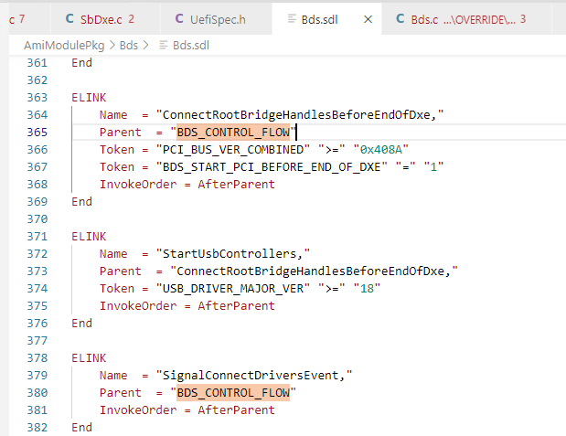
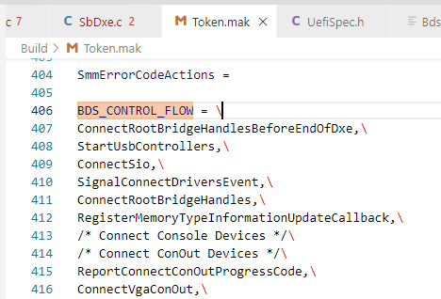
BDS Flow
BDS阶段执行函数主要通过Elink方式挂在BDS_CONTROL_FLOW下一次执行

Slide 16
BDS Flow

Slide 17
作业
作业要求如下：
1.写一个Module
2.Module里创建一个Elink函数，将函数Elink到SetupStringInit
3.功能是读取网卡的型号信息，并将信息显示在屏幕上

