Slide 1
DXE介绍

Slide 2
DXE Phase简介
DXE Foundation
DXE Dispatcher
DXE Driver
DXE Flow

Slide 3
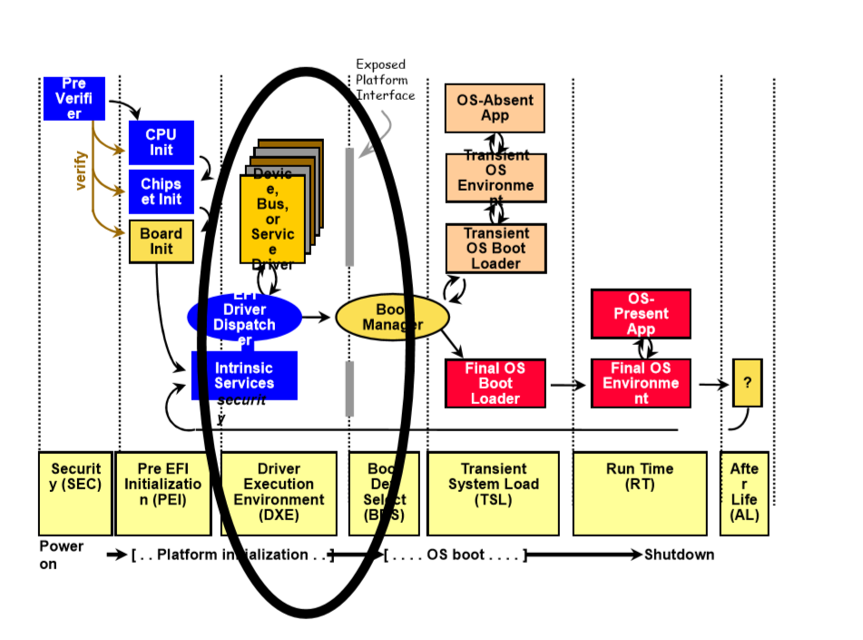
DXE Phase简介
What is DXE Phase？
The Driver Execution Environment(DXE) phase is where most of the system initialization is performed

Slide 4
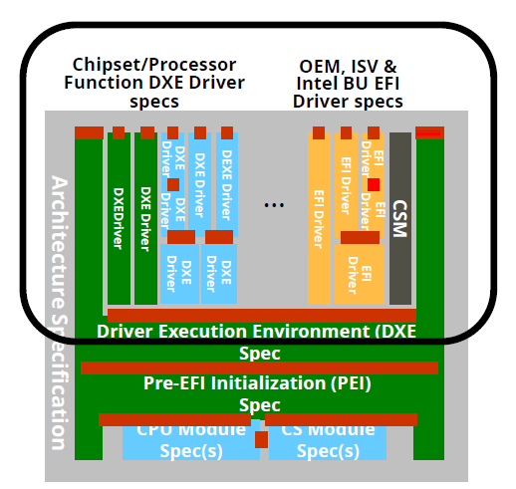
DXE Phase简介
Why need DXE phase？
DXE phase drivers build the interface for EFI framework
Easy to integrate 3rd party code
− Initialize Code
− Runtime Code
− VGA, Network Onboard Driver

Slide 5
DXE Phase简介
DXE Feature
All Drivers are compressed
Code is running on RAM
CPU Cache Enabled
All Memory Resource are accessible
DXE core is not related to platform
Avoid using Interrupt
Single Thread
What DXE Phase do？
Run all DXE drivers, Make them ready
Check Architectural Protocols
Invoke BDS

Slide 6
DXE Foundation
DXE Foundation is a boot service image that is responsible for producing UEFI system table and its associated set of services as following:
UEFI Boot Services
UEFI Runtime Services
DXE Services
The DXE Foundation is designed to be completely portable with no processor, chipset, or
platform dependencies.

Slide 7
DXE Foundation Data Structure

Slide 8
DXE Dispatcher
What is Dispatcher?
After DXE Foundation is initialized, control is passed to DXE Dispatcher.
The DXE Dispatcher is responsible for loading and invoking DXE Drivers found in Firmware Volumes
Dispatcher Dependence
The DXE Dispatcher is also required to execute the DXE drivers in the correct order, since Some DXE drivers may depend on the services produced by other DXE drivers
Similar to PEI Dispatcher, The DXE dispatcher can look up the dependency expression by looking the dependency section in a DXE driver file

Slide 9
DXE Driver
The DXE Drivers are the actually initialize the platform and provide the services required to boot the UEFI-compliant operating system or a set of UEFI-compliant system utilities.
There are two basic classes of DXE drivers:
Early DXE Drivers
Basic Services
Processor Initialization Code
Chipset Initialization Code
Platform Initialization Code
Architectural Protocols
DXE Drivers that follow the UEFI Driver Model
Console Devices
Boot Devices
Bus Controller

Slide 10
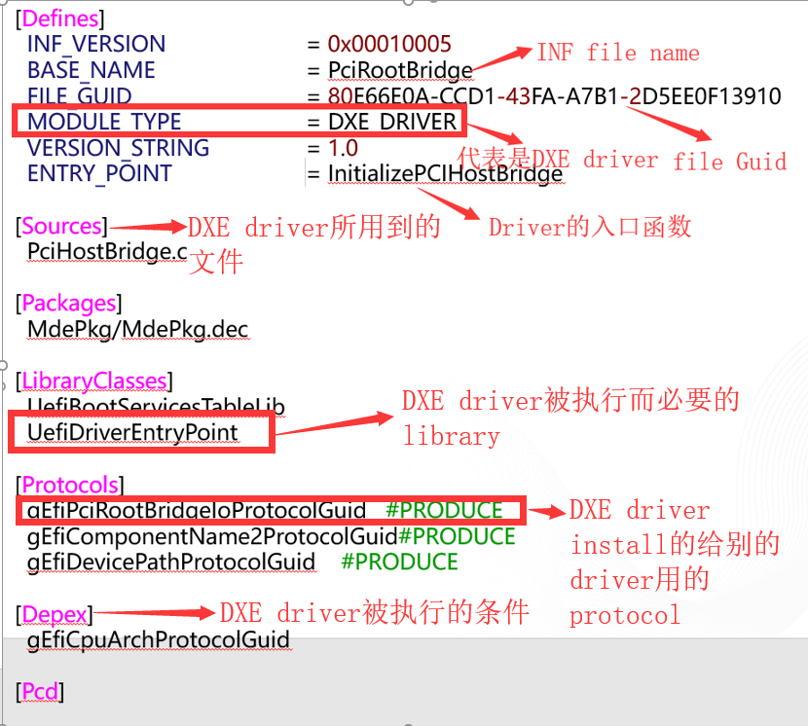
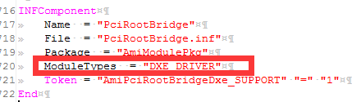
DXE Driver-INF

Slide 11
DXE Driver-Protocol
定义DXE Protocol
struct{
EFI_PCI_ROOT_BRIDGE_IO_PROTOCOL_IO_MEM Read;
EFI_PCI_ROOT_BRIDGE_IO_PROTOCOL_IO_MEM Write;
} EFI_PCI_ROOT_BRIDGE_IO_PROTOCOL_ACCESS;
struct_EFI_PCI_ROOT_BRIDGE_IO_PROTOCOL {
........
EFI_PCI_ROOT_BRIDGE_IO_PROTOCOL_ACCESS Pci;
……..
} EFI_PCI_ROOT_BRIDGE_IO_PROTOCOL;

Slide 12
DXE Driver-Install Protocol
EFI_STATUS EFIAPI
InitializePCIHostBridge(
IN EFI_HANDLE ImageHandle,
IN EFI_SYSTEM_TABLE *SystemTable
)
{
EFI_PCI_ROOT_BRIDGE_IO_PROTOCOL *Protocol;
……..
// initialize functions
Protocol->Pci.Read=PciRead;
Protocol->Pci.Write=PciWrite;
……..
// Install protocol
Status = gBS->InstallProtocolInterface(&Handle,& gEfiPciRootBridgeIoProtocolGuid,EFI_NATIVE_INTERFACE, &Protocol);
}

Slide 13
DXE Driver-Invoke Protocol
{
……..
// Locate Protocol
Status = pBS->LocateProtocol (&gEfiPciRootBridgeIoProtocolGuid,NULL,
&PciRootBridgeIo);
ASSERT_EFI_ERROR (Status);
……..
//Call the function
Status = PciRootBridgeIo->Pci.Read(PciRootBridgeIo,
Width,
Address64,
1,
&Buffer8 );
……..
}

Slide 14
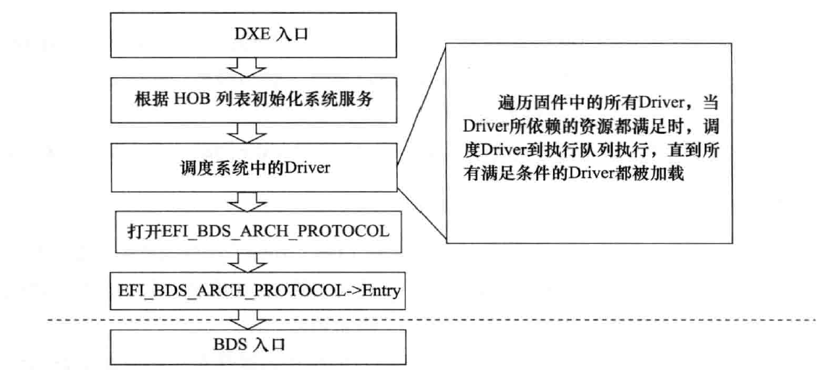
DXE Flow
PEI
DxeIpl

Slide 15
作业
要求如下：
1.写一个DXE driver，要求install一个读写PCI设备的Protocol，Protocol里有两个功能函数，两个函数的功能如下：
Read函数：读取PCI寄存器的值
Write函数：向PCI寄存器写值
2.Locate自己创建的Protocol，使用Read函数读取PCI VIDDID的值，调用Write函数给PCI设备分配IO或者Memory地址

