Slide 1
HOB简介
BIOS 段钧
2020/06/19

Slide 2
Hob Services
CreateHob
GetHobList

Slide 3
HOB Services
Creates data structures called Hand-Off Block (HOB) that are used to pass information to the next phase.

Slide 4
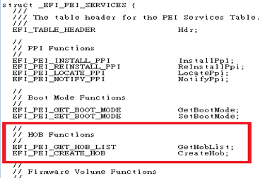
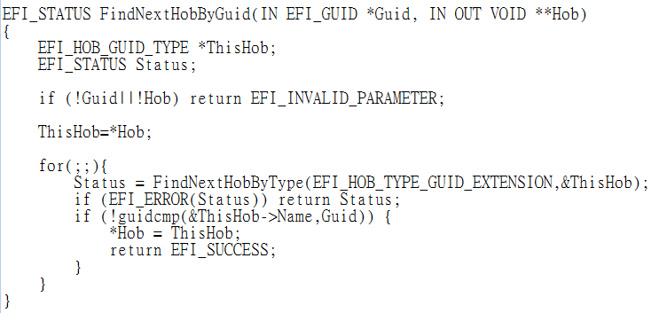
PEI (EFI_PEI_SERVICES)
[ EFI_PEI_SERVICES ]
CreateHob
GetHobList
[ AmiCompatibilityPkg\Library ]
FindNextHobByGuid
FindNextHobByType

Slide 5
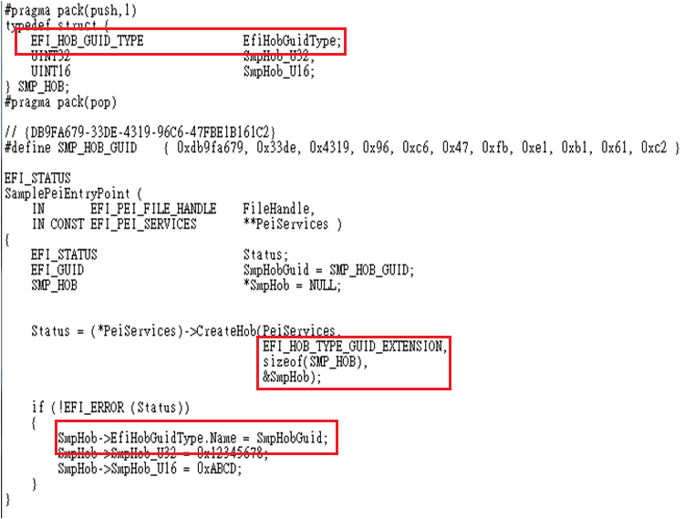
PEI (EFI_PEI_SERVICES) -> CreateHob

Slide 6
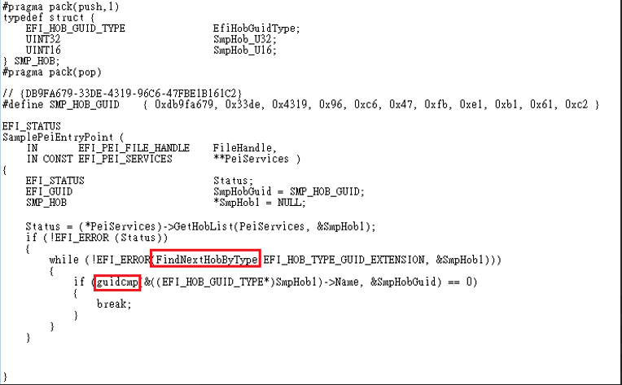
PEI (EFI_PEI_SERVICES) -> GetHobList

Slide 7
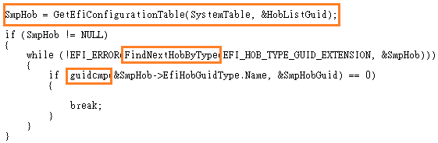
DXE (EFI_SYSTEM_TABLE) -> Get Hob

