Slide 1
海光平台开机流程
昆山软件 BIOS

Slide 2
Power On Flow
PSP
SMU
ABL
BIOS Boot Flow
PCIe/SATA/USB/UMC/SPD
Power on 注意事项

Slide 3
Power On Flow
Ac In
Power On
CPLD
BMC/SIO
BIOS
OS

Slide 4


PSP
Platform Security Processor (PSP)
To initialize DRAM and basely function before the x86 cores are released.
The PSP executes AGESA firmware images called “Bootloaders” to initialize the system.
Processor
PSP
SMU
PSP
SMU
(
MP
0
)
(
MP
1
)
(
MP
0
)
(
MP
1
)
X
86
Core
X
86
Core
X
86
Core
X
PMU
86
Core
PMU
X
86
Core
X
86
Core
X
86
Core
X
86
Core
X
86
Core
X
86
Core
X
86
Core
X
PMU
86
Core
PMU
X
86
Core
X
86
Core
X
86
Core
X
86
Core
PSP
SMU
PSP
SMU
(
MP
0
)
(
MP
1
)
(
MP
0
)
(
MP
1
)
X
86
Core
X
86
Core
X
86
Core
X
PMU
86
Core
PMU
X
86
Core
X
86
Core
X
86
Core
X
86
Core
X
86
Core
X
86
Core
X
86
Core
X
PMU
86
Core
PMU
X
86
Core
X
86
Core
X
86
Core
X
86
Core

Slide 5
SMU
System Management Unit(SMU)
The system management unit (SMU) is a subcomponent of the SOC that is responsible for a variety of system and power management tasks during boot and runtime.
The SMU uses two blocks, System Management Controller (SMU) and Platform Security Processor (PSP), in order to assist with many of these tasks.
At the architectural level, the PSP is known as MP0 and the SMU is known as MP1.
The SMU does not require software initialization. Upon successful boot-up the SMU is ready for operation.

Slide 6
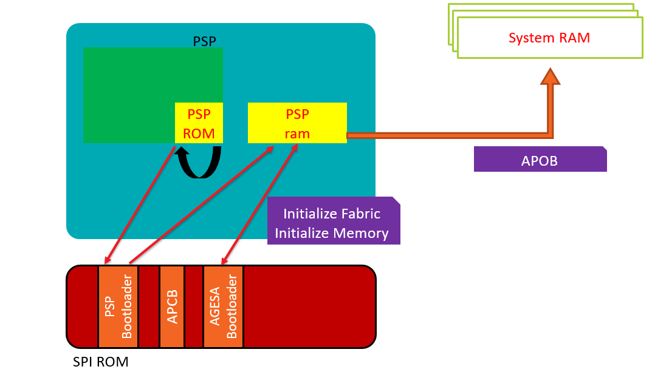
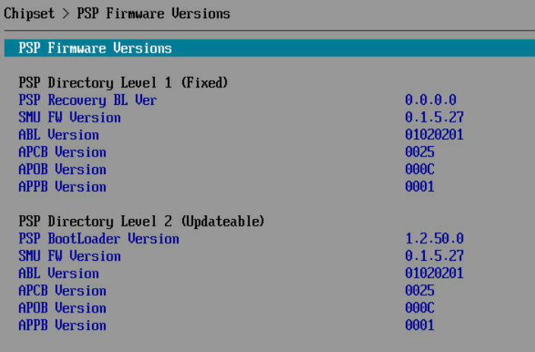
ABL
AGESA Bootloaders (ABL)
Loaded PSP bootloader into PSP SRAM
Retrieve APCB data.
Initialize “Data Fabric”
Initialize “Memory”
Create APOB

Slide 7
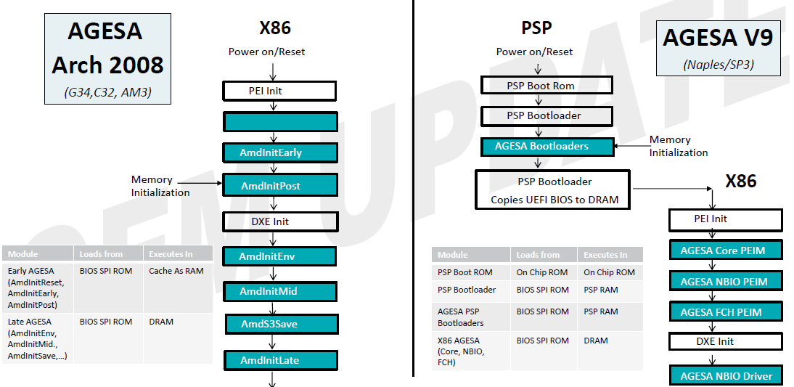
BIOS Boot Flow

Slide 8
Platform Initialization
The Platform Security Processor (PSP) is an security processor that executes firmware images called “Bootloaders” prior to the release of the “Main Cores”
Family 17h and future programs support AGESA Bootloaders (ABLs)
The ABLs are responsible for initializing the “Data Fabric” and “Memory” interface.
The ABLs are delivered as binary images from HYGON
The ABL receives platform BIOS input via an input data structure called “AGESA PSP Configuration Block” (APCB)
The APCB is created by the platform BIOS at build time and stored in the ROM
The results of ABL execution are provided via an output buffer called “AGESA PSP Output Block” (APOB )

Slide 9
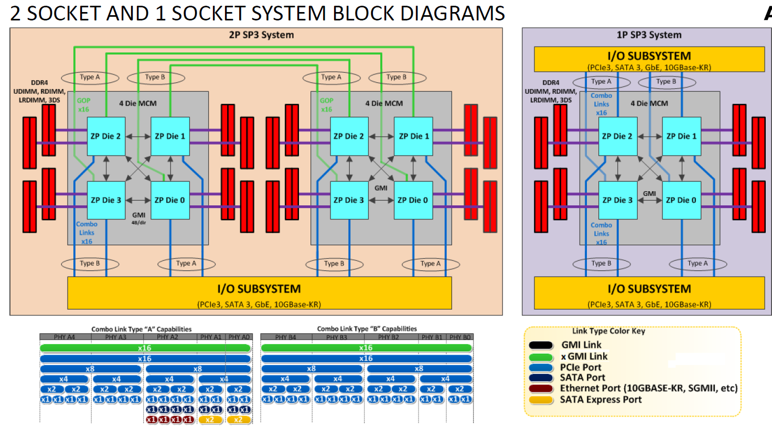
Block Diagram

Slide 10
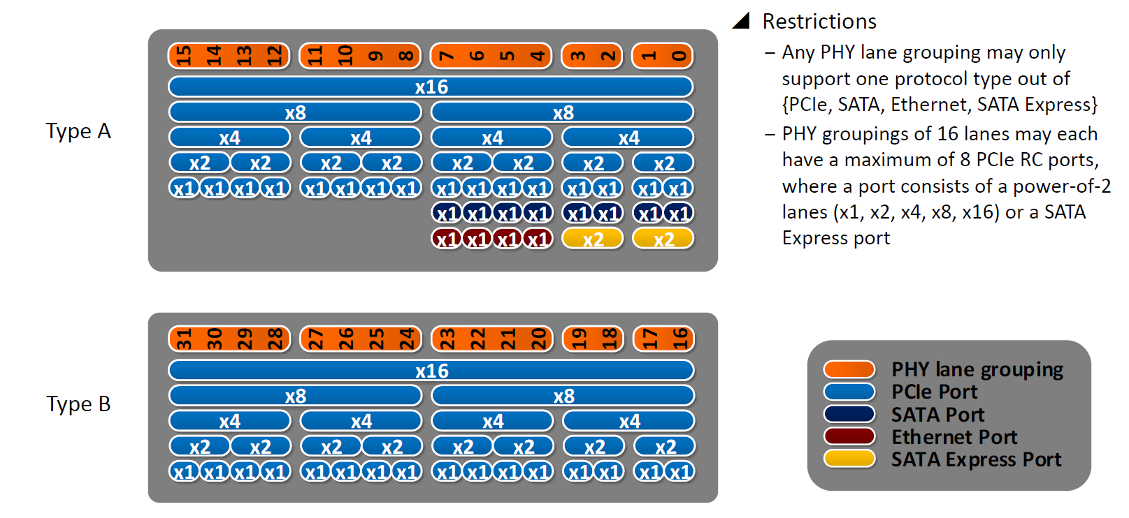
PCIe DXIO

Slide 11
USB
SL1芯片有4个die，die 0和die1各有一个XHCI控制器，每个控制器支持2个USB 2.0 port和2个USB 3.0 port。
SL1R2芯片有2个die，die 0和die1各有一个XHCI控制器，每个控制器支持4个USB 2.0 port和4个USB 3.0 port。
DM1芯片有1个die，die 0有一个XHCI控制器，每个控制器支持4个USB 2.0 port和4个USB 3.0 port。

Slide 12
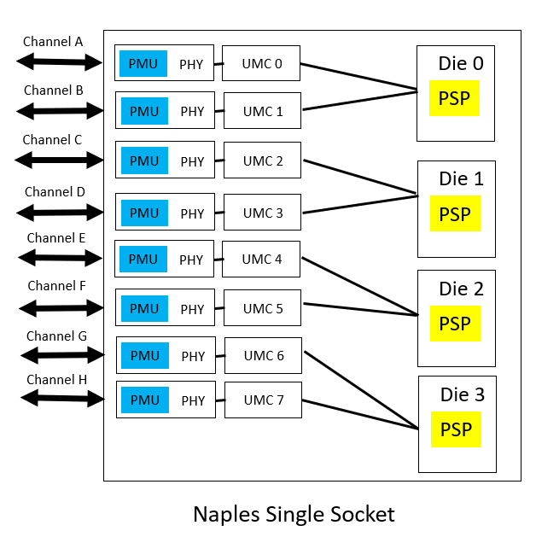
UMC
Unified Memory Controller – The DRAM controllers, one channel per UMC

Slide 13
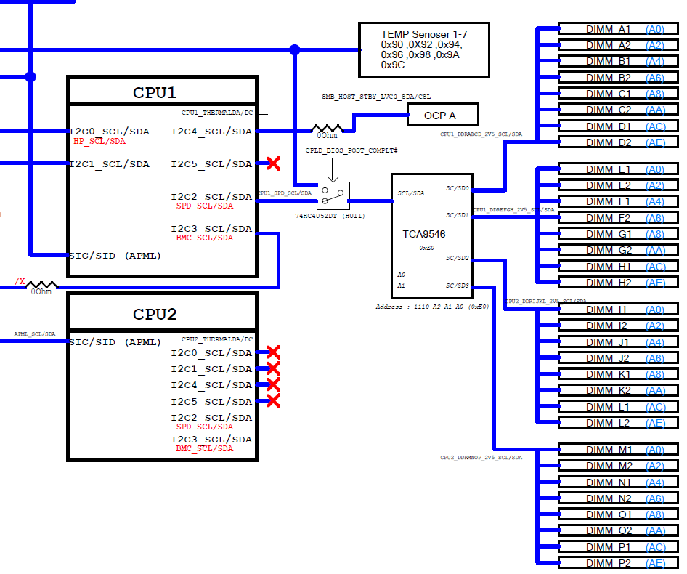
SPD Switch
BMC
Power On: BIOS
After BIOS Post Complete: BMC

Slide 14
注意事项

