Slide 1
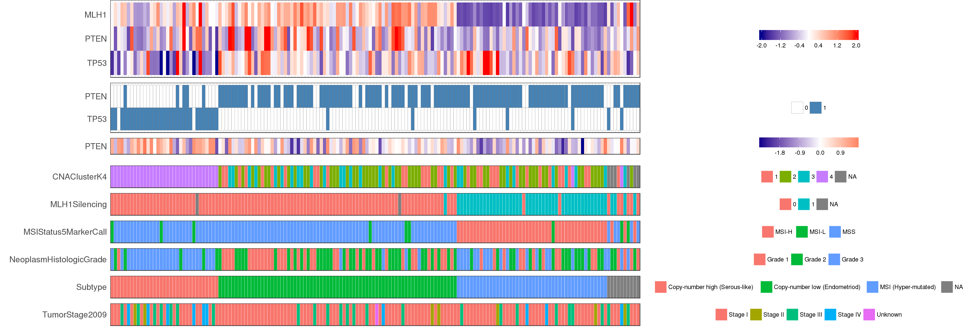
Order by TCGA defined subtype
https://apps.medgen.iupui.edu/rsc/content/35/
RNA
mutation
protein
MLH1 RNA level is low in MLH1 silencing group defined by hypermethylation of MLH1 promoter
TP53 mutated group has higher grade, higher stage tumor
PTEN mutation are mutual exclusive to TP53 mutation
PTEN protein level is high in TP53 mutated group while PTEN RNA level is low

Slide 2
Analysis panel demo
two_groups_of_patients_to_analyze.xlsx

