Slide 1
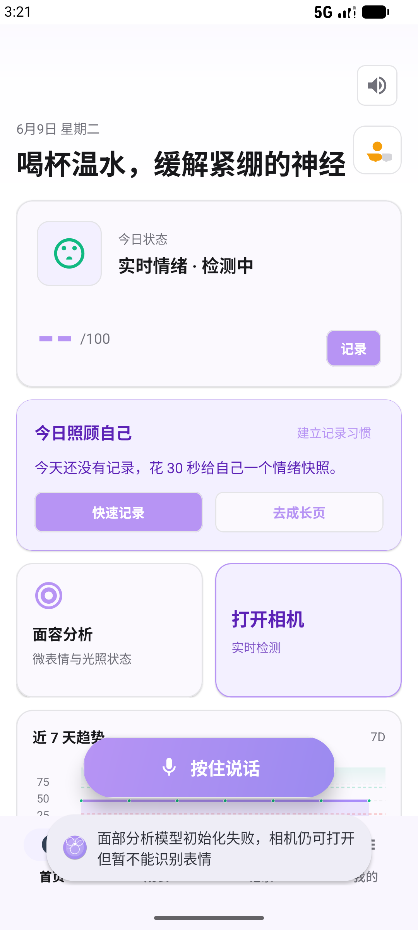
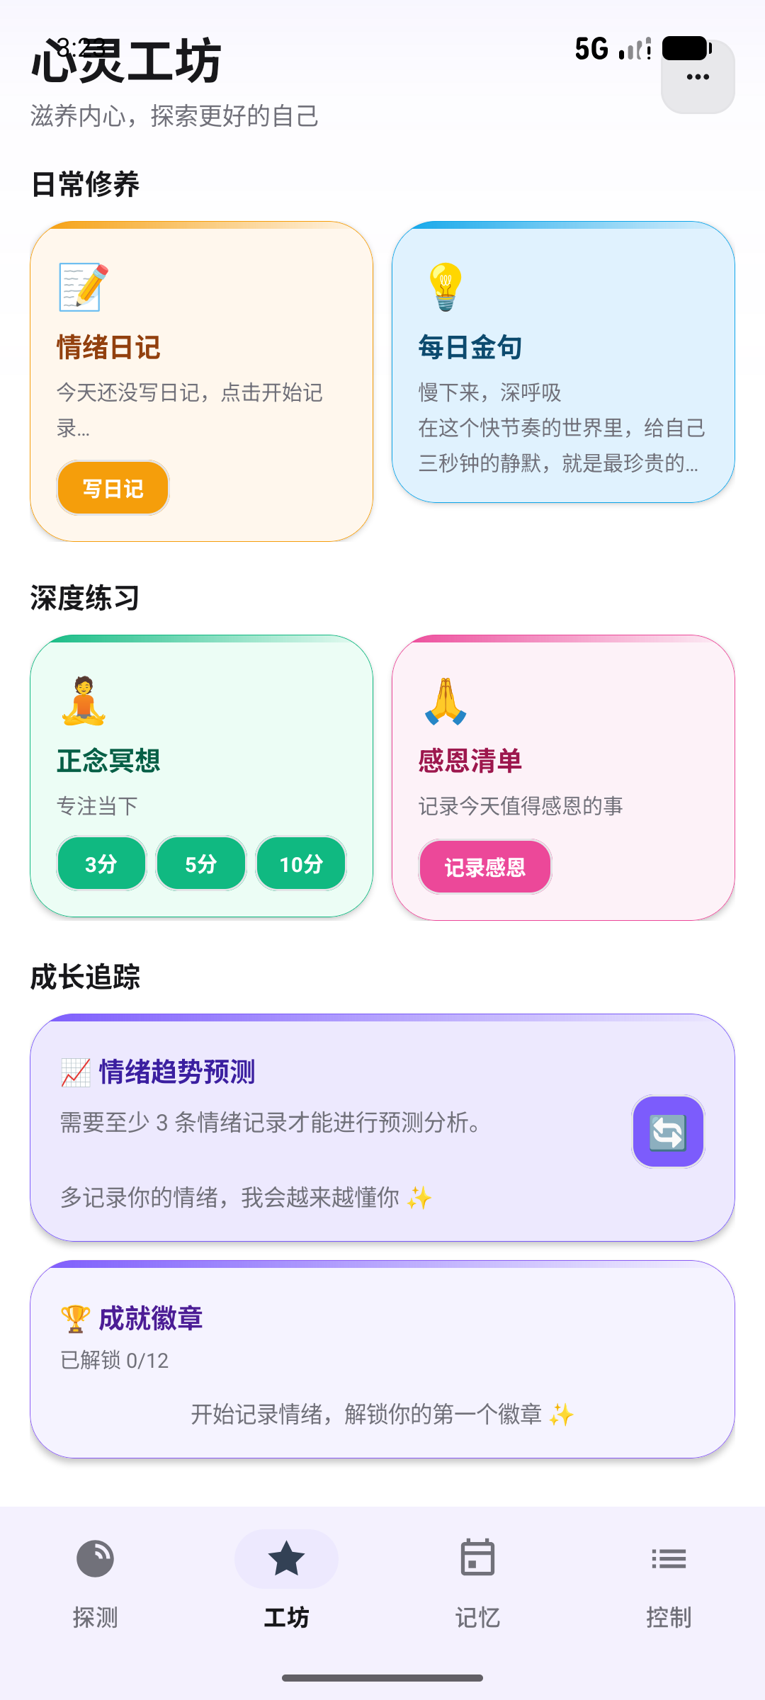
EmoScope
A Privacy-Preserving Mobile System for Multimodal Emotion Recognition
Ziyang Huang 2025112735
School of Economics and Management, Harbin Institute of Technology
Thesis
A smartphone can combine facial, vocal, contextual, and historical signals into a continuous wellness workflow while keeping biometric analysis primarily on-device.
EmoScope | 5-minute oral presentation | 1/7
Notes:
Good morning everyone. Today I am going to present my project, EmoScope, a privacy-preserving mobile system for multimodal emotion recognition. The motivation is simple: many people want to understand their emotional changes, but traditional mood-tracking apps usually ask users to manually record how they feel. EmoScope tries to make this process more continuous by combining facial expression, voice, recent memory records, and user-controlled intervention tools.

Slide 2
The problem: self-report breaks down
Mood diaries are useful, but they miss the moments when support is most needed.
Recall bias
Low compliance
Missing high-need data
Users reconstruct feelings after the fact, so records may not reflect the original moment.
Recording requires effort; engagement often drops quickly in mental health apps.
Stress or fatigue can make users less willing to open the app and write.
Research question
Can a consumer smartphone collect helpful emotional context while keeping sensitive biometric analysis mainly on the device?
Passive signals
User agency
Local-first privacy
EmoScope | 5-minute oral presentation | 2/7
Notes:
The problem starts from self-report. Mood diaries are useful, but they are easy to forget, especially when users are stressed, tired, or anxious. In those moments, the user may need support the most, but may be least willing to open an app and write a record. This creates missing data and makes long-term reflection difficult. So the research question behind EmoScope is: can a normal smartphone collect helpful emotional context while keeping sensitive biometric analysis mainly on the device?

Slide 3
System architecture
From multimodal sensing to cautious, user-facing feedback.
Input layer
On-device AI
Memory engine
Feedback layer
Camera frames
Voice transcript
Ambient light
Recent records
→
52 blendshapes
EWMA smoothing
10 emotion dimensions
0-100 score
→
SQLite records
30-day trends
Keyword ranking
JSON export
→
Care card
LLM response
Weekly report
SOS support
Design principle
Sensing is continuous, interpretation is cautious, and emergency action remains user-confirmed.
EmoScope | 5-minute oral presentation | 3/7
Notes:
The system design has four major parts. First, the camera captures facial frames and MediaPipe FaceLandmarker extracts 52 blendshape coefficients. Second, these signals are mapped into ten emotion dimensions and smoothed by an exponentially weighted moving average. Third, voice input, speech rate, ambient light, and recent records are fused into a short supportive response. Finally, the local memory engine summarizes 30-day emotional trends and keeps the user's records available for export.

Slide 4
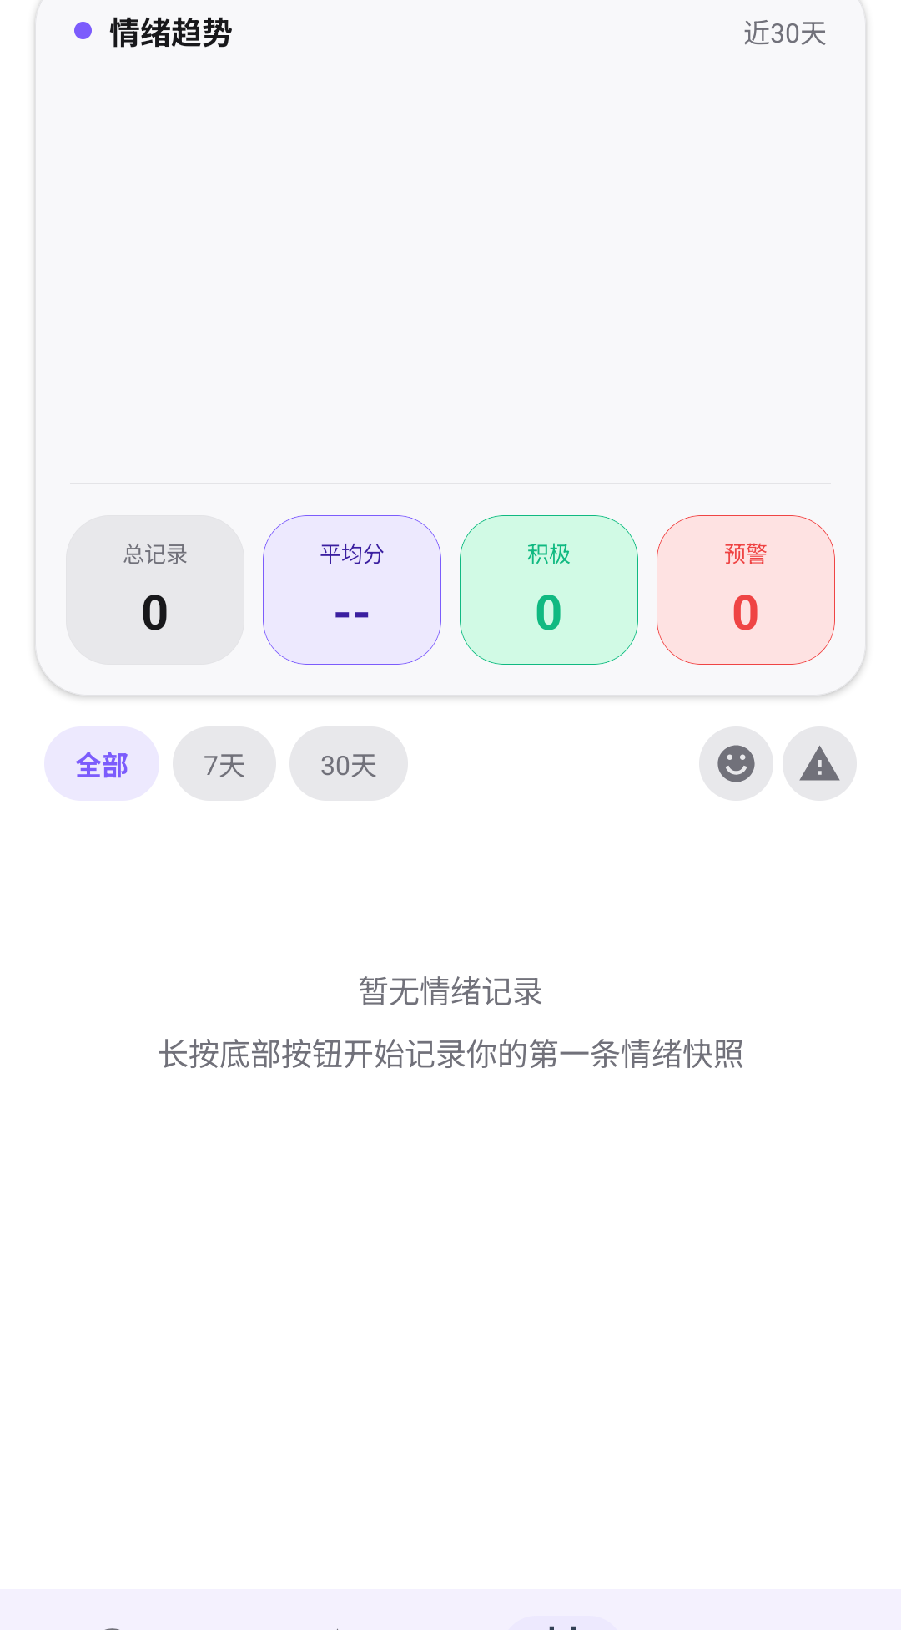
Interface workflow
The app closes the loop from sensing to reflection to action.
Workflow
1. Sense current state
2. Interpret with context
3. Suggest gentle action
4. Review long-term trend
Home radar
Wellness workshop
Emotion history
EmoScope | 5-minute oral presentation | 4/7
Notes:
Here are the main user interfaces. The home radar gives immediate feedback and quick recording. The wellness workshop offers low-intensity actions such as journaling, breathing, gratitude practice, and weekly reports. The history page helps users review longer-term emotional changes. The point is not only to detect emotion, but to close the loop from sensing, to interpretation, to action.

Slide 5
Functional evaluation
Prototype validation focused on engineering feasibility, not clinical diagnosis.
4 Hz
>40 pts
3-5 pp
100%
<0.5s
stable facial inference
wellness-score range
post-smoothing jitter
synthetic regex extraction
manual SOS
Face analysis
Memory engine
Safety workflow
Interpretation
Stable 4 Hz inference; EWMA reduced visible jitter in the camera overlay.
Ten-emotion parser reached 100% extraction accuracy on synthetic records.
Manual, shake, and passive facial SOS cues were validated for response behavior.
The result supports technical feasibility, while clinical effectiveness still requires user studies and validated scales.
EmoScope | 5-minute oral presentation | 5/7
Notes:
For prototype evaluation, I focused on functional feasibility. Facial inference ran at about 4 Hertz under normal lighting. The wellness score changed by more than 40 points between joy-dominant and anxiety-dominant conditions. The smoothing filter reduced visible frame jitter to about 3 to 5 percentage points. The memory engine's ten-emotion parser reached 100 percent extraction accuracy on synthetic records, and SOS confirmation opened in less than half a second.

Slide 6
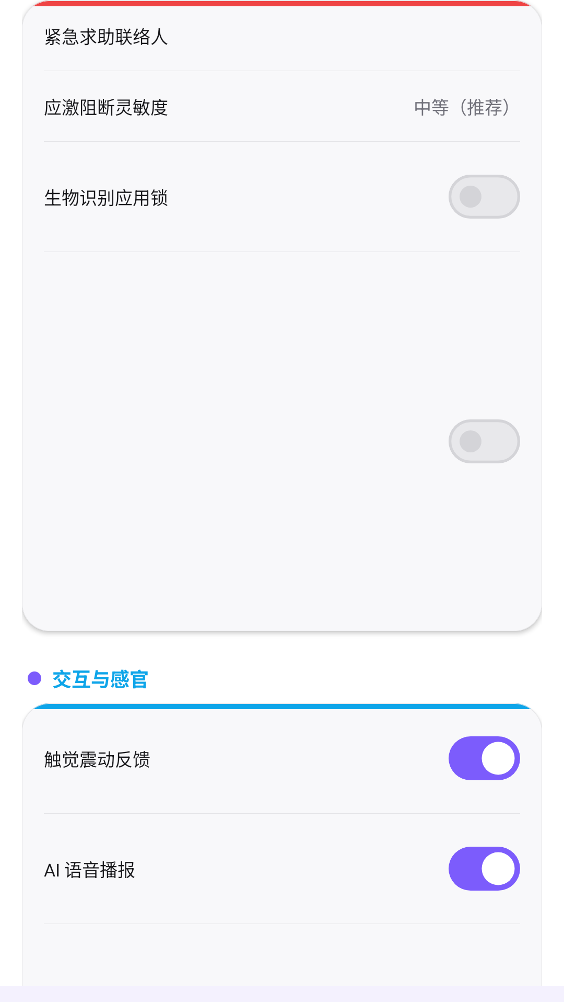
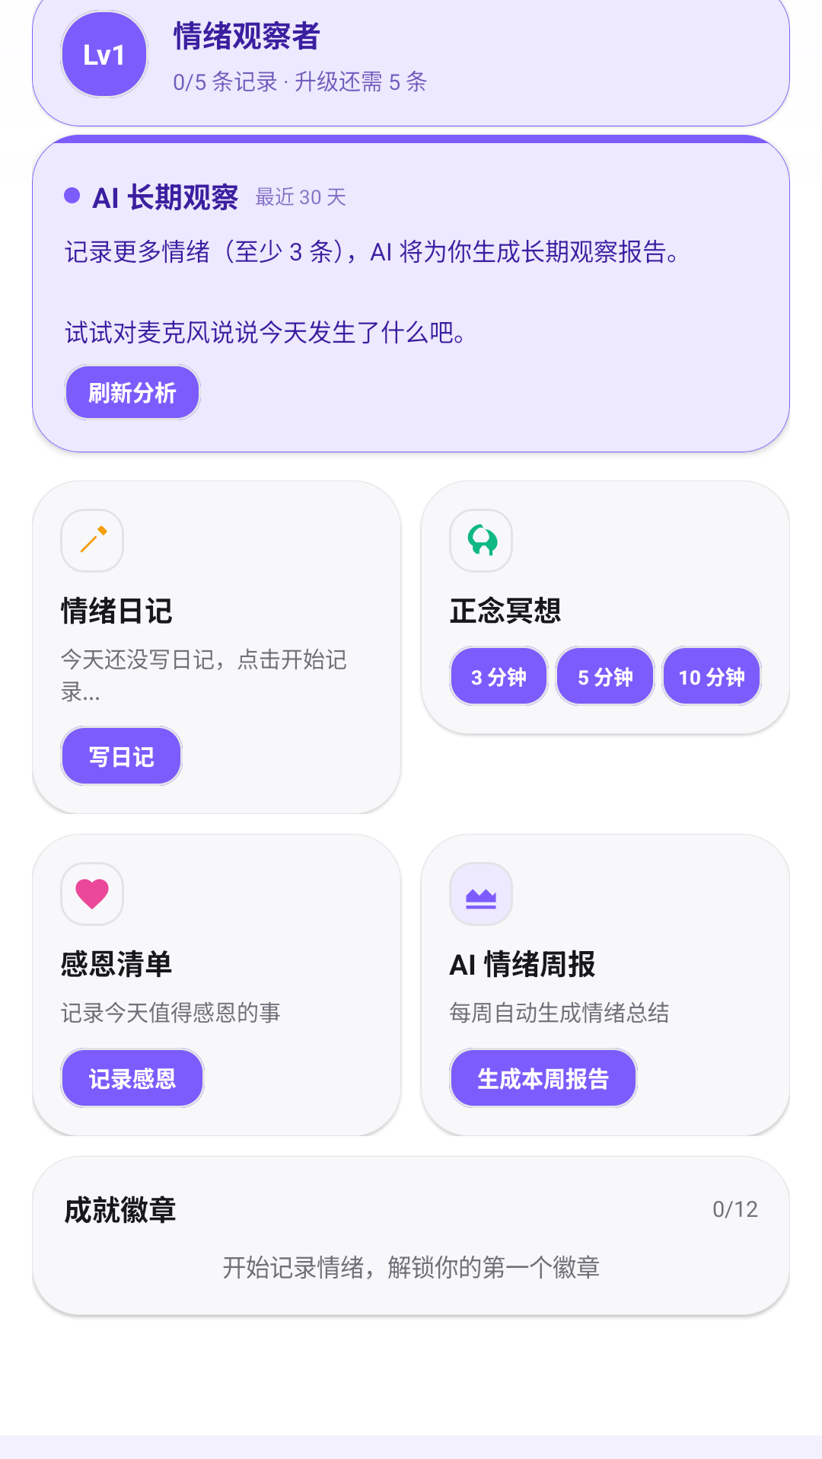
Privacy and user agency
Emotion recognition should support the user, not override the user.
Local-first boundary
Raw facial inference runs on-device; records are stored locally; export and clearing remain user-controlled.
LLM as explanation layer
The model receives structured context and produces supportive language, not the primary detection result.
User-confirmed SOS
Negative signals can surface a cue, but emergency action requires confirmation.
EmoScope | 5-minute oral presentation | 6/7
Notes:
Privacy and user agency are central to the design. Raw facial inference happens locally, and the app stores records on the device. Only structured textual context is sent to the language model when the user asks for feedback. Emergency support is also user-confirmed: negative facial signals can show an SOS cue, but the app does not automatically contact others. This avoids turning emotion recognition into an uncontrolled high-stakes system.

Slide 7
Conclusion
EmoScope demonstrates a practical direction for privacy-preserving, multimodal emotional self-awareness.
What works
What remains
Thank you
On-device facial analysis
Voice-rate context
30-day memory analytics
User-confirmed support
Clinical validation
Fairness evaluation
Full acoustic analysis
Longitudinal user study
Questions?
EmoScope | 5-minute oral presentation | 7/7
Notes:
To conclude, EmoScope shows that a smartphone can combine on-device facial analysis, speech-rate estimation, local memory analytics, and user-confirmed SOS support into one mental wellness workflow. The current prototype is not a clinical diagnostic tool, and future work should include real user studies, fairness evaluation, and comparison with validated scales such as PHQ-9 or GAD-7. But as a prototype, it demonstrates a practical direction for privacy-preserving, multimodal emotional self-awareness. Thank you.

