Slide 1
EmoScope
Sense
A Privacy-Preserving Mobile System for Multimodal Emotion Recognition
face, voice,
light, records
Ziyang Huang 2025112735
School of Economics and Management, Harbin Institute of Technology
Reflect
score, trend,
weekly report
Core claim
Smartphone sensing can support emotional self-awareness when biometric analysis, memory records, and emergency actions are designed around privacy and user control.
Act
care card,
SOS confirm
EmoScope | 5-minute oral presentation | 1/10
Notes:
Good morning everyone. Today I am going to present my project, EmoScope. It is a privacy-preserving mobile system for multimodal emotion recognition and mental wellness support. The basic idea is simple: instead of asking the user to manually record every mood, EmoScope uses the smartphone itself to collect helpful emotional context, while keeping sensitive biometric processing mainly on the device.

Slide 2
Why self-report is not enough
Mood diaries miss important moments when recording requires too much effort.
Recall bias
Compliance decay
Missing high-need data
Users reconstruct past feelings after the emotional moment has already changed.
Manual logging is easy to understand but hard to sustain every day.
Stress and fatigue can reduce the willingness to open an app and write.
Design implication
Less typing
A wellness tool should reduce user burden while still giving the user control over interpretation and action.
More continuity
User control
EmoScope | 5-minute oral presentation | 2/10
Notes:
The first problem is self-report. Mood diaries can be useful, but they depend on memory, motivation, and consistency. When users are stressed, tired, or anxious, they may be exactly the people who need support, but also the least likely to open an app and write a detailed record. This creates missing data and makes long-term emotional reflection less reliable.

Slide 3
Research goal and contribution
EmoScope is positioned as a reflection prototype, not a clinical diagnostic system.
Research question
Can a normal smartphone collect helpful emotional context while keeping sensitive biometric analysis mainly on the device?
Reflection,
not diagnosis
Multimodal sensing
Local memory
User-confirmed safety
Face, voice, ambient context, and recent records are combined into one workflow.
Thirty-day records support longer-term emotional reflection.
SOS support is available without automatic escalation.
EmoScope | 5-minute oral presentation | 3/10
Notes:
The research question behind EmoScope is whether a normal smartphone can combine facial, vocal, contextual, and historical signals into a useful wellness workflow. I do not claim that the app diagnoses mental disorders. Instead, the goal is a reflection system: it helps the user notice emotional patterns, receive gentle feedback, and decide when to take action.

Slide 4
System architecture
Continuous sensing feeds cautious interpretation and user-facing support.
Input layer
On-device AI
Memory layer
Feedback layer
Camera frames
Voice transcript
Ambient light
User records
→
52 blendshapes
EWMA smoothing
10 emotions
0-100 score
→
SQLite records
30-day trends
Keyword ranking
JSON export
→
Care card
LLM response
Weekly report
SOS support
Design rule
Sensing can be continuous, but interpretation must remain cautious and emergency action must remain user-confirmed.
EmoScope | 5-minute oral presentation | 4/10
Notes:
Here is the system architecture. The input layer includes camera frames, voice transcript, ambient light, and recent user records. The on-device AI layer extracts facial blendshape coefficients, maps them into ten emotion dimensions, and smooths the output. The memory layer stores local records and summarizes 30-day trends. Finally, the feedback layer provides care cards, weekly reports, and SOS support.

Slide 5
Emotion scoring model
Blendshape signals are smoothed and converted into a reflective wellness index.
Joy
95
Facial engine
Calm
72
MediaPipe FaceLandmarker returns 52 blendshape coefficients in live-stream mode.
Surprise
50
Fatigue
35
Anxiety
22
Smoothing
15
EWMA with alpha = 0.3 reduces frame-level jitter before feedback is shown.
Anger
Fear
10
Boundary
Reflection index only; not a clinical diagnostic measurement.
EmoScope | 5-minute oral presentation | 5/10
Notes:
For facial analysis, EmoScope uses MediaPipe FaceLandmarker, which returns 52 facial blendshape coefficients. These coefficients are mapped into ten emotion dimensions such as joy, calm, surprise, sadness, anxiety, anger, fear, disgust, contempt, and fatigue. To reduce unstable frame-by-frame changes, I apply an exponentially weighted moving average with alpha equal to 0.3, and then convert the smoothed values into a zero-to-one-hundred wellness score.

Slide 6
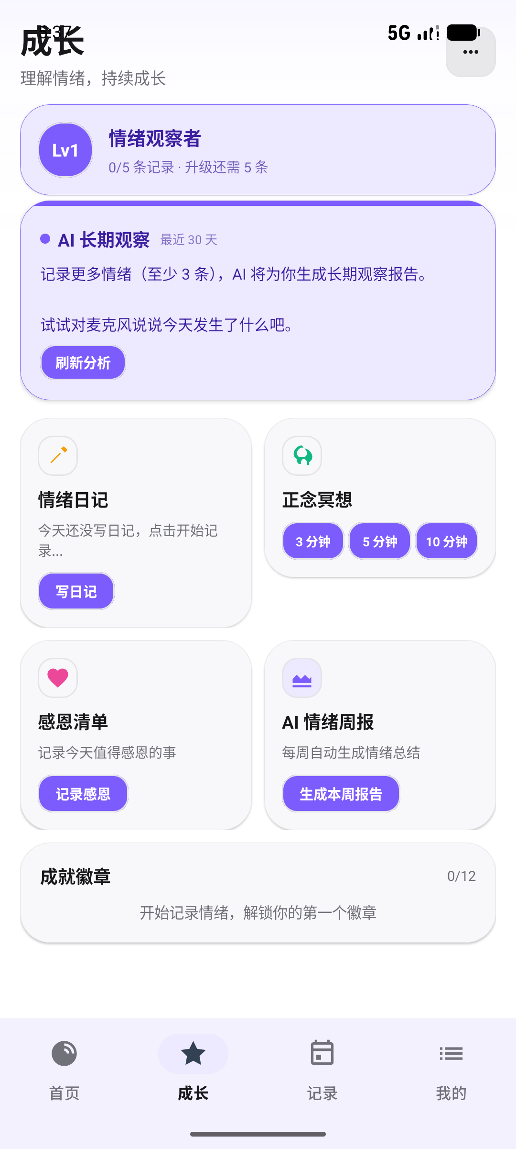
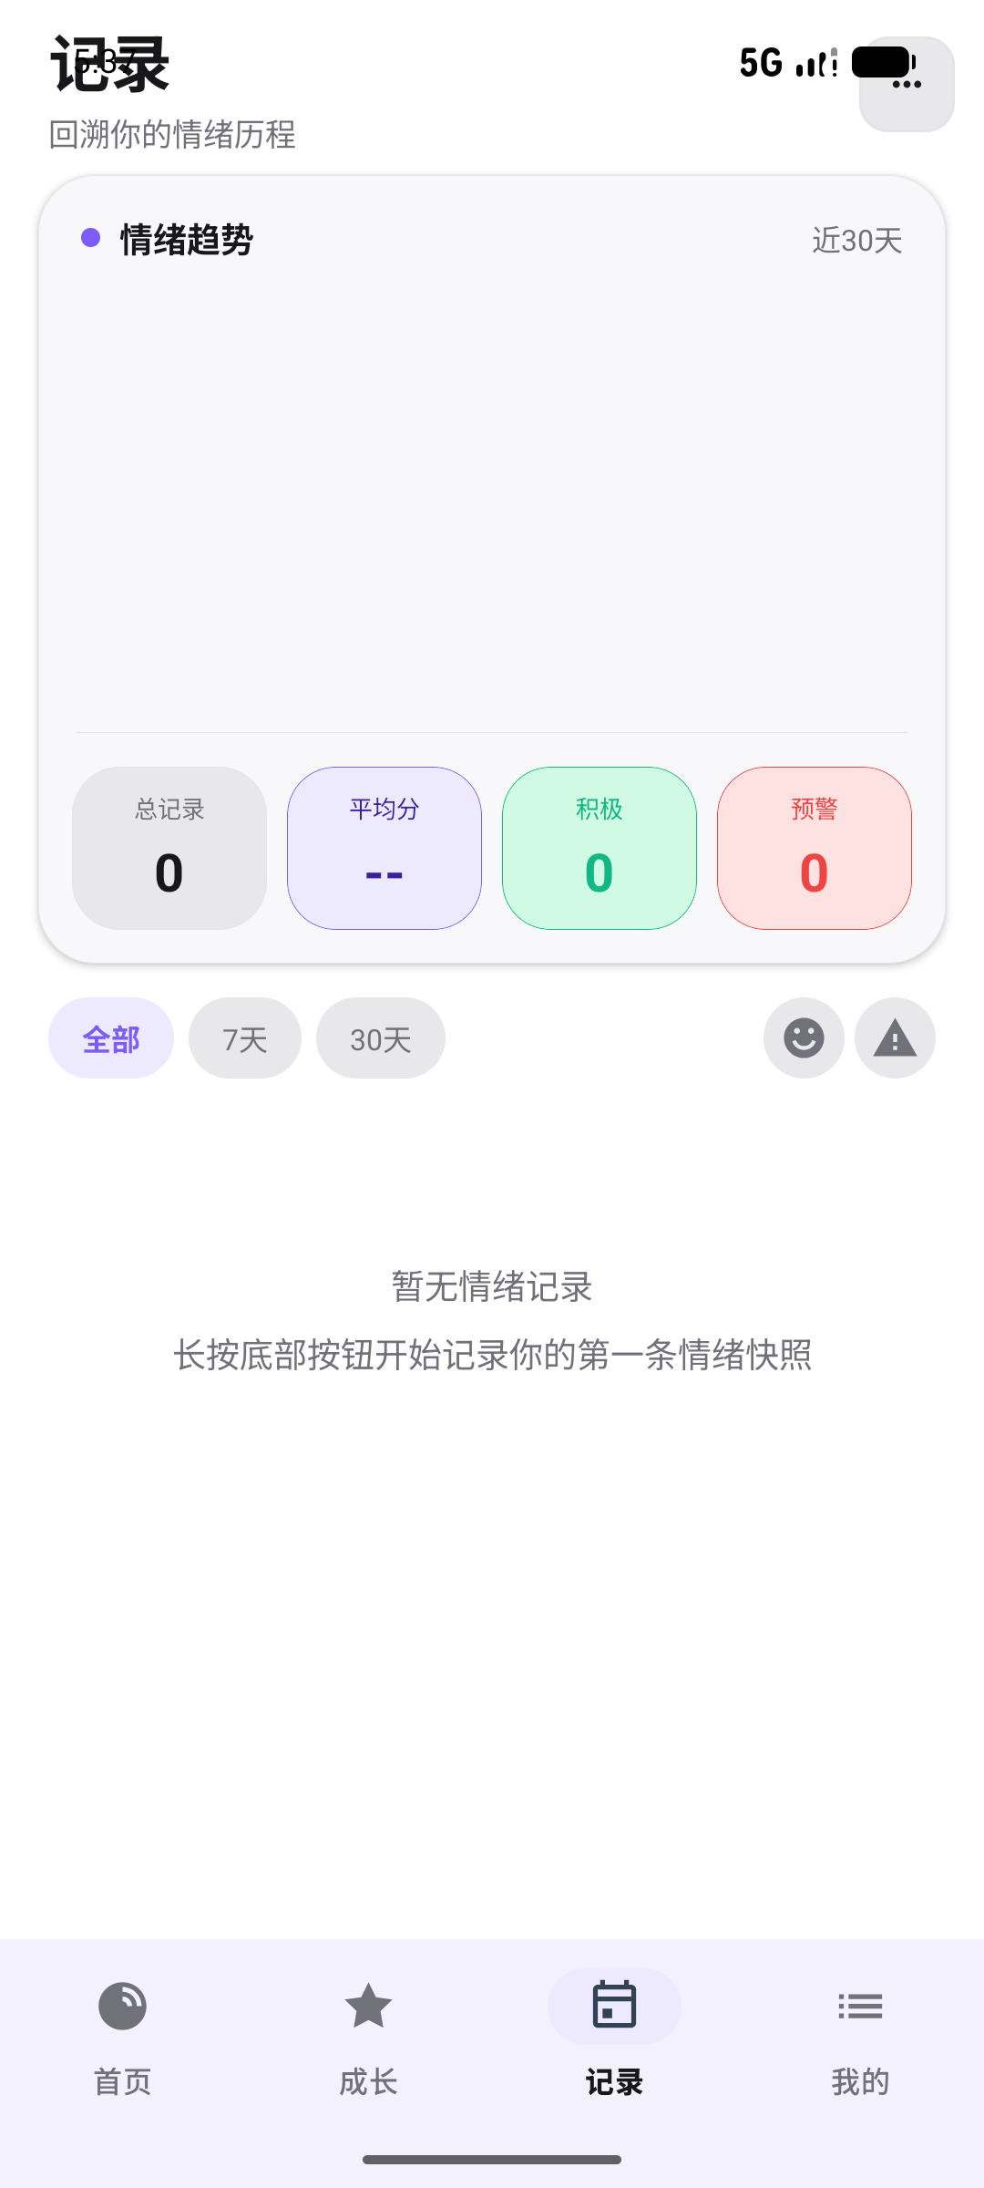
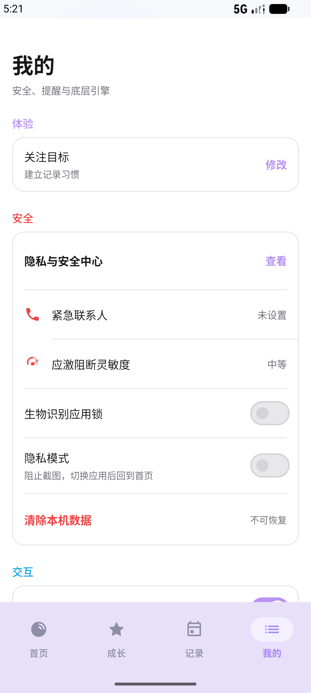
User workflow
The interface connects immediate feedback, gentle action, and long-term review.
Three loops
1. Immediate feedback
2. Reflection and weekly reports
3. Privacy and safety controls
EmoScope | 5-minute oral presentation | 6/10
Notes:
The user workflow has three parts. First, the home screen gives immediate emotional feedback. Second, the growth and wellness functions encourage low-intensity actions, such as journaling, mindfulness, gratitude, and weekly reflection. Third, the records page helps users look back at longer-term emotional changes. This closes the loop from sensing, to interpretation, to action.

Slide 7
Functional evaluation
The prototype was evaluated for engineering feasibility.
4 Hz
>40
3-5 pp
100%
<0.5s
stable facial inference
score range in points
post-EWMA jitter
synthetic extraction accuracy
SOS prompt
What this proves
What it does not prove
Why it matters
The main technical modules can run together in a working Android prototype.
These tests do not establish clinical efficacy or diagnostic accuracy.
Functional stability is the first step before user studies and clinical comparison.
EmoScope | 5-minute oral presentation | 7/10
Notes:
For prototype evaluation, I focused on functional feasibility. Facial inference ran at about four Hertz under normal lighting. The wellness score changed by more than forty points between joy-dominant and anxiety-dominant test conditions. The smoothing filter reduced visible frame jitter to about three to five percentage points. The memory engine also reached one hundred percent extraction accuracy on synthetic ten-emotion records.

Slide 8
Privacy and user agency
The app separates raw sensing, structured support, and final user action.
Ethical stance
Private zone
Minimal sharing
User agency
→
→
The system may suggest support, but it should not turn uncertain emotional inference into automatic high-stakes action.
Camera frames
Blendshape inference
SQLite records
Encrypted keys
Structured mood context
No raw face images
HTTPS request
Readable export
Confirm SOS
Clear local records
Export data
Choose whether to call
Boundary rule: support is guided; escalation is confirmed.
EmoScope | 5-minute oral presentation | 8/10
Notes:
Privacy and user agency are central to the design. Raw facial analysis happens locally, and emotion records are stored on the device. When the language model is used, it receives structured textual context rather than raw face images. Emergency support is also user-confirmed: negative facial signals can show an SOS cue, but the system does not automatically contact others.

Slide 9
Limitations and future work
The prototype is promising, but the evidence boundary must stay clear.
Current limitation
Evaluation gap
Model boundary
Manual blendshape-to-emotion mapping may not generalize across faces, cultures, lighting conditions, and individual habits.
The current tests are functional engineering tests, not clinical validation with real users.
LLM responses are supportive explanations and should not be framed as professional therapy.
Next steps
User study
Fairness audit
PHQ-9 / GAD-7 comparison
Acoustic emotion features
EmoScope | 5-minute oral presentation | 9/10
Notes:
There are still several limitations. The emotion mapping is manually designed, so it may not generalize across different users, cultures, lighting conditions, or facial habits. The current evaluation is engineering validation rather than clinical validation. Future work should include real user studies, fairness evaluation, and comparison with validated scales such as PHQ-9 and GAD-7.

Slide 10
Conclusion
EmoScope demonstrates a practical direction for privacy-preserving emotional self-awareness.
System
Principle
Contribution
On-device facial analysis
Voice-rate estimation
Local memory analytics
Continuous sensing
Cautious interpretation
User-confirmed support
A working prototype that links sensing, reflection, and action.
Thank you
Questions?
EmoScope | 5-minute oral presentation | 10/10
Notes:
To conclude, EmoScope demonstrates a practical direction for privacy-preserving emotional self-awareness. It combines on-device facial analysis, voice-rate estimation, local memory analytics, and user-confirmed support into one mobile workflow. The most important contribution is not a clinical diagnosis, but a safer and more continuous way for users to reflect on emotional change. Thank you.

