Slide 1
EmoScope
Sense
A Privacy-Preserving Mobile System for Multimodal Emotion Recognition
face, voice,
light, records
Ziyang Huang 2025112735
School of Economics and Management, Harbin Institute of Technology
Reflect
score, trend,
weekly report
Core claim
Smartphone sensing can support emotional self-awareness when biometric analysis, memory records, and emergency actions are designed around privacy and user control.
Act
care card,
SOS confirm
EmoScope | 5-minute oral presentation | 1/10
Notes:
Good morning everyone. Today I will present EmoScope. It is a phone app for emotion awareness. It uses face, voice, and records to help users understand their feelings. It also tries to protect privacy.

Slide 2
Why self-report is not enough
Mood diaries miss important moments when recording requires too much effort.
Recall bias
Compliance decay
Missing high-need data
Users reconstruct past feelings after the emotional moment has already changed.
Manual logging is easy to understand but hard to sustain every day.
Stress and fatigue can reduce the willingness to open an app and write.
Design implication
Less typing
A wellness tool should reduce user burden while still giving the user control over interpretation and action.
More continuity
User control
EmoScope | 5-minute oral presentation | 2/10
Notes:
The main problem is mood recording. Many apps ask users to write their mood by themselves. But people may forget, or they may not want to write when they feel tired or stressed.

Slide 3
Research goal and contribution
EmoScope is positioned as a reflection prototype, not a clinical diagnostic system.
Research question
Can a normal smartphone collect helpful emotional context while keeping sensitive biometric analysis mainly on the device?
Reflection,
not diagnosis
Multimodal sensing
Local memory
User-confirmed safety
Face, voice, ambient context, and recent records are combined into one workflow.
Thirty-day records support longer-term emotional reflection.
SOS support is available without automatic escalation.
EmoScope | 5-minute oral presentation | 3/10
Notes:
My research question is simple. Can a normal phone collect useful emotion information and still keep private data safe? EmoScope is not a medical diagnosis tool. It is a reflection tool for daily use.

Slide 4
System architecture
Continuous sensing feeds cautious interpretation and user-facing support.
Input layer
On-device AI
Memory layer
Feedback layer
Camera frames
Voice transcript
Ambient light
User records
→
52 blendshapes
EWMA smoothing
10 emotions
0-100 score
→
SQLite records
30-day trends
Keyword ranking
JSON export
→
Care card
LLM response
Weekly report
SOS support
Design rule
Sensing can be continuous, but interpretation must remain cautious and emergency action must remain user-confirmed.
EmoScope | 5-minute oral presentation | 4/10
Notes:
This is the system design. First, the app gets input from camera, voice, light, and records. Then it analyzes emotion on the phone. After that, it stores records locally and gives feedback to the user.

Slide 5
Emotion scoring model
Blendshape signals are smoothed and converted into a reflective wellness index.
Joy
95
Facial engine
Calm
72
MediaPipe FaceLandmarker returns 52 blendshape coefficients in live-stream mode.
Surprise
50
Fatigue
35
Anxiety
22
Smoothing
15
EWMA with alpha = 0.3 reduces frame-level jitter before feedback is shown.
Anger
Fear
10
Boundary
Reflection index only; not a clinical diagnostic measurement.
EmoScope | 5-minute oral presentation | 5/10
Notes:
For face analysis, EmoScope uses MediaPipe FaceLandmarker. It reads 52 face features. The app maps them to emotions like joy, calm, sadness, and anxiety. A smoothing method makes the result more stable.

Slide 6
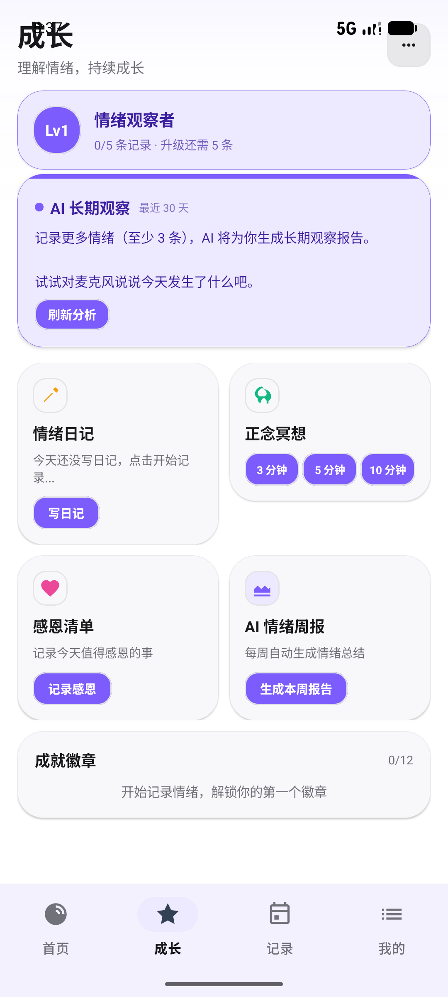
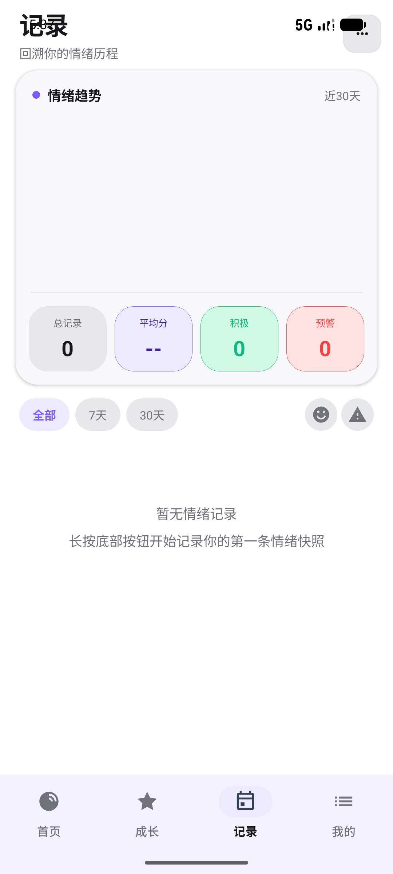
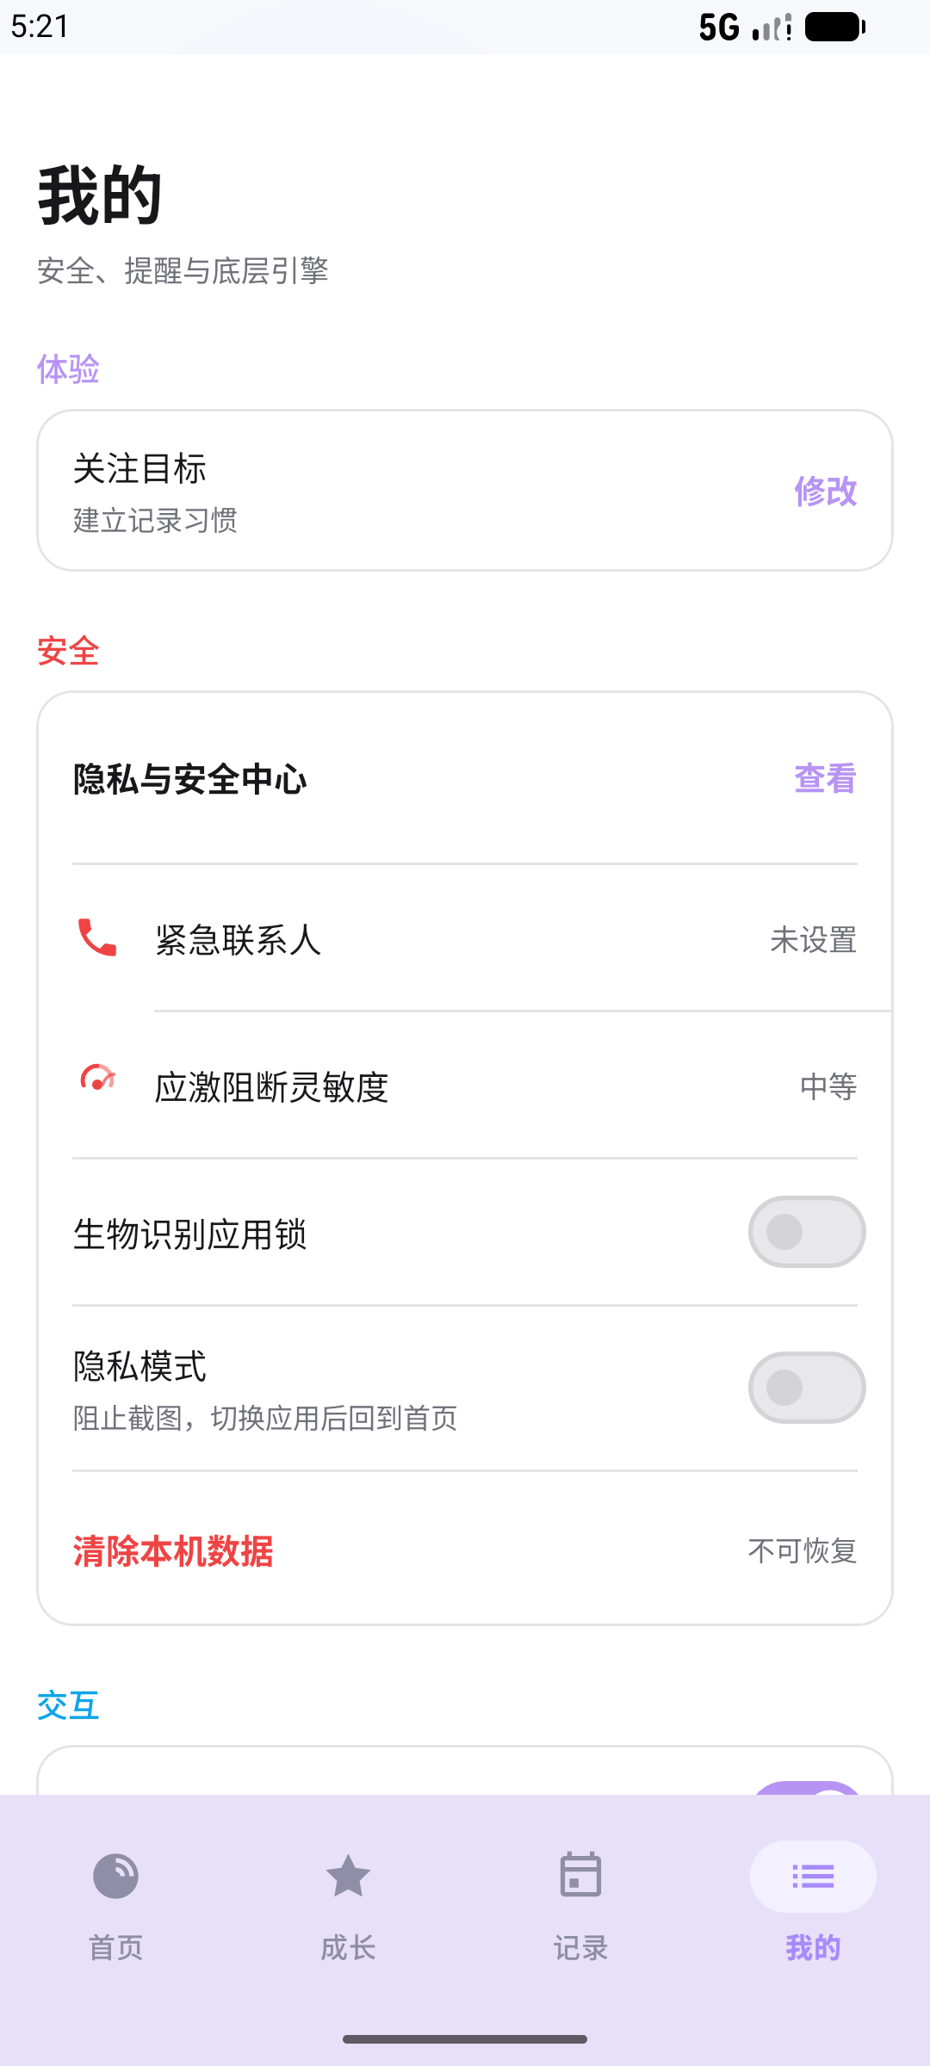
User workflow
The interface connects immediate feedback, gentle action, and long-term review.
Three loops
1. Immediate feedback
2. Reflection and weekly reports
3. Privacy and safety controls
EmoScope | 5-minute oral presentation | 6/10
Notes:
This slide shows the user flow. Users can see feedback, do small wellness activities, and review old records. The goal is not only emotion detection. The goal is to help users reflect and take action.

Slide 7
Functional evaluation
The prototype was evaluated for engineering feasibility.
4 Hz
>40
3-5 pp
100%
<0.5s
stable facial inference
score range in points
post-EWMA jitter
synthetic extraction accuracy
SOS prompt
What this proves
What it does not prove
Why it matters
The main technical modules can run together in a working Android prototype.
These tests do not establish clinical efficacy or diagnostic accuracy.
Functional stability is the first step before user studies and clinical comparison.
EmoScope | 5-minute oral presentation | 7/10
Notes:
I tested the prototype functions. Face analysis ran at about 4 frames per second. The score changed clearly in different test states. The memory parser also worked correctly on test records.

Slide 8
Privacy and user agency
The app separates raw sensing, structured support, and final user action.
Ethical stance
Private zone
Minimal sharing
User agency
→
→
The system may suggest support, but it should not turn uncertain emotional inference into automatic high-stakes action.
Camera frames
Blendshape inference
SQLite records
Encrypted keys
Structured mood context
No raw face images
HTTPS request
Readable export
Confirm SOS
Clear local records
Export data
Choose whether to call
Boundary rule: support is guided; escalation is confirmed.
EmoScope | 5-minute oral presentation | 8/10
Notes:
Privacy is very important in this project. Face data is processed on the phone. Records are stored locally. If SOS support is needed, the user must confirm it. The app does not call others automatically.

Slide 9
Limitations and future work
The prototype is promising, but the evidence boundary must stay clear.
Current limitation
Evaluation gap
Model boundary
Manual blendshape-to-emotion mapping may not generalize across faces, cultures, lighting conditions, and individual habits.
The current tests are functional engineering tests, not clinical validation with real users.
LLM responses are supportive explanations and should not be framed as professional therapy.
Next steps
User study
Fairness audit
PHQ-9 / GAD-7 comparison
Acoustic emotion features
EmoScope | 5-minute oral presentation | 9/10
Notes:
There are still limits. The emotion rules are designed by hand, so they may not fit everyone. The tests are engineering tests, not clinical tests. In the future, I need real user studies.

Slide 10
Conclusion
EmoScope demonstrates a practical direction for privacy-preserving emotional self-awareness.
System
Principle
Contribution
On-device facial analysis
Voice-rate estimation
Local memory analytics
Continuous sensing
Cautious interpretation
User-confirmed support
A working prototype that links sensing, reflection, and action.
Thank you
Questions?
EmoScope | 5-minute oral presentation | 10/10
Notes:
In conclusion, EmoScope shows one possible way to build a safer emotion app. It combines phone sensing, local memory, and user-controlled support. It helps users notice emotional changes. Thank you.

