Slide 1
Towards learning disentangled explanatory factors from which gene expression data is generated
2019-03

Slide 2
Contents
What to do
Disentangle models and metrics
Related work in biology
工作计划

Slide 3









What to do
X
X
Y
Generative Model
Inference Model
$$z_{3}$$
$$z_{3}$$
$$z_{3}$$
Perturbations
$$z_{1}$$
$$z_{2}$$
$$z_{1}$$
$$z_{2}$$
$$z_{1}$$
$$z_{2}$$
Meaningful Factors
Meaningful Factors
Variational Autoencoders Disentanglement
Designed model

Slide 4
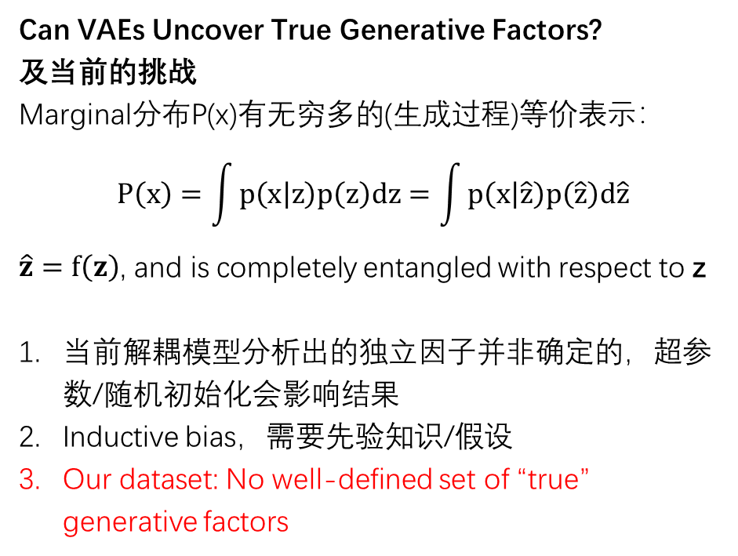
Disentangle models and metrics
X
Can VAEs Uncover True Generative Factors?
及当前的挑战
Marginal分布P(x)有无穷多的(生成过程)等价表示：
$$P\left(x\right)=\int{p\left(x | z\right)p\left(z\right)dz}=\int{p\left(x | \hat{z}\right)p\left(\hat{z}\right)d\hat{z}}$$
$\hat{z}=f\left(z\right)$, and is completely entangled with respect to z
当前解耦模型分析出的独立因子并非确定的，超参数/随机初始化会影响结果
Inductive bias，需要先验知识/假设
Our dataset: No well-defined set of “true” generative factors
Generative Model
Inference Model
$$z_{3}$$
$$z_{1}$$
$$z_{2}$$
Meaningful Factors
Variational Autoencoders Disentanglement
Challenging Common Assumptions in the Unsupervised Learning of Disentangled Representations, ICML2019

Slide 5
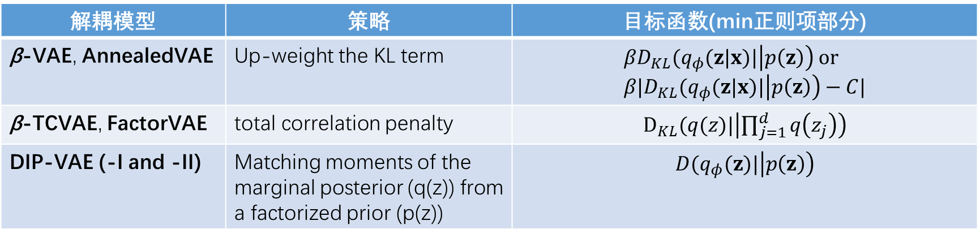
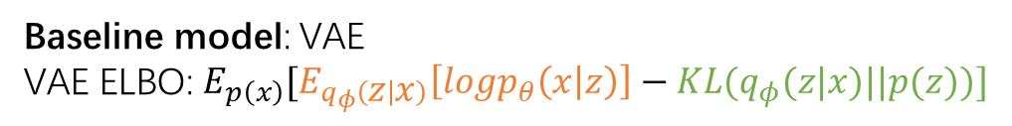
Disentangle models and metrics
Models
Baseline model: VAE
VAE ELBO: $E_{p\left(x\right)}[E_{q_{φ}\left(z | x\right)}\left[logp_{θ}\left(x | z\right)\right]−KL(q_{φ}(z|x)||p(z))]$
解耦模型 | 策略 | 目标函数(min正则项部分)
β-VAE, AnnealedVAE | Up-weight the KL term | $$βD_{KL}(q_{φ}(z|x)|\left|p\left(z\right)\right) or \\ β|D_{KL}(q_{φ}(z|x)|\left|p\left(z\right)\right)−C|$$
β-TCVAE, FactorVAE | total correlation penalty | $D_{KL}(q(z)|\left|\prod_{j=1}^{d}{q\left(z_{j}\right)}\right)$
DIP-VAE (-I and -II) | Matching moments of the marginal posterior (q(z)) from a factorized prior (p(z)) | $$D(q_{φ}(z)|\left|p\left(z\right)\right)$$
Notes:
factorVAE: https://arxiv.org/pdf/1802.05983.pdf
AnnealedVAE: https://arxiv.org/pdf/1804.03599.pdf
DIP-VAE: https://arxiv.org/pdf/1711.00848.pdf
对beta-VAE正则的疑问：对每一维zi而言，q(zi|x)与p(zi)的KL距离小代表该维信息容量小；总体而言，又鼓励q(z|x)与p(z)的距离小。为什么？

Slide 6
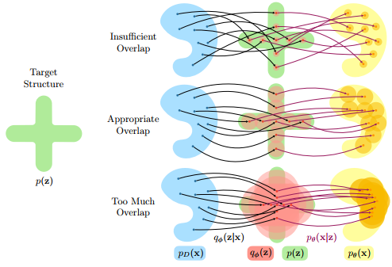
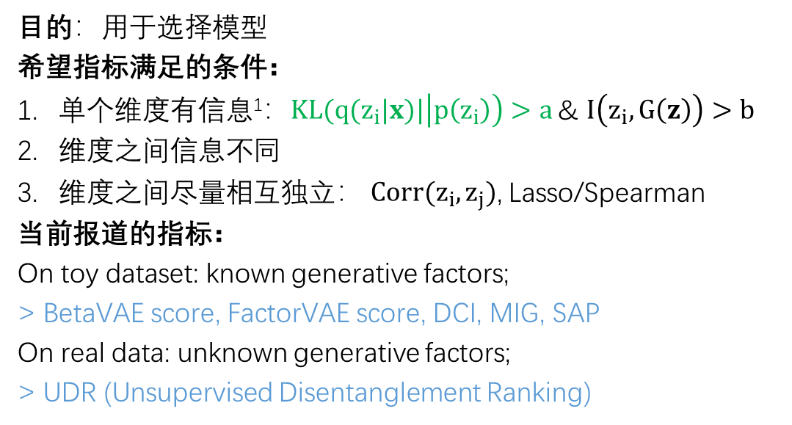
Disentangle models and metrics
Metrics
目的：用于选择模型
希望指标满足的条件：
单个维度有信息¹：$KL(q(z_{i}|x)|\left|p\left(z_{i}\right)\right)>a$ & $I\left(z_{i},G\left(z\right)\right)>b$
维度之间信息不同
维度之间尽量相互独立： $Corr(z_{i}, z_{j})$, Lasso/Spearman
当前报道的指标：
On toy dataset: known generative factors;
> BetaVAE score, FactorVAE score, DCI, MIG, SAP
On real data: unknown generative factors;
> UDR (Unsupervised Disentanglement Ranking)
Our dataset: No well-defined set of “true” generative factors
1. 可以参考AnnealedVAE，或者UDR
Notes:
$KL(q(z_{i}|x)|\left|p\left(z_{i}\right)\right)>threshold$的理解：如果对于样本点，µi 总是0，σi 总是1，意味着latent channels zi have zero capacity（没有样本信息） 。
capacity of the latent channels can only be increased by dispersing the posterior means across the data points, or decreasing the posterior variances, which both increase the KL divergence term.
此外，对$I\left(z_{i},G\left(z\right)\right)$的计算是否可以参考infoGAN?

Slide 7
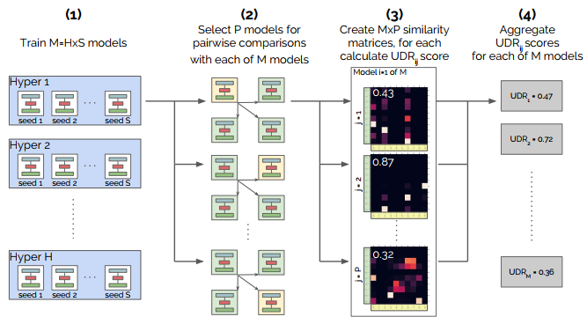

UDR – a first try applied to real world data
Most current model selection need the ground truth generative process and/or attribute labels, which are required by all the currently existing disentanglement metrics
UDR (Unsupervised Disentanglement Ranking) need no ground truth generative process labels
Schematic illustration of the UDR method
Unsupervised Model Selection for Variational Disentangled Representation Learning., ICLR2020

Slide 8
Related work in biology
No landmark exploration in this field.
Some related:
‘Tybalt’ model:
Todo:
1）learn biological signals with VAE;
Data:
1）TCGA data, 10459(samples)ⅹ5000(genes), across 33 cancer-types
Result:
1）已知factor. 例如，male/female, mesenchymal/proliferative/immunoreactive/differentiated states;
2）结果非常粗糙
Extracting a Biologically Relevant Latent Space from Cancer Transcriptomes with VAE, bioRxiv2017.

Slide 9
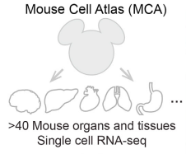
工作计划
数据集
First, single cell expression data, such as MCA
representative, well-annotated subset of MCA data¹, containing 61,637 cells sampled from 43 tissues;
Second, adapted to LINCS data, and applied to our model
模型设置
https://github.com/huanhuan-li/AI2GE4DD
评价指标
训练指标
解耦指标（Page6）
当前结果
各解耦模型均可训练，快速（<1e5 epochs, <3h）
下一步
系统评估及筛选模型
尝试对结果的解释
1. Han et al., Cell 2018
Notes:
解耦的performance是否与最终预测任务的performance有相关关系;

Slide 10
结果
训练指标（重构能力等）
隐变量
隐变量生物学意义分析

Slide 11
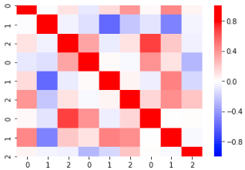
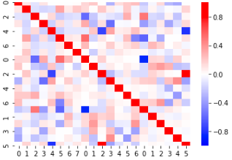
结果
Beta=10

