Slide 1
AI2GE4DD
2019-12
AI2DD group

Slide 2
Contents
Intro to VAE and disentangle VAE;
Intro to our model (not perfect yet);
Intro to dataset;
Discuss the work plan and timeline;
Related work;

Slide 3
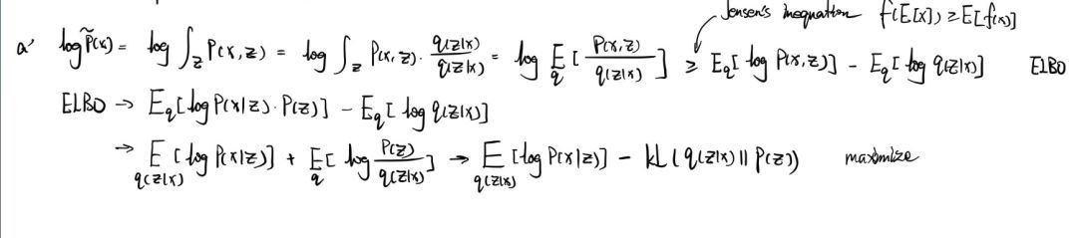
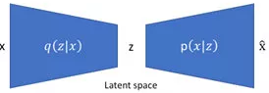

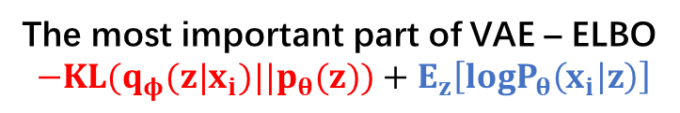
Model – intro to VAE
VAE：基于最大似然，引入变分分布$q_{φ}(z|x_{i})$
The most important part of VAE – ELBO
$$−KL(q_{φ}(z|x_{i})||p_{θ}(z))+E_{z}\left[logP_{θ}\left(x_{i} | z\right)\right]$$

Slide 4
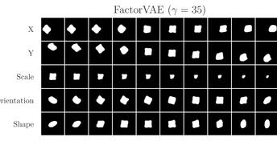

Model – disentangle VAE
Disentangle VAE: 强迫$q_{φ}(z|x_{i})$中z各维独立
解耦模型: | 解耦指标:
BetaVAE Beta-TCVAE FactorVAE AnnealedVAE DIP-VAE-I DIP-VAE-II | BetaVAE评分， FactorVAE评分， MIG SAP， Modularity DCI Disentanglement
Disentangle VAE

Slide 5




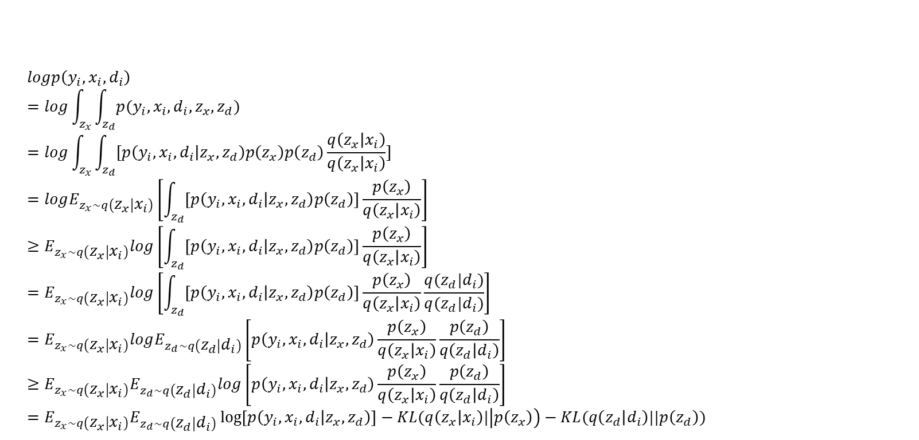



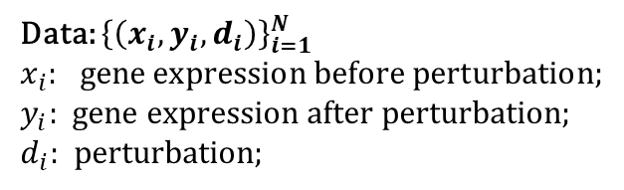

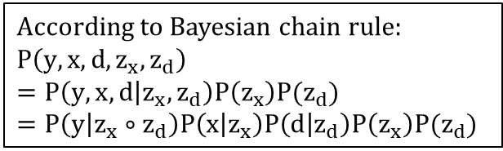
Our prj - AI2GE4DD
Data: ${\left\{\left(x_{i},y_{i},d_{i}\right)\right\}}_{i=1}^{N}$
$x_{i}:$gene expression before perturbation; $y_{i}:$ gene expression after perturbation;
$d_{i}:$perturbation;
$$z_{x}$$
$$z_{y}$$
$$z_{d}$$
According to Bayesian chain rule:
$$P\left(y,x,d, z_{x},z_{d}\right) \\ =P\left(y,x,d | z_{x},z_{d}\right)P\left(z_{x}\right)P(z_{d}) \\ =P\left(y | z_{x}∘z_{d}\right)P\left(x | z_{x}\right)P\left(d | z_{d}\right)P\left(z_{x}\right)P(z_{d})$$
$$x$$
$$y$$
$$d$$
$$logp\left(y_{i},x_{i},d_{i}\right) \\ =log\int_{z_{x}}{\int_{z_{d}}{p(y_{i},x_{i},d_{i},z_{x},z_{d})}} \\ =log\int_{z_{x}}{\int_{z_{d}}{[p\left(y_{i},x_{i},d_{i} | z_{x},z_{d}\right)p\left(z_{x}\right)p\left(z_{d}\right)\frac{q\left(z_{x} | x_{i}\right)}{q\left(z_{x} | x_{i}\right)}]}} \\ =logE_{z_{x}∼q\left(z_{x} | x_{i}\right)}\left[\int_{z_{d}}{\left[p\left(y_{i},x_{i},d_{i} | z_{x},z_{d}\right)p\left(z_{d}\right)\right]\frac{p\left(z_{x}\right)}{q\left(z_{x} | x_{i}\right)}}\right] \\ ≥E_{z_{x}∼q\left(z_{x} | x_{i}\right)}log\left[\int_{z_{d}}{\left[p\left(y_{i},x_{i},d_{i} | z_{x},z_{d}\right)p\left(z_{d}\right)\right]\frac{p\left(z_{x}\right)}{q\left(z_{x} | x_{i}\right)}}\right] \\ =E_{z_{x}∼q\left(z_{x} | x_{i}\right)}log\left[\int_{z_{d}}{\left[p\left(y_{i},x_{i},d_{i} | z_{x},z_{d}\right)p\left(z_{d}\right)\right]\frac{p\left(z_{x}\right)}{q\left(z_{x} | x_{i}\right)}\frac{q(z_{d}|d_{i})}{q(z_{d}|d_{i})}}\right] \\ =E_{z_{x}∼q\left(z_{x} | x_{i}\right)}logE_{z_{d}∼q\left(z_{d} | d_{i}\right)}\left[p\left(y_{i},x_{i},d_{i} | z_{x},z_{d}\right)\frac{p\left(z_{x}\right)}{q\left(z_{x} | x_{i}\right)}\frac{p\left(z_{d}\right)}{q\left(z_{d} | d_{i}\right)}\right] \\ ≥E_{z_{x}∼q\left(z_{x} | x_{i}\right)}E_{z_{d}∼q\left(z_{d} | d_{i}\right)}log\left[p\left(y_{i},x_{i},d_{i} | z_{x},z_{d}\right)\frac{p\left(z_{x}\right)}{q\left(z_{x} | x_{i}\right)}\frac{p\left(z_{d}\right)}{q\left(z_{d} | d_{i}\right)}\right] \\ =E_{z_{x}∼q\left(z_{x} | x_{i}\right)}E_{z_{d}∼q\left(z_{d} | d_{i}\right)}\log\left[p\left(y_{i},x_{i},d_{i} | z_{x},z_{d}\right)\right]−KL(q\left(z_{x} | x_{i}\right)|\left|p\left(z_{x}\right)\right)−KL(q\left(z_{d} | d_{i}\right)||p\left(z_{d}\right))$$
←Bayesian rule, then multiply by constant $\frac{q\left(z_{x} | x_{i}\right)}{q\left(z_{x} | x_{i}\right)}$
← Jensen’s 不等式
← multiply by constant $\frac{q(z_{d}|d_{i})}{q(z_{d}|d_{i})}$
← Jensen’s 不等式
←目标函数

Slide 6



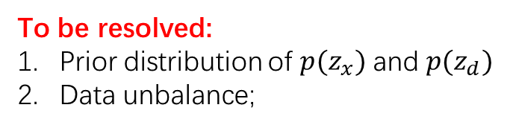
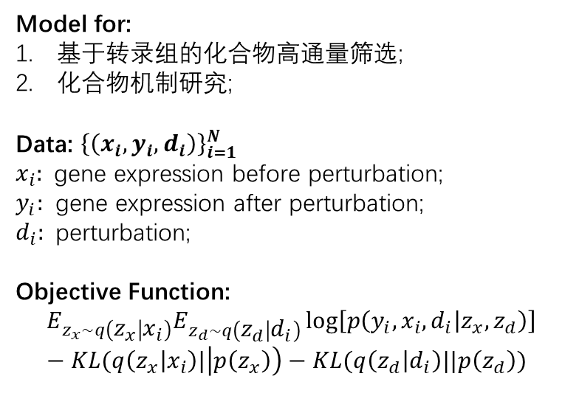






Our prj - AI2GE4DD
Model for:
基于转录组的化合物高通量筛选;
化合物机制研究;
Data: ${\left\{\left(x_{i},y_{i},d_{i}\right)\right\}}_{i=1}^{N}$
$x_{i}:$gene expression before perturbation; $y_{i}:$ gene expression after perturbation;
$d_{i}:$perturbation;
Objective Function:
$$E_{z_{x}∼q\left(z_{x} | x_{i}\right)}E_{z_{d}∼q\left(z_{d} | d_{i}\right)}\log\left[p\left(y_{i},x_{i},d_{i} | z_{x},z_{d}\right)\right]−KL(q\left(z_{x} | x_{i}\right)|\left|p\left(z_{x}\right)\right)−KL(q\left(z_{d} | d_{i}\right)||p\left(z_{d}\right))$$
Model structure:
$$x$$
$$d$$
$$z_{x}$$
$$z_{y}$$
$$z_{d}$$
$$x$$
$$y$$
$$d$$
$$z_{y}=z_{x}∘z_{d}$$
Algorithm
To be added …
To be resolved:
Prior distribution of $p(z_{x})$ and $p(z_{d})$
Data unbalance;

Slide 7
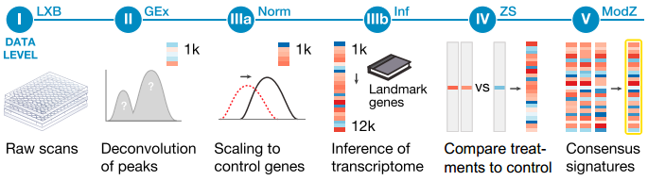
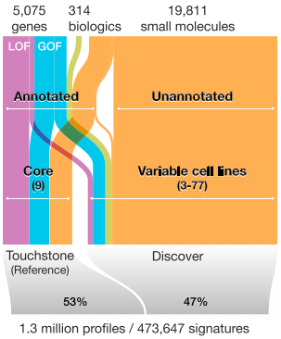

Dataset – L1000
Downloaded (Length: 52407725132 (49G))
CMap-L1000v1 (GEO: GSE92742)
(I) Raw bead count and fluorescence intensity measured by Luminex scanners.
(II) Deconvoluted data to assign expression levels to two transcripts measured on the same bead.
(IIIa) Normalization to adjust for non-biological variation.
(IIIb) Inferred expression of 12,328 genes from measurement of 978 landmarks.
(IV) Differential expression values. (V) Signatures representing collapse of replicate profiles.
More detail about normalization:
loess regression, curve fit by ‘housekeeping’ gene;
Quantile normalization on each plate
Inference:
Subramanian et al., 2017, Cell 171, 1437–1452
http://lincsportal.ccs.miami.edu/dcic-portal/
http://www.lincsproject.org/
Notes:
https://clue.io/connectopedia/core_cmap_cell_panel
Number of profiles from different cell types
Percentage of profiles before perturbation
Ratio of profiles after-treatment/before-treatment

Slide 8
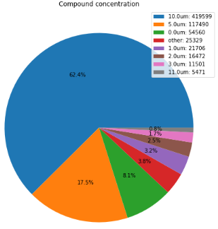
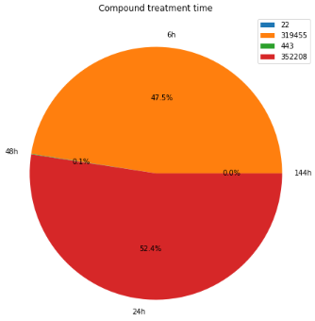
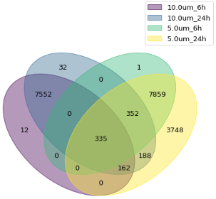
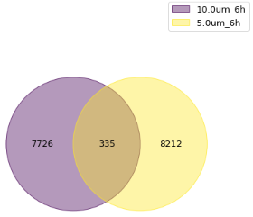
Dataset – L1000
Cell type 1
 | C₁@d@t | … | C_{M}@d@t
Gene1
…
GeneN
 | profiles | Compd types | Cell types
1. compounds@all@all 2. compounds@10uM@6h 3. compounds@10uM@24h 4. compounds@5uM@6h 5. compounds@5uM@24h | 672128 228984 190402 23916 93499 | 19812 8062 8621 8547 12644 | 71 67 30 53 12
Cell type 2
 | C₁@d@t | … | C_{M}@d@t
Gene1
…
GeneN
Cell type 3
 | C₁@d@t | … | C_{M}@d@t
Gene1
…
GeneN
Cell type 4
 | C₁@d@t | … | C_{M}@d@t
Gene1
…
GeneN
Cell type M
 | C₁@d@t | … | C_{M}@d@t
Gene1
…
GeneN
Perturbation:
compound structure + dose + treatment time
不同浓度间，化合物overlap较少
LINCS测试逻辑应该是: 测试一个浓度两个时间点

Slide 9
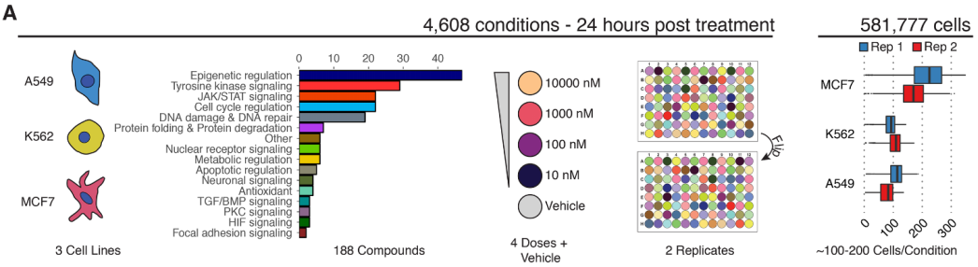
Dataset – Single Cells
chemical transcriptomics at single-cell resolution
S. R. Srivatsan et al., Science 2019

Slide 10
Work plan and timeline
原则：快速跑通流程, 得到结果, 之后迭代;
跑通流程;
Dataset (data format suitable for model training)
Model (Working environment: Dinglab server and GHDDI cluster)
Evaluation
Literature research;
Apply disentangle model to gene expression data, and try to explain latent space;
Learn more about related work and baseline;
02-22
04-01
05-20
组内开题
组内中期
组内答辩
Timeline
03-08
04-12
05-31
毕设开题
毕设中期
毕设答辩

Slide 11
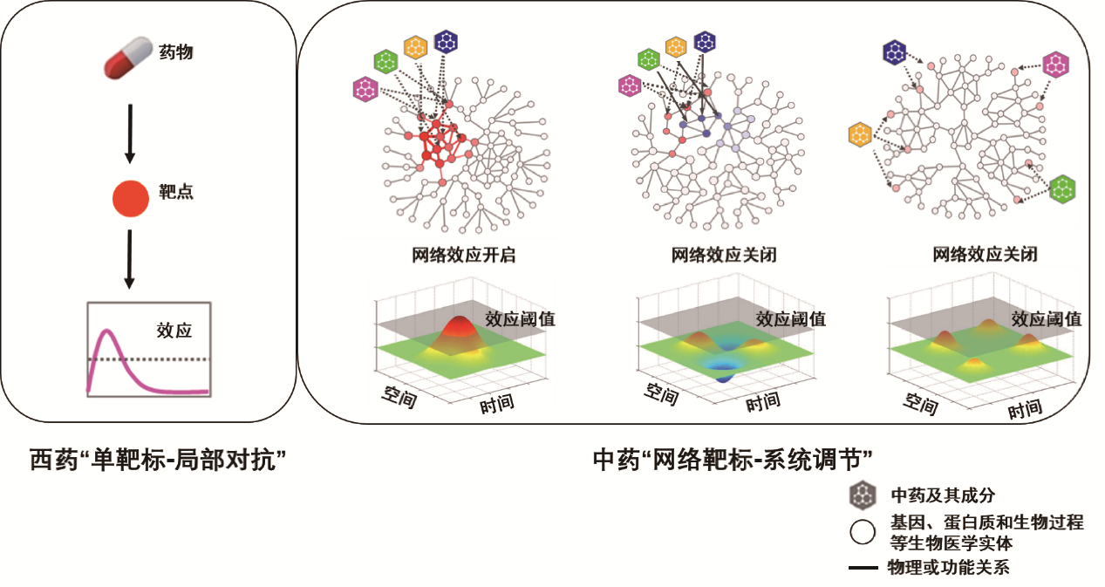
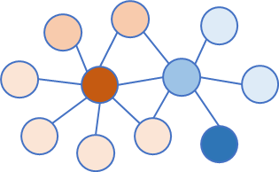
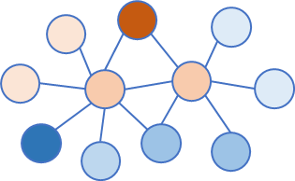
Why Graph Nets: modeling of the ‘network target’
Modeling ‘network target’ on the transcription level
The Rationale of ‘network target’
perturbation
Affect on the network
t0
t1
Features of the ‘difference’ on the level of graph
Graph Neural Network
Notes:
Hypothesis: fixed treatment type (pulse?); fixed concentration; fixed time interval

