Slide 1
Finding Feshbach resonances, fast
Huan Bui
ZGS Sep 01, 2023

Slide 2
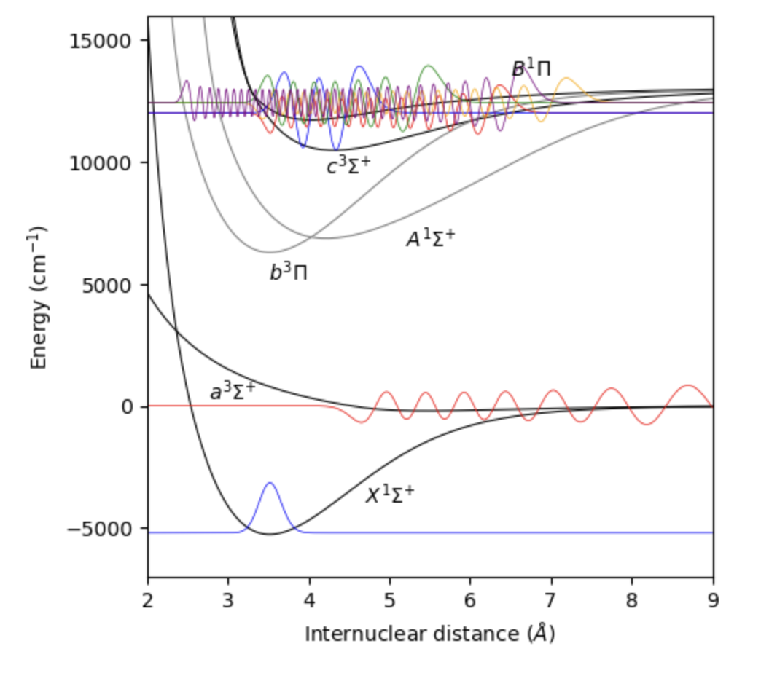
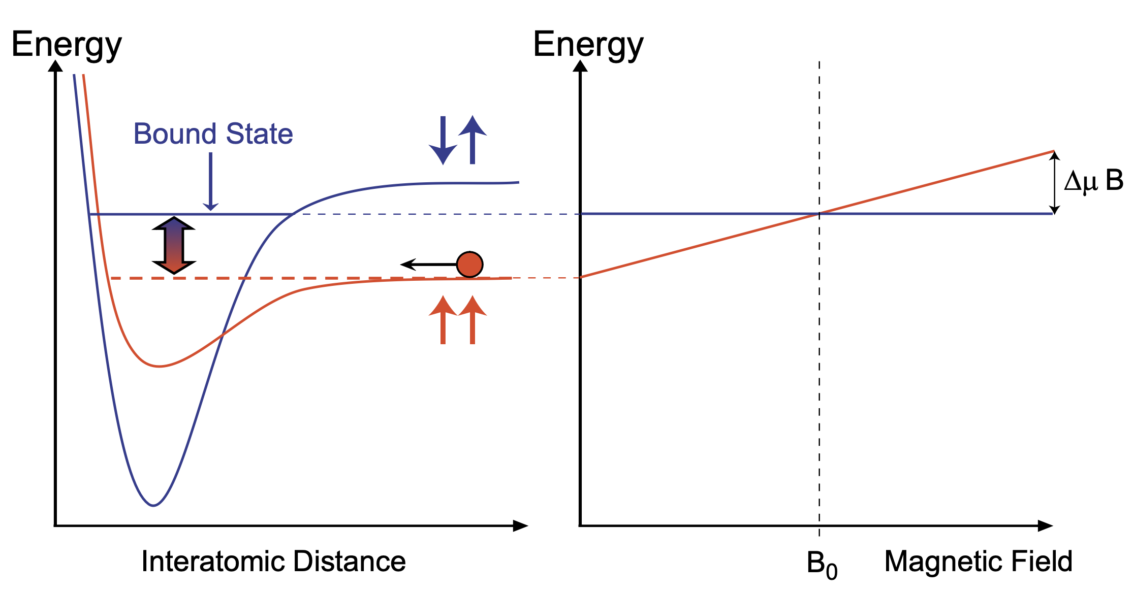
Feshbach resonances revisited
²³Na⁴⁰K
Ground-state alkali atoms collide
Collisions occur within singlet and triplet electronic potentials
A Feshbach resonance occurs when e.g.
Energy _{two atoms in triplet channel} = Energy _{FB molecule in singlet channel}
Singlet-triplet coupling due to hyperfine interaction
Tunable resonance due to differential magnetic moment
triplet
singlet
AMO II S’23, Pset 8

Slide 3
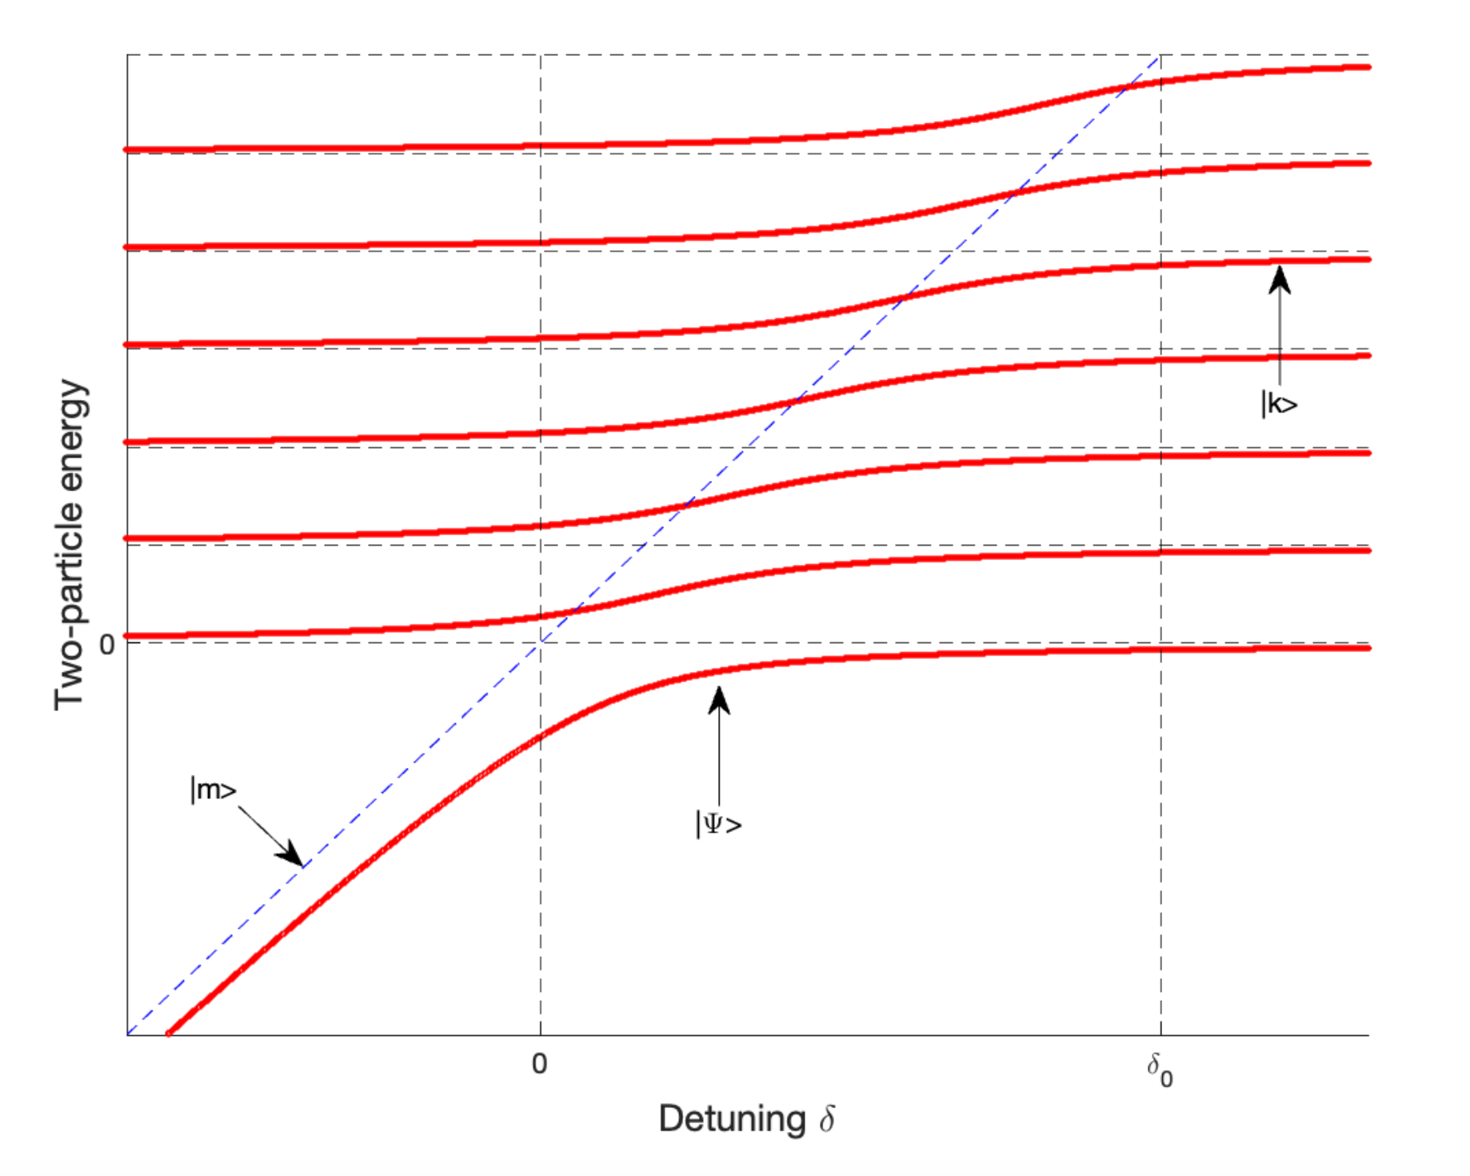
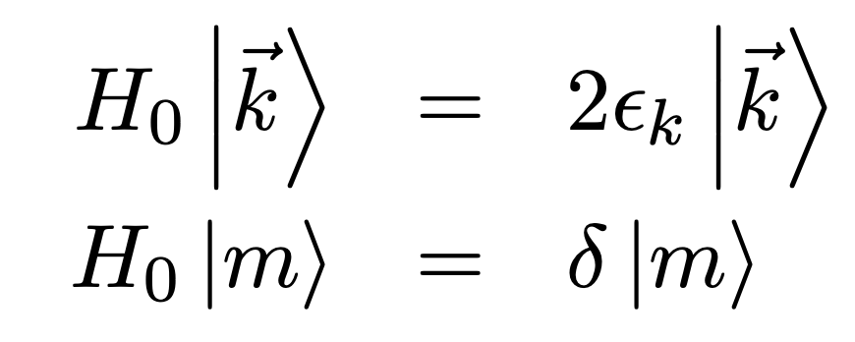
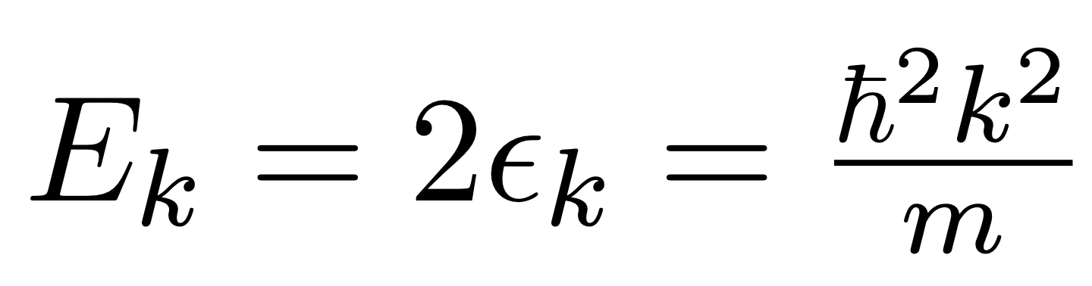
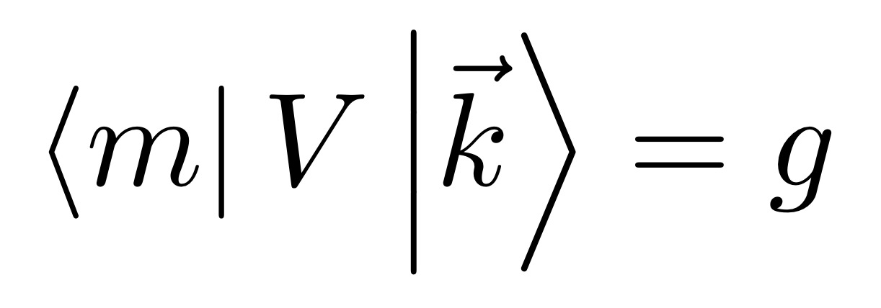
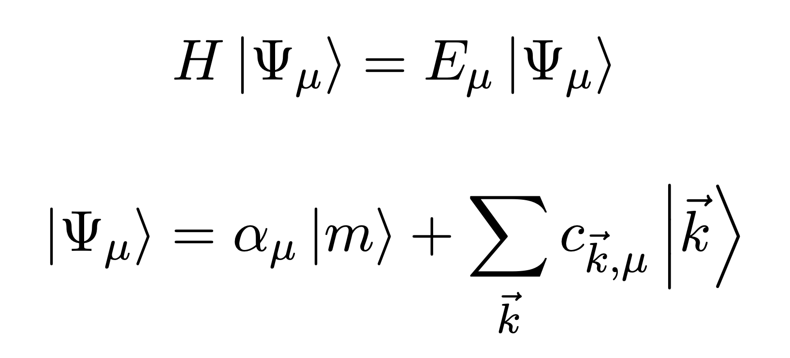

Feshbach resonances: a model from AMO II
A discrete state $\left|m\right\rangle$ coupled to a continuum of states$\left|\vec{k}\right\rangle$:
Solve:
Result:
Molecular binding energy quadratically
Coupling to continuum gives a shift and a width
FB resonance

Slide 4
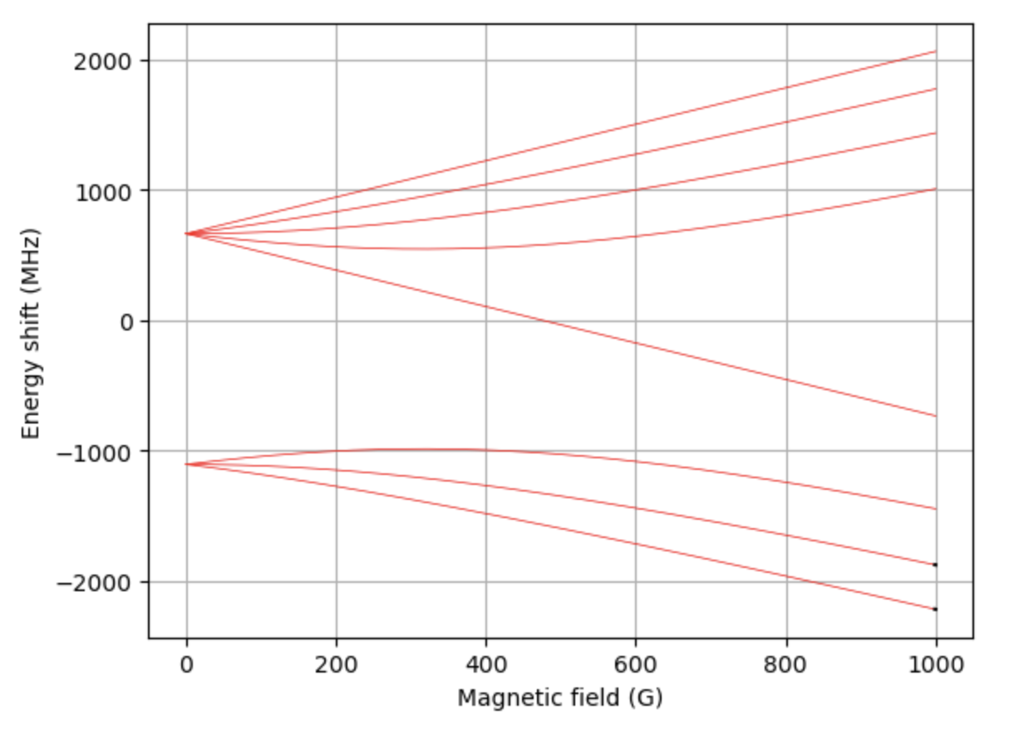
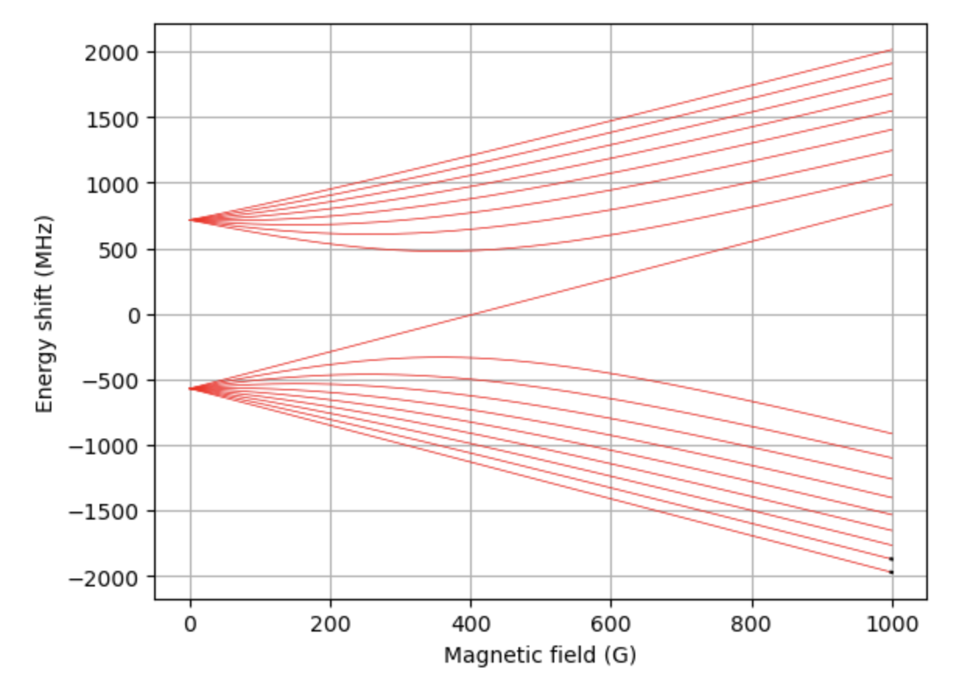
Feshbach resonances: the reality
Scenario: Find FB resonances in e.g. ²³Na⁴⁰K, ⁶Li⁴⁰K, or ⁶Li₂ from spectroscopic data
Problem:
Find Feshbach resonances & widths
Find binding energies of Feshbach molecules
Solution: Calculate, then measure. Two existing methods:
Coupled-channel calculation
Asymptotic bound-state model

Slide 5
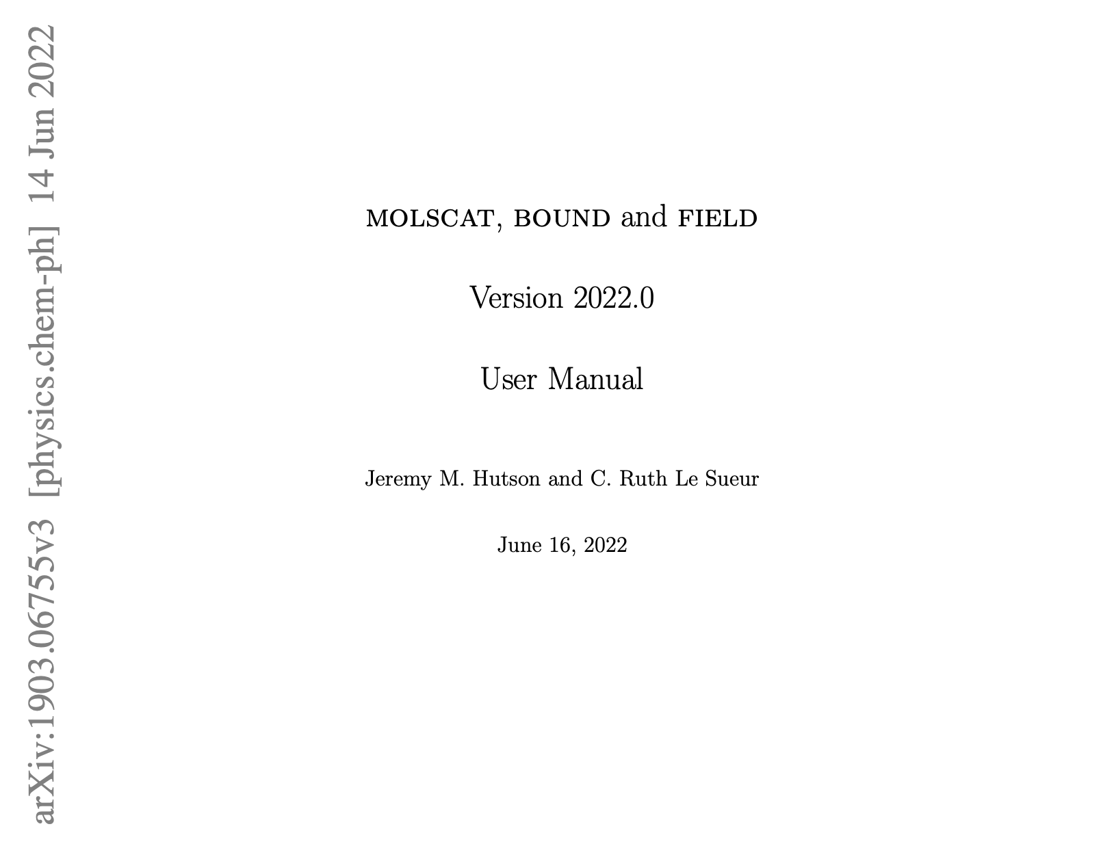
Coupled-channel calculations (CC)
Interactions have spin + orbital degrees of freedom
Resulting in coupled radial SE’s in spin basis
Numerically solve for scattering properties + bound states
Dedicated program by J. M. Hutson & C. R. L. Sueur
3 Fortran programs (code available on Github here):
MOLSCAT (arXiv), BOUND & FIELD (arXiv)
Drawbacks:
Interaction potentials typically not accurate enough
Many degrees of freedom → time consuming
Numerical issues (grid size & numerical accuracy)
Not easy to learn how to use and implement!
210-page user manual

Slide 6
Asymptotic Bound-state Model (ABM)
Tobias Tiecke et al (Phys. Rev. A 82, 042712)
Model description
Obtaining input parameters
Implementation (examples)
Extensions

Slide 7
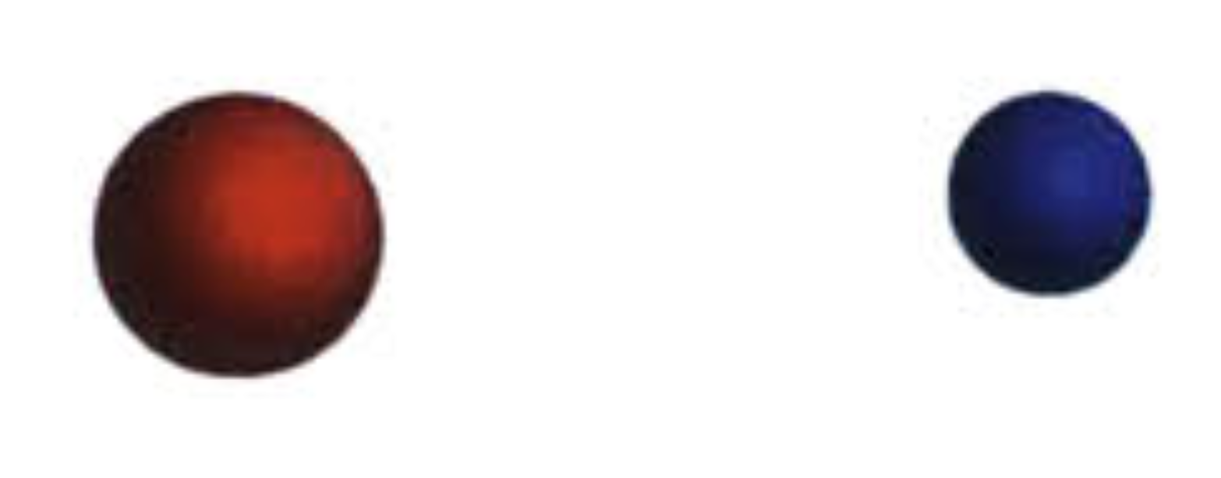
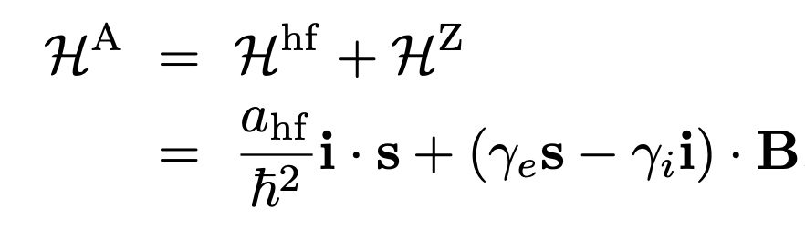

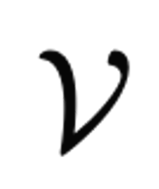
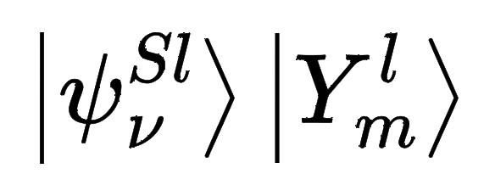
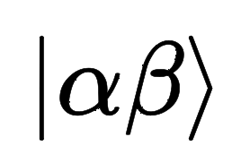
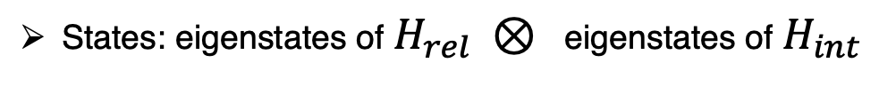

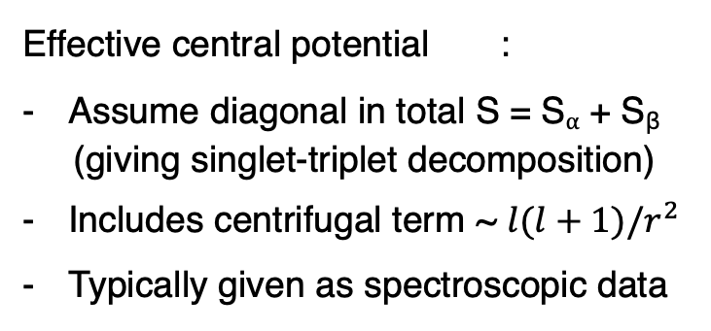
ABM description: Setup
Two atoms ⍺ and β in their electronic ground state
Hamiltonian = Relative motion in COM frame + Internal energy
+ atom β
Effective central potential :
Assume diagonal in total S = S⍺ + S_{β}
(giving singlet-triplet decomposition)
Includes centrifugal term ~ $l(l+1)/r^{2}$
Typically given as spectroscopic data
You may already have this part on your laptop!
States: eigenstates of $H_{rel} ⊗$ eigenstates of $H_{int}$
Bound-state wfns of $V^{S,l}(r)$
Breit-Rabi basis

Slide 8
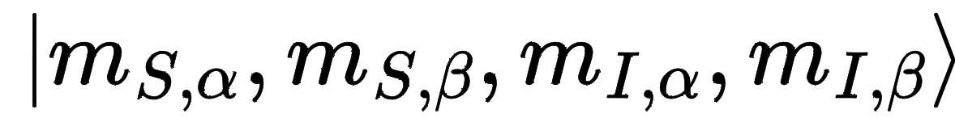
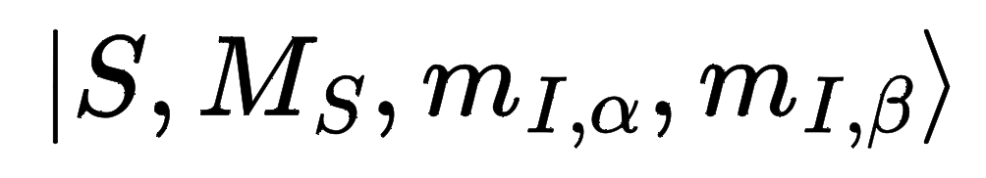

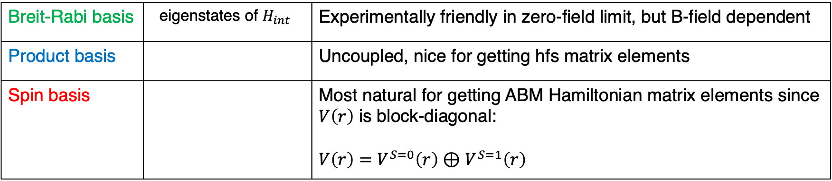

ABM description: Basis states
States: eigenstates of $H_{rel} ⊗$ eigenstates of $H_{int}$
Some bases are more natural than others in different circumstances → need B-field dependent unitaries
Spin basis is most convenient for getting ABM Hamiltonian matrix elements
Bound-state wfns of $V^{S,l}(r)$
Breit-Rabi basis
Breit-Rabi basis | eigenstates of $H_{int}$ | Experimentally friendly in zero-field limit, but B-field dependent
Product basis |  | Uncoupled, nice for getting hfs matrix elements
Spin basis |  | Most natural for getting ABM Hamiltonian matrix elements since $V\left(r\right)$ is block-diagonal: $V\left(r\right)=V^{S=0}\left(r\right)⊕$ $V^{S=1}\left(r\right)$

Slide 9
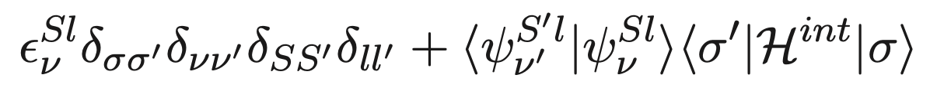
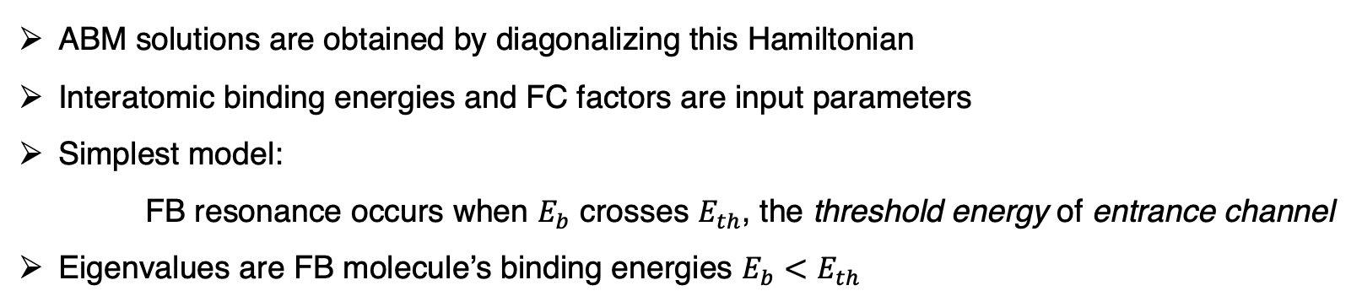
ABM description: Hamiltonian matrix elements
In ABM spin basis:
Spin degree of freedom
Binding energy of
Relative motion Hamiltonian
is diagonal in spin basis
Franck-Condon factor
ABM solutions are obtained by diagonalizing this Hamiltonian
Interatomic binding energies and FC factors are input parameters
Simplest model:
FB resonance occurs when $E_{b}$ crosses $E_{th}$, the threshold energy of entrance channel
Eigenvalues are FB molecule’s binding energies $E_{b}<E_{th}$

Slide 10
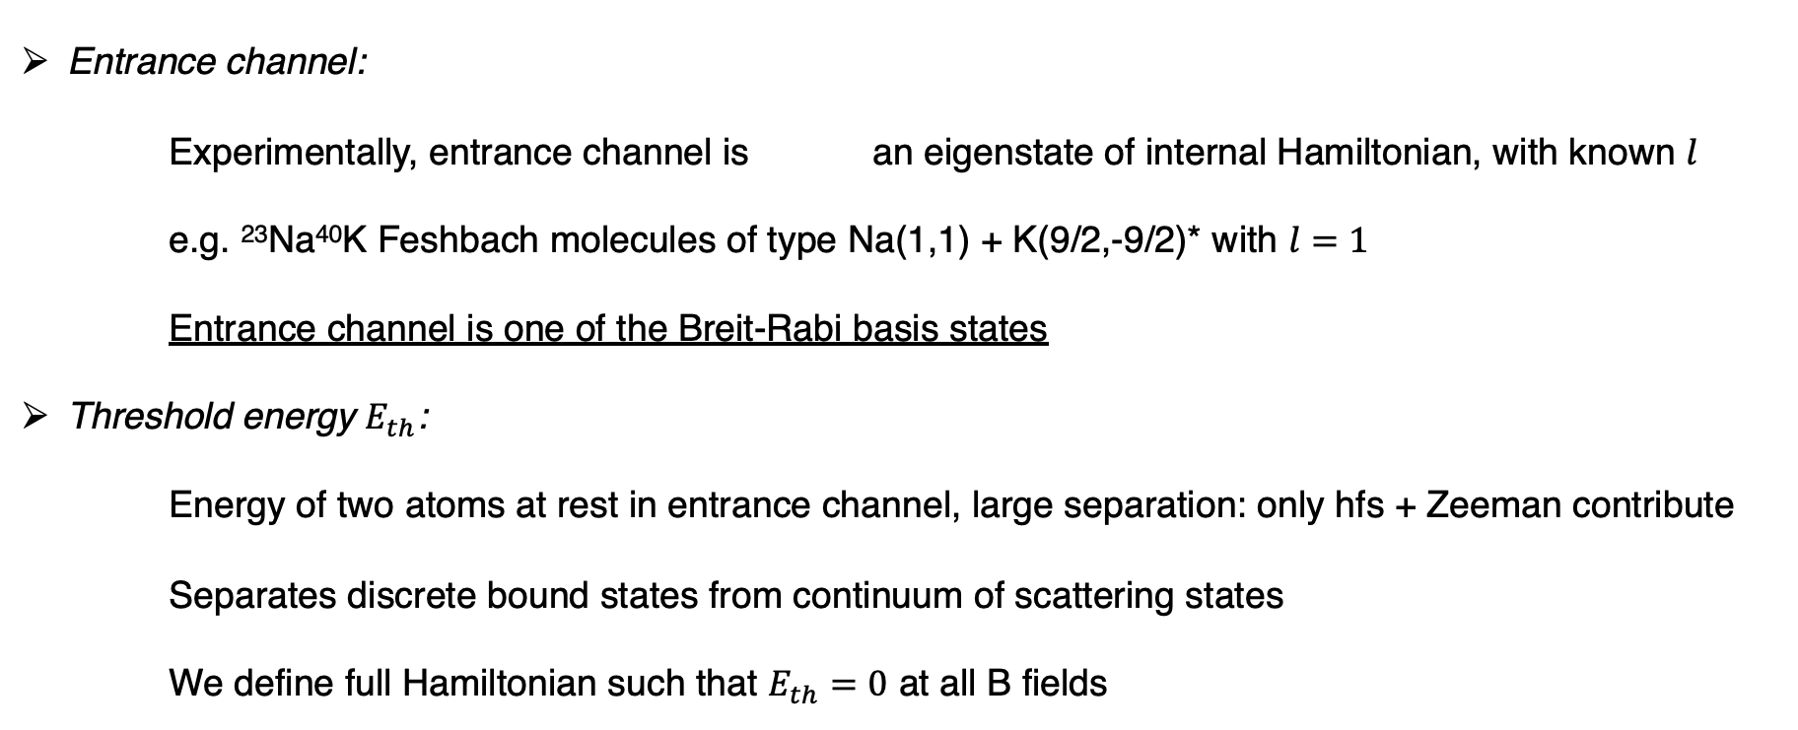
ABM description: Some definitions
Entrance channel:
Experimentally, entrance channel is an eigenstate of internal Hamiltonian, with known $l$
e.g. ²³Na⁴⁰K Feshbach molecules of type Na(1,1) + K(9/2,-9/2)* with $l=1$
Entrance channel is one of the Breit-Rabi basis states
Threshold energy $E_{th}$:
Energy of two atoms at rest in entrance channel, large separation: only hfs + Zeeman contribute
Separates discrete bound states from continuum of scattering states
We define full Hamiltonian such that $E_{th}=0$ at all B fields
(*) in zero-field limit

Slide 11
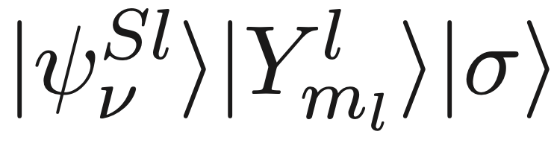
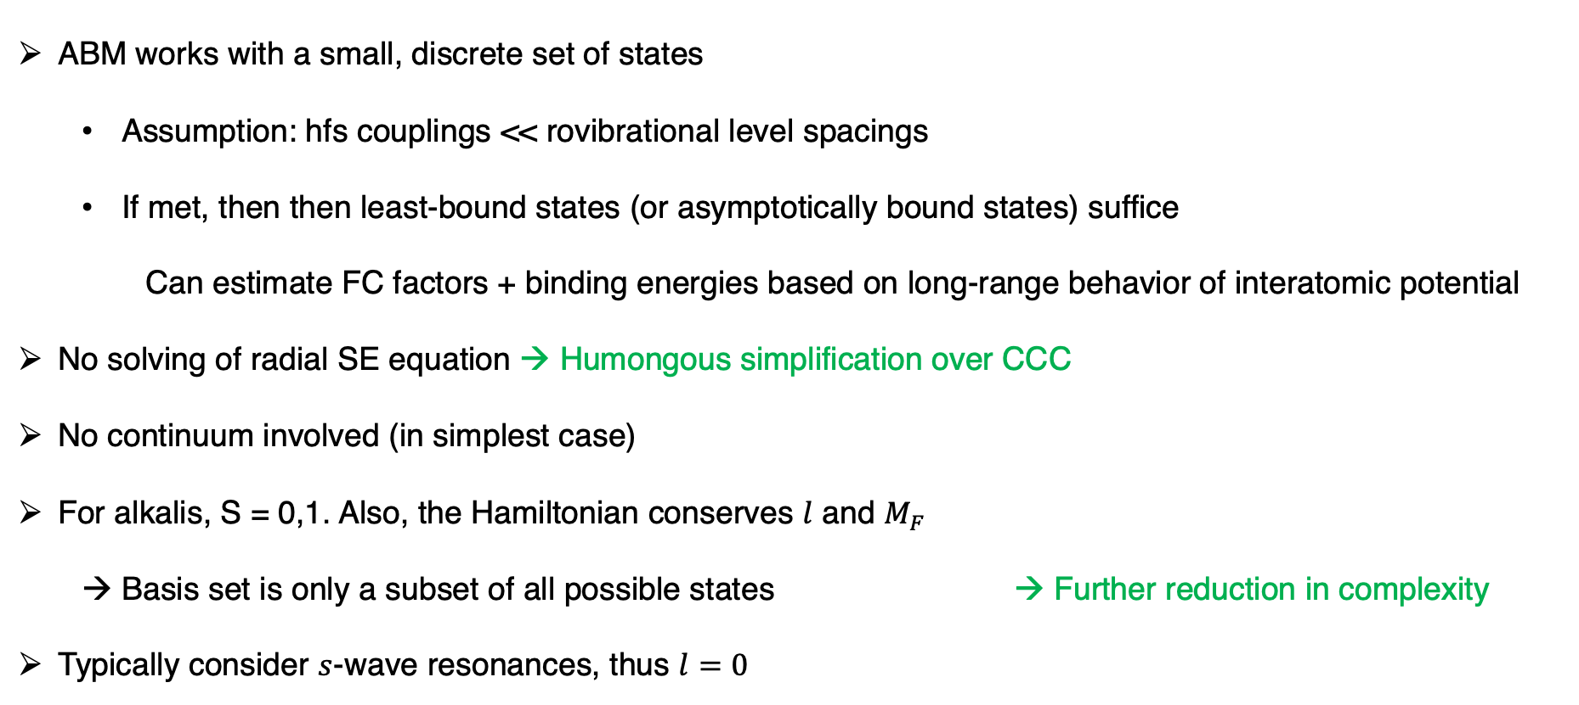
ABM description: assumptions/simplifications
ABM works with a small, discrete set of states
Assumption: hfs couplings << rovibrational level spacings
If met, then then least-bound states (or asymptotically bound states) suffice
Can estimate FC factors + binding energies based on long-range behavior of interatomic potential
No solving of radial SE equation → Humongous simplification over CCC
No continuum involved (in simplest case)
For alkalis, S = 0,1. Also, the Hamiltonian conserves $l$ and $M_{F}$
Basis set is only a subset of all possible states → Further reduction in complexity
Typically consider $s$-wave resonances, thus $l=0$

Slide 12

Recap so far…
Model description
Obtaining input parameters
Implementation (examples)
Extensions
Basis states
Hamiltonian
Rule for getting Hamiltonian matrix elements
???
We need input parameters

Slide 13
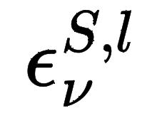
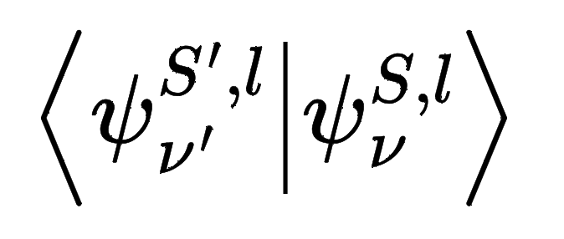
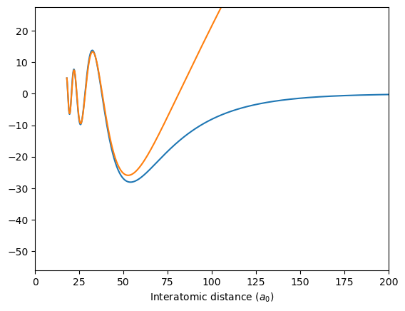
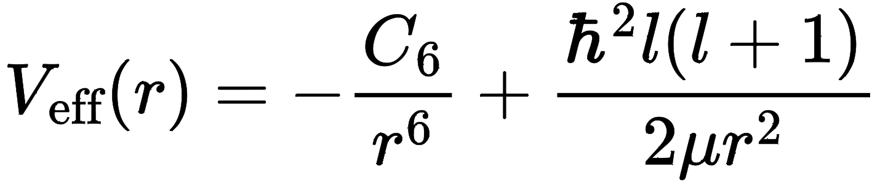


Obtaining input parameters for ABM
Need binding energies and FC factors ..
Can calculate these explicitly from $V\left(r\right)$, the interatomic potential
Tools: LEVEL16 program by LeRoy, or do it yourself (cf. Numerov-Cooley)
Drawbacks: Must know $V\left(r\right)$ to high accuracy, numerical issues,…
Or use the accumulated phase method
Need: scattering length + $C_{6}$ parameter + $l$ quantum no.
Idea:
(1) Integrate SE inward to approximate short-range wfn
(2) Integrate out with guess, varying $E$ so $\left|ψ\right\rangle$ decays properly
Guess wavefunction
$\sim sin(kr+ δ)$ for large $r$
Least-bound state of Na⁴⁰K X¹Σ⁺

Slide 14
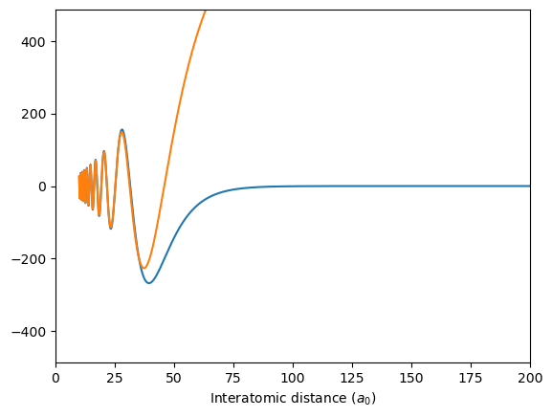


Obtaining input parameters for ABM
Example: ²³Na⁴⁰K
Guess wavefunction
$\sim sin(kr+ δ)$ for large $r$
Guess wavefunction
$\sim sin(kr+ δ)$ for large $r$
FC factor = 0.5
Can be found from wfn’s or
exponential asymptotic form
Least-bound state of Na⁴⁰K X¹Σ⁺
Least-bound state of Na⁴⁰K a³Σ⁺
150 MHz binding energy
1650 MHz binding energy

Slide 15

Implementation
Model description
Obtaining input parameters
Implementation (examples)
Extensions
Model systems: ⁶Li⁴⁰K and ²³Na⁴⁰K (slightly more complicated)
⁶Li: $F=1/2,m_{F}=1/2$, ⁴⁰K: $F=9/2,{ m}_{F}=−7/2$
²³Na: $F=1, m_{F}=1$, ⁴⁰K: $F=9/2,{ m}_{F}=−9/2$
Simplest form with 03 input parameters:
2 binding energies + 1 FC factor
Simply detect where eigenvalues of $H\left(B\right)$ cross $E_{th}=0$
Steps:
Calculate $E_{th}$
Make basis states and unitaries between different bases
Build Hamiltonian, can define such that $E_{th}=0$
Diagonalize and detect crossings
Standard ABM

Slide 16
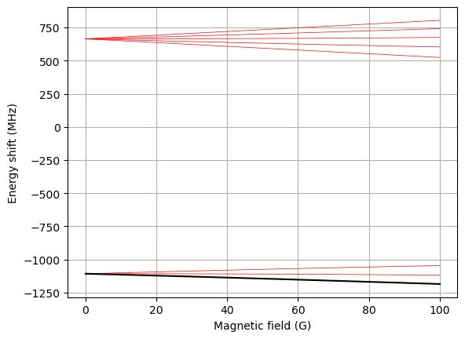
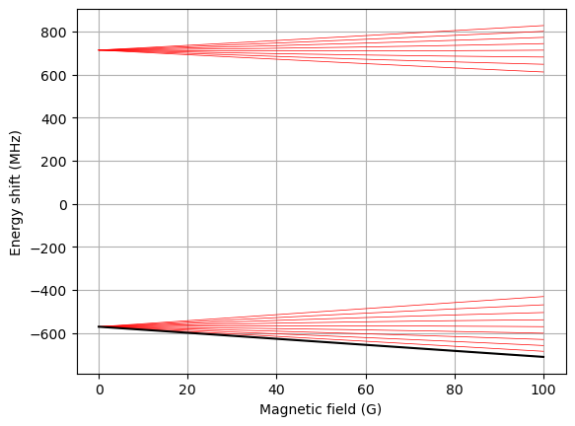
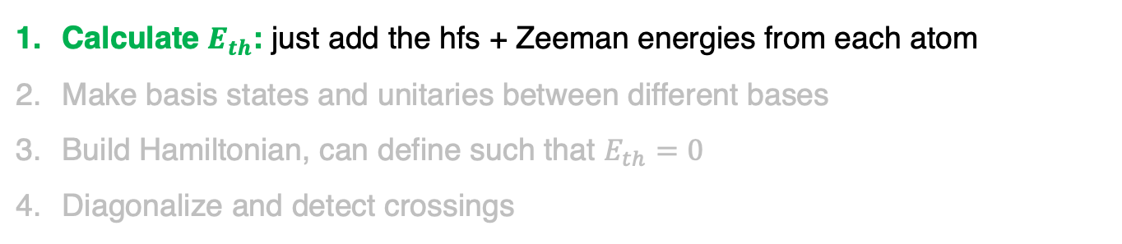


Implementation: Standard ABM
Calculate $E_{th}$: just add the hfs + Zeeman energies from each atom
Make basis states and unitaries between different bases
Build Hamiltonian, can define such that $E_{th}=0$
Diagonalize and detect crossings
²³Na⁴⁰K
²³Na: $F=1, m_{F}=1$
+
⁴⁰K: $F=9/2,{ m}_{F}=−9/2$

Slide 17
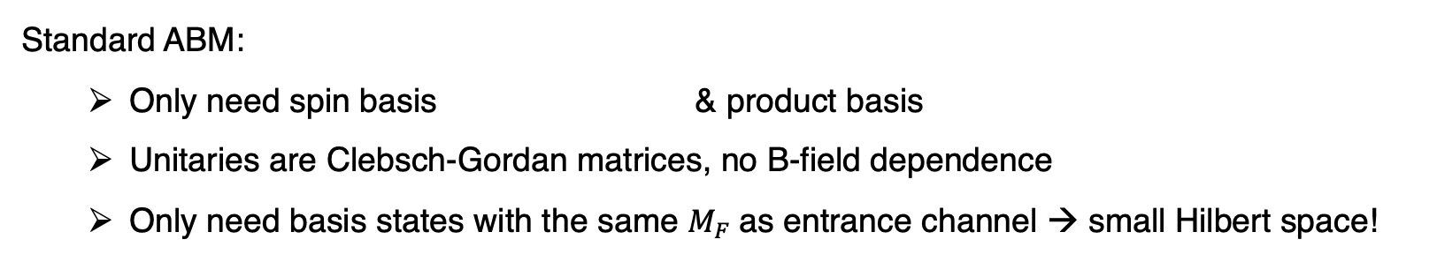
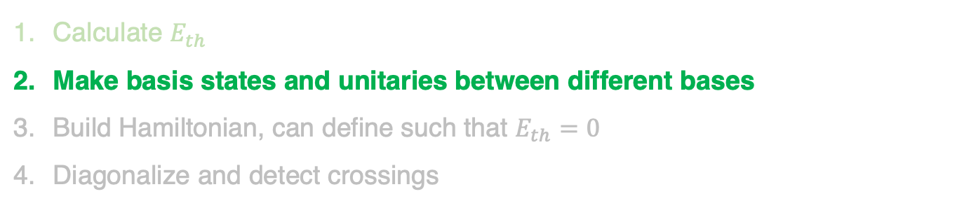
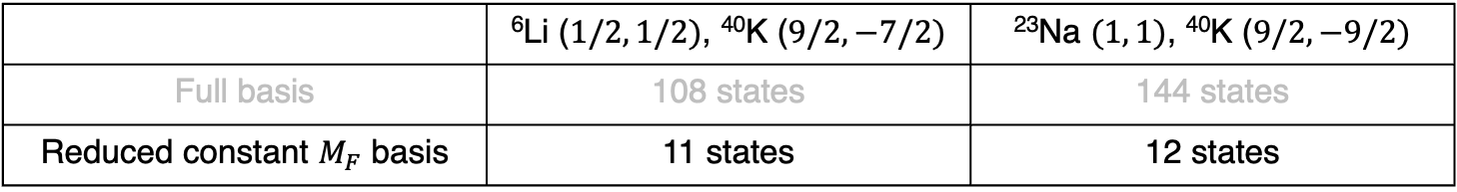
Implementation: Standard ABM
Calculate $E_{th}$
Make basis states and unitaries between different bases
Build Hamiltonian, can define such that $E_{th}=0$
Diagonalize and detect crossings
Standard ABM:
Only need spin basis & product basis
Unitaries are Clebsch-Gordan matrices, no B-field dependence
Only need basis states with the same $M_{F}$as entrance channel → small Hilbert space!
 | ⁶Li ($1/2, 1/2)$, ⁴⁰K ($9/2, −7/2)$ | ²³Na $(1, 1)$, ⁴⁰K ($9/2, −9/2)$
Full basis | 108 states | 144 states
Reduced constant $M_{F}$ basis | 11 states | 12 states

Slide 18
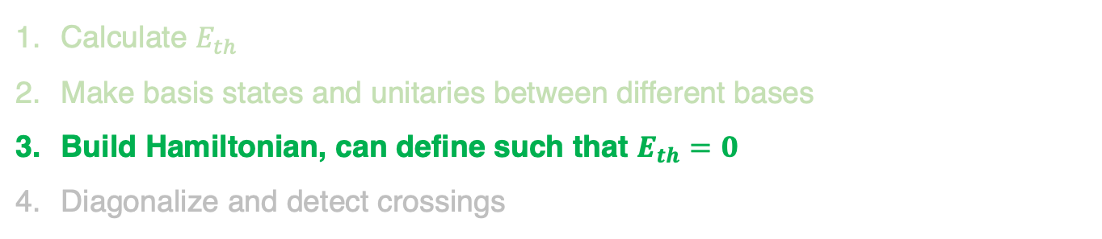
Implementation: Standard ABM
Calculate $E_{th}$
Make basis states and unitaries between different bases
Build Hamiltonian, can define such that $E_{th}=0$
Diagonalize and detect crossings
calculate in product basis,
then transform to spin basis
In ABM spin basis:
Binding energy of
Relative motion Hamiltonian
is diagonal in spin basis
Franck-Condon factor

Slide 19
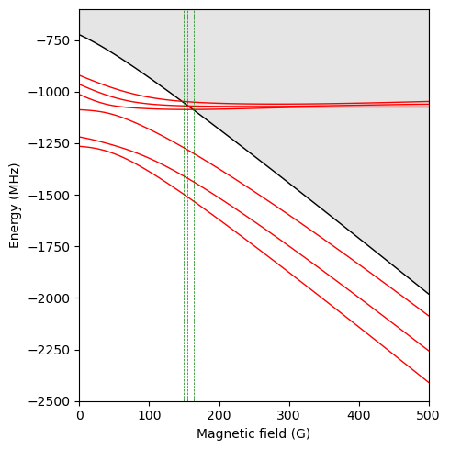
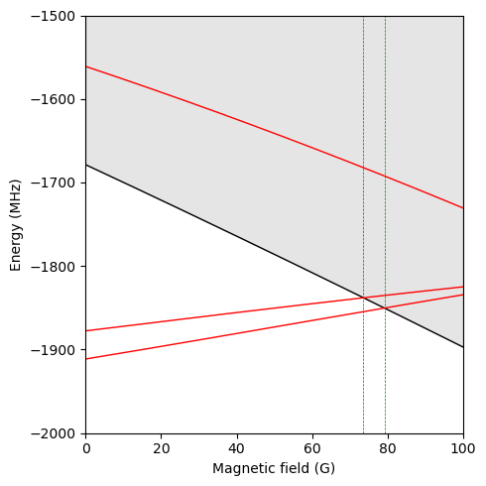
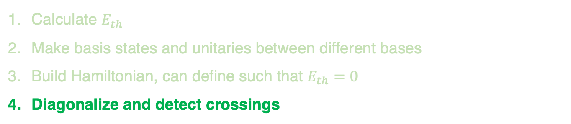
Implementation: Standard ABM
Calculate $E_{th}$
Make basis states and unitaries between different bases
Build Hamiltonian, can define such that $E_{th}=0$
Diagonalize and detect crossings
⁶Li⁴⁰K
²³Na⁴⁰K
Crossings: 149 G, 154 G, 164 G
E threshold
Crossings: 74 G, 79 G
Measured: 149.2 G, 159.5 G, 165.9 G [1]
Measured: 78.3 G, 88.2 [2]

Slide 20
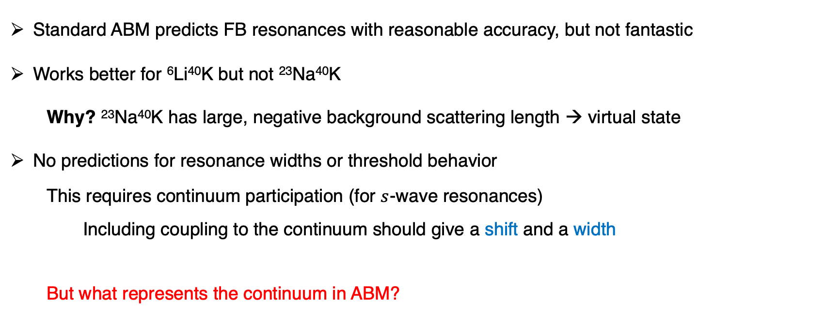
Implementation: Standard ABM
Standard ABM predicts FB resonances with reasonable accuracy, but not fantastic
Works better for ⁶Li⁴⁰K but not ²³Na⁴⁰K
Why? ²³Na⁴⁰K has large, negative background scattering length → virtual state
No predictions for resonance widths or threshold behavior
This requires continuum participation (for $s$-wave resonances)
Including coupling to the continuum should give a shift and a width
But what represents the continuum in ABM?

Slide 21
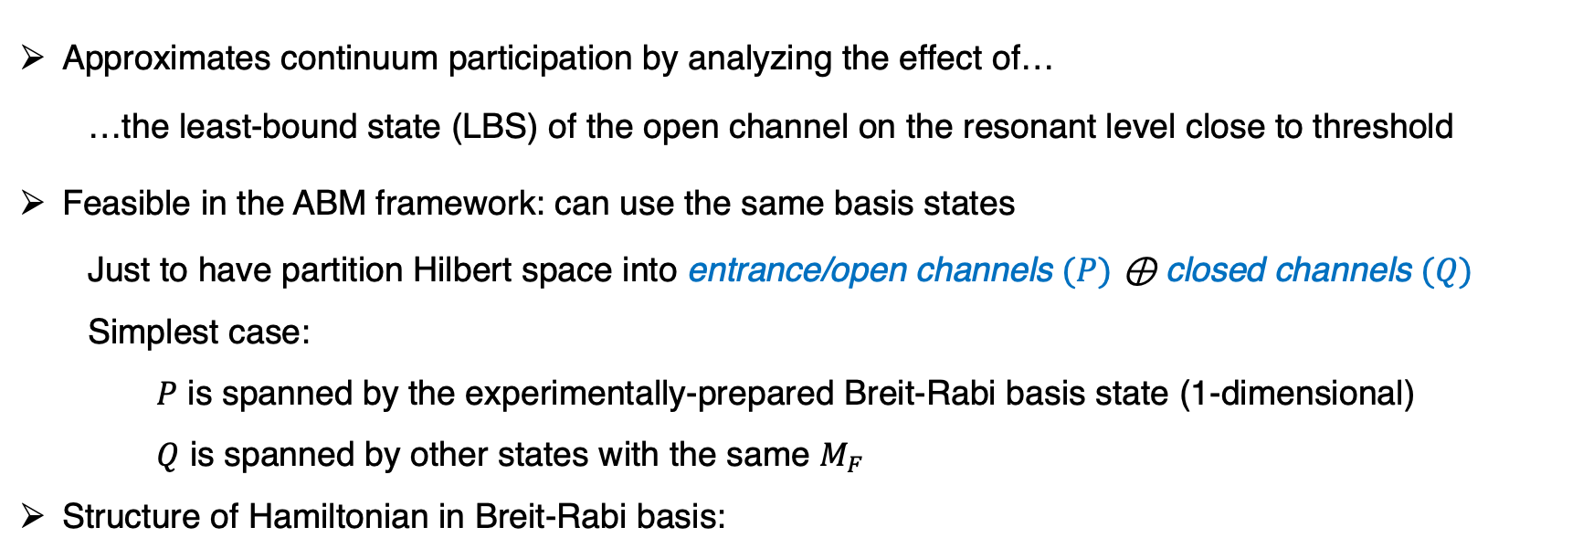

Dressed ABM
Approximates continuum participation by analyzing the effect of…
…the least-bound state (LBS) of the open channel on the resonant level close to threshold
Feasible in the ABM framework: can use the same basis states
Just to have partition Hilbert space into entrance/open channels $(P)$ ⊕ closed channels $(Q)$
Simplest case:
$P$ is spanned by the experimentally-prepared Breit-Rabi basis state (1-dimensional)
$Q$ is spanned by other states with the same $M_{F}$
Structure of Hamiltonian in Breit-Rabi basis:
$$H=H_{PP}+H_{PQ}+H_{QP}+H_{QQ}$$
Bare E_{bind, LBS} of entrance channel
a.k.a. “continuum”

Slide 22
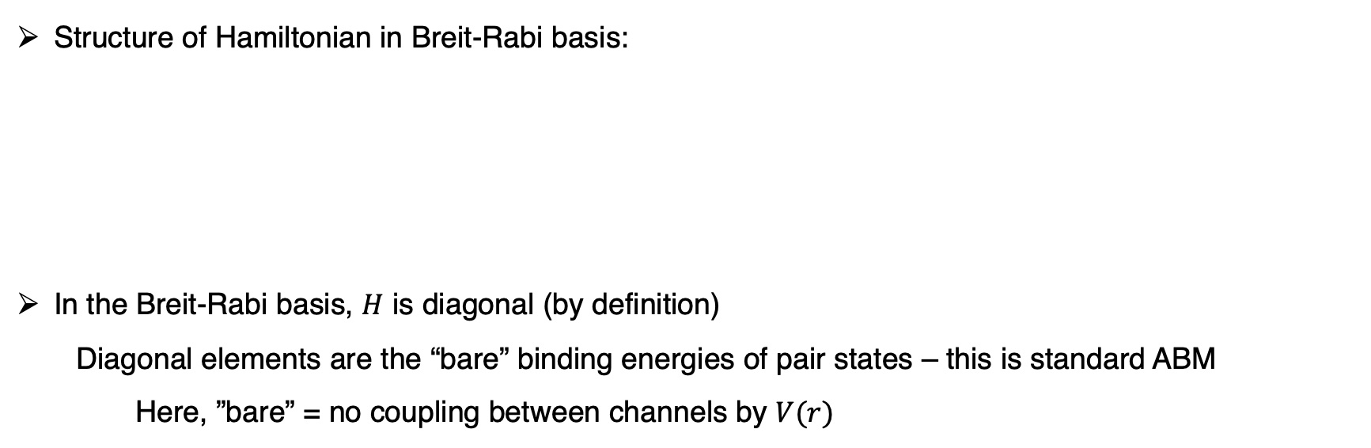

Dressed ABM
Structure of Hamiltonian in Breit-Rabi basis:
In the Breit-Rabi basis, $H$ is diagonal (by definition)
Diagonal elements are the “bare” binding energies of pair states – this is standard ABM
Here, ”bare” = no coupling between channels by $V(r)$
$$H=H_{PP}+H_{PQ}+H_{QP}+H_{QQ}$$
Bare E_{bind, LBS} of entrance channel
Open/closed channel coupling

Slide 23
References
[1] Wille, E., et al. "Exploring an ultracold fermi-fermi mixture: interspecies feshbach resonances and scattering properties of Li 6 and K 40." Physical review letters 100.5 (2008): 053201.
[2] Cheng-Hsun, W., et al. "Ultracold fermionic Feshbach molecules of 23 Na 40K." Phys. Rev. Lett 109 (2012): 085301.

