Slide 1
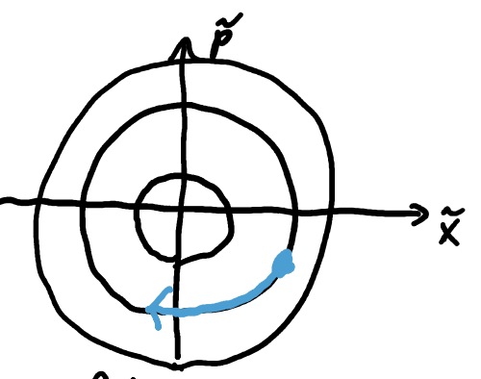
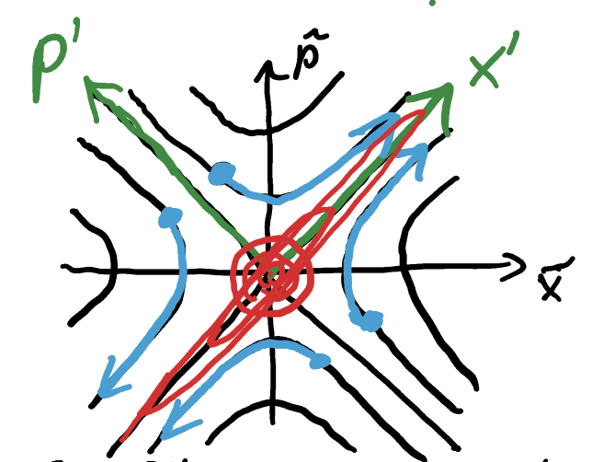
Harmonic Oscillator
Inverted Harmonic Oscillator
Hyperbolic motion
Circular Motion
← Free particle motion →

Slide 2
Quantum harmonic Oscillator
Quantum Inverted harm. Oscillator
Squeezing Hamiltonian
Equivalent form

Slide 3
Quantum Inverted harm. Oscillator
Generic form of the squeezing Hamiltonian

