Slide 1
Finding Feshbach resonances fast
Huan Bui
ZGS Sep 01, 2023

Slide 2
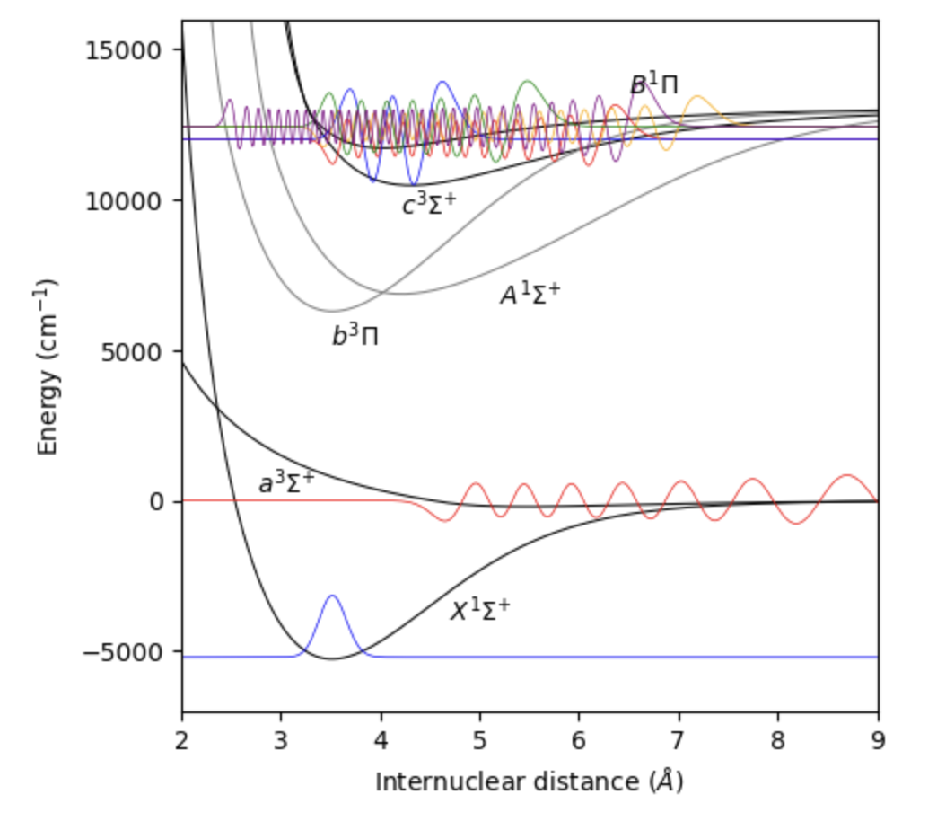
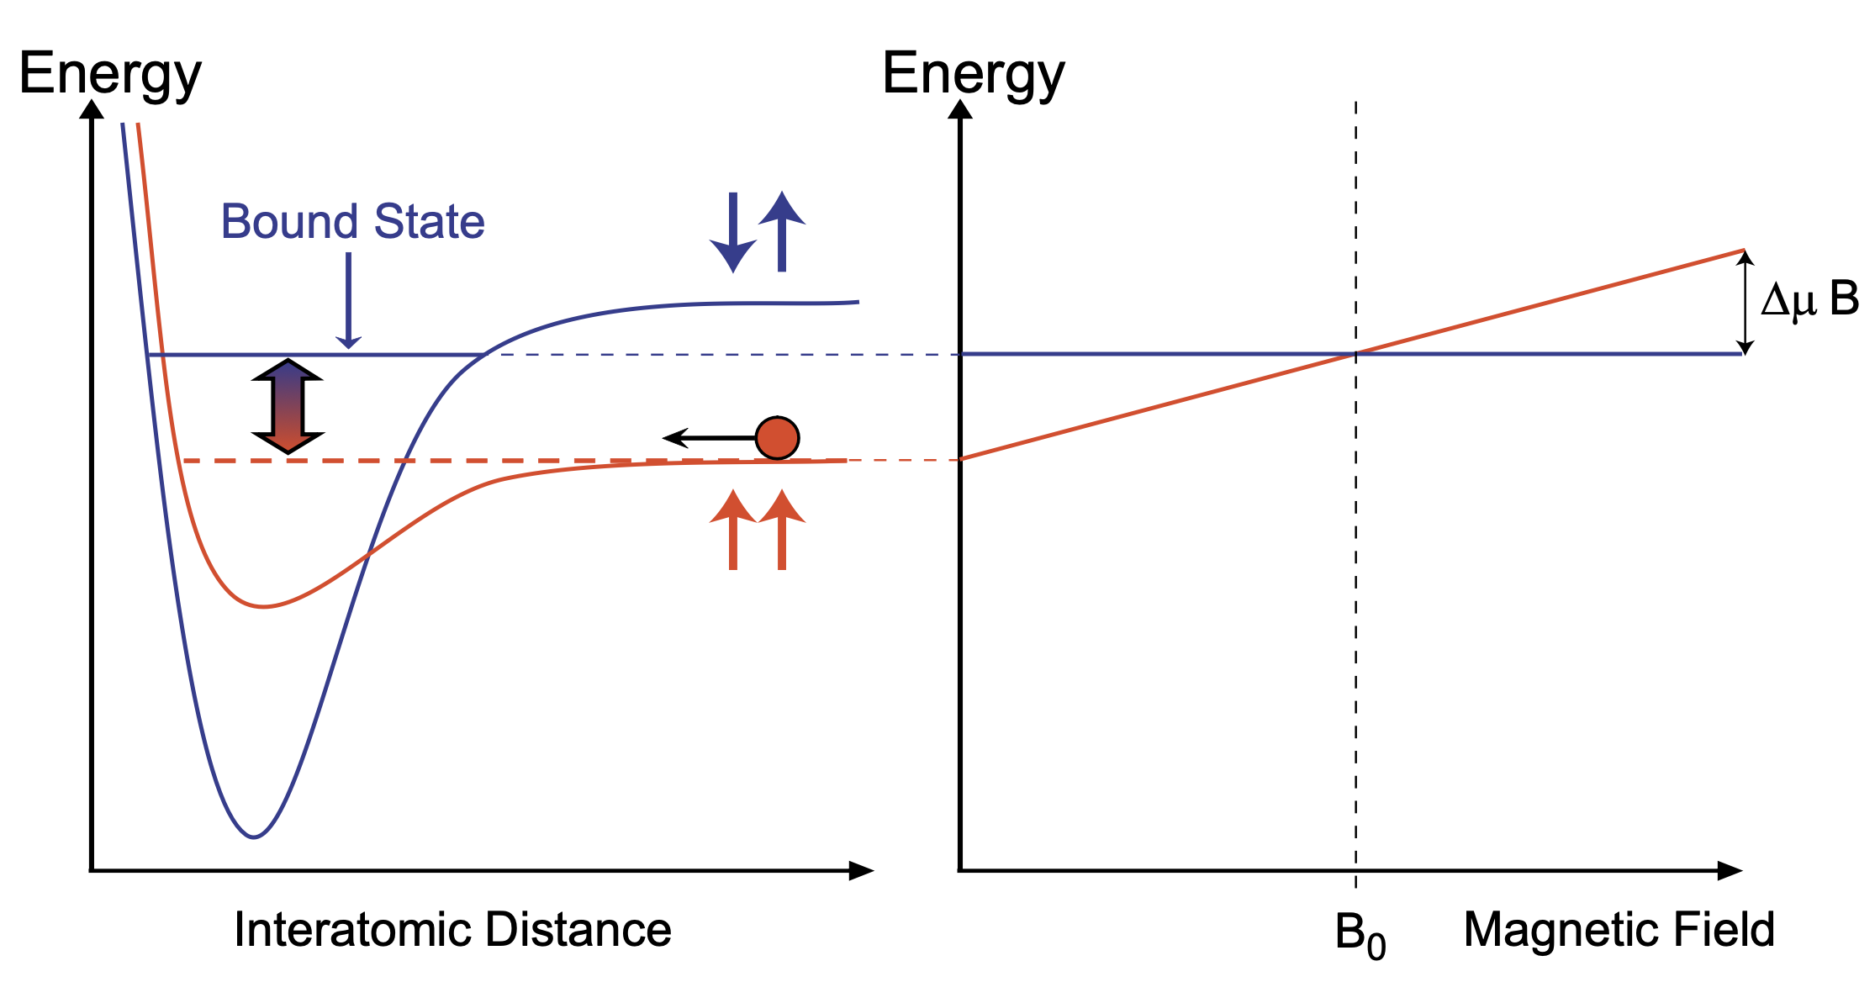
Feshbach resonances
²³Na⁴⁰K
Ground-state alkali atoms collide
Collisions occur within singlet and triplet electronic potentials
A Feshbach resonance occurs when e.g.
Energy _{two atoms in triplet channel} = Energy _{FB molecule in singlet channel}
Singlet-triplet coupling due to hyperfine interaction
Tunable resonance due to differential magnetic moment
triplet
singlet
AMO II S’23, Pset 8

Slide 3
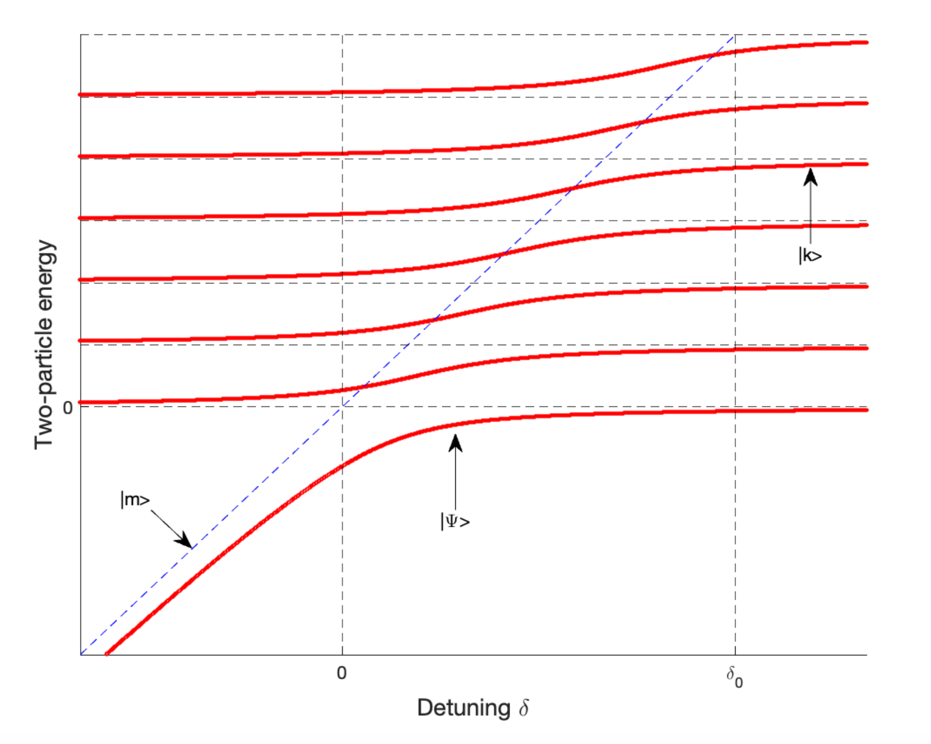
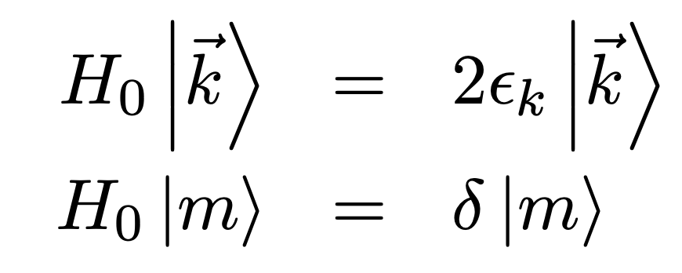
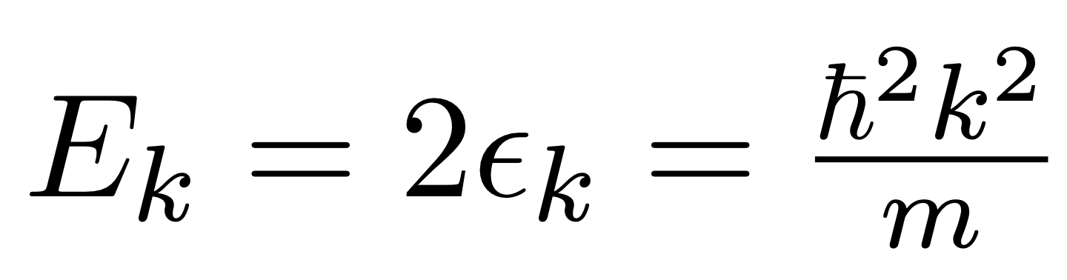
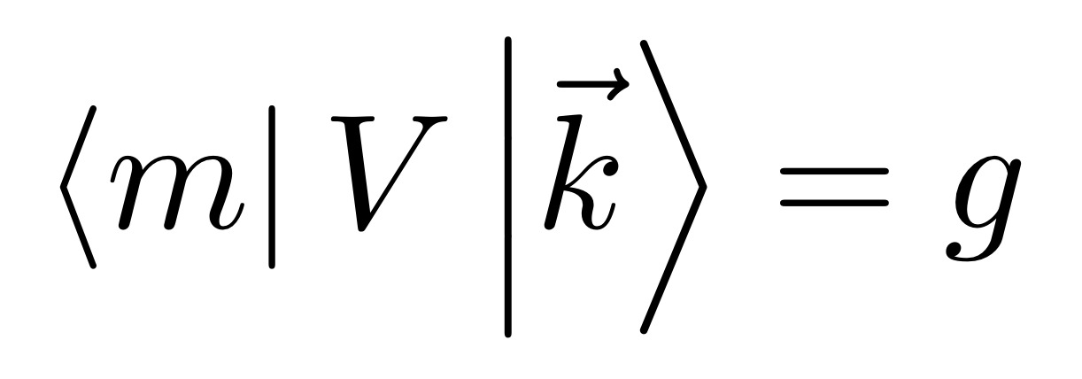
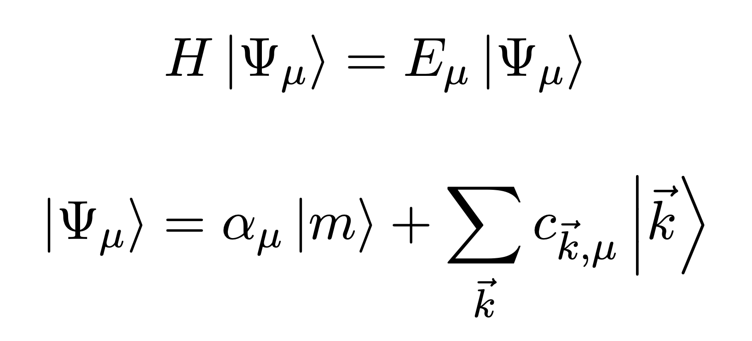

Feshbach resonances: a model from AMO II
A discrete state $\left|m\right\rangle$ coupled to a continuum of states$\left|\vec{k}\right\rangle$:
Solve:
Result:
Binding energy of molecular state varies quadratically
Coupling to continuum gives: shift + width
FB resonance

Slide 4
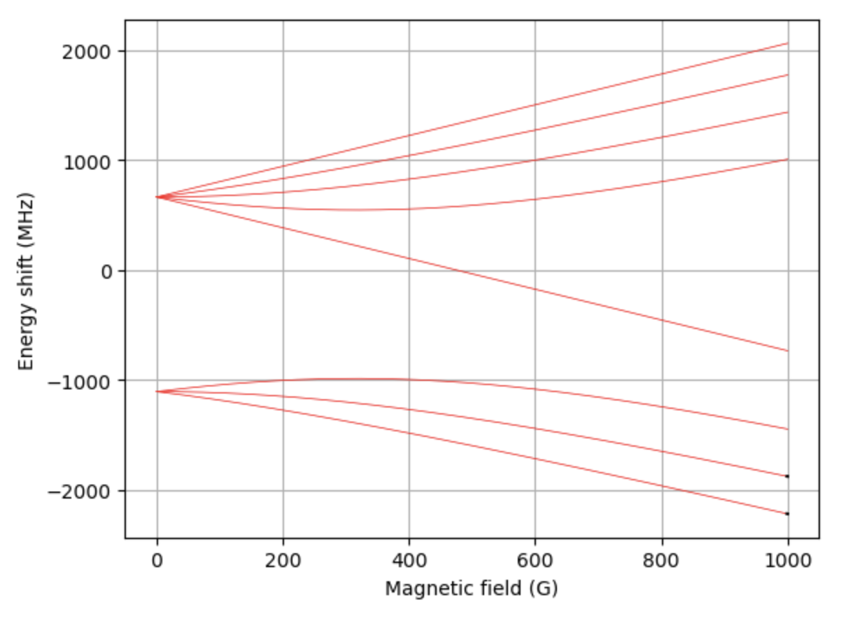
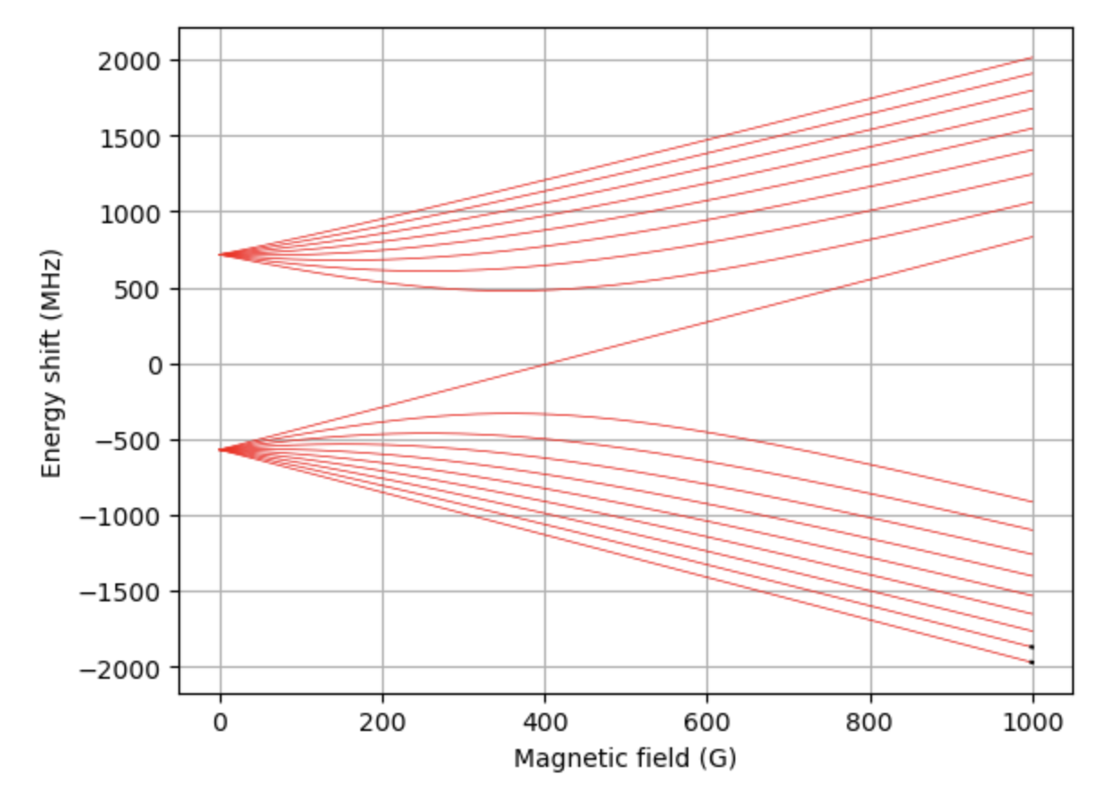



Feshbach resonances: the reality
Scenario: Find FB resonances in e.g. ²³Na⁴⁰K, ⁶Li⁴⁰K, or ⁶Li₂ from spectroscopic data
Spectroscopic data: hyperfine structure + interatomic electronic potentials
Solutions:
Just go measure and hope to see something
Calculate, then measure
Coupled-channel calculation
Asymptotic bound-state model
Ask a theorist

Slide 5
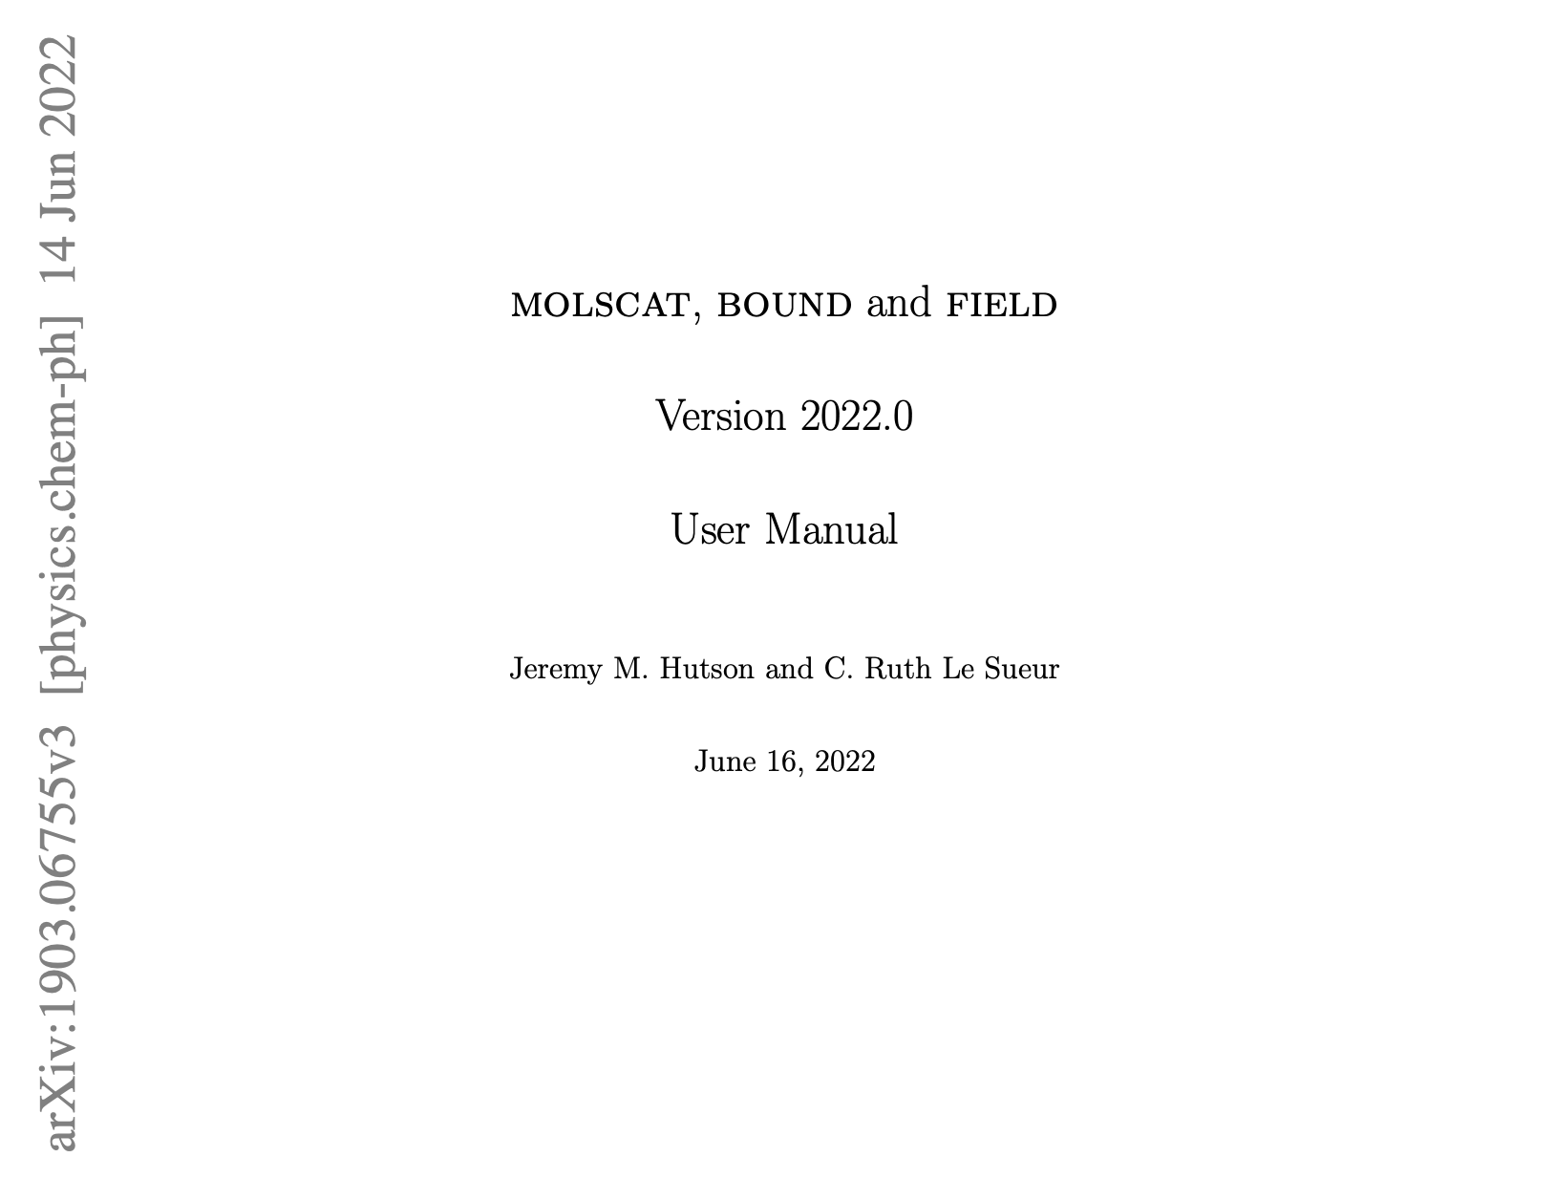
Coupled-channel calculations (CC)
Dedicated program by J. M. Hutson & C. R. L. Sueur
Consists of 3 Fortran programs (code available on Github here):
MOLSCAT (arXiv), BOUND & FIELD (arXiv)
MOLSCAT: quantum scattering calculations
BOUND & FIELD: get bound state
Pros:
Trusted, have been used by many authors
Well-managed
CONS:
Not easy to learn how to use and implement
210-page user manual

Slide 6
Asymptotic bound-state model
A model for Feshbach resonances by Tiecke (Phys. Rev. A 82, 042712)
Simple

