Slide 1
How to quickly find Feshbach resonances
Huan Bui
ZGS Sep 01, 2023

Slide 2
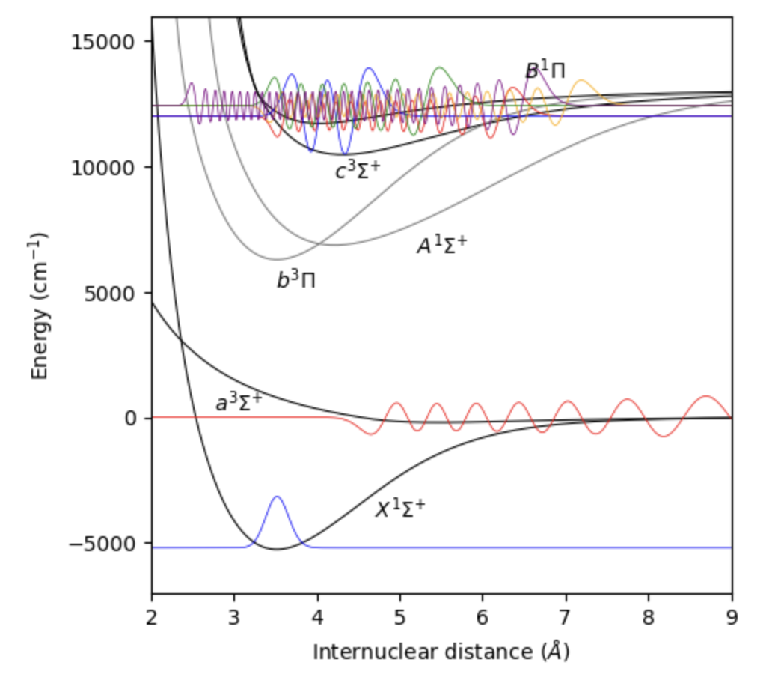
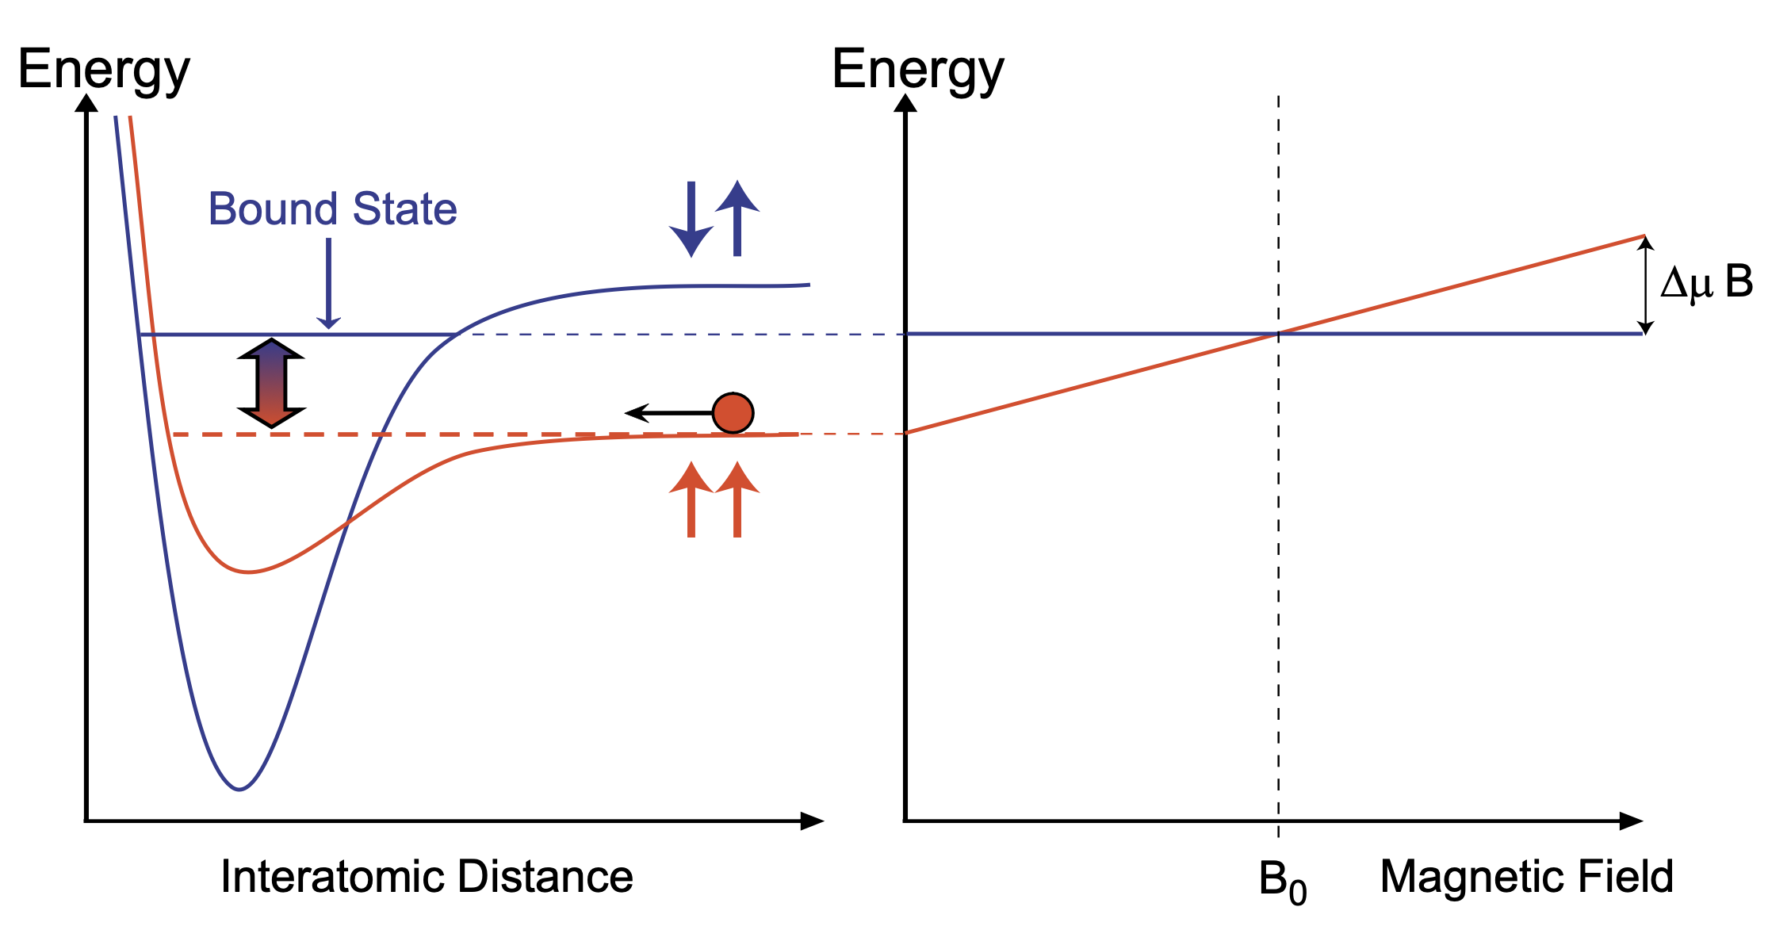
Feshbach resonances
²³Na⁴⁰K
Ground-state alkali atoms collide
Collisions occur within singlet and triplet electronic potentials
A Feshbach resonance occurs when e.g.
Energy _{two atoms in triplet channel} = Energy _{FB molecule in singlet channel}
Singlet-triplet coupling due to hyperfine interaction
Tunable resonance due to differential magnetic moment
triplet
singlet
AMO II S’23, Pset 8

Slide 3
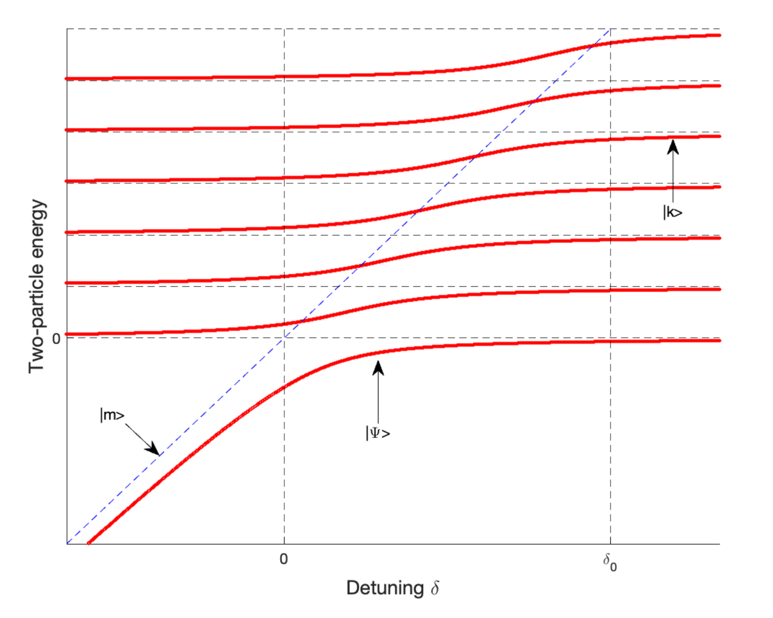
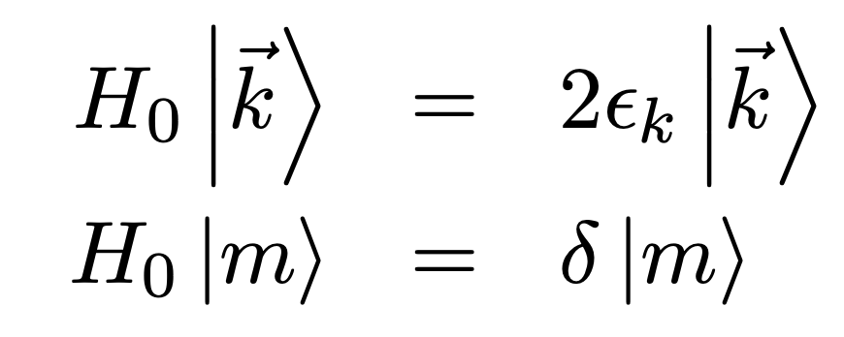
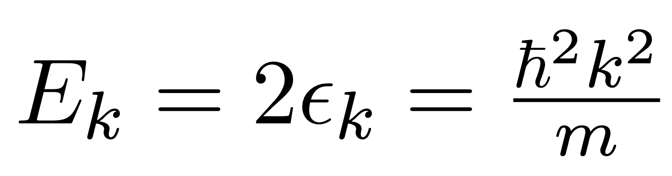
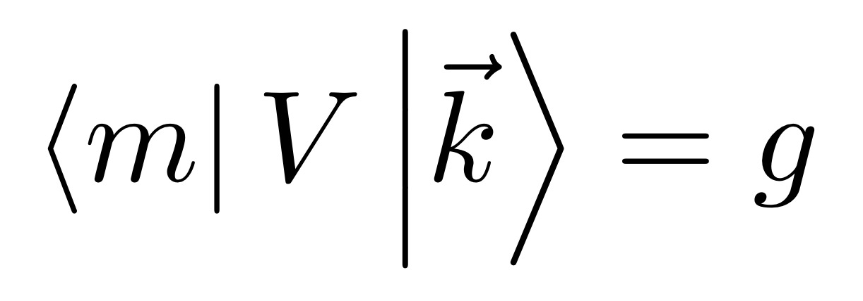
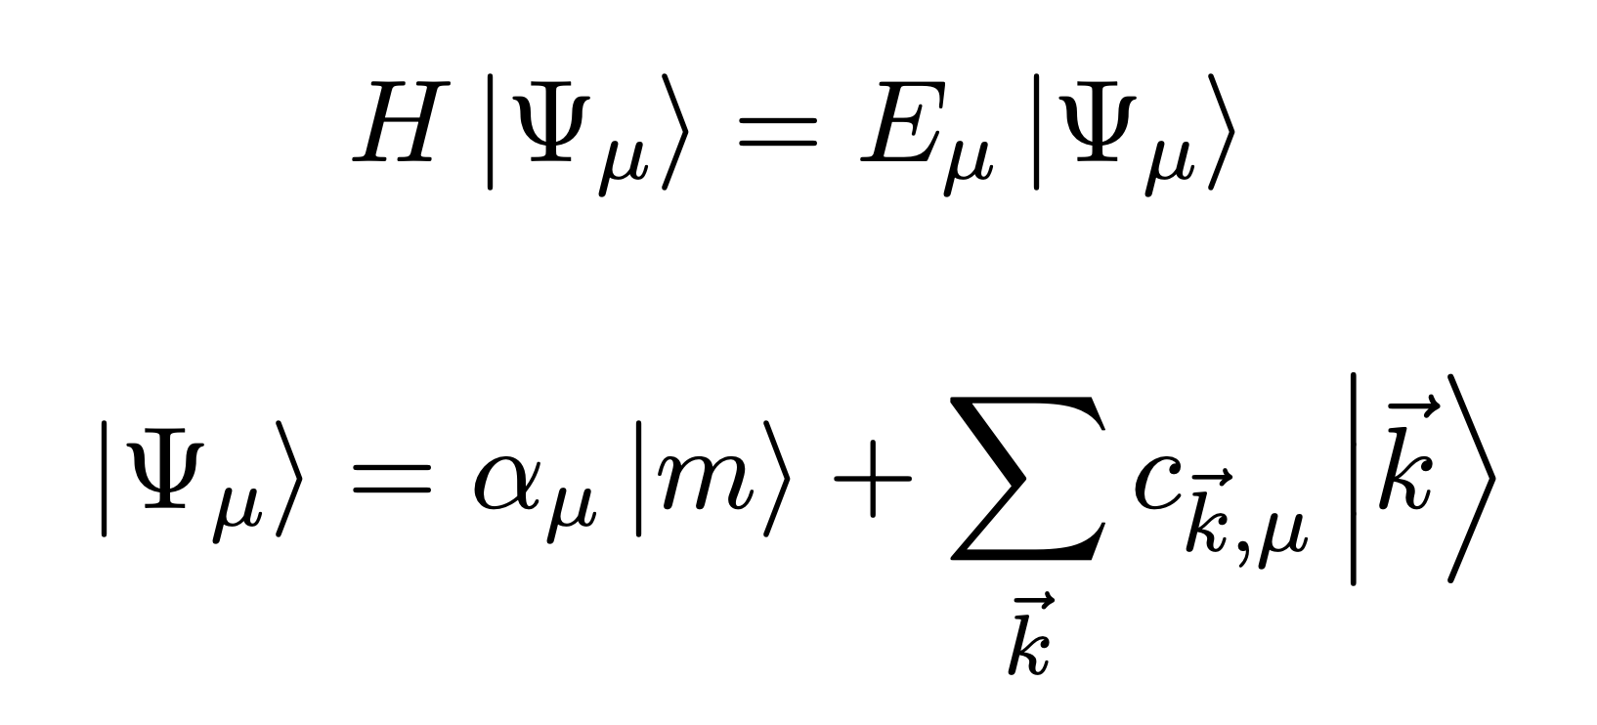

Feshbach resonances: a model from AMO II
A discrete state $\left|m\right\rangle$ coupled to a continuum of states$\left|\vec{k}\right\rangle$:
Solve:
Result:
Molecular binding energy quadratically
Coupling to continuum gives: shift + width
FB resonance

Slide 4
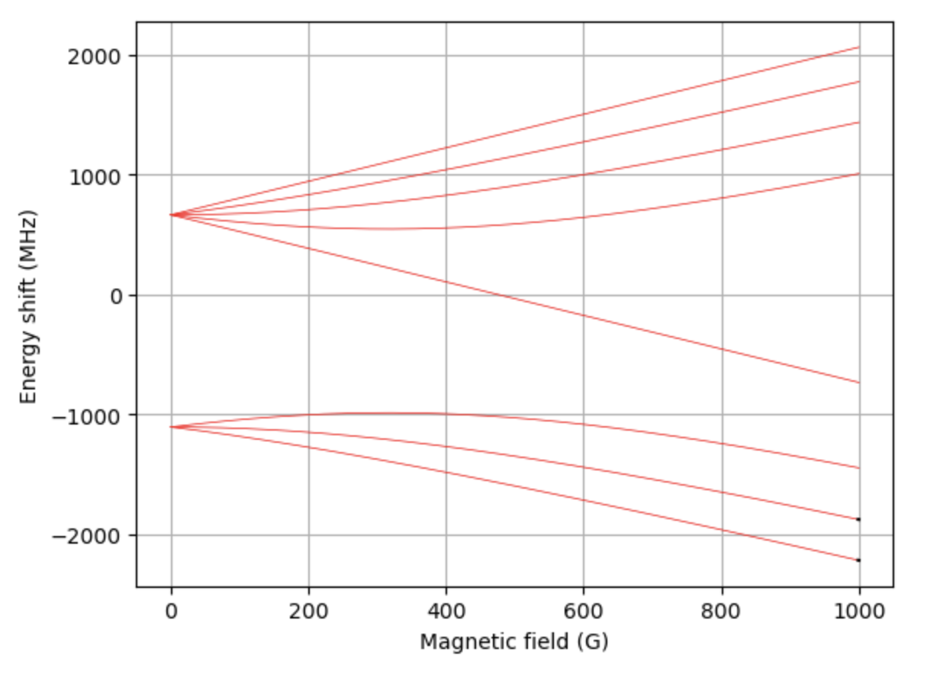
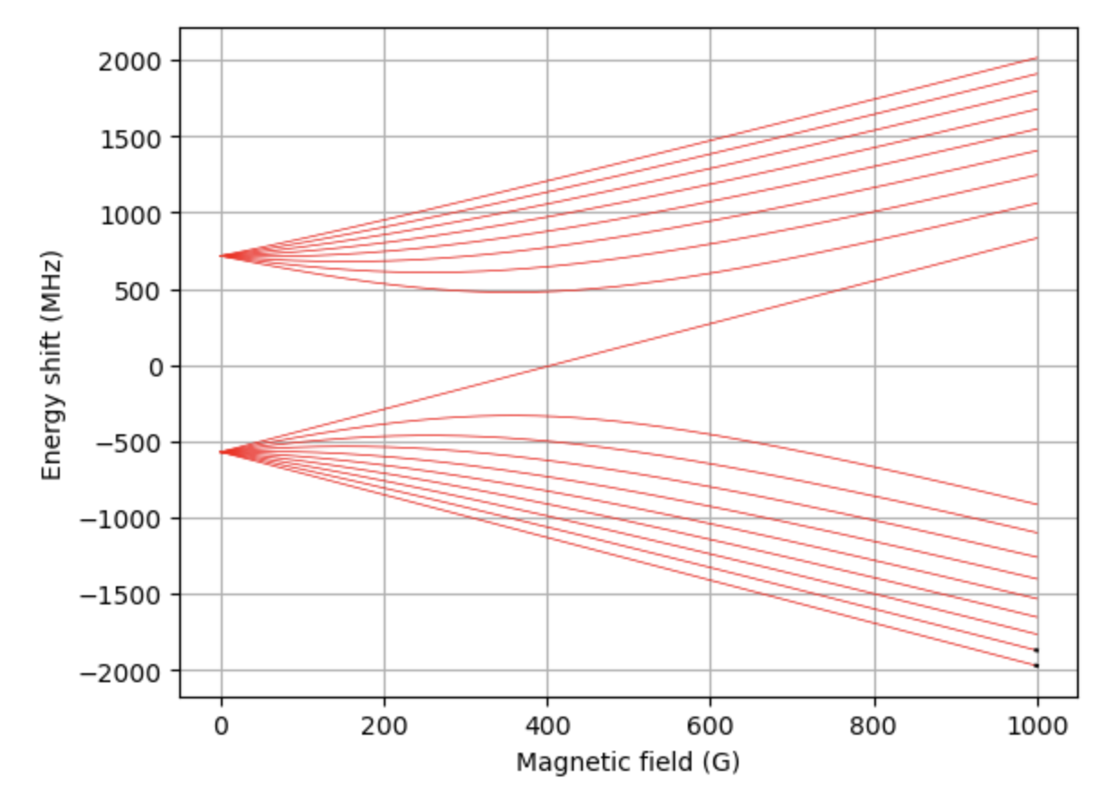
Feshbach resonances: the reality
Scenario: Find FB resonances in e.g. ²³Na⁴⁰K, ⁶Li⁴⁰K, or ⁶Li₂ from spectroscopic data
Problem:
Find Feshbach resonances & widths
Find binding energies of Feshbach molecules
Solution: Calculate, then measure. Two existing methods:
Coupled-channel calculation
Asymptotic bound-state model

Slide 5
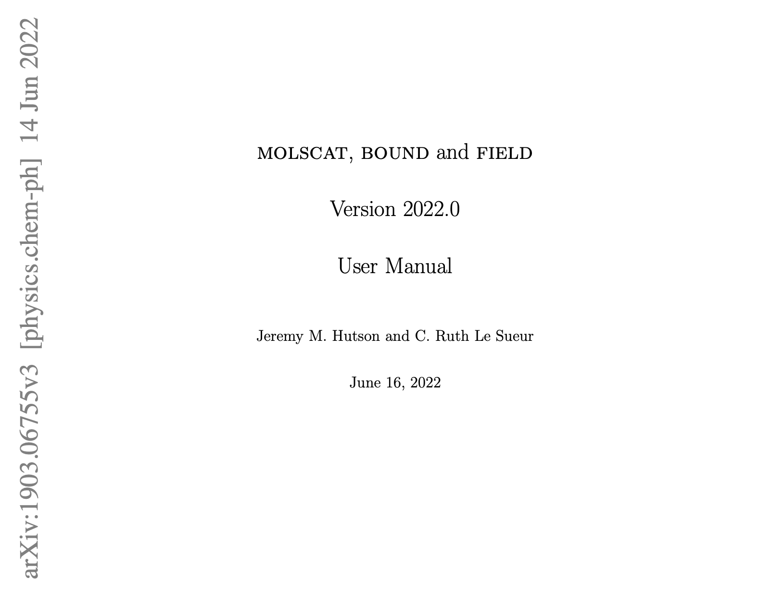
Coupled-channel calculations (CC)
Interactions have spin + orbital degrees of freedom
Resulting in coupled radial SE’s in spin basis
Numerically solve for scattering properties + bound states
Dedicated program by J. M. Hutson & C. R. L. Sueur
3 Fortran programs (code available on Github here):
MOLSCAT (arXiv), BOUND & FIELD (arXiv)
Drawbacks:
Interaction potentially typically not accurate enough
Many degrees of freedom → time consuming
Numerical issues (grid size & numerical accuracy)
Not easy to learn how to use and implement!
210-page user manual

Slide 6
Asymptotic Bound-state Model (ABM)
Tobias Tiecke et al (Phys. Rev. A 82, 042712)
Model description
Obtaining input parameters
Implementation (examples)
Extensions

Slide 7
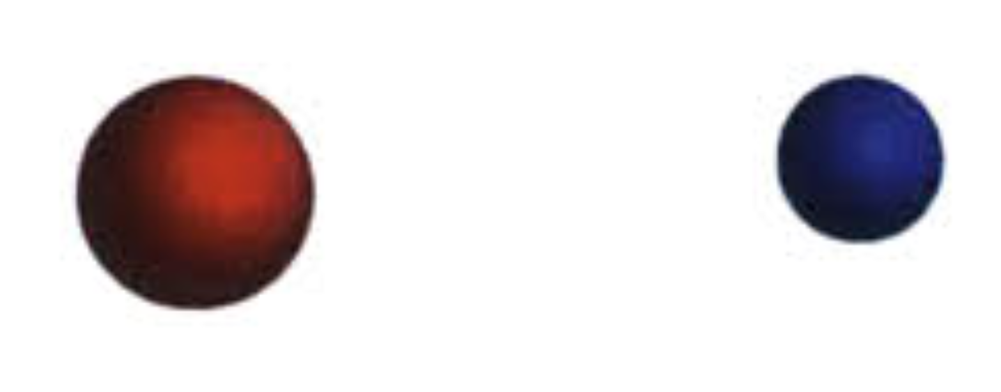
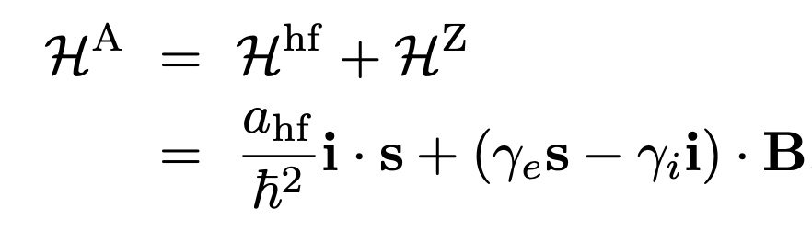

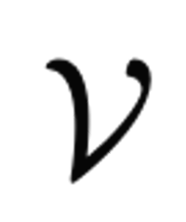
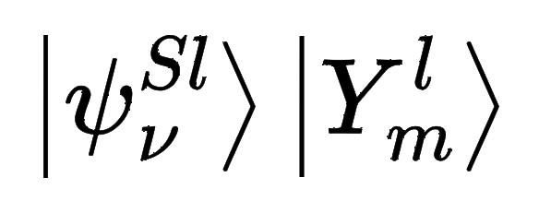
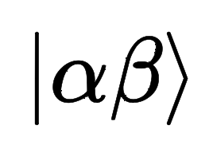
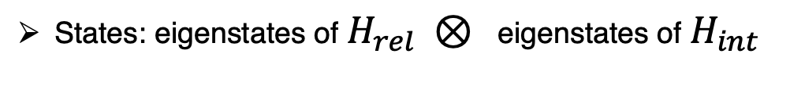

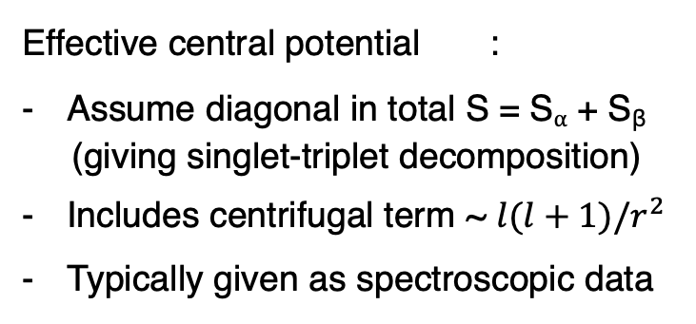
ABM description: Setup
Two atoms ⍺ and β in their electronic ground state
Hamiltonian = Relative motion in COM frame + Internal energy
+ atom β
Effective central potential :
Assume diagonal in total S = S⍺ + S_{β}
(giving singlet-triplet decomposition)
Includes centrifugal term ~ $l(l+1)/r^{2}$
Typically given as spectroscopic data
You may already have this part on your laptop!
States: eigenstates of $H_{rel} ⊗$ eigenstates of $H_{int}$
Bound-state wfns of $V^{S,l}(r)$
Breit-Rabi basis

Slide 8
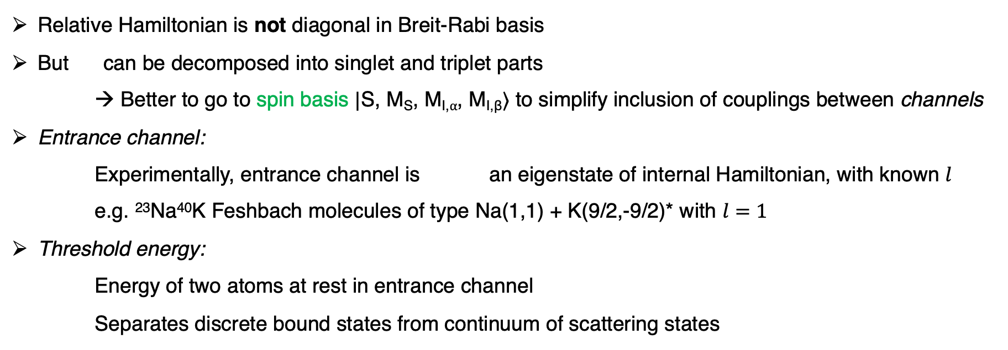
ABM description: Definitions
Relative Hamiltonian is not diagonal in Breit-Rabi basis
But can be decomposed into singlet and triplet parts
→ Better to go to spin basis $|\text{S}\text{, }\text{MS}\text{, }\text{MI}\text{,⍺, }\text{MI}\text{,}\text{β}⟩$ to simplify inclusion of couplings between channels
Entrance channel:
Experimentally, entrance channel is an eigenstate of internal Hamiltonian, with known $l$
e.g. ²³Na⁴⁰K Feshbach molecules of type Na(1,1) + K(9/2,-9/2)* with $l=1$
Threshold energy:
Energy of two atoms at rest in entrance channel
Separates discrete bound states from continuum of scattering states
(*) in zero-field limit

Slide 9
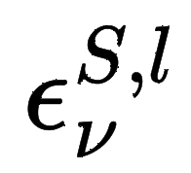

ABM description: Definitions
Relative Hamiltonian is not diagonal in Breit-Rabi basis
But can be decomposed into singlet and triplet parts
→ Better to go to spin basis $|\text{S}\text{, }\text{MS}\text{, }\text{MI}\text{,⍺, }\text{MI}\text{,}\text{β}⟩$ to simplify inclusion of couplings between channels
Entrance channel:
Experimentally, entrance channel is an eigenstate of internal Hamiltonian, with known $l$
e.g. NaK Feshbach molecules of type Na(1,1) + K(9/2,-9/2)* with $l=1$
Threshold energy:
Energy of two atoms at rest in entrance channel
Separates discrete bound states from continuum of scattering states
(*) in zero-field limit
ABM involves no continuum states
Treats a discrete set of with binding energies as free parameters
ABM solutions obtained by diagonalizing the full Hamiltonian

