Slide 1
Finding Feshbach resonances, fast
Huan Bui
ZGS Sep 01, 2023

Slide 2
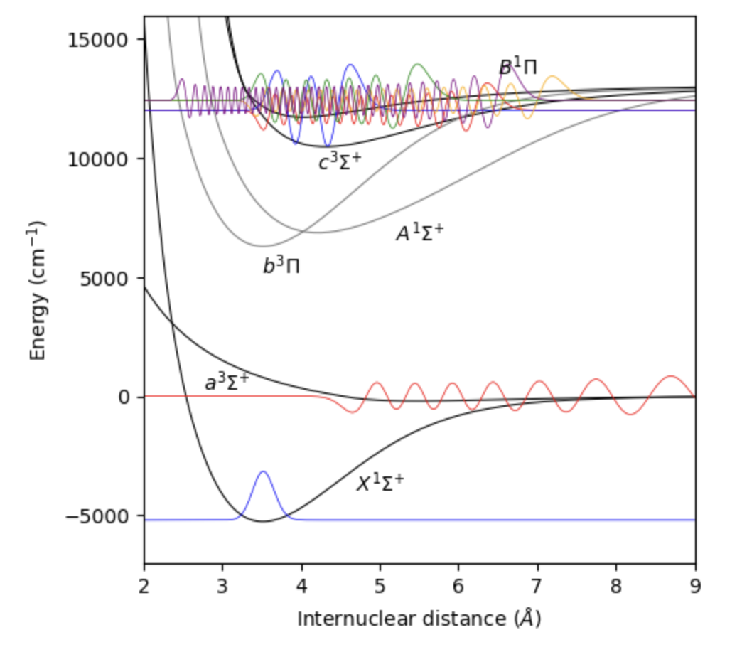
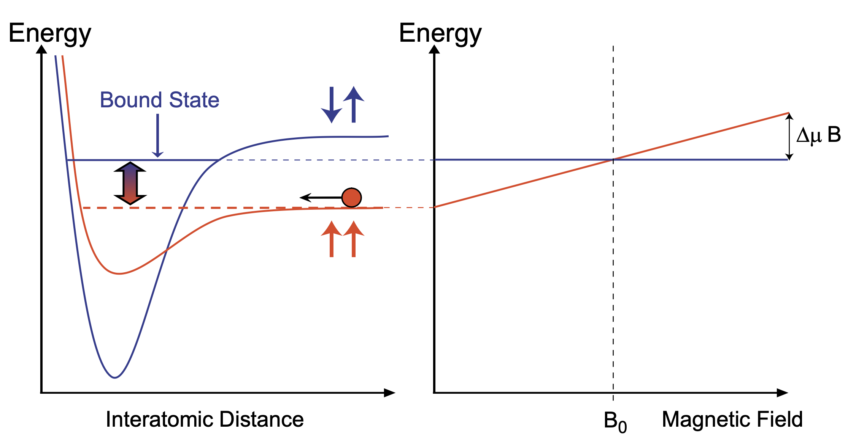
Feshbach resonances revisited
²³Na⁴⁰K
Ground-state alkali atoms collide
Collisions occur within singlet and triplet electronic potentials
A Feshbach resonance occurs when e.g.
Energy _{two atoms in triplet channel} = Energy _{FB molecule in singlet channel}
Singlet-triplet coupling due to hyperfine interaction
Tunable resonance due to differential magnetic moment
triplet
singlet
AMO II S’23, Pset 8

Slide 3
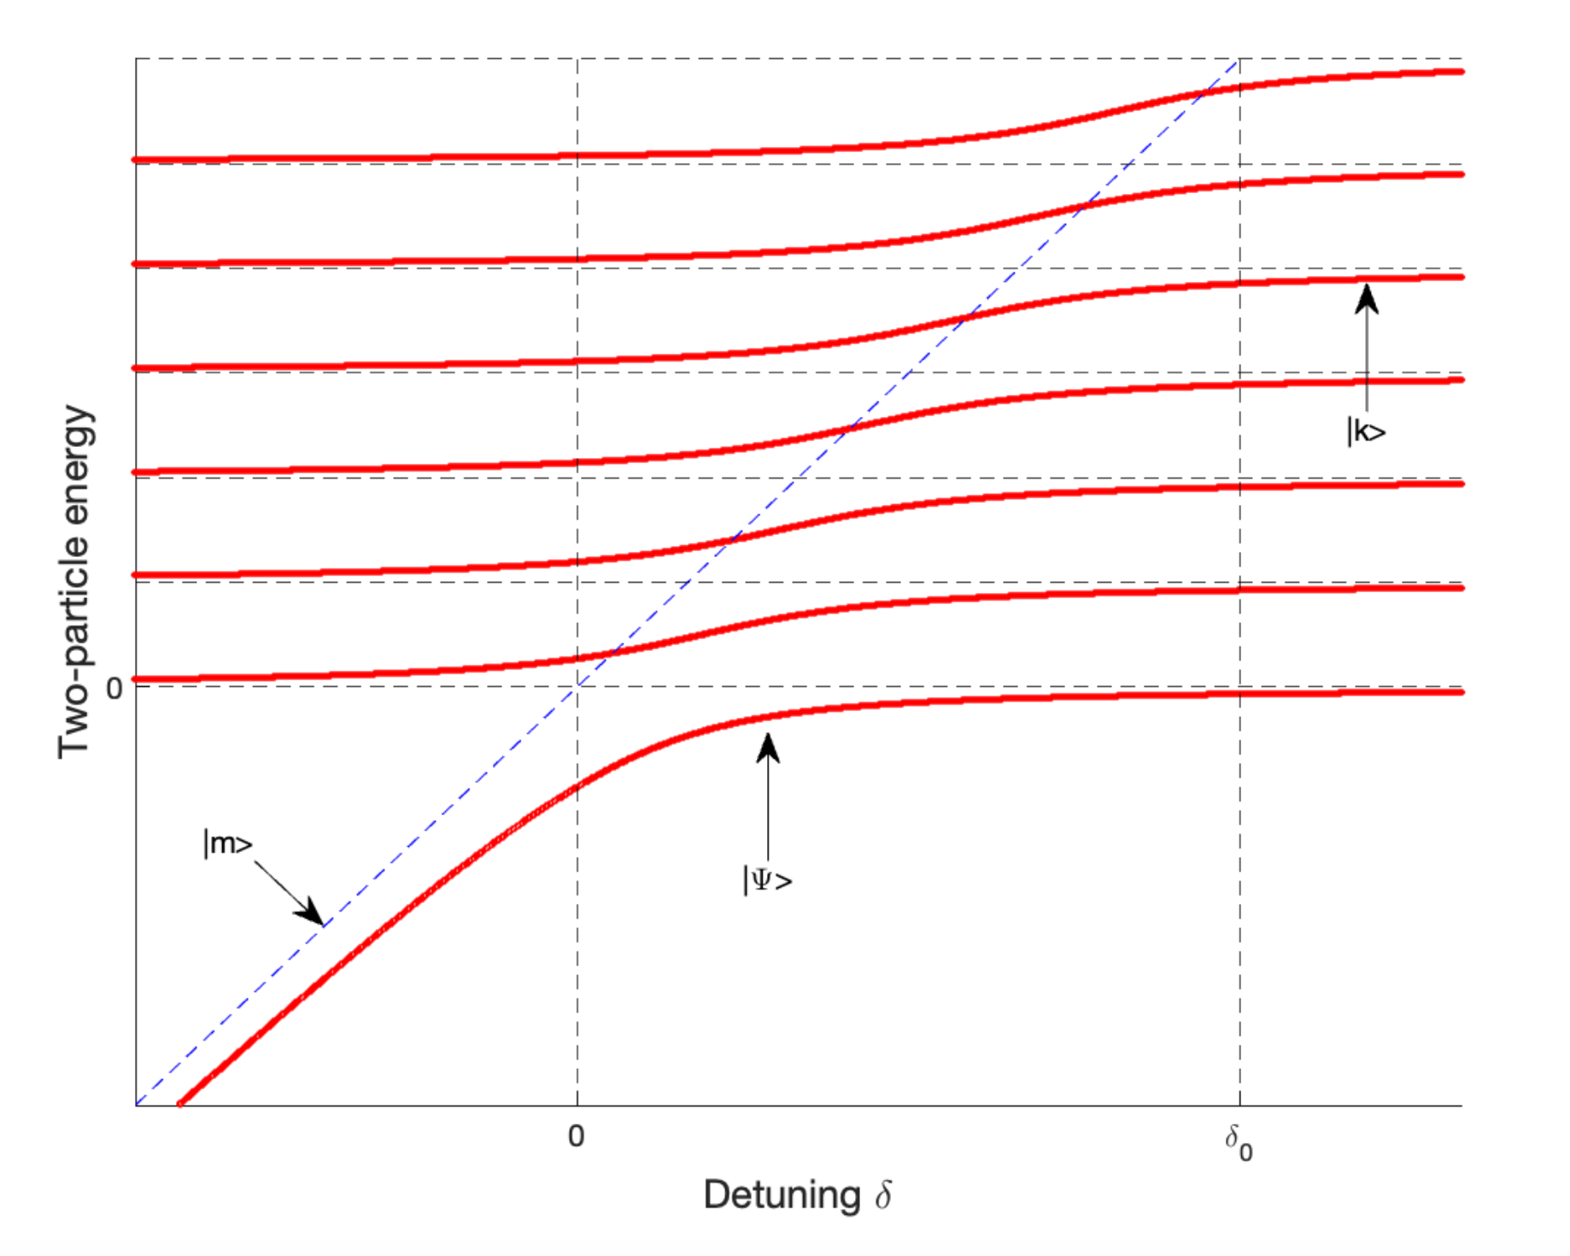
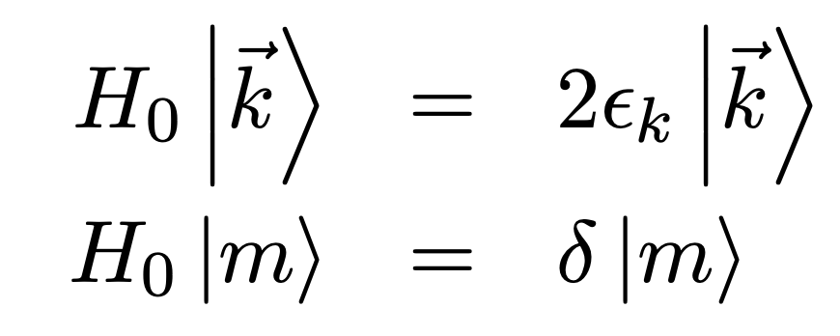
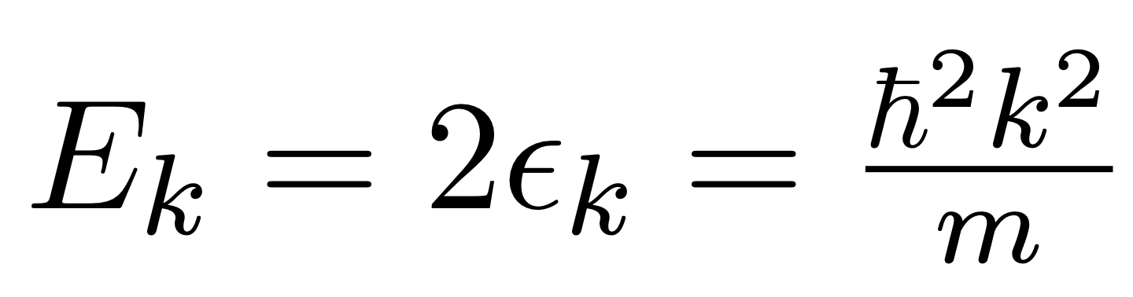
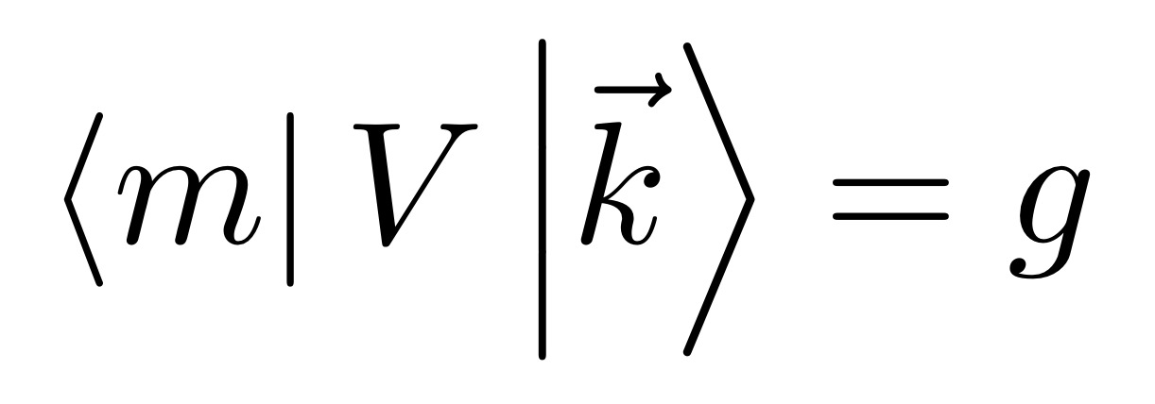
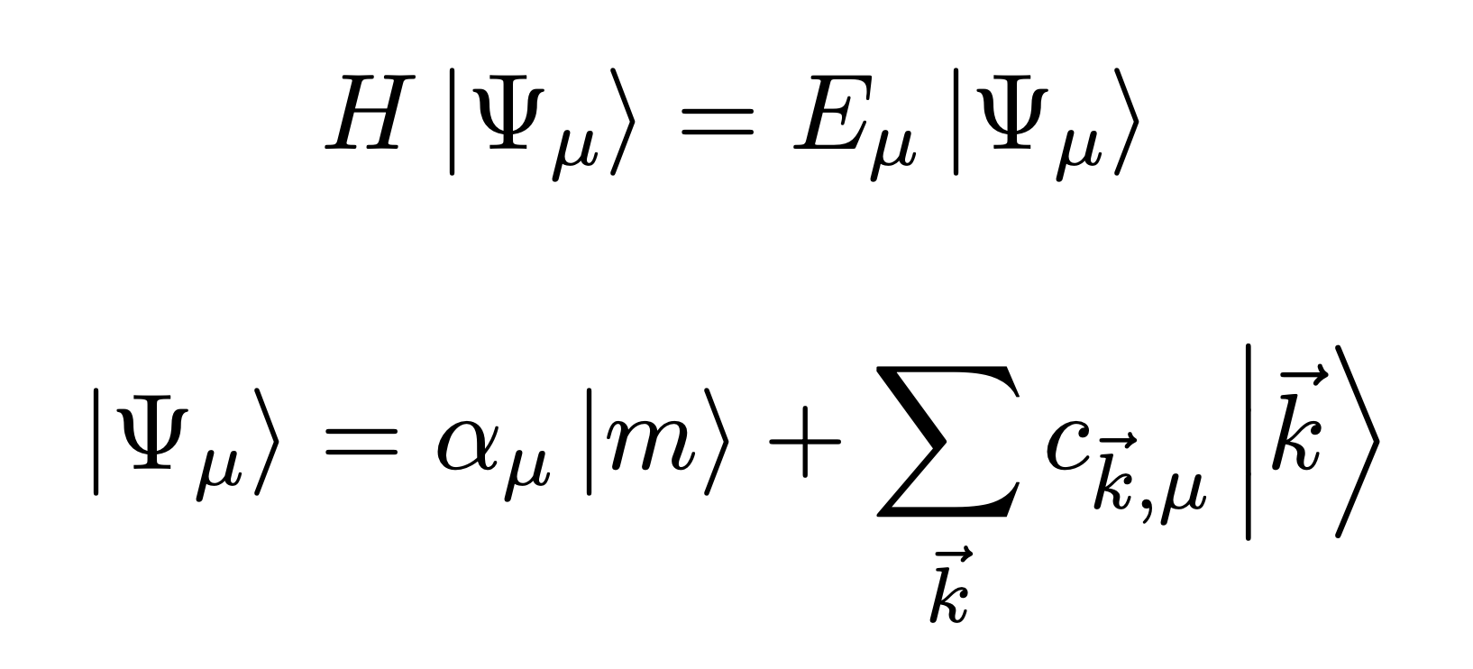

Feshbach resonances: a model from AMO II
A discrete state $\left|m\right\rangle$ coupled to a continuum of states$\left|\vec{k}\right\rangle$:
Solve:
Result:
Molecular binding energy quadratically
Coupling to continuum gives: shift + width
FB resonance

Slide 4
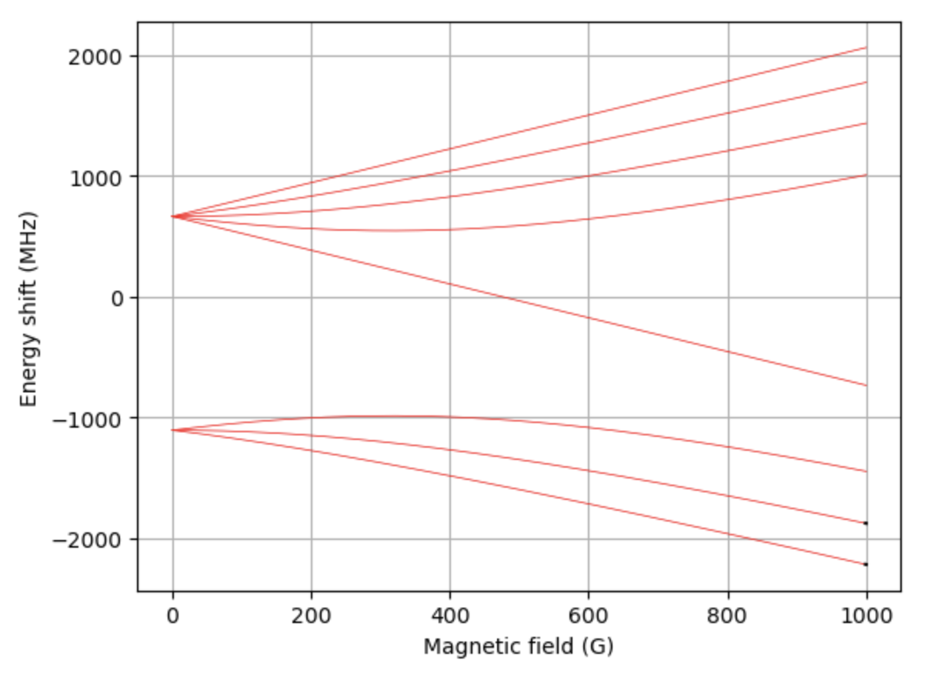
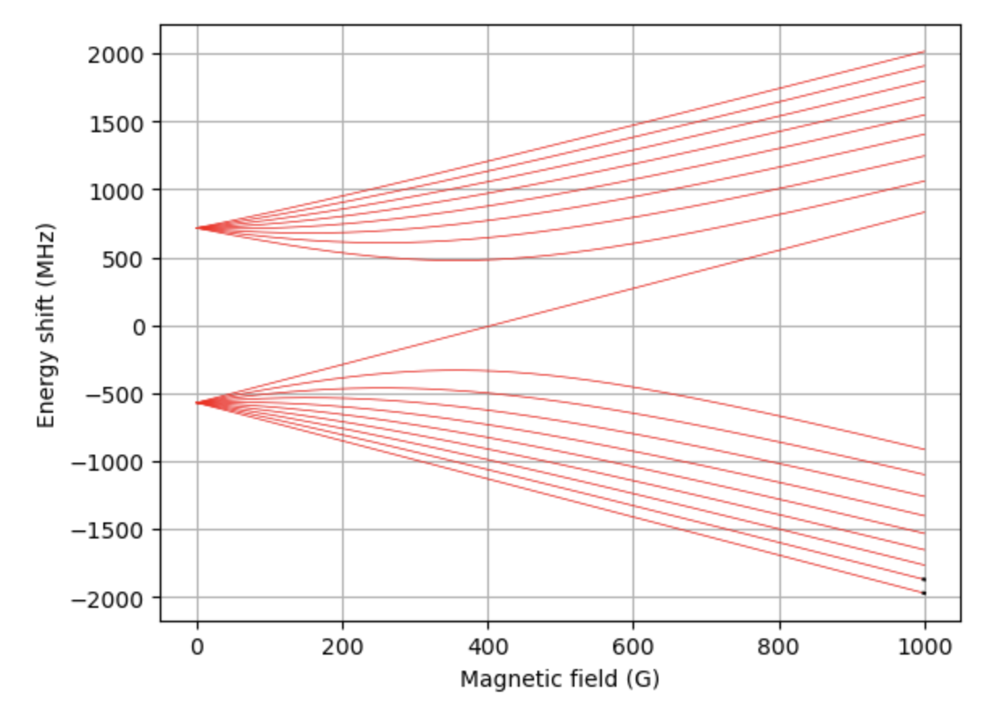
Feshbach resonances: the reality
Scenario: Find FB resonances in e.g. ²³Na⁴⁰K, ⁶Li⁴⁰K, or ⁶Li₂ from spectroscopic data
Problem:
Find Feshbach resonances & widths
Find binding energies of Feshbach molecules
Solution: Calculate, then measure. Two existing methods:
Coupled-channel calculation
Asymptotic bound-state model

Slide 5
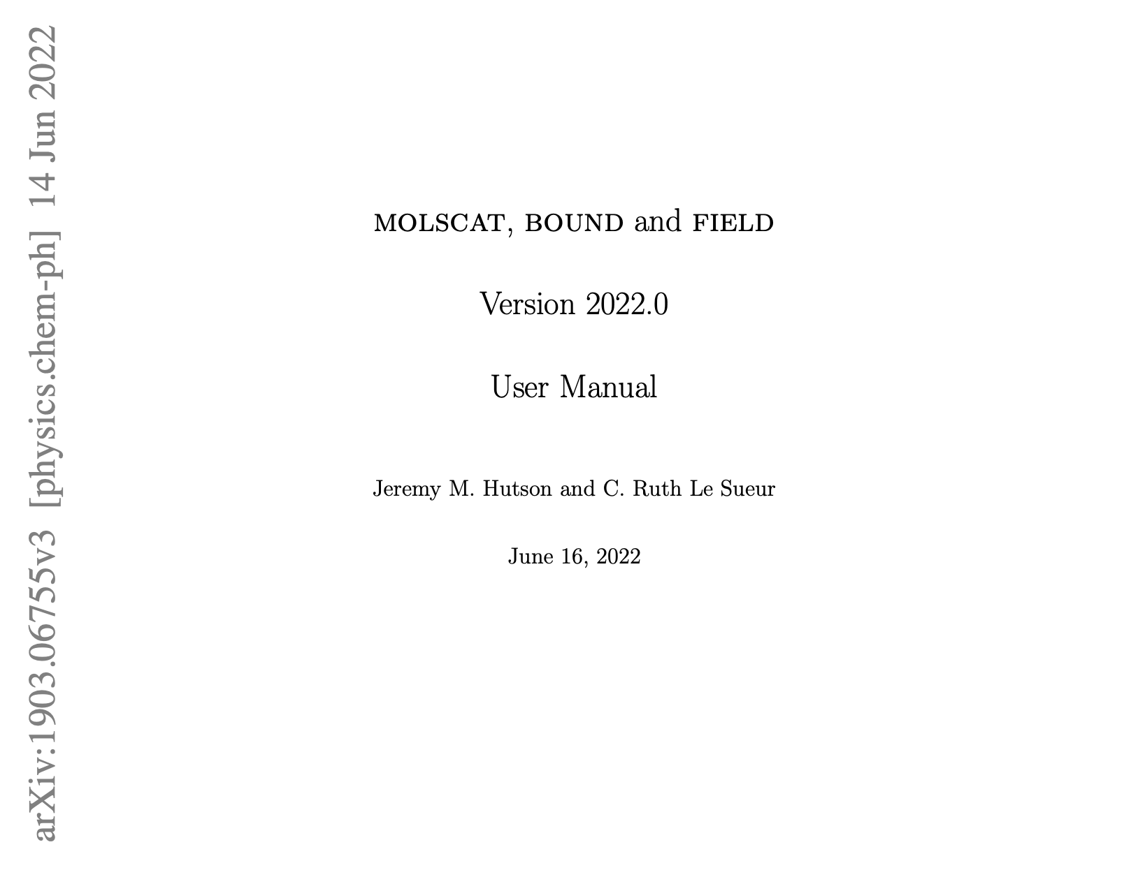
Coupled-channel calculations (CC)
Interactions have spin + orbital degrees of freedom
Resulting in coupled radial SE’s in spin basis
Numerically solve for scattering properties + bound states
Dedicated program by J. M. Hutson & C. R. L. Sueur
3 Fortran programs (code available on Github here):
MOLSCAT (arXiv), BOUND & FIELD (arXiv)
Drawbacks:
Interaction potentially typically not accurate enough
Many degrees of freedom → time consuming
Numerical issues (grid size & numerical accuracy)
Not easy to learn how to use and implement!
210-page user manual

Slide 6
Asymptotic Bound-state Model (ABM)
Tobias Tiecke et al (Phys. Rev. A 82, 042712)
Model description
Obtaining input parameters
Implementation (examples)
Extensions

Slide 7
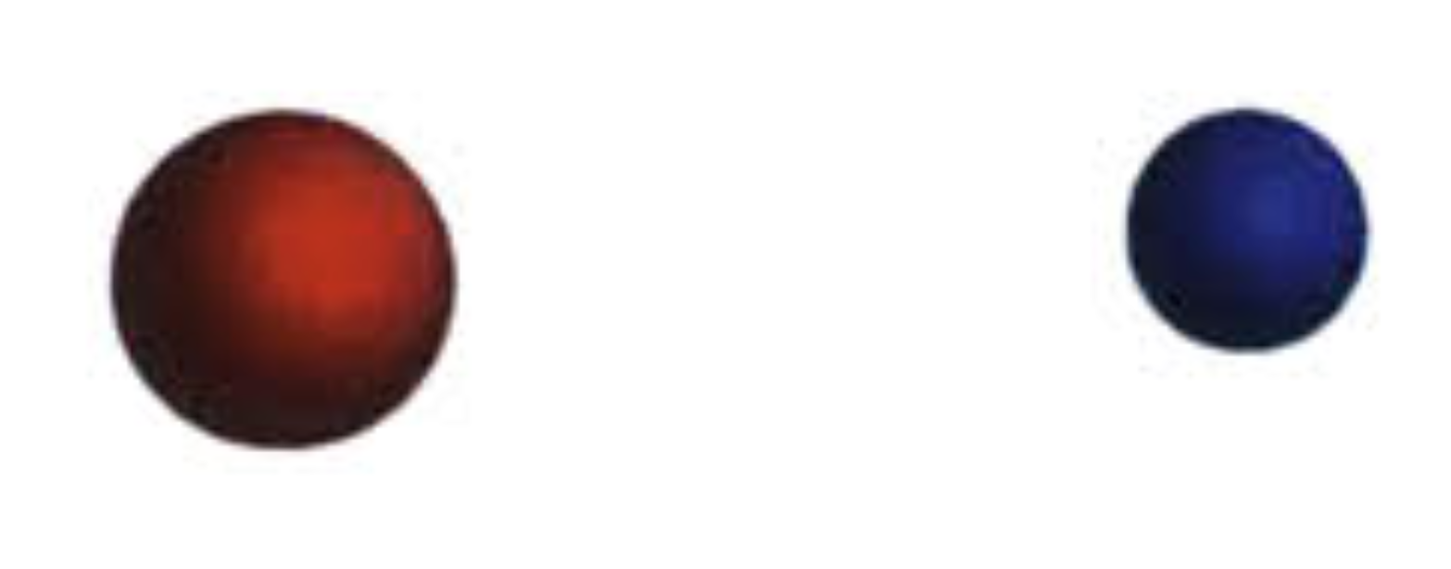
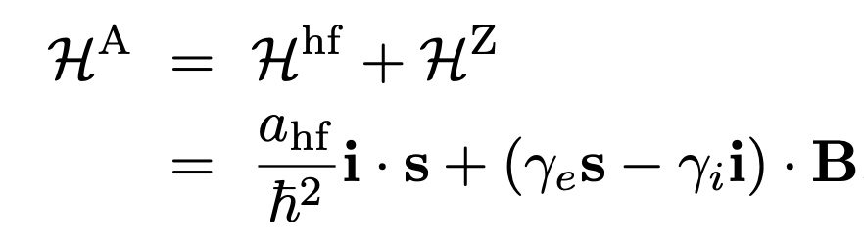

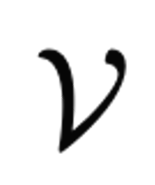
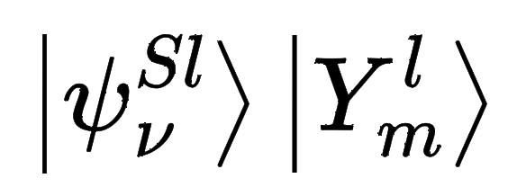
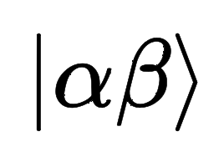
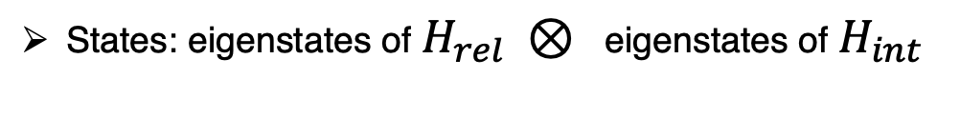

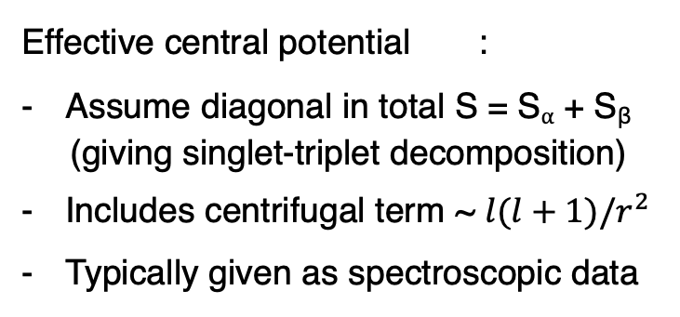
ABM description: Setup
Two atoms ⍺ and β in their electronic ground state
Hamiltonian = Relative motion in COM frame + Internal energy
+ atom β
Effective central potential :
Assume diagonal in total S = S⍺ + S_{β}
(giving singlet-triplet decomposition)
Includes centrifugal term ~ $l(l+1)/r^{2}$
Typically given as spectroscopic data
You may already have this part on your laptop!
States: eigenstates of $H_{rel} ⊗$ eigenstates of $H_{int}$
Bound-state wfns of $V^{S,l}(r)$
Breit-Rabi basis

Slide 8
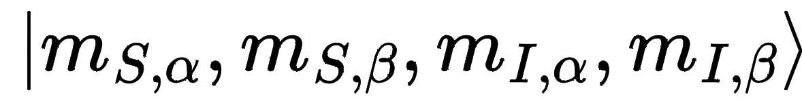
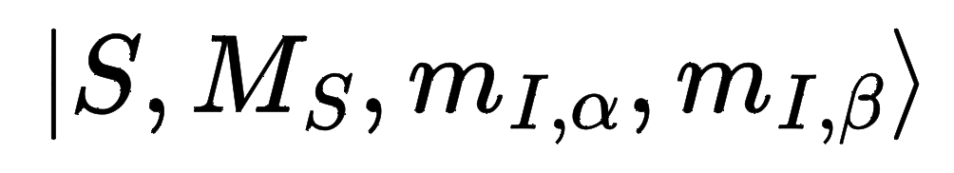

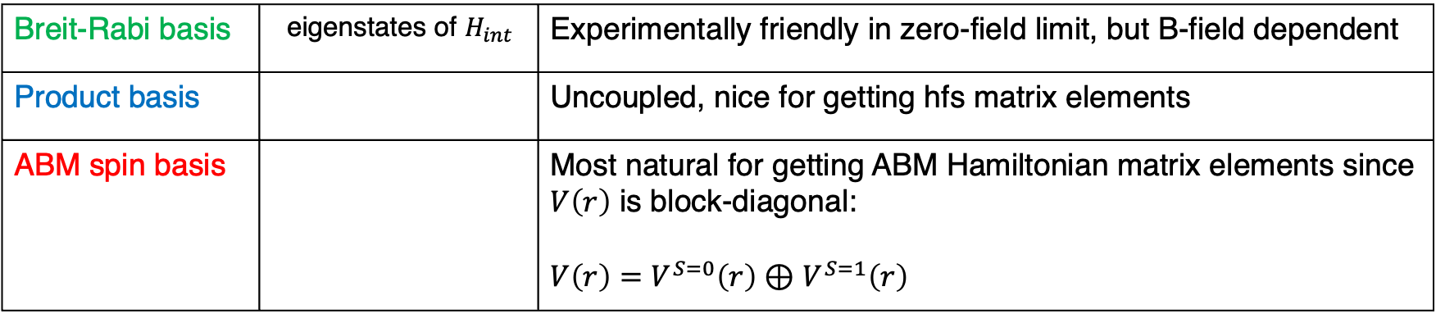

ABM description: Basis states
States: eigenstates of $H_{rel} ⊗$ eigenstates of $H_{int}$
Some bases are more natural than others in different circumstances → need B-field dependent untaries
ABM spin basis is most convenient for getting ABM Hamiltonian matrix elements
Bound-state wfns of $V^{S,l}(r)$
Breit-Rabi basis
Breit-Rabi basis | eigenstates of $H_{int}$ | Experimentally friendly in zero-field limit, but B-field dependent
Product basis |  | Uncoupled, nice for getting hfs matrix elements
ABM spin basis |  | Most natural for getting ABM Hamiltonian matrix elements since $V\left(r\right)$ is block-diagonal: $V\left(r\right)=V^{S=0}\left(r\right)⊕$ $V^{S=1}\left(r\right)$

Slide 9
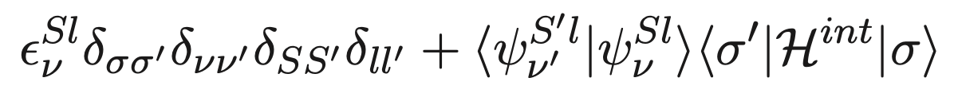
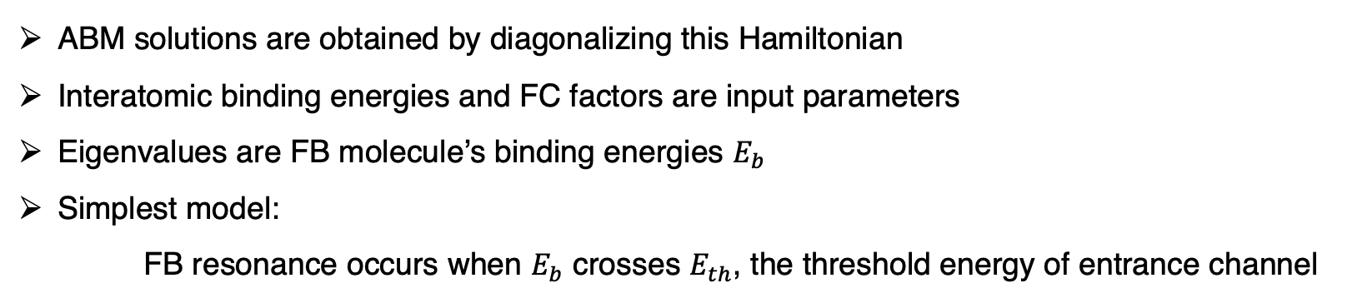
ABM description: Hamiltonian matrix elements
In ABM spin basis:
Spin degree of freedom
Binding energy of
Relative motion Hamiltonian
is diagonal in spin basis
Franck-Condon factor
ABM solutions are obtained by diagonalizing this Hamiltonian
Interatomic binding energies and FC factors are input parameters
Eigenvalues are FB molecule’s binding energies $E_{b}$
Simplest model:
FB resonance occurs when $E_{b}$ crosses $E_{th}$, the threshold energy of entrance channel

Slide 10
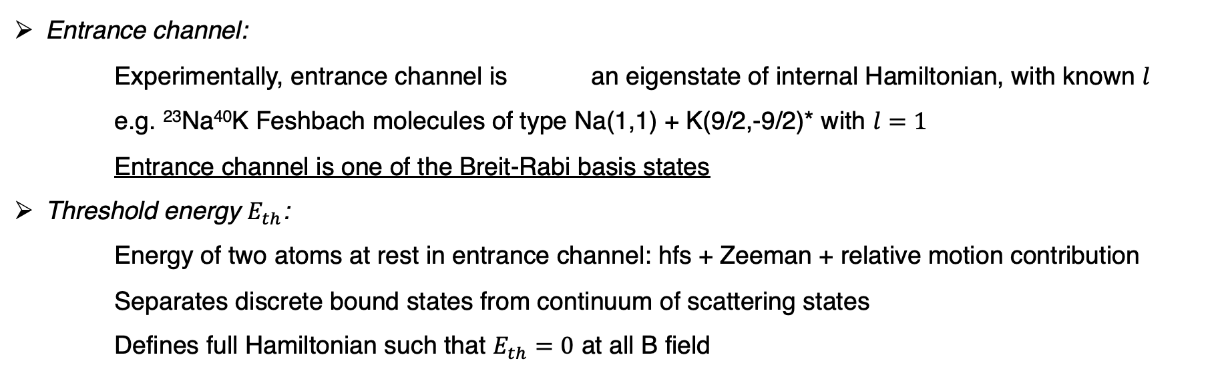
ABM description: Some definitions
Entrance channel:
Experimentally, entrance channel is an eigenstate of internal Hamiltonian, with known $l$
e.g. ²³Na⁴⁰K Feshbach molecules of type Na(1,1) + K(9/2,-9/2)* with $l=1$
Entrance channel is one of the Breit-Rabi basis states
Threshold energy $E_{th}$:
Energy of two atoms at rest in entrance channel: hfs + Zeeman + relative motion contribution
Separates discrete bound states from continuum of scattering states
Defines full Hamiltonian such that $E_{th}=0$ at all B field
(*) in zero-field limit

Slide 11
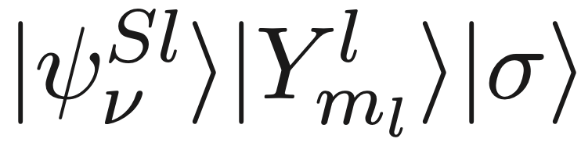
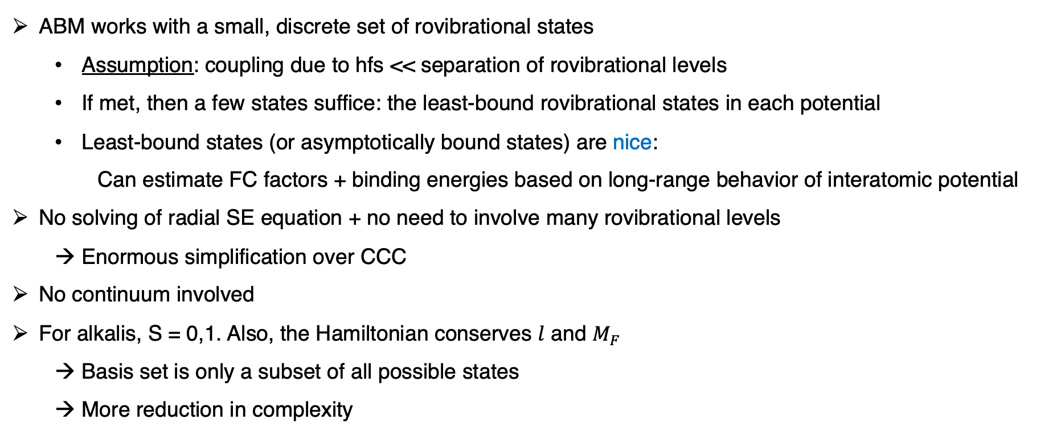
ABM description: assumptions/simplifications
ABM works with a small, discrete set of rovibrational states
Assumption: coupling due to hfs << separation of rovibrational levels
If met, then a few states suffice: the least-bound rovibrational states in each potential
Least-bound states (or asymptotically bound states) are nice:
Can estimate FC factors + binding energies based on long-range behavior of interatomic potential
No solving of radial SE equation + no need to involve many rovibrational levels
Enormous simplification over CCC
No continuum involved
For alkalis, S = 0,1. Also, the Hamiltonian conserves $l$ and $M_{F}$
Basis set is only a subset of all possible states
More reduction in complexity

Slide 12
So far… we have
Basis states
Hamiltonian
Rule for getting Hamiltonian matrix elements
???
We need input parameters

Slide 13
ABM implementation
ABM

