Slide 1

MOTION DETECTION UNTUK SMART CITY

Slide 2
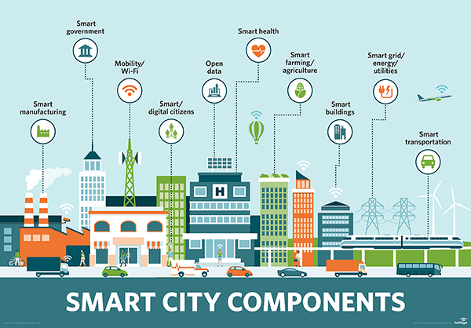
How to be smart?

Slide 3
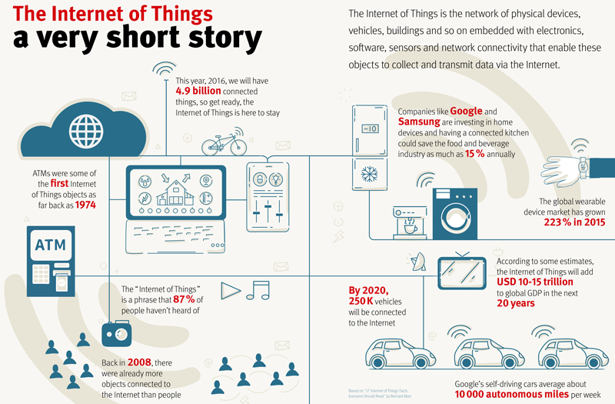

Slide 4
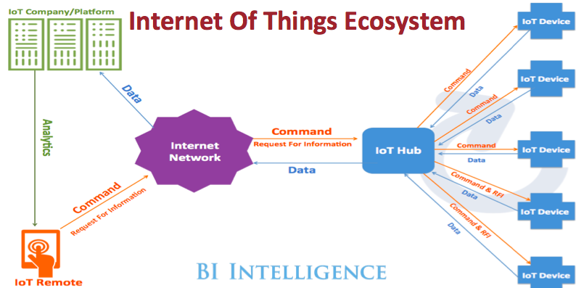

Slide 5
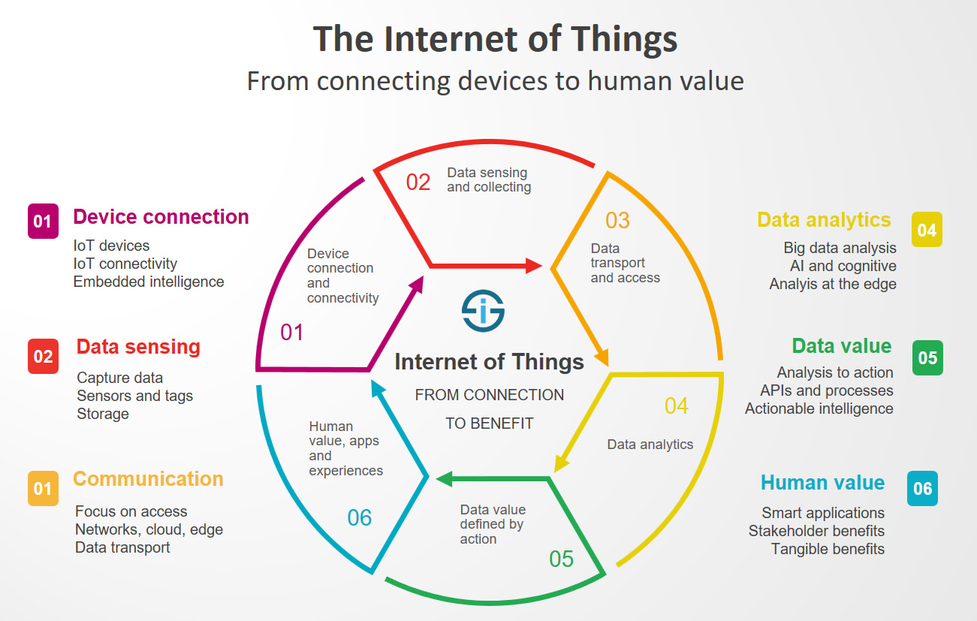

Slide 6
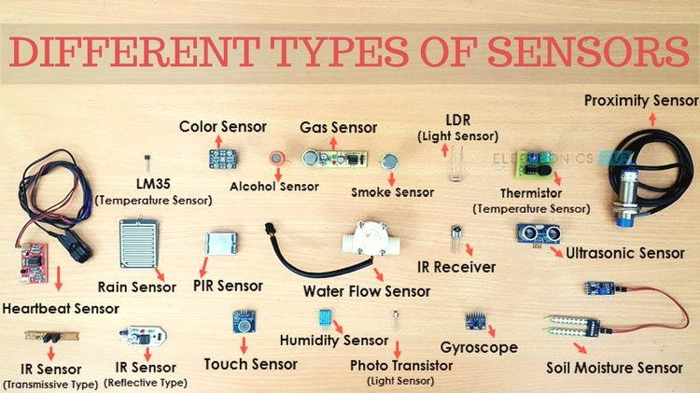
like human, apps need sensors to be smart

Slide 7
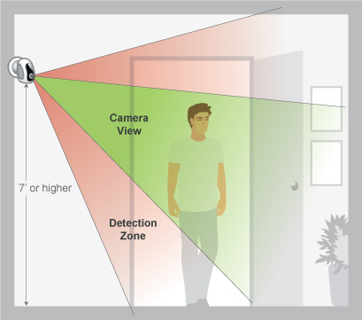
Motion Detection

Slide 8
Whats needed?
web server to play simulation
python 2.7
opencv 2

Slide 9
Web Server
- install apache2
apt-get install apache2
- copy car.mpv to /var/www/
- access using browser : http://localhost/car.mp4

Slide 10
Requirement
sudo apt-get update
sudo apt-get install build-essential cmake pkg-config
sudo apt-get install libjpeg8-dev libtiff5-dev libjasper-dev libpng12-dev
sudo apt-get install libavcodec-dev libavformat-dev libswscale-dev libv4l-dev
sudo apt-get install libxvidcore-dev libx264-dev
sudo apt-get install libgtk-3-dev
sudo apt-get install libatlas-base-dev gfortran
sudo apt-get install python2.7-dev
sudo apt-get install ipython python-opencv python-scipy python-numpy python-pygame python-setuptools python-pip git python-pil

Slide 11
opencv
copy opencv.zip dan opencv_contrib.zip
unzip opencv.zip
unzip opencv_contrib.zip
cd ~
wget https://bootstrap.pypa.io/get-pip.py
sudo python get-pip.py
sudo pip install virtualenv virtualenvwrapper
mkvirtualenv citra
pip install numpy

Slide 12
extract opencv
cd ~/opencv-3.1.0/
mkdir build
cd build
cmake -D CMAKE_BUILD_TYPE=RELEASE \
-D CMAKE_INSTALL_PREFIX=/usr/local \
-D INSTALL_PYTHON_EXAMPLES=ON \
-D INSTALL_C_EXAMPLES=OFF \
-D OPENCV_EXTRA_MODULES_PATH=~/opencv_contrib-3.1.0/modules \
-D PYTHON_EXECUTABLE=~/.virtualenvs/cv/bin/python \
-D BUILD_EXAMPLES=ON ..

Slide 13
finished opencv
make clean
make
sudo make install
sudo ldconfig
ls -l /usr/local/lib/python2.7/site-packages/
sudo pip install opencv-python
Open up a new terminal.

Slide 14
Replace #
#No.1 capture dari stream
cap = cv2.VideoCapture('http://localhost/car.mp4')
#no.2 menampilkan setiap frame
cv2.imshow('Frame',frame)
#no.3 mengubah delay
if cv2.waitKey(50) & 0xFF == ord('q'):

Slide 15
Replace #2
#No.4 resize screen
#resize x:500
r = 500.0 / frame.shape[1]
dim = (500, int(frame.shape[0] * r))
frame = cv2.resize(frame, dim, interpolation = cv2.INTER_AREA)
#no.5 membatasi screen area
rows,cols,cc = frame.shape
frame = frame[35:rows, 0:cols]

Slide 16
Replace #3
#No.6 membuat garis batas untuk penghitungan
for i in range(cols):
frame[200,i] = [255,0,0]
frame[201,i] = [255,0,0]
#no.7a counter
if counter == 1:
print rows, cols
#7b counter
counter = 0
image = 0

Slide 17
#8
if (counter == 2) :
cv2.imwrite('0.jpg',frame)
frame = cv2.imread('0.jpg', 0)
cv2.imshow('Frame',frame)
if (counter == 150) :
cv2.imwrite('1.jpg',frame)
frame = cv2.imread('1.jpg', 0)
cv2.imshow('Frame',frame)
#no.8
if (counter == 200) :
cv2.imshow('Frame',frame)
cv2.imwrite('2.jpg',frame)
counter = counter + 1
#no2 dihapus

Slide 18
#no9
frame1 = cv2.imread('0.jpg')
f1Rows, f1Cols,cc = frame1.shape
frame2 = cv2.imread('1.jpg')
f2Rows, f2Cols,cc = frame2.shape
for i in range(f2Rows):
for j in range(f2Cols):
R1,G1,B1 = frame1[i,j]
R2,G2,B2 = frame2[i,j]
difR = abs(R2-R1)
difG = abs(G2-G1)
difB = abs(B2-B1)
if (difR > 160) & (difG > 160) & (difB > 160) & (difR < 220) & (difG < 220) & (difB < 220):
frame2[i,j] = [difR,difG,difB]
else:
frame2[i,j] = [0,0,0]
cv2.imshow('Frame',frame2)
cv2.imwrite('result2.jpg',frame2)

Slide 19
if (counter%20==0) :
cv2.imwrite(str(image)+'.jpg',frame)
frame = cv2.imread(str(image)+'.jpg', 0)
cv2.imshow('Frame',frame)
frame1 = cv2.imread('0.jpg')
f1Rows, f1Cols,cc = frame1.shape
frame2 = cv2.imread(str(image)+'.jpg')
f2Rows, f2Cols,cc = frame2.shape
for i in range(f2Rows):
for j in range(f2Cols):
R1,G1,B1 = frame1[i,j]
R2,G2,B2 = frame2[i,j]
difR = abs(R2-R1)
difG = abs(G2-G1)
difB = abs(B2-B1)
if (difR > 160) & (difG > 160) & (difB > 160) & (difR < 220) & (difG < 220) & (difB < 220):
frame2[i,j] = [difR,difG,difB]
else:
frame2[i,j] = [0,0,0]
cv2.imshow('Frame',frame2)
cv2.imwrite('result2.jpg',frame2)
image = image + 1

