Slide 1
TIER AND LAYER

Slide 2
Understanding Tier and Layer
1. Presentation Layer: Desktop UI, Web Page or Mobile App
2. Application Layer: Business Logic and Data Validations. Also Middle Layer
3. Data Layer: External data source like SqlServer, Oracle
Presentation
Layer
Application
Layer
Data Layer

Slide 3
Types of Layers
Tier usually means the physical deployment computer
Layer usually means logic software component or Logical separation of code which may or may not rung in the same process or same machine.
Tier are places where Layers are deployed and executed.
Layer and tier may or may not exactly match each other. Each layer may run in an individual tier. However, multiple layers may also be able to run in one tier.

Slide 4
Types of Tiers
1-Tier: All the 3 layers are in same process running in one machine. Embeded database, dbase etc are supposed to be used.
2 Tier: Either presentation layer and application layer will run in one computer or application layer and data layer can only run in one computer.
3 Tier: It’s the simplest case of N-Tier architecture. All three layers will run in three separate computers.

Slide 5
Types of Tiers
N-Tier: 3 or more tiers architecture. Some layer in 3-tier architecture can be broken into many layers eg:
Application Layer = Business Layer + Persistance Layer. This is ideal implementation for Web Based application.
Client
Layer
Client
Presenter
Layer
Business Layer
Persistence
Layer
Data
Layer

Slide 6
Types of Tiers
N-Tier: 3 or more tiers architecture. Some layer in 3-tier architecture can be broken into many layers eg:
Application Layer = Business Layer + Persistance Layer. This is ideal implementation for Web Based application.
Client
Layer
Client
Presenter
Layer
Business Layer
Persistence
Layer
Data
Layer

Slide 7
Overview of Each Layer:
Client layer: this layer is involve with users directly. There may be several different types of clients coexisting, such as WPF, Windows form, HTML web page, Mobile App etc.
Client presenter layer: contains the presentation logic need by clients, such ass ASP.NET in IIS web server.
Business Layer: handles and encapsulates all of business domains and logics; also call domain layer. Can be implemented is using WCF.

Slide 8
Overview of Each Layer:
Persistence layer or DAL: handles the read/write ò the business dât to the data layer.
Data layer: the external data source, such as a SQL Server or Oracle

Slide 9
Advantage of N-Tier architecture
Better Scalability, Finer Security Control, Better fault tolerance ability, independent tier upgrading without affecting other tiers, friendly and efficient development, friendly maintenance and better reusuability.
We should differ the following two cases:
All layers run in one process of a computer: 1 tier architecture.
All layers run in difference processes of a computer = N-Tier architect but deployed in just 1 host.

Slide 10
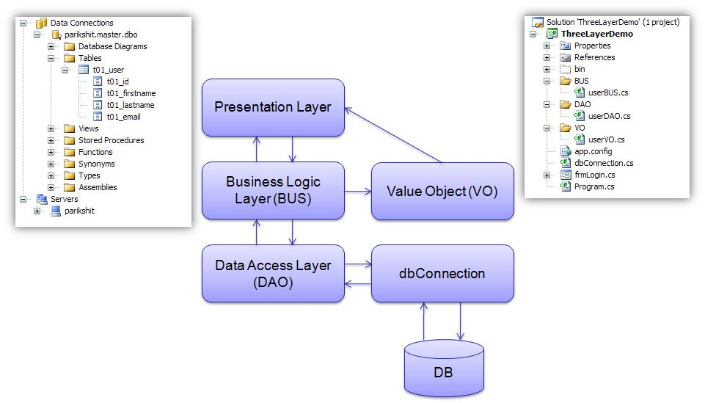
More…

Slide 11
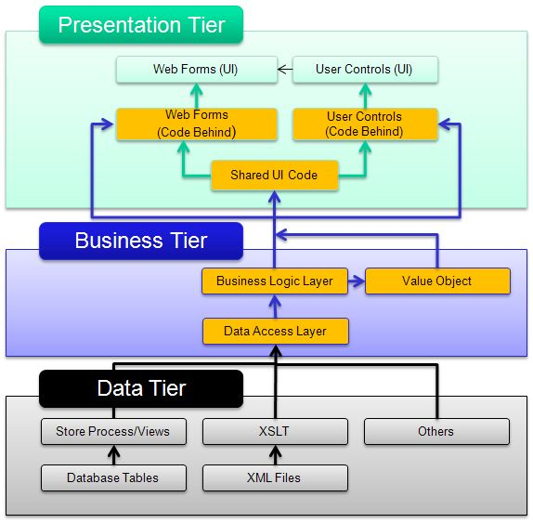
More…

Slide 12
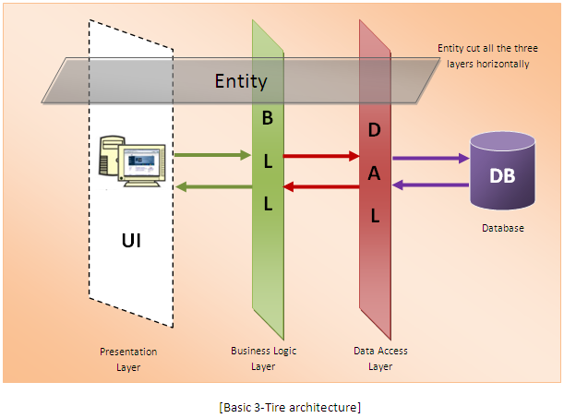
More…

Slide 13
The above describe a very simple architecture of a 3-tier model.
DAL (Data Access Layer) interacts with Database directly, so all the SQL operation are being done within DAL only.
BLL (Business Logic Layer) works like a mediator between DAL and the Presentation Tier.
No direct communication is allowed between DAL and Presentation Layer.

Slide 14
The above describe a very simple architecture of a 3-tier model.
Although there is no physical presence of the Entity Layer, but Entity encapsulates all the information/data and passes it from one layer to the other.
So all the Database object name and the Database Schema is being restricted inside the DAL which gives an extra security layer to the application.
As Business rules/logics are being defined inside BLL, any update to business logic will not impact the DAL and the presentation layer

Slide 15
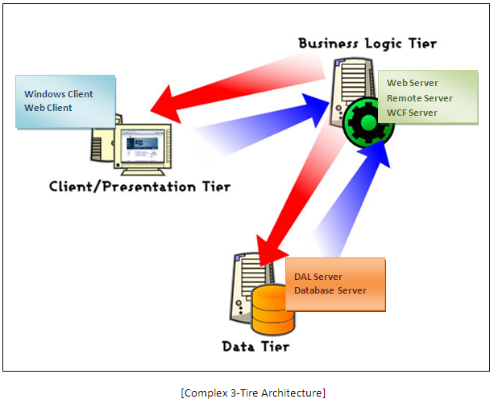
More…

Slide 16
This diagram describes an actual implementation of a 3-tier model.
Data Access Service and the Database Server can be hosted in single Server.
Mostly SQL Server 2000/2005/2008 or Oracle can be hosted on Windows 2000/2003 Server.
Business Server exposes all the operation through Web Service /Remoting/WCF.
A highly configured server with Windows 2000/2003 can be used to host the Business Service, or else Microsoft BizTalk Server also can be used for this.

Slide 17
This diagram describes an actual implementation of a 3-tier model.
Presentation Tier or the Client Consumes the Service exposed at Business Server by using the Proxy through http:// pipeline.
Client can be any standalone machine with the application is being installed in case of Desktop Application (Win-Form or Console Application), or having a Browser to run Web Application.
Data/Information are being encapsulated by entity and transferred from one location to another over network followed by all the network protocol.

Slide 18
SASS-SCSS

Slide 19
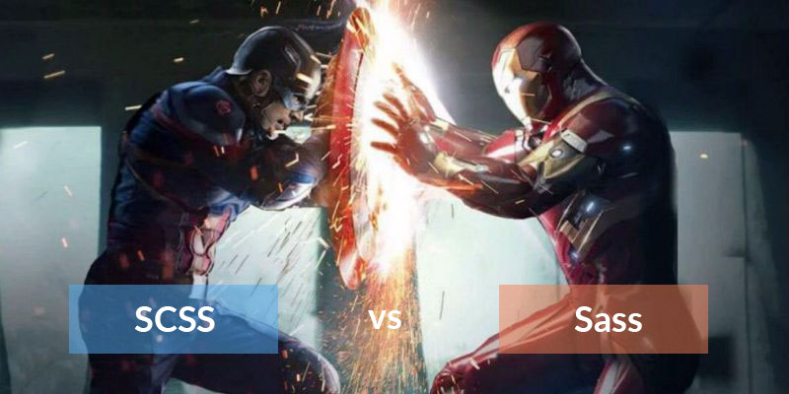

Slide 20
SASS syntax
(Syntactically Awesome StyleSheets)
SCSS syntax
(Sassy CSS)

Slide 21
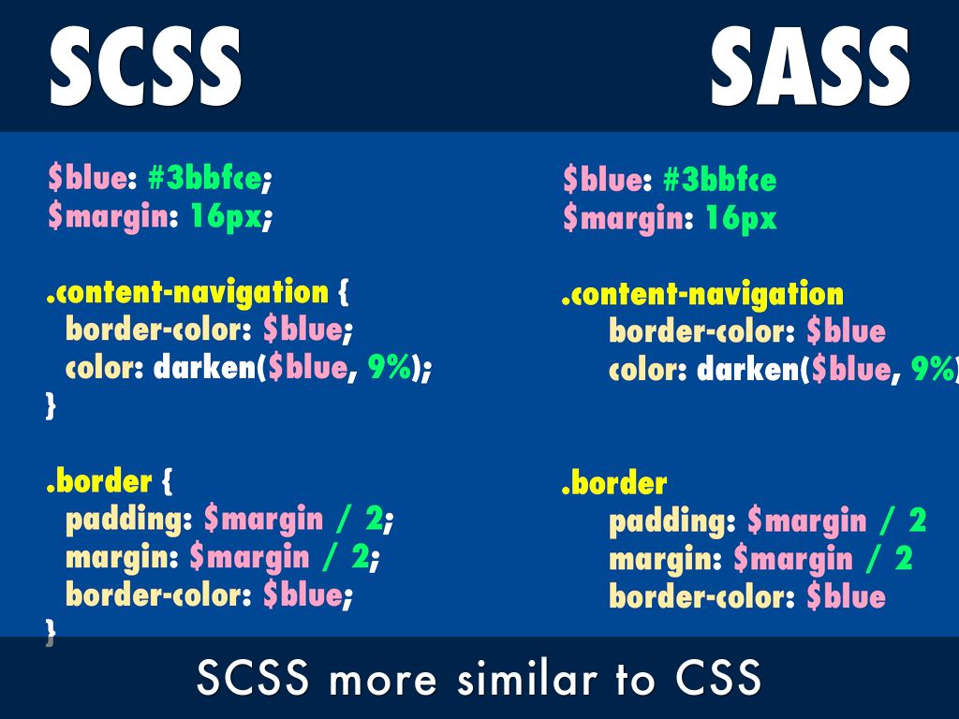

Slide 22
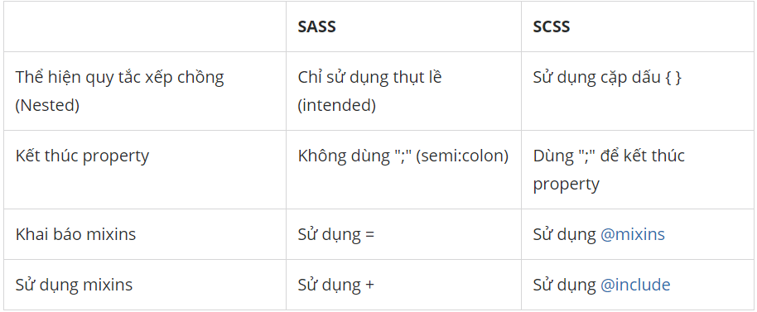

Slide 23
THANKS!

