Slide 1
GRADUATE THESIS DEFENSE
Hybrid Spatial-Frequency Learning with Block-wise DCT for Deepfake and Liveness Detection in eKYC
Two-Stream Architecture with Block-DCT Frequency Branch and Gated Cross-Attention Fusion
Student: Le Ngoc Thanh
ID: 102220041
Class: 22T_KHDL
Advisor: Assoc. Prof. Dr. Pham Cong Thang
Computer Science & Artificial Intelligence
June 2026
THESIS DEFENSE

Slide 2
Defense Overview
01
Project Overview
Problem, Motivation, Objectives & Scope
02
Methodology
Frequency Hypothesis, Block-DCT, Gated Fusion, SFDCT-HFF & Liveness
03
Results
eKYC Deepfake Defense
Cross-Dataset Protocol and Honest Reading
04
Conclusion
Contributions, Limitations & Future Directions
2

Slide 3
01
Project Overview
Problem, Motivation, Objectives & Scope
1.1 Problem and Motivation
CHAPTER ONE
1.2 Objectives and Scope
3

Slide 4
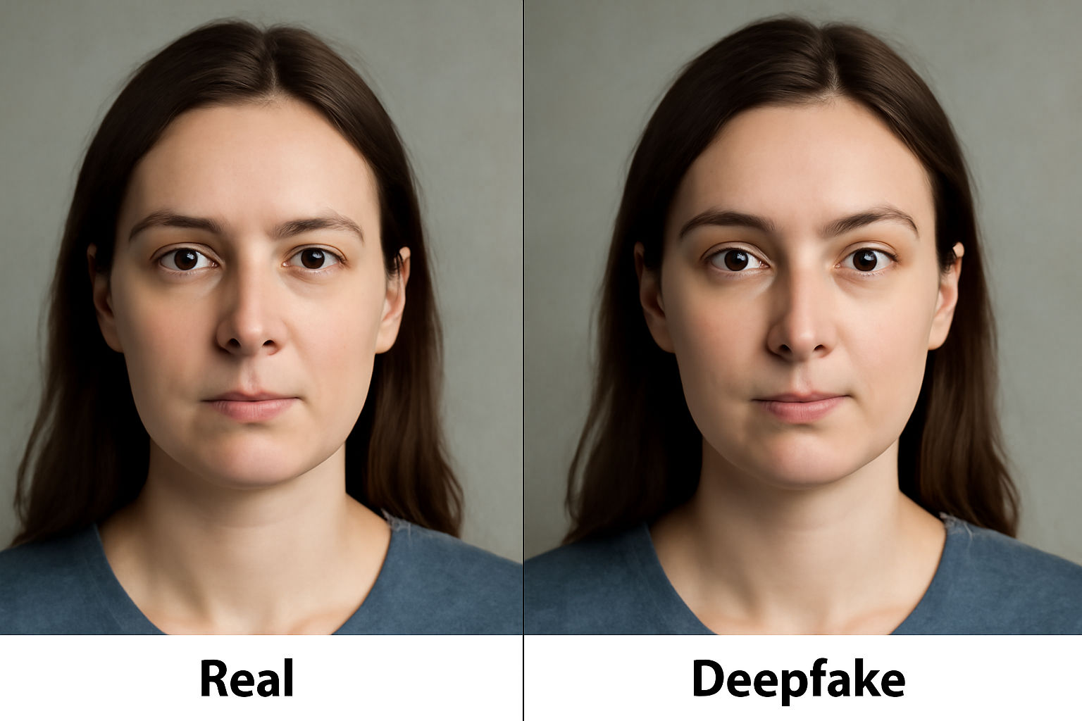
Problem and Motivation: The Generalisation Gap
01 Project Overview
1
eKYC: Face Verification as the First Lock
eKYC opens accounts and confirms payments from one portrait photo. Face verification is the lock on that first door to financial services.
2
Two Distinct Threats
Deepfake (GAN face swap/synthesis) and Presentation Attack (print/replay). Either bypass means identity fraud and direct financial loss.
3
Regulatory Context: Circular 17/2024/TT-NHNN
Mandates biometric checks but fixes no error rate. The operational threshold is left to the system designer.
4
Core Difficulty: The Generalisation Gap
Pixel detectors collapse on unseen forgeries. Attackers always use newer tools than those in the training set.
Real vs. Deepfake face — nearly identical to the human eye
Key message: Face verification is the lock on the first door to financial services. The core problem is not detecting known forgeries but generalising to unseen ones — attackers always use newer tools.
4

Slide 5
Objectives and Scope: Two-Layer Protection System
01 Project Overview
Four Objectives
Scope & Boundaries
Obj 1 — Web Platform
Simple platform to upload or capture a face, fast result
Obj 2 — Deepfake Detector (Main Contribution)
Fusing a block-DCT frequency branch with a CNN backbone via a gated attention, returning a heat map
Obj 3 — Liveness Utility
Secondary: live person vs. printed photo or screen replay
Obj 4 — Cloud Deployment
AWS EC2 deployment for always-on service
In Scope
• Frame-level aligned faces
• No temporal information
• Cross-dataset: FF++ to Celeb-DF-v2
Out of Scope
• Video-level temporal modelling
• 3D physical mask attacks
• Audio deepfake detection
• Direct injection attacks
Evaluation Protocol
DeepfakeBench: train FF++, test Celeb-DF-v2
Key message: The main contribution is the block-DCT frequency branch fused via gated attention. The system is evaluated honestly by cross-dataset protocol: train on FF++, test on Celeb-DF-v2.
5

Slide 6
02
Methodology
Frequency Hypothesis, Block-DCT, Gated Fusion, SFDCT-HFF & Liveness
2.1 Two-Stream SFDCT Architecture
CHAPTER TWO
2.2 Block-DCT Descriptor
2.3 Gated Cross-Attention Fusion
2.4 SFDCT-HFF & Liveness
6

Slide 7
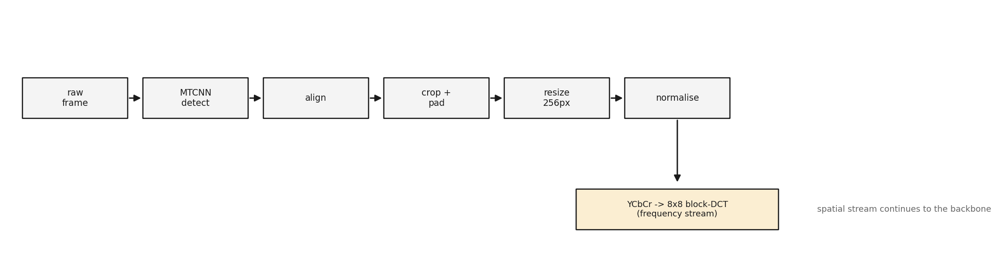
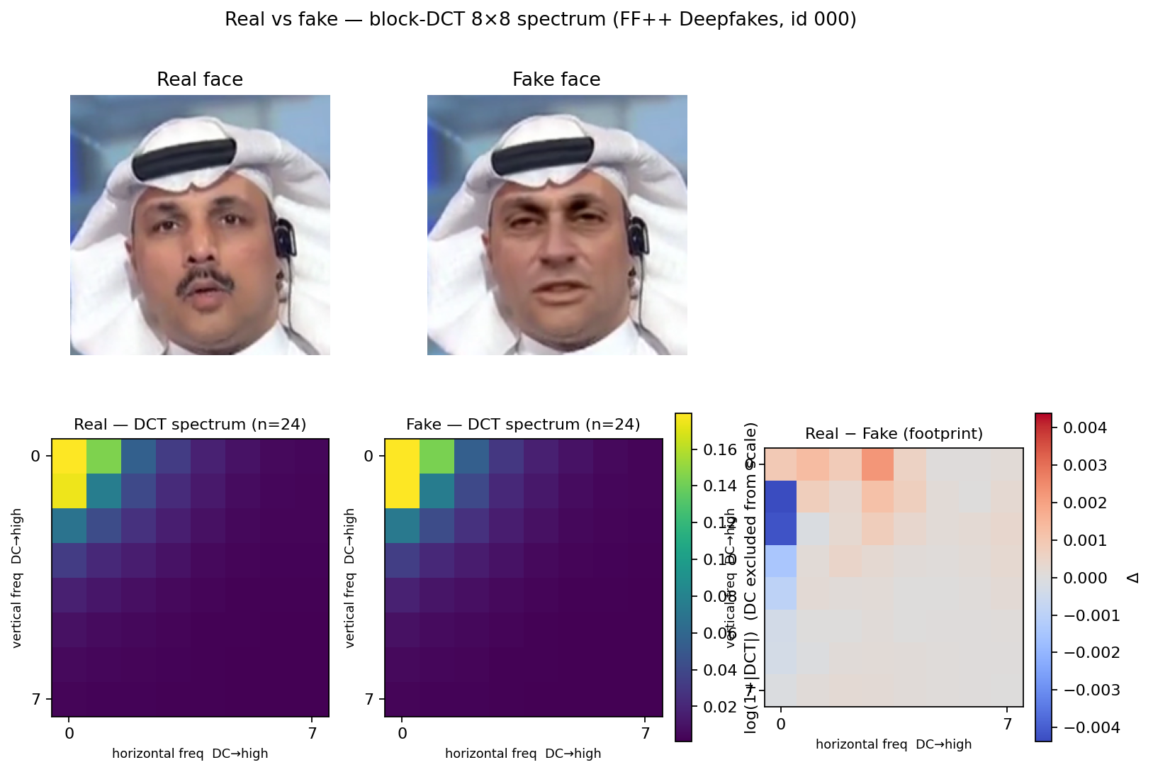
Data Processing Pipeline
02 Methodology

Slide 8
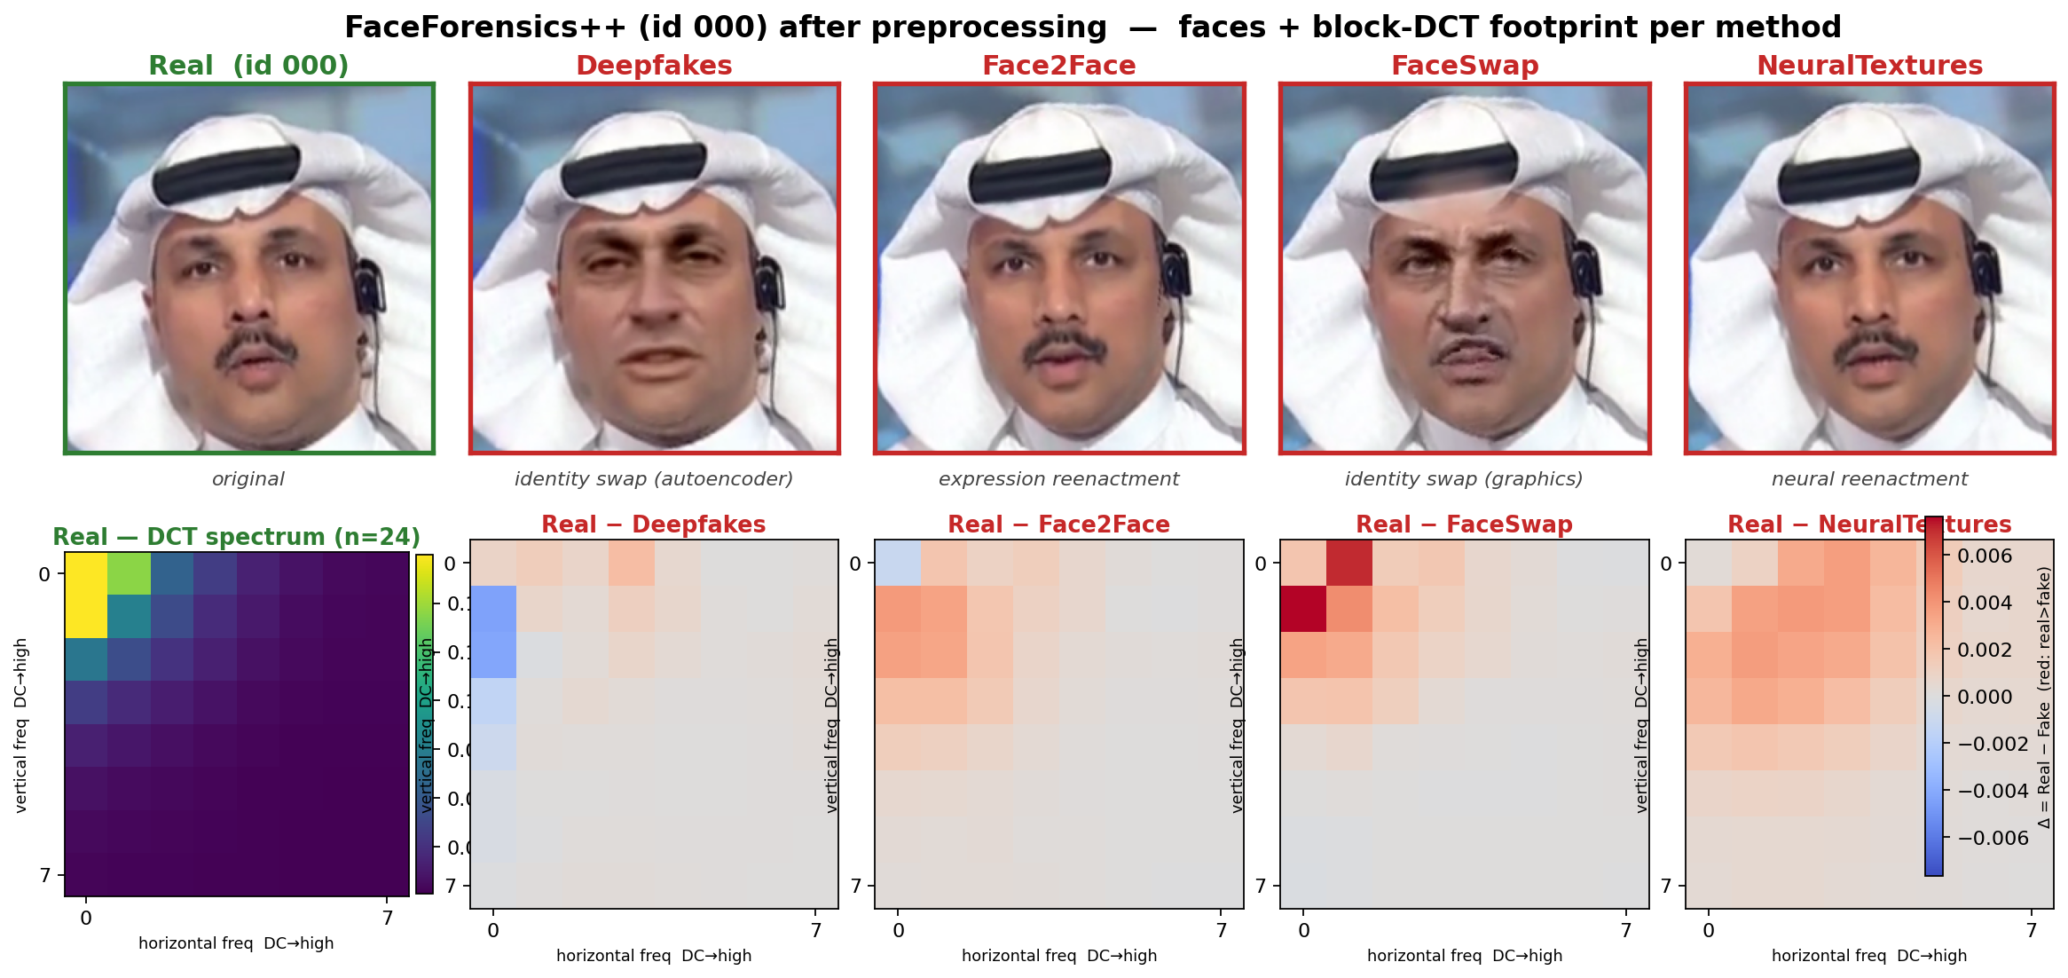
Forgery Footprints — FF++ Manipulations
02 Methodology

Slide 9
The Frequency Hypothesis and Two-Stream SFDCT
02 Methodology
01
02
03
04
Input: Aligned Face
Spatial Stream
Frequency Stream
Gated Fusion + Head
• 256x256 RGB crop
• MTCNN-aligned
• Fed into two parallel streams simultaneously
• EfficientNet-B4
• ImageNet-pretrained
• Reads pixel domain
• Outputs feature map Fs
• YCbCr 8x8 block-DCT
• 16 zigzag bands x 3 ch
• 48-dim descriptor
• Zero learnable params
• Cross-attention merge
• Spatial queries frequency
• Zero-init gate alpha
• Real-or-fake classifier
The Frequency Hypothesis
• Blending boundary: face-swap paste leaves a seam detectable in mid-frequency bands
• Upsampling artifact: GAN generators leave periodic patterns in high-frequency bands
• Frequency inconsistency: spliced sources break the unified frequency signature of real camera capture
Key message: Forgery traces are faint in pixels but loud in mid/high DCT bands. SFDCT reads both views — spatial (pixels) and frequency (DCT) — then merges them via a learned gate that starts closed.
7

Slide 10
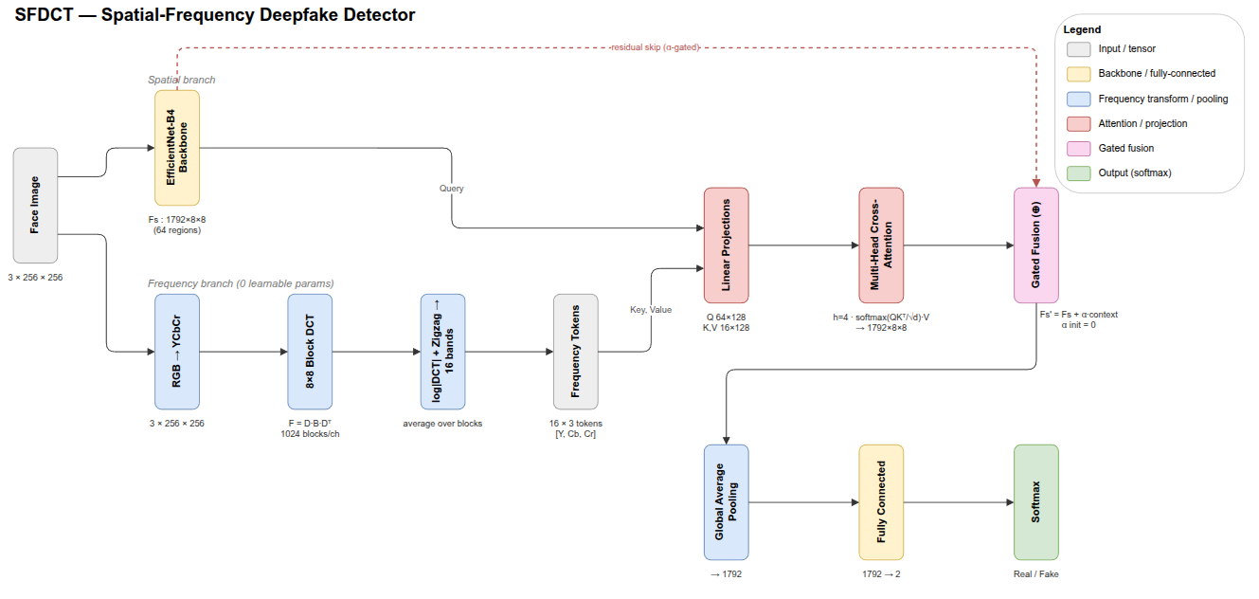
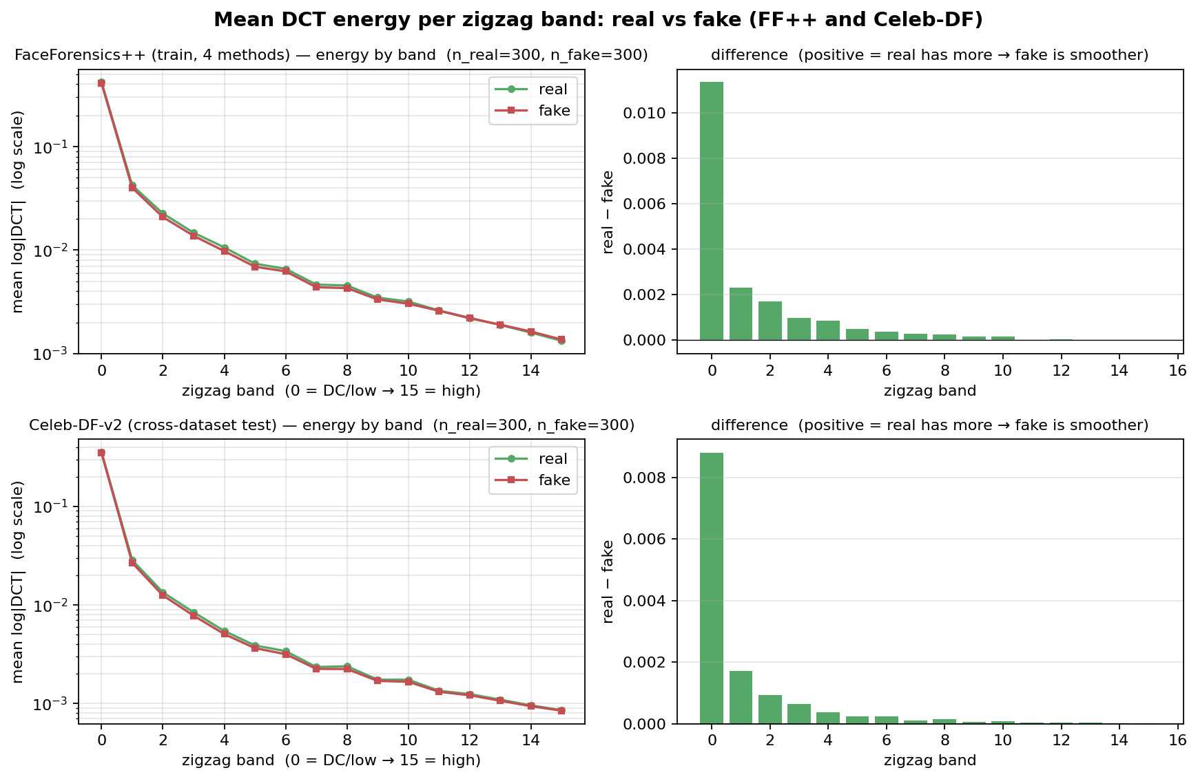
SFDCT — Two-Stream Architecture
02 Methodology

Slide 11
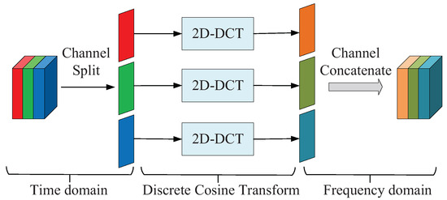
From 8x8 Block-DCT to a 48-Dim Descriptor
02 Methodology
Descriptor Construction Pipeline
1. Colour space conversion — RGB to YCbCr to separate luminance from chrominance
2. Block partition — Non-overlapping 8x8 blocks (matches JPEG grid)
3. Per-block 2D-DCT — 64 coefficients per block
4. Log-magnitude rescale — log(1+|coeff|) prevents DC from swamping artefacts
5. Zigzag grouping — 64 coeffs grouped into 16 bands (floor(rank/4))
6. Per-band mean — 16 bands x 3 channels = 48-dim descriptor
Channel-wise 2D-DCT: Time domain to Frequency domain
Band Range | Frequency | Content | Forgery Trace | Action
0 (DC only) | DC component | Mean intensity | None | Dropped
1 – 3 | Low | Coarse structure, identity | Minimal | Kept (SFDCT) / Dropped (HFF)
4 – 15 | Mid – High | Texture, edges | Blending, upsampling, compression | Kept
Key message: The 48-dim descriptor is fixed (zero learnable parameters), cheap to compute, stable across datasets, and interpretable — each dimension maps to a known frequency band.
8

Slide 12
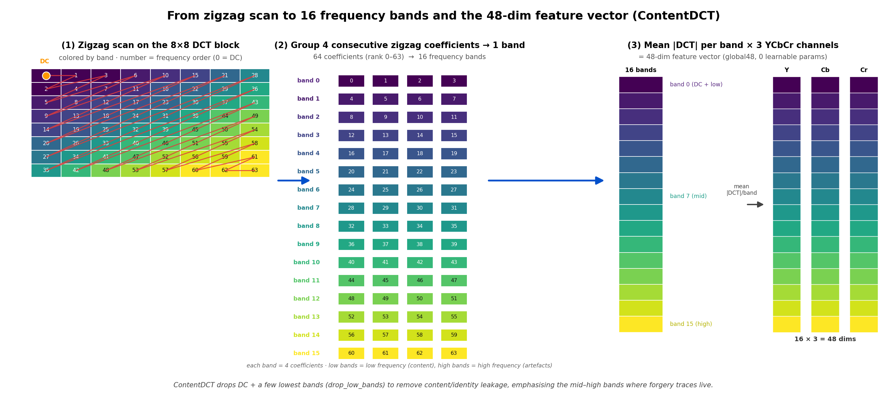
Block-DCT Descriptor — Zigzag to 48-D
02 Methodology

Slide 13
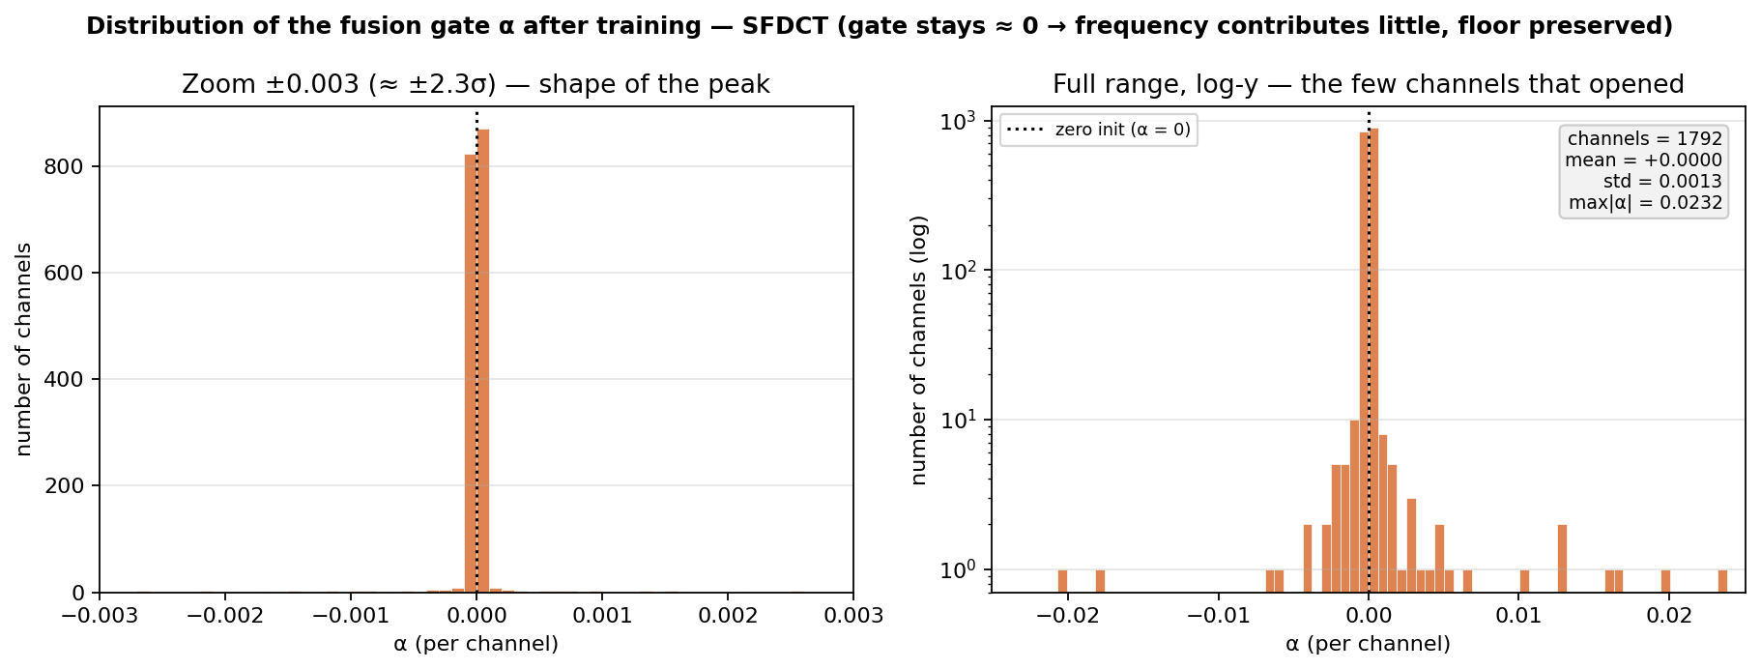
Gated Cross-Attention: Space Queries Frequency
02 Methodology
Cross-Attention Mechanism (Eq. 2.4)
Learned Gate Statistics (after training)
• Query (Q) = Spatial feature map F_s from EfficientNet-B4
• Key (K) = Block-DCT descriptor D
• Value (V) = Block-DCT descriptor D
• Each spatial position retrieves a weighted frequency summary
• Not a flat concatenation — selective, position-aware fusion
1792
+0.0000
0.0232
channels
mean alpha
max |alpha|
• std = 0.0013 — most channels stay near zero
• Only a small fraction of channels open selectively
• The gate acts as a direct meter of frequency contribution
• Consistent with measured gain being small
Gated Residual (Eq. 2.5)
F_fused = F_s + alpha x context
• Scalar gate alpha initialised to 0
• At step 1: fusion = backbone exactly (floor guarantee)
• Gate opens only where frequency context lowers loss
• If frequency is noisy: gradient pulls alpha back to ~0
Key message: The zero-initialised gate is both a safe-fusion design (model starts = backbone) and a direct meter of frequency contribution. The meter reads: gain is small, selective, and honest — max |alpha| = 0.0232 across 1792 channels.
9

Slide 14
SFDCT-HFF Variant and Liveness Reuse
02 Methodology
SFDCT (Baseline Variant)
SFDCT-HFF (High-Frequency Filtered)
• Frequency representation: band statistics
• Keep all 16 bands (after dropping DC)
• 48-dim descriptor per block
• Direct statistical input to fusion gate
Result: AUC = 0.7572
• Frequency representation: high-pass residual image
• Zero lowest DCT bands, inverse DCT
• Multi-scale Conv-BN-ReLU reads residual
• Residual-guided attention steers spatial branch
Result: AUC = 0.7695
Controlled comparison: Same B4 backbone, same zero-init gate, same loss. Only the frequency carrier changes — any gap is attributable to representation choice.
Liveness Module (Secondary)
• Reuses the same design: B4 baseline vs. B4 + block-DCT, no new frequency design
• Physical basis: Screen replay leaves re-capture peaks; print leaves dot patterns — both visible in frequency domain
• Cascade role: Liveness runs first as a pre-filter; a spoof or uncertain verdict stops the request before deepfake computation
Key message: SFDCT-HFF changes only the frequency carrier (residual image vs. band stats), making it a controlled experiment. The same design is reused for liveness as a pre-filter cascade.
10

Slide 15
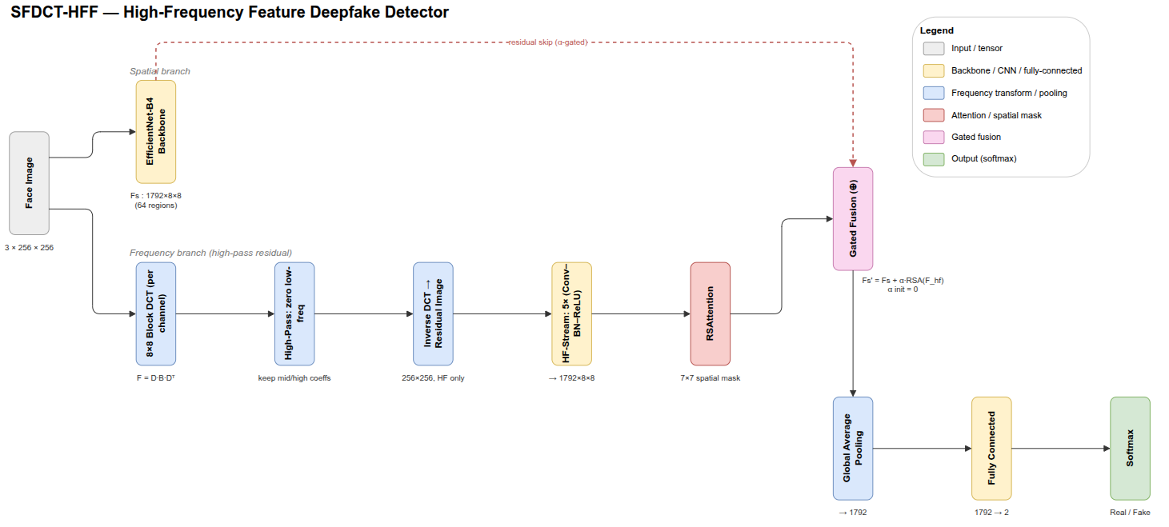
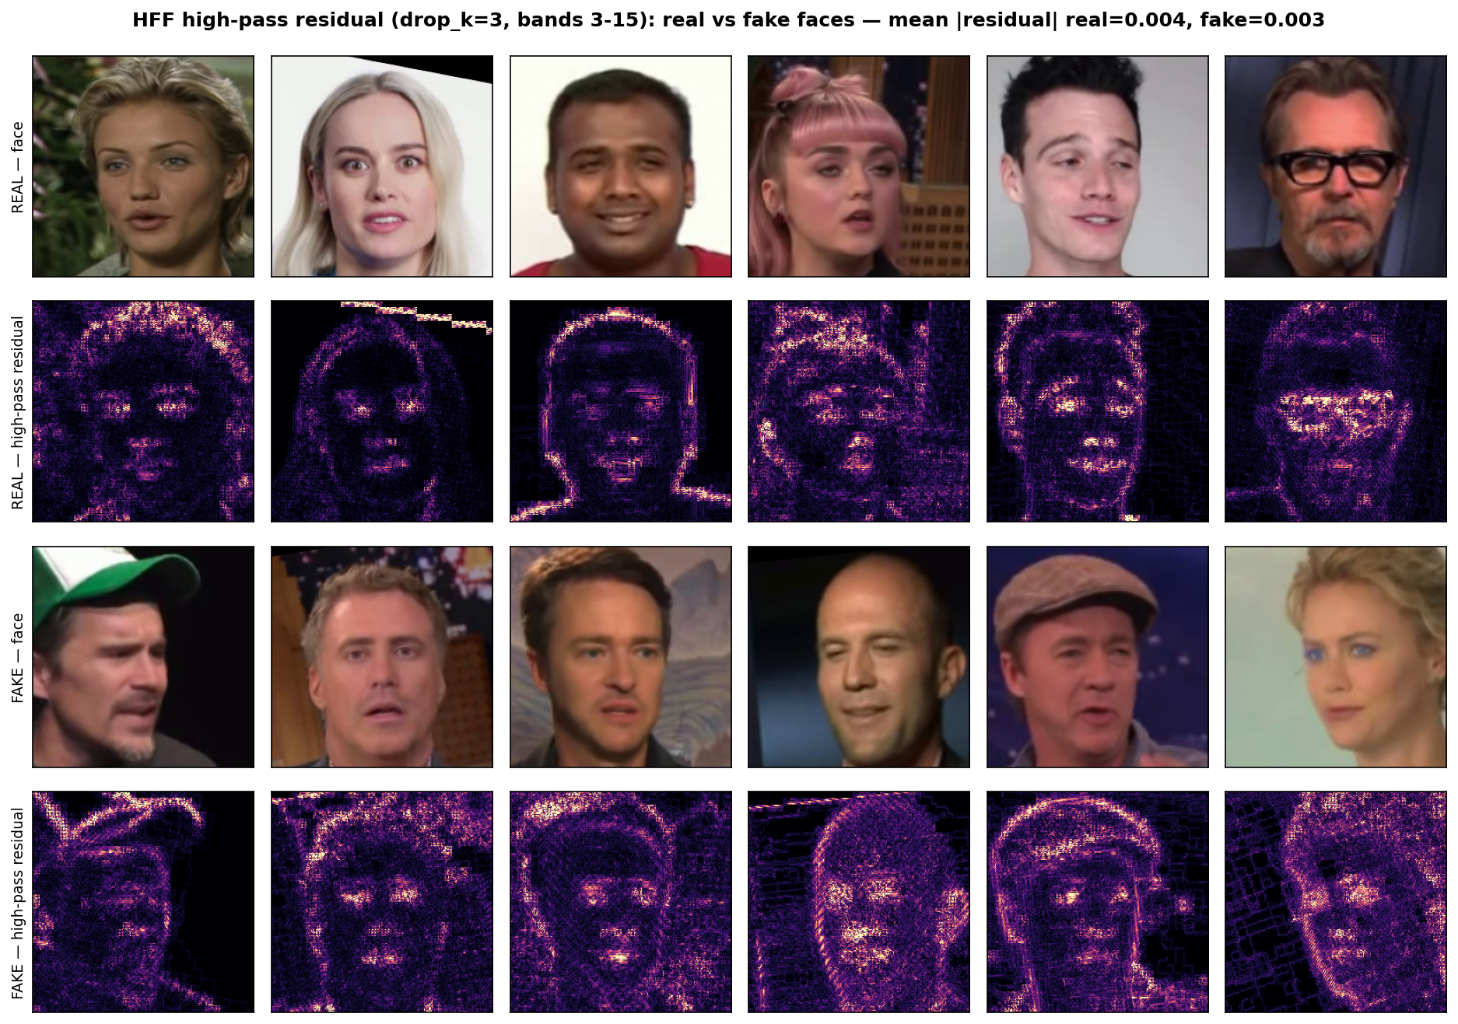
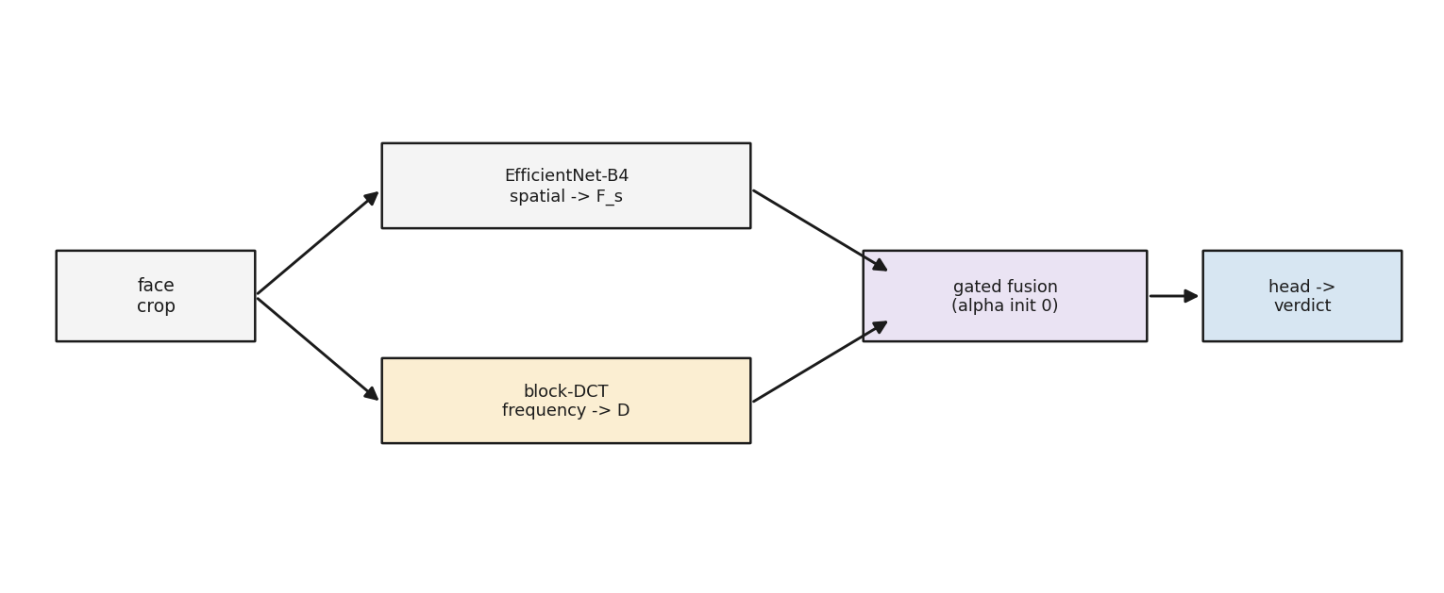
SFDCT-HFF & Liveness Reuse
02 Methodology

Slide 16
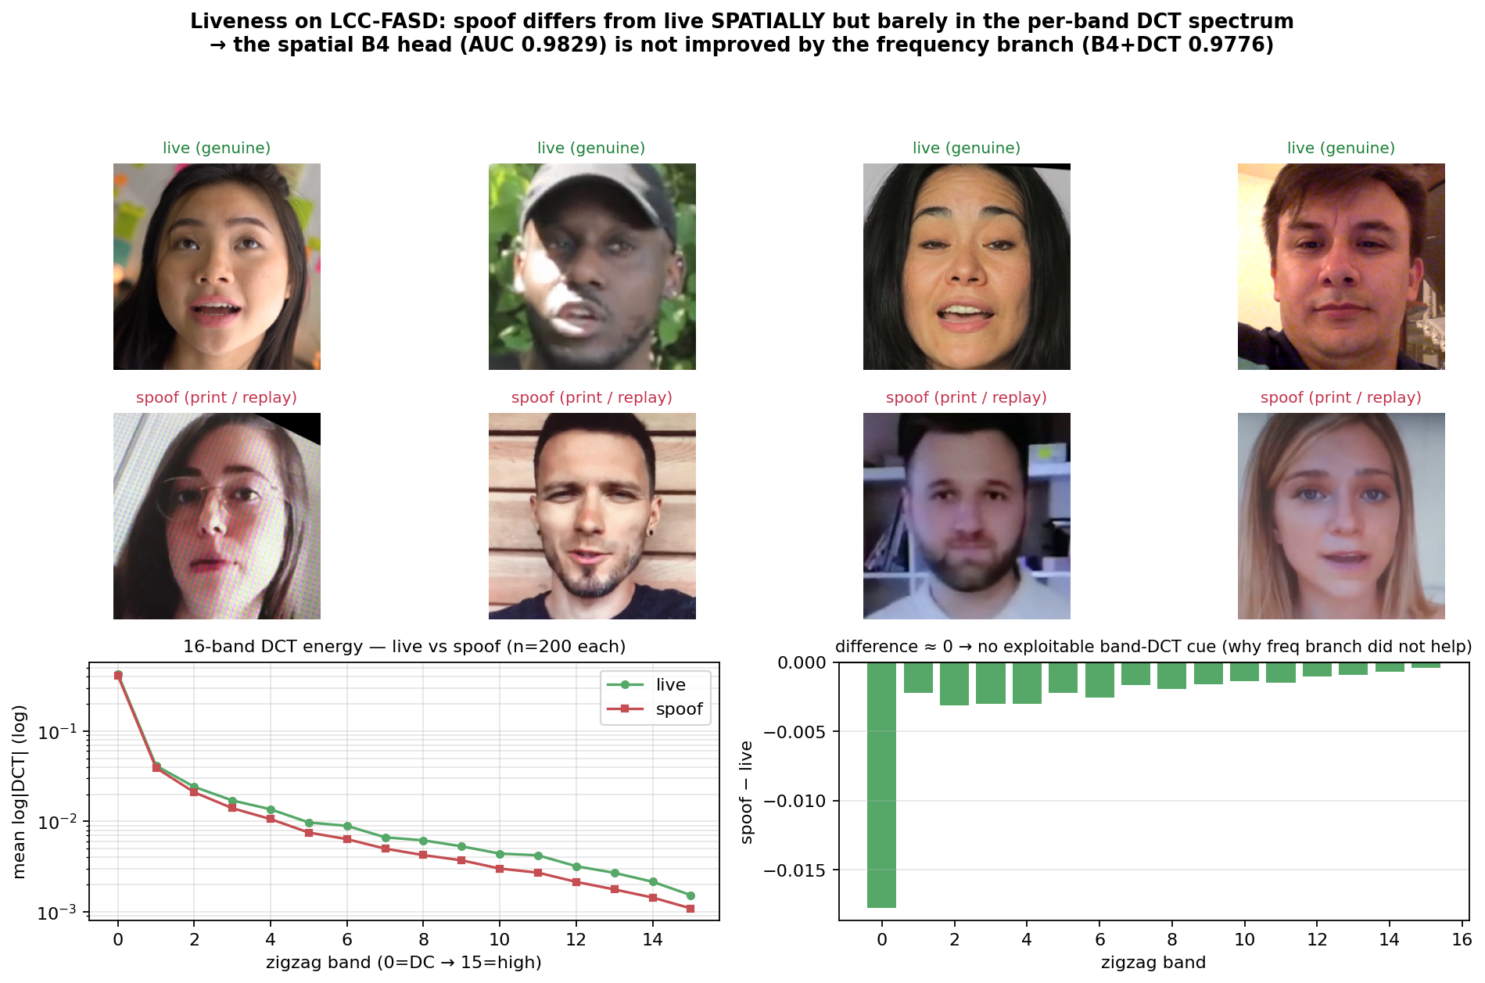
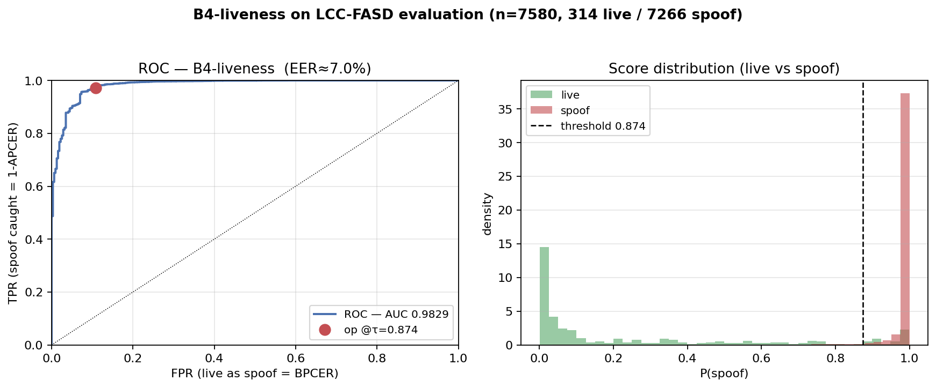
Liveness Detection (Secondary Module)
02 Methodology

Slide 17
03
Results
Cross-Dataset Protocol and Honest Reading
3.1 Cross-Dataset Protocol
CHAPTER THREE
3.2 Cross-Dataset Results and Honest Reading
11

Slide 18
Cross-Dataset Protocol: The Real Test
03 Results
Property | Training: FF++ | Testing: Celeb-DF-v2
Real videos | 1,000 | 590
Fake videos | 4 methods (from 1K real) | 5,639
Frames/video | 32 (evenly sampled) | 32 (evenly sampled)
Protocol Design
• Train only on FF++, test only on Celeb-DF-v2
• Test set never seen during training
• 32 frames/video, fixed for all configs
• Metric: frame-level AUC (threshold-free)
• Both datasets skew fake (~1:4 real:fake)
Sanity check: Baseline EfficientNet-B4 (spatial only) achieves AUC = 0.7497, matching the published value of 0.7487 (diff ~0.001). This confirms the evaluation pipeline is correctly built.
Why Cross-Dataset Matters for eKYC
• Realistic threat model: Attackers in eKYC always use newer forgery tools than those in the training set — the detector is frozen at training time
• In-dataset evaluation is optimistic: Random train/test split on the same dataset measures memorisation, not generalisation
• Cross-dataset = generalisation test: Different forgery methods, different face distributions, different compression pipelines
Key message: The baseline reproduces the published number (0.7497 vs 0.7487), confirming the pipeline. Every subsequent score change can be attributed to model design, not setup error.
12

Slide 19
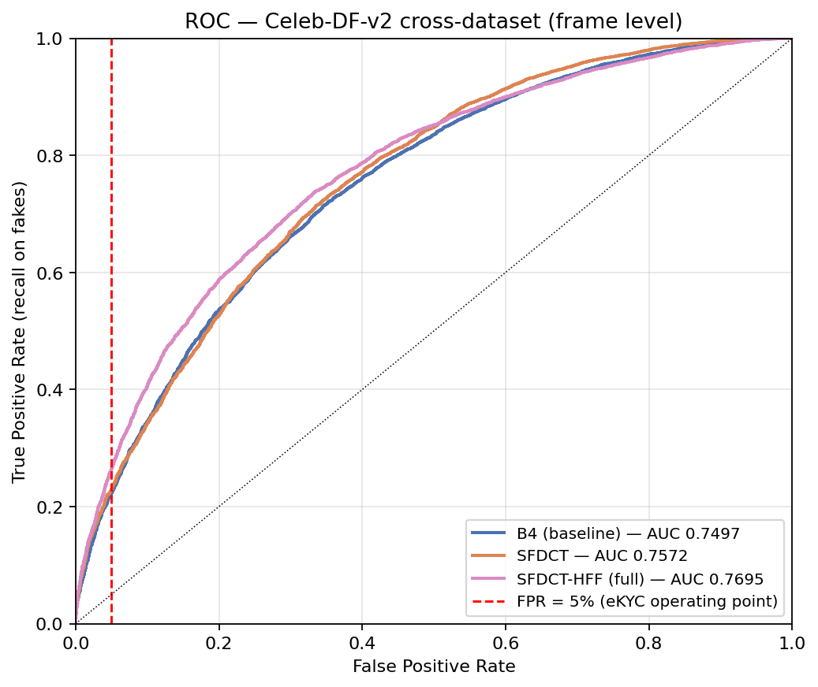
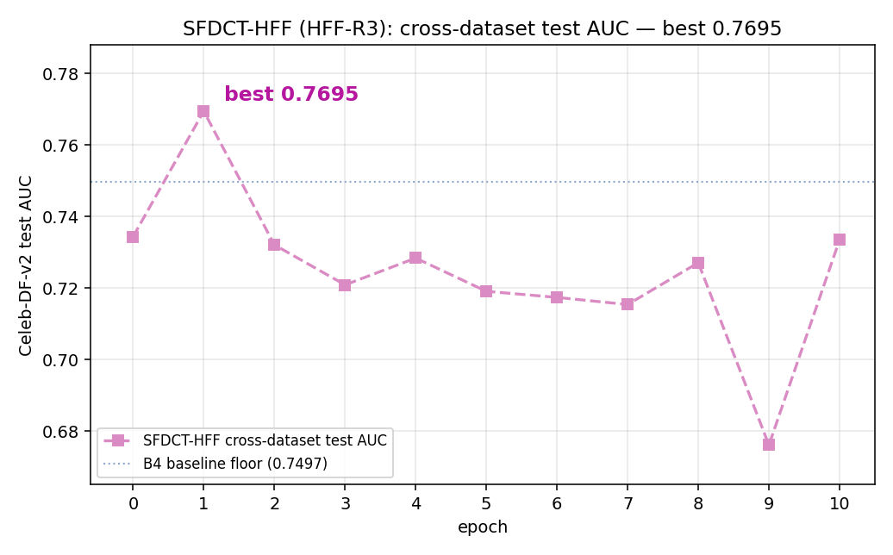
Cross-Dataset Results and an Honest Reading
03 Results
Model | Frame AUC | vs B4 | Floor?
B4 (spatial only) | 0.7497 | — | Yes
SFDCT (band stats) | 0.7572 | +0.0075 | Yes
SFDCT-HFF (full) | 0.7695 | +0.0198 | Yes
Published phase-based freq. | 0.7650 | +0.0153 | —
An Honest Reading
• Order follows hypothesis: B4 < SFDCT < HFF
• Floor holds at frame level for every variant
• Mean-over-run << best: best-on-test is optimistic
• Video bootstrap (518 clips): every paired CI contains zero
• Phase-based freq. method (0.7650) > naive SFDCT
• No SOTA claim — gains sit inside single-seed noise
What the Numbers Mean
At 5% false-positive rate (eKYC requirement), the model catches ~23% of deepfakes. This positions SFDCT-HFF as a risk-screening layer with explanation (Grad-CAM heatmap), not an absolute gate. The output is a signal for human review, not a final verdict.
Key message: The order follows the hypothesis and the floor holds, but at one random seed every paired confidence interval contains zero. This is an honest small improvement, not a superiority claim. A phase-based frequency method scores higher (0.7650).
13

Slide 20
04
Conclusion
Contributions, Limitations & Future Directions
4.1 Conclusion and Contributions
CHAPTER FOUR
4.2 Limitations and Development Directions
14

Slide 21
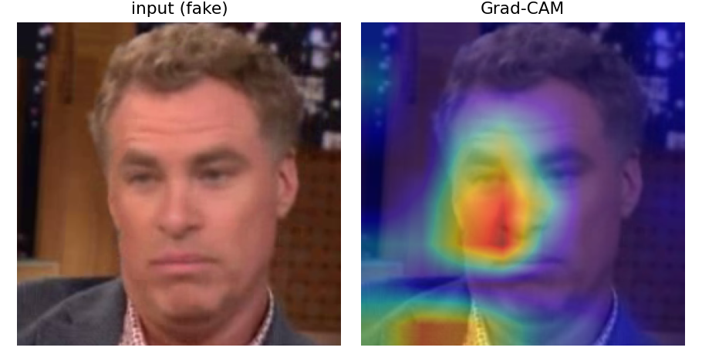
Conclusion and Contributions
04 Conclusion
CONTRIBUTION 01
CONTRIBUTION 02
CONTRIBUTION 03
Zero-Init Floor Guarantee
The gated fusion gate starts at alpha=0, so the model begins exactly equal to the proven backbone. Attaching the frequency branch can never hurt at initialisation.
Honest Evaluation with Bootstrap CI
Baseline reproduces published number. Every paired bootstrap CI contains zero at one seed — reported transparently. No superiority claim is made.
End-to-End Explainable System on CPU
Full pipeline runs on CPU (~1s/image). Returns fake probability, verdict, Grad-CAM heatmap, and DCT spectrum for human reviewer transparency.
Summary Numbers
0.7497
0.7572
0.7695
~0.98
~1s
B4 baseline AUC
SFDCT AUC
SFDCT-HFF AUC
Liveness AUC
CPU latency / image
Key message: The thesis delivers its goal — a cross-dataset deepfake detector for banking eKYC with a zero-init floor guarantee, honest evaluation, and an explainable CPU-ready system. The frequency gain is small and transparently reported, not claimed as SOTA.
15

Slide 22
Limitations and Development Directions
04 Conclusion
Limitations
Development Directions
1. Single run per config
One random seed; no statistical significance; every video-level CI contains zero
2. Modest gains, not SOTA
Improvements are small and within single-seed noise
3. Train/serving crop mismatch
Face alignment differs between training and deployment
4. Robustness untested
No systematic evaluation of re-compression, noise, resolution, adversarial attacks
5. Liveness: one dataset only
LCC-FASD only; cross-dataset behaviour unknown
6. No Vietnamese-face data yet
Test-only probe set in progress; no numbers reported prematurely
1. Multi-seed paired tests
Run multiple seeds with paired statistical tests to confirm frequency benefit
2. Fuse trained liveness score
Replace interim challenge check with the trained liveness scorer in cascade
3. Self-blended training
Integrate self-blended augmentation — strongest cross-dataset technique known
4. Vietnamese test set
Build Vietnamese-face test-only set; expand to diffusion-model forgeries
5. Harden the system
Unify train/serving crop, robustness evaluation, quantisation + pruning + distillation for edge deployment
6. Complete database design
Finish the application database schema and audit logging
Key message: Every limitation is stated transparently, and each development direction directly addresses one limitation. The priority is multi-seed validation, liveness integration, and self-blended training combined with the frequency branch.
16

Slide 23
Thank You
THANK YOU FOR YOUR ATTENTION
SFDCT: Frequency-Aware Deepfake Detection for eKYC
Computer Science & Artificial Intelligence
Graduate Thesis Defense — June 2026
Q & A
Questions and Discussion
17

