Slide 1
GIt

Slide 2
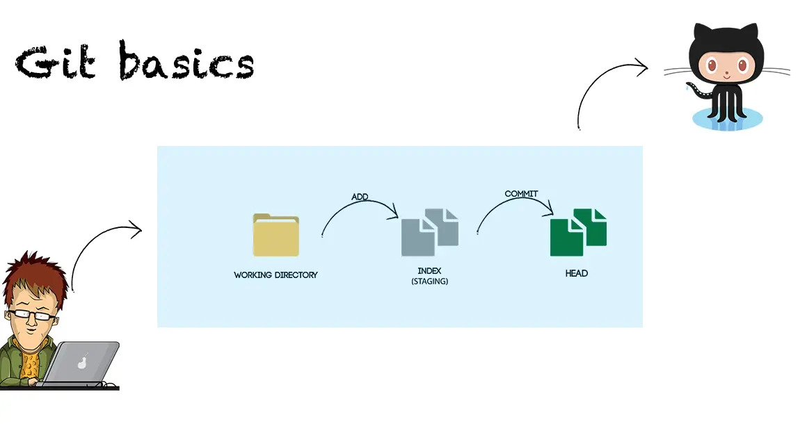
1. Basic practice

Slide 3
2. Advanced practice
Working directory
Staging area
Case 1: Discarding changes for files that have been modified in the staging area.
Git restore –-stage <files>
Case 2: Reverting files to the previous state.
Git restore <files>

Slide 4
2. Advanced practice
Staging area
Local Repository
Case 1: Viewing the commit history.
Git log --oneline
Case 2: Modify the most recent commit message.
Git commit --amend
Case 3: Undoing the last commit and keep the changes locally.
Git reset <commit-hash> --soft
Case 4: Undoing the last commit and delete the changes locally.
Git reset <commit-hash> --hard

Slide 5
2. Advanced practice
Staging area
Local Repository
Case 1: Viewing the commit history.
Git log --oneline
Case 2: Modify the most recent commit message.
Git commit --amend
Case 3: Undoing the last commit and keep the changes locally.
Git reset <commit-hash> --soft
Case 4: Undoing the last commit and delete the changes locally.
Git reset <commit-hash> --hard

Slide 6
2. Advanced practice
Case 5: Reverting to a specific commit.
Git revert <commit-hash>
Case 6: Merge.
Git commit --amend
Case 3: rebase.
Git reset HEAD~1 --soft
Case 4: cherry picks and rebase -i.
Git reset HEAD~1 --hard

