Slide 1
Communication Design Pattern
The PUSH Pattern
Presenter: huan.tran

Slide 2
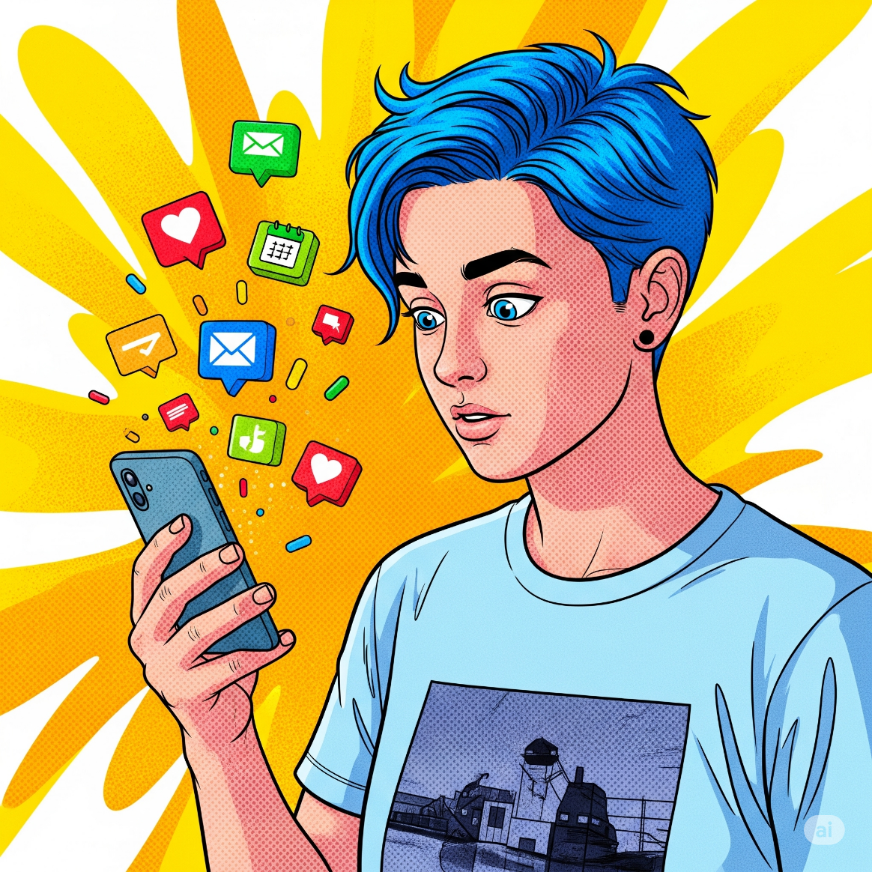
How do apps update us SO fast?
• A new message on WhatsApp.
• A "ping" for a new order notification.
• Live scores changing instantly.
?? Behind this magic is a powerful communication pattern.

Slide 3



Who starts the conversation?
PULL (Client asks)
Client constantly asks: "Anything new?"
PUSH (Server tells)
Server proactively says: "Here's an update!"

Slide 4
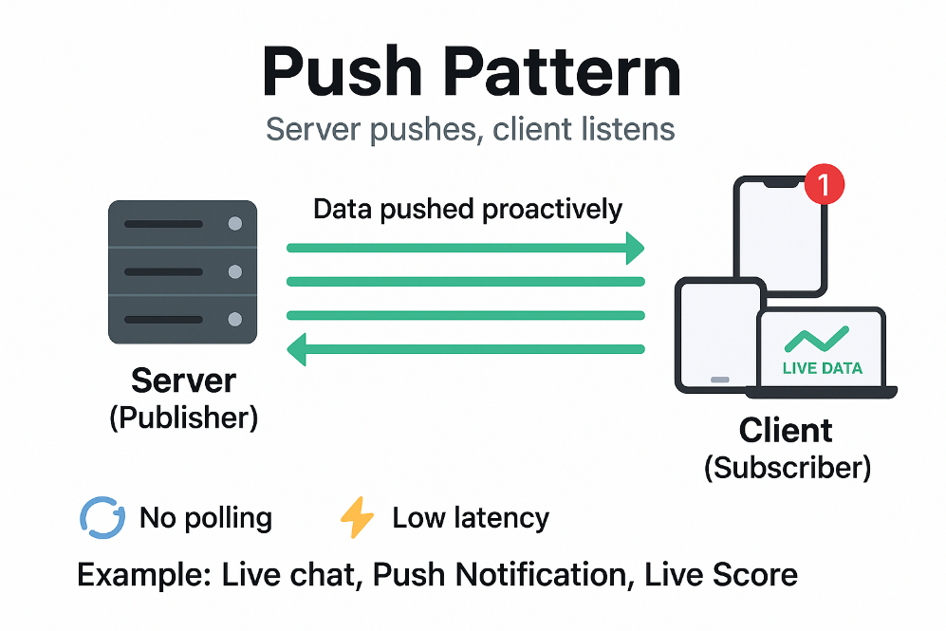
What is the Push Pattern?
A communication pattern where the SERVER proactively SENDS (PUSHES) data to the CLIENT without the client having to request it first.
• Publisher: The server, the source of data.
• Subscriber: The client, listening for data.

Slide 5


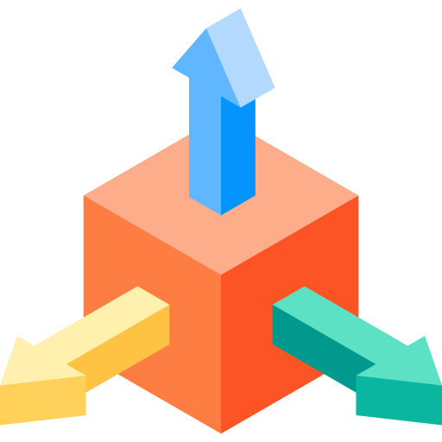
Key Advantages
Real-time Updates
Data is sent almost instantly, minimizing latency.
Efficient Client
Client doesn't waste resources (battery, CPU, network) on constant polling.
Scalable
Easily add more clients (subscribers) to listen to the same data source.

Slide 6



Disadvantages & Challenges
Server Complexity
Server must manage connection states and a list of all clients.
Potential Client Overload
Clients can be overwhelmed if the server pushes too much data too quickly.
Risk of Lost Messages
Requires mechanisms to ensure message delivery, especially if a client disconnects.

Slide 7
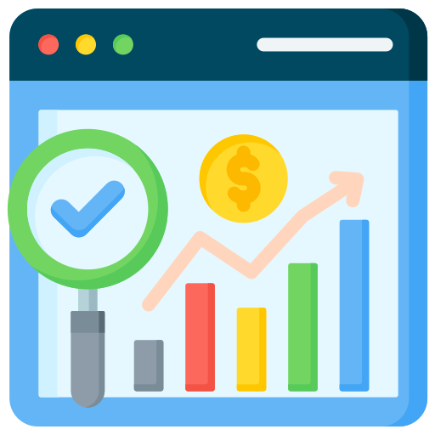
When to Use It?
When you need information delivered instantly!
• Push Notifications
• Messaging Apps & Live Chat
• Financial Dashboards
• Live Location Tracking
• Livestreaming & Live Scores

Slide 8
Enabling Technologies
WebSockets
Creates a persistent, bi-directional connection. The most common choice for real-time web apps.
Server-Sent Events (SSE)
A one-way connection from server to client. Simpler, ideal when only server-to-client push is needed.
Message Brokers (RabbitMQ, Kafka)
Powerful intermediary systems for large-scale, complex, and highly reliable applications.

Slide 9
Summary
1. Push Pattern = Server proactively sends data. The client just listens.
2. Key benefits: Real-time updates and resource efficiency for the client.
3. Use when: Data needs to be delivered instantly and the client doesn't know when new data will arrive.

Slide 10
Thank You!
Questions & Answers?

