Slide 1
Practices for becoming a better programmer
Srikanth P Shreenivas
srikanthps@yahoo.com
http://www.srikanthps.com

Slide 2
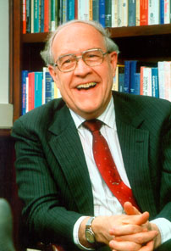
Joys of the craft
The Mythical Man-Month, Frederick P. Brooks. Jr
Why is programming fun? What delights may its practitioner expect as reward?
First is the sheer joy of making things.
Second is pleasure of making things that are useful to other people.
Third is the fascination of fashioning complex puzzle-like objects of interlocking moving parts and watching them work in subtle cycles, playing out the consequences of principles built in the beginning. The programmed computer has all the effects of a pinball machine or jukebox mechanism, carried to the ultimate.
Fourth is the joy of always learning, which springs from non-repeating nature of the task.
Finally, there is the delight of working in such a tractable medium. The programmer, like the poet, works only slightly removed from pure thought-stuff. He builds his castles in the air, from the air, creating by exertion of imagination.
Programming gratifies creative longings built deep within us
Slide <number>

Slide 3
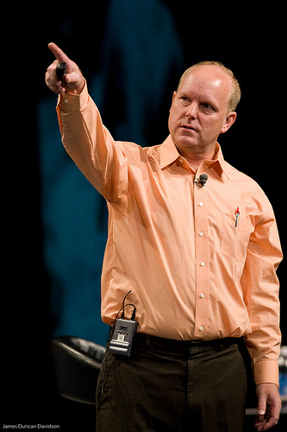
Values of Programming
Implementation Patterns, Kent Beck
Communication
Simplicity
Flexibility
Slide <number>

Slide 4
Communicating through code

Slide 5
Use Meaningful Names
Intention-revealing names
int d; //elapsed time in days
int elapsedTimeInDays;
int fileAgeInDays;
int daysSinceLastModification;

Slide 6
Use Meaningful Names
Avoid Disinformation
Set hobbyList;
Set hobbies;

Slide 7
Use Meaningful Names
Make meaningful distinctions
Public void copy (String s1, String s2)
Public void copy(String destination, String source)
Slide <number>

Slide 8
Meaningful names
Use pronounceable names
class DtaRcrd102
class Customer
Slide <number>

Slide 9
Meaningful names
Use searchable names
int r = 0;
for (int j = 0; j < 5; j++) {
r = r + j * 8;
}
int workingDaysInWeek = 5;
int workingHoursPerDay = 8;
int hoursInWeek = 0;
for (int dayIndex = 0; dayIndex < workingDaysInWeek ; dayIndex ++) {
hoursInWeek = hoursInWeek + dayIndex * workingHoursPerDay;
}
Slide <number>

Slide 10
Meaningful names
Class names
Should be nouns or noun phrases.
Examples: Car, Account, DataRetrievalService, AddressParser
Slide <number>

Slide 11
Meaningful names
Method names
Should be verb or verbPhrases
Examples: parseData, deletePage, save
Methods that return boolean values should sound like question.
Example: isAuthenticated, hasNoErrors, isEmpty
if (user.isAuthenticated()) {
String data = parseData(input);
if (hasErrors(data)) {
throw ErrorInDataException();
}
}
Slide <number>

Slide 12
Meaningful names
Pick one word per concept
Don’t mix words like “fetch”, “get”, “retrieve”.
Be consistent.
Slide <number>

Slide 13
Meaningful names
Don’t use same word for two different concepts
Example: Don’t use “add”, where “insert” makes sense.
Slide <number>

Slide 14
Meaningful names
Use names from problem/solution domain
Prefer “InvoiceGenerator” to “DataExtractor”
Slide <number>

Slide 15
You don’t need comments to communicate

Slide 16
Turning Comments into Code
class InchToPointConvertor {
//convert the quantity in inches to points.
static float parseInch(float inch) {
return inch * 72; //one inch contains 72 points.
}
}
class InchToPointConvertor {
final static int POINTS_PER_INCH=72;
static float convertToPoints(float inch) {
return inch * POINTS_PER_INCH;
}
}
Slide <number>

Slide 17
Turning Comments into Code
class Account {
...
//check if the password is complex enough, i.e.,
//contains letter and digit/symbol.
boolean isComplexPassword(String password) {
//found a digit or symbol?
boolean dg_sym_found=false;
//found a letter?
boolean letter_found=false;
for(int i=0; i<password.length(); i++){
char c=password.charAt(i);
if(Character.isLowerCase(c)||Character.isUpperCase(c))
letter_found=true;
else dg_sym_found=true;
}
return (letter_found) && (dg_sym_found);
}
}
class Account {
...
boolean isComplexPassword(String password){
return containsLetter(password) &&
(containsDigit(password) ||
containsSymbol(password));
}
boolean containsLetter(String password) {
...
}
boolean containsDigit(String password) {
...
}
boolean containsSymbol(String password) {
...
}
}
Slide <number>

Slide 18

Turning comments into code
What’s wrong with Comments?
Nothing wrong with comments. They are not bad.
Why avoid comments?
Are we writing comments because our code is unclear?
Will you keep the comments up-to-date whenever code is updated?
You don’t want:
Unclear code with outdated comments.
Try to convert comments into code that bring out the intent of the code, and use comments sparingly.
Slide <number>

Slide 19
Aiming for Simplicity

Slide 20
Functions
Write small functions
….and try to write even smaller functions.
Aim for functions that are not longer than 4 to 5 lines.
Split the big methods in smaller methods (Extract method)
Use intention-revealing names for methods.
Public List<Person> filterList(List<Person> input) {
List filteredList = new ArrayList();
for (Person p : input) {
if (p.getDateOfBirth().getYear() > 1997) {
filteredList.add(p);
}
if (p.getAddress().getCity().equals(“Bangalore”)) {
filteredList.add(p);
}
}
return filterdList;
}
Public List<Person> selectTeenAgersFromBangalore (List<Person> input) {
List filteredList = new ArrayList();
for (Person p : input) {
if (isTeenAger(p) || isFromBangalore(p)) {
filteredList.add(p);
}
}
return filterdList;
}
Slide <number>

Slide 21
Functions
Do one thing in a function (Single responsibility)
Public List<Person> filterList(List<Person> input) {
List filteredList = new ArrayList();
for (Person p : input) {
if (p.getDateOfBirth().getYear() > 1997) {
filteredList.add(p);
}
if (p.getAddress().getCity().equals(“Bangalore”)) {
filteredList.add(p);
}
}
return filterdList;
}
Public List<Person> selectTeenAgersFromBangalore (List<Person> input) {
List filteredList = new ArrayList();
for (Person p : input) {
if (isTeenAger(p) && isFromBangalore(p)) {
filteredList.add(p);
}
}
return filterdList;
}
Filtering logic moved out
Slide <number>

Slide 22
Functions
All statements should be at same level of abstraction.
Employee employee = employeeRepository.get(“m100XXXX”);
employee.getSalaryDetails().setBasic( employee.getSalaryDetails().getBasic () * 1.10);
employeeRepository.save(employee);
Employee employee = employeeRepository.get(“m100XXXX”);
raiseSalary(empoyee, “10%”);
employeeRepository.save(employee);
Functions should be read like top-down narrative.
Every function should be followed by functions of next level of abstraction.
Slide <number>

Slide 23
Functions
Have no side effects.
Public boolean checkPassword(String userName, String password) {
User user = userService.getUser(userName);
if (user.password.equals(password)) {
Session.initalize();
return true;
}
return false;
}
Slide <number>

Slide 24
Functions
Command query separation.
Public boolean set(String attribute, String value) {
….
}
if (set(“color”, “red”)) {
….
}
if (attributeExists(“color”)) {
}
Slide <number>

Slide 25
Functions
Prefer exceptions to return codes.
if (deletePage(“myPage”) == E_OK) {
….
}
else {
logger.log (“delete failed”);
}
try {
deletePage(“myPage”);
}
catch (PageCannotBeDeletedException p) {
…
}
catch (PageDoesNotExistException e) {
…
}
Slide <number>

Slide 26
Functions
Format your code.
Use IDE supported code formatting tools.
Configure IDE to support team-specific alignment rules.
opening brace “{“ should be on the same line as the statement.
use space after keywords
  if (someCondtion)
use space to separate method arguments
  doSomething( param1, param2, param3 );
indent each scope by 4 spaces
Ctrl+Shift+F in Eclipse
Slide <number>

Slide 27
DRY – Don’t repeat yourself

Slide 28
Code which started well…
Book Rentals Applications: Maintains a list of books rented to customers.
public class BookRental {
String id;
String customerName;
...
}
public class BookRentals {
private Vector rentals;
public String getCustomerName(String rentalId) {
for (int i = 0; i < rentals.size(); i++) {
BookRental rental = (BookRental) rentals.elementAt(i);
if (rental.getId().equals(rentalId)) {
return rental.getCustomerName();
}
}
throw new RentalNotFoundException();
}
}
public class RentalNotFoundException extends Exception {
...
}
New requirement: Add a method to delete rental given its id.
Slide <number>

Slide 29
Code updated for new requirement…
public class BookRental {
String id;
String customerName;
...
}
public class BookRentals {
private Vector rentals;
public String getCustomerName(String rentalId) {
for (int i = 0; i < rentals.size(); i++) {
BookRental rental = (BookRental) rentals.elementAt(i);
if (rental.getId().equals(rentalId)) {
return rental.getCustomerName();
}
}
throw new RentalNotFoundException();
}
public void deleteRental(String rentalId) {
for (int i = 0; i < rentals.size(); i++) {
BookRental rental = (BookRental) rentals.elementAt(i);
if (rental.getId().equals(rentalId)) {
rentals.remove(i);
return;
}
}
throw new RentalNotFoundException();
}
}
public class RentalNotFoundException extends Exception {
...
}
Duplicate
Code
Slide <number>

Slide 30
Duplicate code should be avoided
What’s wrong with duplicate code?
If there is a bug in the code or code requires changes, then, one has to change it at multiple places. This is error-prone.
public class BookRentals {
private Vector rentals;
public String getCustomerName(String rentalId) {
int rentalIdx = getRentalIdxById(rentalId);
return ((BookRental) rentals.elementAt(rentalIdx)).getCustomerName();
}
public void deleteRental(String rentalId) {
rentals.remove(getRentalIdxById(rentalId));
}
private int getRentalIdxById(String rentalId) {
for (int i = 0; i < rentals.size(); i++) {
BookRental rental = (BookRental) rentals.elementAt(i);
if (rental.getId().equals(rentalId)) {
return i;
}
}
throw new RentalNotFoundException();
}
}
Slide <number>

Slide 31
Removing duplicate code
Point out and remove duplicate code
class Organization {
String id;
String eName; //English name
String cName; //Chinese name
String telCountryCode;
String telAreaCode;
String telLocalNumber;
String faxCountryCode;
String faxAreaCode;
String faxLocalNumber;
String contactPersonEFirstName; //First name and last name in English
String contactPersonELastName;
String contactPersonCFirstName; //First name and last name in Chinese
String contactPersonCLastName;
String contactPersonTelCountryCode;
String contactPersonTelAreaCode;
String contactPersonTelNumber;
String contactPersonFaxCountryCode;
String contactPersonFaxAreaCode;
String contactPersonFaxLocalNumber;
String contactPersonMobileCountryCode;
String contactPersonMobileAreaCode;
String contactPersonMobileLocalNumber;
...
}
Organization’s and Person’s names are stored in English and Chinese.
Organization’s and Person’s Telephone number format is same
Slide <number>

Slide 32
Removing duplicate code
class Organization {
String id;
String eName;
String cName;
TelNo telNo;
TelNo faxNo;
ContactPerson contactPerson;
...
}
class ContactPerson{
String eFirstName;
String eLastName;
String cFirstName;
String cLastName;
TelNo tel;
TelNo fax;
TelNo mobile;
}
class TelNo {
String countryCode;
String areaCode;
String localNumber;
}
Duplicate code removed
class ContactPerson
{
FullName eFullName;
FullName cFullName;
TelNo tel;
TelNo fax;
TelNo mobile;
}
class FullName
{
String firstName;
String lastName;
}
Slide <number>

Slide 33
Removing code smells

Slide 34
Code Smells
Duplicate code
Switch statements
Long method
Large class
Long parameter list
Temporary field
Etc.
“If it stinks, change it.”
Slide <number>

Slide 35
How to remove a long if-then-else-if
class Shape {
}
class Line extends Shape {
Point startPoint;
Point endPoint;
}
class Rectangle extends Shape {
Point lowerLeftCorner;
Point upperRightCorner;
}
class Circle extends Shape {
Point center;
int radius;
}
class CADApp {
void drawShapes(Graphics graphics, Shape shapes[]) {
for (int i = 0; i < shapes.length; i++) {
if (shapes[i] instanceof Line) {
Line line = (Line)shapes[i];
graphics.drawLine(line.getStartPoint(),line.getEndPoint());
}
else if (shapes[i] instanceof Rectangle) {
Rectangle rect = (Rectangle)shapes[i];
graphics.drawLine(...);
graphics.drawLine(...);
graphics.drawLine(...);
graphics.drawLine(...);
}
else if (shapes[i] instanceof Circle) {
Circle circle = (Circle)shapes[i];
graphics.drawCircle(circle.getCenter(), circle.getRadius());
}
}
}
}
Slide <number>

Slide 36
How to remove a long if-then-else-if
To remove long if-else conditions, try to make the code identical in each of the if else blocks
class CADApp {
void drawShapes(Graphics graphics, Shape shapes[]) {
for (int i = 0; i < shapes.length; i++) {
if (shapes[i] instanceof Line) {
draw the line
}
else if (shapes[i] instanceof Rectangle) {
draw the rectangle
}
else if (shapes[i] instanceof Circle) {
draw the circle
}
}
}
}
class CADApp {
void drawShapes(Graphics graphics, Shape shapes[]) {
for (int i = 0; i < shapes.length; i++) {
if (shapes[i] instanceof Line) {
draw the shape
}
else if (shapes[i] instanceof Rectangle) {
draw the shape
}
else if (shapes[i] instanceof Circle) {
draw the shape
}
}
}
}
class CADApp {
void drawShapes(Graphics graphics, Shape shapes[]) {
for (int i = 0; i < shapes.length; i++) {
draw the shape
}
}
}
class CADApp {
void drawShapes(Graphics graphics, Shape shapes[]) {
for (int i = 0; i < shapes.length; i++) {
shapes[i].draw(graphics);
}
}
}
Slide <number>

Slide 37
How to remove a long if-then-else-if
abstract class Shape {
abstract void draw(Graphics graphics);
}
class Line extends Shape {
Point startPoint;
Point endPoint;
void draw(Graphics graphics) {
graphics.drawLine(getStartPoint(), getEndPoint());
}
}
class Rectangle extends Shape {
Point lowerLeftCorner;
Point upperRightCorner;
void draw(Graphics graphics) {
graphics.drawLine(...);
graphics.drawLine(...);
graphics.drawLine(...);
graphics.drawLine(...);
}
}
class Circle extends Shape {
Point center;
int radius;
void draw(Graphics graphics) {
graphics.drawCircle(getCenter(), getRadius());
}
}
interface Shape {
abstract void draw(Graphics graphics);
}
class Line implements Shape {
…
}
class Rectangle implements Shape {
…
}
class Circle implements Shape {
…
}
Slide <number>

Slide 38
Improved Code
interface Shape {
void draw(Graphics graphics);
}
class Line implements Shape {
Point startPoint;
Point endPoint;
void draw(Graphics graphics) {
graphics.drawLine(getStartPoint(), getEndPoint());
}
}
class Rectangle implements Shape {
Point lowerLeftCorner;
Point upperRightCorner;
void draw(Graphics graphics) {
graphics.drawLine(...);
graphics.drawLine(...);
graphics.drawLine(...);
graphics.drawLine(...);
}
}
class Circle implements Shape {
Point center;
int radius;
void draw(Graphics graphics) {
graphics.drawCircle(getCenter(), getRadius());
}
}
class CADApp {
void drawShapes(Graphics graphics, Shape shapes[]) {
for (int i = 0; i < shapes.length; i++) {
shapes[i].draw(graphics);
}
}
}
If we need to support one more shape (e.g., triangle), none of classes needs to change. All it takes is to create a new Triangle class.
Slide <number>

Slide 39
Another Example
There are three types of users: regular users,administrators and guests.
Regular users must change their password once every 90 days (or sooner).
Administrators must change their password once every 30 days.
Guests don't need to change passwords.
Only regular users and administrators can print reports.
Slide <number>

Slide 40
Original code
class InventoryApp {
int getPasswordMaxAgeInDays(UserAccount account) {
switch (account.getType()) {
case UserAccount.USERTYPE_NORMAL:
return 90;
case UserAccount.USERTYPE_ADMIN:
return 30;
case UserAccount.USERTYPE_GUEST:
return Integer.MAX_VALUE;
}
}
void printReport(UserAccount currentUser) {
boolean canPrint;
switch (currentUser.getType()) {
case UserAccount.USERTYPE_NORMAL:
canPrint = true;
break;
case UserAccount.USERTYPE_ADMIN:
canPrint = true;
break;
case UserAccount.USERTYPE_GUEST:
canPrint = false;
}
if (!canPrint) {
throw new SecurityException("You have no right");
}
//print the report.
}
}
class UserAccount {
final static int USERTYPE_NORMAL = 0;
final static int USERTYPE_ADMIN = 1;
final static int USERTYPE_GUEST = 2;
int userType;
String id;
String name;
String password;
Date dateOfLastPasswdChange;
public boolean checkPassword(String password) {
...
}
}
Issue is same as long if-then-else!
Slide <number>

Slide 41

Use subclass to represent type code value
abstract class UserAccount {
String id;
String name;
String password;
Date dateOfLastPasswdChange;
abstract int getPasswordMaxAgeInDays();
abstract boolean canPrintReport();
}
class NormalUserAccount extends UserAccount {
int getPasswordMaxAgeInDays() {
return 90;
}
boolean canPrintReport() {
return true;
}
}
class AdminUserAccount extends UserAccount {
int getPasswordMaxAgeInDays() {
return 30;
}
boolean canPrintReport() {
return true;
}
}
class GuestUserAccount extends UserAccount {
int getPasswordMaxAgeInDays() {
return Integer.MAX_VALUE;
}
boolean canPrintReport() {
return false;
}
}
Subclasses differ in values they return.
Slide <number>

Slide 42
Use an object to represent a type code value
class UserAccount {
UserType userType;
String id;
String name;
String password;
Date dateOfLastPasswdChange;
UserType getType() {
return userType;
}
}
class UserType {
int passwordMaxAgeInDays;
boolean allowedToPrintReport;
UserType(int passwordMaxAgeInDays, boolean allowedToPrintReport) {
this.passwordMaxAgeInDays = passwordMaxAgeInDays;
this.allowedToPrintReport = allowedToPrintReport;
}
int getPasswordMaxAgeInDays() {
return passwordMaxAgeInDays;
}
boolean canPrintReport() {
return allowedToPrintReport;
}
static UserType normalUserType = new UserType(90, true);
static UserType adminUserType = new UserType(30, true);
static UserType guestUserType = new UserType(Integer.MAX_VALUE, false);
}
int getPasswordMaxAgeInDays(UserAccount account) {
return account.getType().getPasswordMaxAgeInDays();
}
void printReport(UserAccount currentUser) {
boolean canPrint;
canPrint = currentUser.getType().canPrintReport();
if (!canPrint) {
throw new SecurityException("You have no right");
}
//print the report.
}
Slide <number>

Slide 43
Better object orientation
Additional Reference: http://www.objectmentor.com/resources/publishedArticles.html

Slide 44
Apply the basic concepts
Goal of OOAD:
Identify the classes and relations between them for a given problem.
Read the problem statement carefully and identify:
Nouns (Classes)
Verbs (Behavior)
Actors (Users)
Identify relationships between classes
Is-A (Generalization / Inheritance)
Has-A (Composition)
Uses (Dependency)
Slide <number>

Slide 45
Example
A basket contains oranges and apples.
1
Basket
*
*
Apple
Orange
1
*
Fruits have cost
Basket
Fruit
int Price;
Apple
Orange
Generalize to accommodate new requirements.
Slide <number>

Slide 46
Example continued…
A user has password. Password can be encrypted and decrypted.
1
1
User
Password
String userid;
public String encrypt();
public String decrypt();
Password is encrypted using a encryption service.
1
1
User
Password
EncryptionService
String userid;
public String encrypt();
public String decrypt();
public String encrypt(String);
public String decrypt(String);
Slide <number>

Slide 47
Single responsibility principle
Class should have one and only one reason to change.
Rectangle
Rectangle
public draw()
public area()
Point topLeftCorner
Point bottomRightCorner
Two responsibilities:
Mathematical model of the geometry of rectangle
Render rectangle to a graphical user interface.
Geometric Rectangle
public area()
Slide <number>

Slide 48
Law of demeter
Principle of least knowledge
Module should not know internal details of objects it manipulates.
A method M of an object O may only invoke the methods of the following kinds of objects:
O itself
M's parameters
any objects created/instantiated within M
O's instance variables
Class PaperBoy {
void collectPaymetents() {
float payment = 2.0;
float fundsCollected = 0.0;
for (Customer customer : customerList) {
try {
fundsCollected += customer.makePayment(payment);
}
catch (NotEnoughMoneyComeLaterException e) {
}
}
}
Class PaperBoy {
void collectPaymetents() {
float payment = 2.0;
float fundsCollected = 0.0;
for (Customer customer : customerList) {
float moneyInWallet = customer.getWallet().getMoney();
if (moneyInWallet >= payment) {
customer.getWallet.setMoney(moneyInWallet – payment);
fundsCollected += payment;
}
}
}
}
Slide <number>

Slide 49
Make good use of polymorphism
In object oriented languages, power of polymorphism comes from Liskov’s substitution principle.
“A subclass can be used as an argument where a base class is expected”
Class Mechanic {
public void repair (Car car) {
}
}
class HyundaiCar implements Car {
}
class MarutiCar implements Car {
}
class HyundaiSantro extends HyundaiCar {
}
HyundaiCar faultyHyundai = new HyundaiCar();
mechanic.repair (faultyHyunai);
MarutiCar faultyMaruti = new MarutiCar();
mechanic.repair(faultyMaruti);
Slide <number>

Slide 50
Program to interface, and put polymorphism to better use
Class Driver {
public void drive (Car car) {
}
public void drive (Truck truck) {
}
}
Class Driver {
public void drive (Vehicle vehicle) {
}
}
Slide <number>

Slide 51
Open-closed principle
Class should be open for extension, but closed for modification.
if ( isGoingToMovie() ) {
Vehicle vehicle = new Car();
driver.drive (vehicle )
}
else ( ifRelocatingToNewHome () ) {
Vehicle vehicle = new Truck();
driver.drive (vehicle );
}
Vehicle vehicle = getVehicle(conditions);
driver.drive (vehicle );
Slide <number>

Slide 52
Writing code that tests code

Slide 53
Problem
You can order a cup of coffee.
A cup of coffee costs Rs. 10.
You can add many ingredients to it, say, chocolate chips, extra cream, Ice cream, etc.
Each ingredients has its own cost.
Slide <number>

Slide 54
Traditional testing
public static void main() {
Coffee c = new Coffee();
c.add(new ExtraCream());
c.add(new ChocolateChip());
long cost = c.getCost();
system.out.println(“Pay : Rs.” + cost);
}
Issue: Requires a human to confirm the value printed on console.
Slide <number>

Slide 55
JUnit style of testing
public class coffeeTest extends TestCase {
public testCompuatationOfCoffeeCost() {
Coffee c = new Coffee();
c.add(new ExtraCream());
c.add(new ChocolateChip());
long cost = c.getCost();
assertTrue(cost > 0);
assetEquals(cost, Coffee.COST + ExtraCream.COST + ChocolateChip.COST);
}
}
Instant feedback (GUI ):
Green Bar indicates success, a red bar indicates failure.
Slide <number>

Slide 56
Test Driven Development Cycle
Add a test
Run all tests and see the new one fail.
Write some code.
Run the automated tests and see them succeed.
Refactor code
Repeat
http://en.wikipedia.org/wiki/Test-driven_development
Slide <number>

Slide 57
Parting thoughts

Slide 58
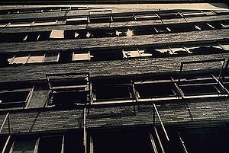
Don’t live with broken windows
The pragmatic programmer by Andrew Hunt, David Thomas
"Consider a building with a few broken windows. If the windows are not repaired, the tendency is for vandals to break a few more windows. Eventually, they may even break into the building, and if it's unoccupied, perhaps become squatters or light fires inside.
Or consider a sidewalk. Some litter accumulates. Soon, more litter accumulates. Eventually, people even start leaving bags of trash from take-out restaurants there or breaking into cars."
Broken Windows = Bad Design, Wrong decisions, Poor code
Psychology or culture at work is one of the factors that contribute to bad code.
So, try to clean up every time you see a messy code.
http://en.wikipedia.org/wiki/Fixing_Broken_Windows
Slide <number>

Slide 59
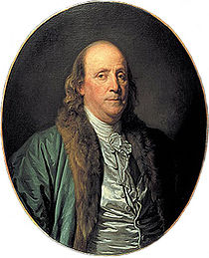
Knowledge Portfolio
The pragmatic programmer by Andrew Hunt, David Thomas
An investment in knowledge always pays the best interest
Benjamin Franklin,
One of the Founding Fathers of the United States of America
Building investment portfolio
Building knowledge portfolio
Invest regularly
Diversify
Manage risk
Buy low, sell high
Review and re-balance
Learn at least one new language every year.
Read a technical book each quarter.
Read non-technical books too.
Take classes.
Participate in local user groups.
Experiment with different environments.
Stay current.
Get wired.
Slide <number>

Slide 60
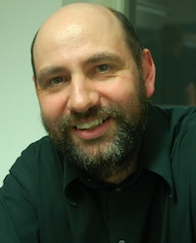
Write programs for fellow humans
Any damn fool can write code that a computer can understand, the trick is to write code that humans can understand.
Martin Fowler,
Author of book “Refactoring”
http://martinfowler.com/distributedComputing/refactoring.pdf
Slide <number>

Slide 61

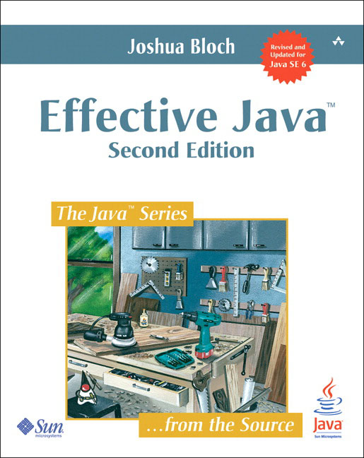

Books for someone aspiring to become a great (Java) programmer
Slide <number>

Slide 62
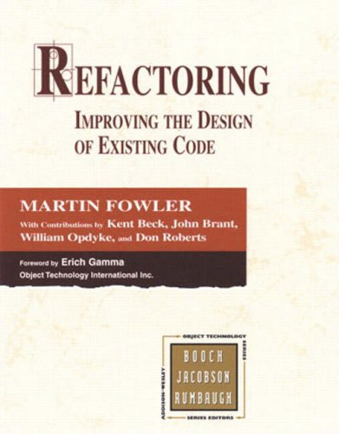
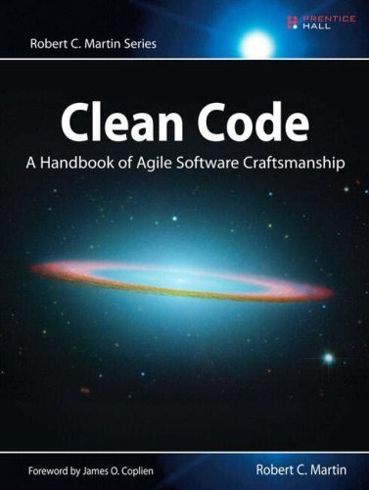



Books for someone aspiring to become a great (Java) programmer
Some examples in these slides are from this book
Free PDF available online (http://www.agileskills.org/download.html.en )
Some examples in these slides are from this book
Slide <number>

Slide 63
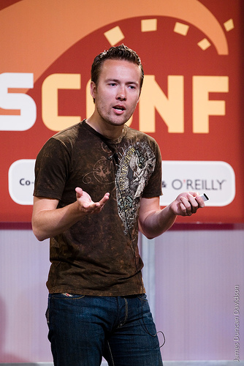
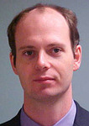
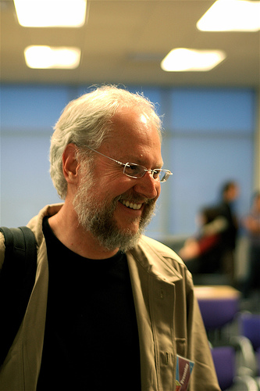



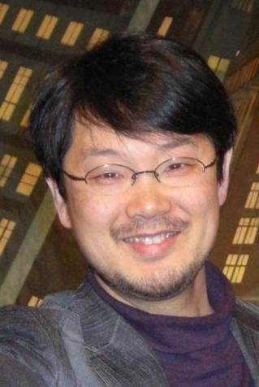
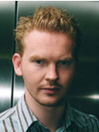


Find a role model and follow them
…read about what they are working on, what they consider exciting.
Rod Johnson,
Founder of Spring Framework
Douglas Crockford,
Yahoo JavaScript Architect
David Heinemeier Hansson
Creator of “Ruby on RAILS” framework
Yukihiro “Matz” Matsumoto,
Creator of “Ruby” language
Gavin King
Creation of “Hibernate” Framework
Slide <number>

Slide 64
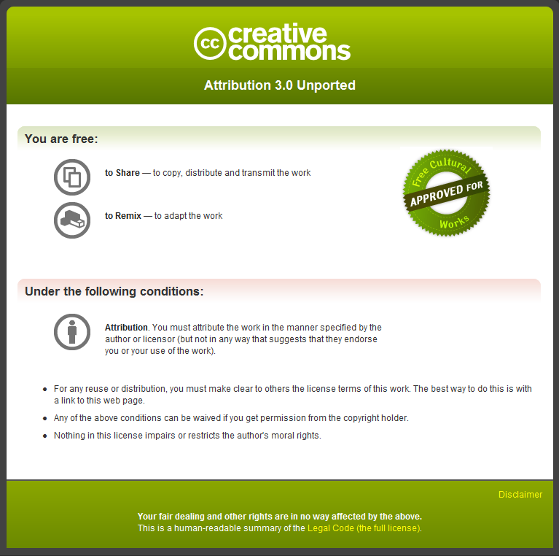
Copyright notice
For more information see http://creativecommons.org/licenses/by/3.0/

Slide 65
Thanks

