Slide 1
Hospital Patient Pathway
Development, feedback
and delivery review
Advanced Information Systems Development
UFCEP6-0-3
Five-person group / Evidence reviewed 28 September 2026
DENG JIN WANG / 01
Notes:
Presenter: DENG JIN WANG
Suggested time: 25 seconds. This is a rehearsal allocation, not a tutor-specified duration.
中文讲稿
大家好，我们是五人小组。本项目用 Camunda BPMN、Forms 和 Java workers，把转诊、预约、财务、治疗及诊所信件连接起来。今天按照 UFCEP6-0-3 的要求，说明已有实现、可核实的改动及计划执行情况。我们会明确区分当前实现、已有运行证据以及下一次发布仍需完成的工作。
Sources / supporting evidence
C:/Users/huanxi/Desktop/ZUOYE/UFCEP6-0-3_Presentation_Assessment_Specification V2 - Tagged.pdf
D:\Camunda-Workspace\models\assignment\Plan and contribution.docx
Evidence date: 28 September 2026. Earlier screenshots are historical examples and are not proof that the latest working copy completed all paths.

Slide 2
One patient pathway, five accountable owners
Administrative automation supports decisions made by authorised clinical staff
Member / student ID | Primary responsibility | Second owner
DENG JIN WANG 23084366 | Referral and consultant review | WU JIA WEI
WU JIA WEI 23084364 | Appointment and integration | LIN JIA QIANG
LIN JIA QIANG 23084368 | Treatment and chemotherapy | WU TONG YU
WU TONG YU 23084362 | Funding, payment and refund | XIAO YU YING
XIAO YU YING 24000813 | Enquiry and clinic letters | DENG JIN WANG
Contribution record: 20% per member. Repository and task evidence still support individual moderation.
DENG JIN WANG / 02
Notes:
Presenter: DENG JIN WANG
Suggested time: 50 seconds. This is a rehearsal allocation, not a tutor-specified duration.
中文讲稿
五名成员分别负责五个业务模块，贡献文档均记录为百分之二十。这是已有文档中的贡献比例，不代表自动证明投入完全相同。吴家伟还负责主流程和集成协调。我们保留第一负责人和第二负责人机制，支持跨模块复核和交接。每个人都需要解释自己的代码、表单、异常分支及证据。
Sources / supporting evidence
D:\Camunda-Workspace\models\assignment\Plan and contribution.docx
C:/Users/huanxi/Desktop/ZUOYE/Case Study - Hospital Patient Referral, Treatment and Administration System.docx
Evidence date: 28 September 2026. Earlier screenshots are historical examples and are not proof that the latest working copy completed all paths.

Slide 3
Release baseline and evidence boundary
Current implementation
Comparison used
6 BPMN files
14 Camunda Forms
6 registered worker job types
Earlier local Sprint 2 ZIP
compared with the current workspace
No formal Release 2 tag supplied
The assessment expects Release 2, Sprint 3/4 evidence and a response to Initial Release feedback.
The supplied plan still describes the Initial Release. Runtime screenshots date from 25–26 September.
DENG JIN WANG / 03
Notes:
Presenter: DENG JIN WANG
Suggested time: 50 seconds. This is a rehearsal allocation, not a tutor-specified duration.
中文讲稿
本次展示要求面向第二次发布，但是当前计划和评估文档仍标注初始发布及 Sprint 1、2。因此我们不把它们包装成已经完成的 Sprint 3、4。前后对比采用桌面保存的早期 Sprint 2 压缩包和当前工作目录，能够证明文件变化，但还不能代替正式的版本标签、导师反馈和验收记录。
Sources / supporting evidence
C:/Users/huanxi/Desktop/ZUOYE/UFCEP6-0-3_Presentation_Assessment_Specification V2 - Tagged.pdf
D:\Camunda-Workspace\models\assignment\Plan and contribution.docx
C:/Users/huanxi/Desktop/ZUOYE/603_Sprint02_COMPLETE_With_Java_Workers_FIXED.zip
D:\Camunda-Workspace\models\assignment\bpmn
Evidence date: 28 September 2026. Earlier screenshots are historical examples and are not proof that the latest working copy completed all paths.

Slide 4
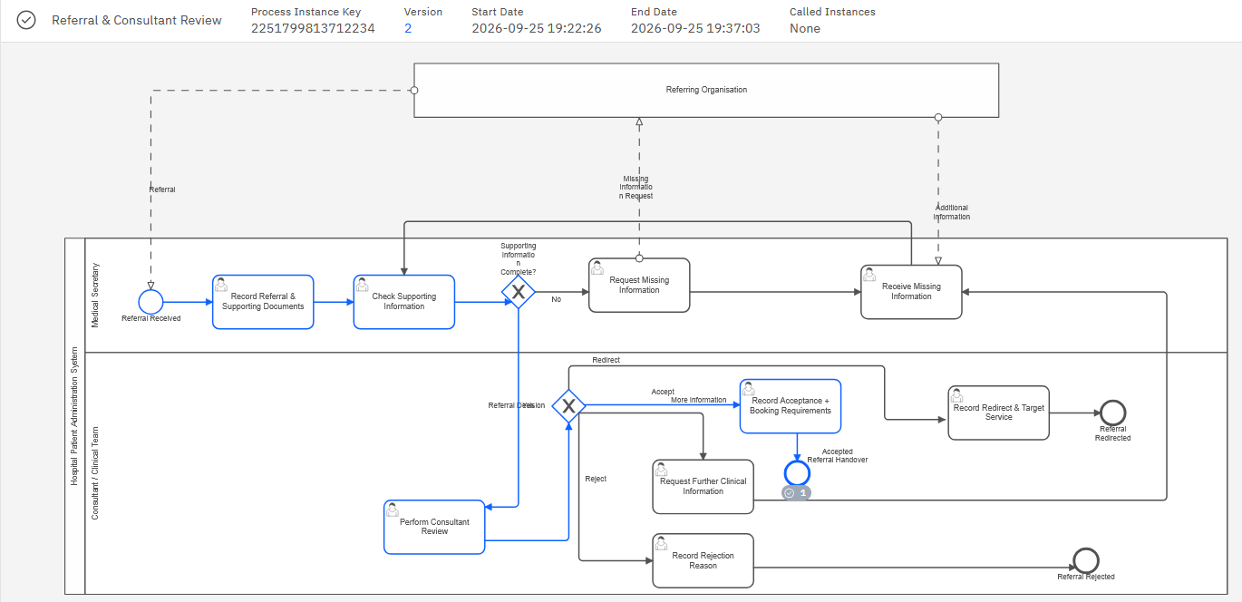
Referral and consultant review
Acceptance gate
Complete information
Consultant decision
ACCEPT permits booking
Historical evidence: accepted referral completed in version 2. Other branches need their own execution evidence.
DENG JIN WANG / 04
Notes:
Presenter: DENG JIN WANG
Suggested time: 55 seconds. This is a rehearsal allocation, not a tutor-specified duration.
中文讲稿
我的模块在资料完整后进入顾问审核，支持接受、拒绝、转诊和继续补充信息。只有接受转诊才进入后续预约。右侧规则来自当前 BPMN，截图显示早期版本接受路径完成。这个模块没有外部 service task，所以 ReferralWorkers 只说明无需注册 worker，不能把一个 Java 文件等同于一个真实 worker。接下来由吴家伟介绍主流程集成和预约。
Sources / supporting evidence
D:\Camunda-Workspace\models\assignment\bpmn
D:\Camunda-Workspace\models\assignment\External_Workers\src\main\java\org\hospital\workers
D:\Camunda-Workspace\models\assignment\evidence\23084366_Referral_Consultant\55c23817-c9ca-4257-8e40-ec960af764d3.png
Evidence date: 28 September 2026. Earlier screenshots are historical examples and are not proof that the latest working copy completed all paths.

Slide 5
The master process controls module handovers
Stage | Condition or handover
1 Referral | Consultant accepts the referral
2 Appointment | Booking and patient communication return to the master
3 Finance | Funding route, payment result or explicit override permits treatment
4 Treatment | Consent, authorisation, resource checks and clinical review
5 Clinic letter | Starts after the treatment subprocess returns
Patient enquiries and refund requests also have independent message-start paths.
WU JIA WEI / 05
Notes:
Presenter: WU JIA WEI
Suggested time: 50 seconds. This is a rehearsal allocation, not a tutor-specified duration.
中文讲稿
当前主流程通过五个 call activities 调用个人模块。接受转诊后进入预约，然后先完成财务模块，再根据清算结果决定是否继续治疗。就诊后的治疗模块结束后进入信件模块。这个顺序比早期并行运行财务和治疗更清楚，但信件启动仍依赖治疗子流程结束，可能晚于真正的就诊时间，这是后面需要说明的限制。
Sources / supporting evidence
D:\Camunda-Workspace\models\assignment\bpmn
C:/Users/huanxi/Desktop/ZUOYE/603_Sprint02_COMPLETE_With_Java_Workers_FIXED.zip
Evidence date: 28 September 2026. Earlier screenshots are historical examples and are not proof that the latest working copy completed all paths.

Slide 6
Appointment rules connect forms to workers
Form input
AppointmentWorkers.java
requestedSlotAvailable
requestedAppointmentDate
long days = ChronoUnit.DAYS
.between(LocalDate.now(),
appointmentDate);
boolean withinTwoWeeks =
days >= 0 && days <= 14;
Worker output
slotAvailable
appointmentWithinTwoWeeks
Boundary: day 0 and day 14 qualify. Past-date rejection and day 15 checks are absent from the test suite.
WU JIA WEI / 06
Notes:
Presenter: WU JIA WEI
Suggested time: 55 seconds. This is a rehearsal allocation, not a tutor-specified duration.
中文讲稿
预约模块的输入来自 AppointmentBooking 表单，worker 返回是否有号源以及是否在十四天内。十四天内除了预约信件，还需要电话联系。没有合适号源时，当前版本会重新打开预约表单，允许修改输入再查询。右侧代码展示了实际计算。需要注意，当前代码没有拒绝过去日期，因此历史截图中的预约完成不能证明日期规则全面正确。
Sources / supporting evidence
D:\Camunda-Workspace\models\assignment\External_Workers\src\main\java\org\hospital\workers
D:\Camunda-Workspace\models\assignment\bpmn
Evidence date: 28 September 2026. Earlier screenshots are historical examples and are not proof that the latest working copy completed all paths.

Slide 7
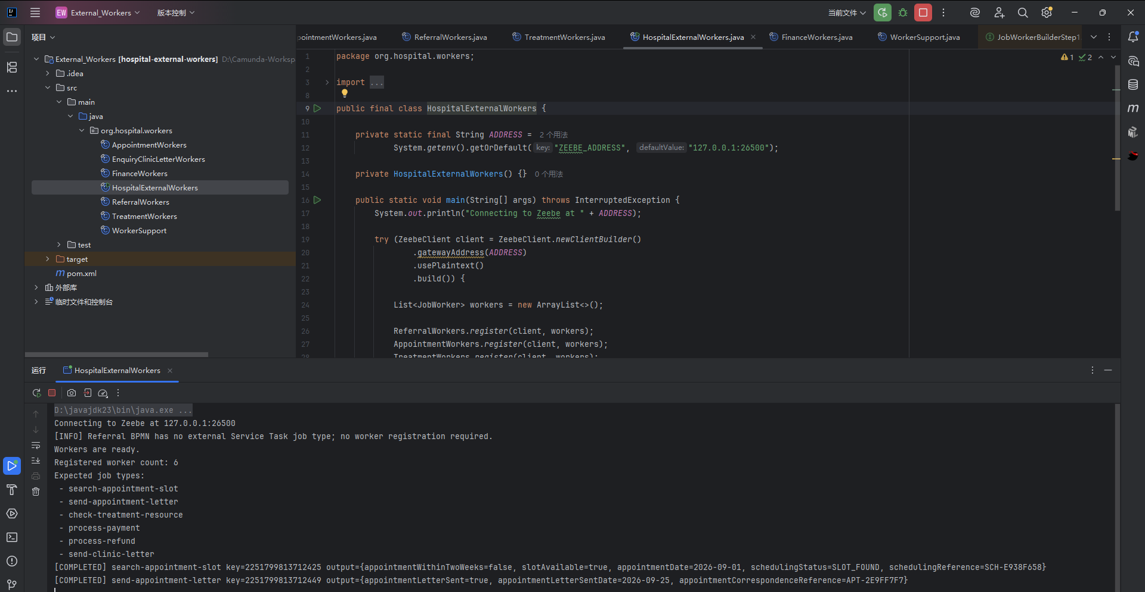
Six workers share one execution adapter
Shared adapter
Read job variables
Run business function
Complete or fail the job
Source: WorkerSupport.java. 30-second job timeout. No persistent idempotency or explicit retry backoff.
WU JIA WEI / 07
Notes:
Presenter: WU JIA WEI
Suggested time: 50 seconds. This is a rehearsal allocation, not a tutor-specified duration.
中文讲稿
Java 使用一个共享适配器接收 job variables，调用业务函数，再将结果写回 Camunda。出现异常时会发送失败命令并减少剩余重试次数。六个 job type 分别属于预约、治疗、财务和信件，转诊不需要外部 worker。截图记录了六个 worker 启动和两个预约任务完成。所有外部服务仍为模拟，不代表已经连接真实医院、支付或邮件系统。
Sources / supporting evidence
D:\Camunda-Workspace\models\assignment\External_Workers\src\main\java\org\hospital\workers
D:\Camunda-Workspace\models\assignment\evidence\java\fd811d22-ea10-40fd-a96d-31543e54de78.png
Evidence date: 28 September 2026. Earlier screenshots are historical examples and are not proof that the latest working copy completed all paths.

Slide 8
Concrete changes in the current workspace
Comparison: earlier local Sprint 2 ZIP versus current files
Area | Earlier snapshot | Current working copy
Master flow | Finance and treatment ran in parallel | Finance returns before treatment gate
Retry inputs | No forms on three retry tasks | Appointment, treatment and payment forms rebound
Clinic letter | 12 forms across the package | 14 forms with separate approval and monitoring
Implementation changes are confirmed by file comparison. Tutor-feedback attribution and runtime impact remain unverified.
WU JIA WEI / 08
Notes:
Presenter: WU JIA WEI
Suggested time: 60 seconds. This is a rehearsal allocation, not a tutor-specified duration.
中文讲稿
这一页展示真实文件差异。早期快照中治疗和财务并行，现在先完成财务并检查清算条件。三个失败或重试任务现在绑定对应表单，因此可以修改输入，而不是沿用旧值。信件审批和监控有了独立表单，数量从十二增加到十四。这些是当前文件能证明的改动，但它们是否真正解决运行问题，还需要重新部署后的回归测试。
Sources / supporting evidence
C:/Users/huanxi/Desktop/ZUOYE/603_Sprint02_COMPLETE_With_Java_Workers_FIXED.zip
D:\Camunda-Workspace\models\assignment\bpmn
Evidence date: 28 September 2026. Earlier screenshots are historical examples and are not proof that the latest working copy completed all paths.

Slide 9
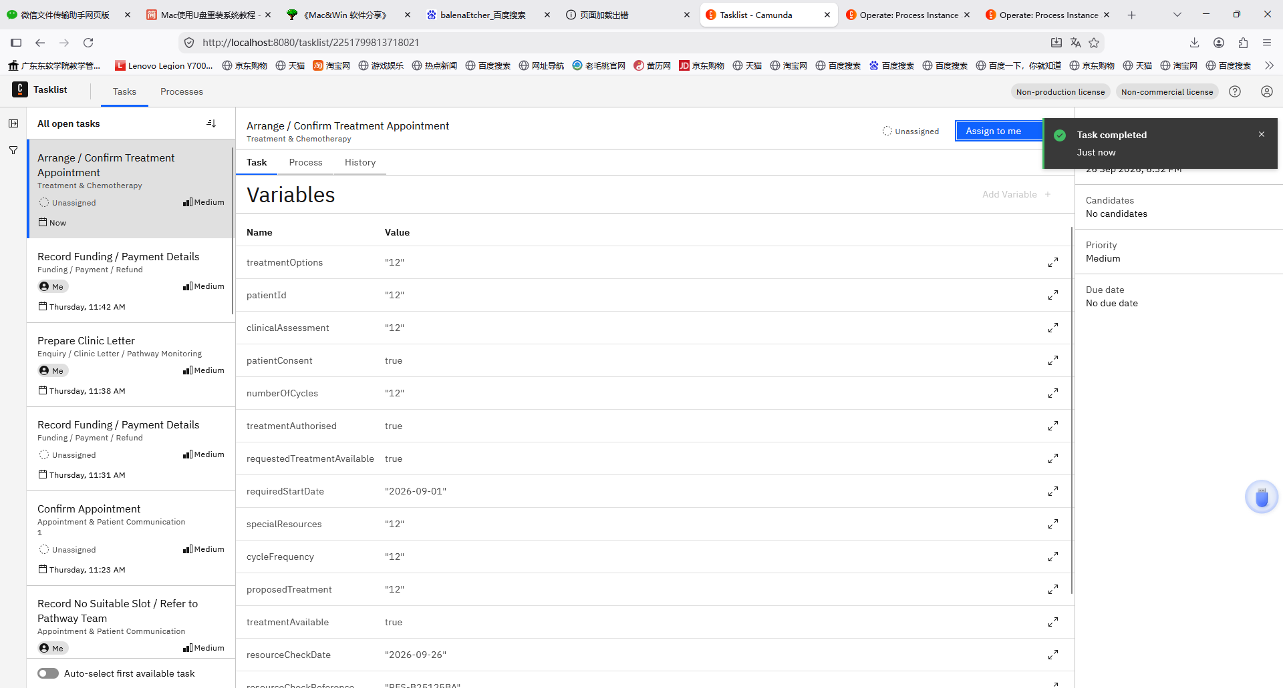
Treatment separates consent from clinical decisions
Required decisions
Patient consent
Authorised request
Resource availability
Clinical cycle review
Historical variables: patientConsent=true, treatmentAuthorised=true, treatmentAvailable=true.
LIN JIA QIANG / 09
Notes:
Presenter: LIN JIA QIANG
Suggested time: 55 seconds. This is a rehearsal allocation, not a tutor-specified duration.
中文讲稿
治疗模块先记录临床评估与患者同意，再检查请求授权和资源可用性。资源不可用时进入记录和重试任务，并重新打开表单。Continue、Delay、Modify 由临床人员决定。截图中的变量表显示同意、授权及资源可用均为 true。这里的资源由输入模拟，不能说明真实治疗资源已经预约，也不能把流程分支当成临床建议。
Sources / supporting evidence
D:\Camunda-Workspace\models\assignment\bpmn
D:\Camunda-Workspace\models\assignment\External_Workers\src\main\java\org\hospital\workers
D:\Camunda-Workspace\models\assignment\evidence\23084368_Treatment_Chemotherapy\3aa91297-4751-4ff4-8939-3bb0eada02ca.png
Evidence date: 28 September 2026. Earlier screenshots are historical examples and are not proof that the latest working copy completed all paths.

Slide 10
Local verification: 11 existing tests passed
11 / 11
Verified
Original sources compile with --release 17
Appointment, resource, payment and letter logic
Zero failed or skipped tests
Existing JUnit tests passed
28 September 2026
No Maven build or broker connection was performed in this verification. Evidence file: test_results.txt.
LIN JIA QIANG / 10
Notes:
Presenter: LIN JIA QIANG
Suggested time: 50 seconds. This is a rehearsal allocation, not a tutor-specified duration.
中文讲稿
我们区分三类证据：静态配置检查、Java 组件测试和 Camunda 运行。制作展示期间，原有源码以 Java 17 目标重新编译，十一项现有 JUnit 测试全部通过。使用的是本地 JUnit launcher，不是 Maven 构建，也没有连接 broker。这证明指定输入下的函数结果，不能证明全部 BPMN 分支或整个患者流程都运行成功。
Sources / supporting evidence
D:\Camunda-Workspace\models\assignment\External_Workers\src\test\java\org\hospital\workers\WorkerLogicSmokeTest.java
D:\Camunda-Workspace\models\assignment\.presentation_work\code_validation\test_results.txt
D:\Camunda-Workspace\models\assignment\bpmn
Evidence date: 28 September 2026. Earlier screenshots are historical examples and are not proof that the latest working copy completed all paths.

Slide 11
Screenshots show selected paths, not full coverage
Evidence | What is visible | What remains unproven
Appointment, v14 | Completed booking and letter path | Telephone and no-slot alternatives
Treatment | Consent/resource variables and trace | Complete current master journey
Finance | Hospital/exemption clearance path | Patient payment, investigation and refund
Clinic letter, v3 | Approved letter path completed | Weekly timer and long-delay escalation
Most screenshots predate the current working copy. Current-version reruns need instance keys and outcomes.
LIN JIA QIANG / 11
Notes:
Presenter: LIN JIA QIANG
Suggested time: 50 seconds. This is a rehearsal allocation, not a tutor-specified duration.
中文讲稿
现有截图不是空白证据，确实可以证明若干历史实例或执行路径。但是它们的范围有限：预约截图完成了不需要电话的路径，财务截图走的是医院承担费用的分支，不是支付退款分支。治疗截图可见执行轨迹，信件截图可见完成时间。没有找到当前主流程带所有子实例的完整证据，所以不能宣称最新版本端到端全部通过。
Sources / supporting evidence
D:\Camunda-Workspace\models\assignment\evidence
D:\Camunda-Workspace\models\assignment\Strengths_and_Weaknesses.docx
Evidence date: 28 September 2026. Earlier screenshots are historical examples and are not proof that the latest working copy completed all paths.

Slide 12
Demonstration walkthrough
Walkthrough based on the supplied T25/T26 scenarios
Normal journey
Exception journey
Accepted referral
Available slot and funding clearance
Authorised treatment
Approved clinic letter
No slot, then revised booking input
Or lost payment confirmation
followed by investigation
Evidence to retain: process version, instance key, inputs, result and linked screenshots.
LIN JIA QIANG / 12
Notes:
Presenter: LIN JIA QIANG
Suggested time: 45 seconds. This is a rehearsal allocation, not a tutor-specified duration.
中文讲稿
现场演示可以围绕一条正常路径和一条异常路径进行。这是演示讲解顺序，来源于原有测试计划，不是已经完成的运行记录。正常路径展示转诊接受、预约、财务、治疗和审批后的信件。异常路径可展示无号源后修改输入并重试，或丢失支付确认后进入调查。每一步都要展示实例标识、关键变量与最终结果。接下来由吴童宇介绍财务控制和项目评价。
Sources / supporting evidence
D:\Camunda-Workspace\models\assignment\Plan and contribution.docx
D:\Camunda-Workspace\models\assignment\bpmn
D:\Camunda-Workspace\models\assignment\External_Workers\src\test\java\org\hospital\workers\WorkerLogicSmokeTest.java
Evidence date: 28 September 2026. Earlier screenshots are historical examples and are not proof that the latest working copy completed all paths.

Slide 13
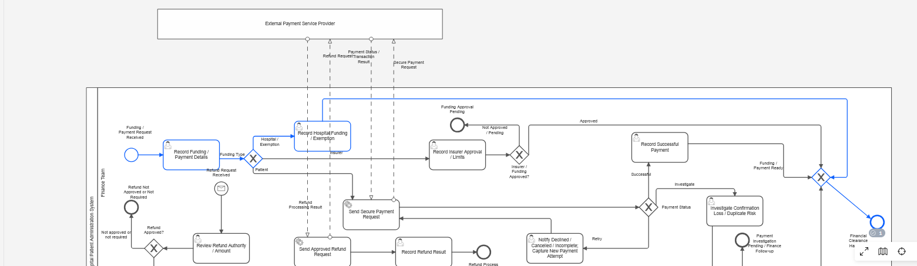
Finance gates treatment and approved refunds
Refund gate: refundRequired = true AND refundApproved = true
Observed route: hospital/exemption. Payment and refund workers are simulations, with separate local tests.
WU TONG YU / 13
Notes:
Presenter: WU TONG YU
Suggested time: 60 seconds. This is a rehearsal allocation, not a tutor-specified duration.
中文讲稿
财务模块区分医院承担、保险及患者付款。支付失败会进入重新输入的任务，确认丢失或重复风险进入调查。退款分支现在同时要求 refundRequired 和 refundApproved，worker 内也有检查。截图只证明医院承担费用的清算路径。我们的防重复处理目前是风险分流，没有持久化的幂等机制，不能说已经从技术上保证绝不重复扣款。
Sources / supporting evidence
D:\Camunda-Workspace\models\assignment\bpmn
D:\Camunda-Workspace\models\assignment\External_Workers\src\main\java\org\hospital\workers
C:/Users/huanxi/Desktop/ZUOYE/603_Sprint02_COMPLETE_With_Java_Workers_FIXED.zip
D:\Camunda-Workspace\models\assignment\evidence\23084362_Funding_Payment_Refund\96a3e3dc-6966-435f-941e-b69da3f41411.png
Evidence date: 28 September 2026. Earlier screenshots are historical examples and are not proof that the latest working copy completed all paths.

Slide 14
Response record: implemented fixes and open evidence
Internal issue-to-change mapping. No completed tutor feedback record was supplied.
Recorded issue / source | Action in current files | Outcome and residual work
Retry/form maintenance risk Strengths and Weaknesses | Rebind three retry input forms | Implemented. Runtime regression still needed.
Approval and authority boundary Case study and local comparison | Explicit refund gate and clinic approval form | Static guard confirmed. Negative engine paths remain.
Incomplete runtime validation Strengths and Weaknesses | 11 component tests now executed | Full master normal/exception evidence still open.
Complete tutor traceability needs the feedback date, wording, first/second owners and a linked review outcome.
WU TONG YU / 14
Notes:
Presenter: WU TONG YU
Suggested time: 55 seconds. This is a rehearsal allocation, not a tutor-specified duration.
中文讲稿
评分要求把反馈、决定、行动、证据和结果连起来。我们没有找到填好的导师反馈记录，因此这一页列的是项目内部问题和文件中已落实的改动，不把它们冒充导师意见。重试表单和审批控制已经实现，但最新版本的运行结果仍需补充。完整端到端验证仍未闭环。收到导师真实反馈后，还需要补上原文、日期和对应责任人。
Sources / supporting evidence
C:/Users/huanxi/Desktop/ZUOYE/UFCEP6-0-3_Presentation_Assessment_Specification V2 - Tagged.pdf
D:\Camunda-Workspace\models\assignment\Strengths_and_Weaknesses.docx
C:/Users/huanxi/Desktop/ZUOYE/603_Sprint02_COMPLETE_With_Java_Workers_FIXED.zip
D:\Camunda-Workspace\models\assignment\bpmn
Evidence date: 28 September 2026. Earlier screenshots are historical examples and are not proof that the latest working copy completed all paths.

Slide 15
Planned effort and observed delivery
Planned work | Estimate | Observed delivery
Sprint 1: models and integration | 40 h | Six BPMN files with a master process
Sprint 2: forms, workers and checks | 35 h | 14 forms, six job types and passing component tests
S2-08: runtime demo (within 35 h) | 4 h | Historical partial evidence. Current master rerun open
Actual effort / variance | Not recorded | A schedule or productivity variance cannot be calculated
75 h is the supplied estimate, not actual effort. File presence alone does not establish acceptance.
WU TONG YU / 15
Notes:
Presenter: WU TONG YU
Suggested time: 55 seconds. This is a rehearsal allocation, not a tutor-specified duration.
中文讲稿
当前计划估计 Sprint 1 为四十小时，Sprint 2 为三十五小时，共七十五小时。这些都是估计，没有实际工时，所以不能计算按时率或工时偏差。模型、表单和 worker 都已存在，但原计划写组件测试待执行，现已能提供十一项通过的本地结果。运行集成仍依赖最终 Camunda 环境。这说明 Done 必须关联验收条件，而不能只表示文件已经写好。
Sources / supporting evidence
D:\Camunda-Workspace\models\assignment\Plan and contribution.docx
D:\Camunda-Workspace\models\assignment\.presentation_work\code_validation\test_results.txt
D:\Camunda-Workspace\models\assignment\bpmn
D:\Camunda-Workspace\models\assignment\External_Workers\src\main\java\org\hospital\workers
Evidence date: 28 September 2026. Earlier screenshots are historical examples and are not proof that the latest working copy completed all paths.

Slide 16
Dependencies explain the integration risk
What supported delivery
What weakened traceability
Named first and second owners
Separate modules with shared variables
One integration coordinator
Several test tasks owned by “Group”
No actual hours or dated completion log
Runtime evidence not tied to final files
Lesson: acceptance needs an accountable owner and evidence from the same version.
WU TONG YU / 16
Notes:
Presenter: WU TONG YU
Suggested time: 50 seconds. This is a rehearsal allocation, not a tutor-specified duration.
中文讲稿
团队按业务领域分工有利于并行开发，但每个模块都依赖上一模块输出的变量。吴家伟负责主流程协调，因此存在集成工作集中的风险。已有第二负责人机制可以降低交接风险，不过组级测试任务只写 Group，没有明确个人。另外，缺少实际工时和任务日期，限制了对延误原因的量化分析。合理的改进是明确个人验收责任，并在每次集成时保留版本和结果。
Sources / supporting evidence
D:\Camunda-Workspace\models\assignment\Plan and contribution.docx
D:\Camunda-Workspace\models\assignment\bpmn
D:\Camunda-Workspace\models\assignment\Strengths_and_Weaknesses.docx
Evidence date: 28 September 2026. Earlier screenshots are historical examples and are not proof that the latest working copy completed all paths.

Slide 17
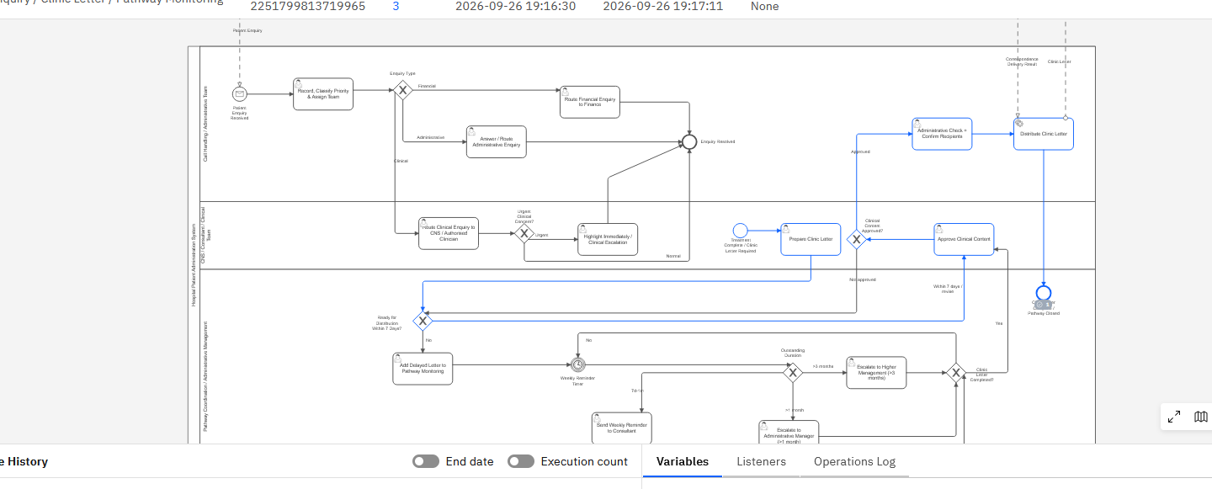
Clinic letters require clinical approval
Approval controls
Separate approval form
BPMN approval gateway
Worker rejects unapproved letters
P7D reminder exists. Letter age bands remain manual. The seven-day consultation target is not validated.
XIAO YU YING / 17
Notes:
Presenter: XIAO YU YING
Suggested time: 60 seconds. This is a rehearsal allocation, not a tutor-specified duration.
中文讲稿
信件模块把起草、临床批准、行政核对和发送分开，worker 也会拒绝未批准的信件。延迟信件进入七天计时和提醒，超过一个月或三个月有不同升级路径。截图显示历史版本的一条批准后完成路径。但年龄段由用户填写，当前信件流程又在治疗子流程结束后启动，因此不能证明所有信件都能在实际就诊七天内发出。
Sources / supporting evidence
D:\Camunda-Workspace\models\assignment\bpmn
D:\Camunda-Workspace\models\assignment\External_Workers\src\main\java\org\hospital\workers
D:\Camunda-Workspace\models\assignment\evidence\24000813_Enquiry_ClinicLetter_Monitoring\213f8afd-02af-4f82-b9e3-3564cac0618d.png
Evidence date: 28 September 2026. Earlier screenshots are historical examples and are not proof that the latest working copy completed all paths.

Slide 18
Remaining limits affect release readiness
Limitation | Consequence | Direction for improvement
Simulated external services | No real booking, delivery or payment confirmation | Replace with verified service adapters
No task role assignments in BPMN | Lanes describe roles without enforcing access | Validate task permissions and audit evidence
Manual letter age and delayed start | Seven-day consultation target is uncertain | Anchor monitoring to consultation time
Permissive inputs and no durable idempotency | Invalid dates and duplicate effects remain possible | Validate inputs and persist transaction identity
XIAO YU YING / 18
Notes:
Presenter: XIAO YU YING
Suggested time: 55 seconds. This is a rehearsal allocation, not a tutor-specified duration.
中文讲稿
这些限制来自代码和模型。第一，外部支付、发送信件及资源服务仍然模拟。第二，BPMN 里有岗位泳道，但没有配置实际任务授权，所以责任区分不等于权限已经实现。第三，信件时钟没有直接绑定就诊时间。第四，日期、金额和重复交易防护还比较简化。因此当前成果适合展示流程原型，不能宣称已经达到真实医院生产环境的安全和可靠性要求。
Sources / supporting evidence
D:\Camunda-Workspace\models\assignment\External_Workers\src\main\java\org\hospital\workers
D:\Camunda-Workspace\models\assignment\bpmn
D:\Camunda-Workspace\models\assignment\Strengths_and_Weaknesses.docx
Evidence date: 28 September 2026. Earlier screenshots are historical examples and are not proof that the latest working copy completed all paths.

Slide 19
Evidence still needed for the second release
Assessment requirement | Evidence required to close the gap
Further development 25% | Identifiable releases and current-version normal/exception runs
Response to feedback 20% | Actual tutor feedback linked to decisions, actions and outcomes
Plan evaluation 25% | Dated progress, revised records, estimates versus actuals and risks
Standups / reviews 30% | SU3 and SU4 individual records. SR3 and SR4 preserved increments
Specification delivery date: 22 October 2026. Exact live activity arrangements come from the module team.
XIAO YU YING / 19
Notes:
Presenter: XIAO YU YING
Suggested time: 50 seconds. This is a rehearsal allocation, not a tutor-specified duration.
中文讲稿
最后回到评分要求。第二次发布需要可以识别的初始版和修改版、真实反馈闭环以及实际交付记录。SU3 和 SU4 分别计算个人成绩，SR3 和 SR4 分别评价当时的增量，后来的修复不能替换之前的评审结果。这一页列出目前缺少的证据，而不是编造新的进度或已完成的 Sprint。我们需要根据真实活动补齐，然后更新展示中的版本和结果。
Sources / supporting evidence
C:/Users/huanxi/Desktop/ZUOYE/UFCEP6-0-3_Presentation_Assessment_Specification V2 - Tagged.pdf
D:\Camunda-Workspace\models\assignment\Plan and contribution.docx
D:\Camunda-Workspace\models\assignment\Strengths_and_Weaknesses.docx
Evidence date: 28 September 2026. Earlier screenshots are historical examples and are not proof that the latest working copy completed all paths.

Slide 20
Current result and next review
Implemented
Five coordinated process areas
Fourteen forms and six worker types
Approval and retry improvements
Next review evidence
A validated current master journey and a traceable response to real feedback
XIAO YU YING / 20
Notes:
Presenter: XIAO YU YING
Suggested time: 35 seconds. This is a rehearsal allocation, not a tutor-specified duration.
中文讲稿
我们的主要成果是把五个模块连接成可执行的流程，并实现了相应表单和六个模拟 worker。当前文件能够证明财务顺序、审批和重试输入方面的改动，十一项现有 Java 测试也已通过。剩余关键工作是把最新主流程的运行证据、真实导师反馈和实际交付记录关联起来。我们愿意进一步展示某个模块的变量、源码和异常分支。谢谢。
Sources / supporting evidence
D:\Camunda-Workspace\models\assignment\bpmn
D:\Camunda-Workspace\models\assignment\External_Workers\src\main\java\org\hospital\workers
D:\Camunda-Workspace\models\assignment\.presentation_work\code_validation\test_results.txt
C:/Users/huanxi/Desktop/ZUOYE/UFCEP6-0-3_Presentation_Assessment_Specification V2 - Tagged.pdf
Evidence date: 28 September 2026. Earlier screenshots are historical examples and are not proof that the latest working copy completed all paths.

Slide 21
Appendix: worker contracts
Exact job type | Key input | Key output
search-appointment-slot | requestedSlotAvailable requestedAppointmentDate | slotAvailable appointmentWithinTwoWeeks
send-appointment-letter | Process context | appointmentLetterSent
check-treatment-resource | requestedTreatmentAvailable | treatmentAvailable
process-payment | paymentScenario | paymentStatus paymentInvestigationRequired
process-refund | refundRequired refundApproved | refundStatus refundReference
send-clinic-letter | clinicLetterApproved | clinicLetterSent
APPENDIX / 21
Notes:
Presenter: Q&A
Suggested time: 0 seconds. This is a rehearsal allocation, not a tutor-specified duration.
中文讲稿
此页用于回答 worker 输入输出和绑定问题。job type 字符串必须与 BPMN 完全一致。转诊只有人工任务，不注册 worker。所有外部操作仍为模拟。
Sources / supporting evidence
D:\Camunda-Workspace\models\assignment\External_Workers\src\main\java\org\hospital\workers
D:\Camunda-Workspace\models\assignment\bpmn
Evidence date: 28 September 2026. Earlier screenshots are historical examples and are not proof that the latest working copy completed all paths.

Slide 22
Appendix: test coverage and gaps
Area | Existing tests passed | Important gaps
Appointment | 3: available, unavailable, corrected retry | 0/14/15-day boundaries and past dates
Treatment | 2: unavailable and corrected retry | Engine approval and cycle routing
Payment / refund | 4: success, lost confirmation, retry, approved refund | Invalid states, rejected refunds and idempotency
Clinic letter | 2: unapproved rejection and approved result | Timer, escalation and master integration
The 26 scenarios in the supplied plan are planned coverage. Eleven local Java tests are executed evidence.
APPENDIX / 22
Notes:
Presenter: Q&A
Suggested time: 0 seconds. This is a rehearsal allocation, not a tutor-specified duration.
中文讲稿
十一项测试调用的是 Java 方法。完整测试计划有 T01 到 T26，但不能把二十六个计划场景当成已经执行。边界日期、全部退款拒绝情况及引擎层测试仍是主要缺口。
Sources / supporting evidence
D:\Camunda-Workspace\models\assignment\External_Workers\src\test\java\org\hospital\workers\WorkerLogicSmokeTest.java
D:\Camunda-Workspace\models\assignment\.presentation_work\code_validation\test_results.txt
D:\Camunda-Workspace\models\assignment\Plan and contribution.docx
Evidence date: 28 September 2026. Earlier screenshots are historical examples and are not proof that the latest working copy completed all paths.

Slide 23
Appendix: local demonstration setup
1 Deploy 6 BPMN models and 14 forms to the matching Camunda environment.
2 From the External_Workers directory, with JDK 17+ and Maven:
mvn test package
java -jar target/hospital-external-workers-1.0.0.jar
3 Start Process_Hospital_Master, complete tasks, and retain instance evidence.
Default gateway: 127.0.0.1:26500 via ZEEBE_ADDRESS. Local plaintext configuration. Maven commands not run here.
APPENDIX / 23
Notes:
Presenter: Q&A
Suggested time: 0 seconds. This is a rehearsal allocation, not a tutor-specified duration.
中文讲稿
此页给出从现有 pom 和 Java 配置整理的运行参考。需要 Java 17 以上和 Maven。先部署主流程、五个子流程和十四个表单，再启动本地 worker。默认地址是本机 26500，且使用明文连接，只适用于现有本地演示配置。命令未在本次工作中以 Maven 执行，不应把这个步骤标记为构建完成。
Sources / supporting evidence
D:\Camunda-Workspace\models\assignment\External_Workers\src\main\java\org\hospital\workers
D:\Camunda-Workspace\models\assignment\External_Workers\pom.xml
D:\Camunda-Workspace\models\assignment\bpmn
Evidence date: 28 September 2026. Earlier screenshots are historical examples and are not proof that the latest working copy completed all paths.

Slide 24
References and supporting evidence
UWE Bristol (2026) UFCEP6-0-3 Presentation Assessment Specification, V2.
UWE Bristol (n.d.) Hospital Patient Referral, Treatment and Administration System.
Project team (2026) Plan and contribution. Initial Release project and test plan.
Project team (2026) Strengths and Weaknesses of the Developed BPM. Sprint 02.
Project team (2026) BPMN, Camunda Forms and Java workers. Current workspace.
Project team (2026) Earlier local Sprint 2 ZIP and 25–26 September screenshots.
Local verification (2026) Original JUnit tests: 11 passed on 28 September.
Exact supporting paths are in slide notes and the companion evidence index. An accessible repository URL was not supplied.
APPENDIX / 24
Notes:
Presenter: Q&A
Suggested time: 0 seconds. This is a rehearsal allocation, not a tutor-specified duration.
中文讲稿
主要引用来自课程要求、案例、团队计划、当前源码、历史快照和原始截图。具体文件路径已放入每页备注和配套讲稿。由于没有提供可访问的仓库网址，这里不虚构在线链接。正式提交前应使用你们真实可访问的仓库地址和版本标识。
Sources / supporting evidence
C:/Users/huanxi/Desktop/ZUOYE/UFCEP6-0-3_Presentation_Assessment_Specification V2 - Tagged.pdf
C:/Users/huanxi/Desktop/ZUOYE/Case Study - Hospital Patient Referral, Treatment and Administration System.docx
D:\Camunda-Workspace\models\assignment\Plan and contribution.docx
D:\Camunda-Workspace\models\assignment\Strengths_and_Weaknesses.docx
C:/Users/huanxi/Desktop/ZUOYE/603_Sprint02_COMPLETE_With_Java_Workers_FIXED.zip
D:\Camunda-Workspace\models\assignment\bpmn
D:\Camunda-Workspace\models\assignment\External_Workers\src\main\java\org\hospital\workers
D:\Camunda-Workspace\models\assignment\External_Workers\src\test\java\org\hospital\workers\WorkerLogicSmokeTest.java
D:\Camunda-Workspace\models\assignment\.presentation_work\code_validation\test_results.txt
D:\Camunda-Workspace\models\assignment\evidence
Evidence date: 28 September 2026. Earlier screenshots are historical examples and are not proof that the latest working copy completed all paths.

