Slide 1
Hospital Patient Pathway
Five designs. One patient journey.
How each decision works, why it exists, and how to demonstrate it
UFCEP6-0-3 · Five-person group
DENG JIN WANG / 01
Notes:
Presenter: DENG JIN WANG
中文讲稿
我们五人设计的是一个患者从转诊到预约、费用清算、治疗和诊所信件的流程。主流程负责模块交接，个人模块负责业务判断。今天每人会展示自己的原始流程图，解释关键分支，并说明现场输入什么、预期走哪条路。材料中的实际运行截图只覆盖部分历史路径，我们会明确证据范围。
Evidence and source paths
C:/Users/huanxi/Desktop/ZUOYE/UFCEP6-0-3_Presentation_Assessment_Specification V2 - Tagged.pdf
C:/Users/huanxi/Desktop/ZUOYE/Case Study - Hospital Patient Referral, Treatment and Administration System.docx
D:\Camunda-Workspace\models\assignment\bpmn
All current-version runtime claims require the matching Camunda instance and version. Historical screenshots are labelled as such.

Slide 2
How the five processes work together
Stage | Decision that allows the next stage | Owner
Referral | Complete information, then consultant ACCEPT | Deng
Appointment | Slot found; letter sent; phone if within 14 days | Wu
Finance | Funding approved, paid, or documented urgent override | Tong
Treatment | Consent, authorised request and resources | Lin
Clinic letter | Clinical approval before distribution | Xiao
Enquiries and refunds start separately. The master passes child variables between modules.
DENG JIN WANG / 02
Notes:
Presenter: DENG JIN WANG
中文讲稿
主流程先调用转诊；只有顾问接受才进入预约。预约完成后，财务结果决定是否可以进入治疗。治疗子流程结束后启动诊所信件。这样设计是为了把临床、行政和财务责任隔开，同时让每一步的状态通过变量传给下一步。患者咨询和退款另有消息入口，不属于普通主线。
Evidence and source paths
D:\Camunda-Workspace\models\assignment\bpmn
C:/Users/huanxi/Desktop/ZUOYE/Case Study - Hospital Patient Referral, Treatment and Administration System.docx
All current-version runtime claims require the matching Camunda instance and version. Historical screenshots are labelled as such.

Slide 3
What changed in the current design
Decision | Earlier behaviour | Current behaviour
Treatment entry | Finance and treatment ran in parallel | Finance clearance gates treatment
Retry | No editable inputs on three retry tasks | Input forms reopen before a new attempt
Refund | Approval alone allowed the branch | Required AND approved
Clinic letter | Preparation carried mixed fields | Separate approval and monitoring
The before/after comparison confirms implementation changes. Tutor feedback attribution is still open.
DENG JIN WANG / 03
Notes:
Presenter: DENG JIN WANG
中文讲稿
早期本地版本中，财务和治疗并行执行，会先开始治疗再判断清算。当前主流程把财务放在治疗前。原来无号源、资源不足和付款失败的重试任务缺少可编辑表单，现在能修改输入再重试。退款增加必须既需要退款又获得批准的条件。信件审批与监控有独立表单。这些是对比文件后能确认的具体改动；不能说它们来自导师反馈，因为我们没有填好的导师反馈记录。
Evidence and source paths
D:\Camunda-Workspace\models\assignment\bpmn
D:\Camunda-Workspace\models\assignment\Strengths_and_Weaknesses.docx
All current-version runtime claims require the matching Camunda instance and version. Historical screenshots are labelled as such.

Slide 4
How we will prove a path
At each decision
At the end
Show input values
Show the selected branch
Show the resulting variables
Record process version and instance key
Keep the completed or pending outcome
Link the exact screenshot to that run
11 existing Java logic tests passed. This does not demonstrate every BPMN route or external service.
DENG JIN WANG / 04
Notes:
Presenter: DENG JIN WANG
中文讲稿
展示时不只看流程图。先说明输入变量，再启动对应流程或在主流程中完成用户任务，然后看网关选择、worker 返回值和结束状态。一个成功截图只能证明它所走过的一条路径。当前有转诊、预约和信件的历史完成实例，财务和治疗有选定路径的轨迹，另外现有十一项 Java 测试已通过。最新主流程的完整正常和异常路径仍要在最终环境中重跑。
Evidence and source paths
D:\Camunda-Workspace\models\assignment\bpmn
D:\Camunda-Workspace\models\assignment\External_Workers\src\test\java\org\hospital\workers\WorkerLogicSmokeTest.java
D:\Camunda-Workspace\models\assignment\.presentation_work\code_validation\test_results.txt
All current-version runtime claims require the matching Camunda instance and version. Historical screenshots are labelled as such.

Slide 5
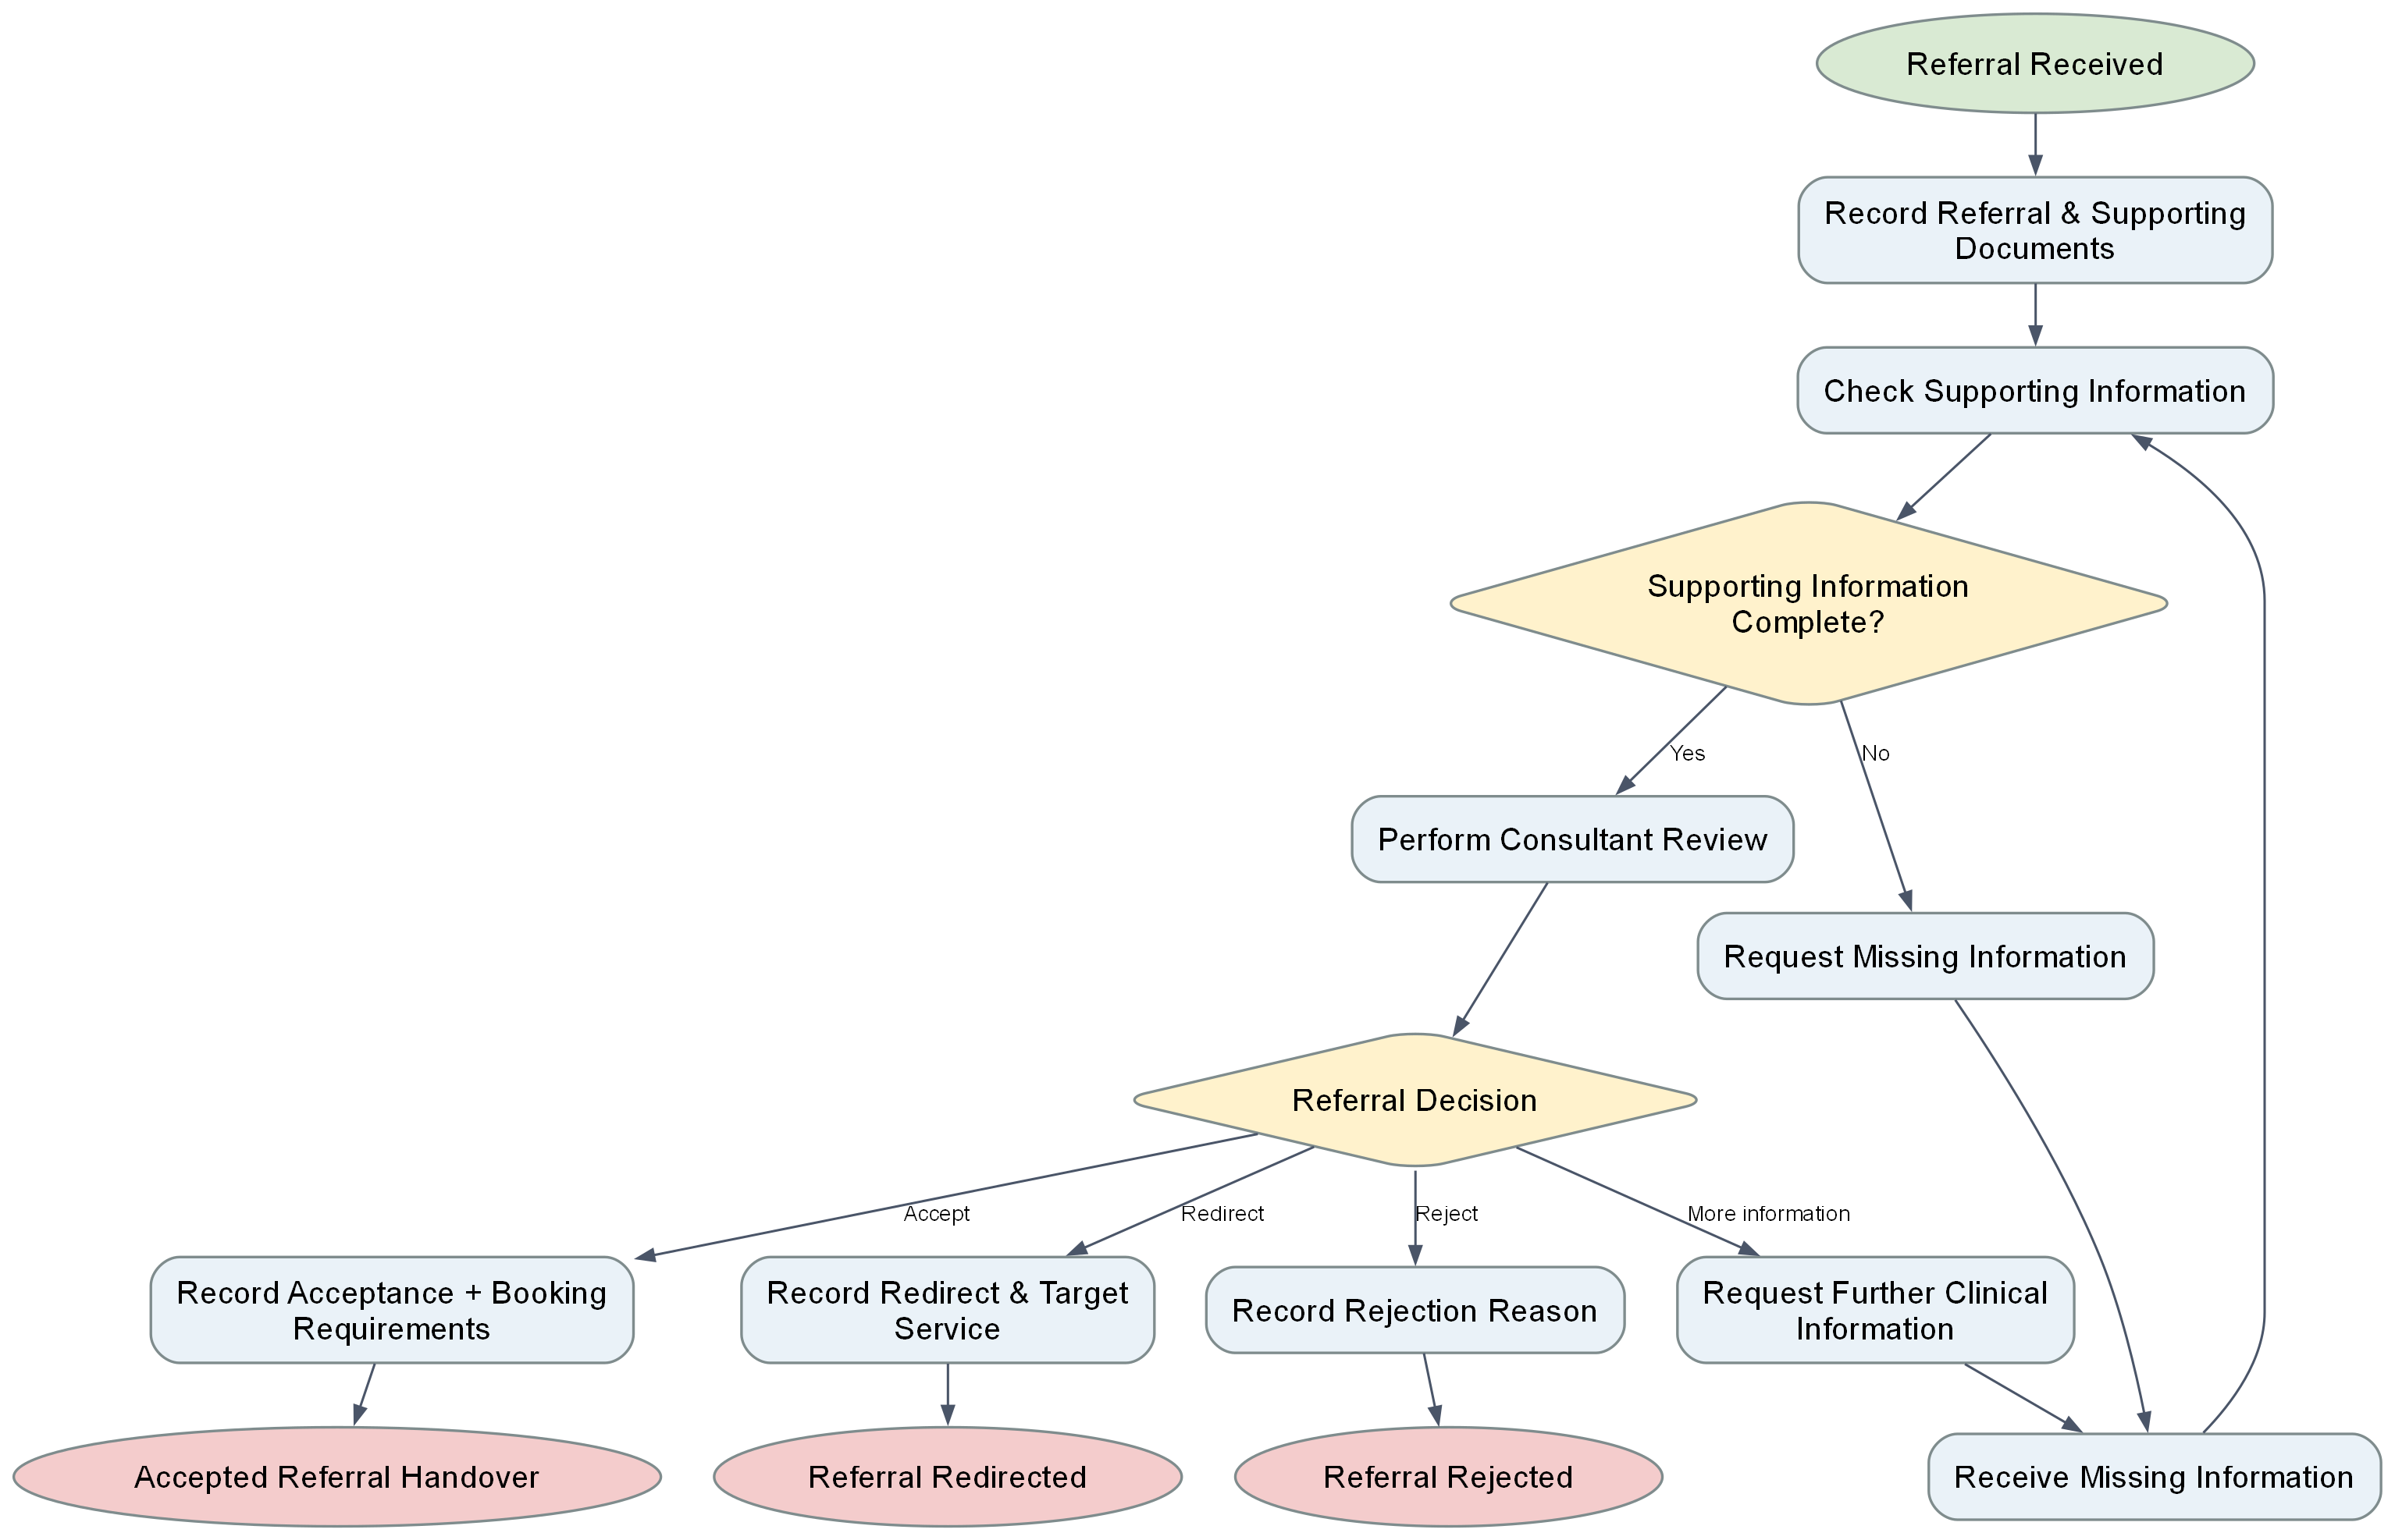
Referral and consultant review: process diagram
Read from intake to the information check, then follow one of four consultant outcomes.
DENG JIN WANG / 05
Notes:
Presenter: DENG JIN WANG
中文讲稿
这是我的完整流程图。从右上接收转诊，先核查材料是否齐全，缺失则请求补充并重新检查。材料齐全后由顾问选择接受、拒绝、转向其他服务或要求更多临床信息。只有接受分支向预约交接。图示是设计逻辑，当前 BPMN 的 REDIRECT 结尾与图示一致。
Evidence and source paths
D:\Camunda-Workspace\models\assignment\bpmn
C:/Users/huanxi/Desktop/ZUOYE/Case Study - Hospital Patient Referral, Treatment and Administration System.docx
D:\Camunda-Workspace\models\assignment\bpmn\23084366_Referral_Consultant_Review\Path_Logic_Diagram.docx
All current-version runtime claims require the matching Camunda instance and version. Historical screenshots are labelled as such.

Slide 6
Referral: the acceptance gate
Input or decision | Branch taken | Result
informationComplete = false | Request missing information | Loop to a new check
ACCEPT | Record acceptance and booking needs | Appointment handover
REJECT or REDIRECT | Record reason or target service | Separate endpoint
MORE_INFORMATION | Request clinical detail | Return to intake
Design reason: administrative completeness and consultant acceptance are different decisions.
DENG JIN WANG / 06
Notes:
Presenter: DENG JIN WANG
中文讲稿
第一道网关看 informationComplete。false 就请转诊方补齐材料，不能直接预约。true 才让顾问审核。第二道网关读 referralDecision：ACCEPT 进入预约；REJECT 记录原因后结束；REDIRECT 记录目标服务后结束；MORE_INFORMATION 回到资料补充。把行政完整性和临床接受分开，是为了避免秘书以材料齐全替代顾问作出临床决定。
Evidence and source paths
D:\Camunda-Workspace\models\assignment\bpmn
C:/Users/huanxi/Desktop/ZUOYE/Case Study - Hospital Patient Referral, Treatment and Administration System.docx
All current-version runtime claims require the matching Camunda instance and version. Historical screenshots are labelled as such.

Slide 7
Referral: a live branch to demonstrate
Demo input
Expected observation
Patient and referral IDs
informationComplete = false, then true
referralDecision = ACCEPT
Missing-information loop first
Then accepted handover
Appointment starts only after ACCEPT
Historical completed evidence exists for ACCEPT; other decisions need separate runs.
DENG JIN WANG / 07
Notes:
Presenter: DENG JIN WANG
中文讲稿
现场可以先录入患者与转诊信息，把 informationComplete 设为 false，观察请求补充后回到检查；再改为 true，让顾问选择 ACCEPT，观察记录接受和主流程进入预约。历史截图只显示 ACCEPT 完成，不证明其他三种决定运行过。这个模块没有 service task，外部转诊方的消息箭头是协作边界，不代表已经实现网络传输。
Evidence and source paths
D:\Camunda-Workspace\models\assignment\bpmn
D:\Camunda-Workspace\models\assignment\evidence\23084366_Referral_Consultant\55c23817-c9ca-4257-8e40-ec960af764d3.png
All current-version runtime claims require the matching Camunda instance and version. Historical screenshots are labelled as such.

Slide 8
Referral: design defence
Why human review?
What still needs work?
A complete form does not equal clinical acceptance. Consultant decisions remain explicit and auditable in the process.
Several user tasks lack a bound form. Unknown decision values from external input have no default branch.
Answer with the actual gate and its variable, then state the untested edge case.
DENG JIN WANG / 08
Notes:
Presenter: DENG JIN WANG
中文讲稿
导师可能会问：为什么转诊没有 Java worker？因为该模块的决定由秘书和顾问完成，当前 BPMN 没有外部 service task。还可能问：如果 API 直接写入一个未知 referralDecision 会怎样？表单的必填选项限制了普通输入，但网关没有默认路径，绕过表单写入未知值可能卡住。这是需要补的健壮性问题。
Evidence and source paths
D:\Camunda-Workspace\models\assignment\bpmn
D:\Camunda-Workspace\models\assignment\External_Workers\src\main\java\org\hospital\workers
All current-version runtime claims require the matching Camunda instance and version. Historical screenshots are labelled as such.

Slide 9
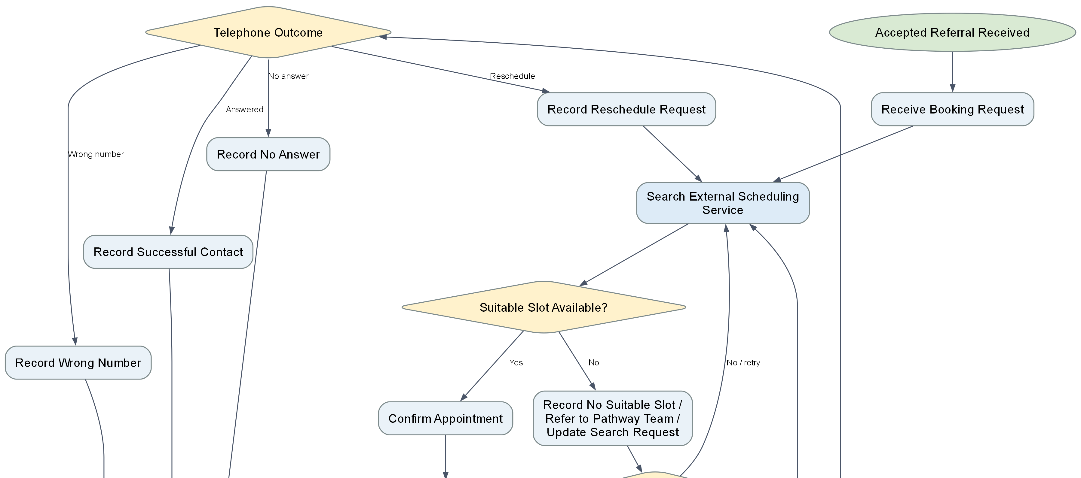
Appointment diagram: slot and retry paths
First decision: slotAvailable. No slot returns to a changed search request.
WU JIA WEI / 09
Notes:
Presenter: WU JIA WEI
中文讲稿
这张是预约流程图的上半部分。先填写预约请求，worker 查询是否有合适号源。无号源时重新打开预约表单，可以调整日期和模拟可用性再查询；紧急转诊还进入人工协调。找到号源后确认预约并发送信件。这里体现了为什么重试任务必须能修改输入，否则会把相同请求无限重复。
Evidence and source paths
D:\Camunda-Workspace\models\assignment\bpmn
C:/Users/huanxi/Desktop/ZUOYE/Case Study - Hospital Patient Referral, Treatment and Administration System.docx
D:\Camunda-Workspace\models\assignment\bpmn\23084364_Appointment_Patient_Communication\Path_Logic_Diagram.docx
All current-version runtime claims require the matching Camunda instance and version. Historical screenshots are labelled as such.

Slide 10
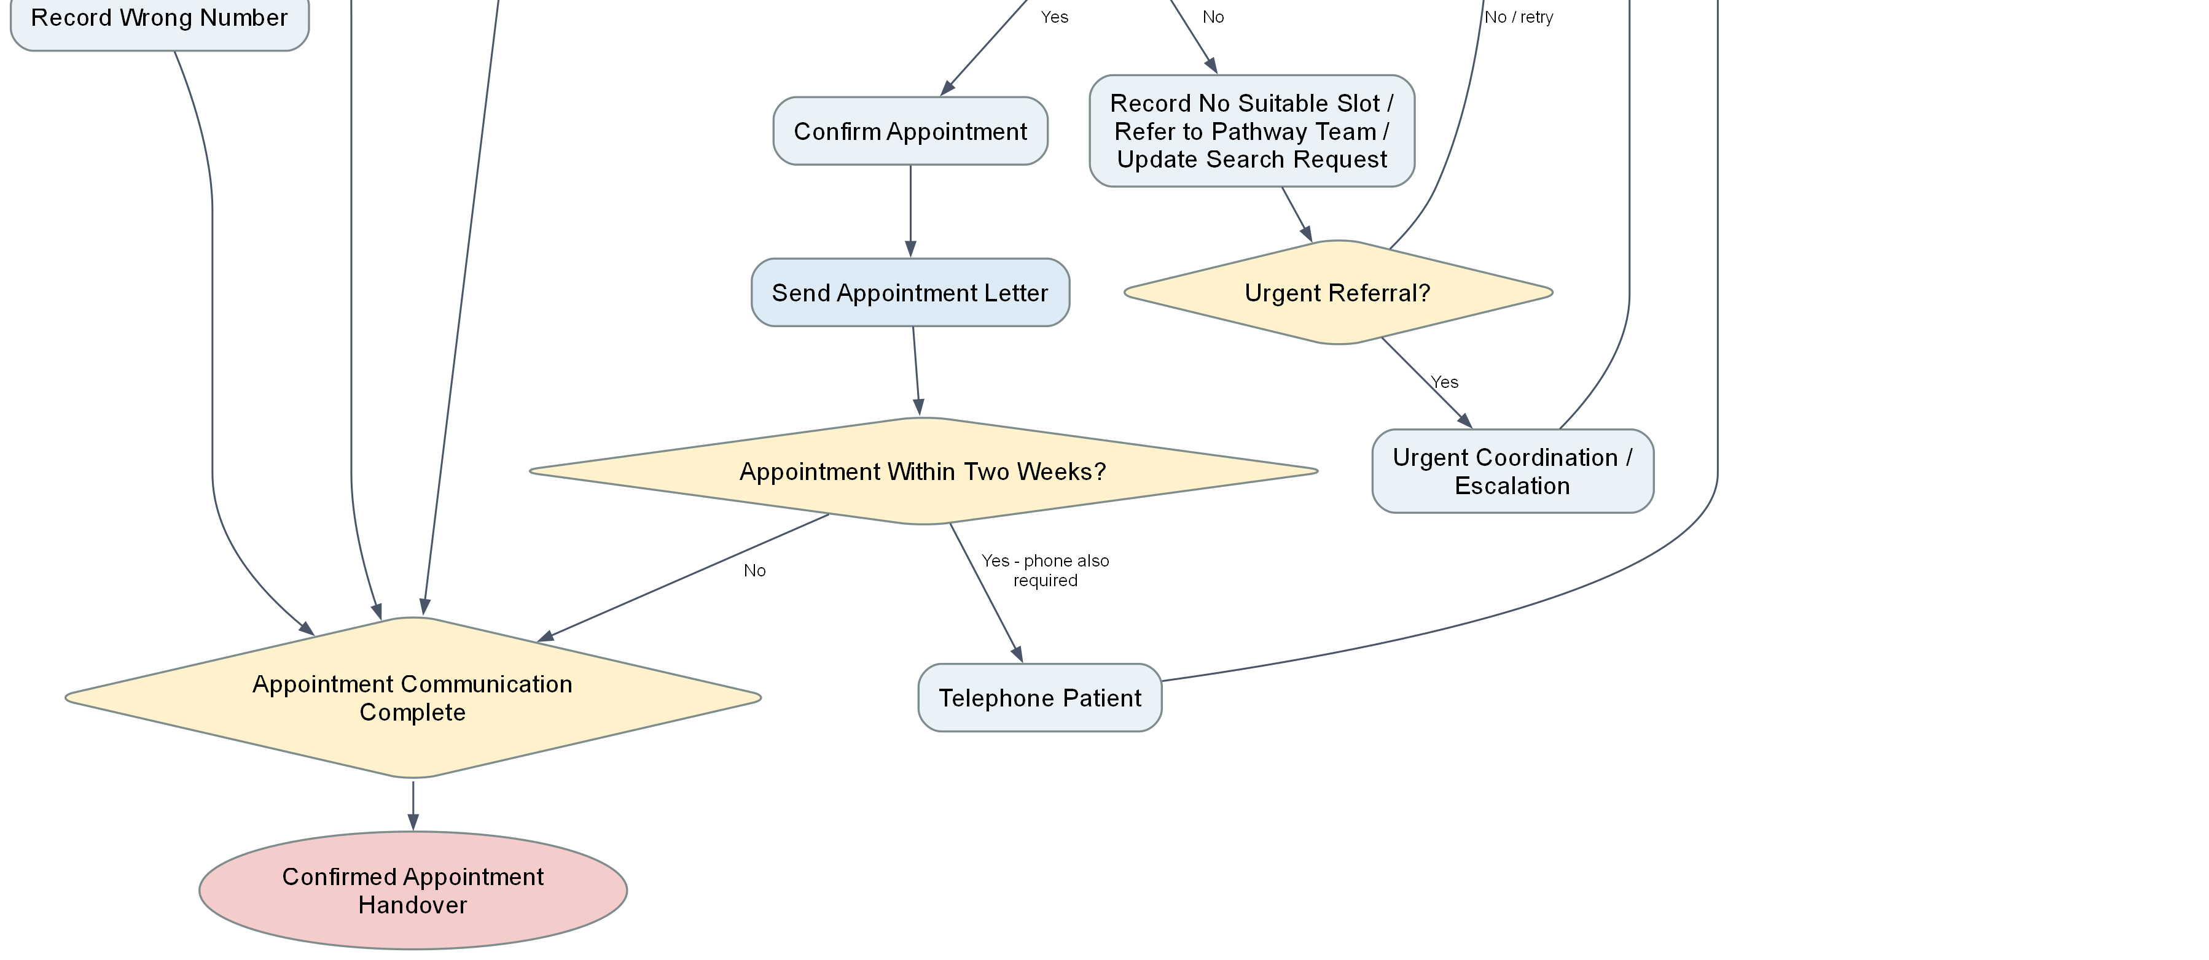
Appointment diagram: patient contact paths
Second decision: appointmentWithinTwoWeeks. Reschedule loops back to the search.
WU JIA WEI / 10
Notes:
Presenter: WU JIA WEI
中文讲稿
这是同一张预约流程图的下半部分。发送预约信件后，若预约日期在十四天内，还要电话联系患者，并记录接通、无人接听、号码错误或要求改期。改期返回重新查号源。当前模型中无人接听和号码错误在记录后仍可到确认交接，因此它记录了结果，但没有实现必须成功联系的额外重拨规则。
Evidence and source paths
D:\Camunda-Workspace\models\assignment\bpmn
C:/Users/huanxi/Desktop/ZUOYE/Case Study - Hospital Patient Referral, Treatment and Administration System.docx
D:\Camunda-Workspace\models\assignment\bpmn\23084364_Appointment_Patient_Communication\Path_Logic_Diagram.docx
All current-version runtime claims require the matching Camunda instance and version. Historical screenshots are labelled as such.

Slide 11
Appointment: the worker controls two gateways
Input / output | Rule in the running logic | Route
requestedSlotAvailable = false | Worker returns slotAvailable = false | Edit booking request and retry
slotAvailable = true | Confirm appointment, send letter | Check 14-day rule
0 to 14 days ahead | appointmentWithinTwoWeeks = true | Telephone contact required
Telephone outcome = RESCHEDULE | New search is needed | Loop to scheduling
The service is simulated. Day 0 and day 14 count; past dates need stronger rejection.
WU JIA WEI / 11
Notes:
Presenter: WU JIA WEI
中文讲稿
预约表单给出 requestedSlotAvailable 和 requestedAppointmentDate。查询 worker 返回 slotAvailable、appointmentDate、appointmentWithinTwoWeeks 和状态。日期按今天到预约日的天数计算，0 到 14 天为 true，所以触发电话任务。号源不存在则进入人工修改表单后重试。这样将服务结果与人工决定分开，但当前日期解析失败会退回默认日期，过去日期也可能报告 SLOT_FOUND，需要增加输入验证。
Evidence and source paths
D:\Camunda-Workspace\models\assignment\bpmn
D:\Camunda-Workspace\models\assignment\External_Workers\src\main\java\org\hospital\workers
All current-version runtime claims require the matching Camunda instance and version. Historical screenshots are labelled as such.

Slide 12
Appointment: normal and exception demonstrations
Normal path
Exception path
Slot available
Date more than 14 days ahead
Letter sent, no phone task
No slot, edit the request, retry
Or choose a date within 14 days
Record the phone outcome
Check slotAvailable and appointmentWithinTwoWeeks in the instance variables.
WU JIA WEI / 12
Notes:
Presenter: WU JIA WEI
中文讲稿
现场正常路径可把 requestedSlotAvailable 设为 true、日期设为十五天后，看到确认和信件，电话网关走 No。异常路径先设 false，看到无号源，修改表单再设 true，观察重试后成功。若日期设为七天后，应该进入电话任务。已有历史截图证明了无电话的完成路径和 worker 输出传入任务，但还不能证明三种演示在当前版本全部通过。
Evidence and source paths
D:\Camunda-Workspace\models\assignment\bpmn
D:\Camunda-Workspace\models\assignment\External_Workers\src\main\java\org\hospital\workers
D:\Camunda-Workspace\models\assignment\evidence\23084364_Appointment_Patient_Communication\54404e0f-98b2-4d6f-b43c-7f3b32c0060f.png
All current-version runtime claims require the matching Camunda instance and version. Historical screenshots are labelled as such.

Slide 13
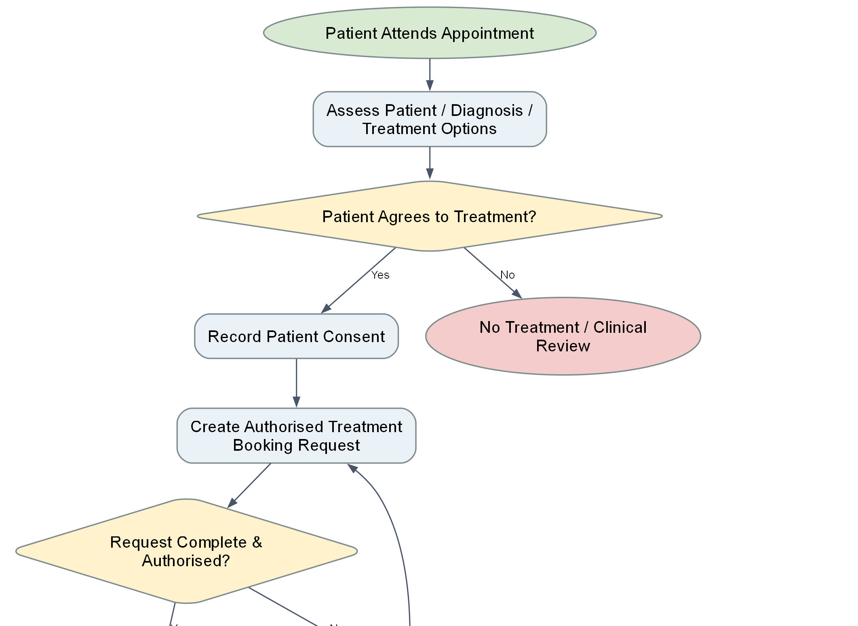
Treatment diagram: consent and authorisation
Consent and authorised request are separate gates before checking resources.
LIN JIA QIANG / 13
Notes:
Presenter: LIN JIA QIANG
中文讲稿
这是治疗图第一段。患者就诊后先做评估并记录是否同意治疗。没有同意就结束治疗子流程，但主流程仍进入诊所信件。若同意，需要授权的治疗请求；未授权时返回修改，不能直接预约治疗。把患者同意和医护授权分别作为门槛，是为了避免把一个签字当作完整的临床批准。
Evidence and source paths
D:\Camunda-Workspace\models\assignment\bpmn
C:/Users/huanxi/Desktop/ZUOYE/Case Study - Hospital Patient Referral, Treatment and Administration System.docx
D:\Camunda-Workspace\models\assignment\bpmn\23084368_Treatment_Chemotherapy\Path_Logic_Diagram.docx
All current-version runtime claims require the matching Camunda instance and version. Historical screenshots are labelled as such.

Slide 14
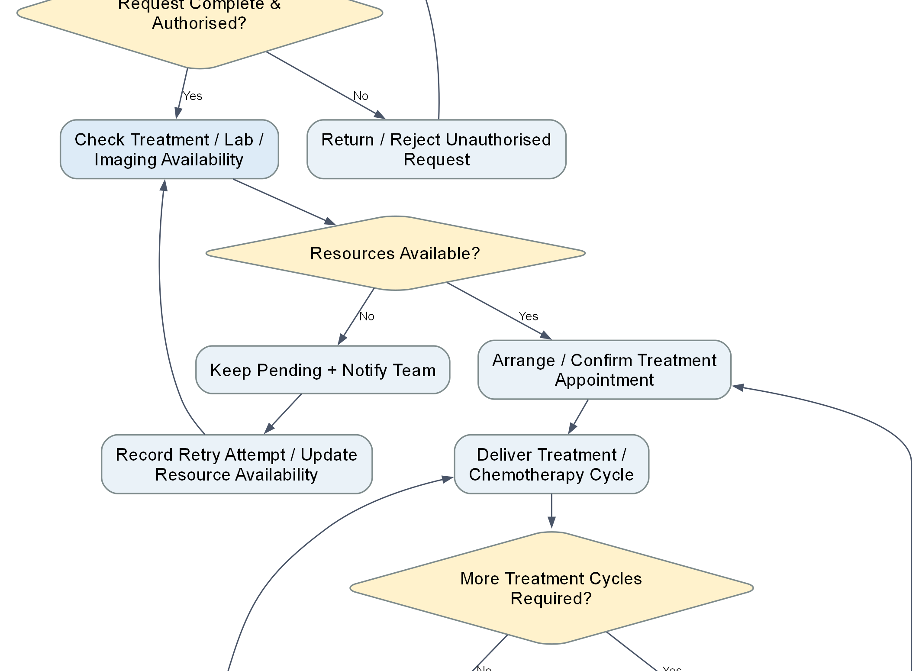
Treatment diagram: resources and cycles
Resource failure returns through an editable retry form; cycle count is a human decision.
LIN JIA QIANG / 14
Notes:
Presenter: LIN JIA QIANG
中文讲稿
这是中间段。授权后 worker 返回资源是否可用。不可用则记录待处理、通知团队，并重新打开治疗请求表单修改资源可用性后再检查。可用才安排治疗。每一疗程后由人工回答是否还有更多周期。这个循环不是自动计数，numberOfCycles 只是文本字段，moreCycles 才决定是否继续。
Evidence and source paths
D:\Camunda-Workspace\models\assignment\bpmn
D:\Camunda-Workspace\models\assignment\External_Workers\src\main\java\org\hospital\workers
D:\Camunda-Workspace\models\assignment\bpmn\23084368_Treatment_Chemotherapy\Path_Logic_Diagram.docx
All current-version runtime claims require the matching Camunda instance and version. Historical screenshots are labelled as such.

Slide 15
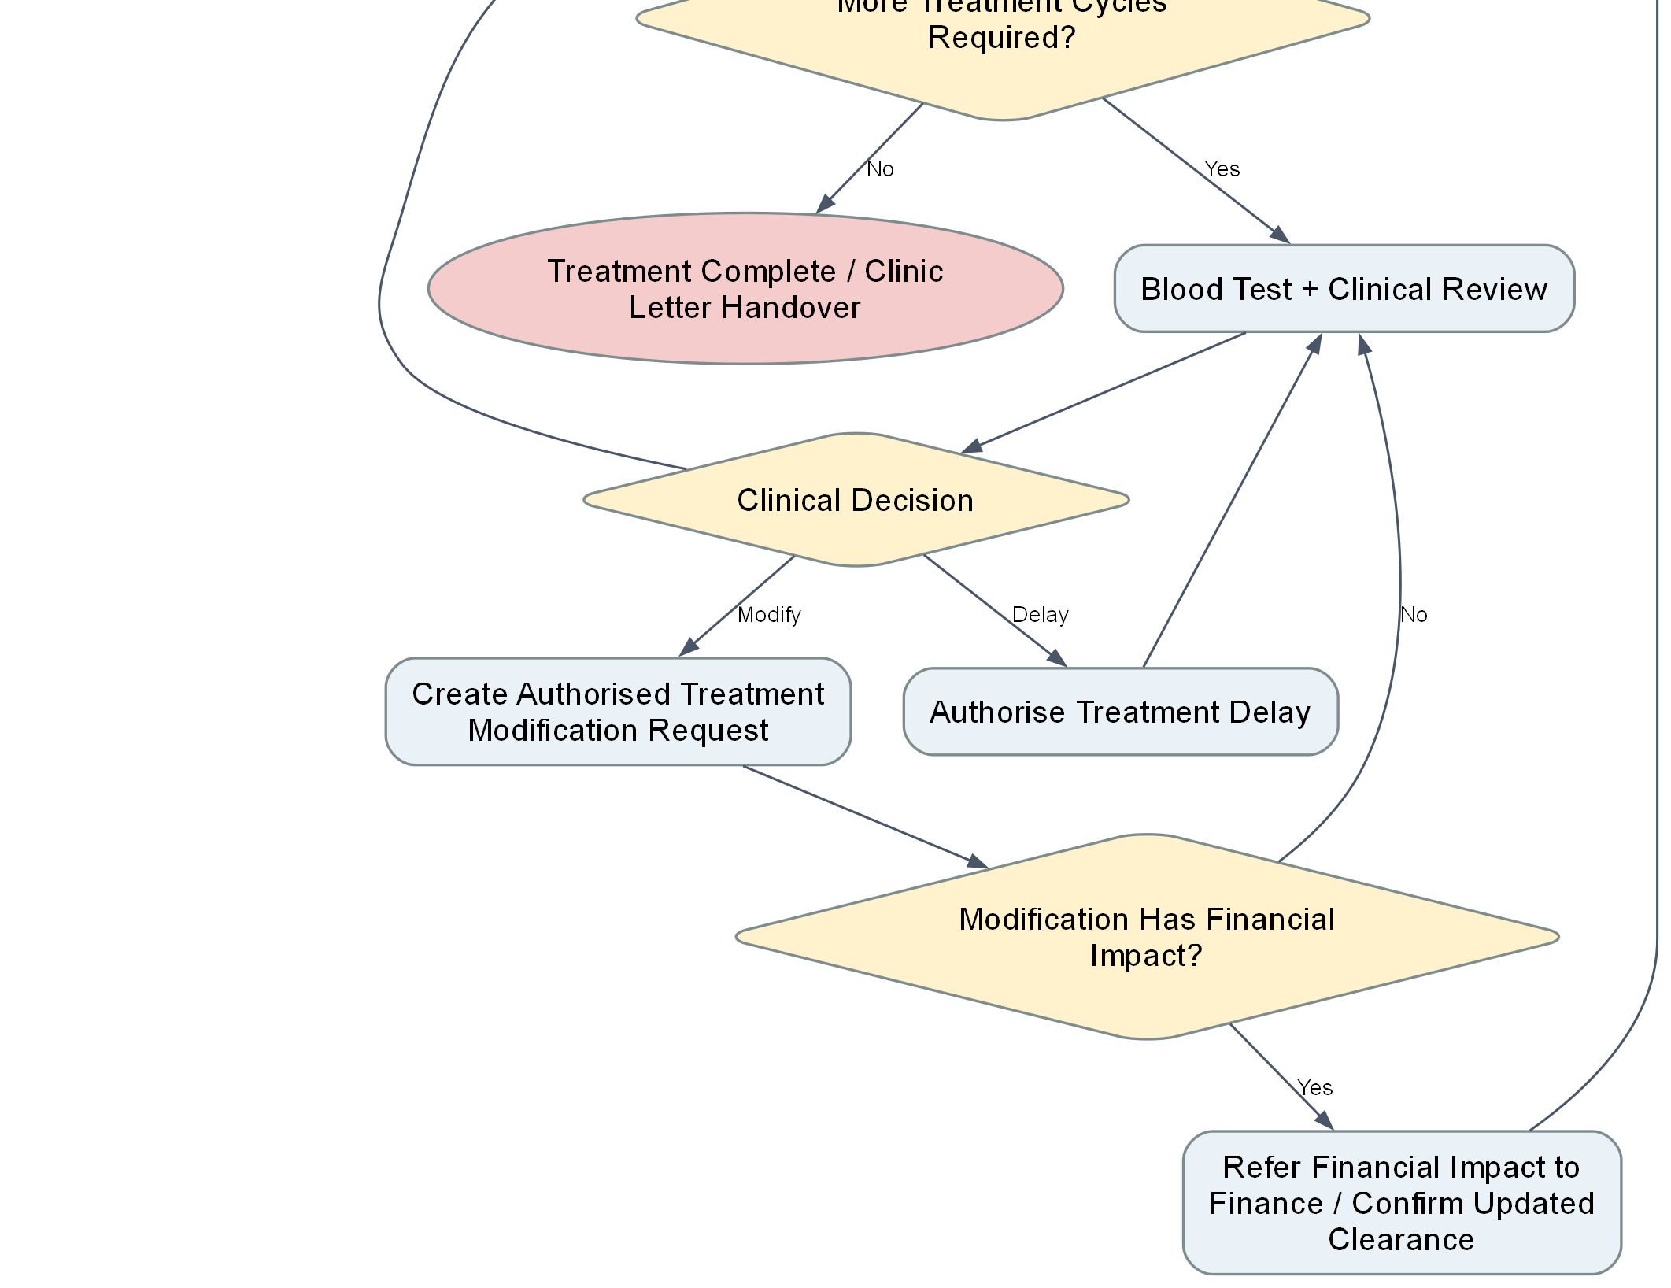
Treatment diagram: clinical review branches
Clinical decisions are human; financial impact requires a manual follow-up in this model.
LIN JIA QIANG / 15
Notes:
Presenter: LIN JIA QIANG
中文讲稿
这是最后一段。临床复核可以继续、延迟或修改。继续进入下一周期，延迟返回复核，修改会检查是否有财务影响。若有财务影响，流程进入人工确认更新清算后再预约。这里的财务影响目前只是人工任务，没有新的显式 financeApproval 变量或重新调用财务子流程，所以现场不能宣称它已自动完成再审批。
Evidence and source paths
D:\Camunda-Workspace\models\assignment\bpmn
C:/Users/huanxi/Desktop/ZUOYE/Case Study - Hospital Patient Referral, Treatment and Administration System.docx
D:\Camunda-Workspace\models\assignment\bpmn\23084368_Treatment_Chemotherapy\Path_Logic_Diagram.docx
All current-version runtime claims require the matching Camunda instance and version. Historical screenshots are labelled as such.

Slide 16
Treatment: how to exercise the important paths
Scenario | Set the input | Expected branch
Declined treatment | patientConsent = false | No-treatment end; master still calls letter
Unauthorised request | treatmentAuthorised = false | Return for correction
Unavailable resource | requestedTreatmentAvailable = false | Pending, edit form, then retry
Cycle review | moreCycles = true; choose DELAY or MODIFY | Review loop or financial-impact check
Do not call resource simulation a real booking or manual financial follow-up an automated approval.
LIN JIA QIANG / 16
Notes:
Presenter: LIN JIA QIANG
中文讲稿
演示时先用 patientConsent=false 展示不治疗结尾和随后信件交接。再用 patientConsent=true、treatmentAuthorised=false 展示返回修正。把授权改为 true，但资源设为 false，展示待处理与重新填写表单；最后资源改为 true，展示预约和周期复核。现有运行轨迹支持部分同意、资源和疗程路径，但最新主流程端到端仍需重跑。
Evidence and source paths
D:\Camunda-Workspace\models\assignment\bpmn
D:\Camunda-Workspace\models\assignment\External_Workers\src\main\java\org\hospital\workers
D:\Camunda-Workspace\models\assignment\evidence\23084368_Treatment_Chemotherapy\7160e529-2306-4d10-904c-3443d1df7edf.png
All current-version runtime claims require the matching Camunda instance and version. Historical screenshots are labelled as such.

Slide 17
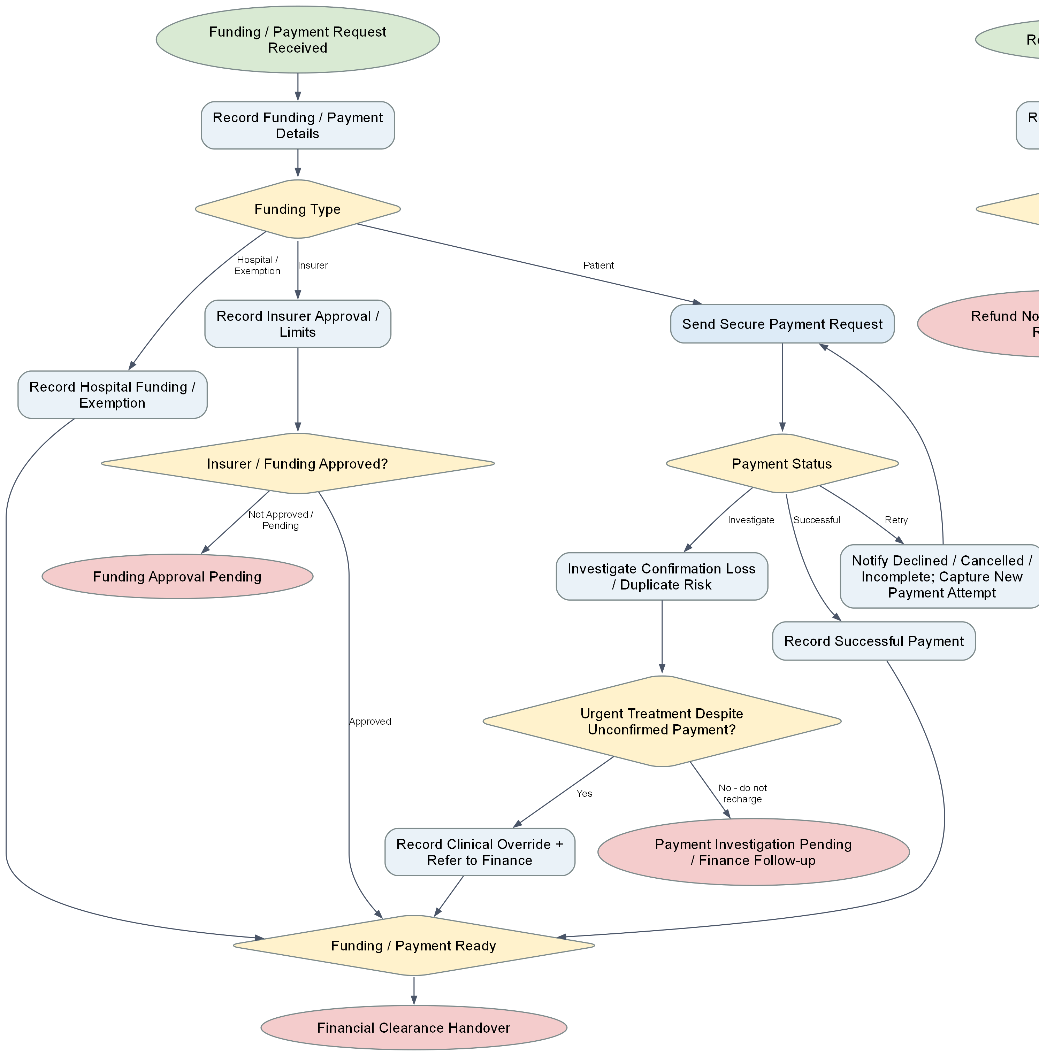
Finance diagram: funding and payment
Payment result and funding route both lead to a clear financial handover or pending endpoint.
WU TONG YU / 17
Notes:
Presenter: WU TONG YU
中文讲稿
这是财务流程图左侧。资金来源有医院承担、保险和患者付款三条路线。保险要记录审批；患者付款由模拟支付 worker 返回状态。SUCCESSFUL 走清算，DECLINED、CANCELLED、INCOMPLETE 可以修改输入再试；CONFIRMATION_LOST 和 DUPLICATE_RISK 先调查，避免盲目重复扣款。紧急治疗允许记录临床例外后继续，但这个布尔选择并不等于真正实现身份权限。
Evidence and source paths
D:\Camunda-Workspace\models\assignment\bpmn
D:\Camunda-Workspace\models\assignment\External_Workers\src\main\java\org\hospital\workers
D:\Camunda-Workspace\models\assignment\bpmn\23084362_Funding_Payment_Refund\Path_Logic_Diagram.docx
All current-version runtime claims require the matching Camunda instance and version. Historical screenshots are labelled as such.

Slide 18
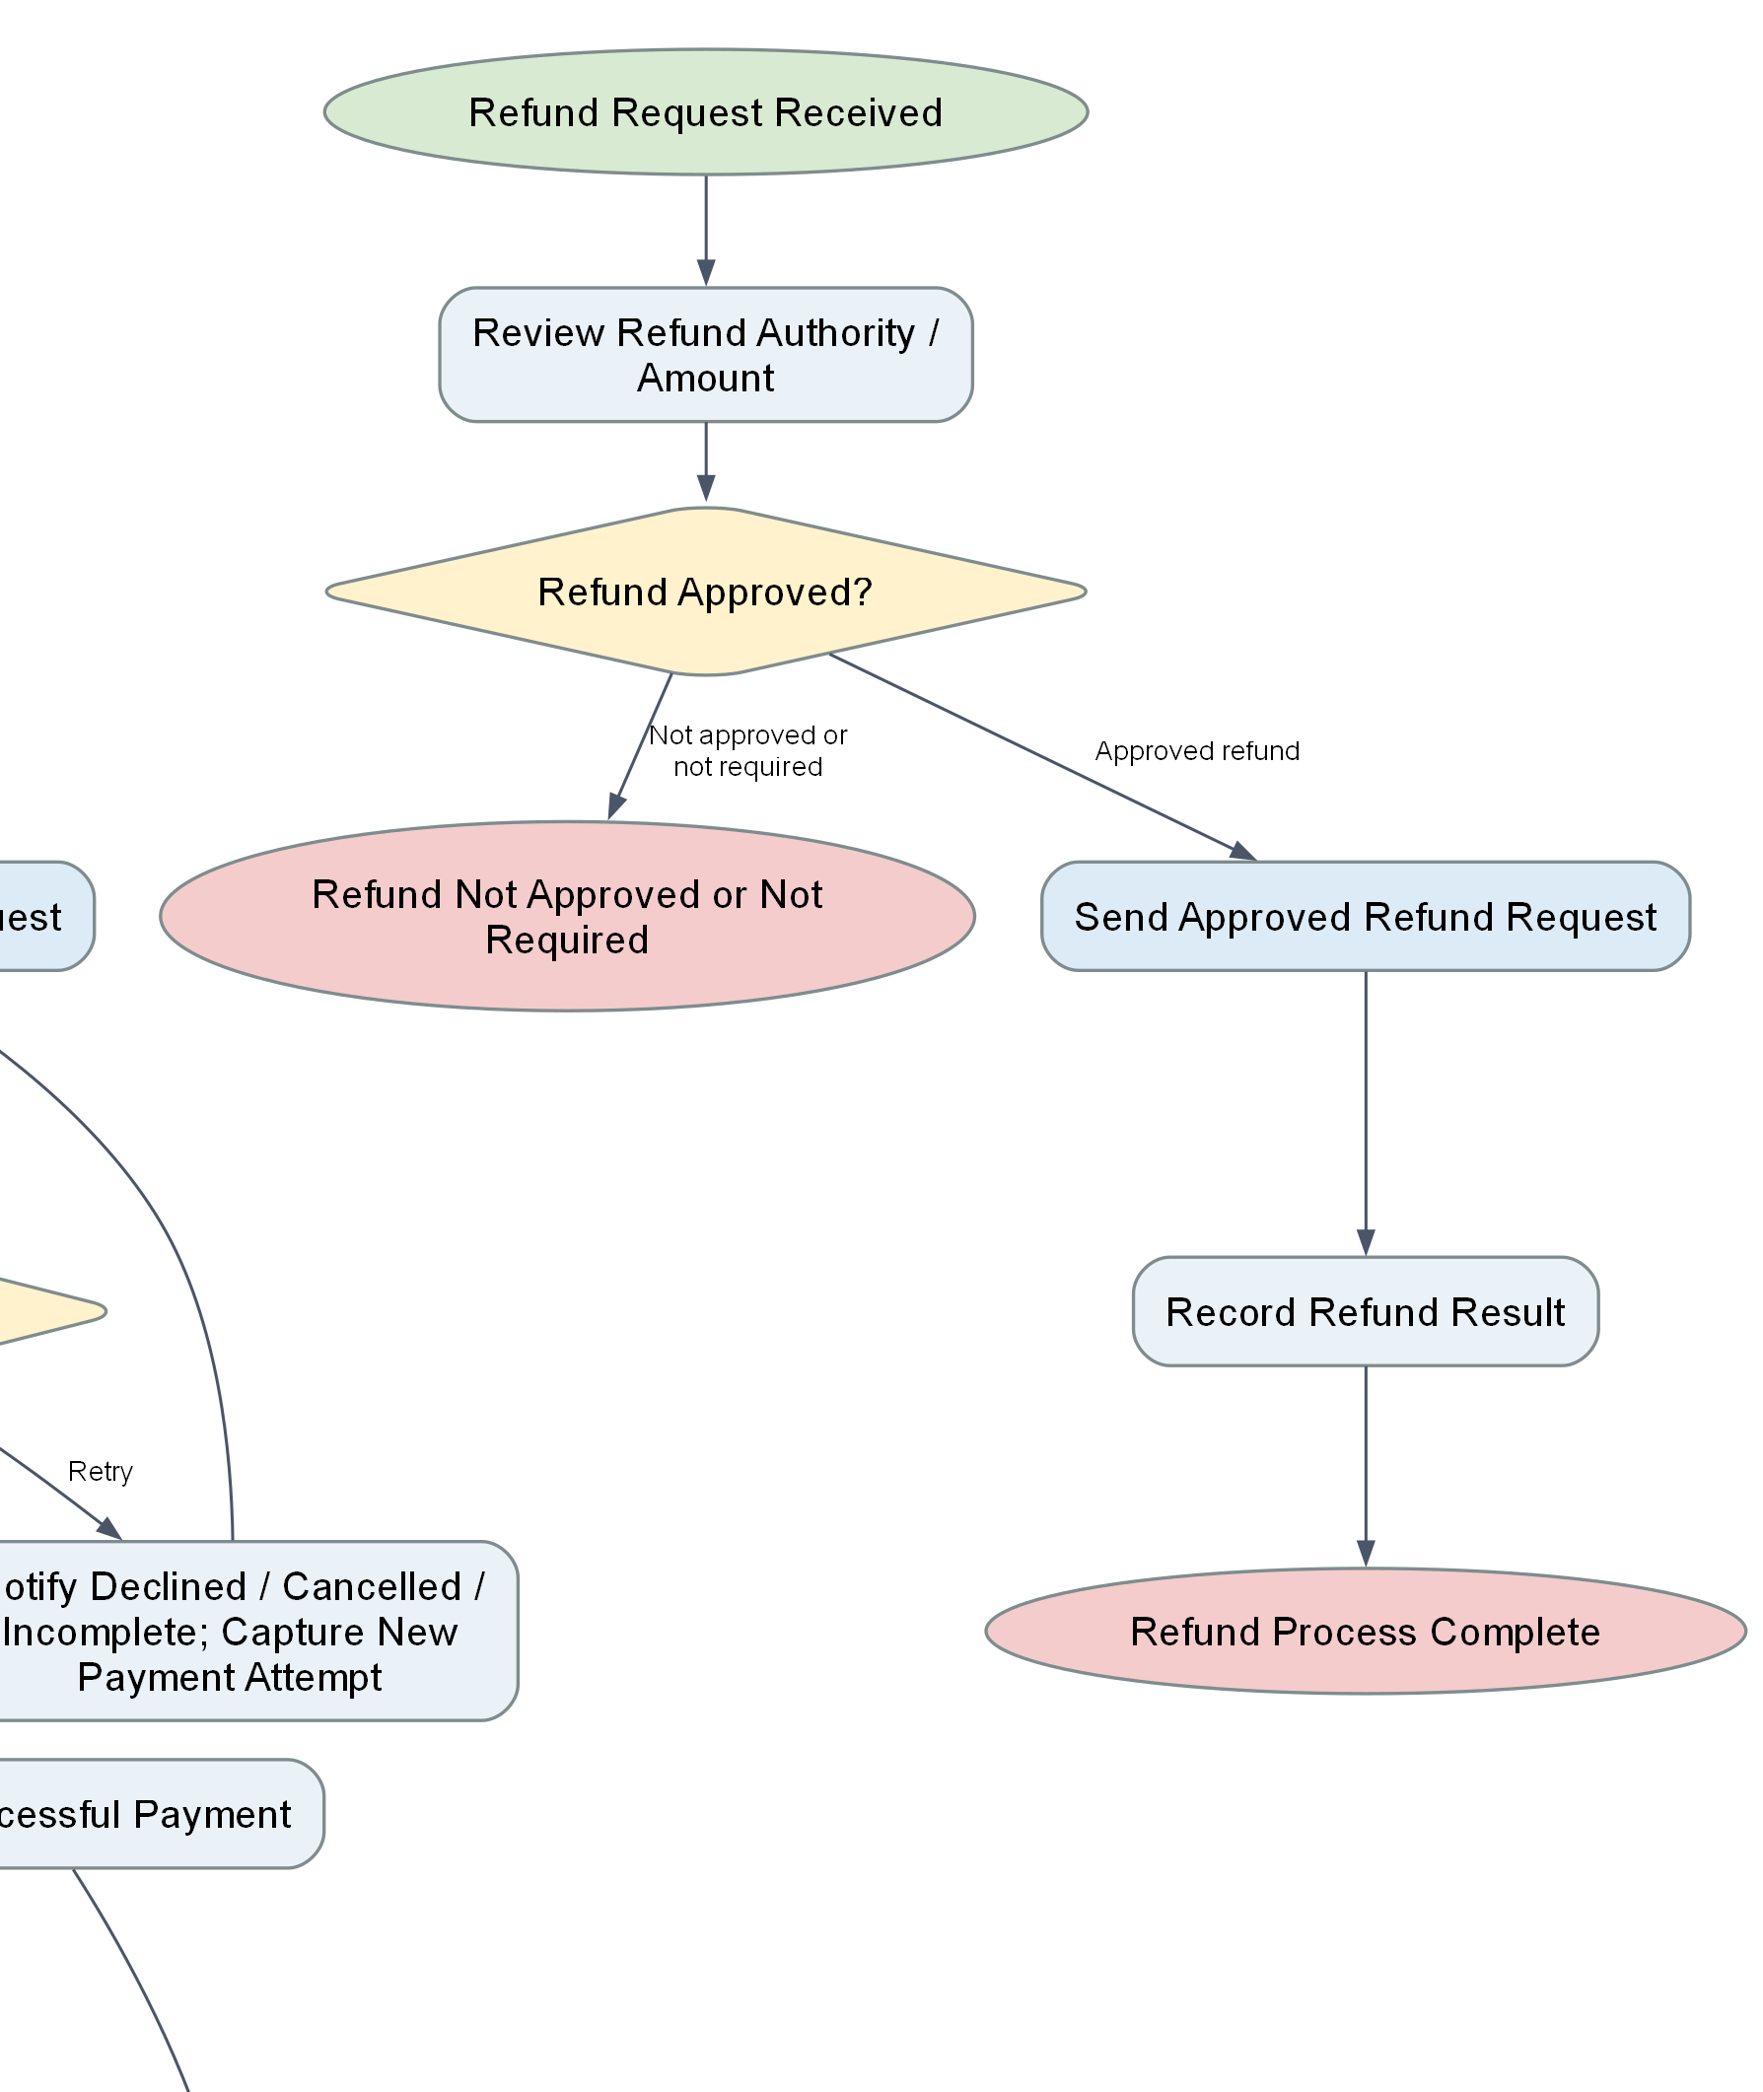
Finance diagram: independent refund route
Refund requires both necessity and approval. It does not run as part of every patient journey.
WU TONG YU / 18
Notes:
Presenter: WU TONG YU
中文讲稿
退款在同一张图右侧，但从独立的退款请求消息启动。先由 Finance 审核是否需要退款及是否批准。只有 refundRequired 和 refundApproved 同时为 true 才调用退款 worker。未批准或不需要退款走不同结尾。这样避免仅凭批准字段就执行一次不必要退款。当前退款服务只模拟返回状态和参考号，并没有真实支付渠道。
Evidence and source paths
D:\Camunda-Workspace\models\assignment\bpmn
D:\Camunda-Workspace\models\assignment\External_Workers\src\main\java\org\hospital\workers
D:\Camunda-Workspace\models\assignment\bpmn\23084362_Funding_Payment_Refund\Path_Logic_Diagram.docx
All current-version runtime claims require the matching Camunda instance and version. Historical screenshots are labelled as such.

Slide 19
Finance: why lost confirmation is different
Worker result | Process response | Reason
SUCCESSFUL | Record payment, permit clearance | Confirmed outcome
DECLINED / CANCELLED / INCOMPLETE | Edit details, then retry | Attempt did not complete
CONFIRMATION_LOST / DUPLICATE_RISK | Investigate; no automatic recharge | Outcome is uncertain
Urgent clinical override | Record exception and refer to Finance | Care may need to continue
No durable idempotency store exists in the current worker layer.
WU TONG YU / 19
Notes:
Presenter: WU TONG YU
中文讲稿
如果支付被明确拒绝，系统可以收集修正后的资料再尝试。若支付确认丢失，不能知道钱是否已经扣走，直接重试可能产生重复扣款，所以流程进入调查。worker 在 CONFIRMATION_LOST 或 DUPLICATE_RISK 下只设置调查标志，不产生新的 transactionReference。这里仍没有持久化幂等键，因此当前实现只能分流风险，不能保证外部系统绝不重复。
Evidence and source paths
D:\Camunda-Workspace\models\assignment\bpmn
D:\Camunda-Workspace\models\assignment\External_Workers\src\main\java\org\hospital\workers
C:/Users/huanxi/Desktop/ZUOYE/Case Study - Hospital Patient Referral, Treatment and Administration System.docx
All current-version runtime claims require the matching Camunda instance and version. Historical screenshots are labelled as such.

Slide 20
Finance: demonstration and evidence boundary
Primary funding demo
Separate refund demo
Hospital / exemption gives clearance
Patient payment with lost confirmation goes to investigation
Required = false blocks refund
Required = true AND approved = true permits the worker
Historical screenshot shows hospital funding only. Payment and refund paths need their own instance evidence.
WU TONG YU / 20
Notes:
Presenter: WU TONG YU
中文讲稿
现场先走医院承担路线，看到清算交接。再把 fundingType 设为患者、paymentScenario 设为 CONFIRMATION_LOST，应该进入调查而不是自动重付；若无紧急例外，会到待财务跟进的终点。退款另起实例，先设 refundRequired=false、refundApproved=true，验证不会调用 worker，再两者都为 true 测批准路径。现有截图只覆盖医院承担分支，后两条应当现场或补录实例证明。
Evidence and source paths
D:\Camunda-Workspace\models\assignment\bpmn
D:\Camunda-Workspace\models\assignment\External_Workers\src\main\java\org\hospital\workers
D:\Camunda-Workspace\models\assignment\evidence\23084362_Funding_Payment_Refund\96a3e3dc-6966-435f-941e-b69da3f41411.png
All current-version runtime claims require the matching Camunda instance and version. Historical screenshots are labelled as such.

Slide 21
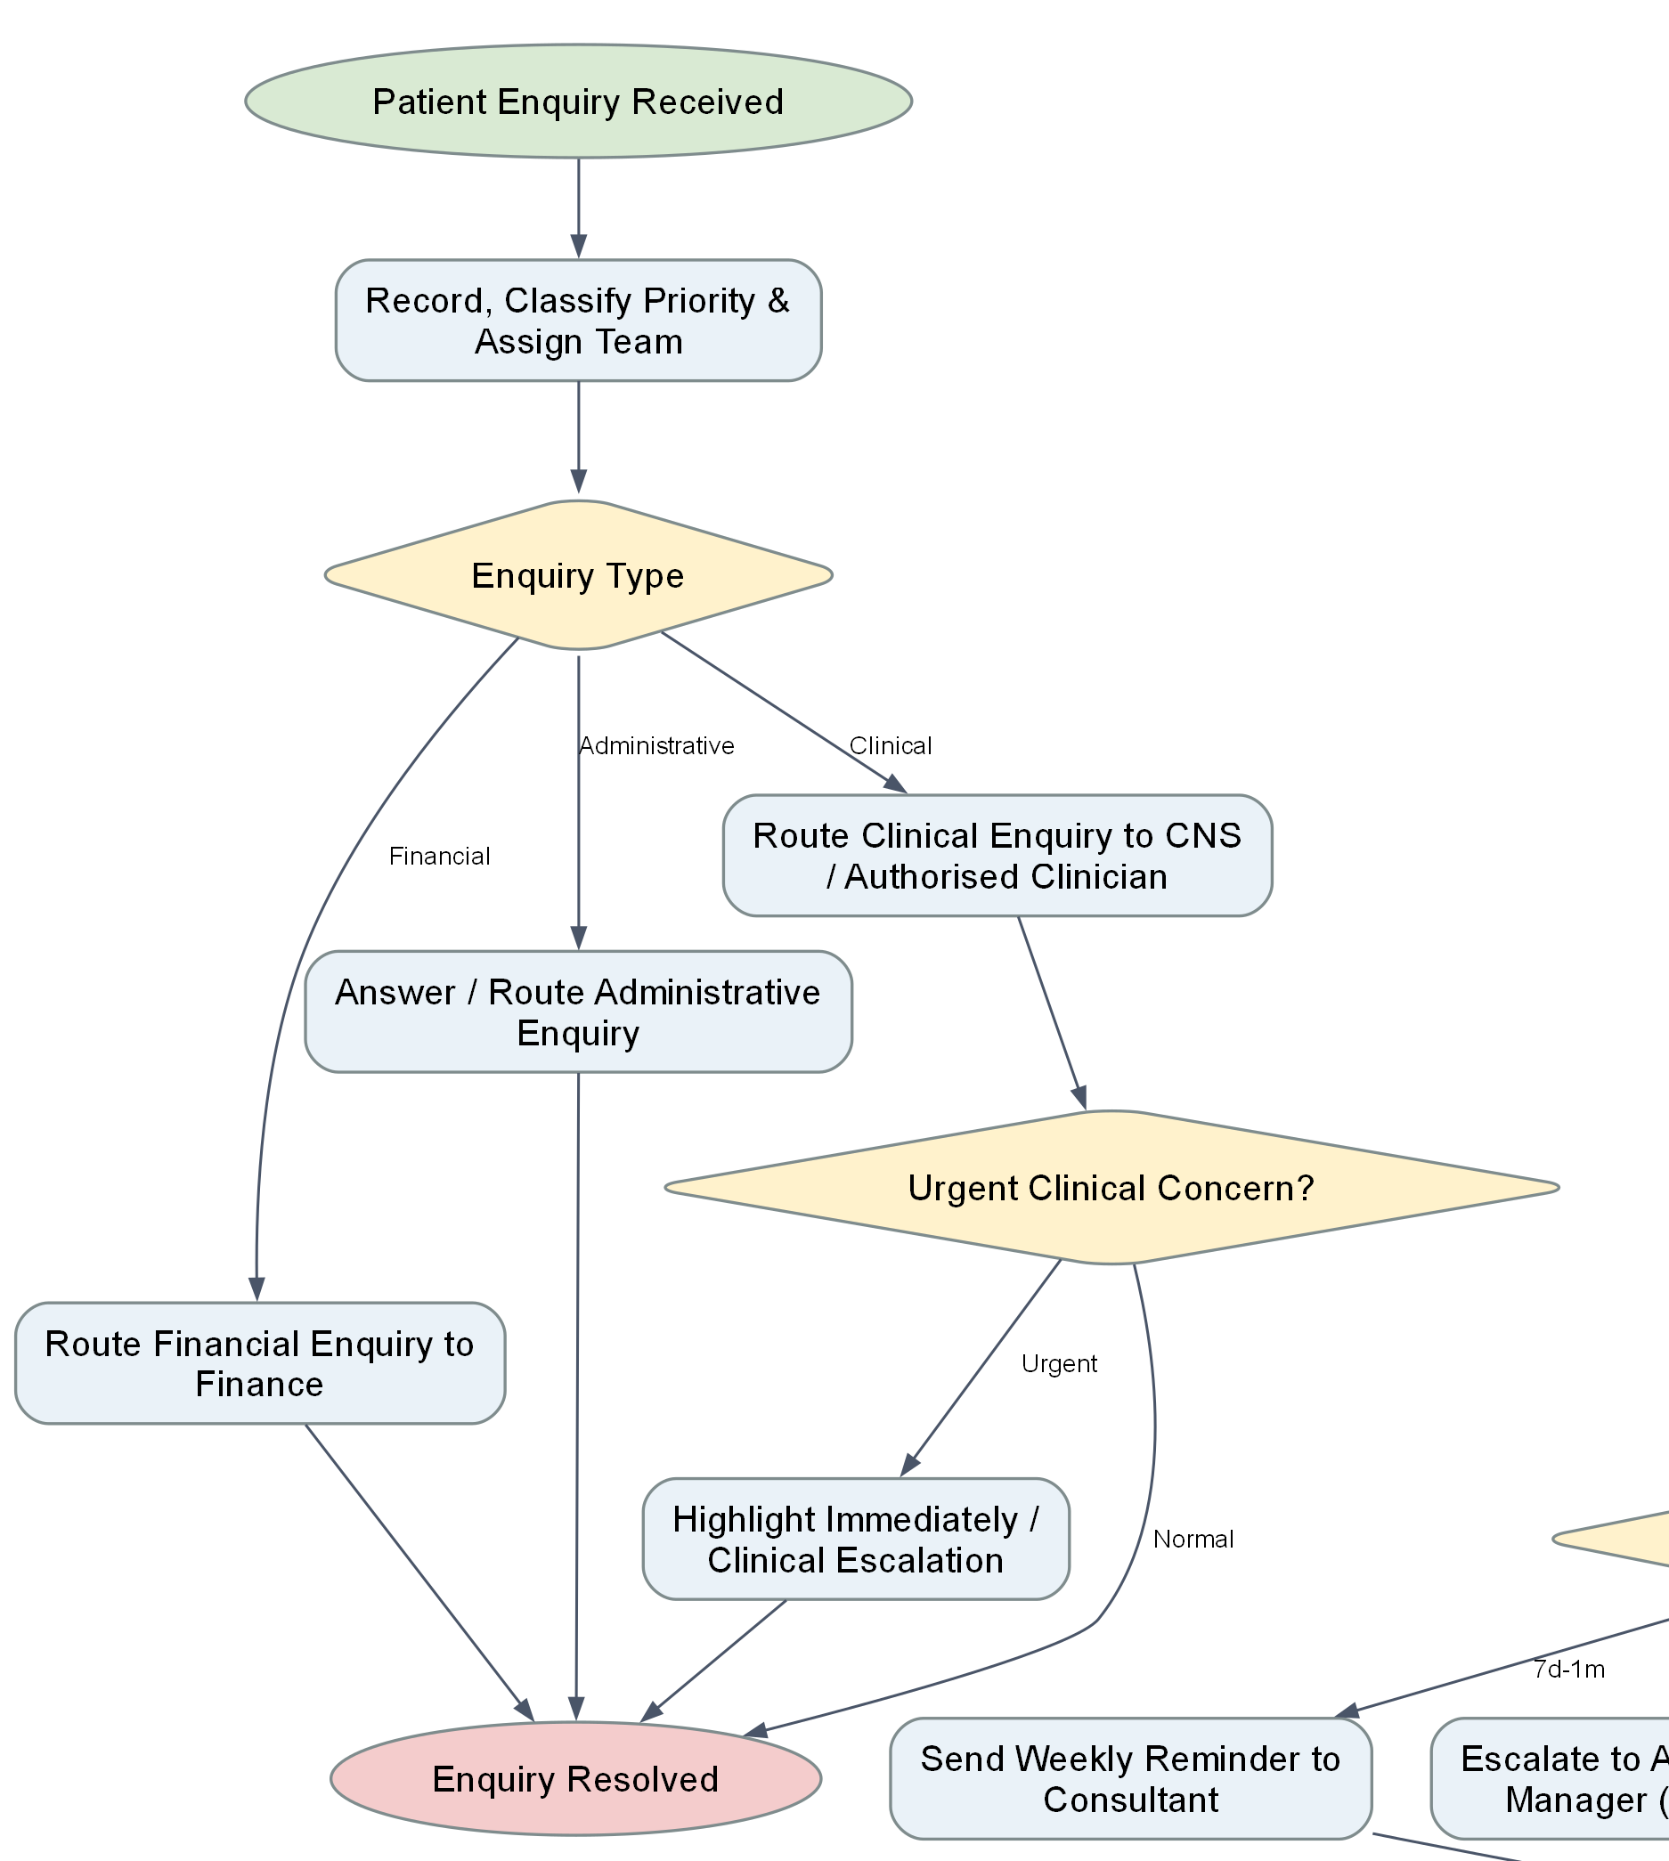
Enquiry diagram: classify and route
Classification decides who handles the enquiry; urgentClinicalConcern decides escalation.
XIAO YU YING / 21
Notes:
Presenter: XIAO YU YING
中文讲稿
这张图左侧是患者咨询，从独立消息入口开始。先记录类别、优先级和是否有紧急临床问题。行政问题由行政团队处理，财务问题给 Finance，临床问题给 CNS 或授权临床人员；紧急临床关注会额外升级。呼叫人员本身不提供临床建议。当前 enquiryPriority 被记录，但实际紧急分支看的是 urgentClinicalConcern。
Evidence and source paths
D:\Camunda-Workspace\models\assignment\bpmn
C:/Users/huanxi/Desktop/ZUOYE/Case Study - Hospital Patient Referral, Treatment and Administration System.docx
D:\Camunda-Workspace\models\assignment\bpmn\24000813_Enquiry_ClinicLetter_Monitoring\Path_Logic_Diagram.docx
All current-version runtime claims require the matching Camunda instance and version. Historical screenshots are labelled as such.

Slide 22
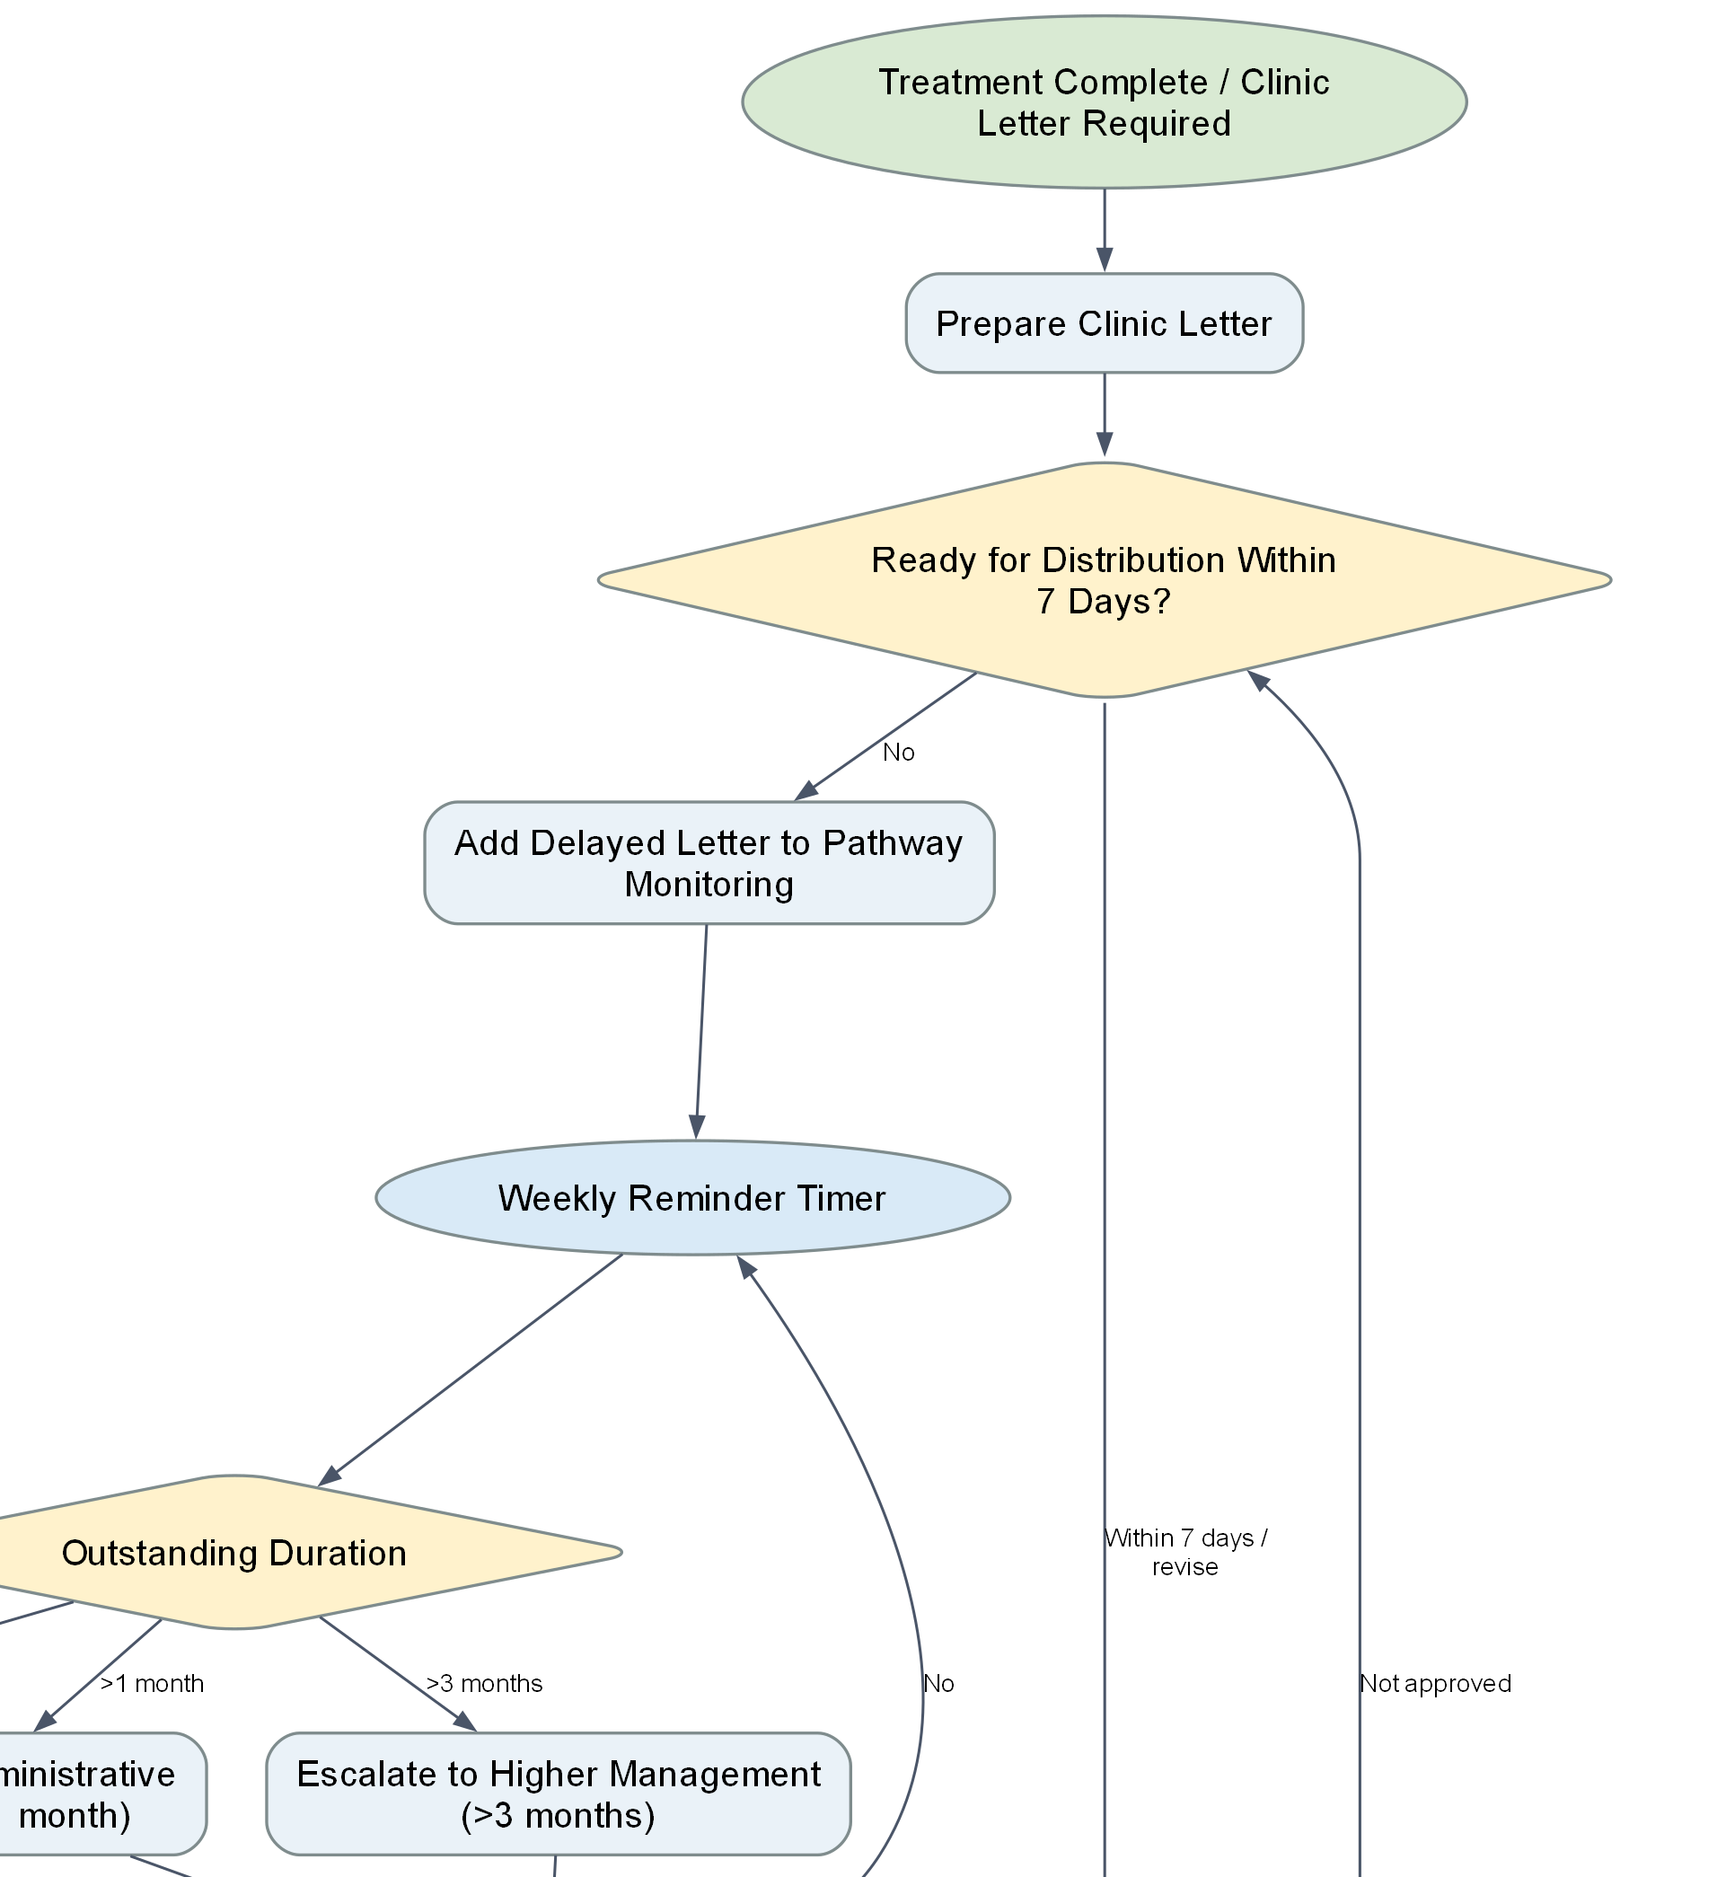
Clinic letter diagram: draft and approval
Clinical approval precedes administrative recipient checking and distribution.
XIAO YU YING / 22
Notes:
Presenter: XIAO YU YING
中文讲稿
这张图右侧上半部分是信件流程。准备临床内容后看七天内能否完成；在正常路径中，临床人员批准内容后，行政人员再核对收件人，最后由发送 worker 返回已发送状态。worker 自身也检查 clinicLetterApproved=true。把临床内容批准和行政收件人核对分开，是为了避免行政任务代替临床判断。拒绝审批会回到时限网关，但当前没有明确回到可编辑正文的任务，这是一个缺口。
Evidence and source paths
D:\Camunda-Workspace\models\assignment\bpmn
D:\Camunda-Workspace\models\assignment\External_Workers\src\main\java\org\hospital\workers
C:/Users/huanxi/Desktop/ZUOYE/Case Study - Hospital Patient Referral, Treatment and Administration System.docx
D:\Camunda-Workspace\models\assignment\bpmn\24000813_Enquiry_ClinicLetter_Monitoring\Path_Logic_Diagram.docx
All current-version runtime claims require the matching Camunda instance and version. Historical screenshots are labelled as such.

Slide 23
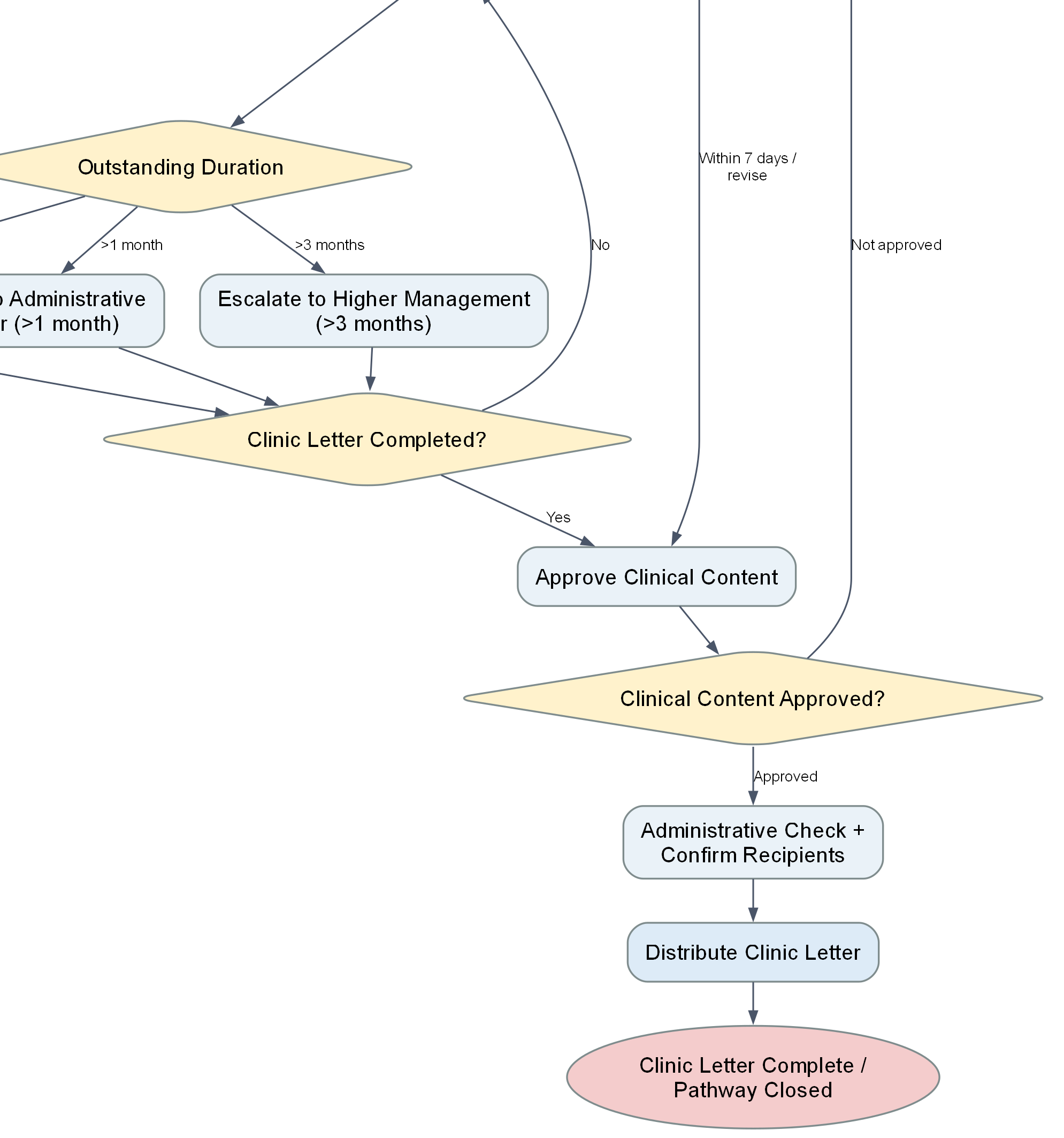
Clinic letter diagram: delay and escalation
The P7D timer is real; the age band and initial seven-day status are entered by a person.
XIAO YU YING / 23
Notes:
Presenter: XIAO YU YING
中文讲稿
右侧下半部分是延误监控。进入监控后确实有 P7D 的七天定时器。之后按人工选的延期区间发提醒或升级：七天到一个月提醒顾问，超过一个月给行政经理，超过三个月给更高管理层。若仍未完成，再等七天。限制是初始七天和年龄区间由表单填写，且主流程要等治疗子流程结束才启动信件，因此不能证明每次就诊都在七天内发出信件。
Evidence and source paths
D:\Camunda-Workspace\models\assignment\bpmn
C:/Users/huanxi/Desktop/ZUOYE/Case Study - Hospital Patient Referral, Treatment and Administration System.docx
D:\Camunda-Workspace\models\assignment\bpmn\24000813_Enquiry_ClinicLetter_Monitoring\Path_Logic_Diagram.docx
All current-version runtime claims require the matching Camunda instance and version. Historical screenshots are labelled as such.

Slide 24
Clinic letter: approval and delay demonstrations
Path to show | Input / observation | Expected result
Unapproved letter | clinicLetterApproved = false | No distribution
Approved letter | Approval true; recipients checked | Send task completes
Delayed letter | Manual age band + P7D wait | Reminder or escalation
Urgent clinical enquiry | urgentClinicalConcern = true | Clinical escalation
The completed historical screenshot covers the approved letter path only.
XIAO YU YING / 24
Notes:
Presenter: XIAO YU YING
中文讲稿
现场可先准备一封信，把 clinicLetterApproved 设为 false，观察它不能进入发送；改为 true 后通过行政核对并发送。延误路径可以展示当前模型和监控表单，若运行环境不方便快进七天，不能临时缩短定时器后说这就是原流程。历史实例完成过批准后发送路径，但未证明周提醒和长延误升级已执行。还可以独立启动咨询，验证财务与临床问题分流。
Evidence and source paths
D:\Camunda-Workspace\models\assignment\bpmn
D:\Camunda-Workspace\models\assignment\External_Workers\src\main\java\org\hospital\workers
D:\Camunda-Workspace\models\assignment\evidence\24000813_Enquiry_ClinicLetter_Monitoring\213f8afd-02af-4f82-b9e3-3564cac0618d.png
All current-version runtime claims require the matching Camunda instance and version. Historical screenshots are labelled as such.

Slide 25
End-to-end demonstration sequence
Speaker | Set or complete | What to show in Camunda
Deng | Complete intake; ACCEPT | Accepted handover
Wu | Available slot; choose date | Letter and phone branch
Tong | Hospital funding or payment result | financialClearance
Lin | Consent, authorisation, resources | Treatment result
Xiao | Approve letter; check recipients | Letter distribution
Run one normal journey plus one chosen exception. Keep version, instance key and final status.
WU JIA WEI / 25
Notes:
Presenter: WU JIA WEI
中文讲稿
五个人现场演示时，最好固定一组输入，依次经过转诊接受、预约有号源、医院承担费用、患者同意且治疗获授权、资源可用、信件批准发送。吴家伟负责展示主流程的实例号和子流程版本，每位负责人解释自己的网关和结果。另选一条异常路径演示，比如无号源修改后重试。每一步截取变量、路径和终点，以便老师追问时可以回到同一实例。
Evidence and source paths
D:\Camunda-Workspace\models\assignment\bpmn
D:\Camunda-Workspace\models\assignment\Plan and contribution.docx
All current-version runtime claims require the matching Camunda instance and version. Historical screenshots are labelled as such.

Slide 26
Feedback response: decision, change, outcome
Problem observed | Decision and implemented change | Outcome still to confirm
Treatment could begin beside finance | Finance clearance before treatment | Current master instance
Retry without editable data | Reopen the right form on retry | No-slot, resource and payment reruns
Approval boundary unclear | Separate clinic approval; two-part refund gate | Negative branches in engine
No completed tutor feedback record was supplied. This table presents verified internal changes.
WU TONG YU / 26
Notes:
Presenter: WU TONG YU
中文讲稿
课程要求每条导师反馈都有决定、行动、证据和结果。我们现在只有团队自评以及前后文件差异，没有填好的导师反馈，所以不能虚构导师原话。当前可以展示三类实际改变：财务先于治疗、重试前可修改输入、信件和退款增加审批控制。结果层面只能说静态配置与十一项 Java 逻辑测试已核对，受影响的最新 Camunda 分支还要重跑。若老师提供反馈，再用原话、日期、责任人和运行结果补齐闭环。
Evidence and source paths
C:/Users/huanxi/Desktop/ZUOYE/UFCEP6-0-3_Presentation_Assessment_Specification V2 - Tagged.pdf
D:\Camunda-Workspace\models\assignment\Strengths_and_Weaknesses.docx
D:\Camunda-Workspace\models\assignment\bpmn
D:\Camunda-Workspace\models\assignment\External_Workers\src\test\java\org\hospital\workers\WorkerLogicSmokeTest.java
D:\Camunda-Workspace\models\assignment\.presentation_work\code_validation\test_results.txt
All current-version runtime claims require the matching Camunda instance and version. Historical screenshots are labelled as such.

Slide 27
Plan evaluation: what the records can support
Plan item | Recorded estimate | Observed status
Sprint 1 models and integration | 40 hours | Six processes present; current master run open
Sprint 2 forms and workers | 35 hours | 14 forms and six service job types present
Component logic tests | Part of Sprint 2 | 11 existing tests passed locally
Actual hours and schedule variance | No actual log | Cannot calculate variance
A completed artefact, a passed logic test and a completed process instance are different evidence.
WU TONG YU / 27
Notes:
Presenter: WU TONG YU
中文讲稿
现有计划给 Sprint 1 估计四十小时、Sprint 2 估计三十五小时，总共七十五小时。它是预计工作量，不是实际工时。模型和表单已经存在，原计划中的 Java 组件测试现在可提供十一项通过的结果；但是最新主流程正常与异常实例尚未完整证明。没有任务实际日期或耗时，我们无法计算工时偏差，也不能声称完全按计划交付。下一次迭代应给集成和测试任务明确第一负责人、完成条件和版本证据。
Evidence and source paths
C:/Users/huanxi/Desktop/ZUOYE/UFCEP6-0-3_Presentation_Assessment_Specification V2 - Tagged.pdf
D:\Camunda-Workspace\models\assignment\Plan and contribution.docx
D:\Camunda-Workspace\models\assignment\.presentation_work\code_validation\test_results.txt
All current-version runtime claims require the matching Camunda instance and version. Historical screenshots are labelled as such.

Slide 28
Release readiness and likely tutor questions
Ready to explain
Still required for Release 2
Each owner has a source diagram
Each path has an input and expected result
11 component tests passed
Current master instance evidence
Actual tutor feedback and response
Actual delivery dates and effort
Presentation requirement: development, feedback response and plan evaluation supported by evidence.
XIAO YU YING / 28
Notes:
Presenter: XIAO YU YING
中文讲稿
老师最可能追问：为什么先财务后治疗、拒绝治疗为何仍需信件、十四天电话如何判定、确认丢失能否重试、信件七天是否真的自动保证。回答要指出具体变量和网关，同时承认当前限制。现在完成的是一个可展示的工作流原型；六种外部服务是模拟，任务泳道尚未实现权限控制，信件时限未从就诊时间自动计算，最新主流程的完整验证与真实反馈记录还需补齐。五个人的详细问答在讲稿末尾。
Evidence and source paths
C:/Users/huanxi/Desktop/ZUOYE/UFCEP6-0-3_Presentation_Assessment_Specification V2 - Tagged.pdf
C:/Users/huanxi/Desktop/ZUOYE/Case Study - Hospital Patient Referral, Treatment and Administration System.docx
D:\Camunda-Workspace\models\assignment\bpmn
D:\Camunda-Workspace\models\assignment\External_Workers\src\main\java\org\hospital\workers
All current-version runtime claims require the matching Camunda instance and version. Historical screenshots are labelled as such.

Slide 29
Sources and evidence used
Requirements
Implementation and observed results
Presentation assessment brief
Hospital case study
Original team plan and reflection
Five team process diagrams
Current executable model and forms
Worker logic tests and selected instances
Exact source paths and image evidence are in slide notes and the companion speaking guide.
XIAO YU YING / 29
Notes:
Presenter: XIAO YU YING
中文讲稿
课程评分说明决定了展示结构；医院案例决定了转诊、两周电话、财务与信件的业务规则；五张团队原始流程图与现有 BPMN 提供设计证据；现有 Java 测试与历史 Camunda 实例提供有限运行证据。可点击的本地路径写在各页备注和配套讲稿中。正式提交时仍需补充你们真实可访问的仓库地址以及初始版和第二版标识。
Evidence and source paths
C:/Users/huanxi/Desktop/ZUOYE/UFCEP6-0-3_Presentation_Assessment_Specification V2 - Tagged.pdf
C:/Users/huanxi/Desktop/ZUOYE/Case Study - Hospital Patient Referral, Treatment and Administration System.docx
D:\Camunda-Workspace\models\assignment\Plan and contribution.docx
D:\Camunda-Workspace\models\assignment\bpmn
D:\Camunda-Workspace\models\assignment\External_Workers\src\main\java\org\hospital\workers
D:\Camunda-Workspace\models\assignment\.presentation_work\code_validation\test_results.txt
All current-version runtime claims require the matching Camunda instance and version. Historical screenshots are labelled as such.

