Slide 1
Huanyu Monthly Update

Slide 2
Outline
Introduction to Research Idea
Scores Data
Methods & Results
Exploratory Data Analysis
Census Data
Methods & Results
SLR Exploration
Introduction
Model Performance

Slide 3
Introduction to Research Idea
This study explored UHF-level population data to understand the similarities and differences across various socio-economic and demographic factors and how these factors influenced decision-making patterns and response to health crises during and after the COVID-19 pandemic.

Slide 4
Scores Data: Methods & Results
Merge 3 Scores:
Agency Score
Temporal Discounting Score
Loss Aversion Score
Standardization:
Scaled all scores to a range of 1-100
Summarizing Data:
Combined scores and participants at the UHF level
Calculated the median score for each UHF
Filtering:
Filtered UHF levels where participants > 15 and got 18 regions in total
Exported the results into 1_output/dat_merge_2_UHF>=15.csv

Slide 5
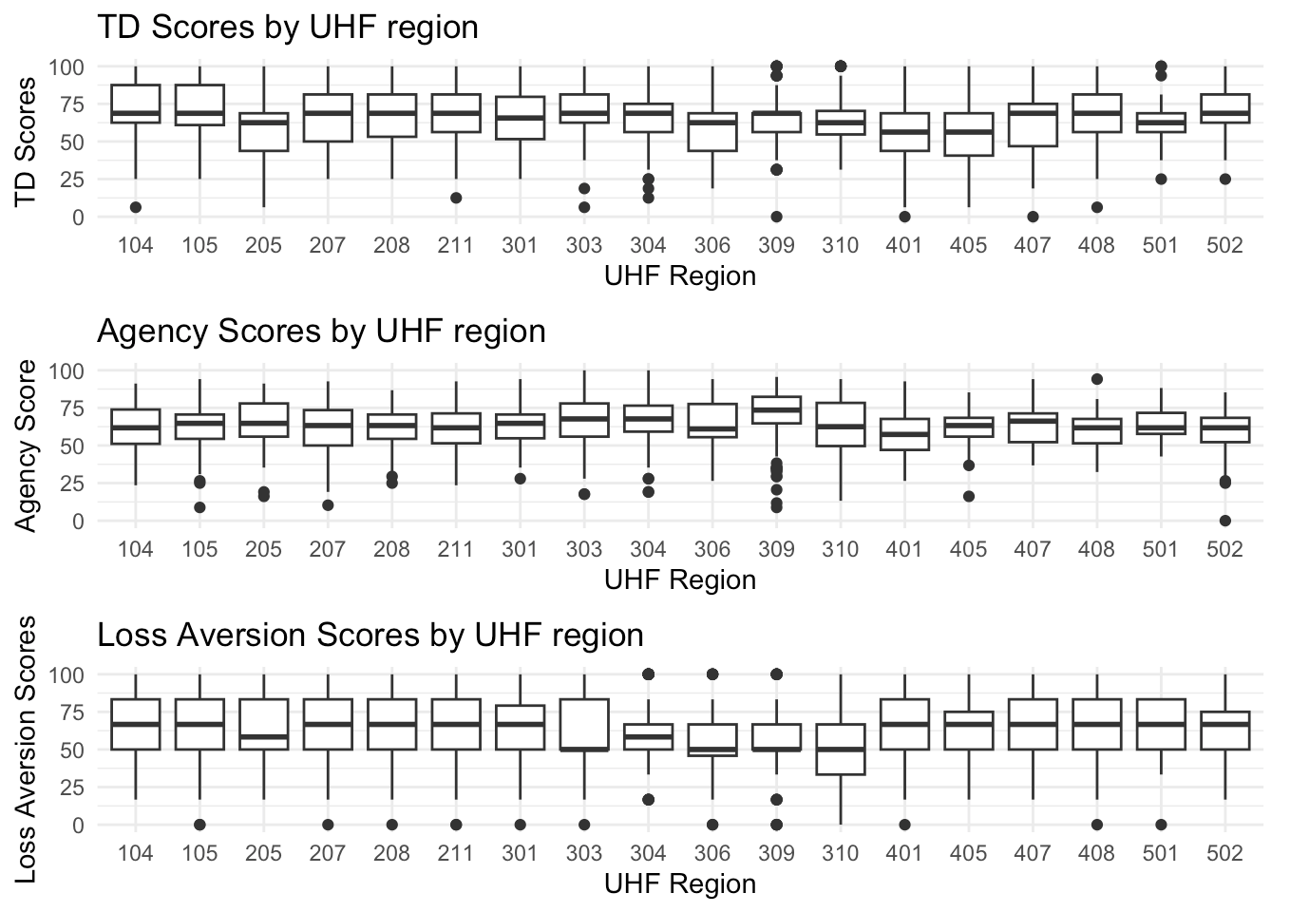
Scores Data: Exploratory Data Analysis
Comment:
UHF 401 (Long Island City - Astoria) has the lowest median scores for both temporal discounting and agency, while UHF 309 (Union Square - Lower East Side) has the highest median score for agency.

Slide 6
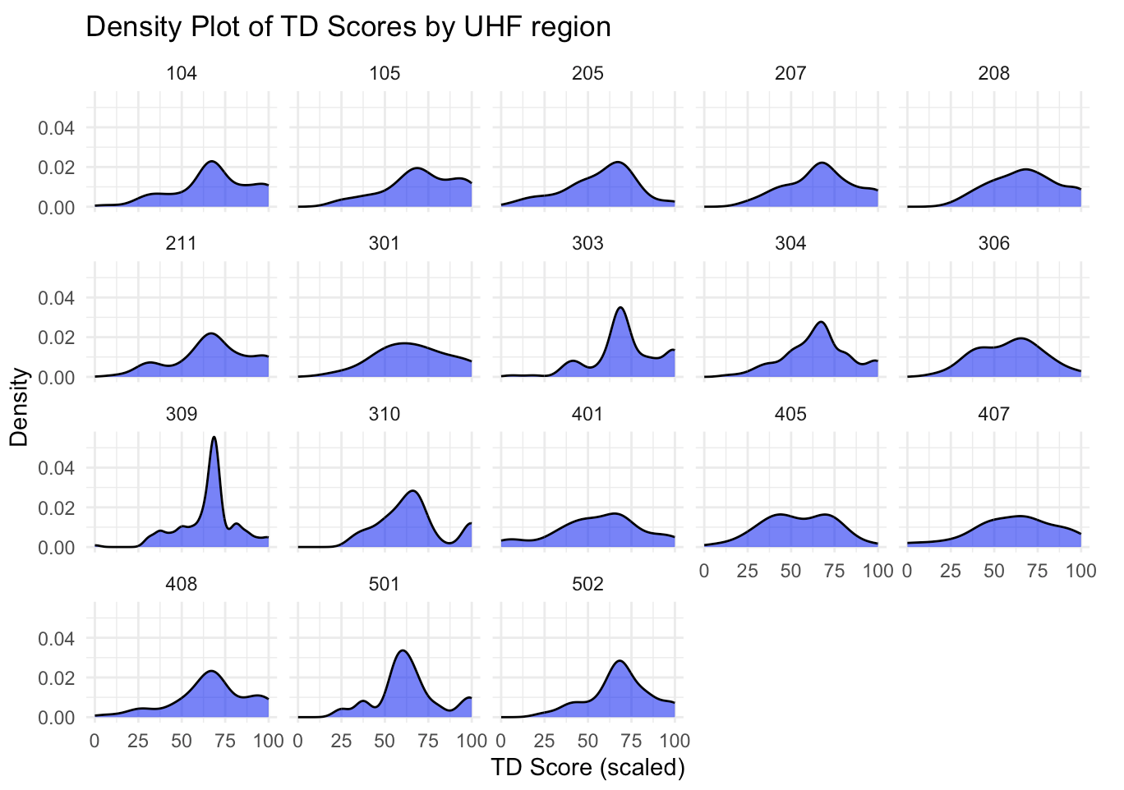
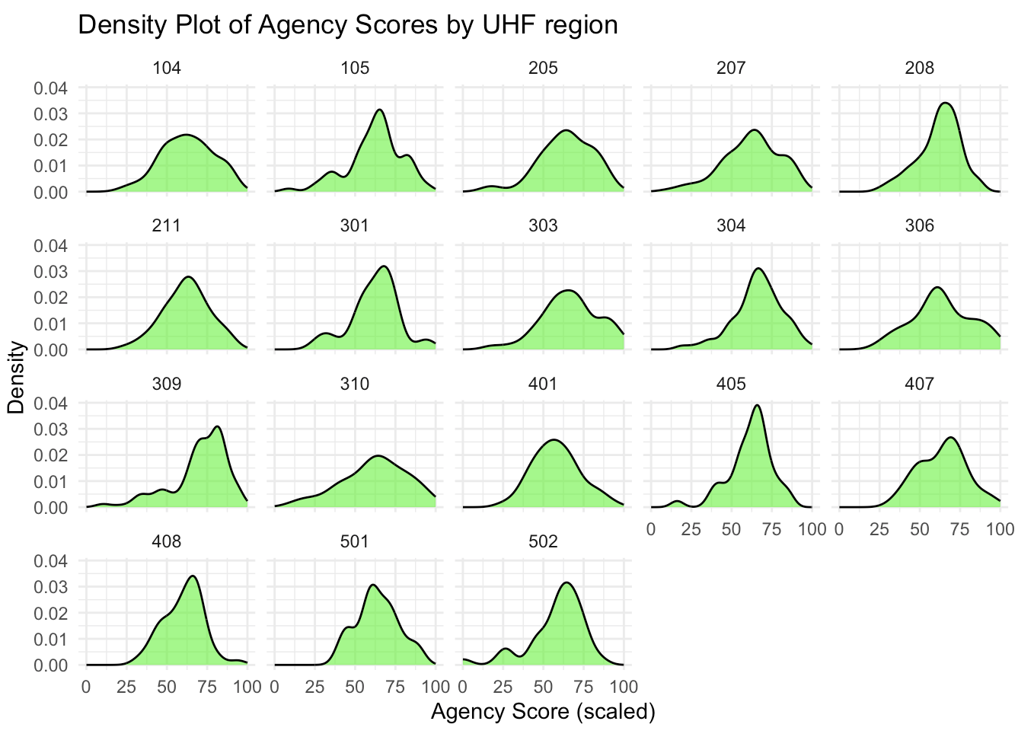
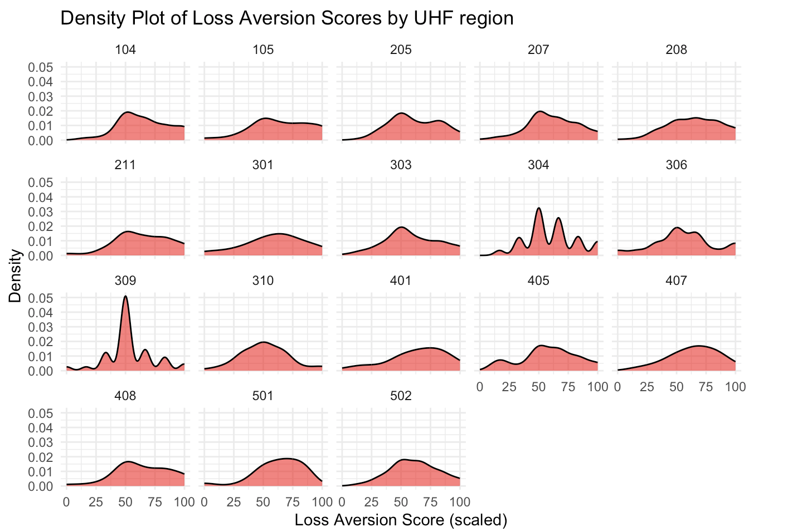
Scores Data: Exploratory Data Analysis
Comment:
All three scores follow normal distributions on UHF level in general, including those with smaller sample sizes (region 301 - Washington Heights, 407 - Southwest Queens, 501 - Port Richmond).

Slide 7
Census Data: Methods & Results
Merge ZCTA - ZIP Code - UHF mapping to one dataset
Exported the results into 2_output/mapping_guide.csv
Download census data
include population, individuals without health insurance, education levels, household income, household numbers, households without vehicles, age distribution, and employment status
Converted the census data from ZCTA level to UHF level and got 42 regions in total; 2_output/uhf_summary.csv

Slide 8
SLR Exploration: Introduction
Aim to fit a SLR model about scores based on census data from 18 UHF regions.
Then use it to predict scores for the remaining 24 UHF regions.

Slide 9
SLR Exploration: Model Performance
Detailed code and results: model.html
Whole dataset after prediction: 3_output/whole_dataset.csv

